Slide 1
NNDSS eSHARE Webinar
July 2026
Office of Public Health Data, Surveillance, and Technology
July 21, 2026

Slide 2

Meeting Agenda
NNDSS eSHARE Webinar
July 21, 2026, 3:00 pm ET
Welcome
General NNDSS Announcements
- Public Health Information Network Messaging System (PHIN MS) Update
- Key Dates for 2024 and 2025 NNDSS Annual Data Reconciliation
- Status of 2024 and 2025 NNDSS Annual Data Reconciliation
Highlights from the 2026 Council of State and Territorial Epidemiologists
(CSTE) Annual Conference
Q&A
01
02
03
04

Slide 3

General NNDSS Updates
Andrew Kuehl, MIT, PMP
Office of Public Health Data, Surveillance, and Technology

Slide 4
PHIN MS Update
Sunsetting November 30, 2026
Mercury S3 available as an alternative
Support team will help jurisdictions:
  Understand their SFTP/API options
  Set up connections
  Test connections
  Cutover to production
Send PHIN MS requests to edx@cdc.gov

Slide 5
Key Dates for 2024 and 2025 NNDSS Annual Data Reconciliation
Feb 17: Reconciliation kick-off and eSHARE
Feb 18: Reconciliation module open for 2024
Mar 2: Reconciliation module open for 2025
July 17: Final day for jurisdictions to submit STD/CS data
August 7: Lock All data (STD and non-STD data)
August 17: STD Manager approval
August 28: All data State/Territorial Epidemiologist approvals complete
Notes:
​

Slide 6
Status of 2024 and 2025 NNDSS Annual Data Reconciliation
2024 | Percentage
Started | 98.2%
STD Approved | 28.3%
EPI Approved | 23.6%
2025 | Percentage
Started | 70.9%
STD Approved | 18.9%
EPI Approved | 14.5%
* As of 7/17/2026

Slide 7

CSTE 2026 Annual Conference Highlights
Section 508 alternative text version available on slide 39

Slide 8

Highlights from 2026 CSTE Annual Conference
Agenda:
Conference Theme – A Beacon for Public Health: Epidemiology Guiding the Way for 75 Years and Beyond
Overview of 2026 CSTE Annual Conference
Plenary Sessions
Sunday Workshop Review
Highlights from the Surveillance/Informatics Track
Review of Approved 2026 Position Statements
Surveillance/Informatics and Data Modernization Updates
Q&A

Slide 9

Overview of 2026 CSTE Annual Conference
Registered Attendees: 2,473
  2,405 attendees onsite
99 breakout sessions
4 EpiVision sessions
83 discussion sessions
173 poster presentations
Thursday: Annual Business Meeting

Slide 10
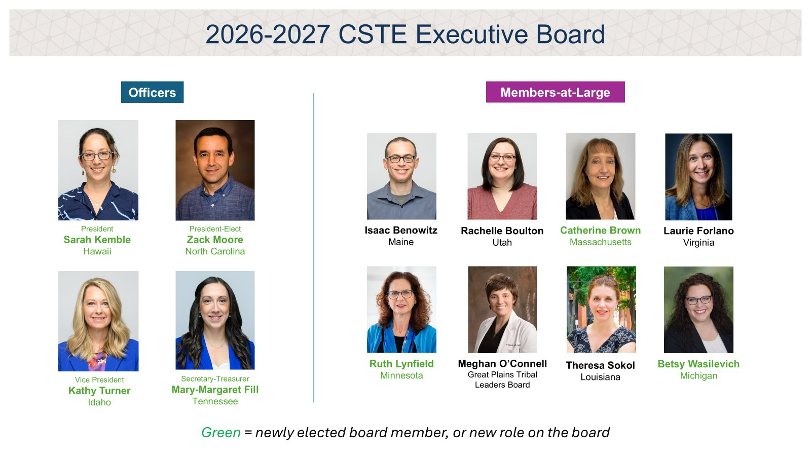
2026-2027 CSTE Executive Board
Section 508 alternative text version available on slide 41

Slide 11

Plenary Sessions
Monday: The Midnight Call for Health
Dr. Bisola Ojikutu, Boston Public Health Commission
Tuesday: The AI Revolution in Public Health: Promise, Peril, and Accountability
Robbie Goldstein, MA Department of Public Health Commissioner
Kara Swisher, New York Magazine
Wednesday: Resilience and Moving Forward
Dr. Allision Arwady, CDC
Dr. Leonard Marcus, Harvard

Slide 12
Sunday Workshop Review: Informatics & Data Modernization
"The Boston Data Party: Revolutionizing Public Health Surveillance and Informatics"
Objectives
  Participants will discuss and analyze scenarios to identify key challenges and emerging opportunities.
  Participants will produce a cohesive, collective output through the rotating world café process.
  Participants will evaluate and prioritize scenario-based solutions and barriers using dot-voting to surface key themes (e.g., high impact, major barriers, innovative) that will inform future CSTE member discussions and products.

Slide 13
Sunday Workshop Review: Informatics & Data Modernization 1
Half-day morning workshop
CDC Opening Remarks
Three scenarios: Considering key needs to discontinue manual reporting for eCR, discussing surveillance system functionality in context of a rubella outbreak, and evaluating data visualization tools to preserve essential functions and reduce cost
  Facilitators led attendees through table-discussions on these via a World Café
  Attendees engaged in a gallery walk to review outputs and dot vote on key priorities/needs, barriers/challenges, and innovative/nice-to-have ideas

Slide 14
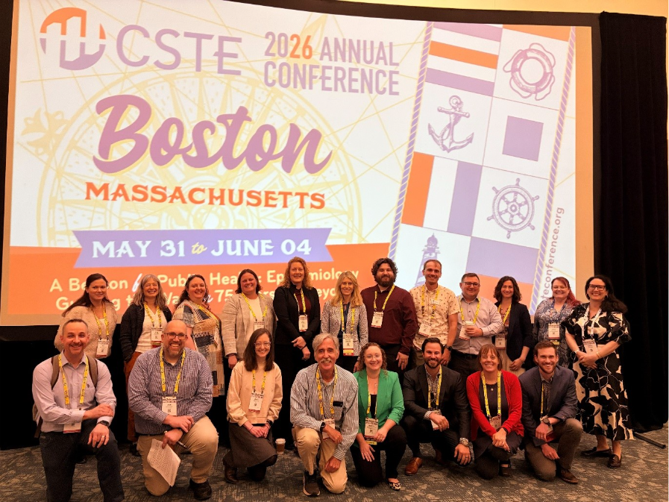
Sunday Workshop Review: Informatics & Data Modernization 2
196 attendees representing 62 STLT jurisdictions, CDC, non-profits, private sector, Tribal-serving, and academia
Next Steps
  Share out document containing raw and summarized outputs with attendees and CSTE S/I Chairs
  CSTE S/I Chairs review and identify areas to bring to their specific communities

Slide 15
Sunday Workshop Review: Practical AI for Public Health
"Navigating the AI Harbor: A Hands-on Workshop for Modern Epidemiologists"
Hosted in Partnership with PubHealth Futures
Objectives
  Identify high-impact AI use cases relevant to your jurisdiction’s data workflows
  Apply prompt engineering techniques to extract structured information from unstructured public health data (e.g., electronic case reports)
  Understand how to generate and use synthetic data to prototype AI solutions without compromising PII
  Build interactive dashboards and analytics from AI-processed public health data
  Evaluate foundational steps for bringing AI into your agency, from data readiness to enterprise capability

Slide 16
Sunday Workshop Review: Practical AI for Public Health 1
211 attendees from 69 different STLT jurisdictions, CDC, non-profits, private sector, Tribal-serving, and academia.
Half-day afternoon workshop
Didactic presentation; breakout groups to review specific tools with AWS, Cloudwick, and Inductive Health teams; CDC AI team presentation and Q&A

Slide 17
Sunday Workshop Review: Syndromic Surveillance
Revolutionary Insights: Building Broader Use of Syndromic Data
  Only the 2nd annual syndromic surveillance workshop!
94 attendees representing 50 different STLT jurisdictions
  Up from 65 attendees representing 44 jurisdictions at first workshop
Activities included:
  Programmatic use of syndromic surveillance panel
    Panelists use syndromic surveillance in their work, but they are not syndromic epidemiologists/analysts
  Programmatic use discussion tables
    Attendees were grouped by the program area they work in or were interested in discussing
  Functional exercise
    Fictional scenario based on a measles outbreak
    4 quick rounds where attendees received new information/discussion prompts

Slide 18

Highlights from the Surveillance/Informatics Track
20 breakout sessions (~130 abstracts presented)
15 discussion sessions
  Several discussion sessions dedicated to CSTE workgroup/CoP meet and greats to discuss priorities for the upcoming year
32 posters presented
  Poster award winner: Validation of Syndromic Surveillance Firearms Syndromes in Illinois Reveals Mixed Results (IL)
Abstracts spanned across S/I, including, but not limited to: syndromic surveillance, AI, eCR, ELR, surveillance systems, data modernization, data quality, data visualization, data automation, FHIR and interoperability, and tribal/community data sharing

Slide 19
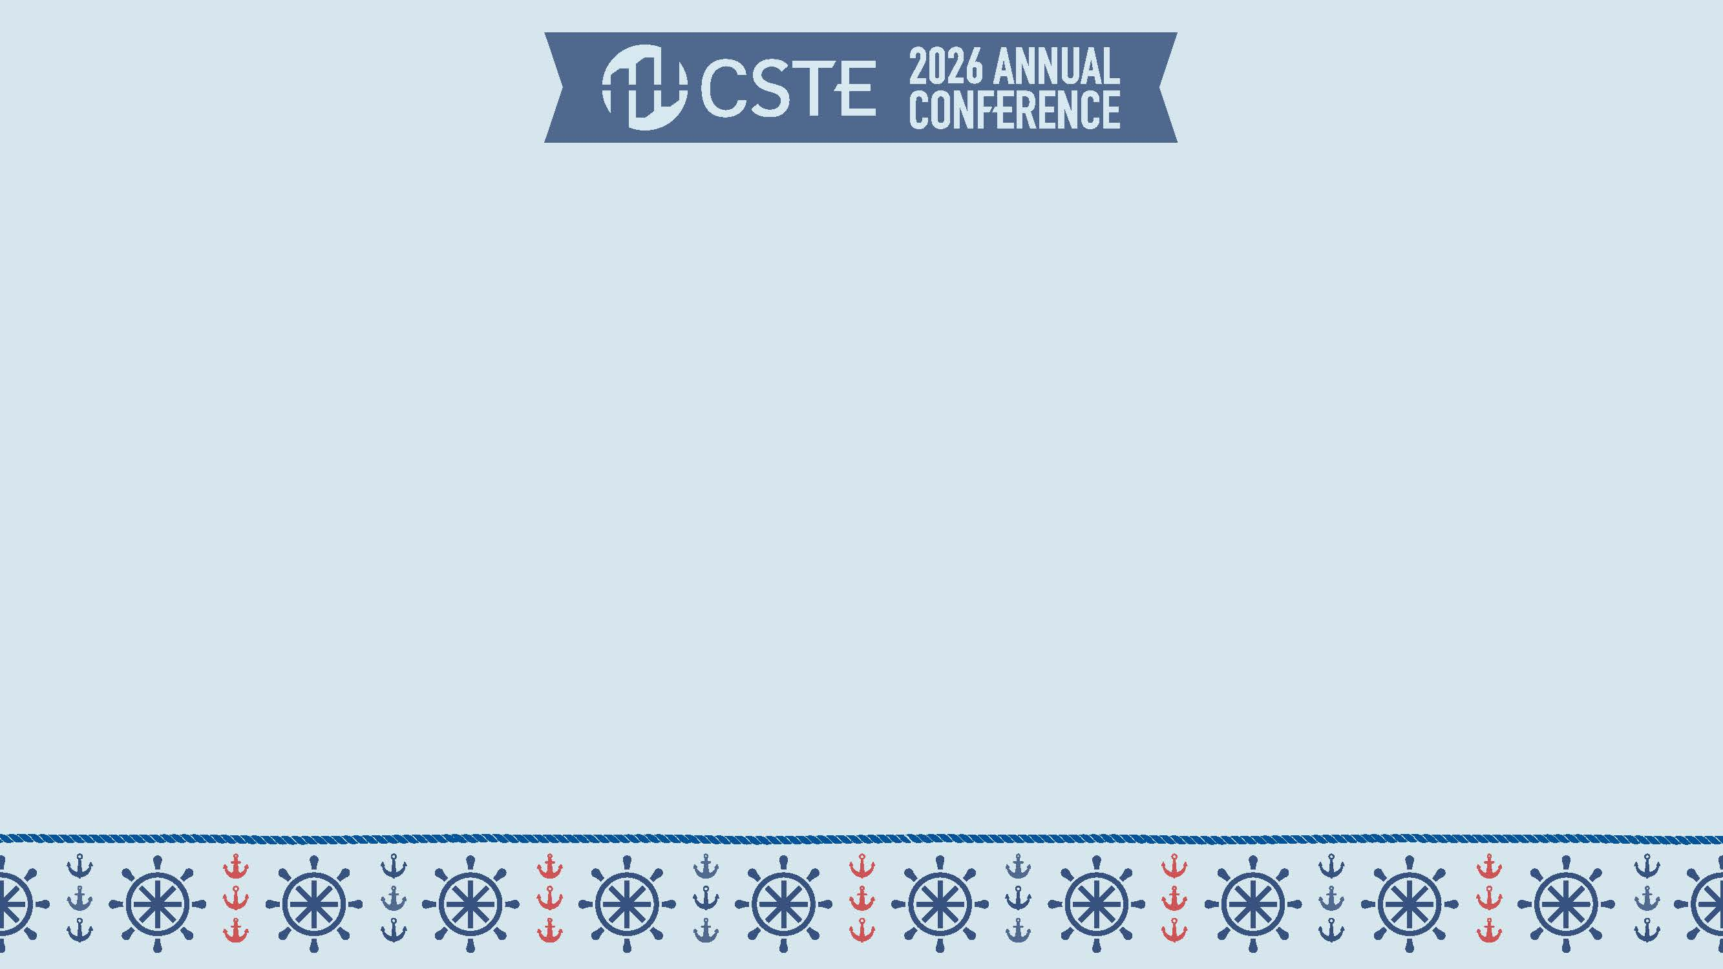
Review of Approved 2026 Position Statements

Slide 20
New Case Definitions, non-NNCs
ID | Title | Details
26-EH-01 | Standardized Surveillance Case Definition for Mortality Due to Environmental Heat | Establishes a standardized case definition for mortality due to environmental heat Note: Does not address other conditions that could be exacerbated by environmental heat; surveillance period is ongoing Clinical + epi linkage, vital records, and other records like healthcare, EMS, workers’ comp may trigger reports to public health Case classification criteria include epi linkage and vital records or C/ME evidence Cases may be classified as “confirmed” or “probable” Recommends “confirmed” and “probable” case counts be released

Slide 21
New Case Definitions, non-NNCs 2
ID | Title | Details
26-ID-05 | Standardized Surveillance Case Definition for Human New World Screwworm (NWS) Myiasis to Support One Health Response | Note: NNC Recommendation was rejected by ID Committee Establishes a standardized case definition for human NWS myiasis Clinical + epi linkage, laboratory, vital records, and healthcare records criteria may trigger reports to public health Case classification criteria include clinical, lab, and epi linkage Cases may be classified as “confirmed,” “probable,” or “suspect” Recommends “confirmed” case counts be released

Slide 22
Updated Case Definitions, Non-NNCs
ID | Title | Details
26-ID-01 | Update to the Standardized Case Definition for Extrapulmonary Nontuberculous Mycobacteria Infection | Adds Mycobacteria ulcerans to the list of species excluded from the case definition (along with the previously excluded M. gordonae) Expands clinical criteria for case classification to include night sweats and skin infections not limited to cellulitis (e.g., abscess)

Slide 23
New NNCs
ID | Title | Details
26-ID-08 | Public Health Reporting and National Notification for Respiratory Syncytial Virus (RSV)-Associated Pediatric Mortality | Creates a pediatric-specific case definition for RSV-associated mortality, in alignment with case definitions for COVID-19- and influenza-associated pediatric mortality (25-ID-03 and 26-ID-03, respectively) Note: 18-ID-01 will remain active for populations 18+ years Clinical + lab criteria, vital records criteria may trigger reports to public health Case classification criteria include clinical, laboratory, and vital records Cases may be classified as “confirmed,” “probable,” or “suspect” Recommends RSV-associated pediatric mortality be routinely notifiable to CDC for “confirmed” cases only

Slide 24
Updates to NNCs – Changes to Subtypes/Condition Categories
ID | Title | Details
26-ID-04 | Update to the Standardized Case Definition for Public Health Reporting and National Notification for Measles | Expands clinical, epi linkage criteria that may trigger reports to public health; adds vital records to case ascertainment Explicitly defines community transmission for the purpose of epi linkage criteria within the position statement “Confirmed” cases may be: “Laboratory-Confirmed,” which now allows “confirmed” cases to meet confirmatory laboratory evidence alone, or “Epidemiologically-Linked,” which allows “confirmed cases” to meet clinical + epi linkage of contact with a “Confirmed, Laboratory-Confirmed” case without requiring lab evidence Updates “probable” case classifications to mirror 2025’s operational guidance, which will be replaced by this position statement Adds “suspect” case classification (2012’s “probable”) Remains immediately notifiable, urgent (within 24 hours) to CDC, with the addition of “probable” cases to “confirmed” cases for release

Slide 25
Updates to NNCs – No Longer Notifiable
ID | Title | Details
26-ID-06 | Update to Public Health Reporting and National Notification of Psittacosis (Chlamydia psittaci infection) | Updates clinical criteria for case classification Updates laboratory criteria for both case ascertainment and classification based on additional testing methodologies Establishes epidemiologic linkage criteria for case classification and incorporates epidemiologic linkage into “probable” case classification Adds a “suspect” case classification Establishes criteria for enumerating new cases of psittacosis Recommends the removal from the NNC List, thus ending notifications to CDC for “confirmed” and “probable” cases
Notes:
Clinical – based on additional experience in outbreaks

Slide 26
Updates to NNCs – No Changes to Notifiability
ID | Title | Details
26-ID-02 | Update to Public Health Reporting and National Notification for HIV Infection | Removes opportunistic infections as a criterion for Stage 3 HIV Removes laboratory criteria paired with a physician diagnosis to trigger reports to public health Revises Stage 0 HIV to add Stage 0 – Acute HIV Infection to distinguish among individuals with recent HIV infection and those with acute infection Further updates made to align with 2014 MMWR case definition Adds case classifications for perinatal exposure Remains routinely notifiable to CDC for “confirmed” cases only

Slide 27
Updates to NNCs – No Changes to Notifiability 2
ID | Title | Details
26-ID-03 | Update to Public Health Reporting and National Notification for Influenza-Associated Pediatric Mortality | Updates align with case definitions for COVID-19- and RSV-associated pediatric mortality (25-ID-03 and 26-ID-08, respectively) Revises lab criteria for both case ascertainment and classification to address changes in testing availability and practice Expands case ascertainment and classification criteria to include vital records Creates “probable” and “suspect” case classifications Remains routinely notifiable to CDC for “confirmed” cases only

Slide 28
Updates to NNCs – No Changes to Notifiability 3
ID | Title | Details
26-ID-07 | Update to Public Health Reporting and National Notification of Acute and Chronic Q fever (Coxiella burnetii) | Simplifies clinical criteria that may trigger reports to public health; removes epi linkage criteria for case ascertainment Updates and expands laboratory criteria for both ascertainment and classification to include metagenomic sequencing Updates and broadens clinical criteria for case classification and delineates between “acute” and “chronic” Q fever Defines epi linkage criteria for case classification Adds “suspect” case classification Remains routinely notifiable to CDC for “confirmed” and “probable” cases

Slide 29
Implementation Notes
Finalized approved position statements available by July 30, 2026
Effective date for position statements: January 1, 2027*
  * CSTE and CDC are collaborating to implement an early effective date for 26-ID-05, NWS; CSTE members will be notified as soon as possible with additional details
CDC webpages and State Epi Letter with updated event codes expected early 2027

Slide 30
Additional SI / DM updates
GenV3 Implementation
  CSTE is partnering with CDC OPHDST in the development of a national strategy for GenV3 implementation
    reduces reporting burden
    improves data quality through use of data elements standardized by DSWG
    strengthens interoperability
    enhances CDC's ability to detect and respond to public health threats.
  Builds on work of case service design
  Held 4 Listening to Action sessions with STLT to inform roadmap
  Anticipated early fall 2026

Slide 31
Additional SI / DM Updates 1
Data Standardization Workgroup – public website coming soon!
Reportable Conditions Knowledge Management System (RCKMS)
  Content Development & Maintenance: Reporting Specifications for 262 conditions are currently available in RCKMS
    Materials availabe at https://rckms.org/content-repository/
  RCKMS Authoring Support available to 78 jurisdictions utilizing RCKMS
    https://www.rckms.org/rckms-authoring-support-team/ ​
Electronic Case Reporting (eCR) Consensus Criteria
  Consensus-based criteria for percent completeness thresholds for priority data elements sent in the electronic initial case report (eICR) & requirements for distinct phases of the eCR onboarding process, to reduce the variation in PHA requirements for healthcare organizations implementing eCR
  Published in February 2026: https://libraries.cste.org/wp-content/uploads/2026/07/CSTE-eCR-Consensus-Criteria-20260204.pdf

Slide 32
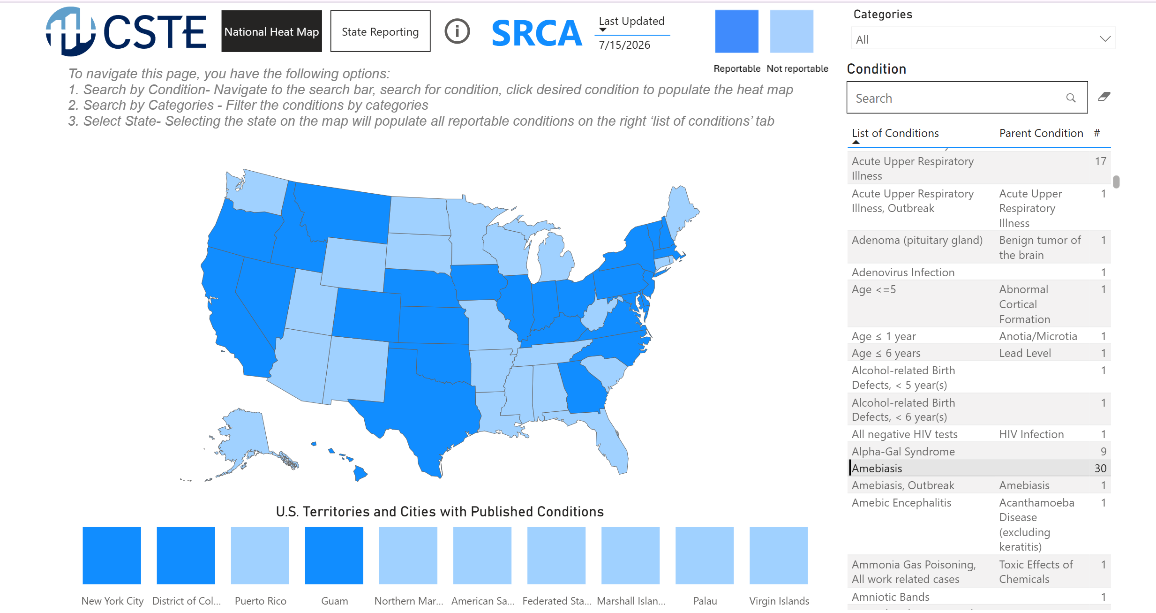
Additional SI / DM Updates 2
State Reportability Conditions Assessment (SRCA)
Heat Map
Screenshot of the SRCA heat map with list of conditions listed on right column

Slide 33
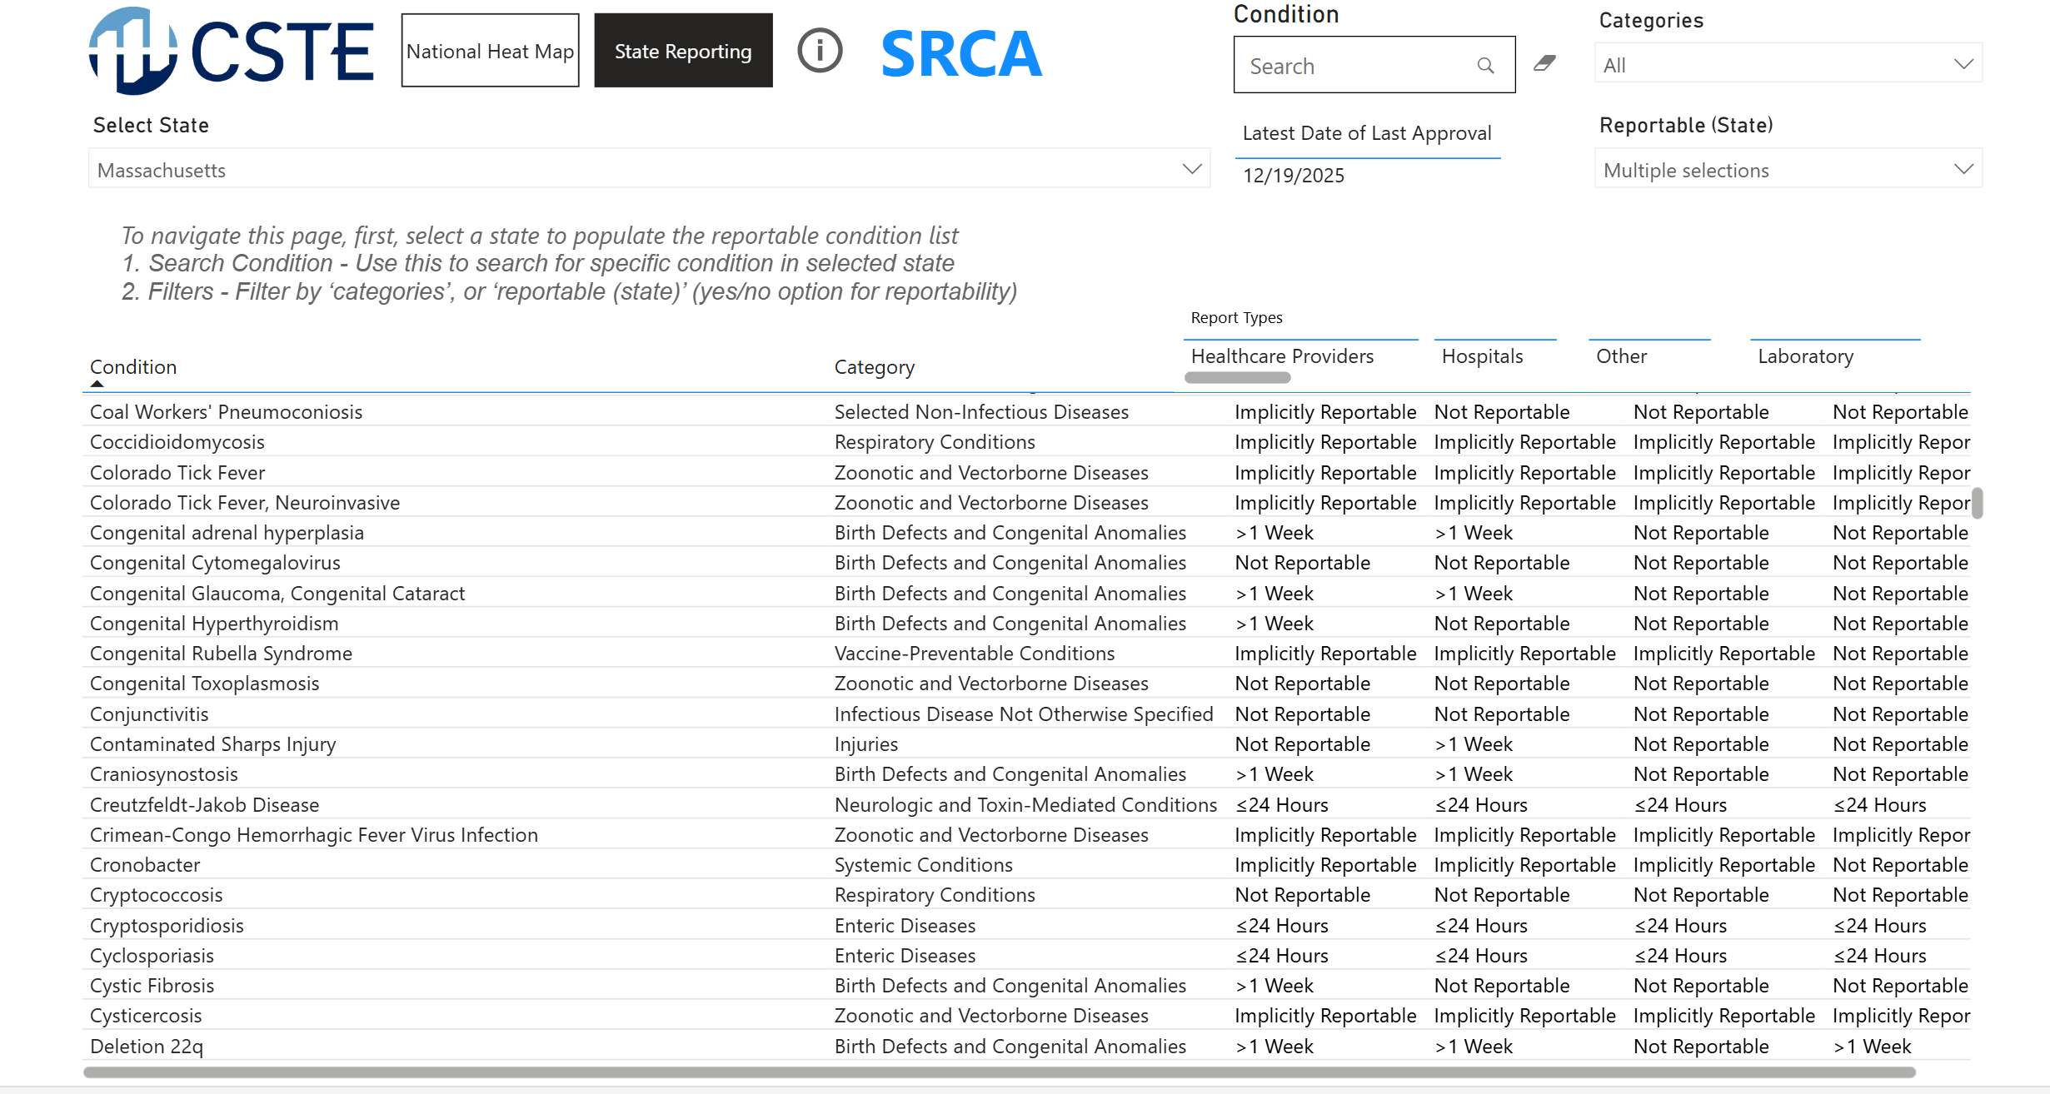
Additional SI / DM Updates 3
State Reportability Conditions Assessment (SRCA)
State Reportability​
Screenshot of SRCA ‘state reportability’ tab with list of conditions and reporting timeline/reporter types listed

Slide 34
Additional SI / DM Updates 4
Data Privacy Training Series
  Course 1 – Basic Principles of Privacy Risk in Public Health
  Course 2 – Privacy Risk Assessment and Control Guidance
  Course 3 – Community Data Reporting Privacy Risk Considerations
Public Health Interoperability Essentials Training
Disability Definitions Implementation Toolkit – Enhancing Syndromic Surveillance for Emergency Response
Strengthening Syndromic Surveillance Data Sharing with Tribes and Tribal Epidemiology Centers
Notes:
Urls for links in above slide:
Basic Principles of Privacy Risk in Public Health: https://learn.cste.org/users/sign_in?return_to=https:%2F%2Flearn.cste.org%2Fmain%2Flearning%2Flearn%2Fcourses%2F7cc0e56f-f727-4494-81de-7382975df1e8
V

Slide 35
CSTE S/I Steering Committee, Subcommittees, Workgroups
Steering Committee
S/I Steering Committee
Chair: Erin Holt Coyne (TN)
Vice Chair: Keegan McCaffrey (CO)
Subcommittees
Electronic Laboratory and Disease Reporting (ELDRS)
Co-Chairs: Jennifer Stewart (NC) and Kate Goodin (TN)
Surveillance Policy
Co-Chairs: Benjamin Schram (ND) and TBD
Surveillance Practice & Implementation (SPIS)
Chair: Sarah Solarz (MN) and TBD
Workgroups
National ELR Workgroup
Co-chairs: Nicole Stuver (TN) and Cody McNeese (OR)
eCR Workgroup
Co-chairs: Sara Mader (WI) and TBD
Data Governance Workgroup
Co-chairs: Allison Culpepper (FL) and Chris Dumas (SD)
Data Release, Presentation, Access, Suppression, and Sharing Workgroup
Co-chairs: MaryKate Martelon (MA) and Abigail Cheney (MI)
Data Standardization Workgroup
Co-chairs: Laura Erhart (AZ) and Judie Hyun (MD)
Data Modernization Workgroup
Co-chairs: Chris Baumgartner (WA) and Noel Clarin (Fairfax county)
Frontline Tools Workgroup
Co-chairs: Teri Bills (UT) and Paul Lloyd (WA)
Section 508 alternative text version available on slide 40

Slide 36
Q&A

Slide 37
Thank you!
Next NNDSS eSHARE: August 18, 2026
Subscribe to
Case Surveillance News
Access NNDSS’ Technical Resource Center
Email edx@cdc.gov for technical help
Learn about case surveillance modernization
For more information, contact CDC
1-800-CDC-INFO (232-4636)
TTY: 1-888-232-6348 https://www.cdc.gov/
Follow us on social @CDCgov
The findings and conclusions in this report are those of the authors and do not necessarily represent the official position of the U. S. Centers for Disease Control and Prevention.
Notes:
Please see the following urls for the links shown in the above slide:
Case Surveillance News: https://www.cdc.gov/nndss/technical-resource-center/news.html
Technical Resource Center: https://www.cdc.gov/nndss/technical-resource-center/index.html
Case Surveillance Modernization: https://www.cdc.gov/nndss/case-surveillance-modernization/index.html

Slide 38
Appendix:
Accompanying Text

Slide 39
Accompanying Text for Slide7
(Section 508 Compliant Text)
The graphic shows the CSTE Annual Conference Logo in a nautical theme with text titled “CSTE 2026 Annual Conference” “Boston Massachusetts May 31st to June 04.”
The bottom text of the graphic reads “A beacon for Public Health Epidemiology, guiding the way for 75 years and beyond.”
Return to relevant slide

Slide 40
Accompanying Text for Slide 35
(Section 508 Compliant Text)
The graphic shows an org chart of CSTE S/I Steering Committee, Subcommittees, and Workgroups.
S/I Steering Committee:
Chair: Erin Holt Coyne (TN)
Vice Chair: Keegan McCaffrey (CO)
Subcommittees:
Electronic Laboratory and Disease Reporting (ELDRS)
Co-Chairs: Jennifer Stewart (NC) and Kate Goodin (TN)
Surveillance Policy
Co-Chairs: Benjamin Schram (ND) and TBD
Surveillance Practice & Implementation (SPIS)
Chair: Sarah Solarz (MN) and TBD
Workgroups:
National ELR Workgroup
Co-chairs: Nicole Stuver (TN) and Cody McNeese (OR)
Return to relevant slide
eCR Workgroup
Co-chairs: Sara Mader (WI) and TBD
Data Governance Workgroup
Co-chairs: Allison Culpepper (FL) and Chris Dumas (SD)
Data Release, Presentation, Access, Suppression, and Sharing Workgroup
Co-chairs: MaryKate Martelon (MA) and Abigail Cheney (MI)
Data Standardization Workgroup
Co-chairs: Laura Erhart (AZ) and Judie Hyun (MD)
Data Modernization Workgroup
Co-chairs: Chris Baumgartner (WA) and Noel Clarin (Fairfax county)
Frontline Tools Workgroup
Co-chairs: Teri Bills (UT) and Paul Lloyd (WA)
Return to relevant slide

Slide 41
Accompanying Text for Slide 10
(Section 508 Compliant Text)
2026-2027 CSTE Executive Board
Officers:
President: Sarah Kemble (Hawaii) – Green (newly elected board member, or new role on board)
President Elect: Zack Moore (North Carolina) - Green (newly elected board member, or new role on board)
Vice-President: Kathy Turner (Idaho) - Green (newly elected board member, or new role on board)
Secretary-Treasurer: Mary-Margaret Fill (Tennessee) - Green (newly elected board member, or new role on board)
Members-at-Large:
Isaac Benowitz (Maine)
Rachelle Boulton (Utah)- Green (newly elected board member, or new role on board)
Catherine Brown (Massachusetts) - Green (newly elected board member, or new role on board)
Laurie Foriano (Virginia)
Ruth Lynfield (Minnesota) - Green (newly elected board member, or new role on board)
Meghan O’ Connell (Great Plains Tribal Leaders Board)
Theresa Sokol (Lousiana)
Betsy Wasilevich (Michigan) - Green (newly elected board member, or new role on board)
Return to relevant slide

