Slide 1
NNDSS eSHARE April 2026 Webinar
Centers for Disease Control and Prevention
Office of Public Health Data, Surveillance, and Technology
April 21, 2026

Slide 2

Agenda
Introductions
Public Health Information Network Messaging System (PHIN MS) Update
2024 and 2025 NNDSS Annual Data Reconciliation Updates
Generic Version 3 (Generic v3) Updates
  Pilot-ready Generic v3 Message Mapping Guide (MMG)
  Generic v3 Pilot Details
Questions & Answers

Slide 3
PHIN MS Update
Andrew Kuehl, MIT, PMP
Office of Public Health Data, Surveillance, and Technology

Slide 4
PHIN MS Update X
Sunsetting November 30, 2026
Mercury S3 available as an alternative
Support team will help jurisdictions:
  Understand their SFTP/API options
  Set up connections
  Test connections
  Cutover to production
Send PHIN MS requests to edx@cdc.gov
4

Slide 5
2024 and 2025 NNDSS Annual Data Reconciliation Updates
Andrew Kuehl, MIT, PMP
Office of Public Health Data, Surveillance, and Technology

Slide 6
Key Dates from Reconciliation Calendar
Feb 17: Reconciliation kick-off and eSHARE
Feb 18: Reconciliation module open for 2024
Mar 2: Reconciliation module open for 2025
July 17: CDC program databases closed
August 7: Lock STD data
August 17: STD Manager approval
August 28: State/Territorial Epidemiologist approvals complete
6

Slide 7
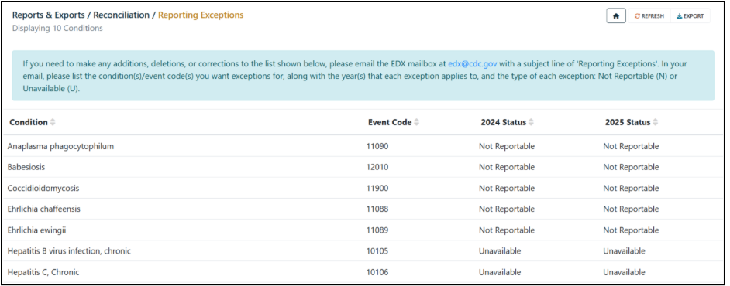
Reporting Exceptions
Important reminder: Jurisdictions should review reporting exceptions before final state/territorial epi approval.
Review 2024 and 2025 reporting exceptions in the MVPS portal and confirm accuracy
Email edx@cdc.gov (subject: “Reporting Exceptions”) to request additions, deletions, or corrections.
Reconciliation User Guide includes
additional guidance beginning
on page 16.
Exception updates submitted after data is finalized may not be incorporated.
7

Slide 8

Reconciliation Support
CDC’s NNDSS team is available to assist with 2024 and 2025 reconciliation
Email edx@cdc.gov with “Reconciliation” in the subject line
8

Slide 9
Generic v3 Updates
Peter Boersma, MPH
Office of Public Health Data, Surveillance, and Technology

Slide 10
Pilot-Ready Generic v3 Message Mapping Guide (MMG)

Slide 11
Pilot-Ready Generic v3 MMG
Noteworthy Changes
Updated MMWR Week and Year Description
Removed CDC Outbreak ID
Updated Specimen Source Site value set
Updated data element identifier for:
  Age
  Date First Received by Public Health Agency
  Date First Received by State Health Agency
  Date First Received by Local Health Agency
11

Slide 12
Generic v2 to Generic v3 Crosswalk
New artifact compares core Generic v3 to Generic v2.0.1
Aligns each Generic v3 data element with its Generic v2.0.1 counterpart, as applicable
Identifies whether the element is the same, new, retired, or revised
Provides details on the change, rationale on the change, and jurisdiction implementation guidance
12

Slide 13
Supplemental Guidance
Supplemental resource for jurisdictions and CDC programs as they implement the Generic v3.0 MMG
The primary implementation guidance is still within the Generic v3.0 MMG
This document allows for greater descriptions and implementation notes than can be included in an MMG format
13

Slide 14
Additional Updates
Submitted Generic v3 data elements to OMB for all conditions
Researching and meeting with STLTs and CDC programs to discuss how to improve onboarding by decreasing time and burden
Comparing current condition-specific guides to Generic v3
14

Slide 15
Generic v3 Pilot Details

Slide 16
Generic v3 Pilot
Pilot of Core Generic v3 to start week of April 27th, 2026
Objectives:
  Receive detailed feedback on Generic v3 from pre-onboarding
  Send a Generic v3 test message, containing only demographic and basic case data elements
  Provision a Generic v3 message to a CDC program
16

Slide 17
Data Elements In Generic v3 Pilot
“Core” Generic v3
  Contains demographic and basic data elements
  Condition-agnostic
  Similar in scope to Generic v2
  Lines 2-68 in the Generic v3 MMG
17

Slide 18
Conditions For Generic v3 Pilot*
Monkeypox
Q Fever
Plague
Tularemia
Chagas
*Conditions chosen for inclusion based on bandwidth of CDC program and current use of Generic v2 MMG only, with no condition-specific MMG.
18

Slide 19
Pilot Steps
Gap Analysis
Finalize Generic v3 MMG
Message Creation
Message Validation
Send Test Message
Complete Onboarding
Route Creation
STLT
CDC
STLT
CDC/STLT
19

Slide 20
Future Condition-Specific Pilots
Following successful pilot of core Generic v3, we intend to develop and test condition-specific guides aligned with Generic v3
Timeline to be determined, but likely starting in the fall after completion of this core Generic v3 pilot
20

Slide 21
Request To Join The Pilot!
Interested jurisdictions should email edx@cdc.gov with “Generic v3” in the subject line
21

Slide 22

Questions & Answers 3

Slide 23
Q & A 3
Thank you!
Next NNDSS eSHARE: May 19, 2026
Subscribe to
Case Surveillance News
Access NNDSS’ Technical Resource Center
Email edx@cdc.gov for technical help
Learn about case surveillance modernization
For more information, contact CDC
1-800-CDC-INFO (232-4636)
TTY: 1-888-232-6348 cdc.gov
Follow us on X (Twitter) @CDCgov & @CDCEnvironment
The findings and conclusions in this report are those of the authors and do not necessarily represent the official position of the U. S. Centers for Disease Control and Prevention.

