Slide 1
NNDSS eSHARE February 2026 Webinar
Centers for Disease Control and Prevention
Office of Public Health Data, Surveillance, and Technology
February 17, 2026

Slide 2
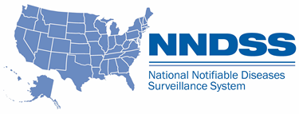
Agenda
Introductions
Generic Version 3 (Generic v3) Updates
Annual Reconciliation of 2024 and 2025 NNDSS Data
Questions & Answers

Slide 3
Generic v3 Updates
Peter Boersma, MPH Office of Public Health Data, Surveillance, and Technology

Slide 4
Generic v3 Updates(2)
Released revised Generic v3 draft on Tuesday, February 5th
Continue to meet with partners to discuss Generic v3
Drafting governance processes for condition-specific value sets and data elements
Drafting transition and implementation guidance
Creating a Generic v2 to Generic v3 crosswalk
Please email any feedback to edx@cdc.gov with "Generic v3" in the subject line
4

Slide 5
Annual Reconciliation of 2024 and 2025 NNDSS Data
Andrew Kuehl, MIT, PMP Office of Public Health Data, Surveillance, and Technology

Slide 6
2024 and 2025 Annual Reconciliation
CDC will resume annual reconciliation and publication of NNDSS national case surveillance data in 2026.
2024 and 2025 reconciliation will be completed concurrently, but independently in the Message Validation, Processing, and Provisioning System (MVPS).
6

Slide 7
2024 Reconciliation Considerations
Some jurisdictions opted to review and lock their 2024 data in the reconciliation module last year.
Any locking or approval actions taken last year will remain in place.
Jurisdictions may unlock 2024 data, send updates, and re-lock as needed.
Some jurisdictions also completed state epidemiologist approvals. These will remain in place.
Please email edx@cdc.gov if changes need to be made to locked or approved 2024 data
7

Slide 8
Key Dates from Reconciliation Calendar
Feb 17: Reconciliation Kick-off and eSHARE
Feb 18: Reconciliation Module Open for 2024
Mar 2: Reconciliation Module Open for 2025
July 17: CDC Program databases closed
August 7: Lock STD data
August 17: STD Manager approval
August 28: State/Territorial Epidemiologist Approvals Complete
8

Slide 9
COVID-19 and Monkeypox Virus
In previous reconciliations (2023) COVID-19 and monkeypox virus had separate processes
COVID-19 will not be reconciled for 2024 and 2025 as it is no longer nationally notifiable
2024 and 2025 reconciliation for monkeypox virus will be done in 1CDP on same schedule as other conditions (Feb 18 to Aug 28)
9

Slide 10
Conditions Reconciled Outside of MVPS
Arboviral diseases (ArboNET)
HIV diagnosis
Influenza associated pediatric mortality
Novel influenza A virus infections
Animal rabies
Tuberculosis
Varicella mortality
Monkeypox virus
10

Slide 11
Event code changes for 2024
Category | Condition | Event Code
New | Invasive Cronobacter infection among infants | 13060
New | Ehrlichia muris eauclairensis infection | 11092
New | Ehrlichia infection, other spp. or unspecified | 11093
Retired | Ehrlichiosis/anaplasmosis, undetermined | 11091
Retired | Zika virus infection, non-congenital | 50221
Retired | Zika virus infection, congenital | 50222
Retired | Carbapenemase-producing CRE (CP-CRE) | 50244
11

Slide 12
Event code changes for 2025
Category | Condition | Event Code
New | Anthrax, cutaneous | 10352
New | Anthrax, ingestion | 10353
New | Anthrax, inhalation | 10354
New | Anthrax, injection | 10355
New | Anthrax, welder’s | 10356
New | Oropouche virus disease, non-congenital | 50290
New | Oropouche virus disease, congenital | 50291
Retired | Coronavirus disease 2019 (COVID-19) | 11065
12

Slide 13
Reconciliation Functions in MVPS

Slide 14
Reconciliation Process in MVPS
Review stratification reports and line lists;
Review reporting exceptions and any cases sent with retired event codes;
Lock conditions as counts are finalized;
Ability to unlock/re-lock as needed for case updates
Approval of STD conditions by STD Manager; and
Approval of all conditions by State/Territorial Epidemiologist.
14

Slide 15
MVPS User Roles and Functions
 | Jurisdiction User | Jurisdiction Data Manager | STD Manager | State/Territorial Epidemiologist
Review stratification reports and line lists* | X | X | X | X
Lock and submit conditions*⁺ | X | X | X | X
Update user access and permissions | - | X | - | -
Approve STD conditions | - | - | X | -
Verify reporting exceptions and conditions sent with retired event codes | - | - | - | X
Approve final report and complete reconciliation | - | - | - | X
*Users can only view data for event codes they have permission to access.
⁺ “Show Reconciliation” option must be toggled ON to view the reconciliation module and the lock conditions page.
15

Slide 16
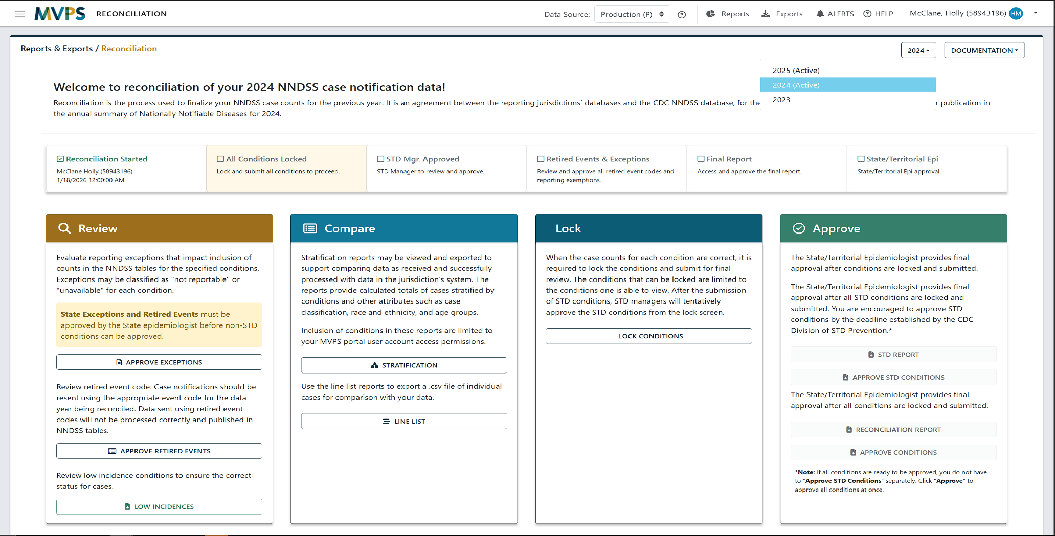
Reconciliation Module
16

Slide 17
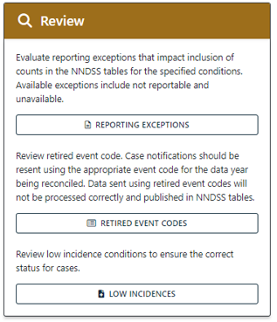
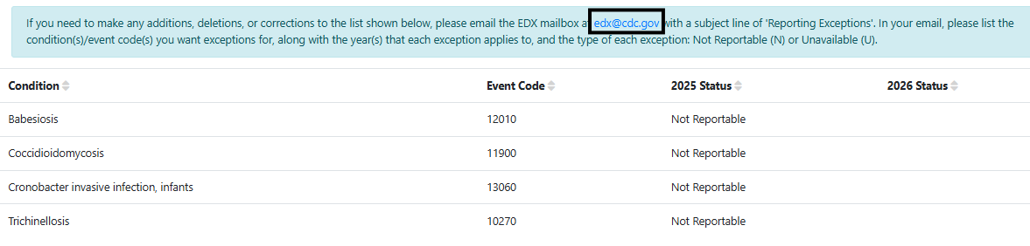
Reporting Exceptions
This screen will populate if your jurisdiction has reported any reporting exceptions for 2024 or 2025.
A link to send an email to edx@cdc.gov is provided on this screen if you need to make any changes.
17

Slide 18
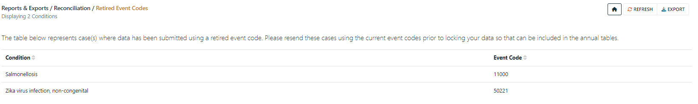
Retired Event Codes
This screen will populate if your jurisdiction has sent any cases with event codes that are retired.
These messages error out. Case notification updates with current event codes are required for cases to be counted.
18

Slide 19

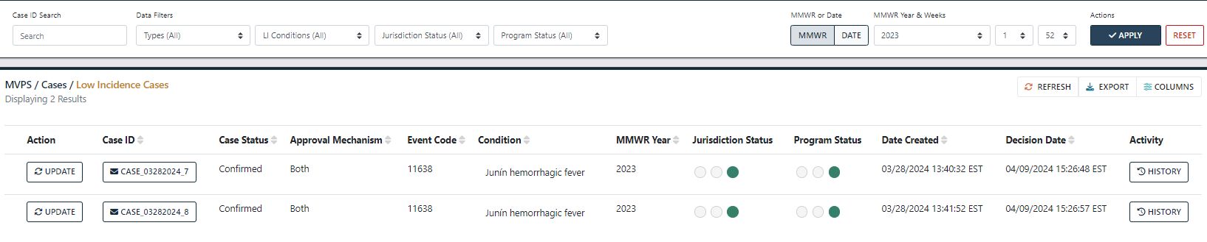
Low Incidence Conditions
This will link to the Low Incidences module (LIV) with cases requiring response.
Conditions requiring LIV response cannot be locked until the LIV process is complete.
19

Slide 20
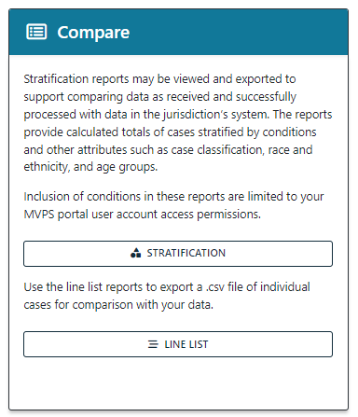
Stratification Reports and Line Lists
Stratification reports and line lists in MVPS may be used to compare data within NNDSS databases to data in local systems.
If you cannot see data for a condition while reviewing these reports, ensure your permissions include access to the event code.
Jurisdiction Data Managers can manage and edit event code access.
20

Slide 21
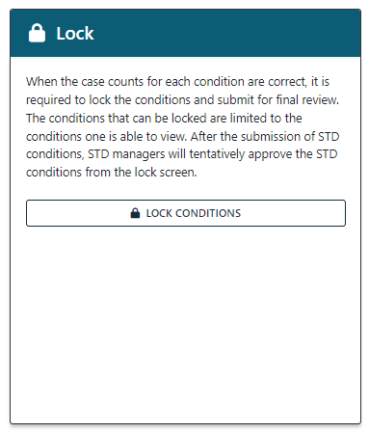
Lock, Unlock, and Submit Conditions
Jurisdictions can lock conditions themselves within MVPS as case counts are verified.
Jurisdictions can also unlock conditions as needed, if updates are sent after locking.
Once conditions are locked and verified, the locked conditions must be submitted to move to the next steps in the process.
21

Slide 22

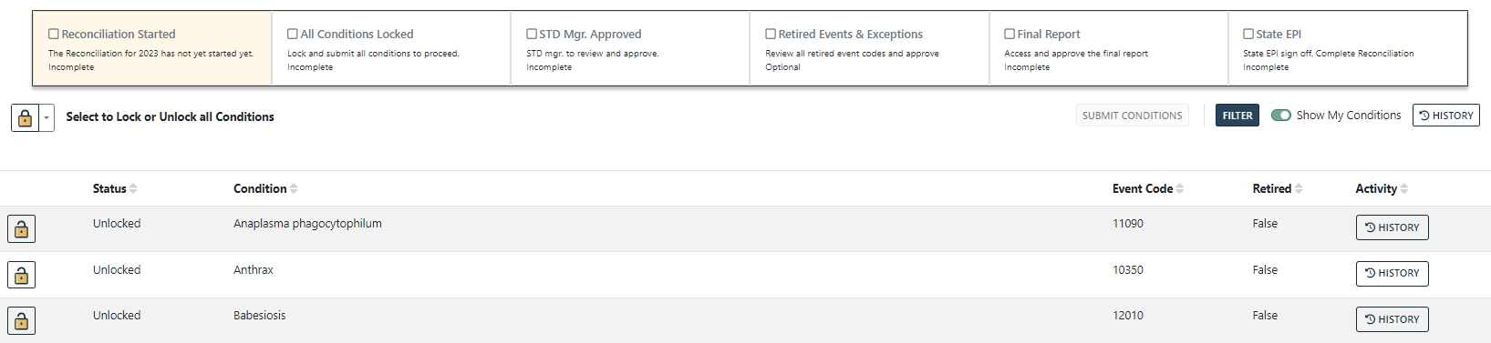
Lock, Unlock, and Submit Conditions(2)
Click the padlock icon to lock the condition
Status bar on Lock page updated to show milestones and progression through reconciliation process
Status will progress after locking first condition →
22

Slide 23
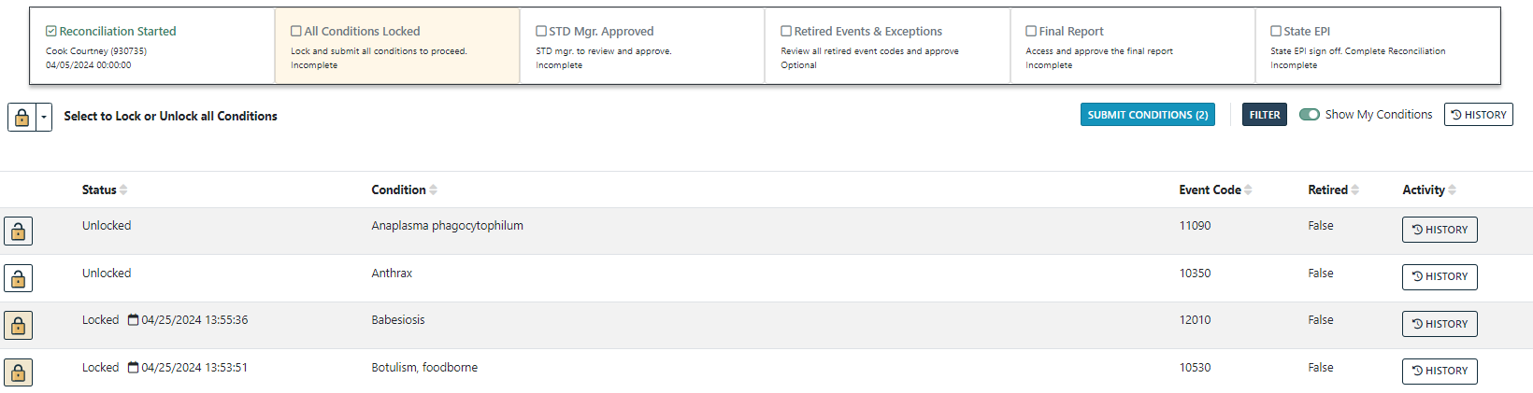
Lock, Unlock, and Submit Conditions(3)
First condition locked triggers “Reconciliation Started”
Status bar updates with date and user that completed the task
23

Slide 24

Lock, Unlock, and Submit Conditions(4)
Click the padlock icon to unlock the condition, if case updates for that condition need to be sent
Once updates have been verified, click the padlock icon to re-lock
24

Slide 25
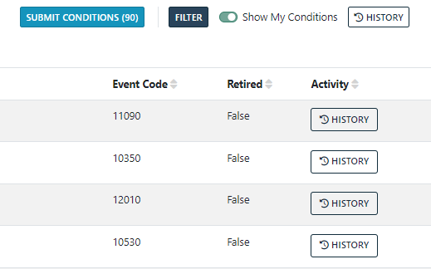
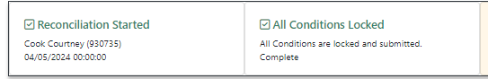
Lock, Unlock, and Submit Conditions(5)
Locked conditions must be submitted to move forward in the process
Click Submit Conditions to do this
In this example, we are submitting after all conditions are locked, but they do not need to be submitted all at once
Example: Submitting STD conditions for STD Manager approval before other conditions are locked/ready for approval.
After all conditions have been locked and submitted, the status bar will update to show this:
25

Slide 26
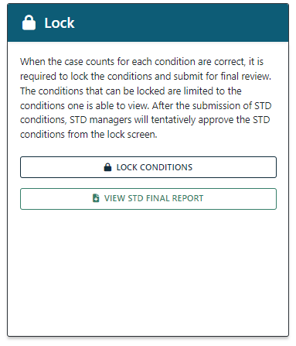
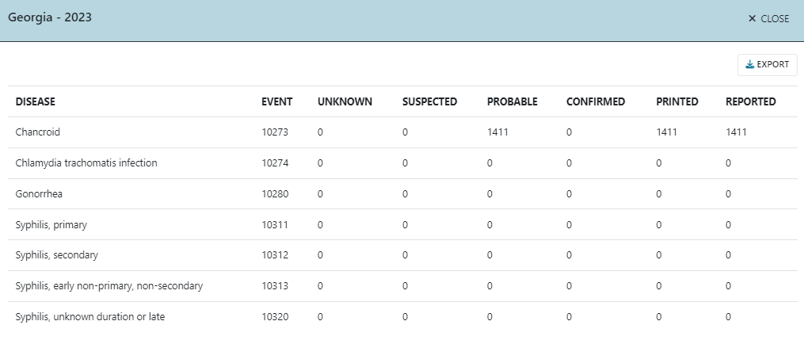
Approval: STD Manager
All STD conditions must be approved by the STD Manager before they can be approved by the State/Territorial Epidemiologist.
The STD Manager will get an email alert when all STDs have been locked/submitted.
The STD Final Report provides a quick reference of STD condition counts for the STD Manager.
26

Slide 27
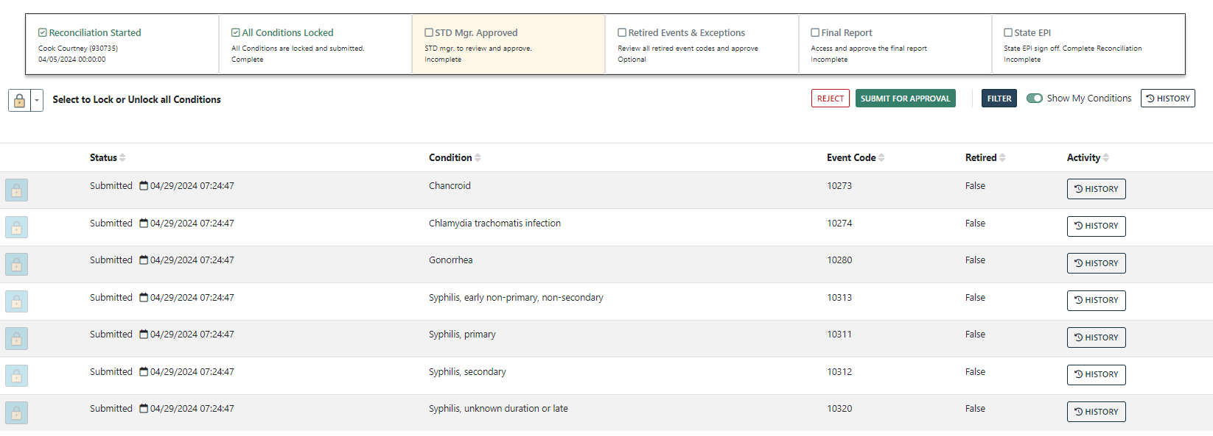
Approval: STD Manager(2)
To approve as the STD Manager, click to the Lock Conditions screen.
Locked and submitted STD conditions will be shown.
Click Submit for Approval.
27

Slide 28
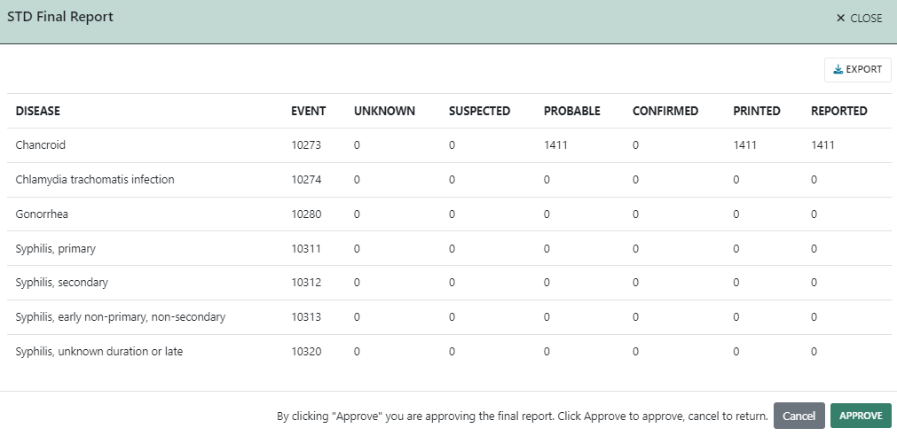
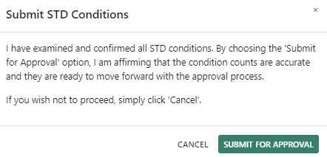
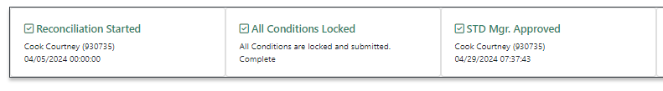
Approval: STD Manager(3)
After clicking Submit for Approval, the STD Final Report will pop up to confirm the conditions. Click Approve to approve the final report.
In the next pop up, click Submit for Approval for final STD Manager approval.
The status bar will update after STD Manager approval.
28

Slide 29
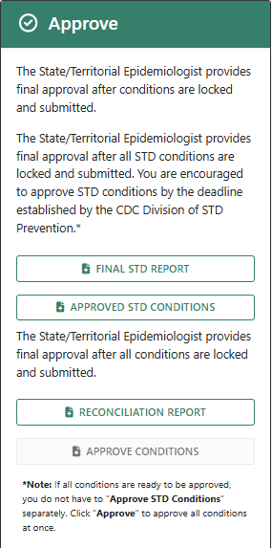
Review/Approve: State/Territorial Epidemiologist
Reporting Exceptions
Retired Events
Final Report
Available after all conditions have been locked and submitted; and STD conditions have STD Manager approval.
Approve Conditions
29

Slide 30
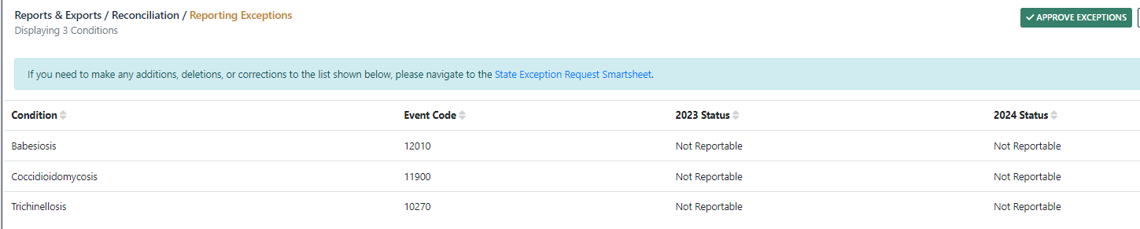
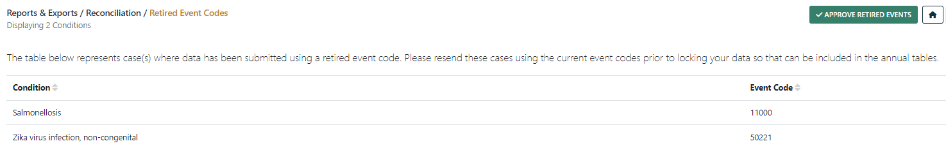
Review/Approve: State/Territorial Epidemiologist(2)
Clicking Approve Exceptions and Approve Retired Events will navigate to those screens, where an Approve button will now be visible.
After approving both, the status bar will update.
30

Slide 31
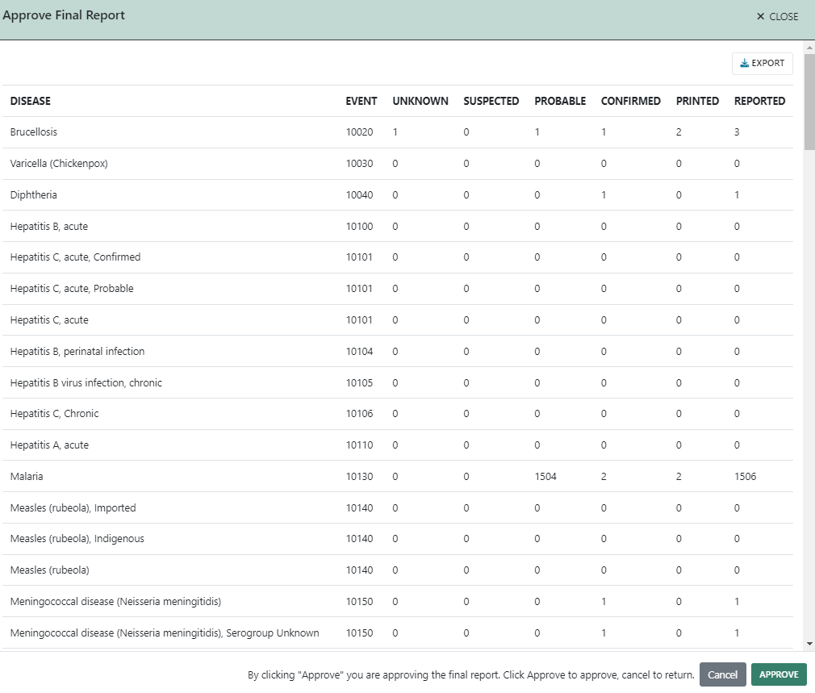
Review/Approve: State/Territorial Epidemiologist(3)
Clicking Approve Conditions will bring up the Lock Conditions screen with the Approve button now visible.
Click Approve once you are ready for final approval of your 2024 or 2025 data. This will first bring up the final report for approval.
Click Approve to approve the report.
31

Slide 32
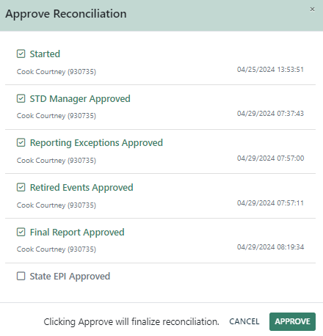
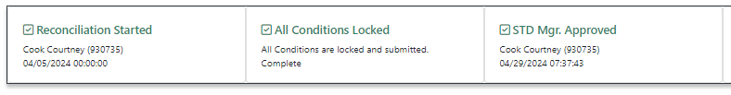
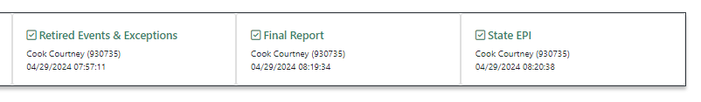
Approve: State/Territorial Epidemiologist
After approving the final report, the next pop-up reviews all reconciliation steps with a final Approve button to finish reconciliation.
The status bar will update after completing these steps:
32

Slide 33
MVPS Help: User Guides and Job Aids
The Help Center in the MVPS portal has several user guides and job aids available to assist you with the reconciliation process and with general MVPS use.
The Help Center may be found by:
Clicking Help in the top right corner:
Clicking Help Center in the bottom toolbar:
33

Slide 34
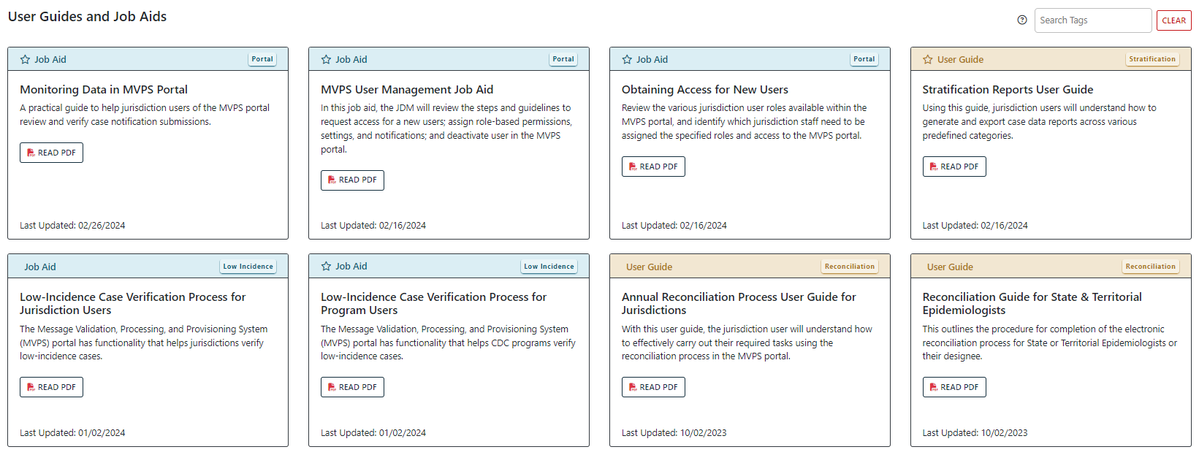
MVPS Help: User Guides and Job Aids(2)
Two reconciliation-specific guides are available:
General user guide walking through the full reconciliation process.
State/Territorial Epidemiologist guide walking through tasks specific to the final approval process.
34

Slide 35
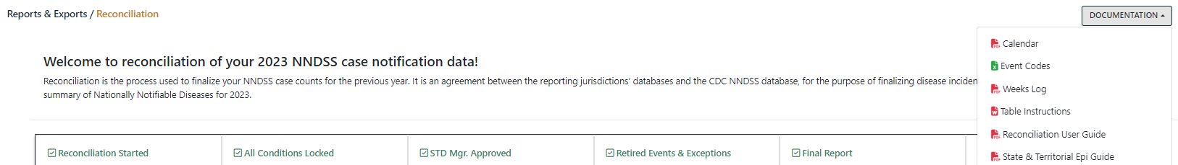
MVPS Help: User Guides and Job Aids(3)
The reconciliation user guides are also available under Documentation in the main Reconciliation screen, along with:
Reconciliation calendar
Event code list
MMWR weeks
Table instructions
35

Slide 36
MVPS Help: User Guides and Job Aids(4)
Additional MVPS user guides and job aids that may be useful during reconciliation:
Monitoring Data in the MVPS Portal
Stratification Reports User Guide
MVPS Line List User Guide
Low Incidence Case Verification Process for Jurisdiction Users
MVPS User Management Job Aid
36

Slide 37

Reconciliation Support
CDC’s NNDSS team is available to assist with 2024 and 2025 reconciliation
Email edx@cdc.gov with “Reconciliation” in the subject line
37

Slide 38

Questions & Answers 3

Slide 39




Q & A 3
Thank you! Next NNDSS eSHARE: March 17, 2026
Subscribe to Case Surveillance News
Access NNDSS’ Technical Resource Center
Email edx@cdc.gov for technical help
Learn about case surveillance modernization
For more information, contact CDC 1-800-CDC-INFO (232-4636) TTY: 1-888-232-6348 cdc.gov
Follow us on X (Twitter) @CDCgov & @CDCEnvironment
The findings and conclusions in this report are those of the authors and do not necessarily represent the official position of the U. S. Centers for Disease Control and Prevention.

