Slide 1
NNDSS eSHARE September 2025 Webinar
Centers for Disease Control and Prevention
Office of Public Health Data, Surveillance, and Technology
September 16, 2025

Slide 2

Agenda
Introductions
New World Screwworm (NWS) Response
Generic Version 3 (Generic v3) Development
Public Health Information Network Vocabulary Access and Distribution System (PHIN VADS) Update

Slide 3
New World Screwworm (NWS) Response
Marion Rice, MPH
National Center for Emerging and Zoonotic Infectious Diseases

Slide 4
Background

Slide 5

New World Screwworm (Cochliomyia hominivorax)
New World Screwworm (NWS) is a parasitic fly that can cause myiasis (infestation) and feeds on living tissue
Primarily affects animals but can also infest humans
NWS myiasis can cause extensive tissue destruction and can be fatal
Prompt identification, reporting, and treatment of NWS cases is critical
Top image courtesy of Mark Fox, CDC
Bottom image courtesy of Denise Bonilla, U.S. Department of Agriculture.
5

Slide 6
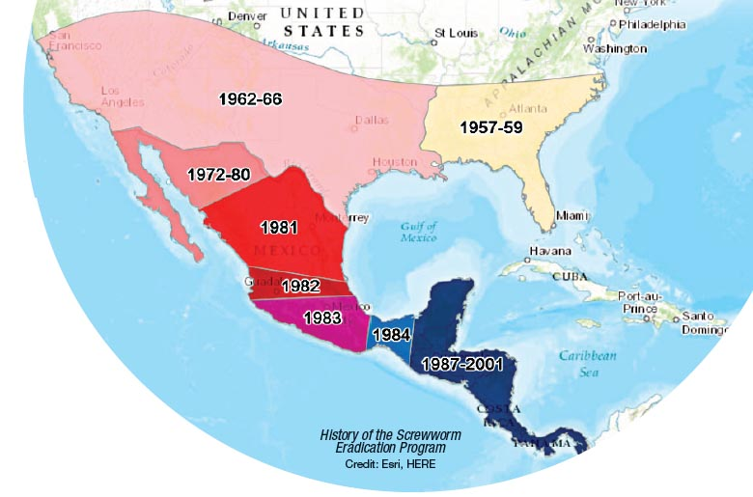
History of NWS
Formerly a significant economic pest of livestock in U.S.
Eradication strategy developed by USDA relies on release of sterile male flies
Eradicated from the U.S. since 1966 with re-eradication in 2017 after reintroduction
NWS was declared eradicated in Panama in 2006
6

Slide 7
NWS Outbreak in Central America and Mexico
Reemergence of NWS beginning in Panama in 2022
As of September 9, 2025:
Locally acquired animal and human NWS cases identified in every country in Central America, and in Mexico
More than 115,000 animal cases, 750 human cases, including 6 human deaths.
Northernmost case, now inactive, identified in an animal in Mexico, approximately 370 miles from the U.S. – Mexico border*
Control efforts underway in Central America and Mexico
Preparing for a potential incursion of NWS into the United States
*https://www.usda.gov/about-usda/news/press-releases/2025/07/09/secretary-rollins-takes-decisive-action-and-shuts-down-us-southern-border-ports-livestock-trade-due
7

Slide 8
NWS Domestic Response Planning
Federal interagency coordination for NWS preparedness
Led by USDA
Coordinated through the One Health Coordination Unit - New World Screwworm Interagency Working Group
CDC’s role: respond to human NWS cases in the U.S.
Support public health efforts for response to a human NWS case in the United States
Appropriate diagnosis and management of NWS infestations in people
Proper specimen collection and submission of suspect NWS maggots to public health officials
Case investigation and rapid reporting of suspect NWS cases to guide public health response to NWS
8

Slide 9
Public Health Response to Human NWS

Slide 10
Suspected Cases of Human NWS Myiasis
Report cases of unspecified myiasis or myiasis suspected to be NWS to CDC
CDC’s Diagnostic Parasitology Laboratory, DPDx, provides confirmatory testing for NWS by telediagnosis and specimen submission
For myiasis cases with a strong indication of NWS, CDC NWS Team will notify:
STLT public health for the case
CDC leadership
USDA
DPDx to prioritize diagnosis for these cases
10

Slide 11
Overview of Human NWS Case Investigation
STLT Public Health
CDC
USDA
11

Slide 12
NWS Case Investigation: CDC Shares Results
STLT Public Health
CDC
USDA
STLT Public Health Lab
CDC DPDx Result
12

Slide 13
NWS Case Investigation: Case Notification
STLT Public Health
CDC
USDA
STLT Public Health Lab
CDC DPDx Result
Jurisdiction notification and reporting
Notification to
CDC NWS Team
13

Slide 14
NWS Case Investigation: CDC and STLT Coordination
STLT Public Health
CDC
USDA
STLT Public Health Lab
CDC DPDx Result
Jurisdiction notification and reporting
Notification to
CDC NWS Team
CDC NWS Team and STLT public health coordination
*Case notification in 1CDP
Case data submission to CDC
14

Slide 15
NWS Case Investigation: CDC Notifies Federal Partners
STLT Public Health
CDC
USDA
STLT Public Health Lab
CDC DPDx Result
Jurisdiction notification and reporting
Notification to
CDC NWS Team
CDC NWS Team and STLT public health coordination
*Case notification in 1CDP
Notification to USDA
Case data submission to CDC
15

Slide 16
NWS Case Investigation: STLT Case Investigation
STLT Public Health
CDC
USDA
STLT Public Health Lab
CDC DPDx Result
Jurisdiction notification and reporting
Notification to
CDC NWS Team
CDC NWS Team and STLT public health coordination
*Case notification in 1CDP
Notification to USDA
Case investigation
Coordination with STLT agencies
*CRF completed in 1CDP
Case data submission to CDC
16

Slide 17
NWS Case Investigation: Federal Partner Coordination
STLT Public Health
CDC
USDA
STLT Public Health Lab
CDC DPDx Result
Jurisdiction notification and reporting
Notification to
CDC NWS Team
CDC NWS Team and STLT public health coordination
*Case notification in 1CDP
Notification to USDA
Case investigation
Coordination with STLT agencies
*CRF completed in 1CDP
CDC NWS Team coordination for NWS One Health Call
Coordination and preparation for NWS response
Case data submission to CDC
17

Slide 18
NWS Case Investigation: NWS One Health Call
STLT Public Health
CDC
USDA
STLT Public Health Lab
CDC DPDx Result
Jurisdiction notification and reporting
Notification to
CDC NWS Team
CDC NWS Team and STLT public health coordination
*Case notification in 1CDP
Notification to USDA
Case investigation
Coordination with STLT agencies
*CRF completed in 1CDP
CDC NWS Team coordination for NWS One Health Call
Coordination and preparation for NWS response
NWS One Health Call
with STLT public health, agriculture, USDA, and CDC
Case data submission to CDC
18

Slide 19
NWS Resources for Case Investigation and Reporting

Slide 20
Human NWS Case Investigation Guide
Directs collection of detailed information to assess risk and direct interventions
Information needed from the 10 days prior to symptom onset through the last day of treatment
Data kept locally but information will need to be shared with NWS response partners
The case investigation guide will be shared with public health partners when finalized
20

Slide 21
NWS Case Report Form (CRF)
Developed using the Case Notification Minimal Data Necessary (MDN)
Case Notification MDN data elements
NWS response-specific data elements
Submitted to CDC in 1 CDC Data Platform (1CDP)
Used for case notification and case reporting
Case notification: create a record in 1CDP and enter limited data elements, including
Reporting jurisdiction
Case status
Laboratory results
Additional information available (e.g., onset date, treatment date)
Case reporting: as the investigation progresses, complete the full CRF in 1CDP
21

Slide 22
CDC NWS Data Platform

Slide 23
NWS data platform in 1CDP
NWS data platform established in 1CDP
NWS CRF data submission from jurisdictions
Direct entry
CSV bulk upload
Staff working on NWS, including those who will submit case data to CDC, will need access to 1CDP and the NWS platform in 1CDP
Email newworldscrewworm@cdc.gov, subject line “NWS 1CDP Access” with
Name, email address, role, and if they are a current 1CDP user for each of these staff in your jurisdiction
23

Slide 24
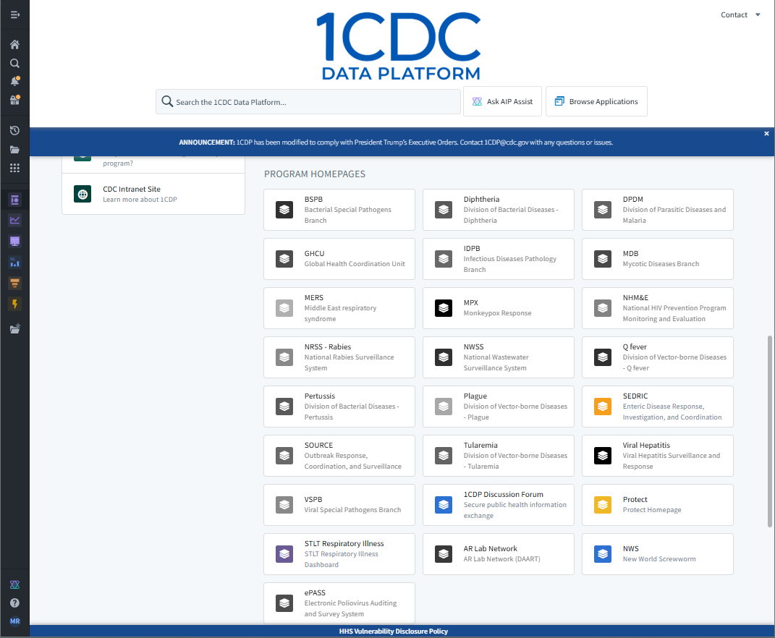
How to Access NWS in 1CDP
24

Slide 25
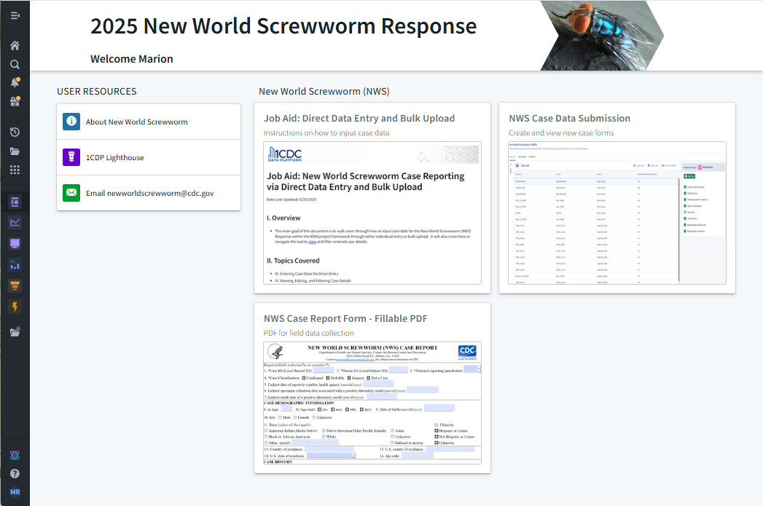
2025 NWS Response Page
25

Slide 26
2025 NWS Response Data Submission
26

Slide 27
2025 NWS Response Resources
27

Slide 28
Reminders
Contact CDC if you receive reports of human myiasis cases
Request access to NWS in 1CDP for staff working on NWS
Email newworldscrewworm@cdc.gov, subject line “NWS 1CDP Access” with
Name, email address, role, and if they are a current 1CDP user for each of these staff in your jurisdiction
If you have questions about NWS, email newworldscrewworm@cdc.gov
28

Slide 29
CDC New World Screwworm contacts
CDC New World Screwworm Team newworldscrewworm@cdc.gov
CDC DPDx (Diagnostic Parasitology Laboratory) dpdx@cdc.gov
CDC Parasitic Clinical Inquiries parasites@cdc.gov, 404-718-4745
CDC Emergency Operations Center (EOC) Watch Desk (after hours/holidays/weekends), 770-488-7100

Slide 30

Questions & Answers

Slide 31
Case Notification Modernization: Next Steps in Generic V3 Development
Peter Boersma, MPH
Office of Public Health Data, Surveillance, and Technology

Slide 32
Case Notification Modernization Summary
Aims:
Reduce the burden of reporting and data management for public health agencies
Ensure that data and related products are accessible, timely, and actionable for decision-making
Guiding principles for a modernized Case Notification system:
Establish a standardized set of data elements applicable across conditions for both routine surveillance and emergency response
Allow flexibility within a standardized framework to support various data exchange methods and the addition of new data elements as needed
Utilize the One CDC Data Platform (1CDP) as the centralized solution for data ingestion, validation, management, and sharing
Incorporate lessons learned from historical data collection and management processes to guide a phased transition to the future state
Implement robust governance and transparent communication to encourage stakeholder engagement throughout the development and rollout of the phased transition approach
32

Slide 33
Generic v3 Supports the Future of Case Surveillance
Combines response and routine case notification
Greater standardization of data elements
Less variability in implementation guides
Alignment with healthcare and current national standards
Will leverage CDC’s enterprise data platform (1CDP)
Faster development and onboarding
33

Slide 34
Generic v3 Overview
New Draft Generic v3 Content
Generic v3 has a total of 101 data elements.
Serves as the core of case notification
Can be sent with condition-specific guides
Can be sent with HL7 v2 ®
Generic v3 will retire 25 of the data elements from Generic v2
Minimal Data Necessary (MDN) elements
Core elements recommended by Data Standardization Working Group (DSWG)
Maintained Generic v2 elements
34

Slide 35
Retired Content from Generic v2
Illness End Date/Duration
State Case Identifier
Imported Country/State/City/County
State/City/County of exposure
Transmission mode
Immediate National Notifiable Condition
Case Outbreak Indicator
Jurisdiction Code
Reporting Source Type Code/Zip Code
Case Investigation Start Date
Date Reported
Date CDC Was First Verbally Notified of This Case
Reporting State/County
35

Slide 36
Content Added to Generic v3
MDN
Includes adding Exposures, Signs & Symptoms, Industry & Occupation, Disability
DSWG-recommended core
Preferred Language
Housing Status
Estimated Date of Delivery
Admitted to ICU
Case Counting Date
New approach for capturing most epidemiologically relevant date
Ultimately replacing MMWR week/year
36

Slide 37
Additional Generic v3 Changes
CDC to provide supplemental guidance to further define data elements and support implementation
Moving commonly collected data from condition-specific guides (e.g., lab, travel, medication) to Generic v3 to standardize reporting
37

Slide 38
Generic v3
Travel
Immunization
Medication
Signs and Symptoms
Exposures
Industry and Occupation
Generic v3
Laboratory
Disability
Underlying Health Conditions
Case Notification MDN
Base Generic v3
Section 508 alternative text version
available on slide 61
38

Slide 39
Generic v3
Travel
Immunization
Medication
Signs and Symptoms
Exposures
Industry and Occupation
Generic v3
Laboratory
Disability
Underlying Health Conditions
Case Notification MDN
Base Generic v3
Section 508 alternative text version
available on slide 62
39

Slide 40
Example Data Elements: Base Generic v3 Block
Person ID/Case ID
Demographics
Address
Case Counting Date
Condition Code
Case Status
Hospitalization
Indicator of Signs or Symptoms
Base Generic v3
40

Slide 41
Example Data Elements: Exposures Block
Exposures
Exposure
Exposure Indicator
First Date of Exposure
Last Date of Exposure
41

Slide 42
Data Collection is Driven by Priorities, Which Can Vary by Condition and by Routine/Response Use
Base Generic v3 block is always requested for all conditions
In a response, it is expected that, at a minimum, all MDN data elements are reported, regardless of condition
Outside of a response, data elements will be assigned a Priority Level (1-3, or not used) to guide reporting
42

Slide 43
Example: Condition #1 in a Routine Scenario
Required*
Priority 1
Priority 2
Priority 3
Will not use in routine
Travel
Immunization
Medication
Signs and Symptoms
Exposures
Industry and Occupation
Generic v3
Case Notification MDN
Laboratory
Disability
Underlying Health Conditions
Base Generic v3
(Includes required data elements)
Section 508 alternative text version
available on slide 63
*Mandatory data elements for sending messages; if not present, messages are rejected
43

Slide 44
Example: Condition #1 in a Response Scenario
Required*
Priority 1
Priority 2
Priority 3
Will not use in routine
Travel
Immunization
Medication
Signs and Symptoms
Exposures
Industry and Occupation
Generic v3
Case Notification MDN
Laboratory
Disability
Underlying Health Conditions
Base Generic v3
(Includes required data elements)
Section 508 alternative text version
available on slide 64
*Mandatory data elements for sending messages; if not present, messages are rejected
44

Slide 45
Example: Condition #2 in a Routine Scenario
Condition-specific questions
Required*
Priority 1
Priority 2
Priority 3
Will not use in routine
Travel
Immunization
Medication
Signs and Symptoms
Exposures
Industry and Occupation
Generic v3
Laboratory
Disability
Case Notification MDN
Underlying Health Conditions
Base Generic v3
(Includes required data elements)
Section 508 alternative text version
available on slide 65
*Mandatory data elements for sending messages; if not present, messages are rejected
45

Slide 46
Example: Condition #2 in a Response Scenario
Condition-specific questions
Required*
Priority 1
Priority 2
Priority 3
Will not use in routine
Travel
Immunization
Medication
Signs and Symptoms
Exposures
Industry and Occupation
Generic v3
Disability
Underlying Health Conditions
Case Notification MDN
Laboratory
Base Generic v3
(Includes required data elements)
Section 508 alternative text version
available on slide 66
*Mandatory data elements for sending messages; if not present, messages are rejected
46

Slide 47
Special Topic #1: Value Sets
In Generic v2-based condition-specific guides, the CDC Program defined value sets
In Generic v3, the CDC Program still defines the value sets, but values will be selected from a superset of values
47

Slide 48
Special Topic #2: Laboratory Results
Generic v2-based condition-specific guides had three data elements to send lab results:
Coded qualitative result (coded)
Coded organism result (coded)
Quantitative result (text)
Generic v3 has a single data element to send lab results:
Test result (data type varies)
48

Slide 49
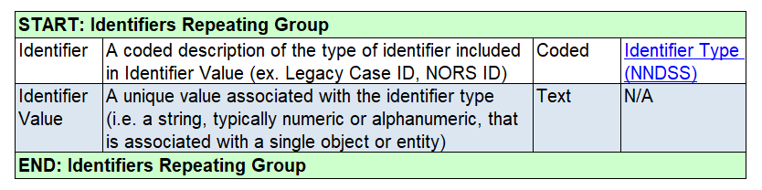
Special Topic #3: Identifier Repeating Group
In Generic v2, each identifier associated with a case was included as a single, stand-alone data element.
In Generic v3, identifiers are transmitted in a single repeating group that includes the type of identifier and the identifier value.
49

Slide 50
Timeline for Receiving Feedback and Final Release
October 1:
Release Generic v3
for feedback
Early December:
Release updated Generic v3 draft
June 2026:
Release final Generic v3
2025
2026
October 31:
Deadline for feedback
December 2025 – May 2026:
Staggered adoption of Generic v3 HL7 Implementation Guide
50

Slide 51
Potential Feedback Area: Generic v3 Onboarding Strategy
Partial onboarding of Generic v3 content
Example: Onboard base Generic v3 block for all conditions, onboard blocks and condition-specific content later
Full onboarding of Generic v3 content
Other options
51

Slide 52
Other Potential Feedback Areas
Questions or concerns you may have about implementing the case counting date ​
Whether data elements that were removed from Generic v2 need to be kept​
Questions or concerns you may have regarding the Generic v3 content and how Priority Levels are defined and used
Questions or concerns you may have regarding the implementation of Generic v3 and how that impacts condition-specific guides that already are implemented ​
52

Slide 53
Other Potential Feedback Areas (continued)
Whether the descriptions and guidance are clear or if implementation questions persist​
Whether moving to a single field for test results will help or hinder sending laboratory data
Whether the use case behind an identifier repeating group is clear and would be feasible to implement​
Suggestions for other changes to Generic v2 that should be adopted with Generic v3
53

Slide 54
Next Steps
Release draft Generic v3 data dictionary, HL7 implementation guide, and supplemental guidance. Target release date: October 1
Request jurisdiction feedback on draft materials, as well as onboarding pathway
Initial round of feedback requested by October 31
Email edx@cdc.gov with Subject Line, “Generic v3 Feedback”
Meet with interested jurisdictions, respond to provided feedback, and release additional drafts, guidance, and answers to questions as able
54

Slide 55
Questions & Answers 1

Slide 56
PHIN VADS Update
Desiree Mustaquim, PhD, MPH, BS
Office of Public Health Data, Surveillance, and Technology

Slide 57

PHIN VADS Outage & Support Options
Please contact the PHIN VADS help desk at phinvs@cdc.gov for support
If you need a value set, please provide the following to the help desk:
Value set name
Value set OID
Any other details that would help us assist you
A six-week, planned outage of PHIN VADS will occur from Monday Sept 29 to Friday Nov 7
57

Slide 58
Questions & Answers 3

Slide 59




Q & A 3
Thank you! Next NNDSS eSHARE: October 21, 2025
Subscribe to Case Surveillance News
Access NNDSS’ Technical Resource Center
Email edx@cdc.gov for technical help
Learn about case surveillance modernization

Slide 60
Appendix: Accompanying Text

Slide 61
Accompanying text for slide 38 (Section 508 compliant text version)
The draft structure of Generic v3 includes 10 blocks of data elements. At the bottom of the structure is base Generic v3. Base Generic v3 contains 54 data elements, covering IDs, case status, hospitalization and demographics. The content of base generic v3 is comparable to the content of Generic v2 as it is similarly basic, condition-agnostic data.
The draft structure of Generic v3 also has nine standardized blocks beyond base Generic v3. These blocks are laboratory, signs & symptoms, travel, medication, immunization, exposure, underlying health conditions, industry & occupation, and disability.
Return to relevant slide

Slide 62
Accompanying text for slide 39 (Section 508 compliant text version)
Similar to the last slide, this slide shows the 10 blocks of data elements that make up the draft structure of Generic v3.
Circled in blue is the content that makes up Case Notification MDN. Case Notification MDN content includes the base Generic v3, laboratory, signs & symptoms, exposure, underlying health conditions, industry & occupation, and disability blocks.
Return to relevant slide

Slide 63
Accompanying text for slide 43 (Section 508 compliant text version)
This slide shows the draft Generic v3 structure for a fictitious scenario, the reporting of condition #1 in a routine scenario. In the upper right-hand corner are the priorities of required 1, 2, 3, and 'will not use in routine'.
In the figure, only the Base Generic v3 is highlighted. It is highlighted in blue to indicate it has a priority of 1. This means that for condition # 1 in a routine reporting scenario, the only data that needs to be sent to CDC is what is included in Base Generic v3.
Return to relevant slide

Slide 64
Accompanying text for slide 44 (Section 508 compliant text version)
This slide shows the draft Generic v3 structure for a fictitious scenario, the reporting of condition #1 in a response scenario. In the upper right-hand corner are the priorities of required 1, 2, 3, and 'will not use in routine'.
In the figure, the coloring of blocks has been changed from the last slide so that signs & symptoms, exposures, industry & occupation, laboratory, disability, and underlying health conditions are all now priority 1. This shows that for condition # 1 in a response reporting scenario, all 7 of these blocks are now high priority for CDC because they are part of Case Notification MDN.
Return to relevant slide

Slide 65
Accompanying text for slide 45
This slide shows the draft Generic v3 structure for a fictitious scenario, the reporting of condition #2 in a routine scenario. In the upper right-hand corner are the priorities of required 1, 2, 3, and 'will not use in routine'. This figure also contains an 11th block for condition-specific data elements.
In the figure, the coloring of blocks indicates that lab and the condition-specific block are priority 1, travel, exposures, industry & occupation, and disability are priority 2, medication and signs & symptoms are priority 3 and that there is potentially limited use for immunization or underlying health condition.
Return to relevant slide

Slide 66
Accompanying text for slide 46
This slide shows the draft Generic v3 structure for a fictitious scenario, the reporting of condition #2 in a response scenario. In the upper right-hand corner are the priorities of required 1, 2, 3, and 'will not use in routine'.
In the figure, the coloring of blocks has been changed from the last slide so that signs & symptoms, exposures, industry & occupation, disability, and underlying health conditions are all now priority 1. This means that for condition # 1 in a response reporting scenario, all 7 of these blocks are now high priority for CDC in addition to the condition-specific data elements because they are part of Case Notification MDN.
Return to relevant slide

