Slide 1
NNDSS eSHARE August 2025 Webinar
Centers for Disease Control and Prevention
Office of Public Health Data, Surveillance, and Technology
August 19, 2025

Slide 2
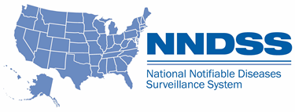
Agenda
Recap of last eSHARE
Answers to frequently received questions
  Case Notification Minimal Data Necessary (MDN)

Slide 3
July eSHARE Recap
Case surveillance data (including NNDSS) have been defined as a core data source in the Public Health Data Strategy (PHDS) since 2023
  The PHDS is the overarching strategy for data and technology for public health and is updated yearly with relevant milestones.
One CDC Data Platform (1CDP) was launched at CDC in October 2024.
  1CDP is on a three-year roadmap (FY25 to FY27) to full scalability and operation across CDC and with partners.
Case surveillance/NNDSS Message Validation, Processing, and Provisioning System [MVPS] is being migrated into 1CDP in FY25 and FY26.
  CDC is postponing NNDSS reconciliation and publication of 2024 annual data until 2026.
  The migration of MVPS to 1CDP will not change the way jurisdictions send data to CDC in 2025.
3

Slide 4

Terminology Recap
The project name for the case surveillance work in 1CDP is 1CDP Case Data Exchange (CDE)
1CDP CDE Pipeline will process, validate, and provision all case data, including what is currently being sent to NNDSS.
1CDP Case Profile Manager (CPM) will be used to define the data collection needed for a case, which can include core, program-specific, and response-specific data content.
4

Slide 5
Case Notification MDN for Response Recap
Co-developed by CDC, CSTE, and partners in 2024
Forms the foundation for response data
Key artifacts available
  Internal CDC release: April/May
  Shared with jurisdictions: July
6 jurisdictions in Engagement Group
11+ jurisdictions provided detailed feedback
26 CDC program reps engaged
Input from CSTE, APHL, OPHDST, ORR
5

Slide 6

Benefits of Case Notification MDN
 | Standardized: Provides a consistent set of data elements to quickly develop and implement response data collection
 | Easy to use data once sent: Flows into established data dissemination templates, including visualizations and tools
 | Faster: Enables timely reporting of critical case data elements early in a response
 | Integration: as more MDNs are defined, harmonized MDN data elements enable simpler cross-data source and cross-program analysis
Green check: available now; Yellow triangle: in progress
6

Slide 7
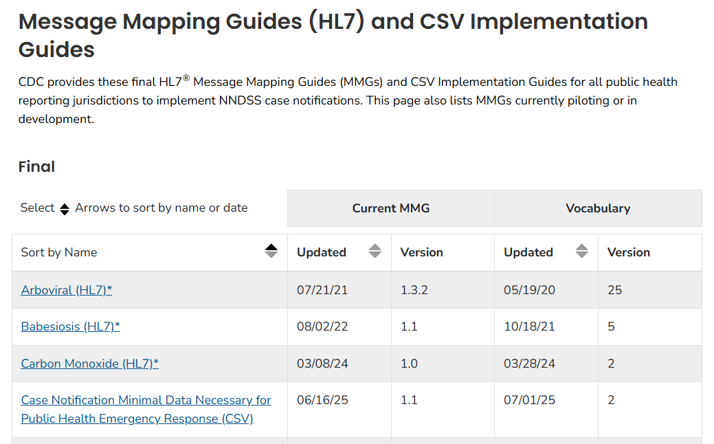
Where can I find the Case Notification MDN?
Implementation Guides
7

Slide 8
Will case notification MDN data be accepted in HL7v2 format?
Currently: Partially (for GenV2-aligned data elements)
Future: Full support planned via 1CDP
For new emergency responses, options for jurisdictions:
  If submitting existing data elements via HL7v2® (GenV2 or condition-specific MMG): can continue
  For new data elements: CSV or direct entry available
  Non-HL7 jurisdictions: Use CSV or direct data entry
Implementation guidance will depend on the condition and the data transmission capabilities of your jurisdiction
CDC is developing 1CDP as a flexible system that allows for multiple transmission mechanisms to meet jurisdictions where they are, from data entry forms to HL7v2 and API-enabled transmission
8
Disclaimer: HL7® is a registered trademark of Health Level Seven International and use of this trademark does not constitute an endorsement by HL7.

Slide 9
Will jurisdictions that send HL7v2 messages need to submit GenV2 and MDN CSV/direct entry?
Yes, in the short-term before GenV3 is available
  Alternatively, all case data can be submitted via CSV or direct data entry
Next step: roll out MDN as part of GenV3, enabling a single standardized message into 1CDP
9

Slide 10
What is Generic version 3 (GenV3)?
An update to GenV2
A condition-agnostic list of core data elements for case data
Adopts CDC/CSTE Data Standardization Workgroup (DSWG)-recommended data elements and national standards
Will use GenV2 as a base and includes the following changes:
  Adds: MDN and new core data elements
  Removes: Rarely used or unclear GenV2 data elements
New MDN content*
(27 data elements)
Draft Generic v3* content
(81 data elements)
New DSWG-recommended core content
(12 data elements)
Generic v2 content (67 data elements)
Retired generic v2 content
(25 data elements)
10
*Generic v2 data elements used in Generic v3 and MDN Data elements reflect latest DSWG standards, as applicable

Slide 11
What is the status of GenV3?
In development
Will be shared with CDC programs and jurisdictions for input and iteration
  In addition to what has already been recommended by DSWG
Timeline forthcoming very soon!
11

Slide 12
Can you clarify what is meant by “core” data?
Core may be used in two contexts: at the data source level and the data element level
Core data sources:
  Essential, routinely collected datasets
  Examples: Case surveillance, emergency department visits, and commercial laboratory data
Core data elements:
  Apply to all diseases/conditions/events
  Defined before data collection begins
  Routinely transmitted either as part of ongoing, or emergency response case surveillance
  Includes GenV2 and MDN elements
12

Slide 13
Three categories of case surveillance data elements are transmitted from jurisdictions to CDC
Core Data Elements
for all diseases/conditions/events,
pre-defined, routinely transmitted
Program-specific Data Elements
for a subset of diseases/ conditions/events,
pre-defined, routinely transmitted
Response-specific Data Elements
defined at the time of response, specific to the response, ad-hoc transmission
Case Notification Minimal Data Necessary (MDN)
for situational awareness in a response
13

Slide 14
How do current NNDSS terms align with the three content categories?
Generic version 2 (GenV2)
Case notification minimal data necessary (MDN)
Generic version 3 (GenV3) *in development*
Core case data elements
NNDSS: Condition-specific message mapping guide (MMG) data elements
Non-NNDSS: other sources of program case data (e.g., REDCap)
Program-specific data elements
Response-specific data elements
Response-specific data elements
14

Slide 15

Q & A

Slide 16




Thank you!
Next NNDSS eSHARE: September 16, 2025
Subscribe to
Case Surveillance News
Access NNDSS’ Technical Resource Center
Email edx@cdc.gov for technical help
Learn about case surveillance modernization

