Slide 1
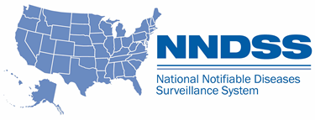
National Notifiable Diseases Surveillance System (NNDSS) eSHARE April Webinar
Center for Surveillance, Epidemiology, and Laboratory Services
Division of Health Informatics and Surveillance
April 19, 2022

Slide 2

Agenda
Agenda
  NNDSS Updates and Announcements
  State Panel Discussion—Data, Data Everywhere: Jurisdiction Views on Data Quality and Cleaning
    Florida, Oregon, and Utah
  Questions and Answers
2
2

Slide 3
NNDSS Updates and Announcements
Center for Surveillance, Epidemiology, and Laboratory Services
Michele Hoover, MS
Data Standardization and Assistance Team
Center for Surveillance, Epidemiology, and Laboratory Services

Slide 4

PHIN VADS Case View version 12: https://phinvads.cdc.gov/vads/ViewView.action?id=8DC8B0CD-E99E-EC11-81AB-005056ABE2F0
Lab Test Type (COVID-19): https://phinvads.cdc.gov/vads/ViewValueSet.action?id=1CE2C9AB-367D-EC11-81AA-005056ABE2F0
Vaccine Type (NND): https://phinvads.cdc.gov/vads/ViewValueSet.action?id=171C100C-CF94-4C17-B6FC-179E5CCE389C
Lab Test Interpretation (VPD): https://phinvads.cdc.gov/vads/ViewValueSet.action?id=8BC53B67-CE8E-4014-97CC-5CA9E4F1EA53
Updates: Coronavirus Disease 2019 (COVID-19) MMG
  NEW: The PHIN Vocabulary Access and Distribution System (VADS) COVID-19 Case Notification View has been updated
      Version 12 is now the most up-to-date version
      Includes three additional values to Lab Test Type (COVID-19)
      Includes an additional value to Vaccine Type (NND)
      Includes two additional values and six value name changes to Lab Test Interpretation (VPD)

Slide 5
5
Updated STD MMG
  Version 1.2.0 is the most current
  Uses the NEW PHIN VADS Case Notification View “STD Case Notification (v1.2)” Version 1
      Updated value set for Test Type (INV290)
      Updated value set for Type of Complications Indicator (INV920) to align with the approved chlamydia position statement to include information on lymphogranuloma venereum (LGV)
      Updated to Genv2.0.1 in Test Case Scenario Worksheet and other
      formatting updates
      Updated test data in Test Case Scenario Worksheet
  Value set for Test Type (INV290) updated for STD v1.0.x; uses PHIN VADS Case Notification View “STD Case Notification” Version 13
STD v1.2.0 MMG: https://ndc.services.cdc.gov/mmgpage/std-message-mapping-guide/
PHIN VADS Case Notification View “STD Case Notification (v1.2)” version 1: https://phinvads.cdc.gov/vads/ViewView.action?id=14699798-FF9B-EC11-81AB-005056ABE2F0
PHIN VADS Case Notification View “STD Case Notification” version 13: https://phinvads.cdc.gov/vads/ViewView.action?id=FF7CF554-059C-EC11-81AB-005056ABE2F0

Slide 6
CS
Updated Congenital Syphilis (CS) MMG
  Version 1.1.2 is the most current
  Uses the NEW PHIN VADS Case Notification View “CS Case Notification (v1.1)” Version 1
      Updated value set for Test Type (INV290)
      Updated to Genv2.0.1 in Test Case Scenario Worksheet and other formatting updates
      Updated test data in Test Case Scenario Worksheet
  Value set for Test Type (INV290) updated for CS v1.0.x, uses PHIN VADS Case Notification View “CS Case Notification” Version 10
CS v1.1.2 MMG: https://ndc.services.cdc.gov/mmgpage/congenital-syphilis-message-mapping-guide/
PHIN VADS Case Notification View “CS Case Notification View (v1.1)” version 1: https://phinvads.cdc.gov/vads/ViewView.action?id=E28235F5-FB9B-EC11-81AB-005056ABE2F0
PHIN VADS Case Notification View “CS Case Notification” version 10: https://phinvads.cdc.gov/vads/ViewView.action?id=60E53DCC-FF9B-EC11-81AB-005056ABE2F0
6

Slide 7
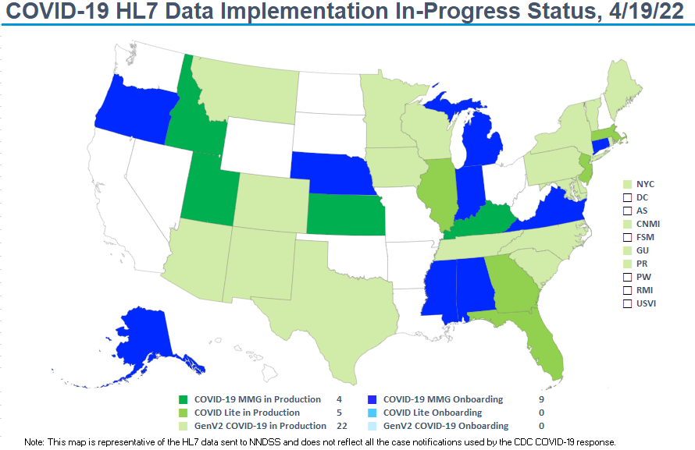
Plan
7

Slide 8
Reconciliation: What’s Next?

Slide 9
State Panel Discussion—Data, Data Everywhere: Jurisdiction Views on Data Quality and Cleaning
Center for Surveillance, Epidemiology, and Laboratory Services
Michele Hoover, MS
Data Standardization and Assistance Team
Center for Surveillance, Epidemiology, and Laboratory Services

Slide 10
COVID-19
State Panelists
  Florida Department of Health
    Allison Culpepper, Kristen Jezeski, and Kim Wiley
  Oregon Health Authority–Division of Public Health
    June Bancroft and Robert Laing
  Utah Department of Health
    Rachelle Boulton and Jason Barnes
10

Slide 11
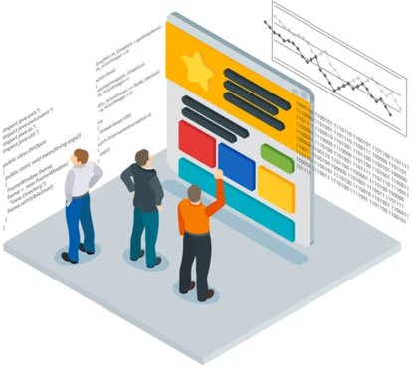
Slide11
Topics for Discussion
  Processes for Data Quality and Cleaning
    Data quality affected by volume of data
    New processes added
  Useful Tools for Tracking Data across Data Sources
  Tracking Messages during Reconciliation

Slide 12

Open Discussion

Slide 13

Next NNDSS Webinar: September 21, 2021
Subscribe to the monthly NNDSS newsletter, Case Surveillance News
Access the NNDSS Technical Resource Center
Email edx@cdc.gov to request NNDSS technical assistance or begin onboarding HL7 message mapping guides
Next NNDSS eSHARE:
May 17, 2022 (more details coming soon)

