Slide 1

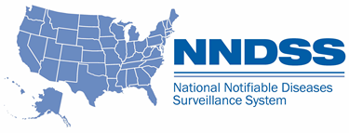
National Notifiable Diseases Surveillance System (NNDSS) eSHARE November Webinar
Center for Surveillance, Epidemiology, and Laboratory Services
Division of Health Informatics and Surveillance
November 16, 2021

Slide 2

Agenda
Agenda
  NNDSS Updates and Announcements
  Planning Ahead to 2022: Message Mapping Guide (MMG) Roundup
  Questions and Answers
2
2

Slide 3
NNDSS Updates and Announcements
Center for Surveillance, Epidemiology, and Laboratory Services
Michele Hoover, MS
Data Standardization and Assistance Team
Center for Surveillance, Epidemiology, and Laboratory Services
Sara Johnston, MPH
NNDSS Program Lead
Center for Surveillance, Epidemiology, and Laboratory Services

Slide 4
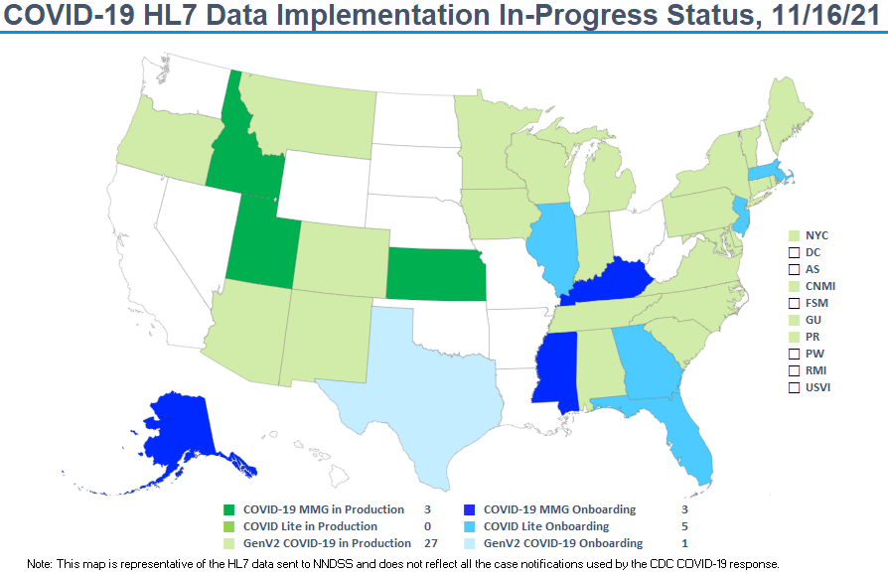
stat

Slide 5
Planning Ahead to 2022: MMG Roundup
Center for Surveillance, Epidemiology, and Laboratory Services
Michele Hoover, MPH
Data Standardization and Assistance Team
Center for Surveillance, Epidemiology, and Laboratory Services

Slide 6

6
Why are We Doing This?
  Help jurisdictions plan 2022 work
    Assess system changes
    Develop Statement of Work (SOW)
    for contracts
    Increase epidemiology and informatics capacity
  Discuss MMG incentives and benefits

Slide 7

Funding Opportunities
  Funding may be available to help implement MMGs
    May vary by program
    Plan activities for current cooperative agreements
  Reach out to your program contacts to discuss options

Slide 8

MMG Status and Program Capacity

Slide 9
Open for General Onboarding

Slide 10
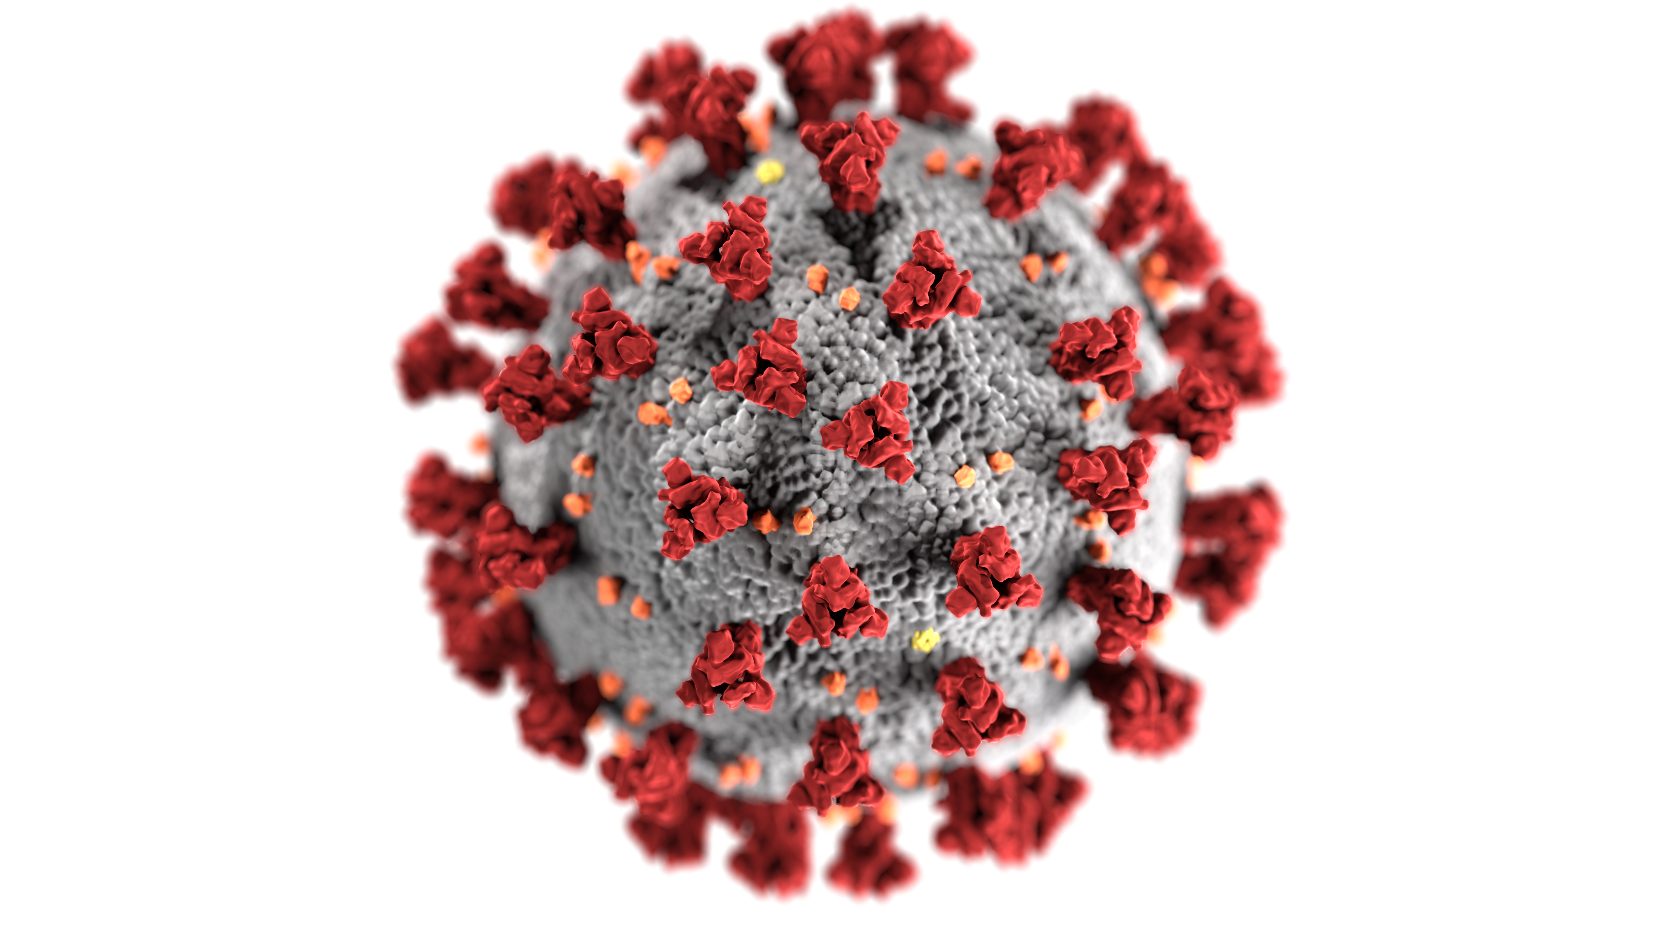
COVID-19 MMG
  MMG status
    COVID-19 v1.1 is open for general onboarding
  Onboarding capacity
    Currently supporting onboarding and pre-onboarding for 20 jurisdictions
  Benefits of sending data through the MMG
    Turn off data extracts and uploads
      CSV DCIPHER uploads
      Vaccine breakthrough data entry and uploads to REDCap
    Used in major reports and publications

Slide 11

Arbo
Arboviral MMG
  MMG status
    Arboviral v1.3.2 is open for general onboarding
    Considering an update to the guide in 2023 to at least incorporate
    vaccine data for dengue
  Onboarding capacity
    5–7 jurisdictions may onboard at once
  Benefits of sending data through the MMG
    Stop data entry into ArboNET and other formats
    Streamlines reporting by sending data integrated into surveillance systems
    Eliminates the need to export data from other systems
    39 conditions for one MMG
  Additional informatics funding
    For jurisdictions not yet onboarded, funding may be available; please contact the Vector-borne ELC mailbox (vbdelc@cdc.gov), if interested

Slide 12
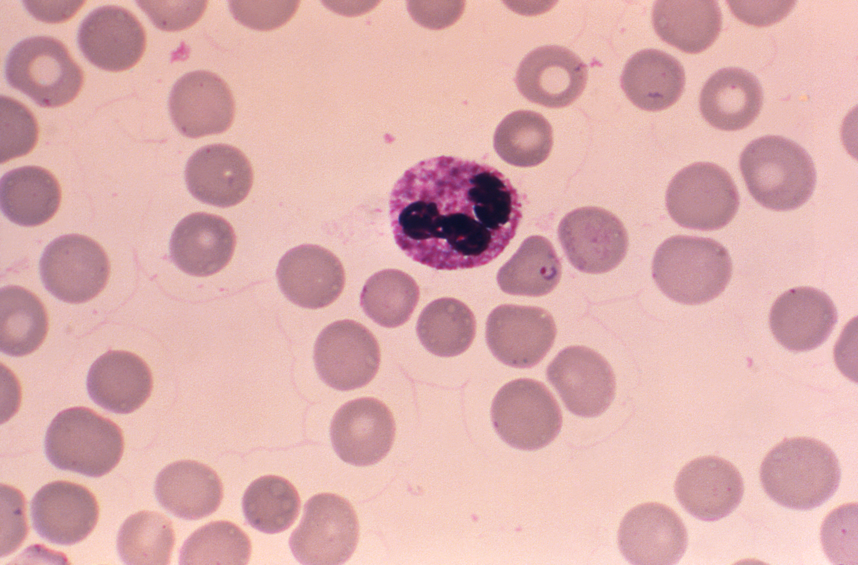
Babesiosis
Babesiosis MMG
  MMG status
    Babesiosis v1.0.2 is open for general onboarding
    Adding “Mother’s Local Record ID” in early 2022
  Onboarding capacity
    3–4 jurisdictions may onboard all 3 MMGs from the CDC’s Division of Parasitic Diseases and Malaria at once: malaria, babesiosis, and trichinellosis
    Planning 3–4 states in a joint cohort per quarter
  Benefits of sending data through the MMG
    Opportunity to implement with 2 other MMGs, which would give Epidemiology and Laboratory Capacity Health Information Systems (ELC HIS) credit for 3 MMGs
    Turn off legacy formats of reporting (i.e., paper or surveillance system exports)
    More standardization for better consistency across the nation
    Helps raise national awareness of this emerging infection
  Additional informatics funding
    Funding for general tickborne disease surveillance activities is available through Division of
    Vector-Borne Diseases (DVBD)

Slide 13

Malaria
Malaria MMG
  MMG status
    Malaria v1.0.2 is open for general onboarding
  Onboarding capacity
    3–4 jurisdictions may onboard all 3 MMGs from the CDC’s Division of Parasitic Diseases and Malaria at once: malaria, babesiosis, and trichinellosis
    Planning 3–4 states in a joint cohort per quarter
  Benefits of sending data through the MMG
    Opportunity to implement with 2 other MMGs, which would give ELC HIS credit for 3 MMGs
    Turn off legacy formats of reporting (i.e., paper or surveillance system exports)

Slide 14

Trichinellosis
Trichinellosis MMG
  MMG status
    Trichinellosis v1.0.3 is open for general onboarding
  Onboarding capacity
    3–4 jurisdictions may onboard all 3 MMGs from the CDC’s
    Division of Parasitic Diseases and Malaria at once: malaria,
    babesiosis, and trichinellosis
    Planning 3–4 states in a joint cohort per quarter
  Benefits of sending data through the MMG
    Opportunity to implement with 2 other MMGs, which would give ELC HIS credit for 3 MMGs
    Turn off legacy formats of reporting (i.e., paper or surveillance system exports)
    Generic V2 (GenV2) data elements will help enhance national surveillance along with the ability to capture multiple iterations of data through repeating blocks

Slide 15

Lyme
Lyme and Tickborne Rickettsial Diseases
  (TBRD) MMG
  MMG status
    Lyme/TBRD v1.0.1 is open for general onboarding
  Onboarding capacity
    To be assessed as programs onboard jurisdictions
  Benefits of sending data through the MMG
    Faster, more complete national surveillance results reported by CDC, if data are submitted with MMG
    Reconciliation: Close out will be more streamlined if reporting through one mechanism
    Turn off legacy formats of reporting (i.e., paper or surveillance system exports)
    Less need of paper and manual data entry
  Additional informatics funding
    Please contact the Vector-borne ELC mailbox (vbdelc@cdc.gov), if interested

Slide 16

STD
STD and Congenital Syphilis (CS) MMG
  MMG status
    STD v1.1 and CS v1.1 are open for general onboarding
    Updated versions of STD and CS guides anticipated for early 2022
      Updated value set for Test Type (INV290) for STD and CS guides
      Updated value set for Type of Complications Indicator to align with
      the approved chlamydia position statement to include information on
      Lymphogranuloma venereum (LGV)
  Onboarding capacity
    5 jurisdictions may onboard at once
  Benefits of sending data through the MMG
    Turn off Congenital Syphilis REDCap reporting
    Faster results reported from CDC if data are provided to NNDSS
    Reconciliation: Close out will be more streamlined if reporting through one mechanism

Slide 17

TB
Tuberculosis and Latent TB Infection (LTBI) MMG
  MMG status
    TB/LTBI MMG v3.0.2 is open for general onboarding
    Establishing additional TB/LTBI MMG cohorts for 2022
      Email edx@cdc.gov if interested in joining
  Onboarding capacity
    5–8 jurisdictions may onboard at once
  Benefits of sending data through the MMG
    Incorporates the RVCT2020 reporting requirements, including Molecular Drug Susceptibility Testing (DST) and Multi-drug resistant (MDR) supplemental data
    Responsive to new tests and drugs with minimal modifications and vocabulary updates
    Aligns with the structure and harmonized vocabulary used in GenV2
    Data are received through the Message Validation, Processing, and Provisioning System, offering more transparency to examine message status and data validation

Slide 18
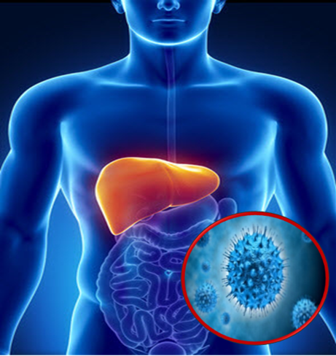
Hepatitis
Hepatitis MMG
  MMG status
    Hepatitis v1.0.1 is open for general onboarding
    New major version, Hepatitis v2.0, anticipated in 2022
      Email edx@cdc.gov if interested in joining the v2.0 pilot
  Onboarding capacity
    5–7 jurisdictions may onboard at once
  Benefits of sending data through the MMG
    Enhanced clinical, risk factor information
    Used in major reports/publications such as the CDC Viral Hepatitis Annual Surveillance Report and Healthy People 2030, and other research/scientific manuscripts
    New focus: completion of data elements for pregnancy status and country of birth
  Additional Informatics funding
    PS21-2103 Cooperative Agreement will support informatics work for surveillance

Slide 19
Opening Soon

Slide 20

H
Healthcare-Associated Infections,
Multidrug Resistant Organisms (HAI-MDRO) MMG
  MMG status
    V1.0.1 anticipated for general onboarding before the end of the year
    CDC is re-engaging with Emerging Infections Program (EIP) sites to assess ability to send MuGSI conditions alongside HAI-MDRO national notifiable conditions
  Onboarding capacity
    5–8 jurisdictions may onboard at once
  Benefits of sending data through the MMG
    Improves surveillance, supports urgent public health response, reduces duplication, and provides CDC with data unavailable elsewhere (e.g., health disparities)
    HL7 is the only reporting method for HAI/MDROs for NNDSS
    Use in major reports/publications and national strategic planning
  Additional informatics funding
    ELC Strengthening HAI/AR Program Capacity (ARP) supplement may be used for epidemiology and laboratory support

Slide 21
Coming in 2022

Slide 22

FDD
Foodborne and Diarrheal Diseases (FDD) MMG
  MMG status
    Updated V1.2 of FDD guide projected to be posted early 2022
  Onboarding capacity
    To be assessed once open for general onboarding, estimated for late summer 2022
  Benefits of sending data through the MMG
    Meeting ELC goals
    Stop sending paper case report forms
    Reconciliation: Close out will be more streamlined if reporting through one mechanism
    Timely data collection and analysis: outbreak investigations, epi tends, & risk factors
    More secure data transmission
    FoodNet able to capture case metadata and improve identification of co-infections
  Additional informatics funding
    EIP funding for existing FoodNet sites

Slide 23

RIBD
Respiratory and Invasive Bacterial Diseases
(RIBD) MMG
  MMG status
    RIBD v1.1.1 currently published
    An updated version anticipated for early 2022
      Minor updates to align with current shared MMG standards
  Onboarding capacity
    Target date for onboarding is unknown at this time, due to COVID-19 MMG onboarding priority
    Jurisdictions that received funding for “pre-onboarding” work are encouraged to work on those activities, although timing for movement to “onboarding” is not yet known
  Benefits of sending data through the MMG
    Turn off legacy reporting streams
  Additional informatics funding
    Anticipated to help support surveillance for legionella, psittacosis, invasive pneumococcal disease (IPD), Haemophilus influenzae, and meningococcal disease

Slide 24

VPD
Vaccine Preventable Diseases (VPDs): Mumps, Pertussis, and Varicella MMGs
  MMG status
    Mumps v1.0.1, Pertussis v1.0.1, and Varicella v3.0.1 guides are
    currently published
    All three should be onboarded at the same time
  Onboarding capacity
    Target date for onboarding is unknown at this time, due to COVID-19 MMG onboarding priority
  Benefits of sending data through the MMG
    Turn off legacy reporting streams

Slide 25

V
VPDs: Measles, Rubella, and Congenital Rubella Syndrome (CRS) MMGs
  MMG status
    Measles, Rubella, and Congenital Rubella Syndrome (CRS) anticipated for release in 2022
    All three should be onboarded at the same time
  Onboarding capacity
    Target date for onboarding is unknown at this time, due to COVID-19 MMG onboarding priority
  Benefits of sending data through the MMG
    Turn off legacy reporting streams

Slide 26
Piloting in 2022

Slide 27

CO
Carbon Monoxide Poisoning (CO) MMG
  MMG plans
    Association of Public Health Laboratories (APHL) to re-initiate cohort for piloting CO MMG v1.0
      Email edx@cdc.gov if interested in joining the pilot
  Onboarding capacity
    5–8 jurisdictions may onboard at once
  Benefits of sending data through the MMG
    Reduces the burden of data cleaning by improving data transmission and
    data consolidation
    Improves data quality and completeness for surveillance activities and analyses
    Provides standardized data elements and valid values for variables
    Supports linkage of records to find a new or prevalent case
    Helps calculate more accurate counts and rates of morbidity and mortality

Slide 28

BSP
Bacterial Special Pathogens: Brucellosis,
Hansen’s disease, and Leptospirosis MMGs
  MMG status
    Anticipate Council of State and Territorial Epidemiologists (CSTE) webinar for jurisdiction feedback around spring 2022
    Piloting anticipated around summer of 2022
      Email edx@cdc.gov if interested
  Onboarding capacity—To be determined after piloting
  Benefits of sending data through the MMG
    Less need for paper and manual data entry
    Improve transmission and consolidate data streams, including provisioning
    in DCIPHER
    Quicker turnaround for data utilization
        Early identification of geographic expansion or increases in cases
        Major reports/publications

Slide 29

29
Resources
  Message mapping guide information for implementation can be found at https://ndc.services.cdc.gov/message-mapping-guides/
  To request technical assistance, join an onboarding cohort, or participate as a pilot for a new MMG, please email the CDC Electronic Data Exchange mailbox at edx@cdc.gov

Slide 30

Open Discussion

Slide 31

Agenda

Slide 32


Next NNDSS Webinar: September 21, 2021
Subscribe to the monthly NNDSS newsletter, Case Surveillance News
Access the NNDSS Technical Resource Center
Email edx@cdc.gov to request NNDSS technical assistance or begin onboarding HL7 message mapping guides
Next NNDSS eSHARE:
January 18, 2022 (more details coming soon)

