Slide 1
NNDSS Modernization Initiative (NMI): November eSHARE Webinar
Division of Health Informatics and Surveillance
November 17, 2020

Slide 2
Agenda
Welcome and Announcements
State Panel on Using Innovative Methods to Enhance Data Collection and Reporting During the Response
Arizona, Florida, and Utah
Questions and Answers

Slide 3
NMI Updates and Announcements
Michele Hoover, MS
Lead, State Implementation and Technical Assistance

Slide 4
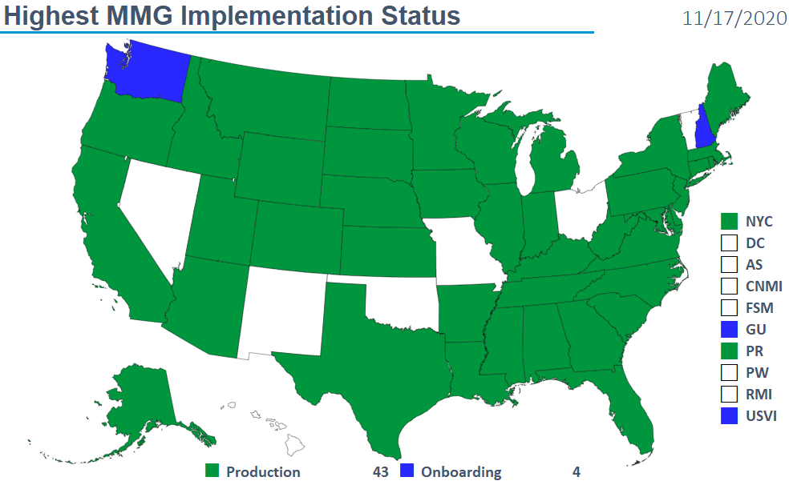
Highest MMG Implementation Status

Slide 5
2019 NNDSS Reconciliation: Timeline
October 30, 2020: Last day for jurisdictions to transmit routine updates to 2019 data.
December 7, 2020: Last day for State/Territorial Epidemiologist to return approved counts.
December 7, 2020: Finalized 2019 NNDSS database closed at CDC.
May 2021: Publication of Finalized 2019 tables.

Slide 6
2019 NNDSS Annual Tables: Options for Implementation
Select one of the following:
Normal sign off completed.
Additional changes to 2019 data needed. Will complete sign off on 2019 data by 12/7/2020.
Unable to complete the reconciliation process for 2019 data this year. “Finalize” data as is with notation in CDC publications that, due to the pandemic, data was not finalized and may differ from what is published by the jurisdiction.
Do not publish jurisdiction 2019 (non-STD) data in the 2019 annual NNDSS tables. Include a notation that finalized data for the jurisdiction are not available for publication.

Slide 7
State Panel Discussion: Using Innovative Methods to Enhance Data Collection and Reporting During the Response

Slide 8
State Panelists
Arizona Department of Health Services
Laura Erhart, Teresa Jue, and Susan Robinson
Florida Department of Health
Allison Culpepper
Utah Department of Health
Rachelle Boulton

Slide 9
Health Information Exchange (HIE)

Slide 10
Arizona’s Experiences with Health Information Exchange (HIE)
November eSHARE
Nov. 17, 2020

Slide 11
Health Department-HIE Collaboration
History
Timeline for COVID-19 Response

Slide 12
Timeline for COVID-19 Response
Data Pull
(Fri)
Identify cases from surveillance system that are missing any of the data elements of interest (for conf/prob COVID-19 cases) (SAS)
Format into structure required for HIE data requests (SAS)
File Exchange (Fri – Mon)
HD drops file into SFTP (Fri)
HIE pulls file and loads query
Query results returned via SFTP (Mon/Tues)
Processing (Tues)
Reformat results into structure and codes needed for batch processing into surveillance system (SAS)
Batch processing upload

Slide 13
Impacts and challenges
Impact: updates to surveillance system
Challenges include identifying the correct question and interpretation
Hospitalization
Comorbidities

Slide 14
Higher Education & Universities

Slide 15
Utah Higher Education Collaboration
For COVID-19 Contact Tracing
Rachelle Boulton, MSPH
DCP Informatics Program
November 2020
HEALTHIEST PEOPLE | OPTIMIZE MEDICAID | A GREAT ORGANIZATION

Slide 16
Utah Higher Education Collaboration
Utah Higher Education Collaboration
Unified statewide response set by COVID-19 public health policy group
Local health departments worked individually with universities to determine contact tracing procedures
University liaison
Deputize university employee
Separate contact tracing program
UDOH provided legal, technical, and procedural advice and guidance
HEALTHIEST PEOPLE | OPTIMIZE MEDICAID | A GREAT ORGANIZATION

Slide 17
Point of Care (POC) Testing Pilot

Slide 18
CSTE COVID-19 Reporting Application Pilot
CSTE COVID-19 Reporting Application Pilot
Rachelle Boulton, MSPH
DCP Informatics Program
November 2020
HEALTHIEST PEOPLE | OPTIMIZE MEDICAID | A GREAT ORGANIZATION

Slide 19
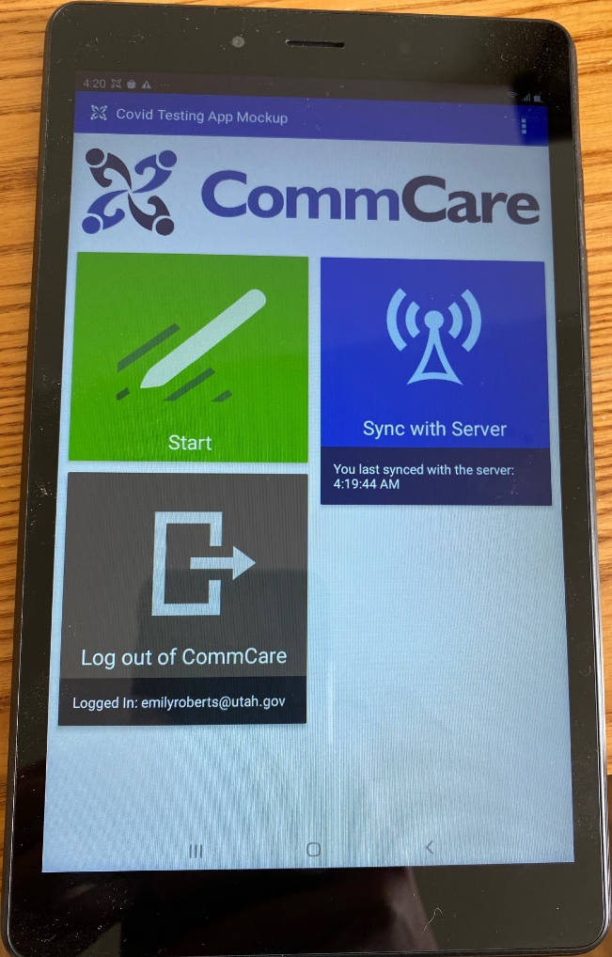
CSTE COVID-19 Reporting Application Pilot
CSTE/World Economic Forum partnership
Tablets customized with CommCare software
Results automatically sent and housed in the cloud
Full pilot implemented in less than 36 hours, actual training and setup per site averaging 2-3 hours total
Successes:
Portability, data quality, workflow
Challenges:
Software updates, API connection issues, pilot discontinued
Pilot successfully demonstrated the benefits of a tool like this for low-resource sites who are not able to devote additional resources for electronic reporting
HEALTHIEST PEOPLE | OPTIMIZE MEDICAID | A GREAT ORGANIZATION

Slide 20
Open Discussion

Slide 21
Subscribe to monthly NNDSS newsletter (NMI Notes) at https://www.cdc.gov/nndss/trc/news/
Access the NNDSS Technical Resource Center at
https://www.cdc.gov/nndss/trc/
Request NNDSS technical assistance or onboarding at
edx@cdc.gov
Next NMI eSHARE is December 15, 2020 – details at
https://www.cdc.gov/nndss/trc/onboarding/eshare.html

