Slide 1

NNDSS Modernization Initiative (NMI):
June eSHARE Webinar
Division of Health Informatics and Surveillance
June 23, 2020

Slide 2

Agenda
Welcome and Announcements
Overview of the COVID-19 HL7 Case Notification Message
Questions and Answers

Slide 3
NMI Updates and Timeline
Michele Hoover, MS
Lead, State Implementation and Technical Assistance

Slide 4
Finalized Guides
Onboarding Open to All | Onboarding For Pilots Only | Onboarding On Hold
Arboviral v1.3 | Babesiosis | Mumps
Gen v2 | FDD | Pertussis
Hepatitis | HAI MDRO | Varicella
 | Lyme/TBRD
 | Malaria
 | STD & CS
 | TB/LTBI
 | Trichinellosis
 | RIBD
New version of guide coming soon!
6/23/2020

Slide 5
Overview of the COVID-19 HL7
Case Notification Message
Sara Imholte Johnston, MPH
NNDSS Program Manager
Loretta Foster, MPH
Epidemiologist

Slide 6
Finalized COVID-19 Message Mapping Guide
Contains all data elements from the May COVID-19 case report form (CRF)
COVID-19 message fulfills reporting for notifiable conditions and DCIPHER COVID case
Process for COVID-19 MMG will differ from others due to emergency response
6

Slide 7
Routine NNDSS Case Notification Process to the National Center for Immunization and Respiratory Diseases (NCIRD)
Jurisdiction
CDC
Jurisdiction Surveillance System(s)*
National Notifiable Diseases Surveillance System (NNDSS)
NCIRD NNDSS Analytic Database (NNAD)
MMG
NETSS
NBS MM
*May include outbreak system, integration engine, etc.

Slide 8
Emergency COVID-19 Case Notification Process with basic info through NNDSS and additional info directly in DCIPHER
Jurisdiction
CDC
CSV
Jurisdiction Surveillance System(s)*
National Notifiable Diseases Surveillance System (NNDSS)
NCIRD NNDSS Analytic Database (NNAD)
Data Collation and Integration for Public Health Event Response (DCIPHER)​
Genv2 MMG
NETSS
NBS MM
*May include outbreak system, integration engine, etc.

Slide 9
COVID-19 MMG Case Notification Process with all COVID-19 case info through NNDSS and passed to DCIPHER
Jurisdiction
CDC
Jurisdiction Surveillance System(s)*
National Notifiable Diseases Surveillance System (NNDSS)
NCIRD NNDSS Analytic Database (NNAD)
Data Collation and Integration for Public Health Event Response (DCIPHER)​
COVID-19 MMG
*May include outbreak system, integration engine, etc.

Slide 10
Multisystem Inflammatory Syndrome (MIS)
Case Notification Process with basic info initiated in NNDSS, additional info directly in DCIPHER
Jurisdiction
CDC
CSV
2
Jurisdiction Surveillance System(s)*
National Notifiable Diseases Surveillance System (NNDSS)
NCIRD NNDSS Analytic Database (NNAD)
Data Collation and Integration for Public Health Event Response (DCIPHER)​
Genv2 MMG
NETSS
NBS MM
1
*May include outbreak system, integration engine, etc.

Slide 11
Example COVID-19 Notification
ID, age, sex, hospitalized…
Signs and symptoms, exposures, etc.
Order Number, Test Ordered Name…
Generic v2
COVID-19-specific Data Elements
Lab Template
(Optional)
One HL7 message
11

Slide 12
External Review Results
4 Business Day Review
  6/5 – 6/11
15 Entities Provide Feedback
  3 Internal CDC Groups
  12 States
308 Comments total
THANK YOU!
12

Slide 13
Differences from the Case Report Form
Repeating Groups Used for:
  Exposures
  Travel
  Clinical Findings
  Treatment/Intervention
  Signs and Symptoms
  Risk Factors
Tribal Enrollment:
  Indicate tribe enrolled
Selected Text Fields Changed to Coded
Information Added to MMG
  Pregnancy Trimester, Weeks Gestation
  Industry and Occupation Repeating Group
  Travel Dates
  Type of Other Diagnosis
  Reason for Testing
  Supporting Lab Information
  Vaccine Information
13

Slide 14
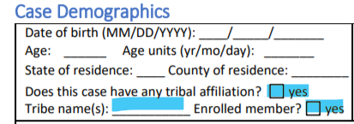
Differences from the Case Report Form
Tribal Enrollment:
  Indicate tribe enrolled instead of check box for enrolled
Language
  Can send for any case
Text to Coded
  Language
  State
  Country
  Tribe Name
  Tribe Enrolled
  Critical Infrastructure Workplace Setting
Guide has been updated based on external review feedback.
14

Slide 15
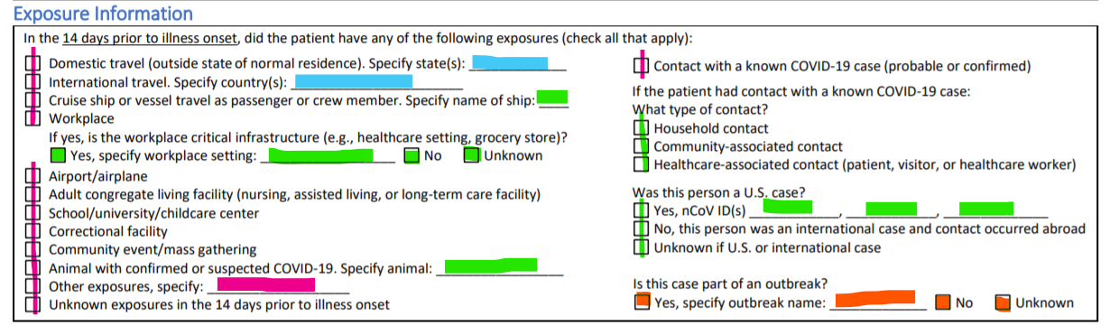
Exposure Information
2 Data Element Repeating Group
  Exposure – Pink
  Exposure Indicator (new)
Travel History Repeating Group – Blue
7 Individual Data Elements – Green
  Critical Infrastructure Workplace Setting – coded
Gen v2 Outbreak Data Elements - Orange
15

Slide 16
Travel History Repeating Group
4 Data Element Repeating Group
  International Destination of Recent Travel
  Travel State
  Date Left for Travel
  Date of Return from Travel
Similar to Format Used in Other MMGs
  Malaria, Babesiosis, Foodborne, etc.
Can Repeat as Often as Needed
International | State | Left for Travel | Return from Travel
Italy |  | 2020/02/13 | 2020/02/20
USA | Alabama | 2020/03/01 | 2020/03/10
 | Montana | 2020/03/12 | 9999/99/99
16

Slide 17
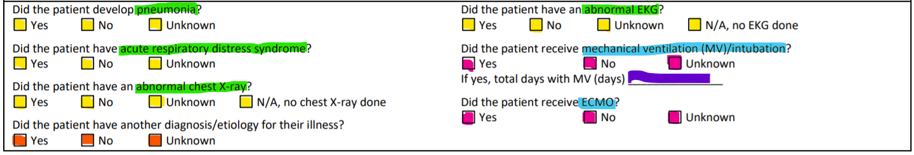
Clinical Information
Clinical Finding Repeating Group (2 DE)
  Clinical Finding - Green
  Clinical Finding Indicator - Yellow
Secondary Diagnosis (2 DE) – Orange
  Additional data element to specify type of Secondary Diagnosis if known (text)
Treatment/Medical Intervention Repeating Group (3 DE)
  Treatment/Medical Intervention – Blue
  Treatment Indicator - Pink
  Treatment Duration – Purple
    Can be used for both M/V and ECMO or skipped for ECMO
17

Slide 18
Signs and Symptoms Repeating Group
2 Data Element Repeating Group
  Signs and Symptoms
  Signs and Symptoms Indicator
Similar to Format Used in Other MMGs
Can Repeat as Often as Needed
Please Complete for each value in the Signs and Symptoms value set
Sign/Symptom | Indicator
Fever >100.4 | Yes
Subjective Fever | Unknown
Chills | Yes
Rigor | No
Muscle Aches (Myalgia) | Yes
18

Slide 19
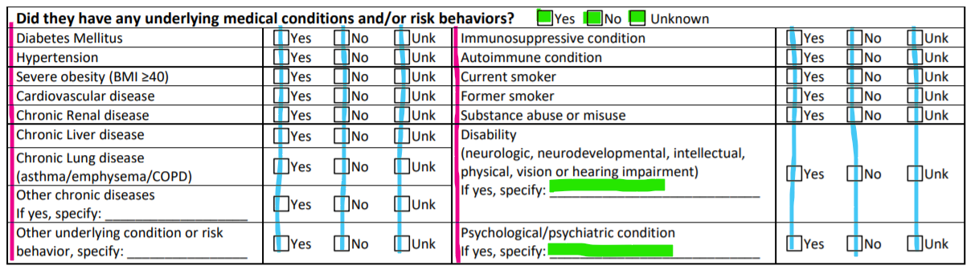
Risk Factor Information
  Risk Factor Repeating Group (2 DE)
    Patient Epidemiological Risk Factors (Pink)
    Patient Epidemiological Risk Factors Indicator (Blue)
  Individual Data Elements (3 DE) – Green
    Additional data element to specify type of Disability or Psychological Condition if known (text)
19

Slide 20
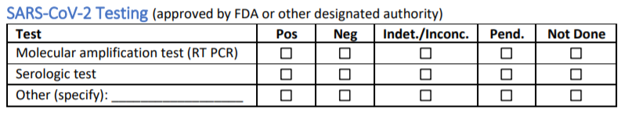
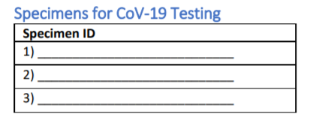
Laboratory Repeating Group
8 Data Element Repeating Group
  Test Type
  Specimen Source
  Test Result
  Test Result Quantitative & Unit
  Specimen Collection Date
  Performing Laboratory Specimen ID
  Performing Laboratory Type
Expanded Value Sets
Reason for Testing
20

Slide 21
Vaccine Information
15 Data Elements
  6 Individual Data Elements
  9 Data Elements in 1 Repeating Group
Previously Used in Other VPD MMGs
  Completely Harmonized
  Vaccine Type Value Set is Only Difference

Slide 22
Data Element Priority Changes
Increase
  Interpreter – 3 to 2
    Assist with the creation of public health messaging
  Tribal Affiliation – 3 to 2
    Help inform health equity concerns in vulnerable populations
  Workplace Critical Infrastructure – 3 to 2
    Identify at-risk occupations in the population
  Workplace Critical Infrastructure Setting – 3 to 2
    Identify at-risk occupations in the population
  First Positive Specimen Date – 3 to 2
    Assess epidemiologic trends
Increase cont.
  Primary Language – 3 to 2
    Supports Sec. 4302 of the Affordable Care Act aimed to collect data to reduce health disparities
Decrease
  Date of First ICU Admission – 1 to 2
    High priority but understand many do not currently collect at this time
  Type of Healthcare Occupation – 1 to 2
    Allow more flexibility for implementation of industry/occupation data elements
    Encourage use of I&O in conjunction

Slide 23
Other External Review Changes
Value Sets
  Detection Method
  Tribes
  Clinical Finding Indicator
  Lab Test Type
  Specimen Type
New Data Elements
  Exposure Indicator
    Creates exposure repeating group to allow for YNU response for all exposures
  Reason for Testing
Removed Data Elements
  Symptom Onset Date
    Map CRF field to Date of Illness Onset in Gen v2
  Symptom Resolution Date
    Map CRF field to Illness End Date in Gen v2

Slide 24
Next Steps for COVID-19 MMG
Summer
Publish COVID-19 MMG to the NNDSS website
Complete readiness assessments for initial cohort
Kick-off for initial cohort
METS available to jurisdictions
Request participation in a future COVID-19 cohort
Summer/Fall
Begin onboarding
Revise MMG, as needed

Slide 25
Questions Slide
Questions?

Slide 26
Subscribe to monthly NNDSS newsletter (NMI Notes) at
https://www.cdc.gov/nndss/trc/news/
Access the NNDSS Technical Resource Center at
https://www.cdc.gov/nndss/trc/
Request NNDSS technical assistance or onboarding at
edx@cdc.gov
Next NNDSS eSHARE is July 28, 2020 – details to come at
https://www.cdc.gov/nndss/trc/onboarding/eshare.html

Slide 27
Appendix

Slide 28
NNDSS Data Reconciliation & COVID-19 Case Definition
NNDSS 2019 Data Reconciliation process timeline has changed:
  Last day to transmit/update 2019 final data: Sept. 30, 2020.
  Last day for State/Territorial Epidemiologist to sign-off: Oct. 30, 2020.
The COVID-19 case definition is available on the NNDSS Surveillance Case Definitions webpage: https://ndc.services.cdc.gov/conditions/coronavirus-disease-2019-covid-19/.
  Please begin using immediately for all 2020 case notifications being sent to NNDSS.

Slide 29
Multisystem Inflammatory Syndrome Case Notification
Health Alert Network Advisory issued on May 14, 2020 for Multisystem Inflammatory Syndrome in Children (MIS-C) Associated with Coronavirus Disease 2019 (COVID-19)
  Includes case definition
Plan to receive cases through NNDSS
  Gen v2, NETSS, NBS
New event code for MIS: 11066.
NNDSS case notification will initiate DCIPHER record; additional data added via DCIPHER web entry or CSV upload

Slide 30
Recent Updates to Finalized MMG Value Sets
Lab Template:
  Ordered test (PHVS_LabTestOrderables_CDC)
  Lab Test Result Name (PHVS_LabTestName_CDC)
  Specimen (PHVS_Specimen_CDC)
  Body Site (PHVS_BodySite_CDC)
  Microorganism (PHVS_Microorganism_CDC)
For more information, visit the HL7 Resource Center:
https://ndc.services.cdc.gov/message-mapping-guides/.

Slide 31
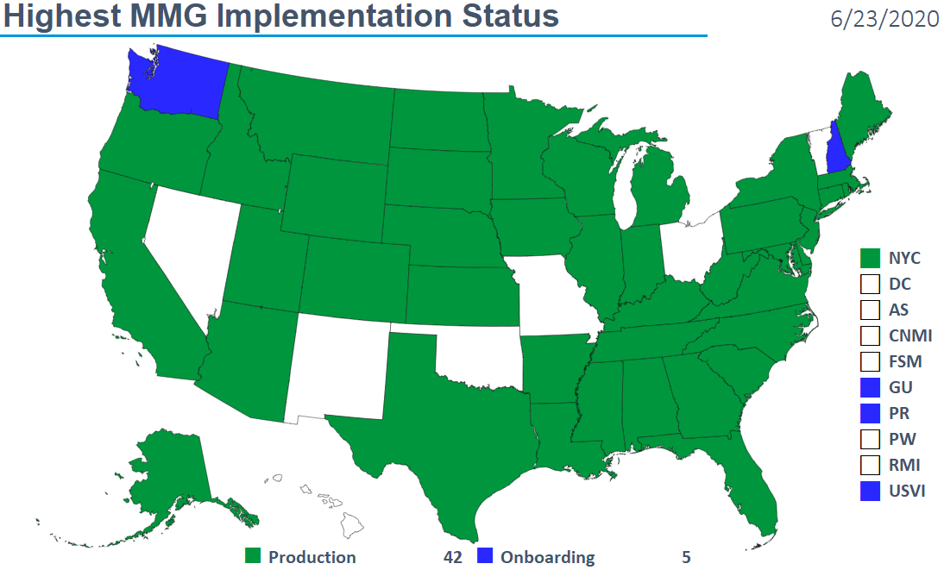
Highest MMG Implementation Status

Slide 32
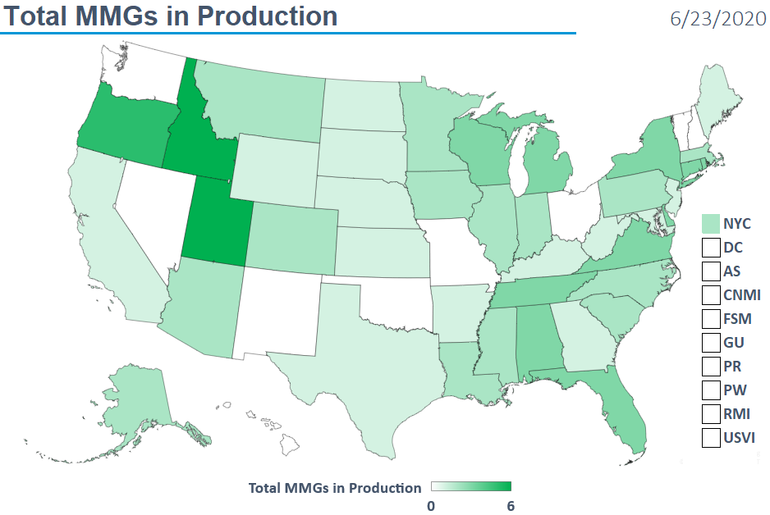
Total MMGs in Production

Slide 33
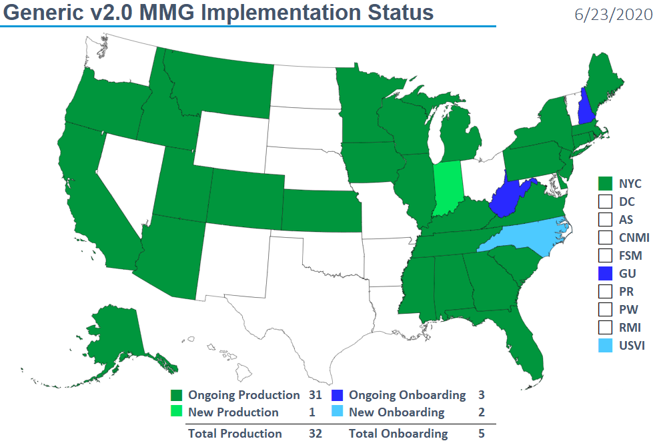
Generic v2.0 MMG Implementation Status

Slide 34
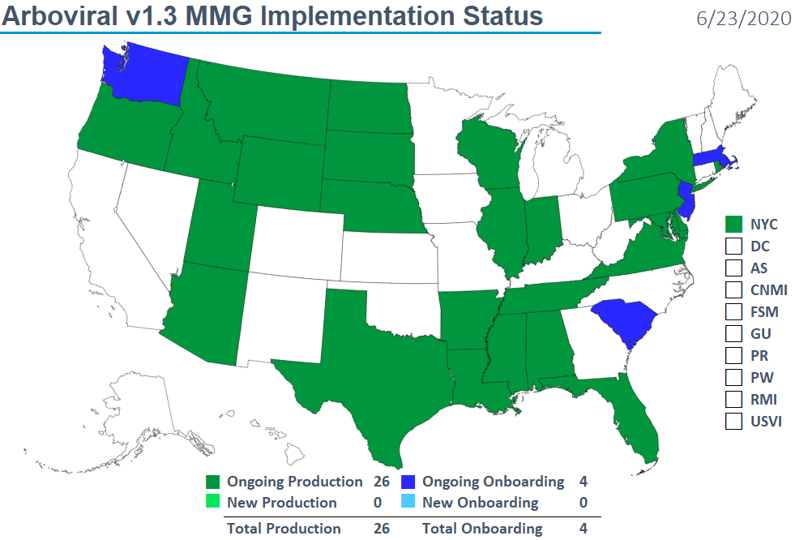
Arboviral v1.3 MMG Implementation Status

Slide 35
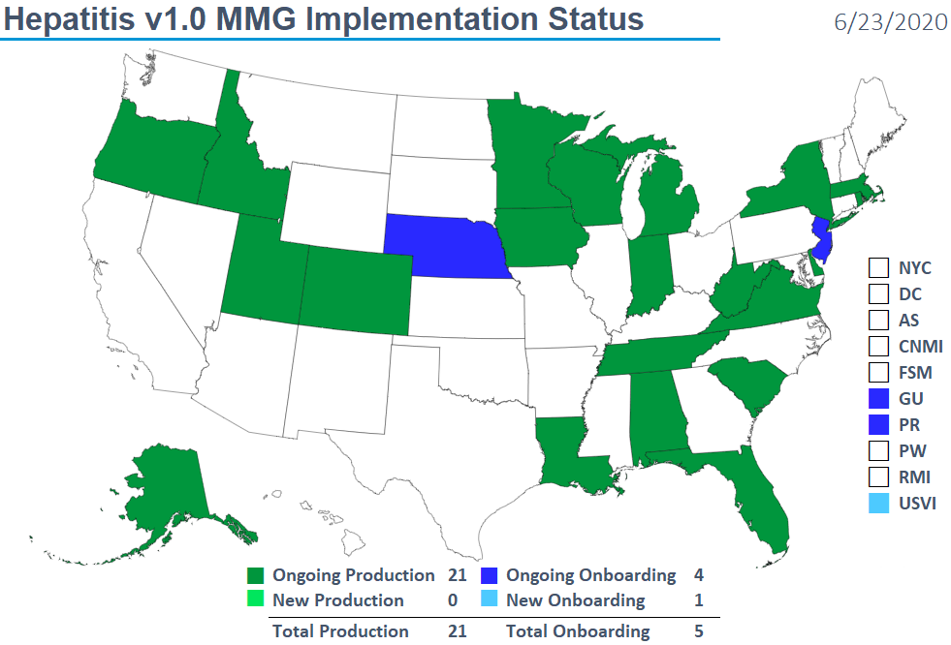
Hepatitis v1.0 MMG Implementation Status

Slide 36
NNDSS HL7 Message Mapping Guide Estimated Timeline
6/11/2020

