Slide 1

NNDSS Modernization Initiative (NMI):
May eSHARE Webinar
Division of Health Informatics and Surveillance
May 19, 2020

Slide 2

Agenda
Welcome and Announcements
Laboratory Reporting Updates
Questions and Answers

Slide 3
NMI Updates and Timeline
Michele Hoover, MS
Lead, State Implementation and Technical Assistance

Slide 4
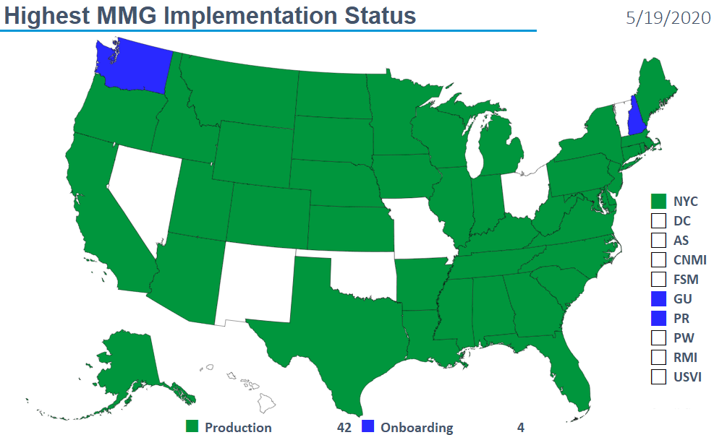
Highest MMG Implementation Status

Slide 5
Finalized Guides
Onboarding Open to All | Onboarding For Pilots Only
Arboviral v1.3 | Babesiosis/Trichinellosis
Gen v2 | FDD
Hepatitis | HAI MDRO
Malaria | Lyme/TBRD
STD/CS | Mumps, Pertussis, and Varicella
 | TB/LTBI
5/19/2020

Slide 6
NNDSS HL7 Message Mapping Guide Estimated Timeline
5/14/2020

Slide 7
Important Reminders:
NNDSS 2019 Data Reconciliation process timeline has changed:
  Last day to transmit/update 2019 final data: Sept. 30, 2020.
  Last day for State/Territorial Epidemiologist to sign-off: Oct. 30, 2020.
  A detailed timeline is located in the Appendix
The new COVID-19 case definition is now available on the NNDSS Surveillance Case Definitions webpage: https://ndc.services.cdc.gov/conditions/coronavirus-disease-2019-covid-19/.
  Please begin using immediately for all 2020 case notifications being sent to NNDSS.

Slide 8
COVID-19 Message Mapping Guide Planning
We want to support NND notification for COVID-19 cases
Working on a COVID-19 MMG
  Based on case report form (CRF)
  Incorporating aspects of draft Emergency Response MMG (ER MMG)
  Builds on Gen v2
  Reusing items from other finalized guides where appropriate
Anticipate abbreviated development and piloting process
Please use CARES Act funding (ELC supplement) if resources are needed

Slide 9
Multisystem Inflammatory Syndrome Case Notification
Health Alert Network Advisory issued on May 14, 2020 for Multisystem Inflammatory Syndrome in Children (MIS-C) Associated with Coronavirus Disease 2019 (COVID-19)
  Includes case definition
Plan to receive cases through NNDSS
  Gen v2, NETSS, NBS
New event code for MIS: 11066
NNDSS case notification will initiate DECIPHER record; additional data added via DECIPHER web entry or CSV upload

Slide 10
Laboratory Reporting Updates
Jason Hall, CDC Division of Preparedness and Emerging Infections (DPEI)

Slide 11

Reporting COVID-19 Laboratory Data
All U.S. testing sites should submit their COVID-19 testing information to their state or local health department
State or local health departments will send deidentified reports to CDC
CDC will handle submission to
the HHS Protect System

Slide 12
Updates & Progress
CDC efforts to improve laboratory reporting to states and local health departments
  Technical assistance and guidance
  Funding to jurisdictional health departments
  Streamlining Federal reporting, where possible
Jurisdictions are required to submit a 2020 testing plan for COVID-19, which will explicitly detail how a minimum of 2% of the jurisdiction’s population will be tested each month.
Informatics staff should start preparing systems, processes, communication triaging, to anticipate onboarding significant numbers of new data feeds, and new and non-traditional testing sites.

Slide 13
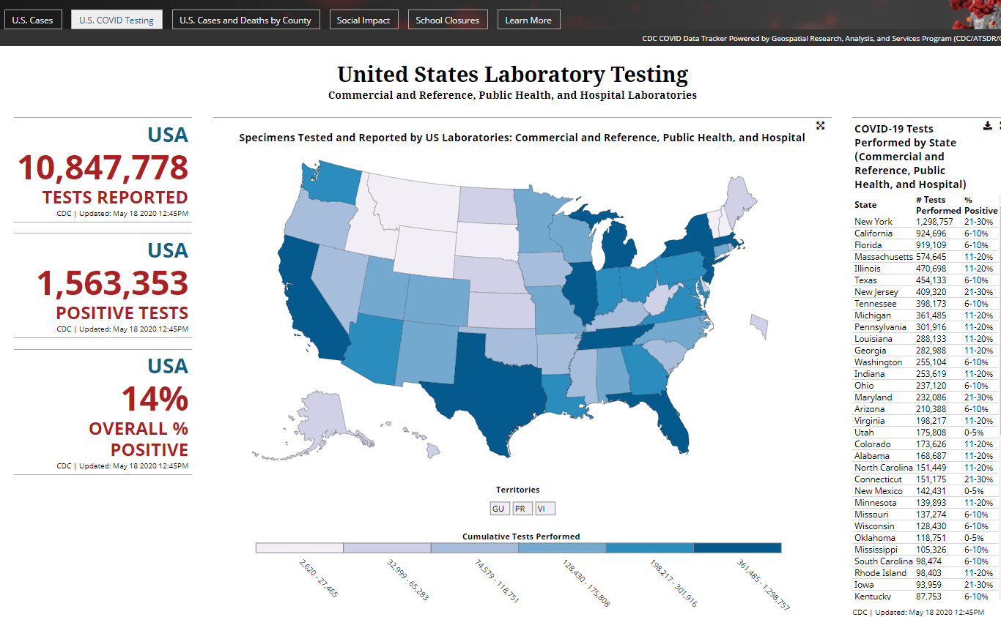
CDC COVID
Data Tracker www.cdc.gov/covid-data-tracker

Slide 14

Electronic Laboratory Reporting
Need Help?
State or local health departments who would like to request assistance can contact CDC at eocevent405@cdc.gov

Slide 15

Q & A

Slide 16
Subscribe to monthly NNDSS newsletter (NMI Notes) at
https://www.cdc.gov/nndss/trc/news/
Access the NNDSS Technical Resource Center at
https://www.cdc.gov/nndss/trc/
Request NNDSS technical assistance or onboarding at
edx@cdc.gov
Next NNDSS eSHARE is June 16, 2020 – details to come at
https://www.cdc.gov/nndss/trc/onboarding/eshare.html

Slide 17
Appendix

Slide 18
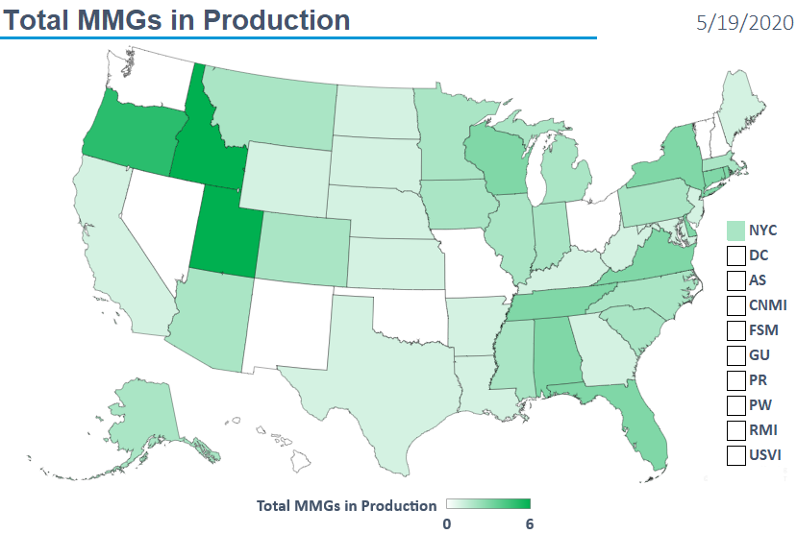
Total MMGs in Production

Slide 19
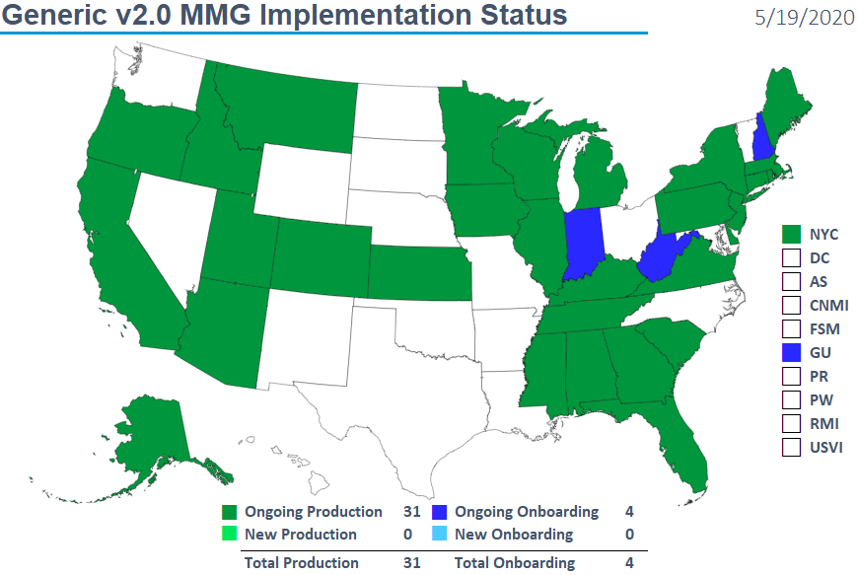
Generic v2.0 MMG Implementation Status

Slide 20
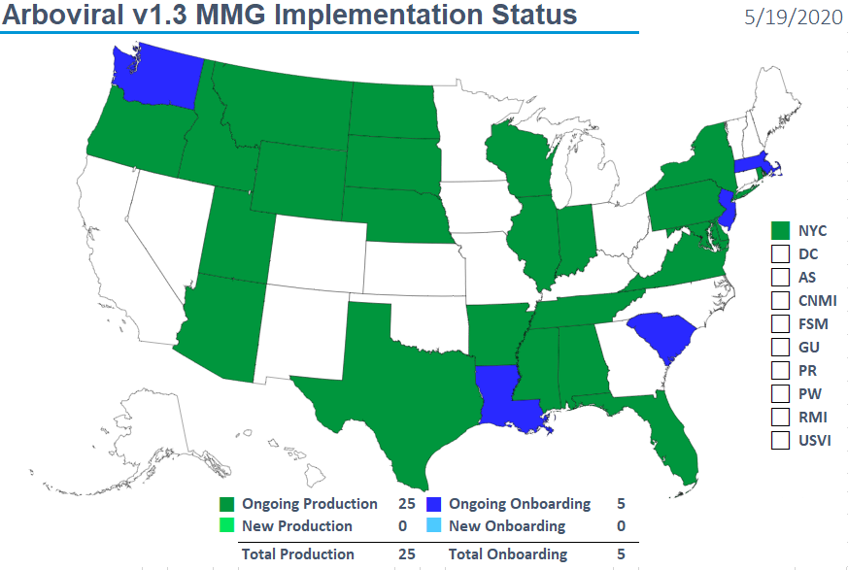
Arboviral v1.3 MMG Implementation Status

Slide 21
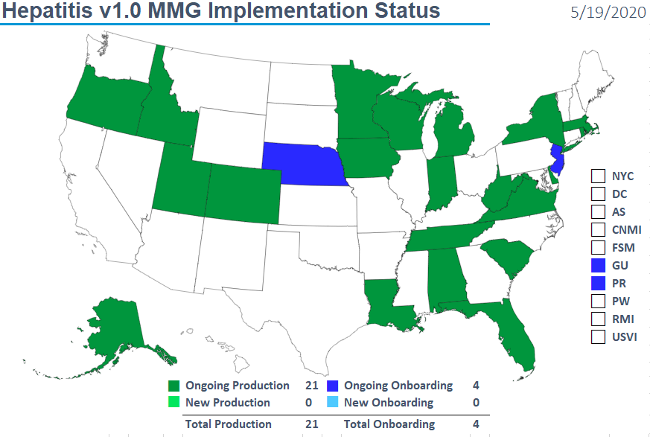
Hepatitis v1.0 MMG Implementation Status

Slide 22
2019 NNDSS Annual Data Reconciliation Shift in Dates Due to COVID-19 response
2019 NNDSS Annual Data Reconciliation
Shift in Dates Due to COVID-19 Response

