Slide 1

NNDSS Modernization Initiative (NMI):
NNDSS Changes Resulting from CSTE Position Statements and Implications for Sending Case Notifications
Division of Health Informatics and Surveillance
January 21, 2020

Slide 2

Agenda
Welcome and Announcements
NMI 2019 Accomplishments and 2020 Current Status
Highlights from the 2020 Letter to State Epidemiologists
NNDSS Event Code List Updates
MMG Value Set Updates
Things to Remember
Questions and Answers

Slide 3
NMI 2019 Accomplishments and
2020 Current Status
Sara Imholte Johnston, MPH
NNDSS Program Manager
Michele Hoover, MS
Lead, State Implementation and Technical Assistance

Slide 4
NMI Implementation Status Jan 1, 2019
NH
WA
VT
ME
AK
MT
ND
MN
OR
NY
MA
ID
SD
WI
RI
WY
MI
CT
IA
PA
NJ
NYC
CA
NE
OH
DE
HI
NV
IL
IN
WV
UT
VA
DC
MD
CO
KS
MO
KY
NC
TN
OK
AR
SC
AZ
NM
MS
AL
GA
TX
LA
Piloting Total of 1 (states)
FL
PR
Onboarding Total of 7 (states)
Production Total of 32 (31 states + NYC)

Slide 5
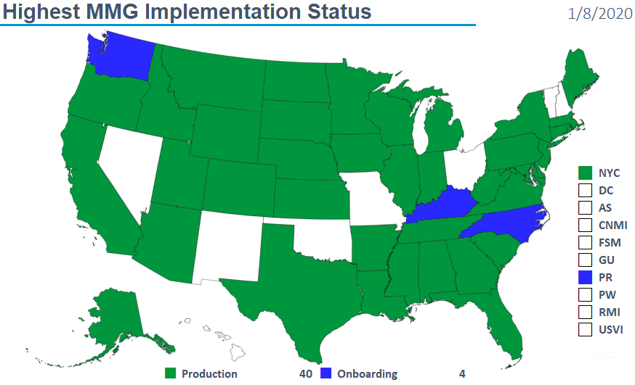
Highest MMG Implementation Status
1/21/2020

Slide 6
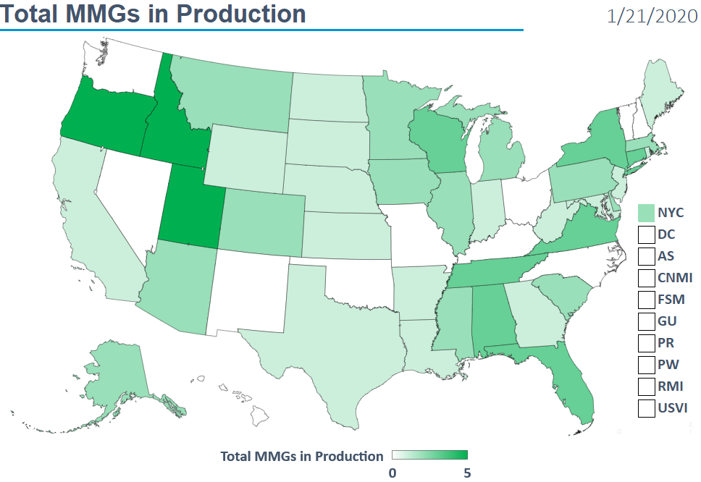
Total MMGs in Production
1/21/2020

Slide 7
Finalized Guides
Onboarding Open to All | Onboarding For Pilots Only | Onboarding On Hold
Arboviral v1.3 | Babesiosis | Mumps
Gen v2 | CS | Pertussis
Hepatitis | FDD | Varicella
 | Lyme/TBRD
 | Malaria
 | STD
 | TB/LTBI
 | Trichinellosis
1/21/2020

Slide 8
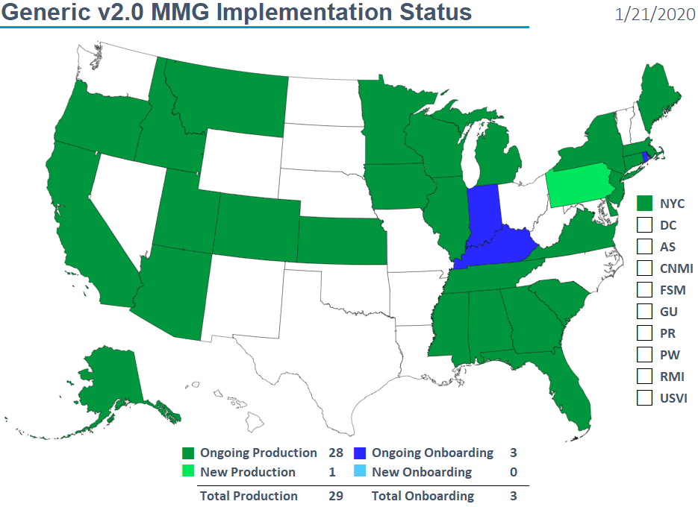
Generic v2.0 MMG Implementation Status
1/21/2020

Slide 9
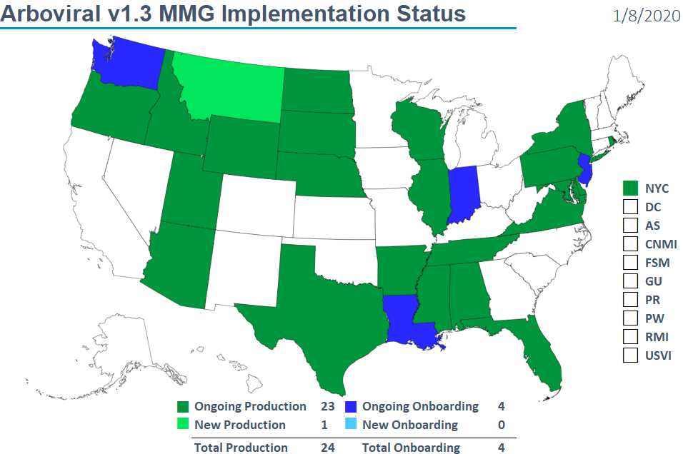
Arboviral v1.3 MMG Implementation Status
1/21/2020

Slide 10
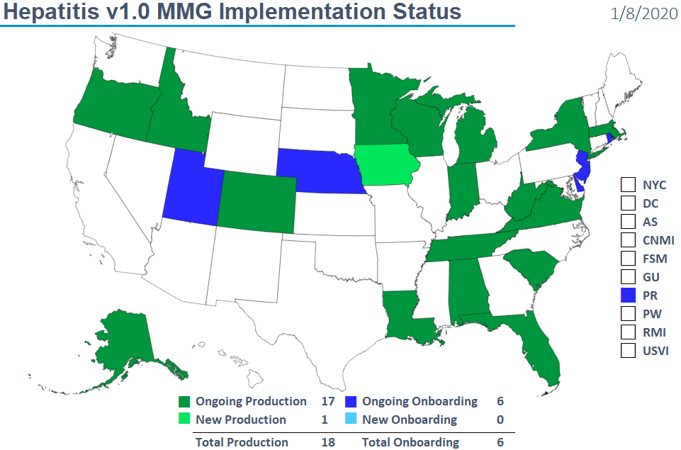
Hepatitis v1.0 MMG Implementation Status
1/21/2020

Slide 11

NNDSS HL7 Message Mapping Guide Estimated Timeline

Slide 12
Highlights from the
2020 Letter to State Epidemiologists
Ruth Jajosky, DMD, MPH
Division of Health Informatics and Surveillance

Slide 13
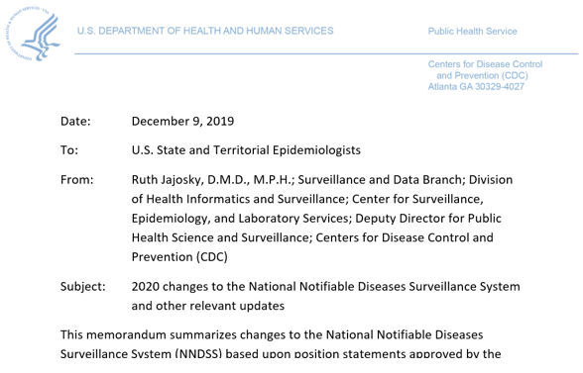
2020 Letter to State Epidemiologists
The 2020 State Epi Letter was distributed on 12/10/2019
  The full letter can be found on the NNDSS Event Codes & Other Surveillance Resources webpage.
  Annual NNDSS Event Code Lists are available at https://ndc.services.cdc.gov/event-codes-other-surveillance-resources/.

Slide 14
2019 CSTE Position Statements to be Implemented in 2020
Updated case definitions for 6 nationally notifiable diseases
  Hepatitis C acute
  Hepatitis C chronic
  Legionellosis
  Pertussis
  Plague
  Spotted Fever Rickettsiosis
Updated case definition for 1 condition under standardized surveillance:
  Acute flaccid myelitis (case definition revision);
Added a condition under standardized surveillance:
  Blastomycosis (new condition and case definition)
Updated case definition for 1 FoodNet condition:
  Yersinosis, non-pestis

Slide 15
Changes in 2020 (1 of 6)
Hepatitis C (19-ID-06)
  Updates 15-ID-03
  Applies to
    Confirmed and probable acute hepatitis C case definition
    Probable chronic hepatitis C case definition
  Publication criteria include confirmed and probable cases.
Legionellosis (19-ID-04)
  Updates 09-ID-45
    Added new clinical criteria (e.g., extrapulmonary legionellosis)
    Updated laboratory criteria
    Added probable case classification for cases with epi linkage.
  Confirmed cases will continue to be published in the weekly and annual NNDSS tables.

Slide 16
Changes in 2020 (2 of 6)
Pertussis (19-ID-08)
  Changes will better capture pertussis cases across all age groups.
  All PCR-positive cases classified as confirmed regardless of cough duration or presence of a pertussis symptom
    More accurately reflects current diagnostic practices
    Decreases the investigative burden
  Streamlines case definition
    Requires confirmatory lab testing for confirmed cases
    Eliminates age-specific classifications
  Data for confirmed, probable, and unknown cases will continue to be published in the NNDSS weekly and annual tables.

Slide 17
Changes in 2020 (3 of 6)
Plague (19-ID-01)
  Revises the 1996 plague case definition:
    Incorporates newer lab diagnostics (PCR, immunohistochemical assays) to minimize the potential for under-reporting of cases diagnosed using only those techniques.
    Allows for clinically compatible illness that may not align with a discrete clinical syndrome.
    Allows for epidemiologic linkage to provide supportive evidence to case classification.
  Confirmed and probable cases will be published in the weekly and annual NNDSS tables.

Slide 18
Changes in 2020 (4 of 6)
Spotted fever rickettsiosis (including Rocky Mountain spotted fever) (19-ID-07)
  Updates the 2010 case definition (09-ID-16)
  Laboratory criteria updated to focus investigations towards suspect patients more likely to be cases.
  Omits Spotted fever rickettsiosis cases from the weekly NNDSS tables
    Weekly case counts are of limited utility because classification is complex and reliable case counts are often delayed.
  Final case counts of confirmed and probable cases will continue to be published in the annual NNDSS tables.

Slide 19
Changes in 2020 (5 of 6)
Acute flaccid myelitis (19-ID-05) (standardized surveillance)
  Updates the 2018 case definition (17-ID-01)
  Changes address
    Confirmatory laboratory/imaging evidence
    Presumptive laboratory/imaging evidence
    Confirmed case classification
    Probable case classification
    New suspect case classification
  The CDC program and CSTE are working to clarify suspect category
    Will include clinical and laboratory/imaging criteria

Slide 20
Changes in 2020 (6 of 6)
Blastomycosis (19-ID-02) (standardized surveillance)
  New condition under standardized surveillance
  CDC is currently seeking Office of Management and Budget Paperwork Reduction Act (OMB PRA) approval to receive data.
  Event code 11910 assigned to this condition.
Yersinosis, non-pestis (19-ID-03) (standardized surveillance)
  Clarifies the laboratory criteria.
  There are no plans to request national data for this condition
  Data for this condition should just be sent by FoodNet sites.

Slide 21
NNDSS Event Code Updates

Slide 22
Changes to Event Codes in 2020
Removed from the event code list due to delay in implementing the MMG:
  Carbapenem resistant Enterobacteriaceae (CRE) (50120)
    (Note: See the next slide for information on sending CP-CRE)
  Carbapenem Resistant Acinetobacter baumannii (CRAB) (50260)
  These conditions should not be sent through NNDSS at this time.
New event code for Blastomycosis (11910)
  Pending OMB PRA approval
  Currently shown on “Introduction” tab of 2020 event code list
  After OMB approval:
    Will be moved to the “Event Codes” tab
    States can begin sending through Gen v2 message

Slide 23
Send C. auris and CP-CRE starting with 2019 data
It is not too late to send case notifications for the following for the entire 2019 surveillance year.
  Candida auris, clinical, which is nationally notifiable (event code 50263);
  Candida auris colonization/screening, which is under standardized surveillance but is not nationally notifiable (event code 50264); and
  Carbapenemase-producing carbapenem-resistant Enterobacteriaceae (CP-CRE), which is nationally notifiable (event code 50244). (Note: Do not send other types of CRE using this event code.)
Included in 2019 the NNDSS tables if received before end of reconciliation.

Slide 24
MMG Value Set Updates
Bill Morrill, MPH
Division of Health Informatics and Surveillance

Slide 25
Recent Updates to Finalized MMG Value Sets
Generic value sets:
  Birth Country, Country, Manufacturers of vaccines, Nationally Notifiable Event Code (Generic)
Lab Template:
  Ordered test (PHVS_LabTestOrderables_CDC)
  Lab Test Result Name (PHVS_LabTestName_CDC)
  Specimen (PHVS_Specimen_CDC)
  Body Site (PHVS_BodySite_CDC)
  Microorganism (PHVS_Microorganism_CDC)

Slide 26
Updates to Value Sets continued:
Condition-specific value sets for Final guides:
  TB
    Medication (TB), Epidemiological Risk Factors (TB), Lab Test Interpretation (TB), and Susceptibility Test Type (TB)
  STD
    Lab Test Type (STD)

Slide 27
Updates to Value Sets continued:
Condition-specific value sets for Final guides:
  FDD
    Organism (FDD)
  VPD Guides
    Vaccine Event Information Source (NND), Type of Long Term Care Facility, Type of Correctional Facility, Lab Test Interpretation (VPD), Lab Test Interpretation (Varicella), Lab Test Name (Mumps)
For more information, visit the HL7 Resource Center:
https://ndc.services.cdc.gov/message-mapping-guides/.

Slide 28
Things to Remember

Slide 29
Highlights
Communicate updated case definitions to surveillance staff
The only new event code for 2020 is Blastomycosis (11910)
  When OMB PRA approval is received, send notifications using the Generic V2 message
If you did surveillance for C. auris or CP/CRE in 2019, it’s not too late to send your data
Update surveillance systems with updated value sets
  For MMGs in HL7 Resource Center, see “PHIN VADS link to the case notification view”

Slide 30

Q & A

Slide 31
Subscribe to monthly NMI Notes news updates at
https://www.cdc.gov/nndss/trc/news/
Access the NNDSS Technical Resource Center at
https://www.cdc.gov/nndss/trc/
Request NNDSS technical assistance or onboarding at
edx@cdc.gov
Next NNDSS eSHARE is February 18, 2020 – details to come at
https://www.cdc.gov/nndss/trc/onboarding/eshare.html

