Slide 1

NNDSS Modernization Initiative (NMI):
MVPS Update and Walkthrough of the MVPS Dashboard
Access the NNDSS Technical Resource Center at
https://www.cdc.gov/nndss/trc/
Subscribe to monthly NMI Notes news updates at
https://www.cdc.gov/nndss/trc/news/
March 20, 2018 Division of Health Informatics and Surveillance

Slide 2

Agenda
Welcome and Announcements
NMI Progress and Timeline
Message Validation, Processing, and Provisioning System (MVPS):
  Updates
  Walkthrough of MVPS Dashboard Enhancements
Questions and Answers

Slide 3
NMI Progress and Timeline
Lesliann Helmus, MSPH, CHTS-CP
Associate Director for Surveillance
Michele Hoover
Lead, State Implementation and Technical Assistance

Slide 4
Anticipated NMI MMG Implementation Timeline
2018
Mar Apr May Jun Jul Aug Sep Oct Nov Dec
2019
Jan Feb Mar Apr May Jun Jul
MMG Name (# of conditions included)
Feb
GEN V2 (63)
IN PRODUCTION
HEPATITIS (8)
IN PRODUCTION
Anticipated NMI MMG Implementation Timeline
      Pilot Test Ready Guide
      Ready to accept Case Notifications
ARBOVIRAL (39)
IN PRODUCTION
STD (7)
CS (1)
MUMPS (1)
PERTUSSIS (1)
*
MMG development by disease program
VARICELLA (1)
**
MMG development process acceleration
FDD (11)
*
RIBD (7)
*
MALARIA (1)
BABESIOSIS (1)
MEASLES (1)
RUBELLA (1)
CRS (1)
CP-CRE (3)
TRICHINELLOSIS (1)
**
TB with LTBI (2)
**
These are planning projections that will be updated as additional information becomes available.
Updated 03/7/18
*
LISTERIOSIS (1)
TICKBORNE (?)

Slide 5

Reminder!
Epidemiology and Laboratory Capacity Health Information Systems Cooperative Agreement recipients must send production data for at least one message mapping guide (MMG) by August 1, 2018.
Onboard for these now:
Arboviral 1.3
Generic v2
Hepatitis
Onboard for these soon:
STD
Congenital Syphilis
Mumps
Pertussis
Varicella

Slide 6
NMI Implementation Status as of March 20, 2018
NH
WA
MT
VT
ME
AK
ND
MN
OR
NY
MA
ID
SD
WI
RI
WY
MI
CT
IA
PA
NJ
NYC
CA
NE
OH
DE
HI
NV
IL
IN
WV
UT
VA
DC
MD
CO
KS
MO
KY
NC
TN
OK
AR
SC
AZ
NM
MS
AL
GA
TX
LA
Piloting Total of 5 (states)
FL
PR
Onboarding Total of 3 (states)
Production Total of 23 (22 states + NYC)

Slide 7
Arboviral 1.3 March 20, 2018
NH
WA
MT
VT
ME
AK
ND
MN
OR
NY
MA
ID
SD
WI
RI
WY
MI
CT
IA
PA
NJ
NYC
CA
NE
OH
DE
HI
NV
IL
IN
WV
T
VA
DC
MD
UT
CO
KS
MO
KY
NC
TN
OK
AR
SC
AZ
NM
MS
AL
GA
TX
LA
Technical Assistance Total of 7 (states)
FL
PR
Onboarding Total of 0 (states)
Production Total of 12 (states)

Slide 8
Generic v2 March 20, 2018
NH
WA
MT
VT
ME
AK
ND
MN
OR
NY
MA
ID
SD
WI
RI
WY
MI
CT
IA
PA
NJ
NYC
CA
NE
OH
DE
HI
NV
IL
IN
WV
T
VA
DC
MD
UT
CO
KS
MO
KY
NC
TN
OK
AR
SC
AZ
NM
MS
AL
GA
TX
LA
Technical Assistance Total of 3 (states)
FL
PR
Onboarding Total of 4 (states)
Production Total of 15 (14 states + NYC)

Slide 9
Hepatitis March 20, 2018
NH
WA
MT
VT
ME
AK
ND
MN
OR
NY
MA
ID
SD
WI
RI
WY
MI
CT
IA
PA
NJ
NYC
CA
NE
OH
DE
HI
NV
IL
IN
WV
UT
VA
DC
MD
CO
KS
MO
KY
NC
TN
OK
AR
SC
AZ
NM
MS
AL
GA
TX
LA
Technical Assistance Total of 3 (states)
FL
PR
Onboarding Total of 4 (states)
Production Total of 7 (states)

Slide 10
STD and Congenital Syphilis March 20, 2018
NH
WA
MT
VT
ME
AK
ND
MN
OR
NY
MA
ID
SD
WI
RI
WY
MI
CT
IA
PA
NJ
NYC
CA
NE
OH
DE
HI
NV
IL
IN
WV
UT
VA
DC
MD
CO
KS
MO
KY
NC
TN
OK
AR
SC
AZ
NM
MS
AL
GA
TX
LA
Piloting Total of 8 (states)
FL
PR
Onboarding Total of 0 (states)
Production Total of 0 (states)

Slide 11
Foodborne Diarrheal Disease
March 20, 2018
NH
WA
MT
VT
ME
AK
ND
MN
OR
NY
MA
ID
SD
WI
RI
WY
MI
CT
IA
PA
NJ
NYC
CA
NE
OH
DE
HI
NV
IL
IN
WV
UT
VA
DC
MD
CO
KS
MO
KY
NC
TN
OK
AR
SC
AZ
NM
MS
AL
GA
TX
LA
Piloting Total of 5 (states)
FL
PR
Onboarding Total of 0 (states)
Production Total of 0 (states)

Slide 12
Measles, Pertussis, and Varicella
Mumps, Pertussis, and Varicella
March 20, 2018
NH
WA
MT
VT
ME
AK
ND
MN
OR
NY
MA
ID
SD
WI
RI
WY
MI
CT
IA
PA
NJ
NYC
CA
NE
OH
DE
HI
NV
IL
IN
WV
UT
VA
DC
MD
CO
KS
MO
KY
NC
TN
OK
AR
SC
AZ
NM
MS
AL
GA
TX
LA
Piloting Total of 8 (7 states + NYC)
FL
PR
Onboarding Total of 0 (states)
Production Total of 0 (states)

Slide 13
Overview of MVPS Upgrade (MVPSu)
Andrew Kuehl, MIT, PMP
MVPS Project Lead
Emani McCullough
MVPS Requirements Team

Slide 14
Agenda
MVPSu Overview—Why the Change?
MVPSu Enhanced Validations
MVPSu Realized Benefits
MVPSu Dashboard Overview
Dashboard Walkthrough—Current State
Dashboard Future Enhancements

Slide 15
MVPSu Overview—Why the Change?
Develop architecture to accelerate MMG implementation
  Component replacement streamlines development and supports more re-use
  Incorporates simplified processing database structure
  Gains efficiencies and flexibility
Develop architecture to support future services
  Building using a modular structure
  Can implement new, incoming services as they become available
  Ability to replace current functionality with new services
Dashboard enhancements
  New technology
  More user-friendly user interface

Slide 16
MVPSu Enhanced Validations
Bringing MVPS validation in alignment with PHIN Messaging Specification for Case Notification v3.0
  Improved structural validations
Bringing MVPS validation in alignment with individual message mapping guides
  Improved content validations
Impact: Potential adjustments for jurisdictions already sending to MVPS
Enhanced validation benefits
  No ambiguity between specifications and system
  Improved data quality

Slide 17
MVPSu Realized Benefits
Reduced MMG implementation time from months to weeks
Improved system stability, troubleshooting
  Quicker issue resolution
Potential to consolidate some legacy systems
Improved dashboard response time
Exploring use of shared services

Slide 18
MVPSu Dashboard Overview
Current state, Phase 1
  New technology
  Same or improved functionality as classic dashboard
  Enriched look and feel
Dashboard development
  Agile development methodology
    Small pieces of functionality to production faster
  Communication about new functionality
    Release notes, landing page highlights
    NMI Notes newsletter, NMI eSHARE calls

Slide 19
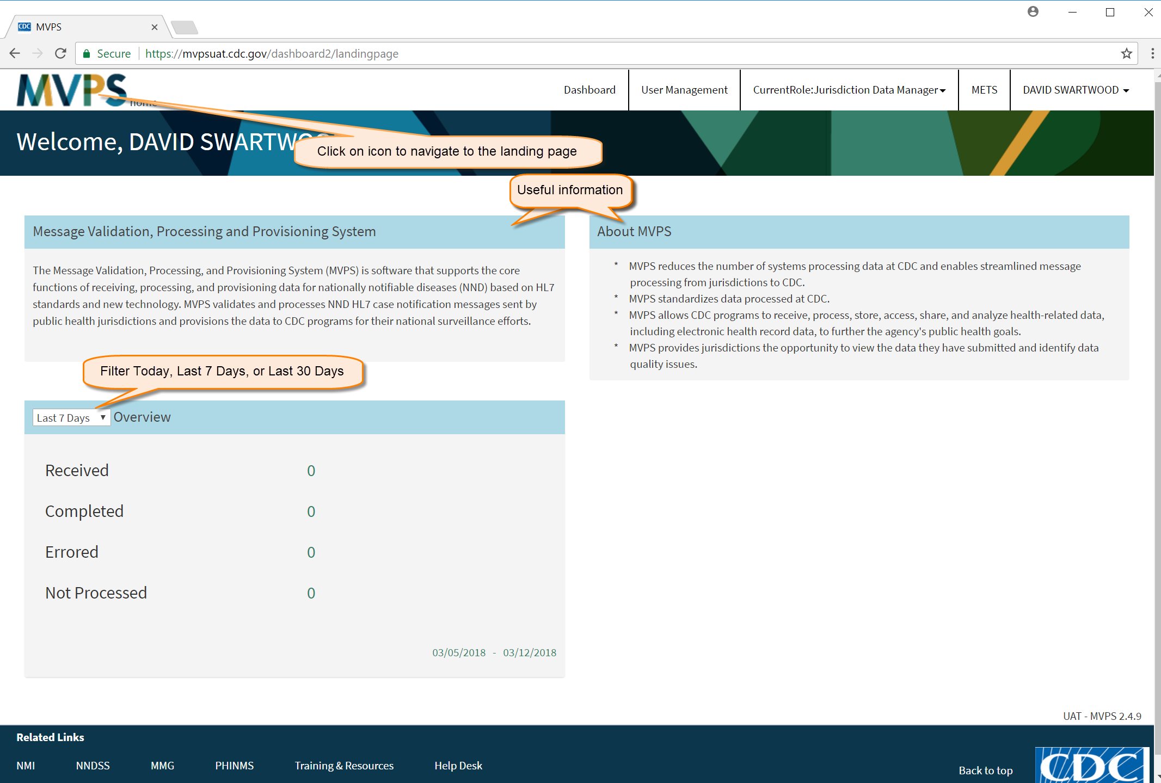
MVPS Dashboard Landing Page

Slide 20
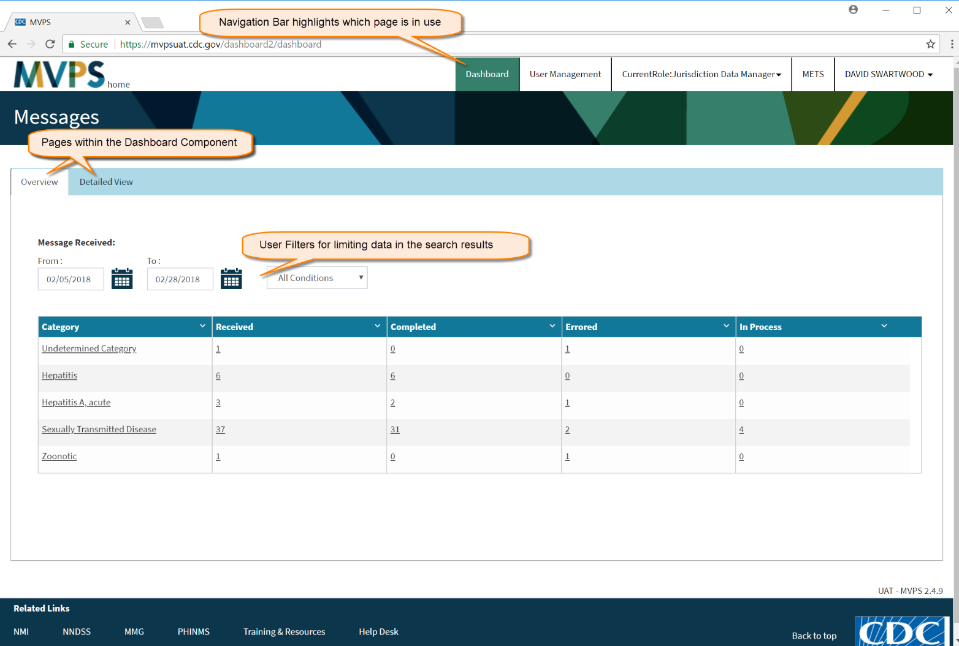
Overview Tab

Slide 21
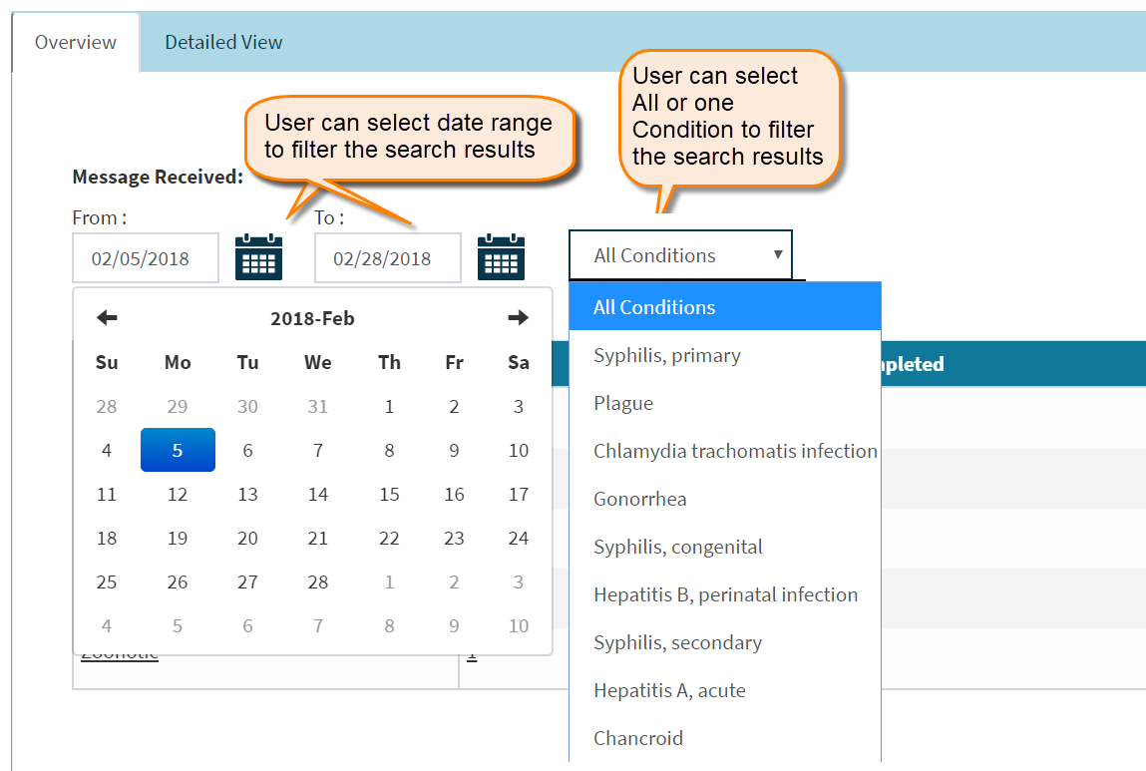
Overview Tab

Slide 22
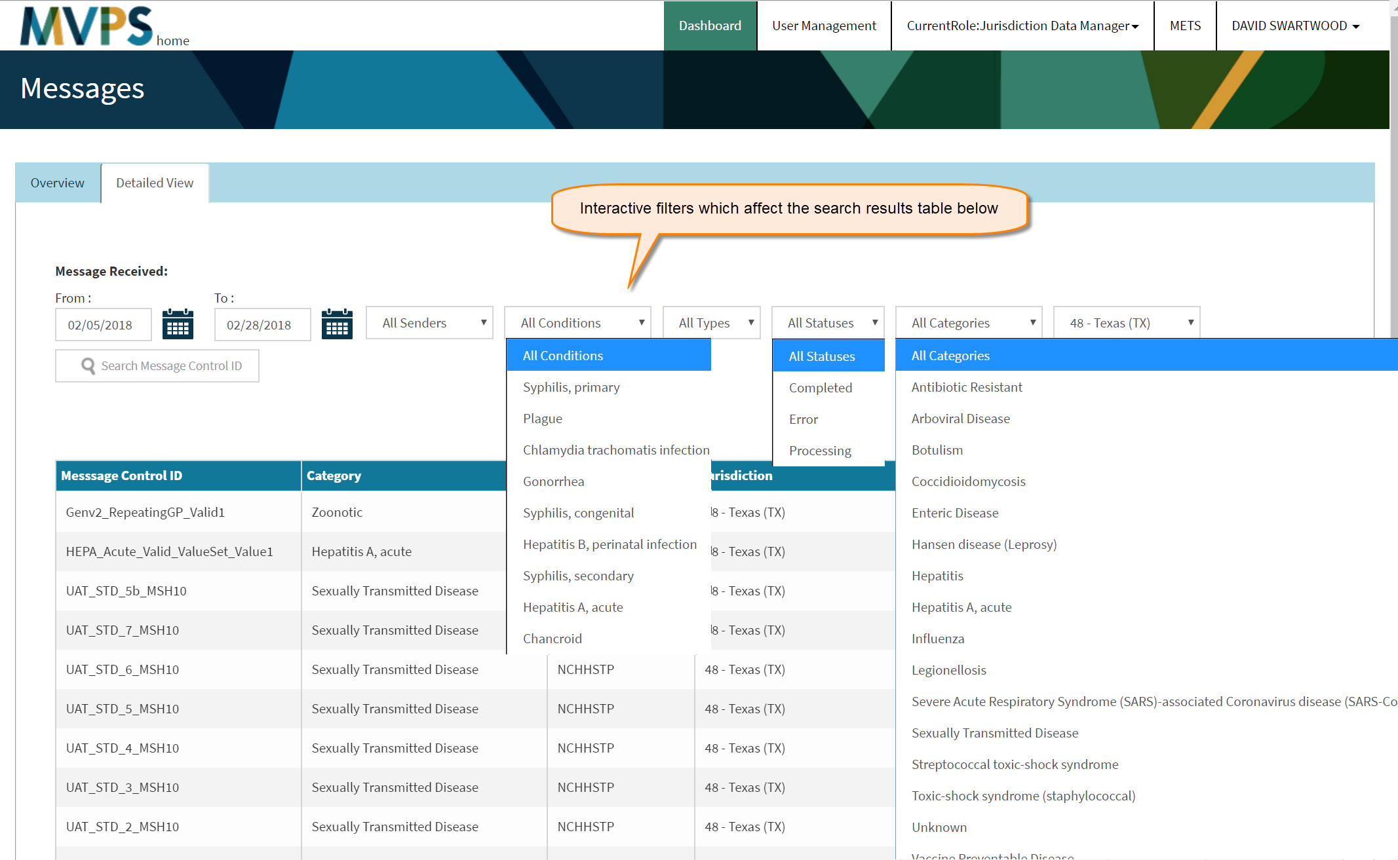
Detailed View Tab

Slide 23
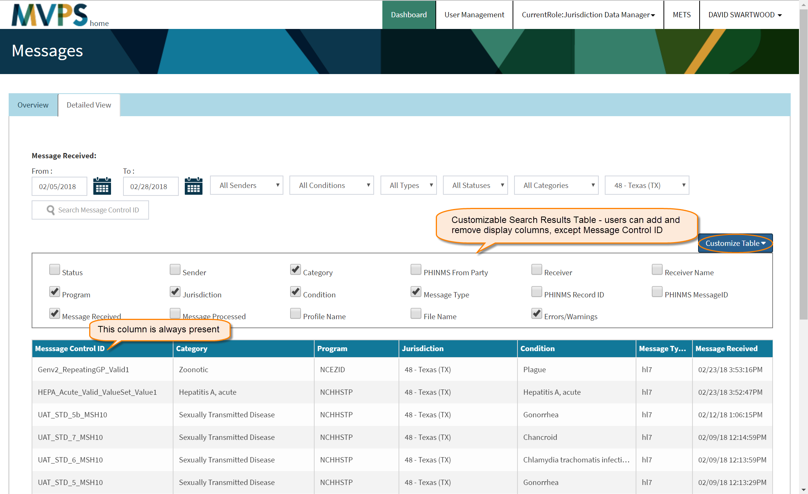
Detailed View Tab

Slide 24
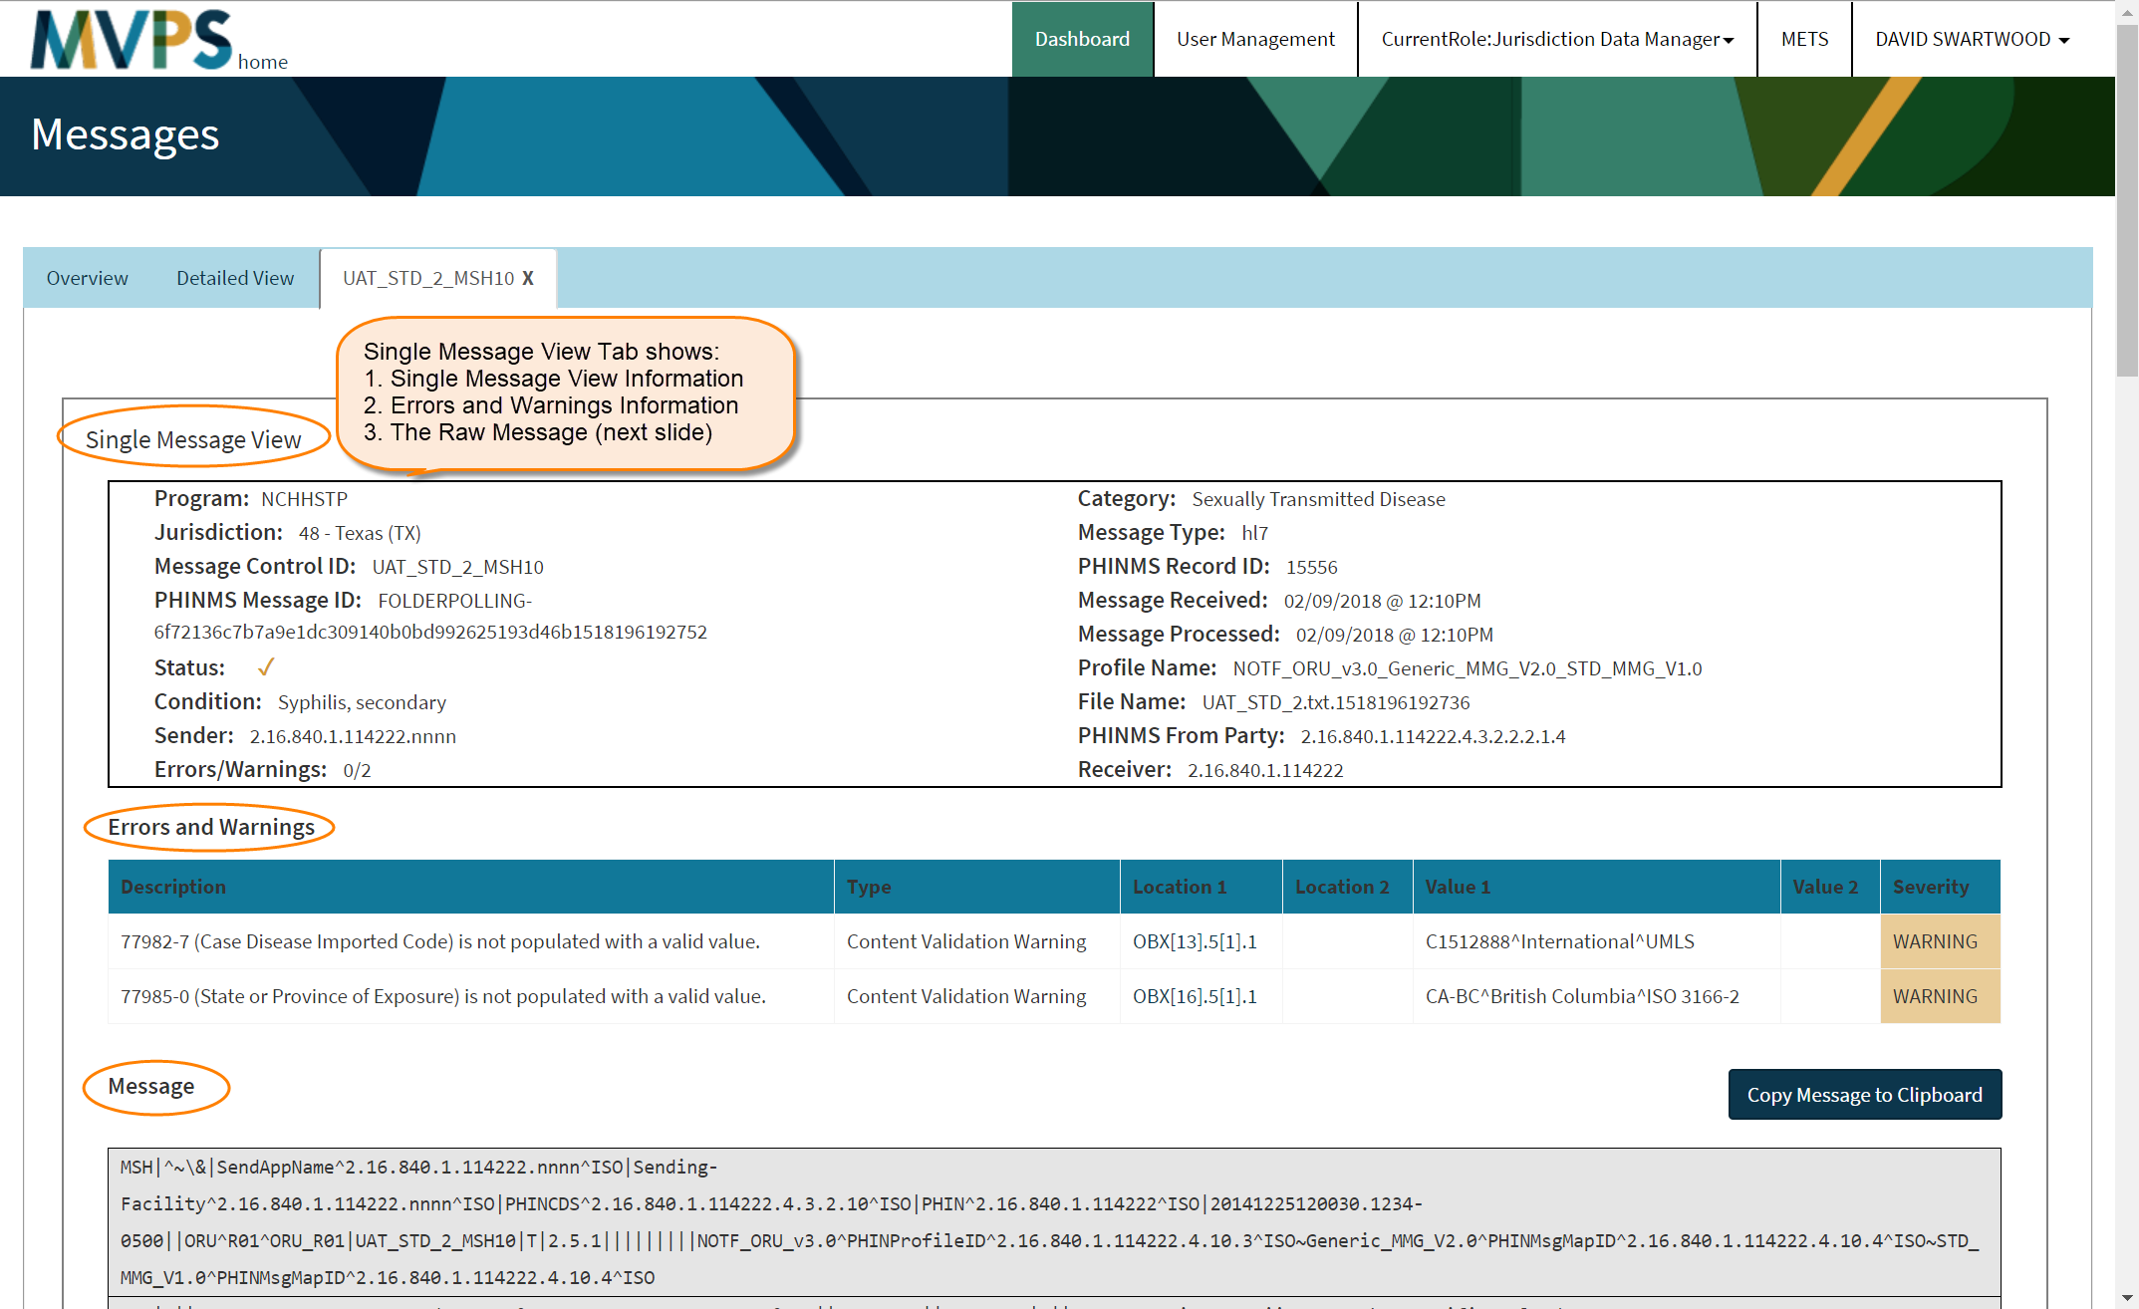
Single Message View Tab

Slide 25
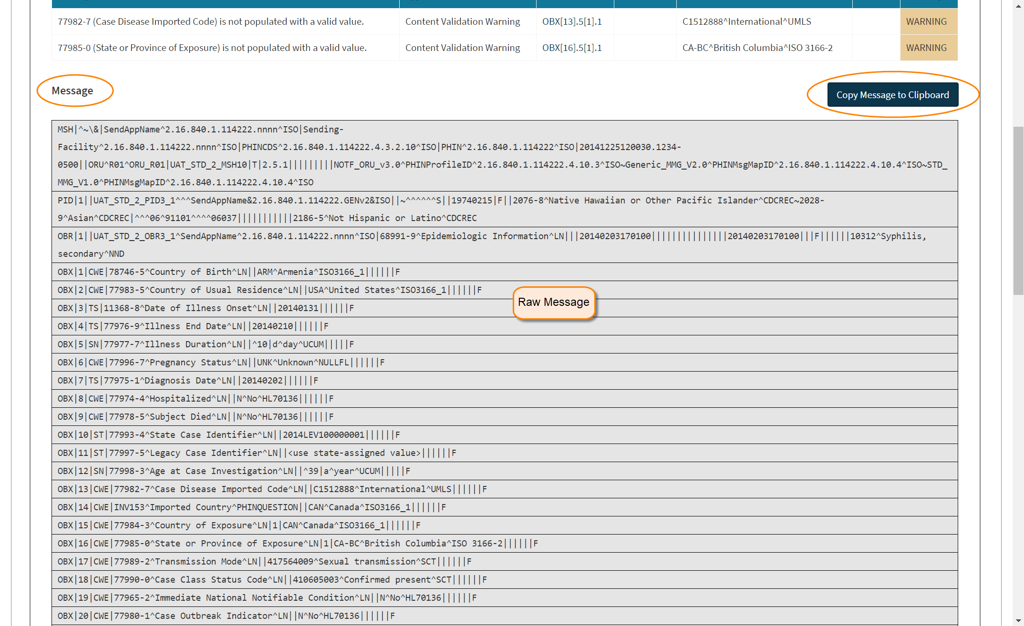
Single Message View Tab

Slide 26
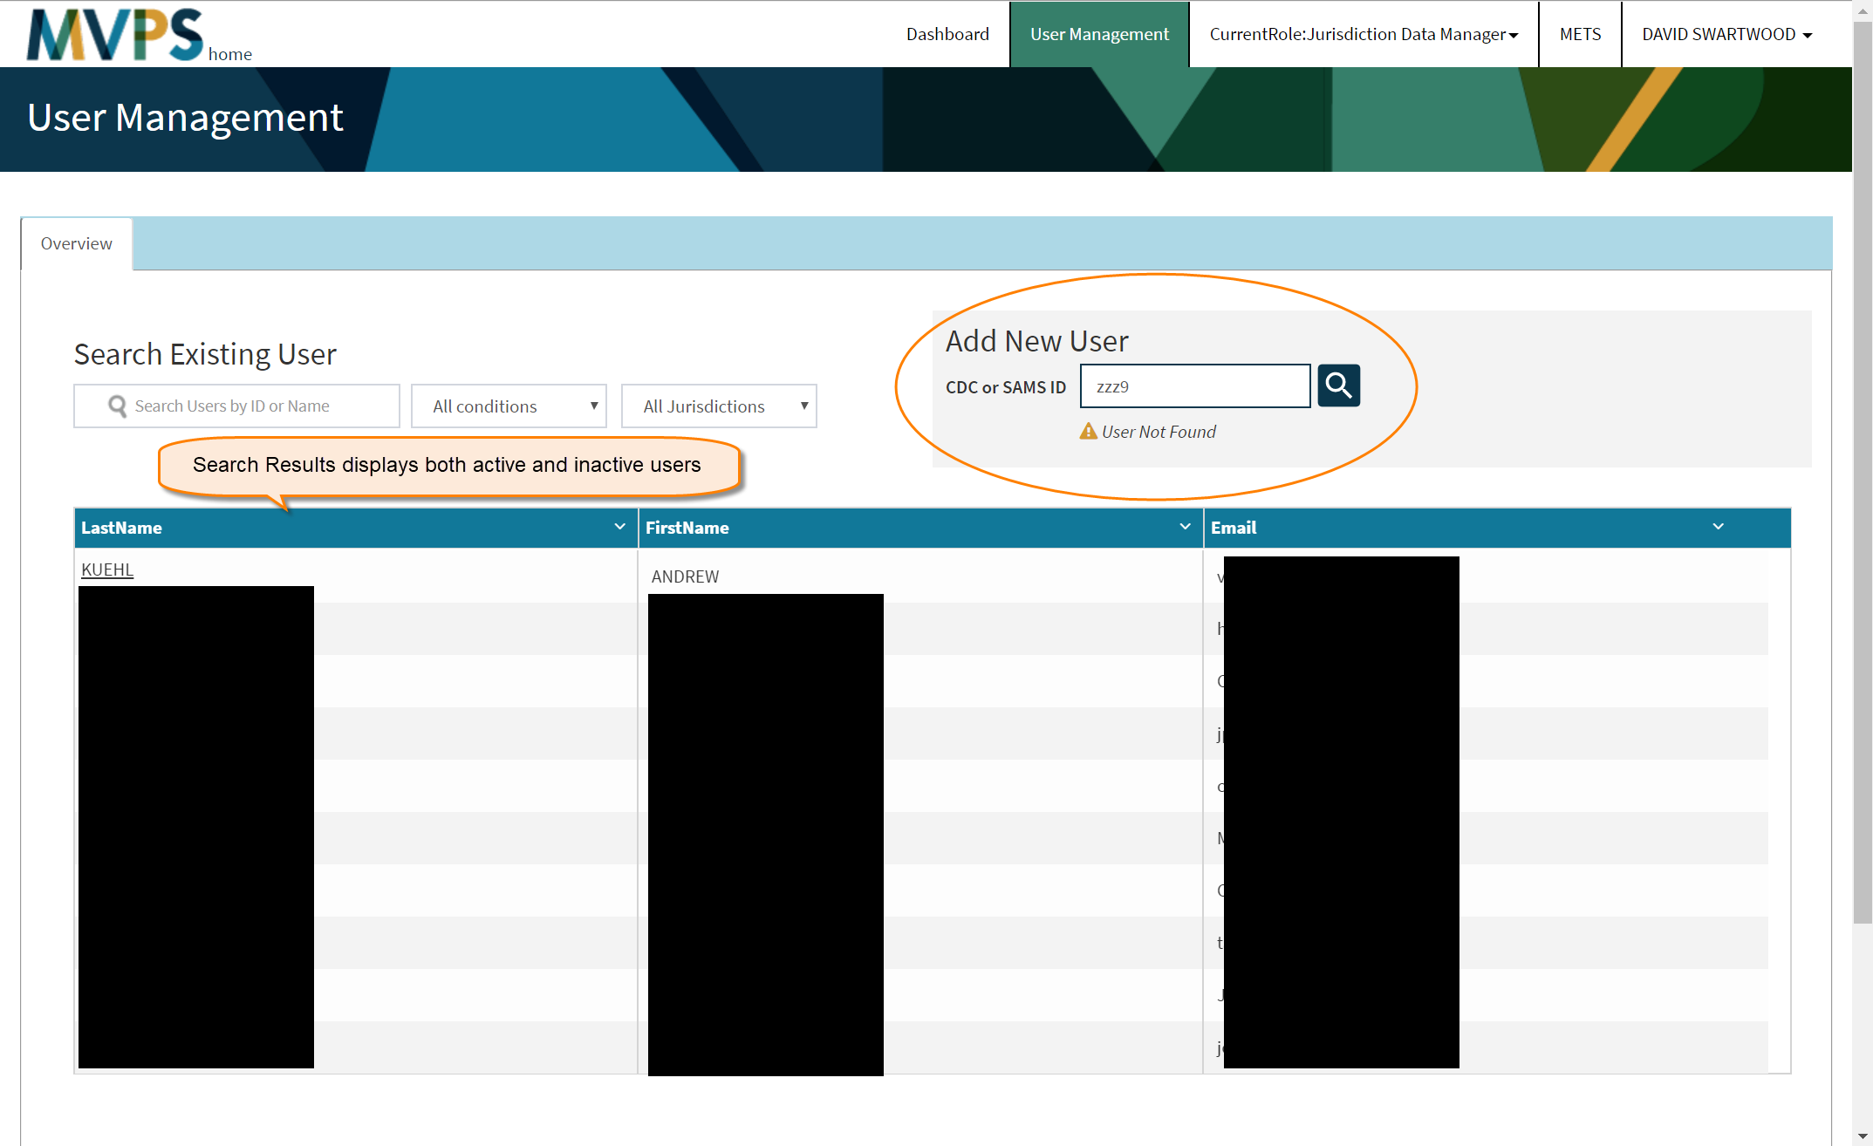
User Management

Slide 27
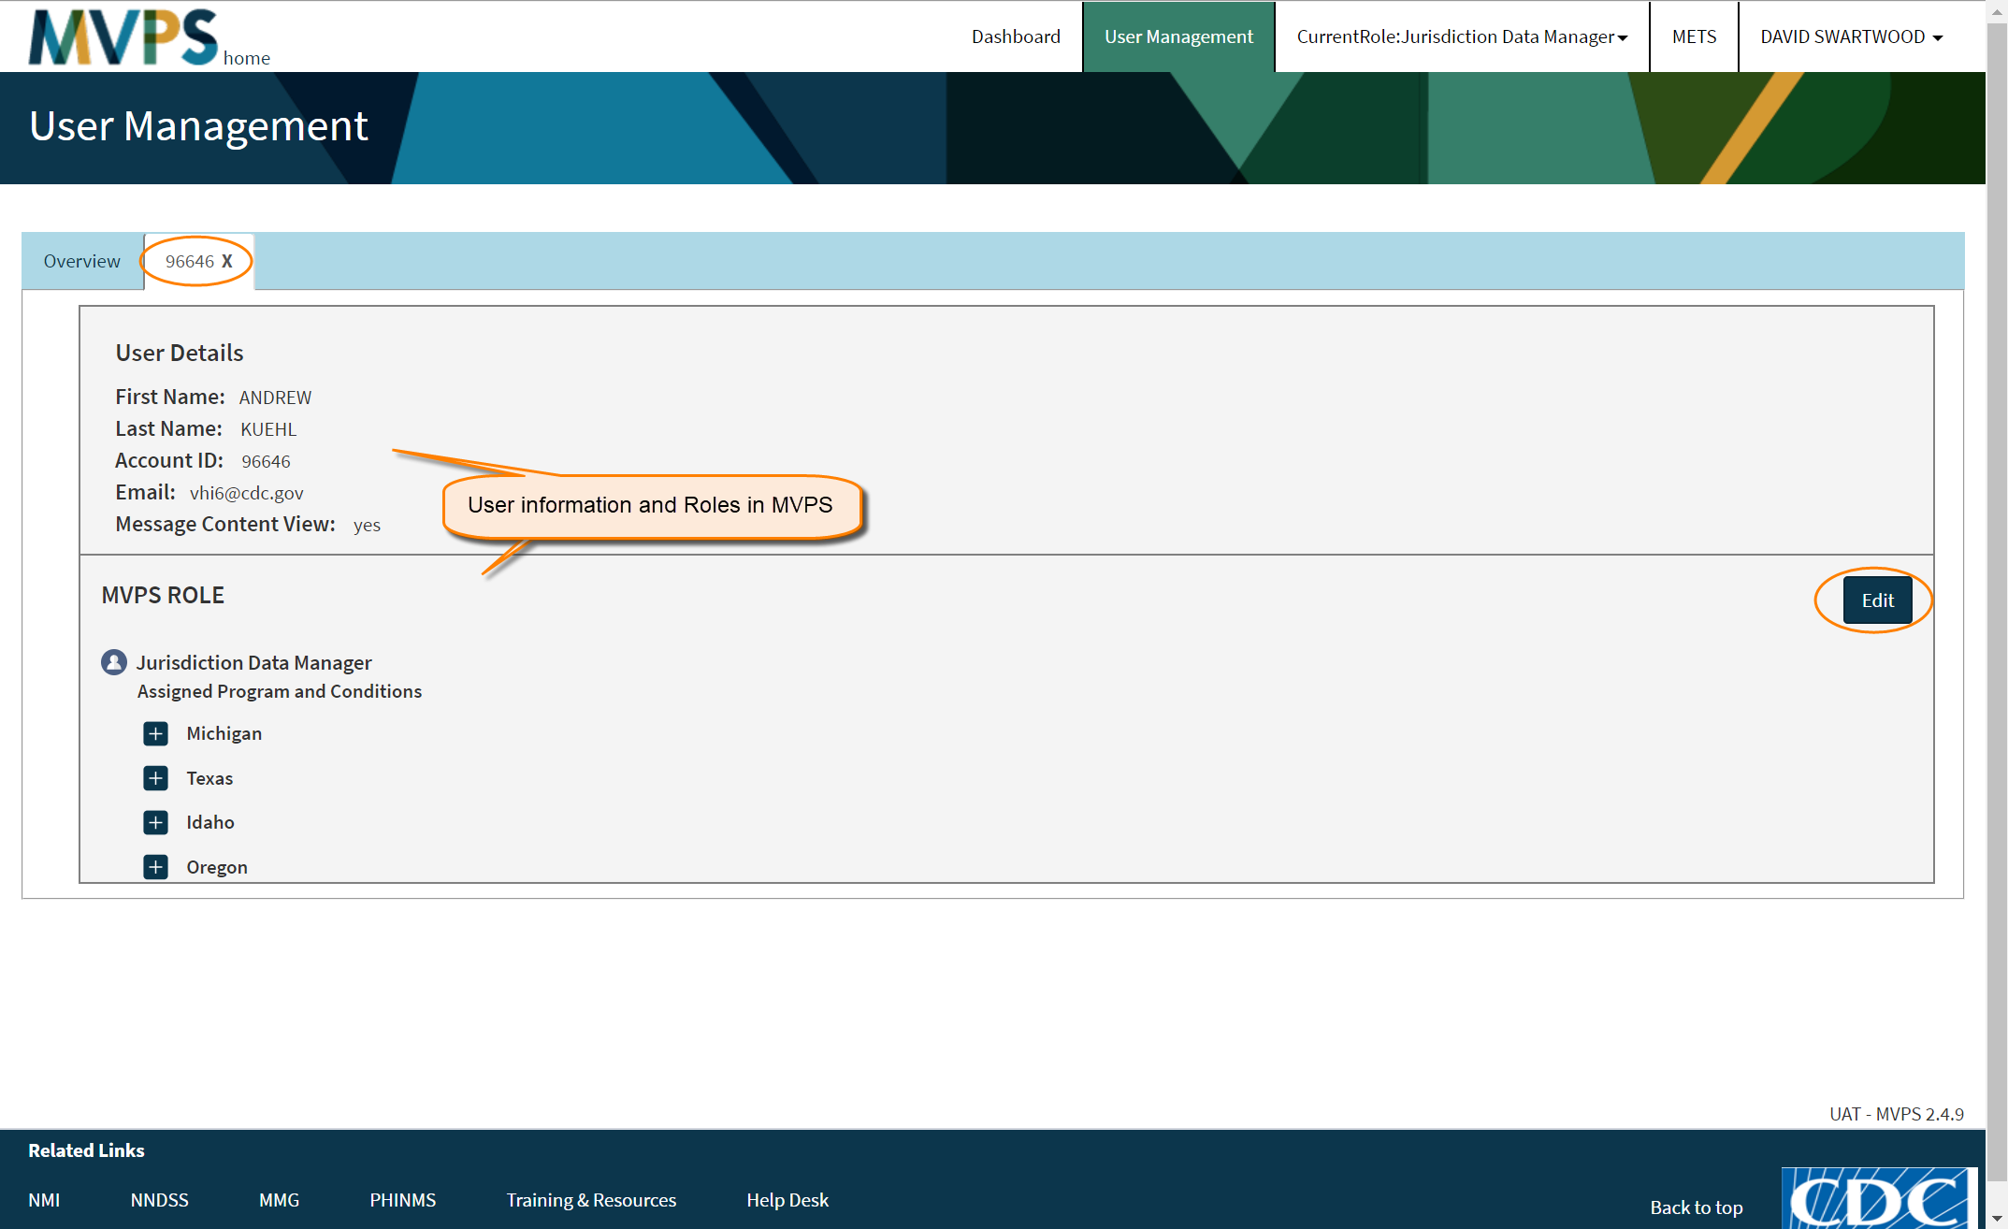
User Management

Slide 28
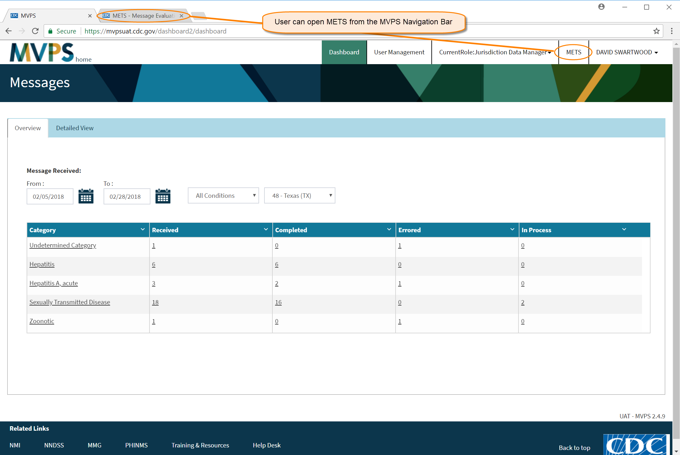
Message Evaluation and Testing Service (METS) Page

Slide 29
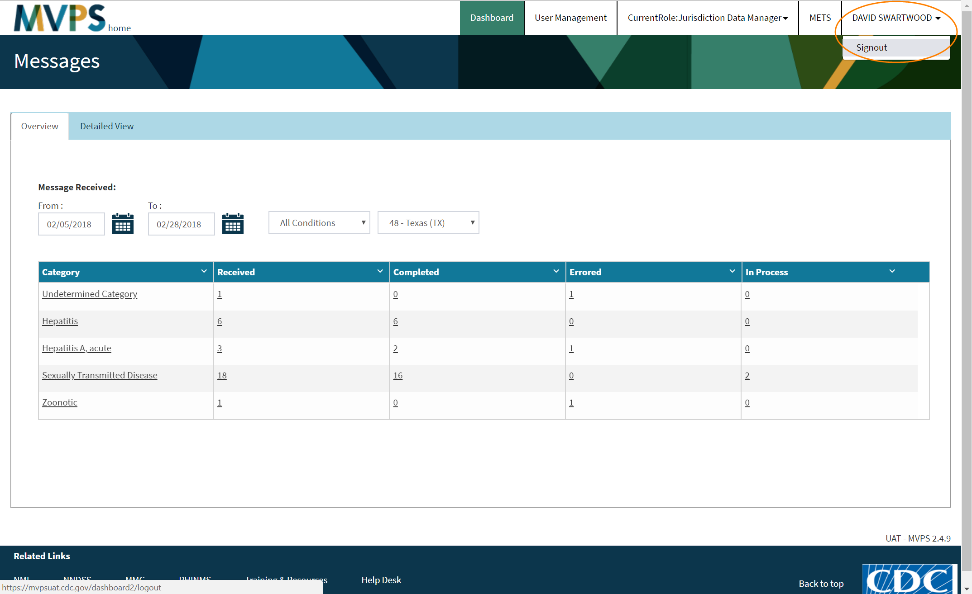
Signing Out

Slide 30
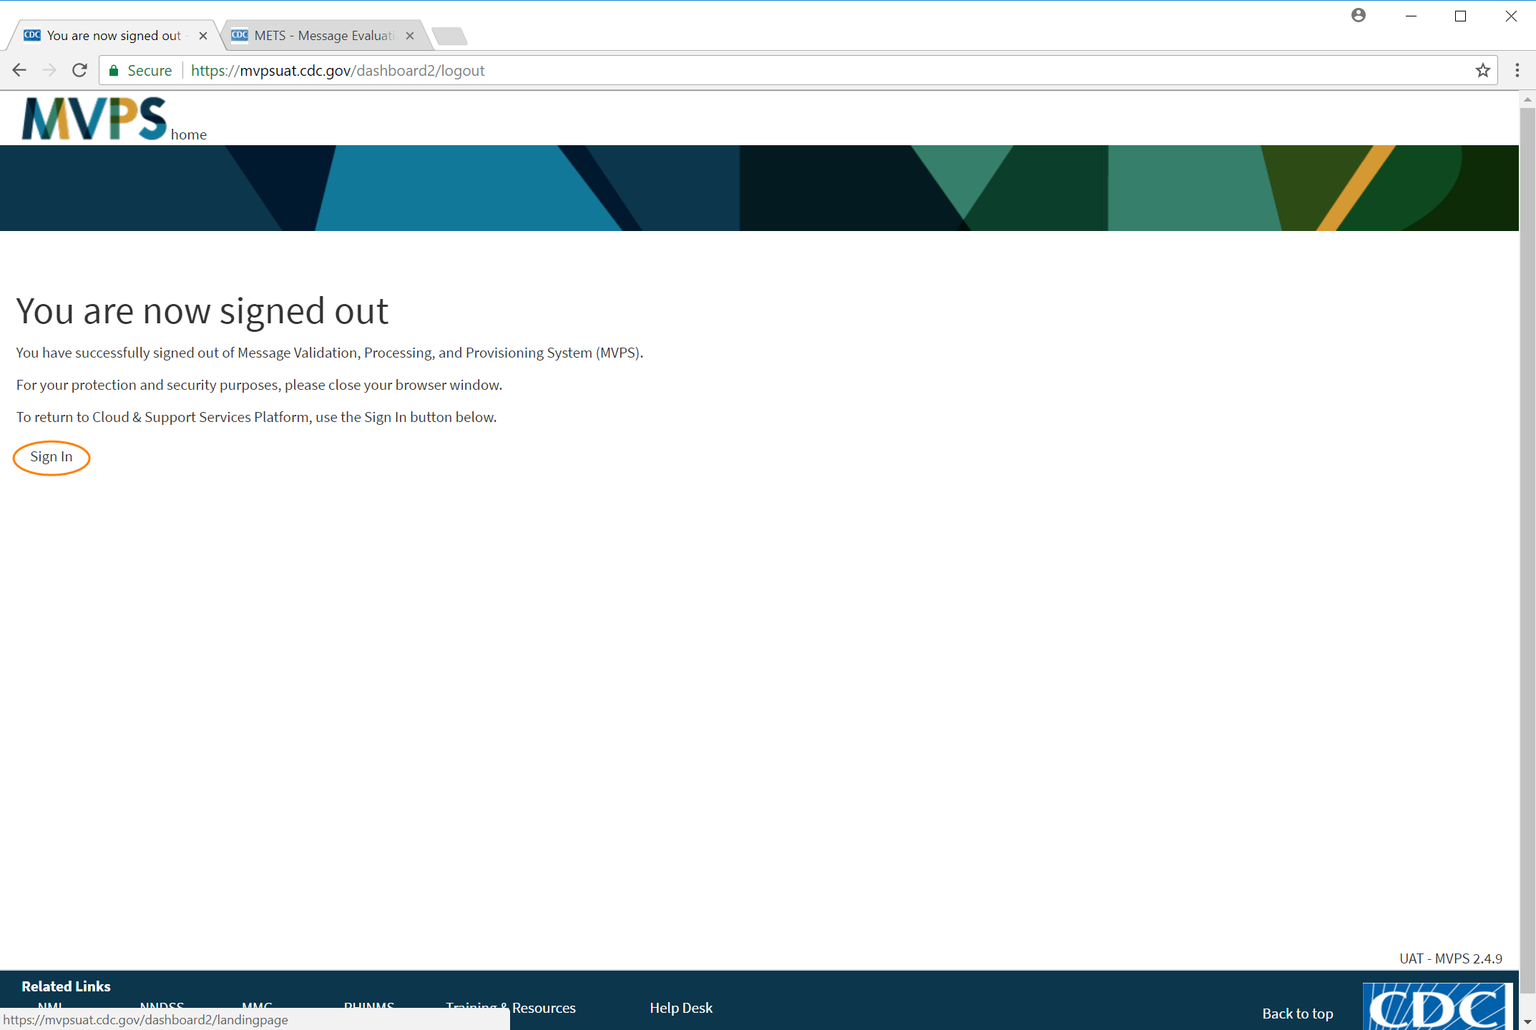
Signing Out

Slide 31
Dashboard Future Enhancements
Error and warning usability improvements
  Filtering, grouping
  Error updates
  Exports
Event code groupings, similar to category groupings
Case counts, Morbidity and Mortality Weekly Report (MMWR) inclusion flags, status
Batch counts, roll-ups
Wildcard search
Email notifications

Slide 32

Questions and Answers

Slide 33
Subscribe to monthly NMI Notes news updates at
https://www.cdc.gov/nndss/trc/news/
Access the NNDSS Technical Resource Center at
https://www.cdc.gov/nndss/trc/
Request NNDSS technical assistance or onboarding at
edx@cdc.gov
Next NNDSS eSHARE is April 17, 2018 – details to come at
https://www.cdc.gov/nndss/trc/onboarding/eshare.html

