Slide 1
NMI eSHARE:
Walkthrough of the NMI Implementation Spreadsheet and
Test Case Scenario Worksheet
New Webinar Information:
Conference Number: 1-877-668-4490
Participant Code: 799 765 273
WebEx meeting: https://cste.webex.com/cste/k2/j.php?MTID=td0a9a37ae49940a935f1a688f38cc40d
-Enter your name and email address
-Enter the session password: nmi1234
-Click "Join Now"
NOTE: Session will be recorded and posted on the NNDSS eSHARE website: https://www.cdc.gov/nndss/trc/onboarding/eshare.html.
March 21, 2017 Division of Health Informatics and Surveillance

Slide 2

Agenda
Welcome and Introductions
Announcements:
  National Notifiable Diseases Surveillance System (NNDSS) Conditions to Use Generic v2-only List updated to include Cyclosporiasis, Trichinellosis, and Malaria
  NMI timeline
Walkthrough:
  NMI Implementation Spreadsheet
  NMI Test Case Scenario Worksheet
Overview of Implementation Steps for NEDSS Base System (NBS) Users
Introduction to NMI eSHARE Clinic
Questions and Answers

Slide 3
Announcement: Conditions Added to Generic v2-only List
The 2017 NNDSS Event Code List and Conditions to Use Generic v2-only List was updated to include:
  Cyclosporiasis (event code 11575),
  Trichinellosis (event code 10270), and
  Malaria (event code 10130).
    States must continue to send Malaria case reports to the National Malaria Surveillance System (NMSS) until they have onboarded the Malaria HL7 Message Mapping Guide (MMG).
The Message Validation, Processing, and Provisioning System (MVPS) is now ready to accept these conditions.

Slide 4
Announcement: Expected Timeline for NMI
Generic v2 and Hepatitis migrate to MVPS update (MVPSu) in late July 2017.
MVPSu ready to receive STD and Congenital Syphilis case notification messages in October 2017.
MVPSu ready to receive Mumps and Pertussis case notification messages in December 2017.
MVPSu ready to receive Varicella case notification messages in February 2018.
Work continues on other MMGs.
MMG team creating re-usable data element blocks and templates, where possible.

Slide 5
Overview of the NMI Implementation Spreadsheet and Test Case Scenario Worksheet
Susan Downer, MS
Terminologist
Association of Public Health Laboratories

Slide 6

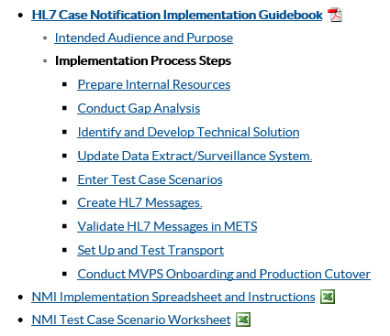
NMI Implementation Spreadsheet and
NMI Test Case Scenario Worksheet
  Find them at https://www.cdc.gov/nndss/trc/onboarding/arboviral.html

Slide 7
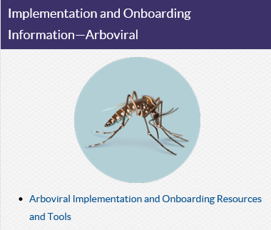
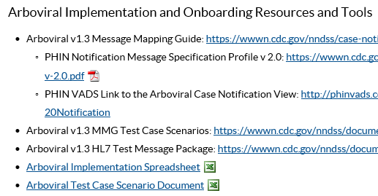
Arboviral Implementation Spreadsheet and
Arboviral Test Case Scenario Worksheet
  Find them at https://www.cdc.gov/nndss/trc/onboarding/arboviral.html

Slide 8
NMI Implementation Spreadsheet
Aids jurisdictions in conducting and documenting a gap analysis between the data elements included in the HL7 case notification message and those collected in the disease surveillance system.
Provides a one-stop shop:
  comprehensive resource and
  jurisdiction worksheet.
Implementation Spreadsheet
Gen v2 MMG
Condition-specific MMG
Case Notification Message Structure Specification/Profile
State Case Reporting Forms and Mappings to Surveillance System Fields

Slide 9
NMI Implementation Process and Tools
NMI Implementation Process and Tools
Data Fields
Date of Birth
MMG Fields
DEM115:Birthdate
DEM152: Race Category
PID|1||5276074529^^^MDCH&2.16.840.1.114222.4.1.3660&ISO||~^^^^^^S||19600101|F||2106-3^Caucasian^CDCREC~1002-5^American Indian^CDCREC|^^ANN ARBOR^26^48105^USA^^^26161|||||||||||2135-2^Hispanic or Latino^CDCREC|||||||20141031
Race
Ethnicity
DEM113: Subject’s Sex
Gender
DEM155: Ethnic Group
....
....
Source System
Implementation
Spreadsheet
HL7 Message
Surveillance System
Implementation Spreadsheet
HL7 Text File

Slide 10
Tabs
Read Me
Introduction and Instructions
Datatypes
Provides Datatype definitions as specified in the PHIN Messaging Guide for Case Notification_v3.0
Max Repeat Listing
Defines the maximum number of repeats allowed for repeating groups
Revision Log
Tab Descriptions
Column Descriptions
Provides a history of changes made to the implementation template

Slide 11
Tabs
All Other Conditions
Summary
Reporting tool (required for onboarding)
Provides space for jurisdictions to document gap analysis and mappings
No additional data entry required; dynamically updates from source columns on the “All Other Conditions” tab
Encompasses conditions other than Arbovirus, i.e., “All Other Conditions”
Compiles segment definition tables and MMG-specified data elements

Slide 12
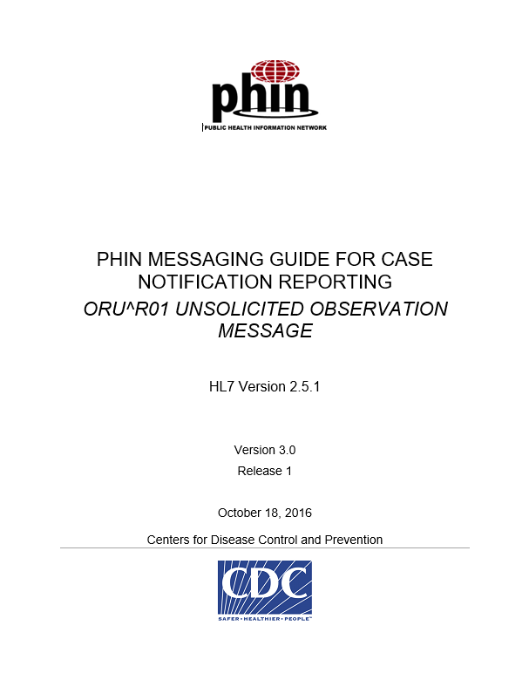
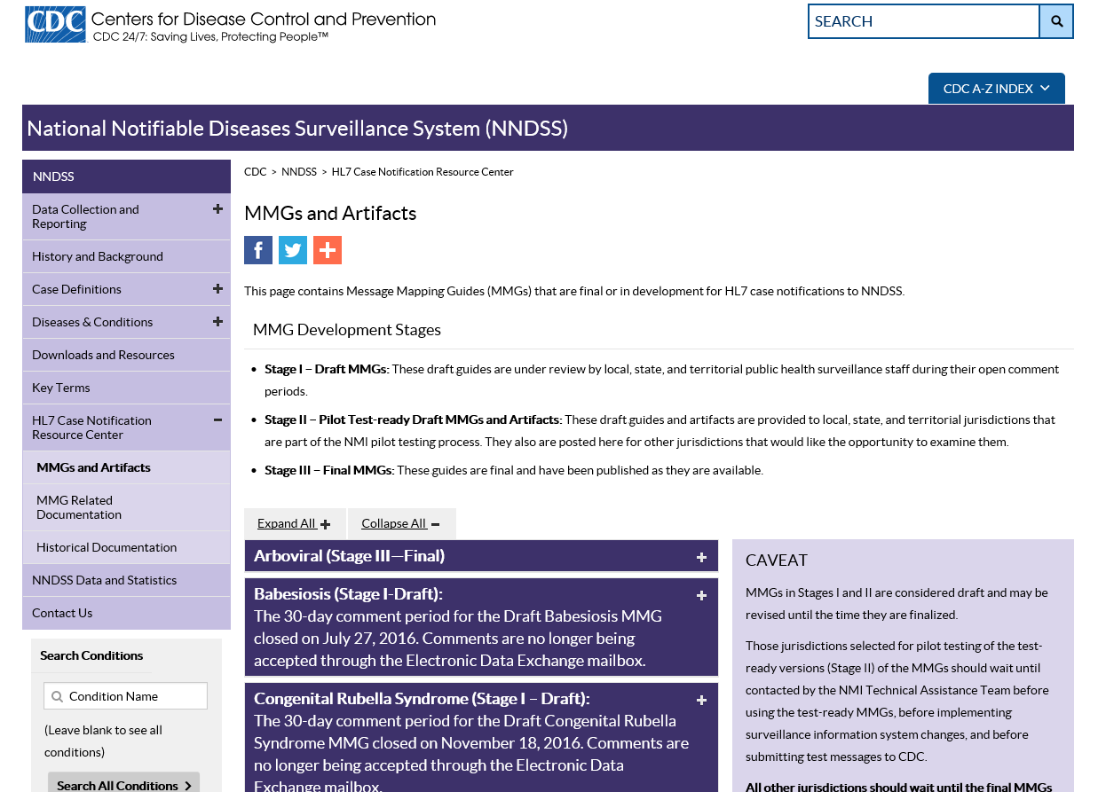
“All Other Conditions” Tab
The “All Other Conditions” tab is the main focus of the spreadsheet. This template
  integrates segment definitions from the PHIN v3 message specification with data elements outlined in the MMGs and
  serves as a worksheet for jurisdictions performing gap analysis.

Slide 13
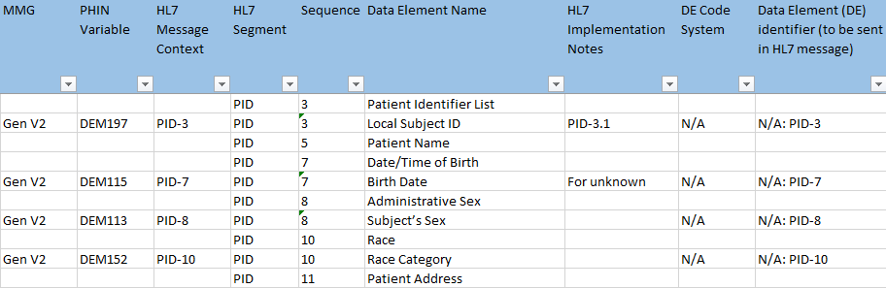
“All Other Conditions” Tab Organization
MMG data elements are displayed with the appropriate message segment.
To hide the PHIN message specification rows, we recommend filtering the “PHIN Variable” column to remove blanks.

Slide 14
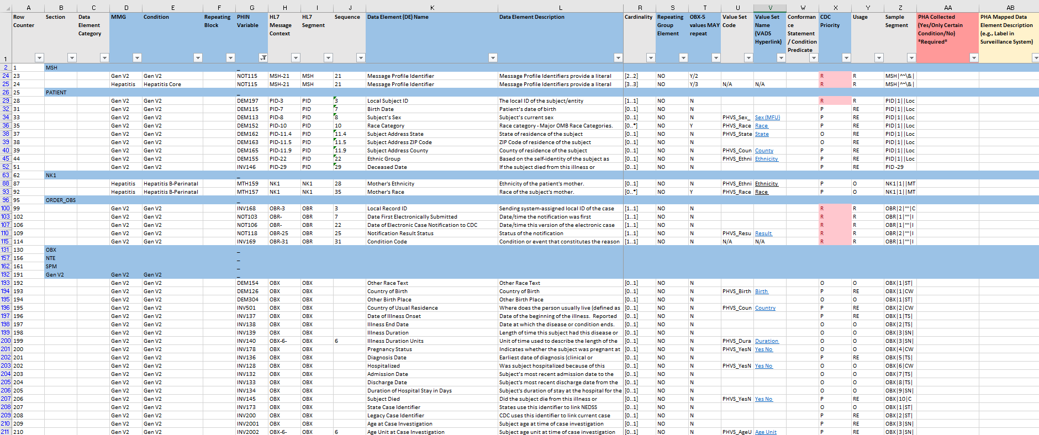
“All Other Conditions” Tab
Very comprehensive—we recommend adjusting the view to meet your needs.

Slide 15
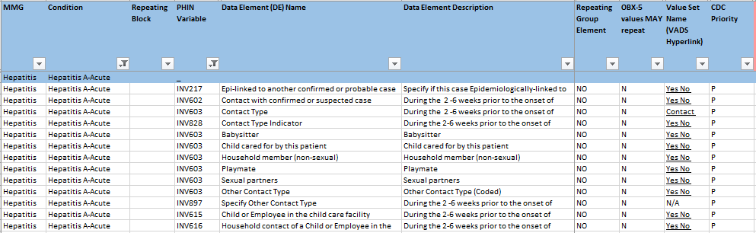
“All Other Conditions” Tab: Filtered View
For example: Hiding columns and filtering to display only the “Hepatitis A-Acute” data elements makes the view more manageable.

Slide 16
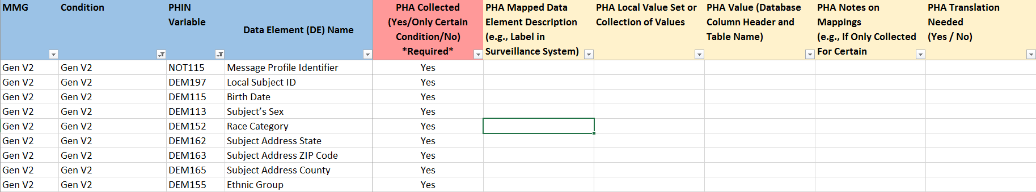
“All Other Conditions” Tab: PHA Columns
Columns AA-AJ have been provided for public health agencies (PHAs) to document their gap analysis and mappings to local data element/fields.
  Column descriptions provided on the “Read Me” tab.
Onboarding: Only the “PHA Collected” column (indicating whether the PHA will send the data element in the HL7 message) is required for onboarding.

Slide 17
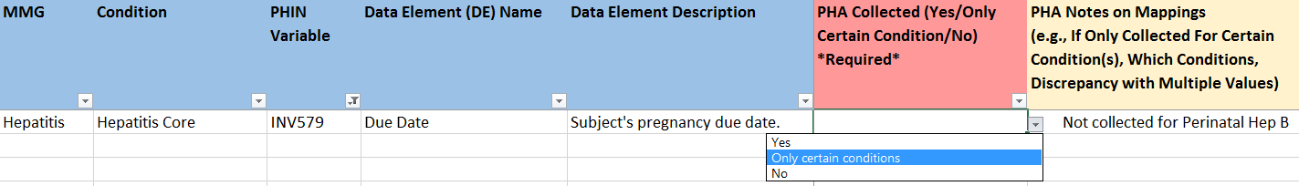
“All Other Conditions” Tab: Gap Analysis
Does our surveillance system currently collect this data element?
Is the data element collected for every condition?

Slide 18
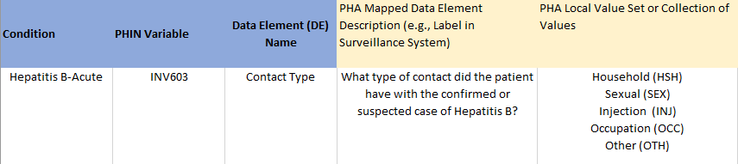
“All Other Conditions” Tab: Gap Analysis
Does the data element description match how our question is worded?
Does the datatype match?
  For example: coded or free text
Do our local values match the value set specified in the MMG for this data element?
  Do the number of responses match? For example: single select (dropdown) or multiselect

Slide 19
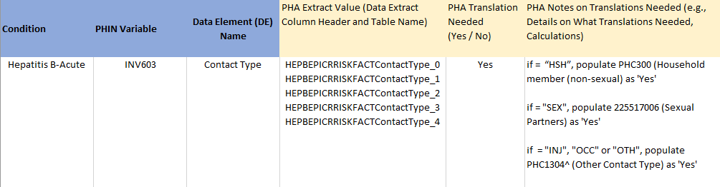
“All Other Conditions” Tab: Mapping
What are the column headers/labels of the database or data extract?
Can this data element be used as-is in the message?
  If not, what translation or script logic needs to be performed?

Slide 20
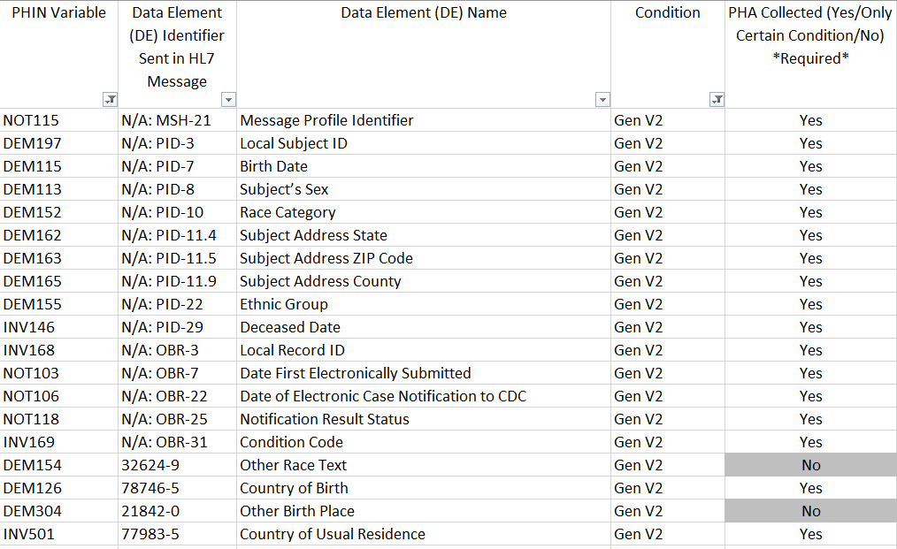
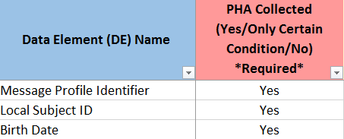
“Summary” Tab
Required for onboarding
Automatically populates from the “PHA Collected” column

Slide 21
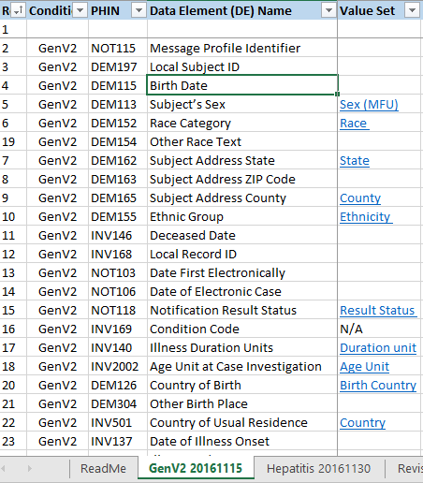
NMI Test Case Scenario
Worksheet
Each tab displays the MMG data elements and expected values for each test scenario record as specified by CDC.
Tabs are identified by the case notification type and the release date of the most recently incorporated test scenario version.

Slide 22
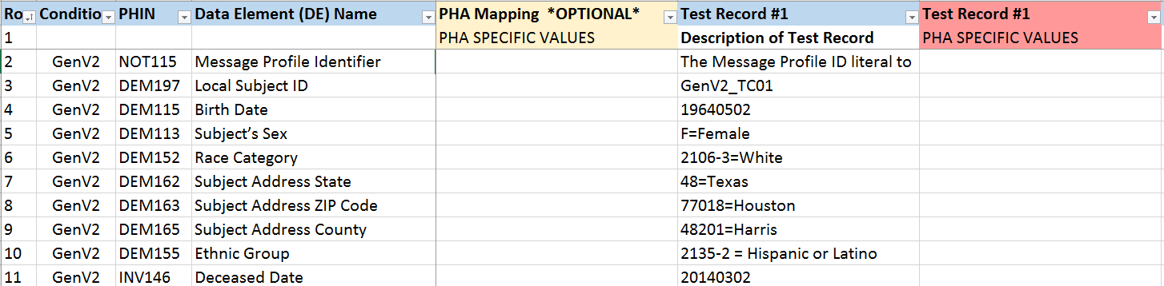
NMI Test Case Scenario Worksheet
Each test scenario record includes a column with expected values for each data element as specified by CDC and, to its right, a column for the PHA to record the actual value that they will send in the test messages.
PHA mapping notes may be included if helpful.

Slide 23
NMI Test Case Scenarios
When populating the “PHA-specific Values,” be sure to indicate when a data element
  is not collected;
  is collected but will be left blank; or
  will differ from the CDC-suggested value (e.g., submitter state is Florida, but Texas is reflected in the test case scenario).
Verify that each data element to be sent (marked as “yes” in the PHA-collected column) is demonstrated (included) in at least one test message.

Slide 24
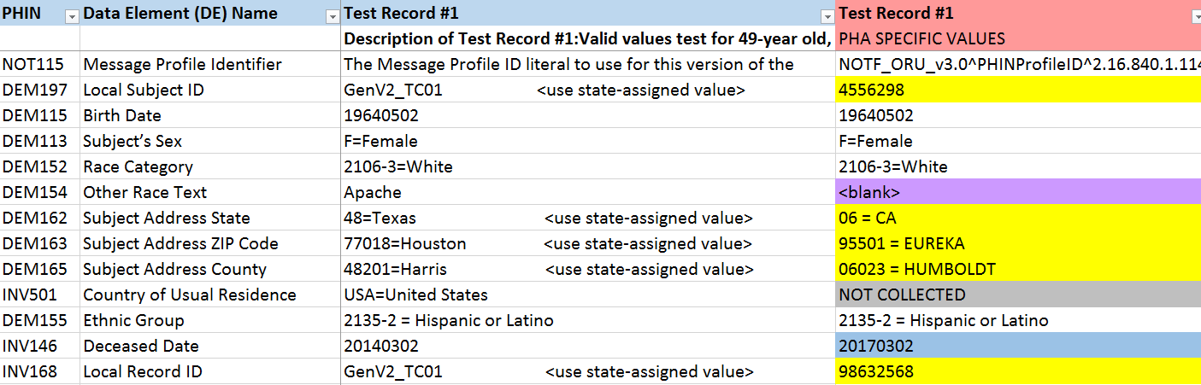
NMI Test Case Scenarios

Slide 25
Updates and Deletes
Scenarios have been included to test the PHA’s ability to send changes to existing cases:
  updates and
  deletes.

Slide 26
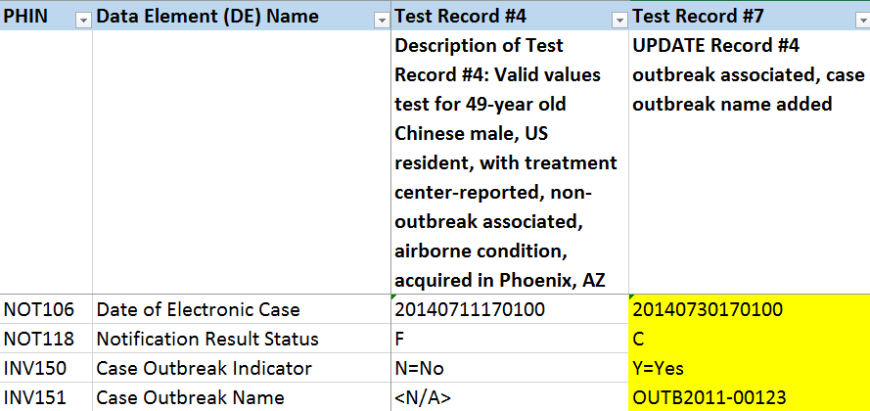
Updates
Changes have been made to at least one data element.
Notification Result Status updated from Final “F” to Corrected “C.”
Date of electronic case notification updated.

Slide 27
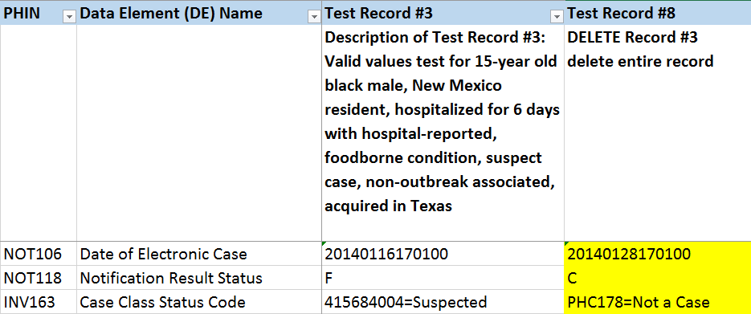
Deletes
Submission no longer meets case criteria. Case Class Status Code = Not a Case.
Notification Result Status updated from Final “F” to Corrected “C.”
Date of electronic case notification updated.

Slide 28
NMI Implementation Resources
NNDSS Resource Center
  https://www.cdc.gov/nndss/trc/index.html
  NNDSS Implementation Spreadsheet and Instructions
    https://ndc.services.cdc.gov/message-mapping-guides/ (Visit specific MMG to access)
  NNDSS Test Case Scenario Worksheet
    https://ndc.services.cdc.gov/wp-content/uploads/2021/02/NMI_arboviral_test_case_scenario_worksheet_20200724.xlsx
Arboviral Implementation and Onboarding Information
  https://www.cdc.gov/nndss/trc/onboarding/arboviral.html
  Arboviral Implementation Spreadsheet
    https://ndc.services.cdc.gov/wp-content/uploads/2021/02/Arboviral_nmi_implementation_spreadsheet_and-instructions_20200724.xlsx
  Arboviral Test Case Scenario Worksheet
    https://ndc.services.cdc.gov/wp-content/uploads/2021/02/NMI_arboviral_test_case_scenario_worksheet_20200724.xlsx

Slide 29
Overview of NMI Implementation Steps for NBS
Jennifer Ward, MS
Epidemiologist/NBS Subject Matter Expert
CSRA, Public Health Programs

Slide 30
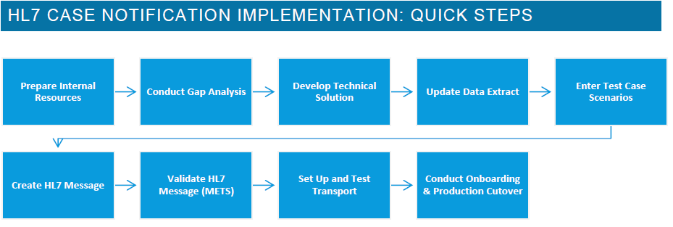
Overview of NMI Implementation Steps for NBS
Graphic excerpt from HL7 Case Notification Implementation Guidebook
Adopt Page Builder Standard Template

Slide 31
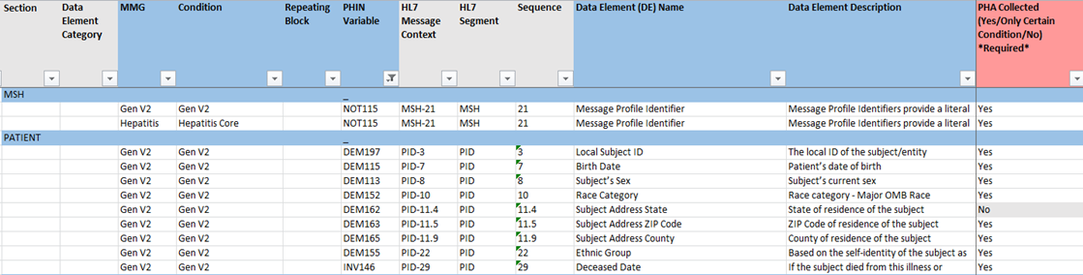
Pre-populated Implementation Spreadsheet
Based on data elements in CDC-provided standard page templates.
Jurisdictions will need to modify if any changes were made to the data elements in the standard page template.
  For example: Jurisdiction decided not to collect the data element.
  Update “All Other Conditions” tab.
    PHA Collected
    PHA Local Value Set. . .
    PHA Notes on Mappings

Slide 32
Test Scenarios
Same test scenarios provided to all jurisdictions by NMI.
Re-ordered to flow with order of data entry based on standard Page Builder templates.

Slide 33
Additional Onboarding Resources for NBS
Documentation available on NBSCentral:
  https://nbscentral.sramanaged.com/redmine/documents/197
NBS NMI Onboarding FAQs
Pre-populated Implementation Spreadsheet
NBS Onboarding Configuration Checklist

Slide 34
Introduction to NMI eSHARE Clinic
Michele Hoover, MS
NMI State Implementation and Technical Assistance Lead
Division of Health Informatics and Surveillance
Center for Surveillance, Epidemiology, and Laboratory Services
Centers for Disease Control and Prevention

Slide 35
Questions and Answers
Questions and Answers

Slide 36
Additional Questions?
Additional Questions?
Email EDX@cdc.gov
Subscribe to monthly NMI Notes news updates at https://www.cdc.gov/nndss/trc/news/index.html!
Access the NNDSS Technical Resource Center at https://www.cdc.gov/nndss/trc/index.html!

