Slide 1
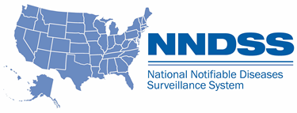
Working Together to Promote Jurisdiction Efficiencies to Send COVID-19 National Notifiable Diseases Surveillance System (NNDSS) Case Notifications
Michele Hoover, MS
Data Standardization and Assistance Team
Division of Health Informatics and Surveillance
Notes:
Good afternoon, my name is Michele Hoover and I am presenting on how we worked together to promote efficiencies to send COVID-19 National Notifiable Diseases Surveillance System Case Notifications.
The National Notifiable Diseases Surveillance System (NNDSS) is a national system designed to allow jurisdictions to provide comprehensive, timely, and high-quality data for public health decision-making at the federal level.
This afternoon I am going to share with you how CDC in collaboration with the Council of State and Territorial Epidemiologists (CSTE), Association of Public Health Laboratories (APHL), and National Electronic Disease Surveillance System Base System (NBS) team worked together to bring in case notifications for COVID-19 with emphasis on the GenV2 format.
On January 21, (CLICK)

Slide 2
2020 Timeline COVID-19 Case Notifications
First CDC-confirmed case of COVID-19
Notes:
The first CDC confirmed case of COVID-19. (CLICK)

Slide 3
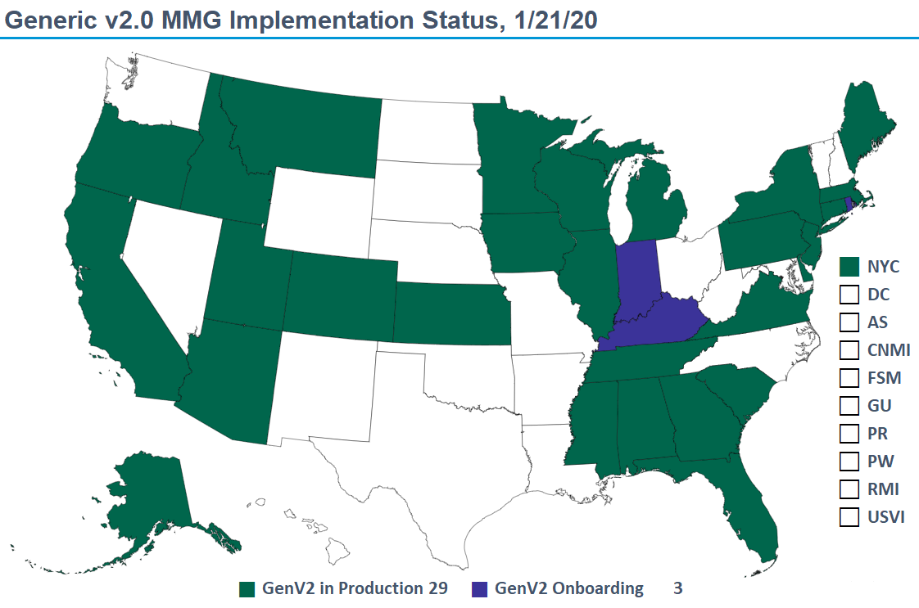
Generic v2.0 MMG Implementation Status
Notes:
This map of the US and associated territories shows jurisdiction implementation of the HL7-based Generic version 2 message on January 21. The 29 jurisdictions shown in dark green were already using the Generic Version 2 to send case notifications to CDC. The 3 states in dark blue were finishing onboarding for the GenV2 message. Therefore, all 32 of these jurisdictions were in a position to begin sending COVID-19 using the GenV2 message.
By January 24 (click)

Slide 4
2020 Timeline COVID-19 Case Notifications
NNDSS can accept COVID-19 reports (all formats)
First CDC-confirmed case of COVID-19
Notes:
NNDSS was ready to accept COVID-19 case notifications in the Generic version 2 format and in three other older formats.
By February 5,

Slide 5
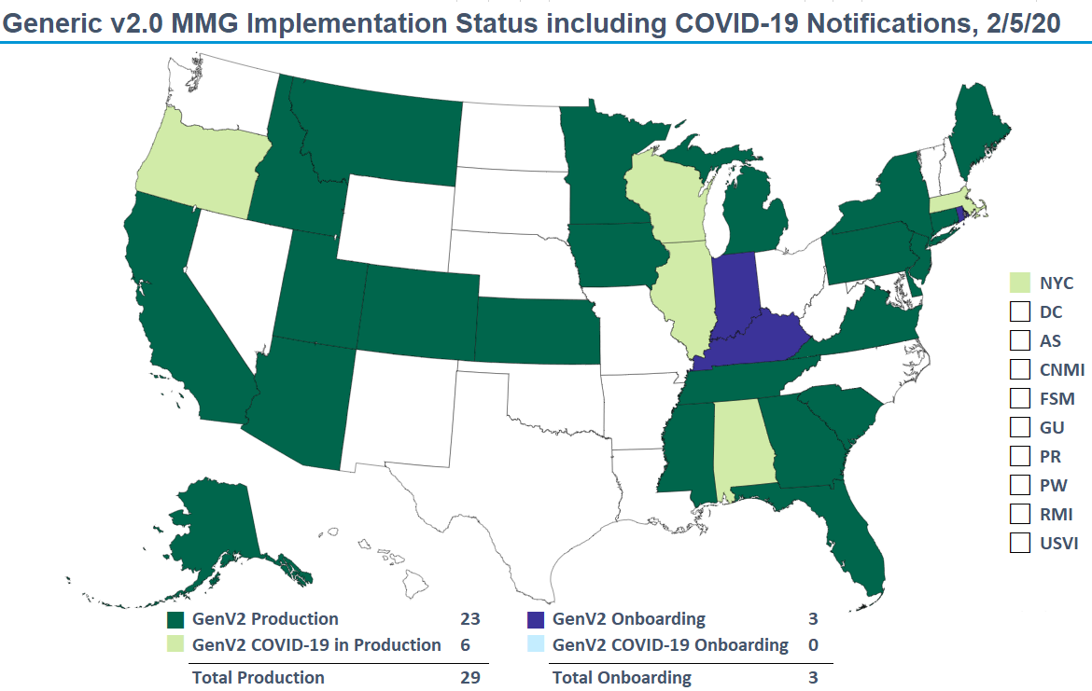
Generic V2.0 MMG Implementation Status
Notes:
6 jurisdictions were sending GenV2 for COVID-19 shown here in light green (OR, WI, IL, AL, MA, NYC) and the 3 jurisdictions in blue that were still in the process of onboarding GenV2, incorporated COVID-19 as part of onboarding.

Slide 6
2020 Timeline COVID-19 Case Notifications
NNDSS can accept COVID-19 reports (all formats)
17% sending COVID-19 case notifications through NNDSS, 60% using GenV2 format
21% of those already sending GenV2 for other conditions
First CDC-confirmed case of COVID-19
Notes:
On February 5, we had 10 or 17% of the 60 jurisdictions that report through NNDSS sending COVID-19 case notifications. Of those, 6 jurisdictions were sending GenV2 for COVID-19, representing 60% of those sending COVID-19. These 6 jurisdictions represented 21% of the 29 jurisdictions already sending GenV2 messages for other conditions.
In April (CLICK)
Speaker reference - 10/60 sending NNDSS = 17%
6/10 sending COVID-19 used GenV2 = 60%
6/29 sending GenV2 were sending COVID-19 through GenV2 = 21%

Slide 7
2020 Timeline COVID-19 Case Notifications
NNDSS can accept COVID-19 reports (all formats)
17% sending COVID-19 case notifications through NNDSS, 60% using GenV2 format
21% of those already sending GenV2 for other conditions
First CDC-confirmed case of COVID-19
Start development of COVID-19 MMG
Notes:
We started the development of the full COVID-19 MMG in order to receive all data elements in the case report form through NNDSS
And during June (CLICK)

Slide 8
2020 Timeline COVID-19 Case Notifications
NNDSS can accept COVID-19 reports (all formats)
17% sending COVID-19 case notifications through NNDSS, 60% using GenV2 format
21% of those already sending GenV2 for other conditions
First CDC-confirmed case of COVID-19
Start development of COVID-19 MMG
COVID-19 MMG released
Notes:
The full COVID-19 MMG was released as final and ready for implementation which is about a year faster than any other guide to date!

Slide 9
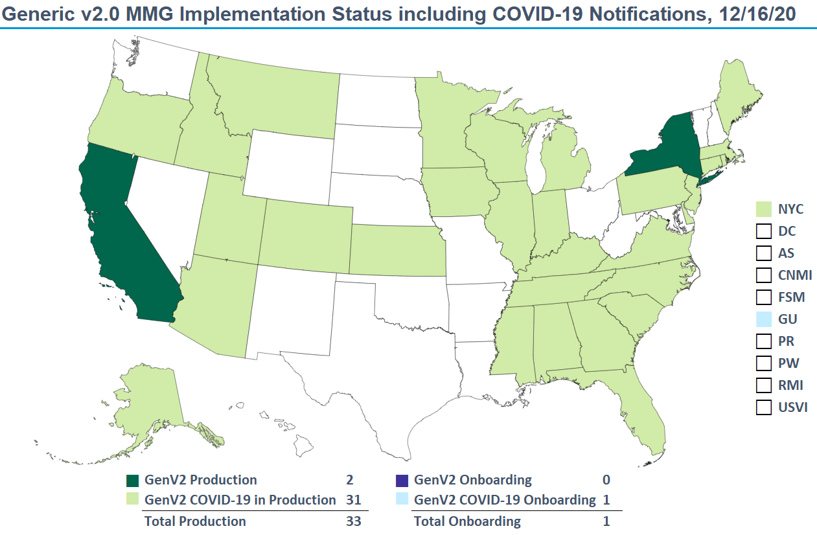
Generic v2.0 MMG Implementation Status
Notes:
By mid-December 2020, 4 states were working with APHL to implement the full COVID MMG. We also had 31 jurisdictions shown here in bright green sending COVID-19 data using GenV2. CA and NY, shown in dark green, were the only two states sending GenV2 messages for other conditions that were not using it for COVID-19.
Additionally, Guam, shown in light blue, had begun onboarding to send COVID-19 case notifications in GenV2

Slide 10
2020 Timeline COVID-19 Case Notifications
NNDSS can accept COVID-19 reports (all formats)
17% sending COVID-19 case notifications through NNDSS, 60% using GenV2 format
21% of those already sending GenV2 for other conditions
82% sending COVID-19 case notifications through NNDSS, 63% using GenV2 format
93% of those already sending GenV2 for other conditions
First CDC-confirmed case of COVID-19
Start development of COVID-19 MMG
COVID-19 MMG is released
Notes:
By December, out of the 60 jurisdictions that report through NNDSS, 49 or 82% were sending COVID-19 case notifications through NNDSS. Of those, 31 jurisdictions were using GenV2 accounting for 63% of those sending COVID-19 through NNDSS.
Out of the original 29 jurisdictions sending GenV2 messages for other conditions, 93% were sending GenV2 for COVID-19.
Speaker reference - 49/60 sending NNDSS = 82%
31/49 sending COVID-19 used GenV2 = 63%
27/29 sending GenV2 were sending COVID-19 through GenV2 = 93%

Slide 11
How Did We Improve the Process? Technical Assistance
Active outreach to jurisdictions to provide technical assistance (TA)
TA is here to help!
Notes:
So, How did we improve the process?
Early in 2020 it was clear that good case surveillance data would be needed. To enable case notification through NNDSS, the NNDSS team, in conjunction with CSTE, APHL, and NBS, began active outreach. Efforts started with the 29 jurisdictions already sending Gen v2 messages for other conditions. We offered technical assistance to help them incorporate COVID-19 into the Gen V2 transmissions and answered questions as they emerged.
As we worked on state outreach the National Center for Immunization and Respiratory Diseases updated their system in order to provision NNDSS data to the response.

Slide 12
How Did We Improve the Process? Established Cohorts
COVID Cohort
Established two cohorts:
1. Jurisdictions using any surveillance system jurisdictions wanting to send case notifications using the COVID-19 message mapping guide (MMG)
Non-NBS
Surveillance System
COVID Cohort
2. Jurisdictions using NBS jurisdictions wanting to send COVID-19 case notifications using GenV2
NEDSS Base System (NBS)
Notes:
Two cohorts were established by APHL
The first cohort was established in July (approximately one month after the full COVID-19 MMG was released). This cohort was for any jurisdictional system to help them send case notifications using the full COVID-19 MMG.
The second cohort was for jurisdictions using the NBS to begin sending GenV2 COVID-19 Messages. ​The NBS cohort helped the jurisdictions set-up the COVID-19 data collection page and then followed the same process used for other states.

Slide 13
How Did We Improve the Process? Revised Onboarding
Revised Gen V2 and COVID-19 MMG onboarding
Notes:
Additionally, we revised the onboarding processes for sending COVID-19 via GenV2 and for sending the full COVID-19 MMG.

Slide 14
What is the Revised Onboarding Process for GenV2?
No test messages or limited production data!
Add Event Code
CDC confirms receipt of COVID-19 GenV2 messages
No major errors identified in GenV2 COVID-19 messages
Ongoing production for GenV2 COVID-19 messages
Notes:
What is the revised onboarding process for GenV2?
It is an abbreviated onboarding process. Jurisdictions already sending Gen V2 did not need to send test messages or limited production data. They could simply add the COVID-19 event code and notify NNDSS that they were ready to send data. CDC confirmed the receipt of the initial production messages and assured that no major errors were identified. The state was considered in production for Gen V2 COVID-19 messages.

Slide 15
How Was Onboarding Process Revised for the COVID-19 MMG?
APHL review of onboarding package
Test messages reviewed
Increased number of limited production messages
Production for COVID-19 upon receipt of year-to-date
Notes:
How Was the Onboarding Process Revised for the COVID-19 MMG?
The NNDSS, APHL and NBS Teams considered lessons learned from onboarding and technical assistance to identify potential barriers, challenges and opportunities for efficiencies.
This resulted in APHL reviewing the onboarding package before it was sent to CDC, so that the kickoff call could be scheduled when CDC received the onboarding package.
Once test messages were reviewed, the jurisdiction was moved to limited production. Any feedback from the CDC program was incorporated during the limited production phase. ​
Hundreds of messages were requested for limited production so that any systematic mapping errors could be identified quickly. All CDC participants committed to an aggressive timeline for providing feedback to jurisdictions. Most feedback was returned from all stakeholders within 3 weeks of initial receipt. ​
The jurisdiction was considered to be in production once the year-to-date file was transmitted. The jurisdiction received quick feedback on any major errors that needed immediate action and general data quality improvements were addressed over time. For jurisdictions that were sending a .csv file, sometimes a few weeks were needed before those files were turned off.​
…
We continue to see the results of these efforts (CLICK)

Slide 16
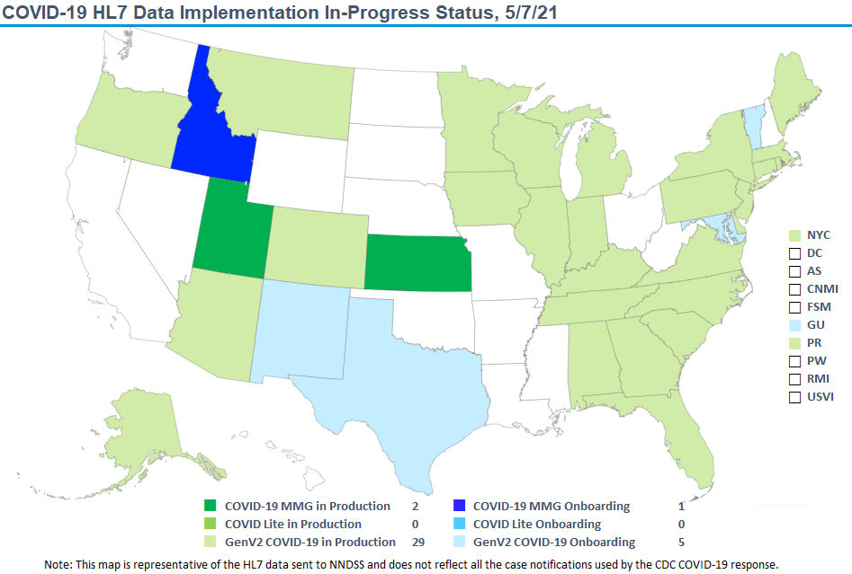
COVID – 19 HL7 Data Implementation
Notes:
As of May 7, 2021 we now have 34 of 60 jurisdictions in various stages of implementing the full COVID-19 MMG, the abbreviated COVID-19 MMG which ONLY includes Vaccine data (referred to as COVID Lite) and the GenV2 MMG. ​
The map shown here is restricted to COVID-19 case notifications sent through HL7 and shows the highest level of guide achievement for jurisdictions.
Utah and Kansas (in bright green) were previously sending GenV2 messages are now sending the full COVID-19 MMG, which includes vaccine data. And Idaho (in bright blue) is finishing the COVID-19 MMG onboarding.
No one is in production or onboarding COVID Lite, but that only became available at the end of February of this year.
We still have 29 jurisdictions (shown in light green) sending COVID-19 data via GenV2 and an additional five jurisdictions (shown in lite blue, NM, TX, MD, VT and Guam) currently onboarding GenV2 for COVID-19.
Not show on the map are states participating in cohorts that started in February of 2021.
We have 8 NBS states working on the full MMG (AL, AK, KY, ME, MS, NE, TN, VA). Another non-NBS cohort with 5 states currently sending COVID-19 using GenV2. Four (FL, GA, IL, and NJ) are working on COVID Lite and Oregon the full MMG.

Slide 17
Special Thanks to State and Local Partners
Evan Brown (AL)​ | Sujata Mallik (KS) | Theresa Kittle (MS)​ | Rob Laing (OR)
Tobytha Powell (AL)​ | Shannon Sandall (KS)​ | Stanford Mwasongwe (MS)​ | Kari Campbell (TN)​
Brenda Ryals (AL)​ | Rana Cook (KY)​ | Britney Rust (MS)​ | Kate Goodin (TN)​
Megan Tompkins (AK)​ | Sravanthi Kotica (KY)​ | Vernesia Wilson (MS)​ | Kayode Olupinyo (TX)​
Nancy Barrett (CT) | Courtney Marshall (KY)​ | Mike Nuss (NE)​ | Rachelle Boulton (UT)​
Alycia McNutt (CT)​ | Deepak Mekala (KY)​ | Harpal Singh (NE)​ | Doug McGowan (UT)​
Kim Wiley (FL)​ | Dimple Patel (KY)​ | Vibha Gujar (NJ)​ | Rebecca Early (VA) ​
Hope Dishman (GA)​ | Judie Hyun (MD)​ | Shahil Patel (NJ)​ | Jessica Mawdsley (VA)​
Grace Njuguna (GA)​ | Chandeep Singh (MD)​ | Stella Tsai (NJ)​ | Charlie Castor (VT)
Robb Byers (ID)​ | Trevor Brown (ME)​ | Joseph Bareta (NM)​ | Madhumathi Cheruvu (VT)​
Kathy Turner (ID)​ | Jenna Strathdee (ME)​ | Isaiah Francis (NM)​ | John Davy (VT)​
Dawn Nims (IL)​ | Jim Collins (MI)​ | Rohith Gudipati (NM)​ | Veronica Fialkowski (VT)​
Nicholas McGee (IL)​ | Carolina Fulper (MI)​ | Carmela Smith (NM)​
Megan Patel (IL)​ | Ed Hartwick (MI)​ | Michelle Barber (OR)​
Notes:
All this would not be possible without our state and local partners especially my co-authors who are bolded.

Slide 18
Special Thanks
APHL Technical Assistance Team
Laura Carlton
Heather Houston
John Park
Natalie Raketich
Amanda Santander
NEDSS Base System Team
Christi Hildebrandt
Jennifer Johnson
Maddie Stewart
Michael Wodajo
CSTE
Shaily Krishan
Becky Lampkins
Notes:
Our APHL, NBS and CSTE colleagues and co-authors in bold

Slide 19
Special Thanks
CDC Partners
Deborah Adams
Lesliann Helmus
Sara Johnston
Andrew Kuehl
Leslyn McNabb
Diana Onweh
Sandy Price
Sandy Roush
Alan Schley
CDC Data Standardization and Assistance Team
Calvin Hightower
Amanda Jones
Hang Nguyen
Tamara Robinson
Jessica Rodgers
Danielle Tack
Melinda Thomas
Angela Agunloye
Shawn Arshad
Josh Bagley
Shanterria Maxey
Doris McGinness
Bill Morrill
Diana Onweh
Sylvia Murphy
Notes:
And finally, our CDC partners and my team

Slide 20
Subscribe to monthly NNDSS newsletter (Case Surveillance News) at https://www.cdc.gov/nndss/trc/news/index.html
Access the NNDSS Technical Assistance and Training Resource Center at
https://www.cdc.gov/nndss/trc/index.html
Request NNDSS technical assistance or onboarding at
edx@cdc.gov
Next NNDSS eSHARE June 2021 – details to come at
https://www.cdc.gov/nndss/trc/onboarding/eshare.html
Notes:
Thank you for your attention as a reminder if your jurisdiction would like to be part of a cohort or have any questions email edx@cdc.gov

