Slide 1
A Safety & Health Curriculum for Young Workers
Miami-Dade County, Florida Edition
DEPARTMENT OF HEALTH AND HUMAN SERVICES
Centers for Disease Control and Prevention
National Institute for Occupational Safety and Health

Slide 2
Young Worker Injuries
Lesson 1: Part 1

Slide 3
Job Safety Quiz
The law says your employer is responsible for providing you with a safe and healthy workplace.
True False
The law sets limits on how late you can work on a school night if you are under 16.
True False
If you are 16 years old you are allowed to drive a car on public streets as part of your job.
True False

Slide 4
Job Safety Quiz (continued)
If you are injured on the job, your employer must pay for your medical care.
True False
How often do teens get injured on the job in the United States?
One per day One per hour
One every 9 minutes

Slide 5
Teen Worker Injury Statistics
Approximately 1.6 million teens, ages 15–17, in the United States work. About 50% of 10th graders and 75% of 12th graders have jobs.
Many youths are injured on the job.
On average, each year
59,800 workers younger than 18 are sent to the ER for job-related injuries, but actual injury statistics are much higher.
37 workers younger than 18 die on the job.
Young workers are twice as likely to be injured than adult workers.
NIOSH 2010 www.cdc.gov/niosh/topics/youth/chartpackage.html
www.cdc.gov/mmwr/preview/mmwrhtml/mm5915a2.htm

Slide 6
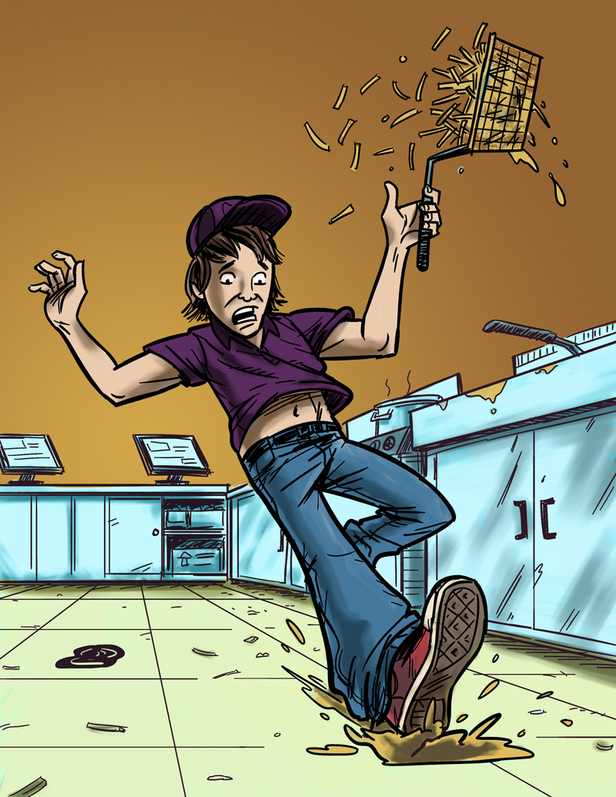
Examples of Teen Work Injuries
Jack’s Story
Job: Fast food worker
Hazard: Greasy, slippery floors
Injury: Injured tailbone
The Impact of Work Injuries
Why do you think this happened?
What could have prevented Jack from getting hurt?
How might this injury impact Jack’s daily life?

Slide 7
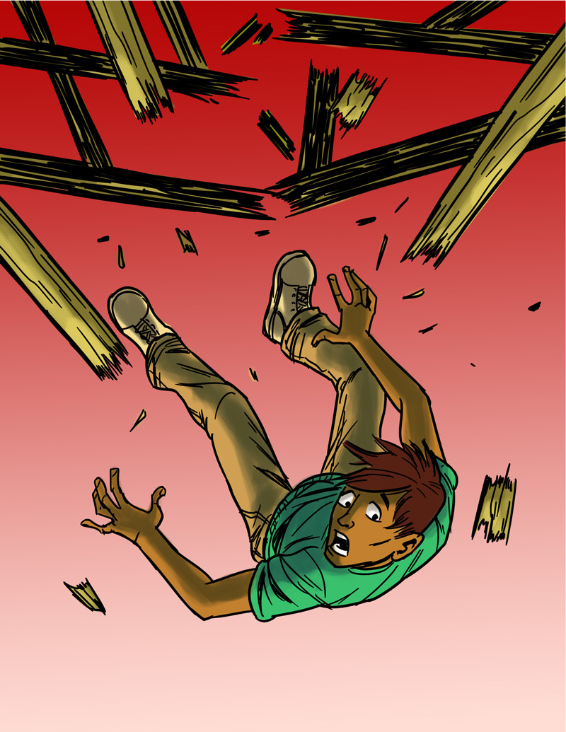
Teen Work Injuries
Antonio’s Story
Job: Construction helper
Hazard: Unguarded chimney hole (on an unfinished roof)
Injury: Broken back
The Impact of Work Injuries
Why do you think this happened?
What could have prevented Antonio from being injured?
How might this injury impact Antonio’s daily life?

Slide 8
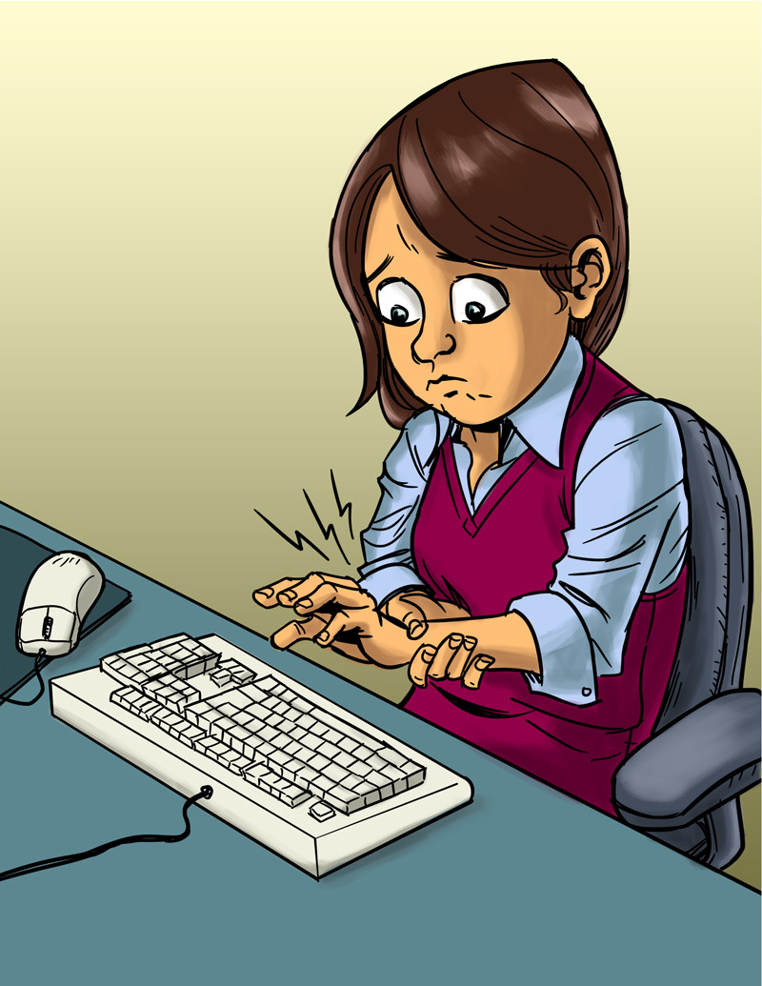
Teen Work Injuries
Angela’s Story
Job: Office worker
Hazard: Excessive typing in an awkward position
Injury: Repetitive stress injury
The Impact of Work Injuries
Why do you think this happened?
What could have prevented Angela from being injured?
How might this injury impact Angela’s daily life?

Slide 9
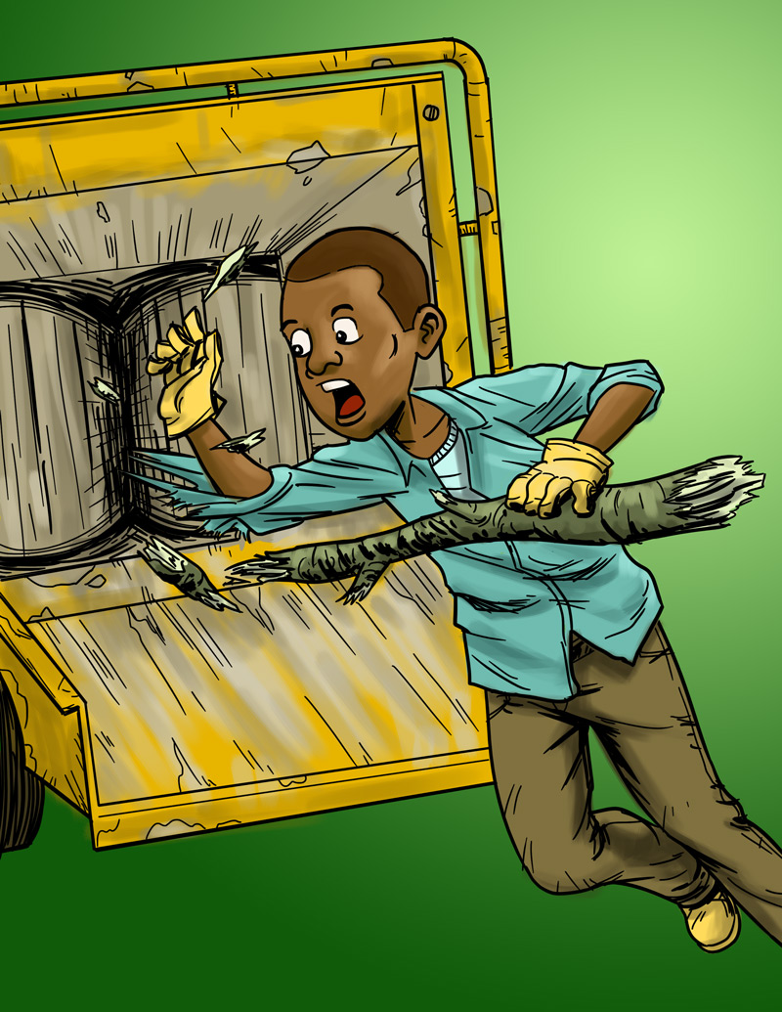
Teen Work Injuries
Terrell’s Story
Job: Landscape worker
Hazard: Wood chipper
Injury: Death
The Impact of Work Injuries
Why do you think this happened?
What could have prevented Terrell from being killed?

Slide 10
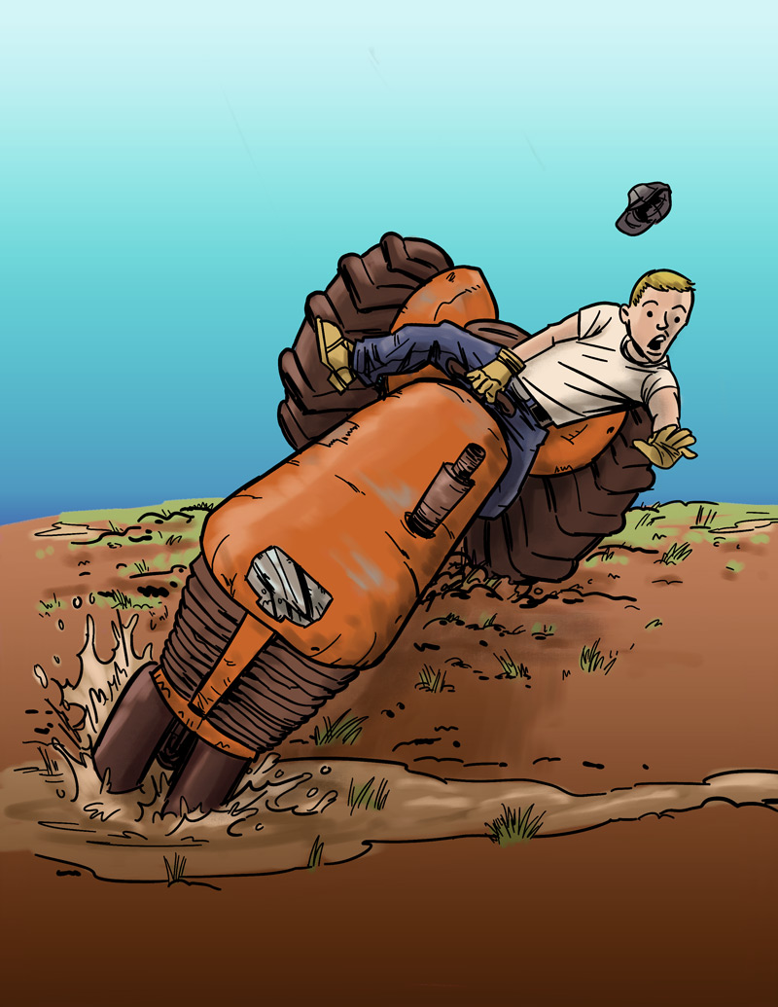
Teen Work Injuries
Cody’s Story
Job: Farm worker
Hazard: Tractor without roll bar
Injury: Legs crushed under tractor
The Impact of Work Injuries
Why do you think this happened?
What could have prevented Cody from getting hurt?
How might this injury impact Cody’s daily life?

Slide 11
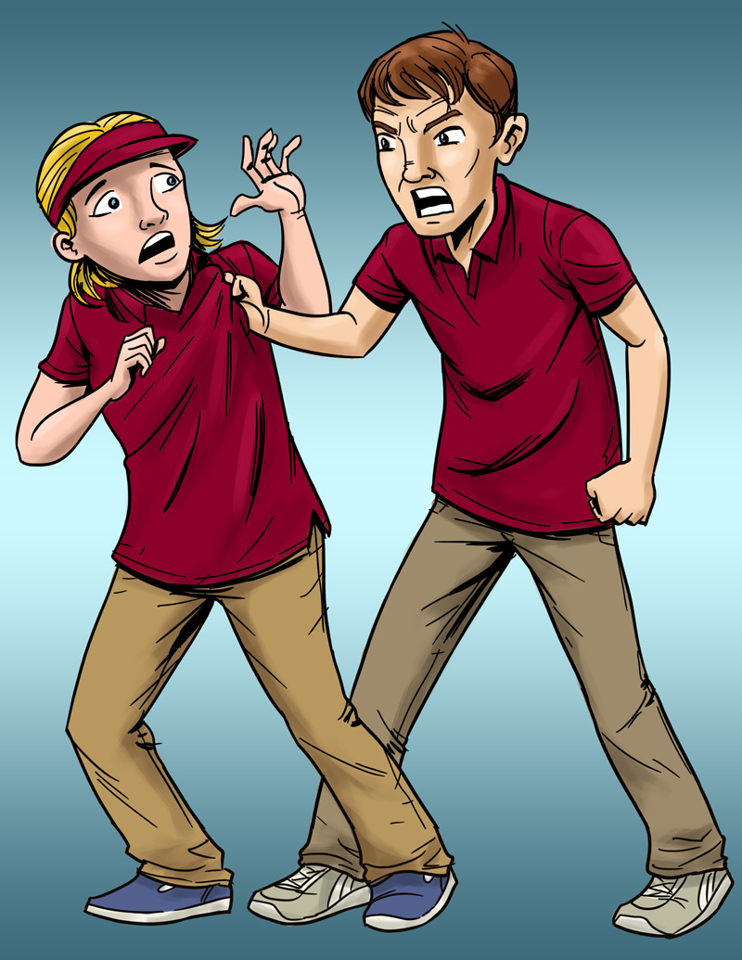
Teen Work Injuries
Lindsey’s Story
Job: Pizza shop cashier
Hazard: Violence (by a co-worker)
Injury: Bumps and bruises caused by abusive co-worker
The Impact of Work Injuries
What could Lindsey's employer have done to stop her abuser?
What would you do in this situation?
How might Lindsey’s life be affected by this incident?

Slide 12
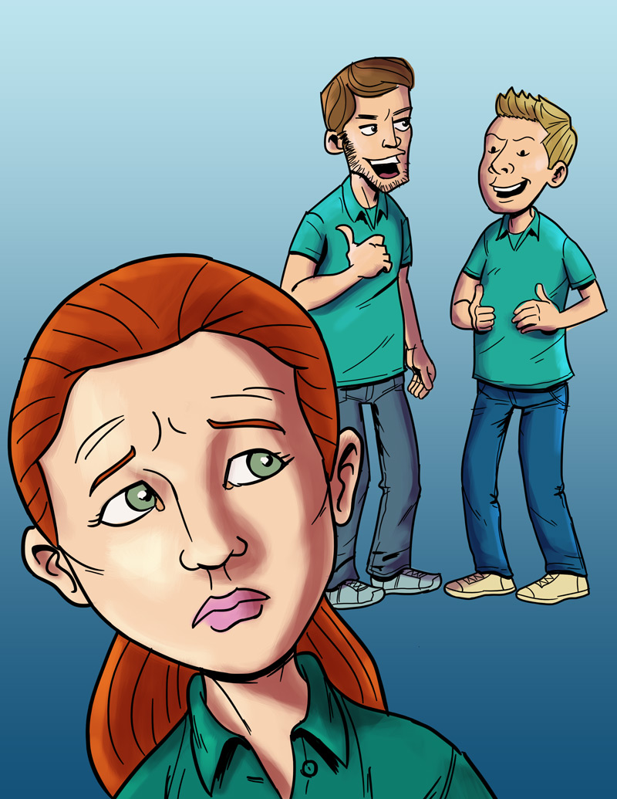
Teen Work Injuries
Anna’s Story
Job: Smoothie shop worker
Hazard: Sexual harassment
Injury: Emotional trauma
The Impact of Work Injuries
What could Anna's employer have done to stop her harasser?
What would you do in this situation?
How might Anna’s life be affected by this incident?

Slide 13
Why are Young Workers More Likely to be Hurt on the Job?
Video and Discussion

Slide 14
Know Your Rights and Responsibilities
Lesson 1: Part 2

Slide 15
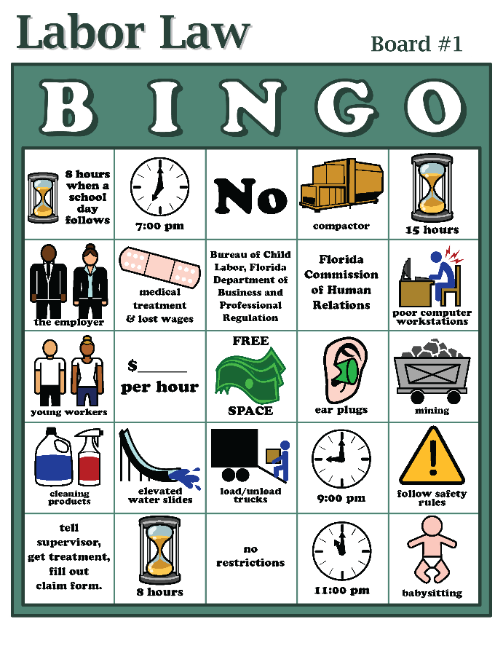
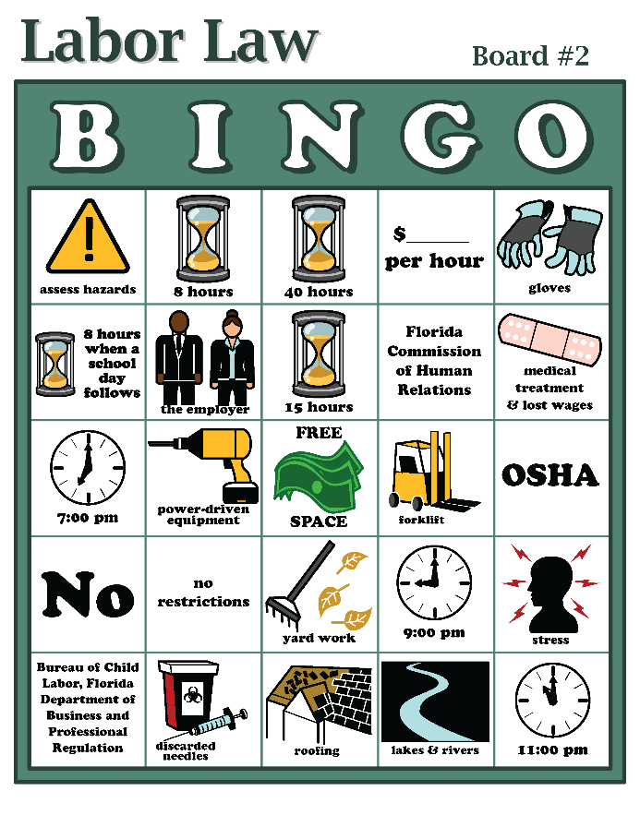
Know Your Rights
Labor Law Bingo Game

Slide 16
Know Your Rights: Main Points
OSHA laws protect workers from job hazards. Employers must provide a safe and healthy workplace, training, and safety equipment.
Tell your supervisor right away if you’re injured at work! You can’t be fired for reporting work hazards.
Departments of Labor enforce child labor laws. The Equal Employment Opportunity Commission (EEOC) protects workers from discrimination and harassment at work.
Child labor laws protect teens from working too long, too late, too early, or in certain dangerous jobs.
Young people have rights and responsibilities at work.

Slide 17
Finding Hazards
Lesson 2

Slide 18
Job Hazards
A job hazard is anything at work that can hurt you either physically or mentally.
Some are obvious (easily seen), but others are not. Some hazards can hurt you now, while others may cause health problems in the future.
Safety hazards can cause immediate injuries
Knives, hot grease
Chemical hazards are gases, vapors, liquids, or dusts that can harm your body
Cleaning products, pesticides

Slide 19
Job Hazards (continued)
Biological hazards are living things that can cause sickness or disease, such as HIV/AIDS, hepatitis, tuberculosis.
Bacteria, viruses
Other health hazards are other harmful things that can injure you or make you sick.
Noise, radiation, repetitive movements, heat, cold, stress, harassment

Slide 20
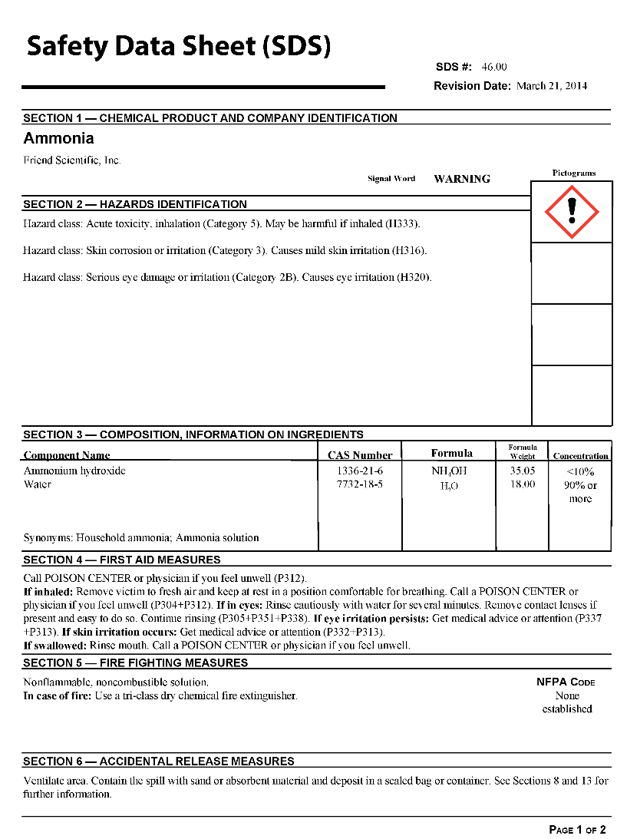
What is an SDS?
Safety Data Sheet (SDS)
Information sheets that manufacturers must send to companies along with their chemical products
An SDS tells you:
What is in the product
How it can harm you
How to protect yourself

Slide 21
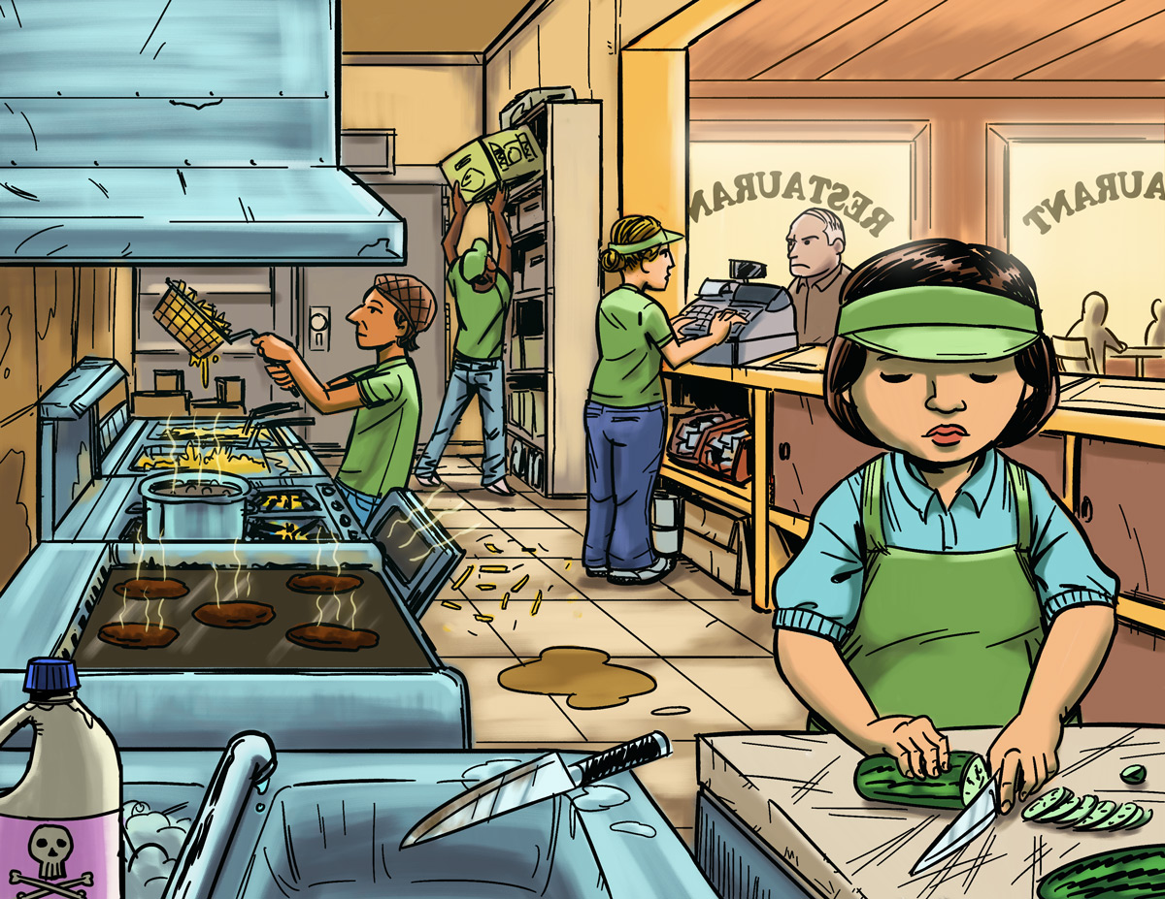
Find The Hazards: Fast Food Restaurant
a
Illustrated Workplaces

Slide 22
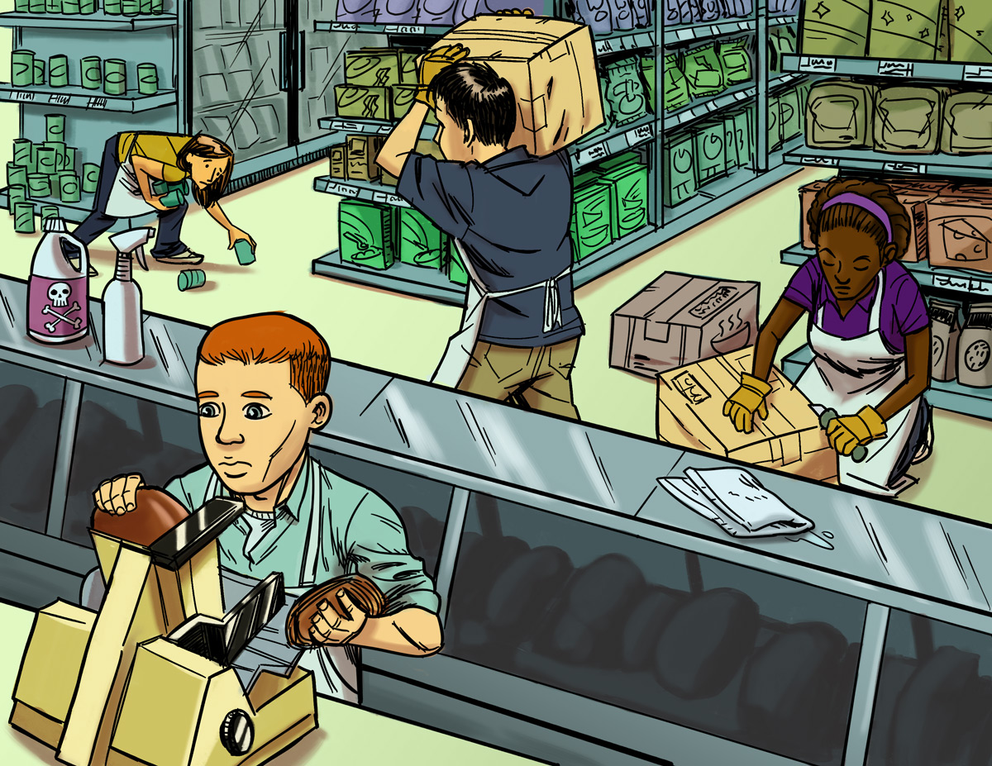
Find The Hazards: Grocery Store
a
Illustrated Workplaces

Slide 23
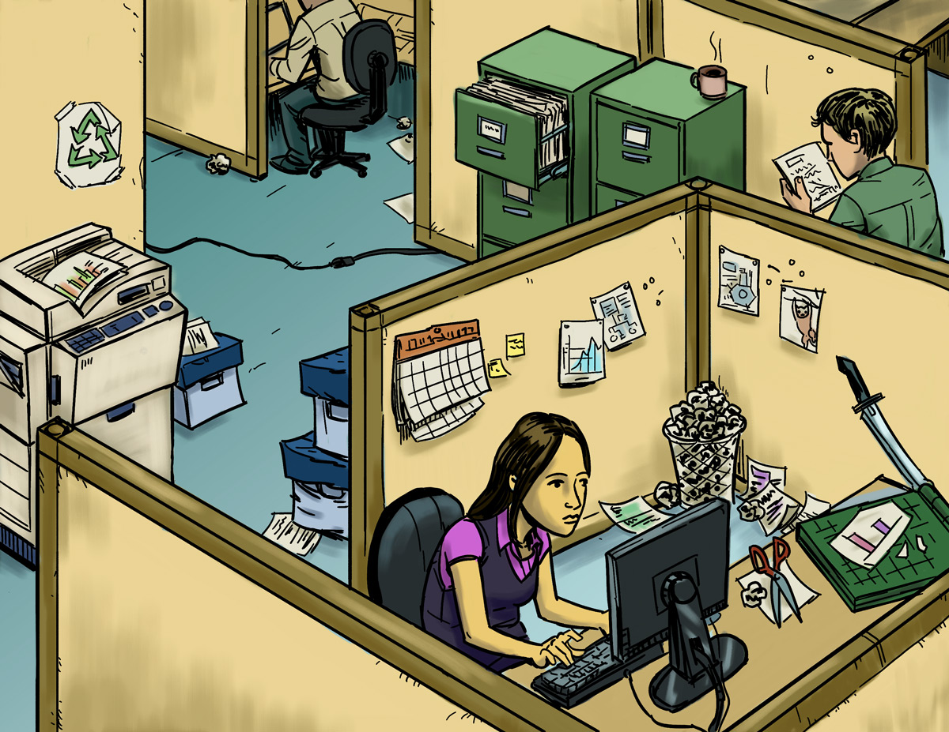
Find The Hazards: Office
a
Illustrated Workplaces

Slide 24
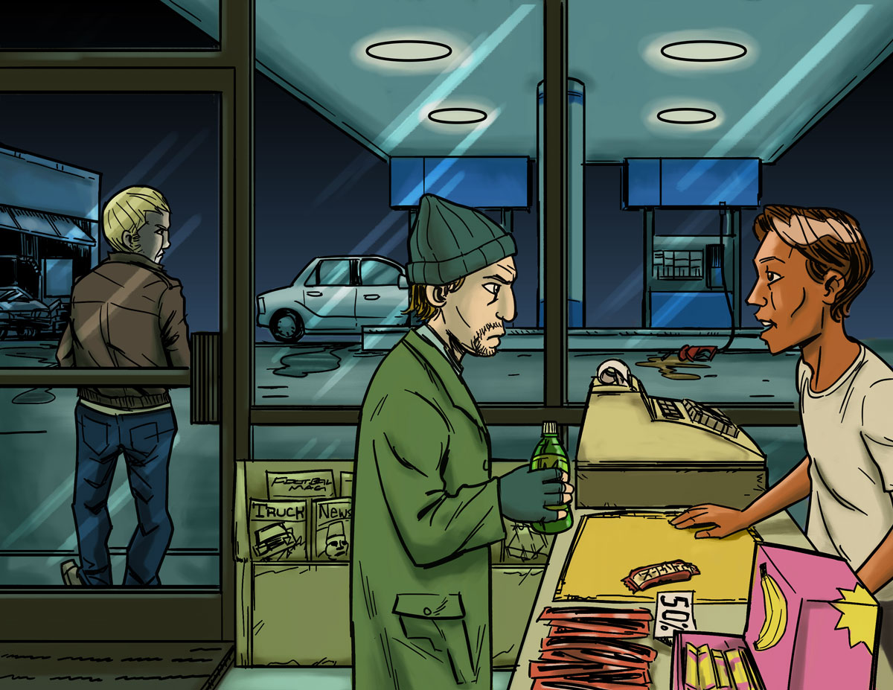
Find The Hazards: Gas Station
a
Illustrated Workplaces

Slide 25
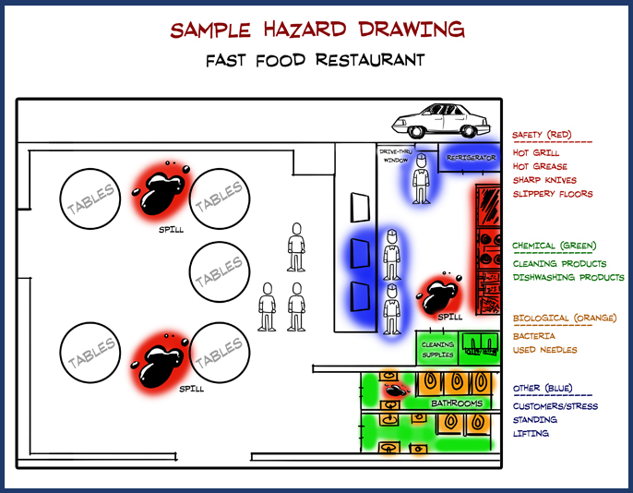
Hazard Mapping Activity

Slide 26
Finding Hazards: Main Points
All workplaces have hazards. A job hazard is anything at work that can hurt you, physically or mentally.
Some job hazards are obvious (easily seen), but others are not. Some hazards can hurt you now, while others may cause health problems in the future.
To be safe on the job, you must identify different types of hazards.
People have a right to know about chemicals and other hazardous substances in their workplaces! When using a new chemical, read labels and check the SDS (Safety Data Sheet).
An SDS tells you what is in a chemical product, how it can harm you, and how to protect yourself.

Slide 27
Making the Job Safer
Lesson 3

Slide 28
Controlling Hazards
a
Remove
the Hazard
$2000
(for example, use safer
chemicals, use a machine guard)
Improve Work
Policies & Procedures
$1000
(for example, conduct training,
assign enough people to do the job)
Wear Personal Protective Equipment (PPE)
$500
(for example, wear gloves, use a respirator)

Slide 29
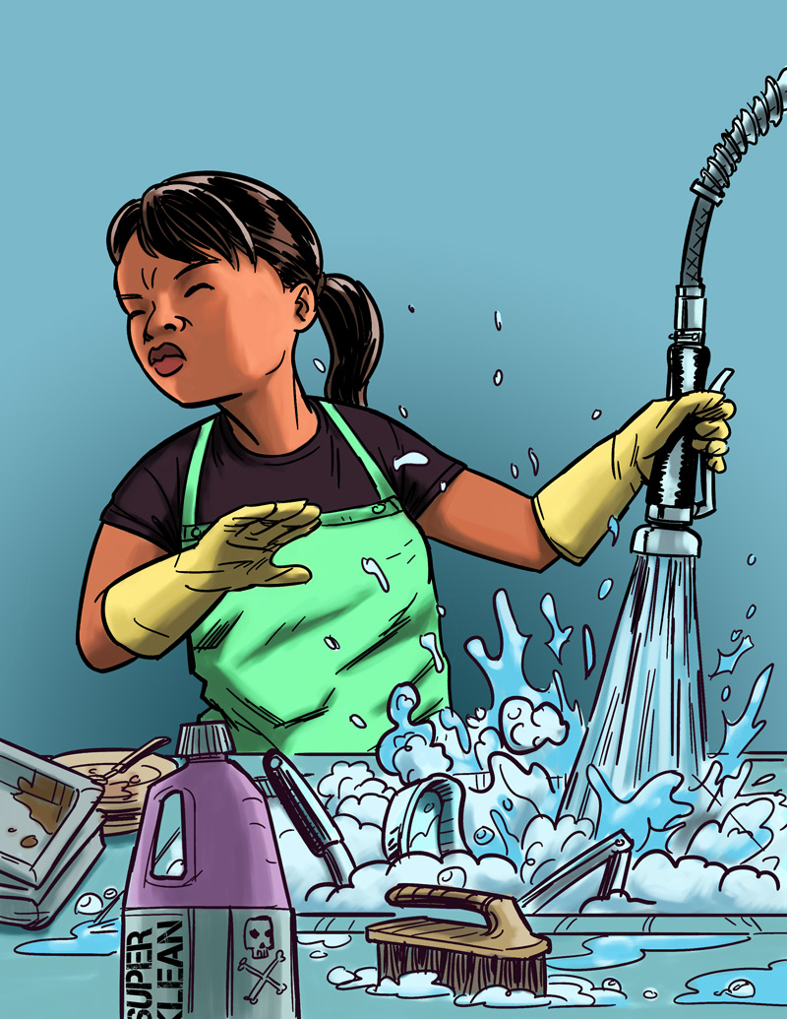
Eliminating or Reducing Hazards
Jasmin’s Story
Job: Hospital dishwasher
Hazard: Chemical dishwashing solution
Injury: Chemical burn to the eye
$25,000 Safety Pyramid Game

Slide 30
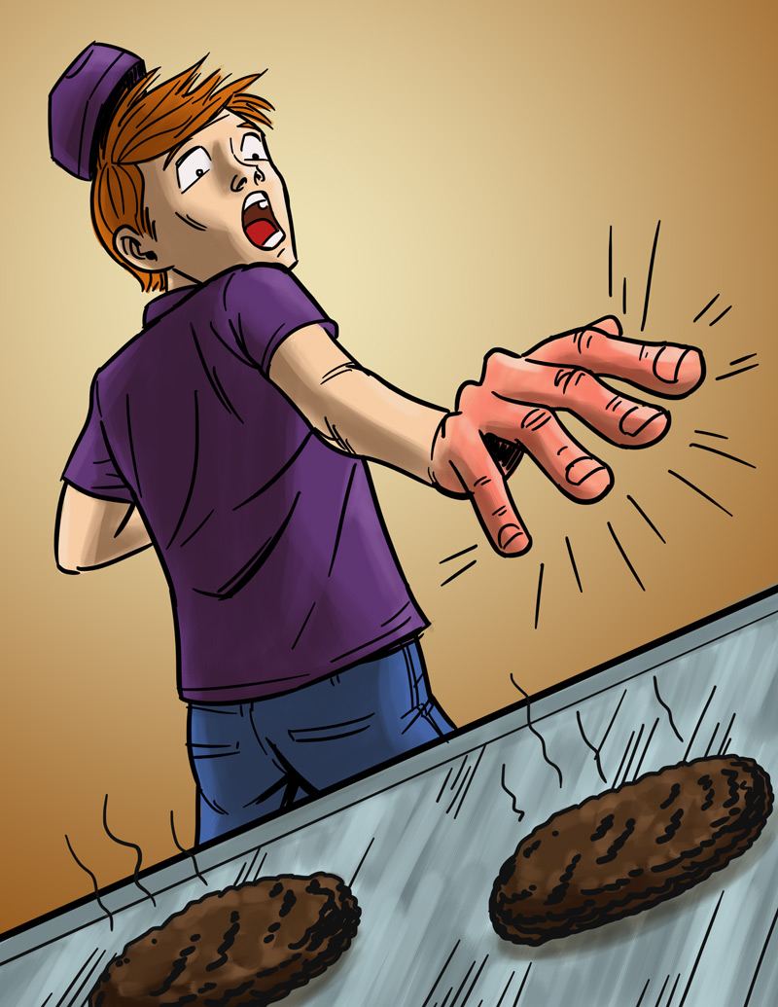
Eliminating or Reducing Hazards
Will’s Story
Job: Fast food worker
Hazard: Hot grill
Injury: Burned hand
$25,000 Safety Pyramid Game

Slide 31
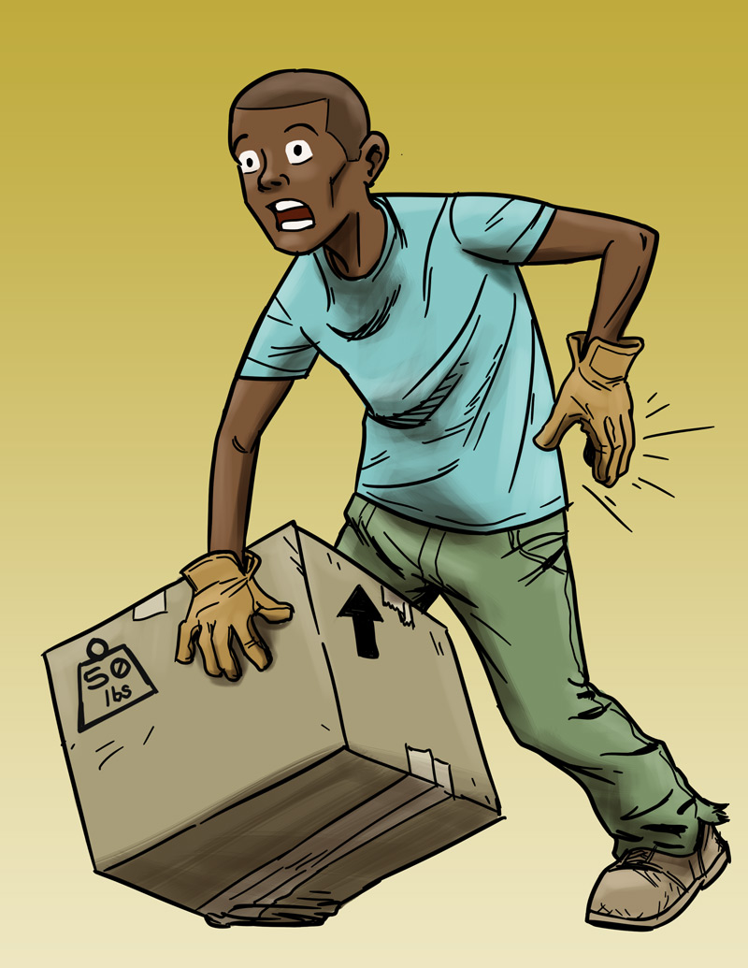
Eliminating or Reducing Hazards
Andre’s Story
Job: Grocery store clerk
Hazard: Lifting heavy boxes
Injury: Back strain
$25,000 Safety Pyramid Game

Slide 32
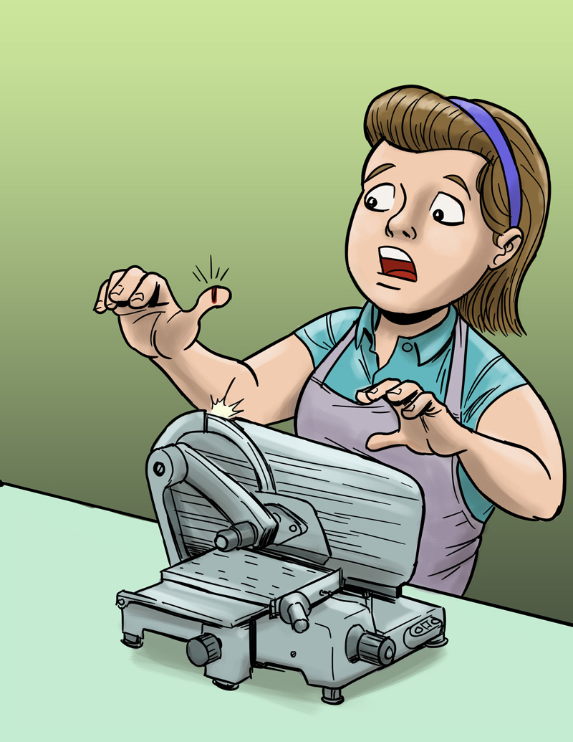
Eliminating or Reducing Hazards
Molly’s Story
Job: Grocery store deli clerk
Hazard: Meat slicer
Injury: Cut finger
$25,000 Safety Pyramid Game

Slide 33
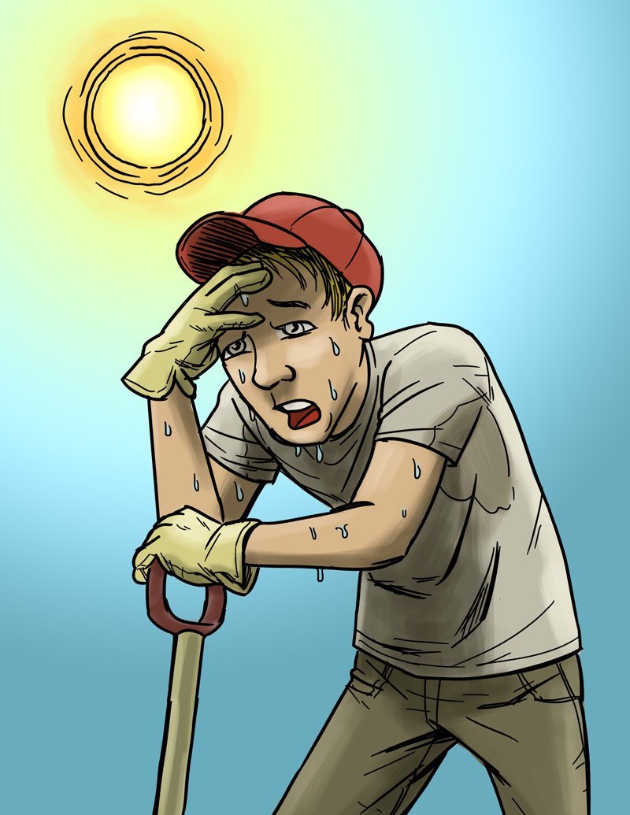
Eliminating or Reducing Hazards
Chris’s Story
Job: City public works employee
Hazard: Excessive heat
Injury: Heat stroke
$25,000 Safety Pyramid Game

Slide 34
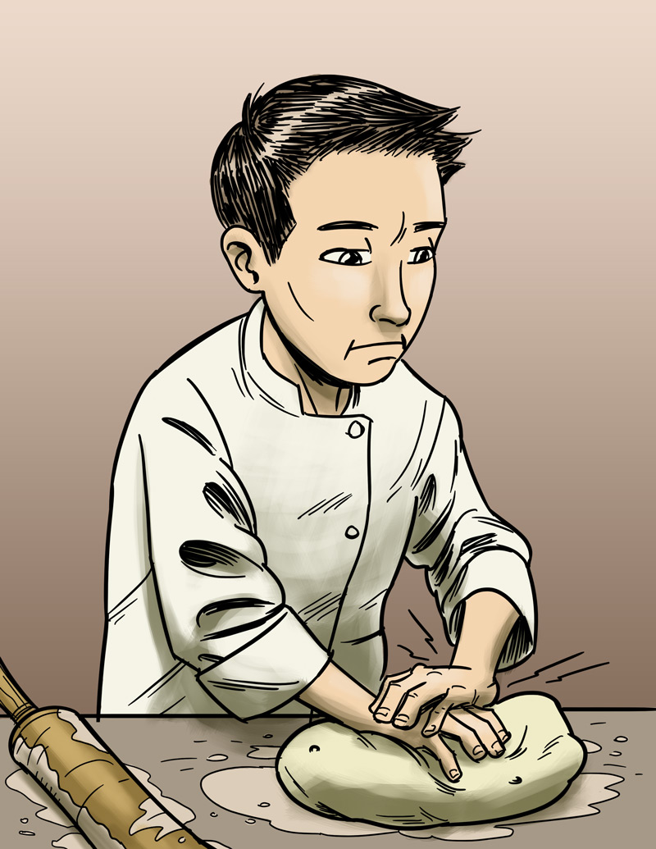
Eliminating or Reducing Hazards
James’s Story
Job: Pizza shop employee
Hazard: Repetitive motion
Injury: Hand, back injury
$25,000 Safety Pyramid Game

Slide 35
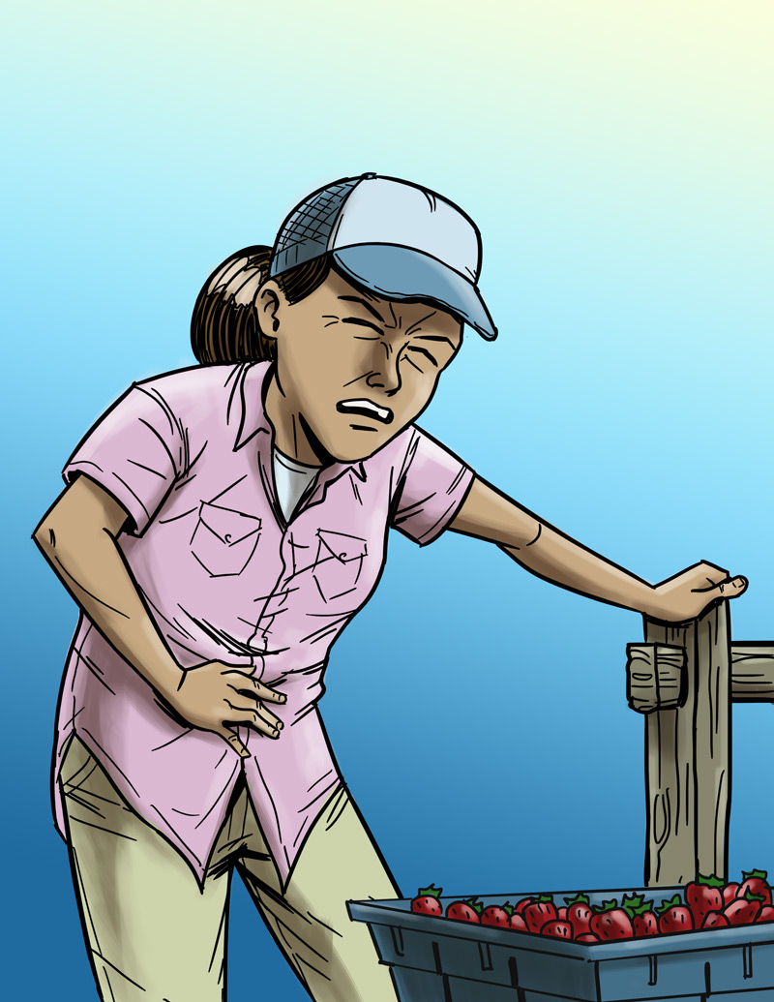
Eliminating or Reducing Hazards
Maria’s Story
Job: Farm worker
Hazard: Pesticide/chemical exposure
Injury: Illness due to poisoning
$25,000 Safety Pyramid Game

Slide 36
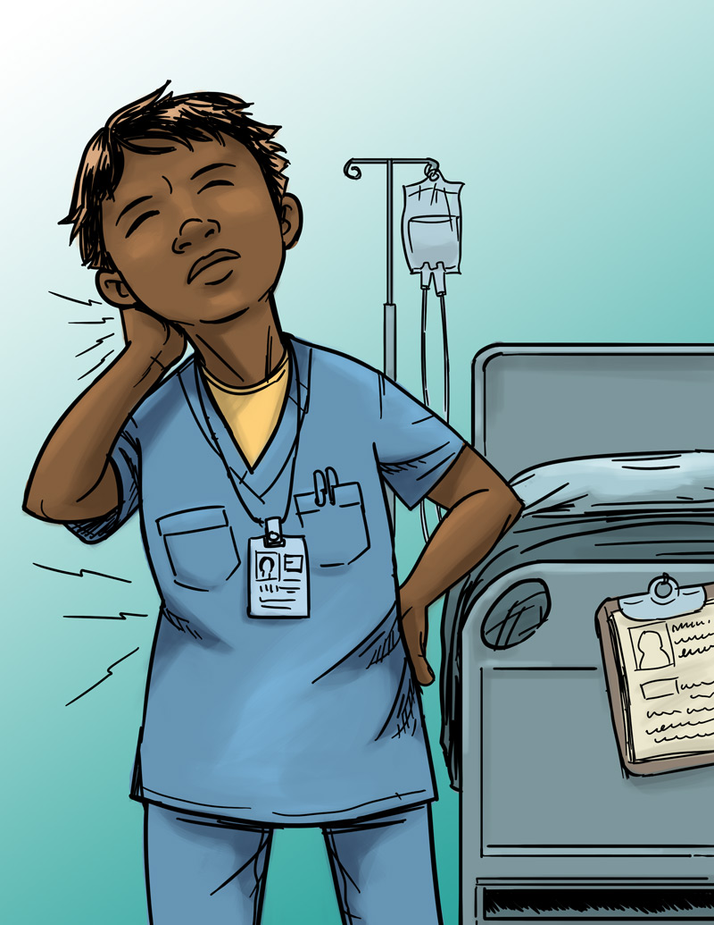
Eliminating or Reducing Hazards
Jada’s Story
Job: Nursing aide
Hazard: Heavy lifting
Injury: Back, neck, and shoulder pain
$25,000 Safety Pyramid Game

Slide 37
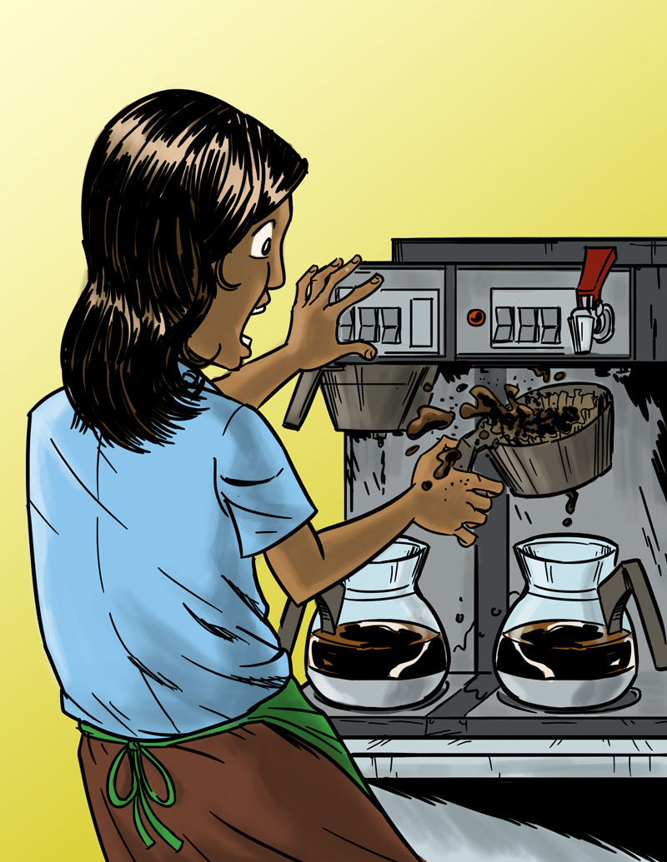
Eliminating or Reducing Hazards
Anita’s Story
Job: Barista
Hazard: Hot liquids
Injury: Burn
$25,000 Safety Pyramid Game

Slide 38
Making the Job Safer: Main Points
The best way to prevent a workplace injury or illness is to remove the hazard. If this can’t be done, then hazards can be controlled through work policies and procedures or the use of PPE (personal protective equipment), such as a respirator or hearing or eye protection.
Personal protective equipment is not usually the best way to protect workers because the hazard is still there, and because the equipment has to fit right and be used every time.
Most workplace injuries and illnesses are caused by unsafe environments—not human error.
A good way to think about addressing hazards in the workplace is, “Fix the workplace, not the worker.”

Slide 39
Emergencies at Work
Lesson 4: Part 1

Slide 40
Emergencies at Work
What is an emergency at work?
An unplanned event that harms or threatens employees, customers, or the public; that shuts down business operations; or that causes physical or environmental damage.

Slide 41
Emergency Action Plans
Many workplaces need an emergency action plan. Workers should receive training on the plan.
The plan should include information about
Different emergencies and how to respond
Locations of meeting places
Evacuation routes
Emergency equipment and alert systems
Key personnel (who’s in charge)
Procedures to follow when someone is injured
Individual worker responsibilities
Practice drills

Slide 42
Emergencies at Work: Main Points
An emergency is any unplanned event that poses a threat.
It is important to know—and to practice—what to do if a crisis happens at work.
Your employer has a legal duty to train you and to let you know what to do in an emergency.
A workplace emergency action plan should include information about emergencies and how to respond to them.

Slide 43
Taking Action
Lesson 4: Part 2

Slide 44
How to Approach a Workplace Problem
Steps in Problem Solving
Define the problem.
Get advice.
Choose your goals.
Know your rights.
Decide the best way to talk to the supervisor.
Contact a state or federal Wage & Hour Division or OSHA for help, if necessary.
Talk to a teacher, parent, co-worker, or other trusted adult.

Slide 45
Taking Action: Main Points
Steps for approaching a workplace problem include: defining the problem; getting advice; choosing goals; knowing your rights; talking to your supervisor.
If you don’t feel comfortable talking with your boss, speak with a trusted adult, OSHA, or another agency.
Trust your instincts! Don’t be afraid to speak up if you have a problem at work!

