Slide 1





Protecting Temporary Workers: Best Practices for Host Employers
INSERT DATE
Slide Deck for Use by Staffing Companies to Educate Host Employers
Link to document:
Protecting Temporary Workers: Best Practices for Host Employers
QR code for document:
Notes:
Notes to presenters:
This slide deck complements the Protecting Temporary Workers: Best Practices for Host Employers document and is intended to be used by staffing companies to educate their host employer clients about the best practices included in the document.
This slide deck includes suggested talking points in the notes section. Additional notes for presenters to keep in mind are in [brackets]. “[Click]” indicates when the presenter should click to activate the custom animation that is programmed into the deck.
The document can be accessed by clicking on the link or scanning the QR code on this slide.
Talking points:
Thank you for joining us today
Speaker introduction/s
I/we are excited to introduce you to a new document, entitled “Protecting Temporary Workers: Best Practices for Host Employers.”
This document was developed by the National Occupational Research Agenda (NORA) Services Sector Council Contingent Workers Workgroup in partnership with the National Institute for Occupational Safety and Health (NIOSH), the American Staffing Association (ASA), the American Society of Safety Professionals (ASSP), and the Safety and Health Assessment and Research for Prevention (SHARP) program within Washington State’s Department of Labor and Industries.
Before we introduce you to this new document, we want to provide a brief introduction to NORA as well as a brief history on how this document came to be.

Slide 2
National Occupational Research Agenda (NORA)
A partnership program, stewarded by NIOSH, that aims to stimulate innovative research and improved workplace safety and health practices
10 sectors and 7 cross-sectors
Each sector/cross-sector has a Council.
Industry Sectors
Agriculture, Forestry and Fishing
Construction
Healthcare and Social Assistance
Manufacturing
Mining
Oil and Gas Extraction
Public Safety
Services
Transportation, Warehousing and Utilities
Wholesale and Retail Trade
Safety and Health Cross-Sectors
Cancer, Reproductive, Cardiovascular and Other Disease Prevention
Hearing Loss Prevention
Immune, Infectious and Dermal Disease Prevention
Musculoskeletal Health
Respiratory Health
Traumatic Injury Prevention
Healthy Work Design and Well-Being
Notes:
NORA is a partnership program, stewarded by NIOSH, that aims to stimulate innovative research and improved workplace safety and health practices. NORA consists of ten industry sectors based on major areas of the U.S. economy, and seven safety and health cross-sectors organized according to the major safety and health issues affecting the U.S. working population.
Each of the 17 sectors and cross-sectors has a Council.
NORA Councils are a national venue for individuals and organizations with common interests in occupational safety and health to come together. Councils aim to:
Develop and maintain a research agenda related to their sector or cross-sector. The 17 research agendas comprise the workplace safety and health research agenda for the nation.
Once the agendas are in place, each NORA Council works to advance the objectives set forth in the agenda through information sharing, partnerships, and enhancing dissemination and implementation of evidence-based practices.
The goal of NORA is to promote widespread adoption of improved workplace safety and health practices.
One of the five main objectives in the research agenda for the Services Sector is to prevent and reduce work-related injuries and illnesses among contingent workers.

Slide 3

Contingent Workers Workgroup
Goal = To raise awareness about safety and health risks and protective factors for temporary agency workers
Notes:
To advance the NORA Services Sector objective to reduce work-related injuries and illnesses among contingent workers, the Council formed a Contingent Workers Workgroup in July 2018.
The goal of the Contingent Workers Workgroup is to raise awareness about safety and health risks and protective factors for temporary agency workers.
Temporary agency workers (hereafter temporary workers) are those who are paid by a staffing company to and assigned to work for a host employer, including both short- and long-term assignments.

Slide 4
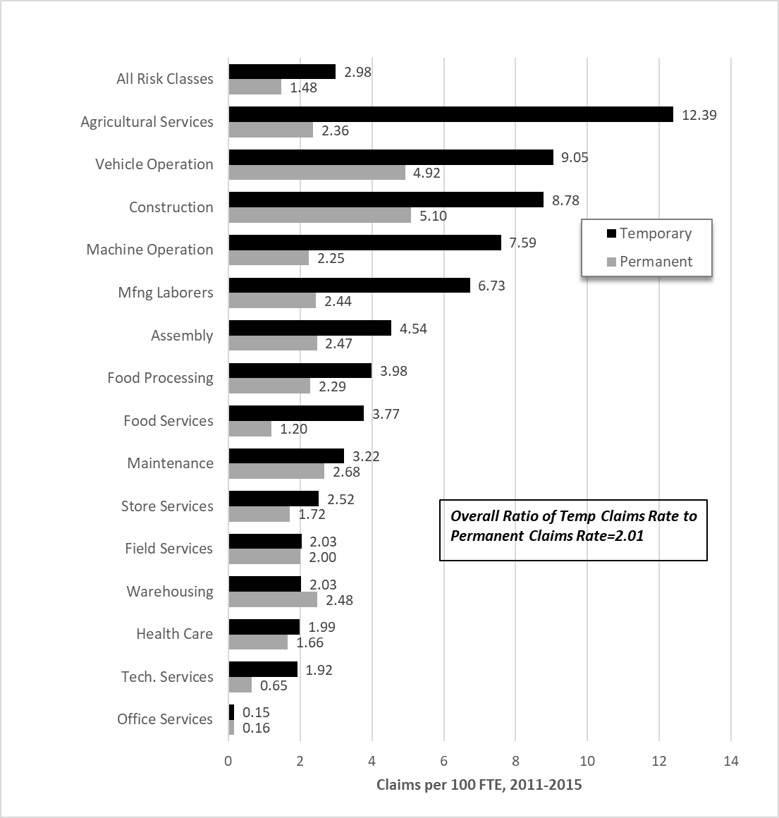
Evidence of Increased Risk
Lost workday claims rate per 100 FTE, by risk class, 2011-2015, WA
Potential contributing factors:
Hazardous jobs
Inexperienced and new to the job
Language and cultural barriers
Fear of speaking up
Employer confusion about OSH responsibilities
Lack of client site-specific training
Foley M. American Journal of Industrial Medicine. 2017;60(10):841-851.
Notes:
There is an increasing body of evidence suggesting temporary workers may be at an increased risk of fatal and non-fatal occupational injuries.
Much of the research that’s been conducted to date is looking at workers’ compensation claims.
The graph shows data from a recent study conducted in WA state in which you can see the black bars, indicating claim rates for temporary workers, were greater than those for permanent workers (those who are directly employed by host employers) across almost all risk classifications. [Note: For the “All Risk Classes” bars, rates have been adjusted to control for differences in the proportion of temporary and permanent workers in each of the individual risk classes. For example, in Office Services there is a greater proportion of temporary workers (46%) compared to permanent workers (31%). Adjustment for these differences corrects for the bias that would occur if the claims rate was simply averaged across all risk classes.]
Other studies looking at workers’ compensation claims have also found higher rates of claims among temporary workers compared to permanent workers.
Many factors may contribute to an elevated risk of work-related injuries among temporary workers, including these:
Temporary workers may be assigned to more hazardous jobs.
Temporary are often inexperienced and new to the job and therefore they may be unfamiliar with the work operations, associated hazards, and protective practices (Bena et al., 2013; Breslin & Smith, 2006; Boden et al., 2016; Rousseau & Libuser, 1997; Thebaud-Mony, 1999).
Temporary workers may have language and cultural barriers.
Temporary workers may not feel comfortable speaking up about safety and health concerns or reporting work-related injuries due to fear of job loss or other negative repercussions.
Given temporary workers have two employers, there may be confusion as to which employer is responsible for different aspects of workplace safety and health, as well as just an overall lack of understanding regarding how to keep workers safe in a dual employment situation.
Finally, temporary workers may not receive sufficient client site-specific safety and health training because host employers often want to onboard them and get them working as quickly as possible.

Slide 5
Costs of Inadequate Safety Controls
Production disruptions
High injury costs
Absenteeism rates
Poor quality
Negative media exposure
OSHA fines
  See example OSHA News Releases
Notes:
Whether permanent or temporary, unsafe working conditions, unclear job assignments, inadequate training, and poor hazard communication put all workers at risk for being injured or becoming ill at work, which can negatively impact a company’s bottom line.
In addition to the sometimes devastating impact of work-related injuries and illnesses on the workers themselves, injuries and illnesses can also lead to production disruptions, high injury costs and absenteeism rates, poor work quality, negative media exposure, and fines from the Occupational Safety and Health Administration (OSHA).
In the event of a temporary worker injury or illness, OSHA could hold both employers responsible for violations of workplace standards.
In some cases, the host employer has been fined more heavily for violations compared to the staffing company because they are the supervising employer.
There are numerous OSHA news releases related to injured temporary workers. [The hyperlink will bring you to a list of all OSHA news releases involving temporary workers.]

Slide 6
Three-Pronged Approach
Safety awareness campaigns focusing on
  Host employers
  Staffing companies
  Temporary workers
Notes:
In order to raise awareness about temporary worker risks and protective factors, the Contingent Workers Workgroup has set out to conduct a series of awareness raising campaigns focusing on host employers, staffing companies, and temporary workers.
[Click] The workgroup decided to start with a campaign focused on host employers because they control and supervise the work and therefore may have the greatest ability to protect the safety and health of temporary workers.

Slide 7
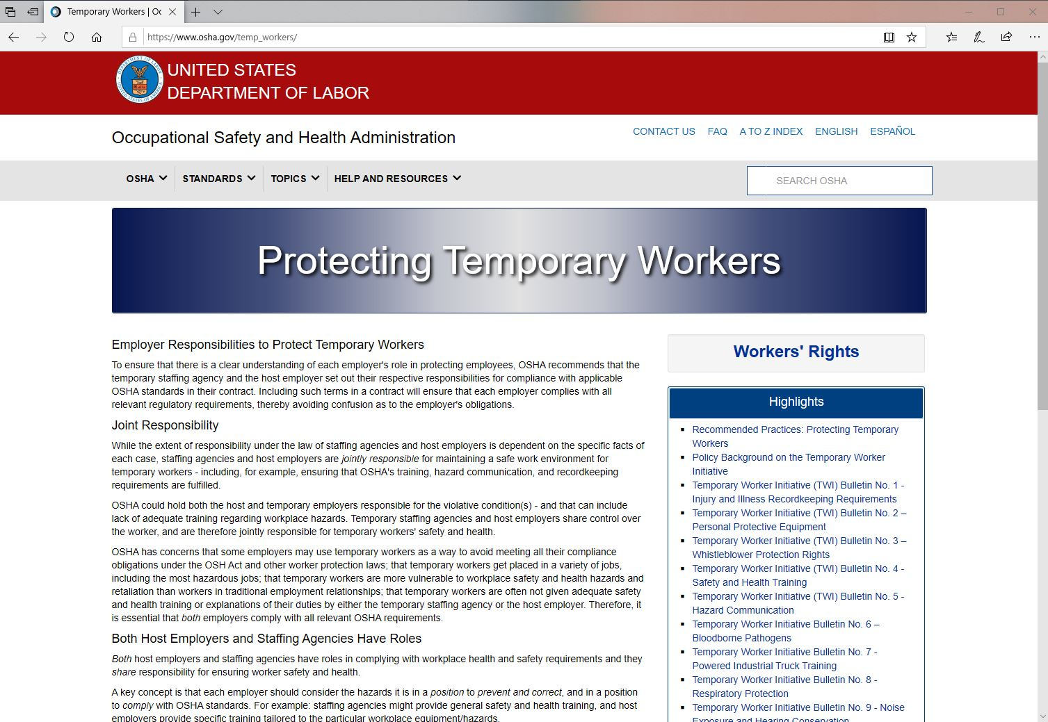
OSHA Protecting Temporary Workers Webpage
Notes:
The Contingent Workers Workgroup aims to build from and expand on the guidance issued through the OSHA Temporary Worker Initiative, which was launched by OSHA in 2013 in response to the high rates of injuries among temporary workers.
The OSHA Temporary Worker Initiative has issued a series of guidance documents and bulletins pertaining to the joint safety and health responsibilities of staffing companies and host employers.
Taking the OSHA Temporary Worker Initiative guidance into consideration, the Contingent Workers Workgroup identified a need for a more in-depth set of best practices for host employers to follow to ensure they are going beyond compliance to protect the safety and health of temporary workers, which leads us to the document we are excited to introduce to you today.

Slide 8
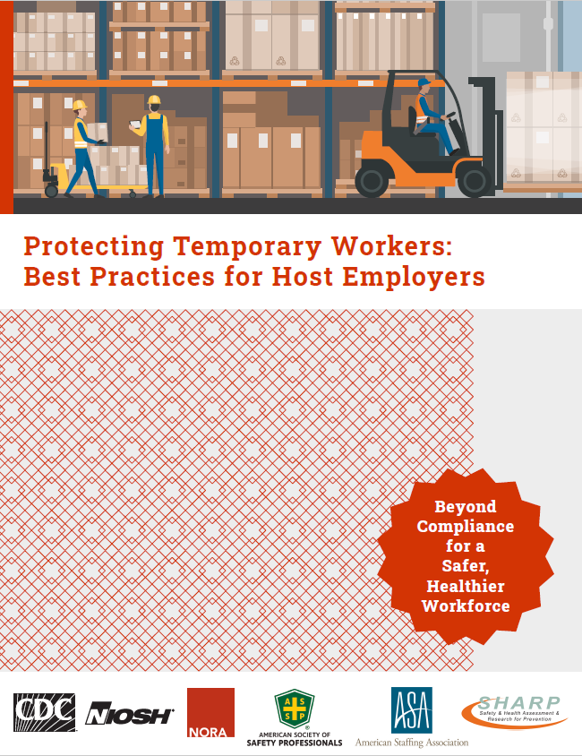
Document Development Process
Notes:
The initial draft of “Protecting Temporary Workers: Best Practices for Host Employers” was created based on:
The OSHA Temporary Worker Initiative guidance documents and bulletins;
Resources developed by the National Safety Council and Business and Legal Resources; and
The knowledge and expertise of the Contingent Workers Workgroup members.
The workgroup solicited feedback on the initial draft from host employers and other stakeholders, and modifications were made based on the feedback received.
The co-branding partners, including ASA, ASSP, and the SHARP program also provided feedback, which was incorporated into the final draft.
This document is intended to apply to host employers across all industries who employ (or are planning to employ) temporary workers at their worksites.
We note a few important disclaimers at the beginning of the document, including these:
First, this is considered a general set of best practices and is not meant to replace the formal elements of an OSH program or legal requirements.
Second, the best practices may need to be modified based on the specific facts of each case. For instance, when a host employer is contracting with multiple staffing companies or rare cases in which the staffing company is the supervising employer.
Third, workplace safety and health laws vary in states with OSHA-approved state plans, so it’s important to check state-specific laws.

Slide 9
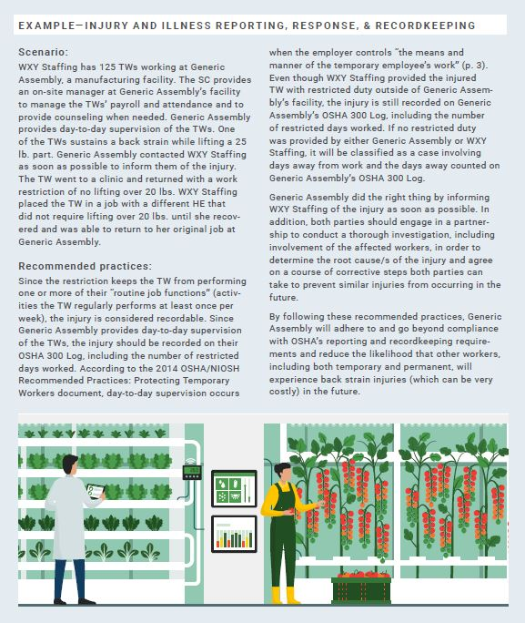
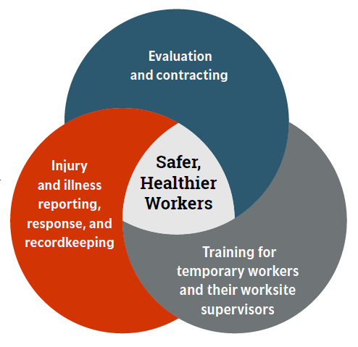
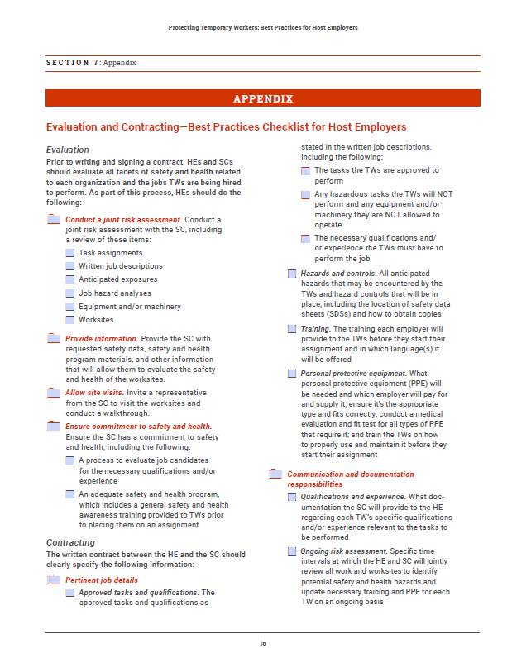
Document organization
Notes:
In this document, the best practices are organized into three sections, which are represented in clockwise order in this Venn diagram:
Evaluation and contracting, which covers how to evaluate and address workplace safety and health in a written contract
Training for temporary workers and their worksite supervisors, and
Injury and illness reporting, response, and recordkeeping
By following these best practices and going beyond compliance with OSHA laws and regulations, host employers can do their part to ensure a safer and healthier workforce.
[Click] Each section includes a set of best practices followed by a scenario. This scenario presents a situation or problem faced by a host employer and a summary of actions the host employer should take.
[Click] There are also checklists related to each of the three main sections of the document included in the appendix. These checklists can be printed or completed electronically.
Finally, at the end of the document there are links to additional resources, including the OSHA Temporary Worker Initiative bulletins.
Now, I/we will go through and give you a sample of the content included in each of the three sections of the document.

Slide 10
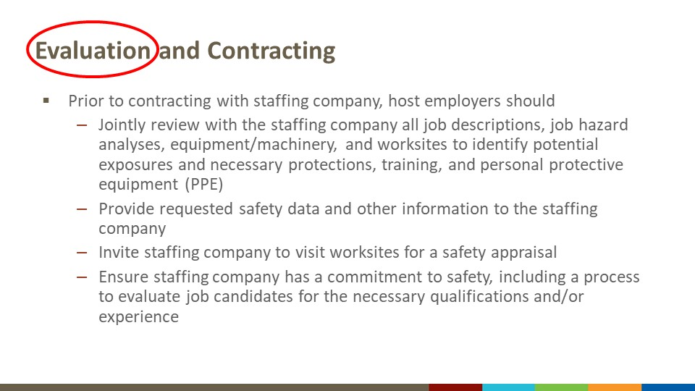
Evaluation and Contracting
Notes:
In terms of evaluation, prior to writing and signing a written contract, host employers and staffing companies should evaluate all facets of safety and health related to each organization and the jobs temporary workers are being hired to perform. As part of this process, host employers should include the following steps:
Jointly review with the staffing company all job descriptions, job hazard analyses, equipment and/or machinery, and worksites to identify potential hazards and the necessary training and personal protective equipment (PPE) for each temporary worker.
Provide the staffing company with requested safety data and other information that will allow them to evaluate the safety and health of the worksite.
Invite a representative from the staffing company to visit the worksite and conduct a walk-through to assess the safety conditions, observe workers engaged in their tasks, and see your safety program in action.
Ensure the staffing company has a commitment to safety and health, including having a process in place to evaluate job candidates for the necessary qualifications and/or experience necessary for the tasks they will perform. Review the staffing company’s safety and health program materials to ensure they are adequate. At a minimum, this training should cover specific details of the assigned job, a basic overview of employer responsibilities and workers' rights and responsibilities, and common hazards and protections including any PPE provided by the staffing company. If the general safety and health awareness training provided by the staffing company is not sufficient, the host employer should document and communicate this to the staffing company with a recommendation for what additional training the staffing company should provide.

Slide 11
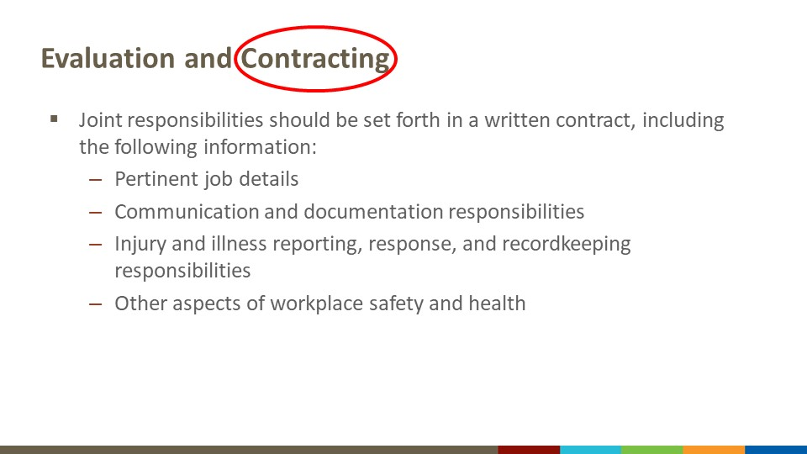
Evaluation and Contracting Continued
Notes:
The division of responsibilities for safety and health between the staffing company and the host employer should be reviewed regularly and set forth in a written contract to encourage proper implementation of and accountability for all pertinent safety and health protections. The written contract should clearly specify the following information:
Pertinent job details, including the tasks temporary workers are approved to perform and the necessary qualifications and/or experience they must have to perform the job; all anticipated hazards and the controls that will be in place; the training each employer will provide; and the required PPE and which employer will pay for and supply it.
Communication and documentation responsibilities of both employers pertaining to worker qualifications and/or experience relevant to the tasks to be performed, ongoing risk assessment, changes to job tasks or hazards, training, and OSHA investigations.
Injury and illness reporting, response, and recordkeeping responsibilities of both employers.
Other aspects of workplace safety and health, such as which employer is responsible for providing direct supervision of the temporary workers and responsibilities related to medical surveillance and monitoring when necessary.

Slide 12

Scenario: Evaluation and Contracting
Notes:
This scenario involves a host employer, MPQZ Logistics, Ltd. and a staffing company, Prize Staffing.
[Read scenario]: Jean Finder, a hiring manager with MPQZ Logistics, Ltd, is working on securing a temporary staffing provider. She knows her company, which recently opened a new warehouse and distribution center, needs temporary workers for picking, packing, and crating services for its busy season. Jean had hoped to quickly finalize an agreement with Prize Staffing, Inc., a staffing company that provides a wide range of temporary workers, including many to other distribution centers in the area. However, Prize Staffing reached out with requests for internal documents; a revised, lengthier contract that included detailed job descriptions of what tasks temporary workers will and will not be permitted to do; and a request to inspect the MPQZ Logistics warehouse before an agreement is signed. Jean has been in touch with other staffing companies that have offered similar services and competitive prices, and they seemed easier to onboard.
According to the best practices, Jean should do the following:
Provide Prize Staffing with the requested safety data, including an Experience Modification Rate letter from her company’s workers’ compensation insurer, OSHA 300 Logs for the last 3 years, and a copy of her company’s safety program materials.
Invite Prize Staffing to visit the warehouse location in order to appraise the safety conditions and to identify the necessary training and PPE requirements for the temporary workers.
Request a copy of Prize Staffing’s safety and health management program materials, including the general safety and health awareness training Prize staffing provides to new temporary workers.
Fully address each employer’s respective responsibilities in a written contract, including the process for modifying job tasks when there is a change of assignment, including providing an updated written job description to the staffing company and the temporary workers, providing an updated job hazard analysis to the staffing company, and updating PPE and training requirements accordingly.

Slide 13
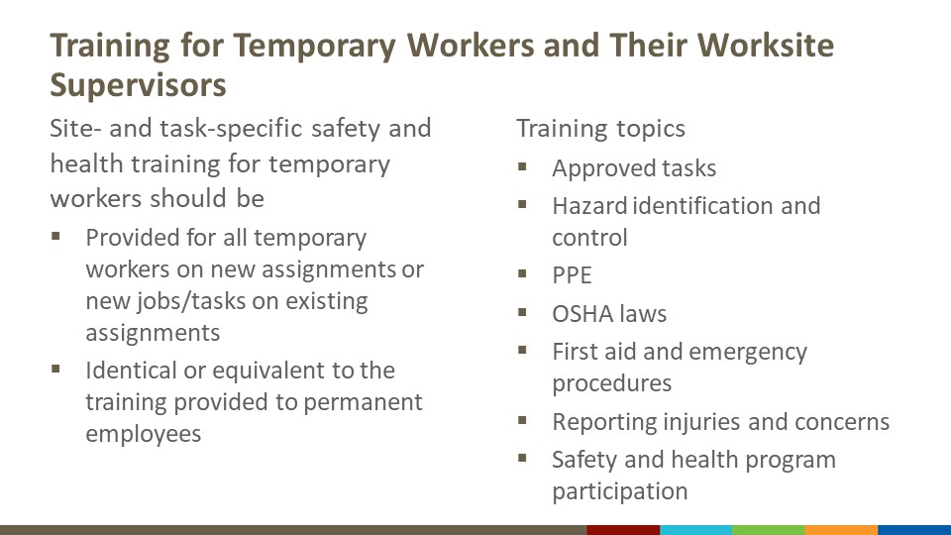
Training for Temporary Workers and their Worksite Supervisors
Notes:
According to OSHA, in most cases the host employer is responsible for providing site- and task-specific safety and health training, and the staffing company is responsible for providing general safety and health awareness training.
Site- and task-specific safety and health training should be provided for all temporary workers before they start new assignments or start new jobs/tasks on existing assignments and should be identical or equivalent to the training provided to permanent employees doing the same or similar work.
The document covers in detail the topics that should be included in site- and task-specific training for temporary workers, including the following:
The tasks temporary workers are approved to perform (including any tasks they are not allowed to perform and equipment or machinery they are not allowed to operate), with an emphasis that they should not perform any new tasks without the host employer first obtaining approval from the staffing company.
How to recognize, reduce, and/or eliminate control site- and task- specific hazards, including the location of safety data sheets (SDSs) for any chemical hazards present.
Required PPE, including who will pay for and supply it and provide training on how to appropriately use it (as well as fit testing if needed).
Employer responsibilities and workers’ rights and responsibilities under OSHA law, emphasizing that temporary workers have the same rights and responsibilities as non-temporary workers.
First aid and emergency procedures.
Procedures for reporting injuries, illnesses and close calls and to communicate safety and health concerns, as well as what to expect after reporting.
How temporary workers can participate in the host employer’s safety and health program, including safety meetings/committees, toolbox talks, scheduled trainings, etc.

Slide 14
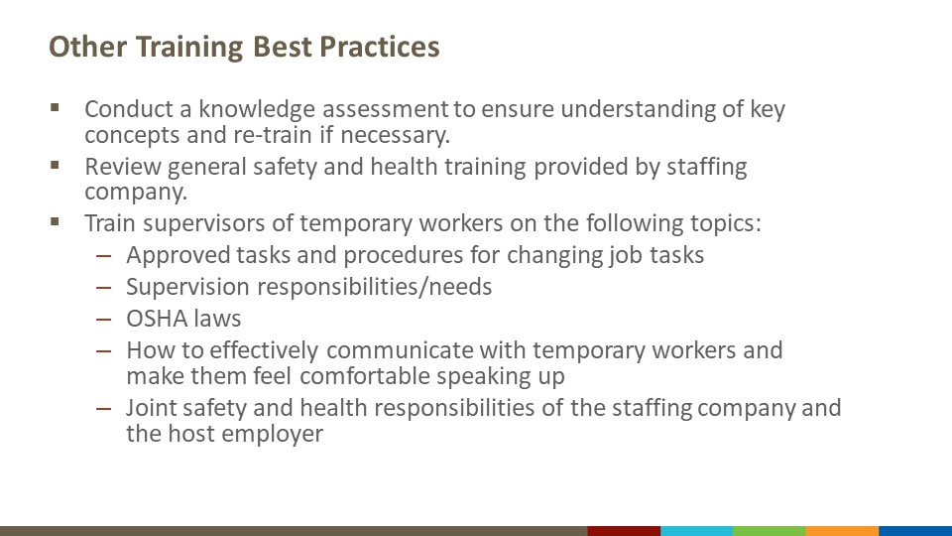
Other Training Best Practices
Notes:
Additional training best practices are to:
Have workers complete a knowledge assessment after training to ensure their understanding of key concepts and re-train if necessary.
Review the general safety and health training provided by the staffing company to determine adequacy.
Train supervisors of temporary workers on the following topics:
The tasks the temporary workers are approved to perform (as well as those they are not approved to perform) and procedures for changing job tasks as stated in the written contract.
Their responsibility to provide temporary workers with the same supervision provided to non-temporary workers doing the same or similar work, as well as the potential need to provide extra mentoring and supervision to new temporary workers who may be inexperienced with the assigned tasks and unfamiliar with the worksite.
OSHA laws pertaining to employer safety and health responsibilities and workers’ rights and responsibilities, including the Right to Refuse Work and Whistleblower Protection Rights.
How to effectively communicate with temporary workers and make them feel comfortable speaking up about safety and health incidents and concerns.
The joint safety and health responsibilities of the staffing company and the host employer as detailed in the written contract.

Slide 15
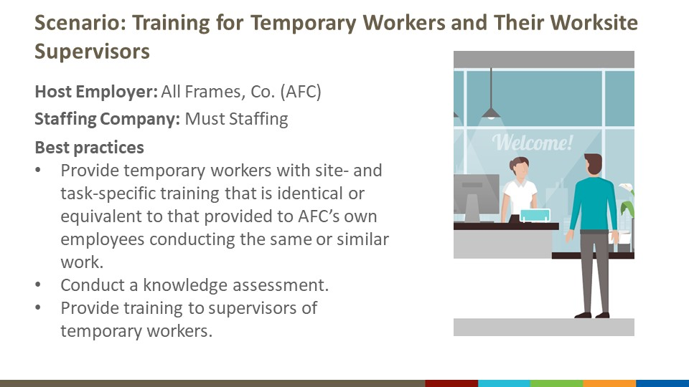
Scenario: Training for Temporary Workers and Their Worksite Supervisors
Notes:
This scenario involves a host employer, All Frames, Co., and a staffing company, Must Staffing.
[Read scenario]: A furniture manufacturer, All Frames Co. (AFC), needs machine operators in production. The company contracts with Must Staffing to provide temporary workers. Must Staffing hires ten temporary workers as power press operators and sends them to work on site at AFC. Must Staffing also hires an on-site staffing representative to coordinate payroll and other administrative functions, but this representative has no supervisory role. Before sending the temporary workers to the AFC worksite, Must Staffing plays a general safety and health awareness training video for them, including a brief section on machine guarding. At the worksite, a supervisor from AFC assigns each of the temporary workers to a particular work area and machine, instructs them to begin working on their assigned tasks, and checks on their work throughout the shift. On the assumption that the temporary workers have experience working with mechanical power presses, no site- or task-specific instruction is provided by AFC.
According to the best practices, AFC should do the following:
Provide the temporary workers with site- and task-specific training that is identical or equivalent to that provided to AFC’s own employees conducting the same or similar work. Although Must Staffing played a general safety and health awareness training video with a brief section on machine guarding, it is still necessary for the temporary workers to receive site- and task-specific training from AFC. The responsibility of providing site- and task-specific training does not shift to Must Staffing just because they hired an on-site staffing representative.
Training should include instructions on how to operate the mechanical power presses safely; how to properly don, doff, adjust, and maintain any required PPE; who to contact regarding safety and health issues or concerns; how to report work-related injuries, illnesses and close calls and what will happen after doing so; emergency procedures and how to obtain first aid; and how temporary workers can participate in AFC’s safety and health program.
Give temporary workers a knowledge assessment to ensure they understand key concepts and re-train them if necessary.
Provide training to AFC’s own employees who will be supervising and controlling the work of temporary workers, including the following topics:
Approved tasks
Process to make changes to jobs/tasks
Supervision and mentoring responsibilities
Employer responsibilities and workers’ rights and responsibilities under OSHA
How to effectively communicate with temporary workers and make them feel comfortable speaking up
Joint safety and health responsibilities of the staffing company and the host employer

Slide 16
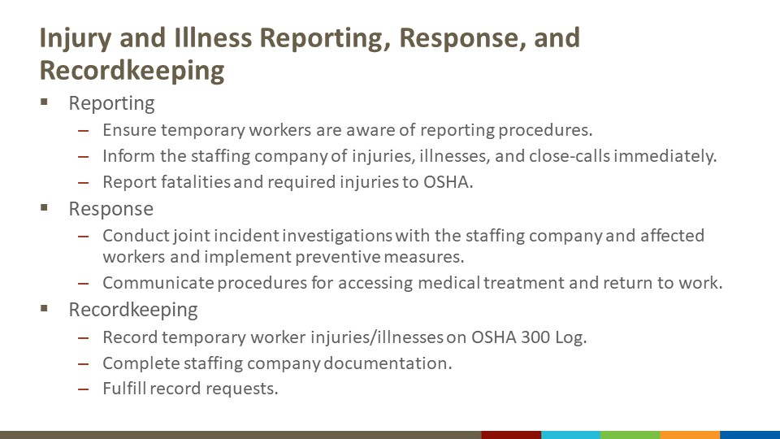
Injury and Illness Reporting, Response, and Recordkeeping
Notes:
Effective injury and illness reporting, response, and recordkeeping are vital to the prevention of future incidents.
With regards to reporting of temporary worker injuries and illnesses, host employers should do the following:
Ensure temporary workers are aware of procedures to report work-related injuries, illnesses, and close-calls and are encouraged to communicate safety and health concerns without fear of retaliation.
Inform the staffing company immediately after an injury or illness occurs.
Report fatalities and required injuries and illnesses to OSHA.
With regards to responding to temporary worker injuries and illnesses, host employers should do the following:
Conduct joint incident investigations with the staffing company and affected worker/s and implement preventive measures.
Ensure temporary workers and their supervisors are aware of the general procedures for accessing medical treatment and returning to work (if applicable) following a work-related injury or illness.
With regards to recordkeeping of temporary worker injuries and illnesses, host employers should do the following:
Record temporary worker injuries/illnesses on their OSHA 300 Log. OSHA requires that injury and illness records be kept by the employer who is providing day-to-day supervision and controlling the means and manner of the work, which in most cases is the host employer.
Complete staffing company documentation of the incident as required by the staffing company's workers' compensation carrier.
Coordinate with the staffing company to make injury and illness records available upon request of a temporary worker or worker representative as indicated in the written contract.

Slide 17
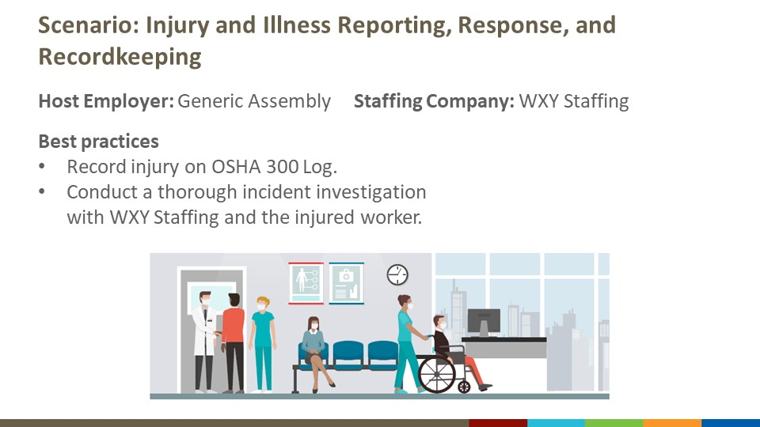
Scenario: Injury and Illness Reporting, Response, and Record Keeping
Notes:
This scenario involves a host employer, Generic Assembly, and a staffing company, WXY Staffing.
[Read scenario]: WXY Staffing has 125 temporary workers working at Generic Assembly, a manufacturing facility. The staffing company provides an on-site manager at Generic Assembly’s facility to manage the temporary workers’ payroll and attendance and to provide counseling when needed. Generic Assembly provides day-to-day supervision of the temporary workers. One of the temporary workers sustains a back strain while lifting a 25-lb part. Generic Assembly contacted WXY Staffing immediately to inform them of the injury. The temporary worker went to a clinic and returned with a work restriction of no lifting over 20 lb. WXY Staffing placed the temporary worker in a job with a different host employer that did not require lifting over 20 lb until she recovered and was able to return to her original job at Generic Assembly.
According to the best practices, General Assembly should do the following:
Record the injury on their OSHA 300 Log. Because the restriction keeps the TW from performing one or more of their “routine job functions” (activities the TW regularly performs at least once per week), the injury is considered recordable. Because Generic Assembly provides day-to-day supervision of the temporary workers, the injury should be recorded on their OSHA 300 Log. Even though WXY Staffing provided the injured TW with restricted duty outside of Generic Assembly’s facility, the injury is still recorded on Generic Assembly’s OSHA 300 Log, including the number of restricted days worked. If no restricted duty was provided by either Generic Assembly or WXY Staffing, it will be classified as a case involving days away from work, with the days away counted on Generic Assembly’s OSHA 300 Log.
Generic Assembly should engage in a partnership with WXY Staffing to conduct a thorough incident investigation, including involvement of the affected worker, in order to determine the root causes of the injury and agree on a course of corrective steps both parties can take to prevent similar injuries from occurring in the future.

Slide 18
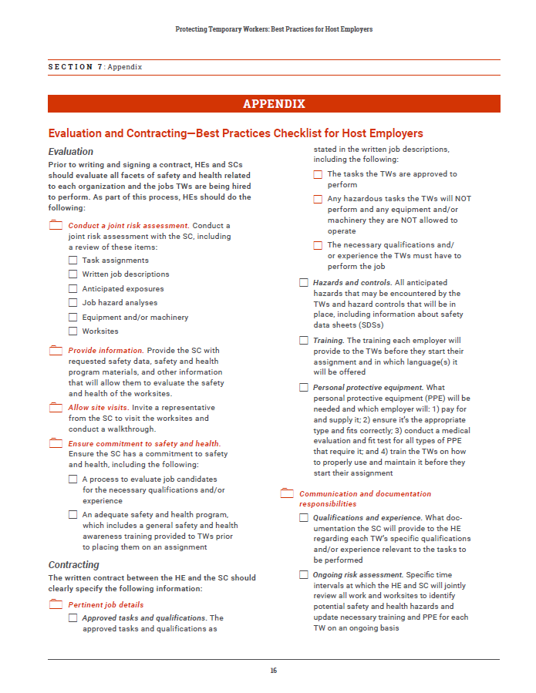
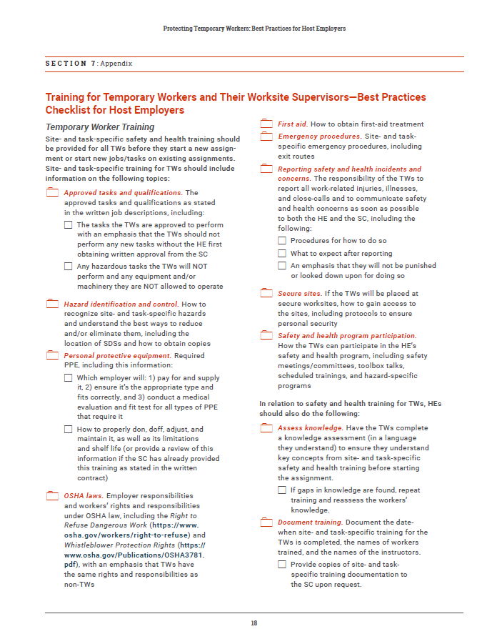
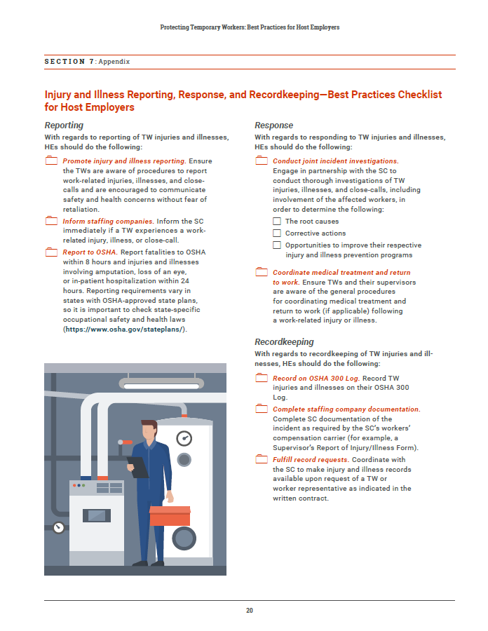
Checklists
Notes:
Again, you can use the checklists included in the appendix to integrate these best practices into your approach. The checklists can be printed or completed electronically.

Slide 19
More Information and Resources
OSHA Temporary Worker Initiative bulletins
ASSP Z10 Guidance Manual
ANSI/ASSP A10.33 Standard
Protecting Temporary Workers: Best Practices for Staffing Companies (coming soon to the NORA Services Sector Council website!)
Notes:
As previously mentioned, OSHA has issued a series of bulletins outlining recommended practices regarding the joint safety and health responsibilities of host employers and staffing companies pertaining to the following topics:
Injury and Illness Recordkeeping Requirements
PPE
Whistleblower Protection Rights
Safety and Health Training
Hazard Communication
Bloodborne Pathogens
Powered Industrial Truck Training
Respiratory Protection
Noise Exposure and Hearing Conservation
Safety and Health in Shipyard
The Control of Hazardous Energy (Lockout/Tagout).
The ASSP Z10 Guidance Manual is a free resource that outlines a proven approach to managing safety and health risks, and provides resources, tools and practical examples tailored to the needs of smaller organizations.
The ANSI/ASSP A10.33 Standard addresses multi-employer worksites for construction and demolition industries (must be purchased).
Also, the Contingent Workers Workgroup is working to develop a similar set of best practices for staffing companies that will also be posted to the NORA Services Sector Council website when available.

Slide 20

Thank you!
[INSERT PRESENTER CONTACT INFO]
Notes:
[Note to presenter: You may wish to add contact information and/or details re: where to find additional information and resources on this slide.]

