Slide 1
Outpatient Dialysis Center Practices Survey & Home Dialysis Practices Survey
Letty Lamping
Public Health Analyst
January 31, 2023
Notes:
Good afternoon. Thank you for joining today’s call. My name is Letty Lamping and today we will cover the outpatient dialysis and home dialysis surveys for 2023.

Slide 2
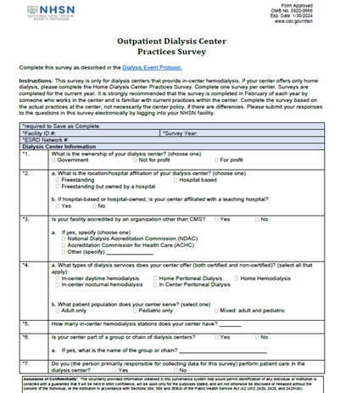
Objectives
Discuss the changes to the Outpatient Dialysis
Center Practices Survey
Review changes to the Home Dialysis
Center Practices Survey
Notes:
Our objective today is to review the changes to both the outpatient dialysis center practices survey and the home dialysis practices survey. Let’s go ahead and dive right in.

Slide 3
Outpatient Dialysis Center Practices Survey
A new version of the Outpatient Dialysis Center Practices Survey will become available on February 1 and must be completed before your facility will be able to enter May 2023 Dialysis Event data.
The survey will ask questions about your facility’s practices during the first week of February 2023.
Facilities will not be able to submit a completed survey until after February 8.
A paper version of the new survey and a table of instructions can be found under the ‘Data Collection Forms and Instructions’ tab of the Dialysis Event
homepage.
Notes:
The 2023 outpatient dialysis survey will be live on February 1 to be saved as incomplete. Remember that a survey must be completed before your facility will be able to enter data for May 2023 forward. As in the past, the survey will ask questions relative to the first week of February and you will be able to save your survey as complete after February 8. A paper version of the survey and TOI are available on the Dialysis event homepage

Slide 4
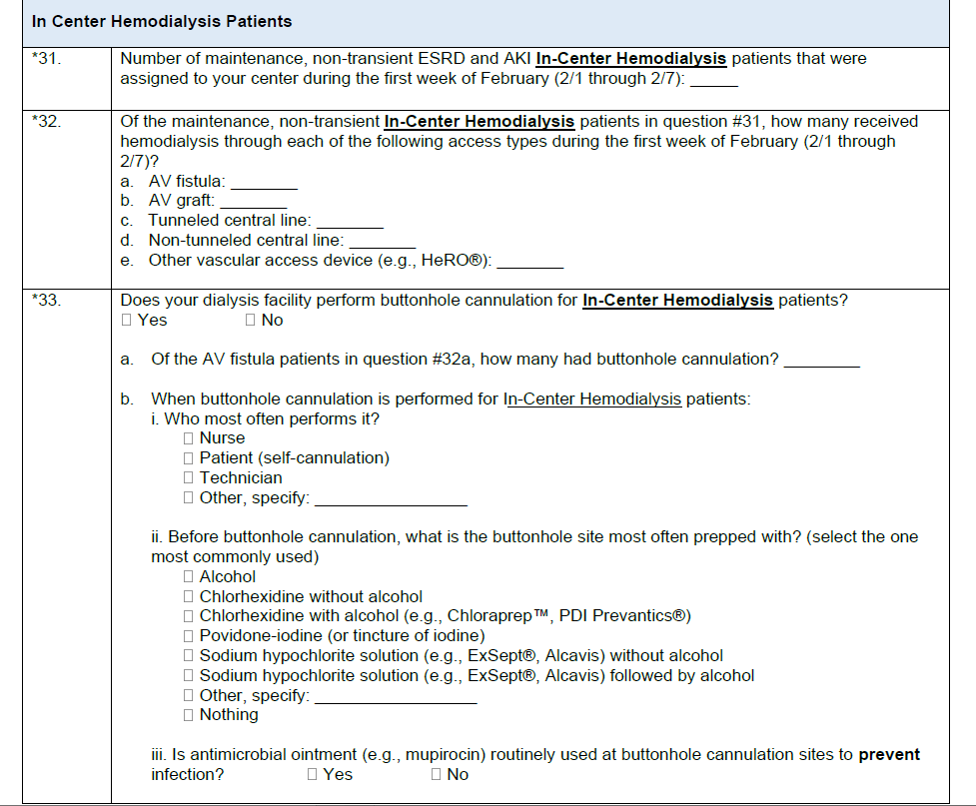
Updated Layout
The layout to 2023 Outpatient Dialysis Center Practices Survey has been updated for clarity and ease of completion.
For example, questions relating to isolation
and screening have all been placed in one
location (questions #13-18); in-center
hemodialysis patients’ questions are all
grouped together (questions #31-40)
Notes:
The survey has undergone some layout changes which were designed to improve ease of completion and clarity. For example, all questions that relate to isolation and screening have all been grouped together; as have all the questions relating to in-center hemodialysis patients. You will find this type of grouping throughout the survey.

Slide 5
Clarified Questions
Notes:
Throughout the survey you will notice that there have been wording changes to various questions. These question revisions were designed to clarify what is being asked for. Let’s review this a little more.

Slide 6
Clarified Questions
Numerous questions throughout the survey have been clarified to minimize and eliminate confusion as to what the question truly means.
A couple of examples include:
Dialysis Center Information Section:
#4 - What types of dialysis services does your center offer (both certified and non-certified)? (select all that apply): Added language to question and additional options (per CMS-3427)
Patient Census Section:
Instructions were updated to include the actual dates in February for which users should be collecting patient census.
Notes:
Several questions have been modified to eliminate confusion. For example, question #4 under Dialysis Center Information, has been expanded to note that the types of services offered including certified and non-certified services. Additionally, as mentioned earlier, the data you are collecting for submission in the survey is for the first week of February, we have added the actual dates Feb 1-8. The following slide outlines the questions that have undergone some clarification in each section.

Slide 7
All Modified Questions
Dialysis Center Information Section:
#4, #8, #11
Isolation and Screening Section:
#14
Patient Census Section:
#24
NEW Staff Section:
#28
In Center Hemodialysis Patients Section:
#33a, #34, #35, #36, & #39
Peritoneal Dialysis (PD) Patients Section:
#42 & #43
Home Hemodialysis Patients Section:
#48a, #49 & #50
Priming Practices Section:
#53
Prevention Activities Section:
#63
New section name from Vascular Access to Arteriovenous (AV) Fistulas or Grafts
#69 & #70
Notes:
This slide simply gives you the questions that have undergone clarification or modification. A crosswalk document, posted to the dialysis webpage, has each question for you to see exactly what the question was in 2022 and what it is on the 2023 survey.

Slide 8
New Questions
Notes:
In addition to the modified questions, there have been several new questions added. These are intended to capture data that previously had not been in the survey. Let’s review a few of those new questions.

Slide 9
Examples of New Questions
Isolation and Screening Section – Question 15: This question asks where you have dialyzed patients with COVID and provides options to select from (isolation room, COVID shift, COVID unit, etc.)
Patient Census Section – Question 25: This question is optional and we’re asking for race of each of the patients treated during the first week of February.
Prevention Activities Section – Question 62a: This question asks what education is provided to your patients when they start dialysis. Some of the options include vascular access care, hand hygiene, recognizing signs of infection.
Notes:
This is just a sampling of the new questions added to the 2023 outpatient dialysis survey. Under the isolation and screening section, we have added a question which asks where your COVID patients were dialyzed and provides options; under the patient census section, question #25 asks for a count of patients treated during the first week in February for each race. Please note that this is an optional question for 2023. And under the prevention activities section (question #62a) we ask what education does your facility provide to patients as they begin dialysis. Those options include but are not limited to vascular access care, hand hygiene, and recognizing the signs of infection.

Slide 10
New Questions
Isolation and Screening Section:
#15 & #18
Patient Census Section:
#25 & #26
NEW Staff Section:
#30
Prevention Activities Section:
#62, #64, & #65
Notes:
As shown with the clarified questions, this slide just gives you an idea of the newly added questions in each section. These questions are also listed on the crosswalk document for your reference.

Slide 11
Questions Deleted
The following questions have been removed/deleted from the survey.
23 - How many acute kidney injury (AKI) patients received hemodialysis in your center during the first week of February?
37 - What type of dialysate is used for in-center hemodialysis patients at your center?
48 - In the past year, has your center’s medical director participated in a leadership or educational activity as part of the American Society of Nephrology’s (ASN) Nephrologists Transforming Dialysis Safety (NTDS) Initiative?
57a - What form of this skin antiseptic is used to prep fistula/graft sites?
60a - What form of this antiseptic/disinfectant is used to prep the catheter hubs?
62a - What form of this antiseptic/disinfectant is used at the exit site?
Notes:
Although there have been several new questions added, we do want you to know that we have also removed some questions that are no longer relevant or have been merged into another question. The six questions on this slide have been removed. We will now move onto the home dialysis survey.

Slide 12
2023 Home Dialysis Center Practices Survey
Notes:
The Home Dialysis Center Practices survey also underwent some changes for 2023 including clarified and new questions. Let’s review some of those changes.

Slide 13
Home Dialysis Center Practices Survey
The Home survey has undergone some reformatting and layout changes for clarity and better flow.
A new version of the Home Dialysis Center Practices Survey will become available on February 1.
The survey will ask questions about your facility’s practices during the first week of February 2023.
Facilities will not be able to submit a completed survey until after February 7.
A paper version of the new survey and a table of instructions can be found under the ‘Data Collection Forms and Instructions’ tab of the Dialysis Event homepage.
Notes:
As with the Outpatient Dialysis Center Practices Survey, the Home survey has undergone some reformatting and layout changes for clarity and better flow. As in previous years, the survey will become available in early February and may be completed and saved after Feb 8. Let’s take a look at a few of the clarified questions for 2023.

Slide 14
Clarified Questions
Notes:
There have been wording changes to various questions throughout the home dialysis survey. These question revisions were designed to clarify what is being asked for. Let’s review this a little more.

Slide 15
Clarified Questions
Dialysis Center Information Section – Question #4, now asks about dialysis services provided including certified and non-certified.
Prevention Activities Section – Question #31 has expanded the options of national or regional infection prevention-related initiatives.
Notes:
Numerous questions have been modified throughout the survey to eliminate confusion. For example, question #4 under Dialysis Center Information has been expanded to note that the types of services offered include certified and non-certified services. Additionally, under the prevention activities, there is an expanded list of options of national or regional infection prevention-related initiatives that your facility may have participated in.

Slide 16
Scope of Clarified Questions
Dialysis Center Information Section:
#3 & #4
Patient Census Section:
#12
NEW Section for Home
Hemodialysis Patients
#23
Prevention Activities Section
#31
Arteriovenous (AV) Fistulas or Grafts Section
#35 & 36
Notes:
This slide simply gives you the questions that have undergone clarification or modification. The crosswalk document has each question for you to see exactly what the question was in 2022 and what it is in 2023.

Slide 17
New Sections and Questions
Notes:
In the home survey, there are eight new questions sprinkled throughout the survey as well as newly identified sections to allow for better flow as well as grouping of questions. Let’s review a few of the newly added questions and sections.

Slide 18
Example of New Sections and Questions
Dialysis Center Information Section – Question #7: This question asks if your facility has been cited for infection control breaches in a state/certification/recertification survey.
Patient Census Section – Questions #13 & #14 ask about patient race and ethnicity
NEW Section for Staff
NEW Section for Peritoneal Dialysis
Notes:
Under the dialysis center information section, a question has been added inquiring as to whether your clinic had been cited for any infection control breaches during the prior year. The patient census section has two new questions relating to patient race and ethnicity. These are both optional questions for 2023 and are expected to become required in 2024. We’ve also added two new sections including one for Staff and one for Peritoneal Dialysis patients.

Slide 19
New Sections and Questions
Dialysis Center Information Section:
#7
Patient Census Section:
#13 & 14
NEW Section for Staff
NEW Section for Peritoneal Dialysis Patients
#17
NEW Section for Home Hemodialysis Patients
#21
Prevention Activities Section
#32, #33, & #34
Notes:
Here we have listed the sections and questions that are new for 2023. These questions are also included in the crosswalk document for your reference.

Slide 20
Email us at NHSN@cdc.gov with 2023 Outpatient Dialysis or Home Dialysis Survey in the subject line with any questions.
Notes:
Both surveys, accompanying TOIs and crosswalk are available on the NHSN Dialysis webpage. As always, please reach out to us at NHSN@cdc.gov with any questions. This concludes our review of the 2023 Outpatient Dialysis Center Practices Survey and the Home Dialysis Center Practices survey. Thank you all for joining today. Have a good afternoon.

