Slide 1
Applying Best Practices for Reporting Medical and Health Information on the Birth Certificate
Introduction and Demo
Monthly VSCP Directors Call
December 14, 2016
Notes:
Thank you for the opportunity to present this demo here today. We are very excited about this product and have high hopes for its ability to improve data quality.

Slide 2

Identified Need for Training
Birth data quality concerns
Lack of awareness of
  Uses of birth data
  Resources available
No formal standardized training available
Solution
  Birth Data Quality Workgroup formed subgroup to develop eLearning
Notes:
Before jumping into the demo, I thought it would be helpful to provide a brief background and context.
As you may know, there have long been concerns about the quality of birth certificate and fetal death data, particularly the medial and health information. Earlier studies pointed to a lack of awareness among hospital staff of the uses of the birth data and standard resources available to them to answer questions about the items.
and while some training existed within jurisdictions, there was little formal standardized training available.
In response, the BDQWG created a subgroup that was charged with developing training to improve the data collection practices for the birth certificate and report of fetal death information.

Slide 3
Training Goals
Improve completeness and accuracy of birth and fetal death reporting across the US
Use a convenient accessible format with a broad reach
Notes:
Our overall goals for the training were to improve the completeness and accuracy of birth and fetal death reporting, and provide this in a convenient, accessible and cost-effective format that could reach a broad audience.
The main factor here was to address the quality of data collected by those who fill out the birth certificates, to improve maternal and infant health in the U.S.

Slide 4
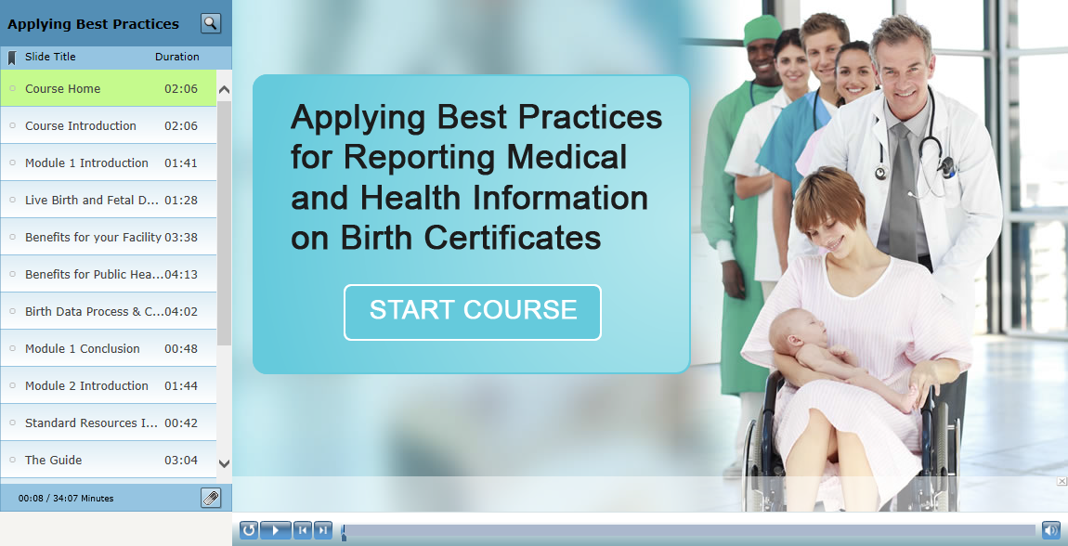
Notes:
Now on to the demo “Applying Best Practices for Reporting Medical and Health Information on Birth Certificates”, I’ve taken screen shots of the course. Most, but not all of the course is shown here. I’ll likely proceed to quickly for you to be able to read most of what’s on the slides, but there’s a link at the end to the course if you want to spend more time exploring.
Also, sorry about any lag with this system. I’ll try to make sure I don’t go too fast and get ahead of myself.

Slide 5
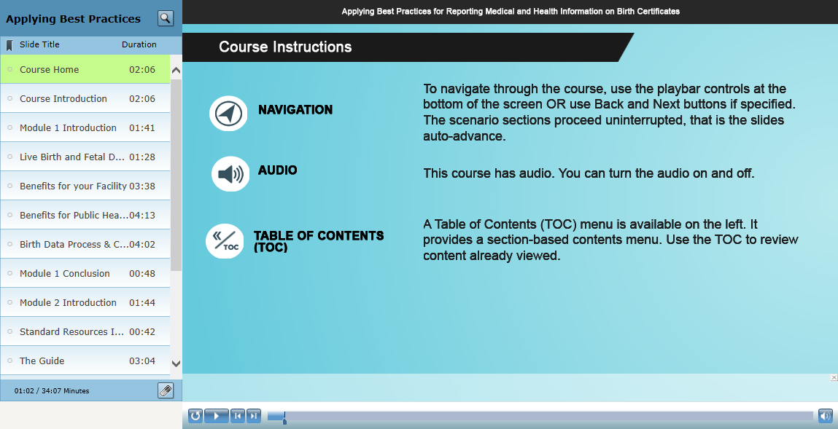
Notes:
We start out with a few logistics. There is audio narration, though you won’t hear it in this demo. The user can turn it off if needed.
Users can navigate through the course using the playbar at the bottom. There are a few slides that don’t have the playbar, but other navigation button are available.
Only after the course has been viewed, we recommend using the Table of Contents on the left to return to different sections of the course.

Slide 6
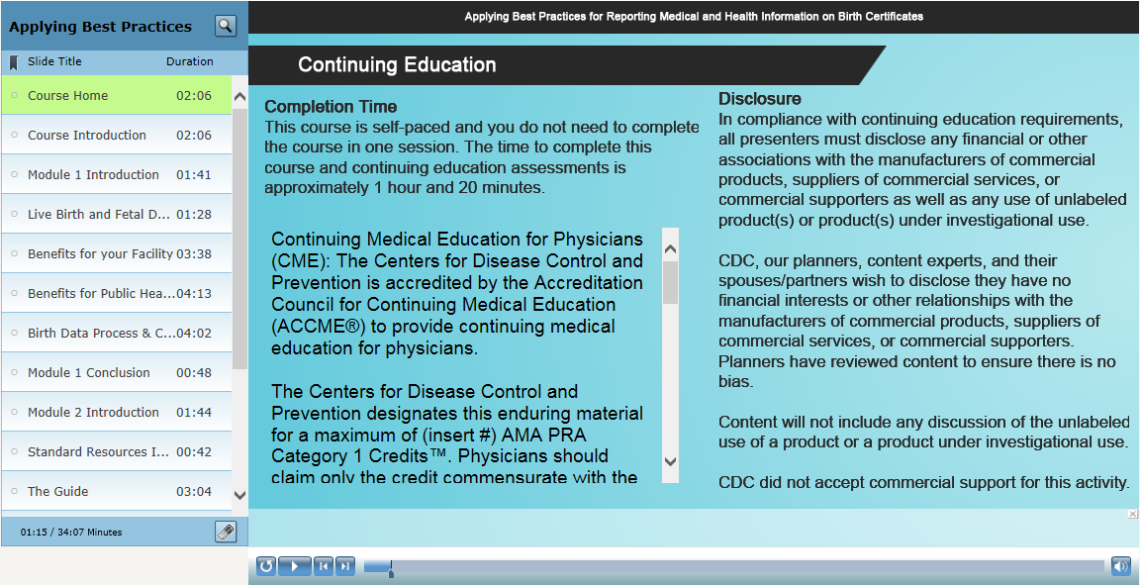
Notes:
This slide provides all of the information on accreditations for the course, which is also available on our landing page with course instructions.

Slide 7
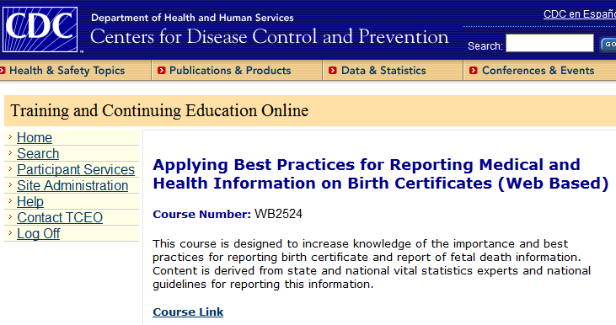

Accreditation
CDC’s Training and Continuing Education Online (TCEO)
  CME: 1.5 credits
  CNE: 1.4 contact hours
  CEU: 0.1 CEUs
  CPH: 2 CPH recertification credits
Certificate of completion
Notes:
Just to highlight the credits available because we’re very please to be able to offer these, the course has been accredited for CME, CNE, CEU, and CPH.
These are available through CDC’s Training and Continuing Education Online, or TCEO.
Learners who do not need continuing education credits can also receive a certificate of completion with the course through CDC Train.
In either case, a short posttest must be complete with a score of at least 80%, and an evaluation completed so that we can receive basic feedback on the course.

Slide 8
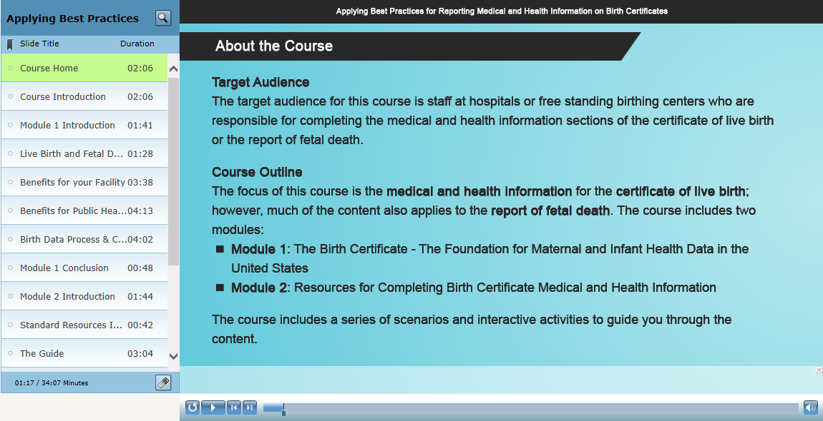
Notes:
The target audience for the course is clinical and non-clinical hospital or birthing facility staff
And the content is partitioned into two separate modules
Module 1 – on the uses of the data, where it goes, and how it is protected, and
Module 2 – standard resources and best practices for reporting this information

Slide 9
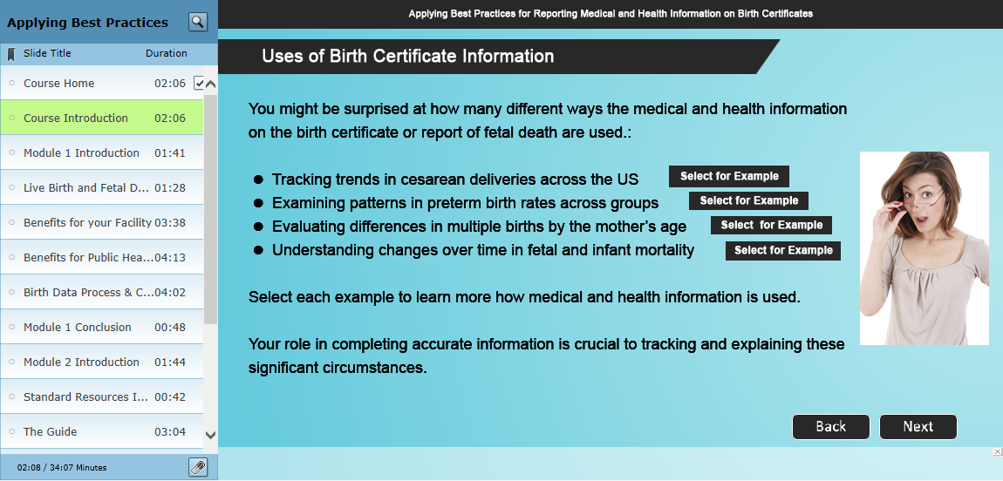
Notes:
To draw the user in from the beginning, we wanted to highlight some of the many uses of the data and provide interactive examples with graphics and explanations.
Here we talk about how birth certificate data can be used to:
Track trends in cesarean delivery
Examine patterns in preterm birth rates
Evaluate differences in multiple births
And examine changes over time in fetal and infant mortality
While we don’t focus as much on the report of fetal death in the course, much of the item-specific content overlaps, or we also feature a special section on cause of fetal death, which we’ll get to.

Slide 10
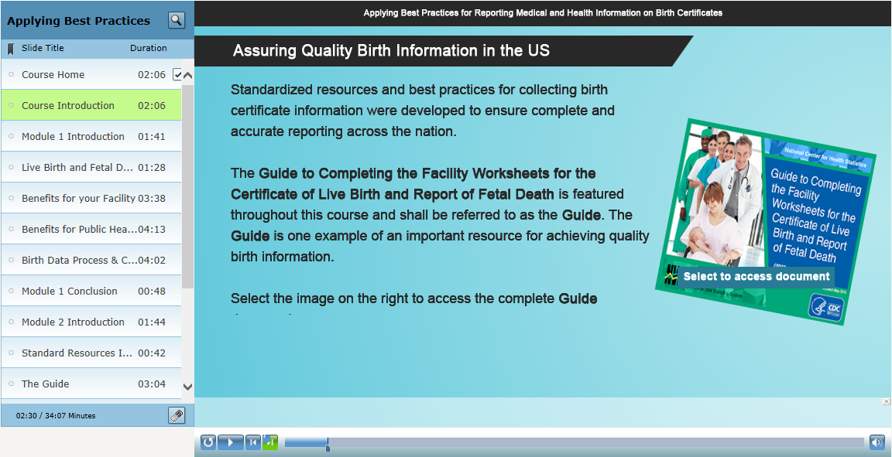
Notes:
You will also see our updated Guide to Completing the Facility Worksheet featured many times throughout the course and accompanied by a link to the latest version of the Guide.

Slide 11
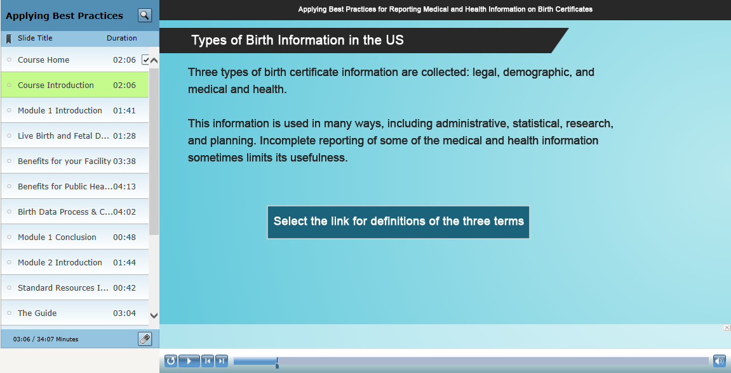
Notes:
We also provide background on the types of information collected – with special emphasis on the medical and health information.

Slide 12
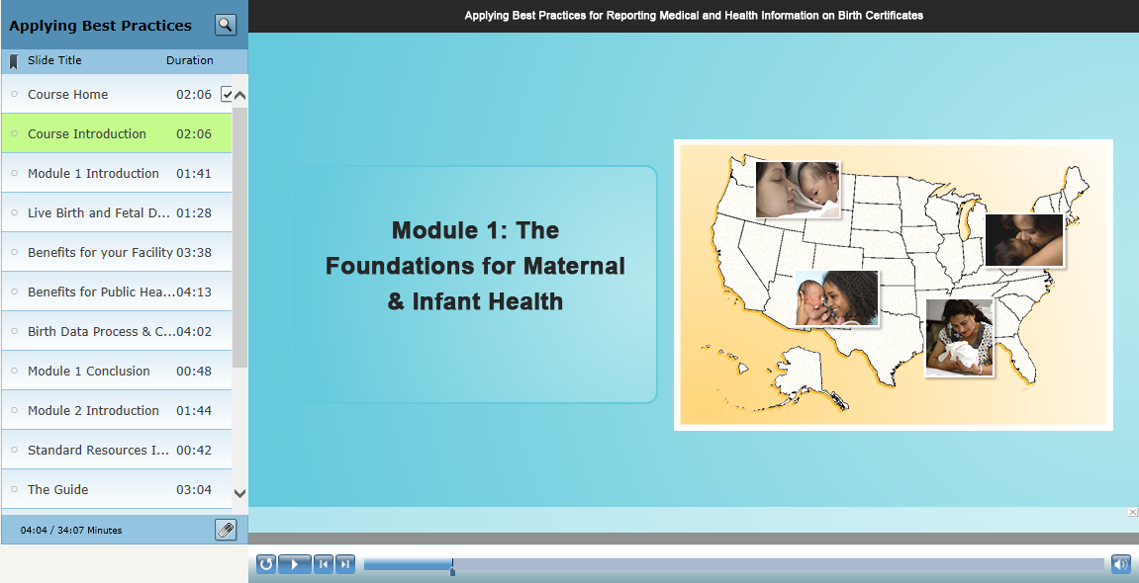
Notes:
Moving on to Module 1 – The Foundations for Maternal and Infant Health

Slide 13
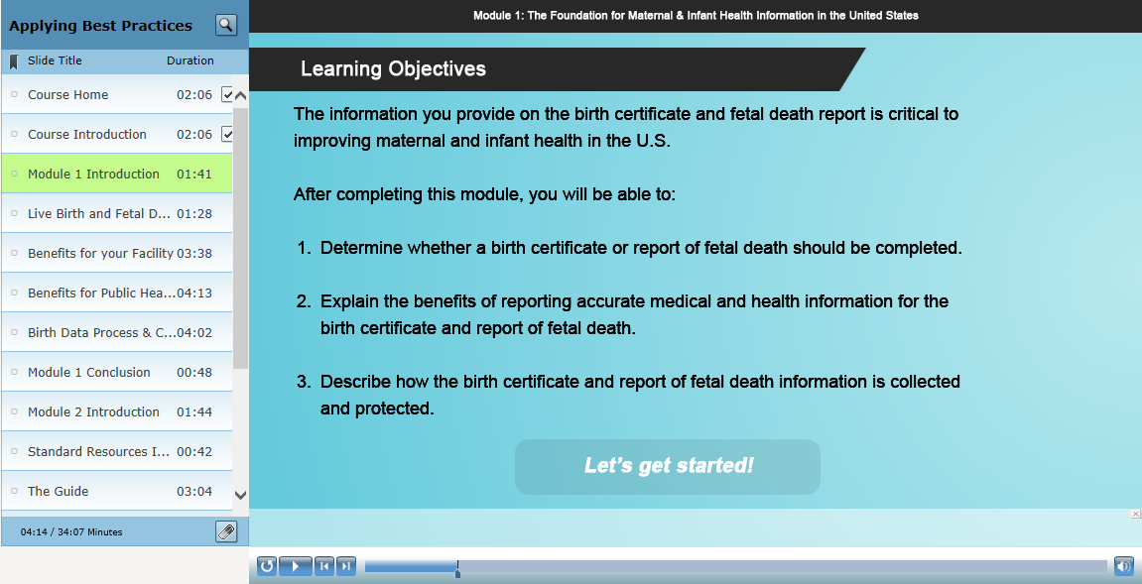
Notes:
The learning objectives for this module will cover:
whether a birth certificate or report of fetal death should be completed
Explain the benefits of reporting accurate medical and health information
And describe how this information is collected and protected
For this demo, I will highlight how the content and knowledge checks reinforce these objectives.

Slide 14
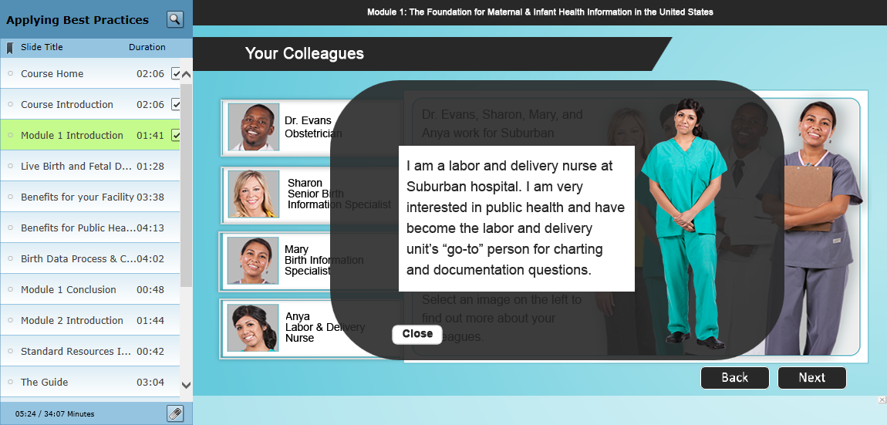
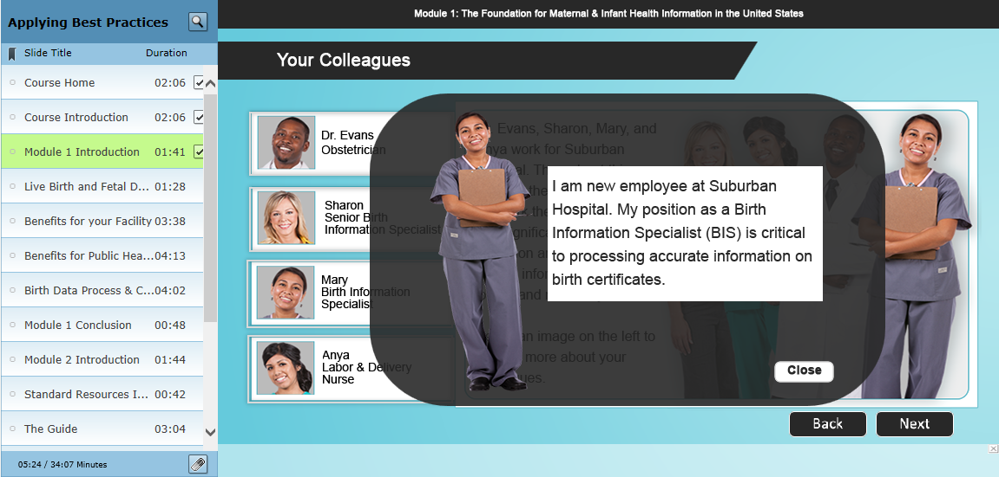
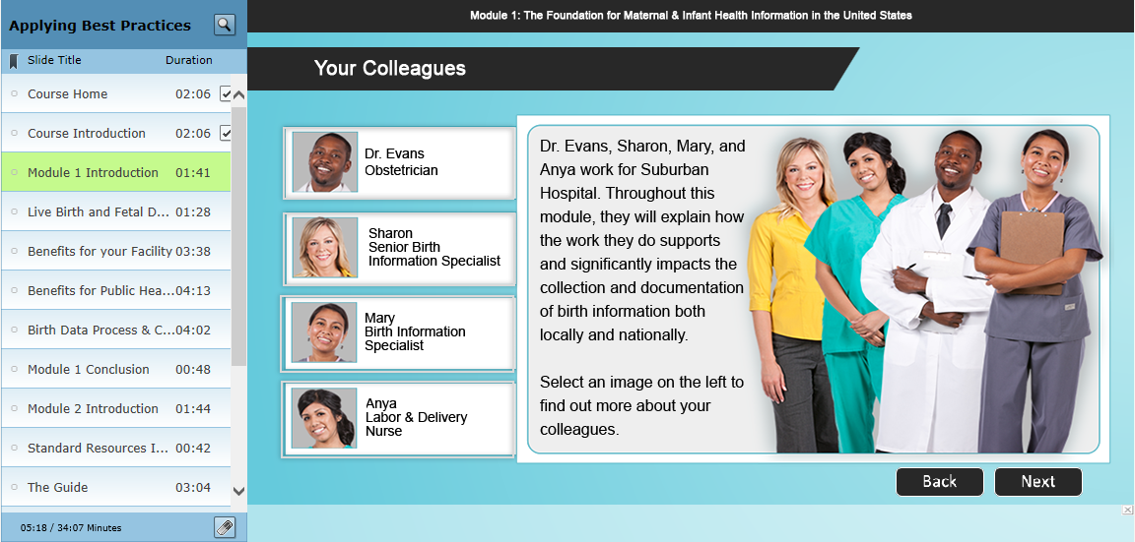
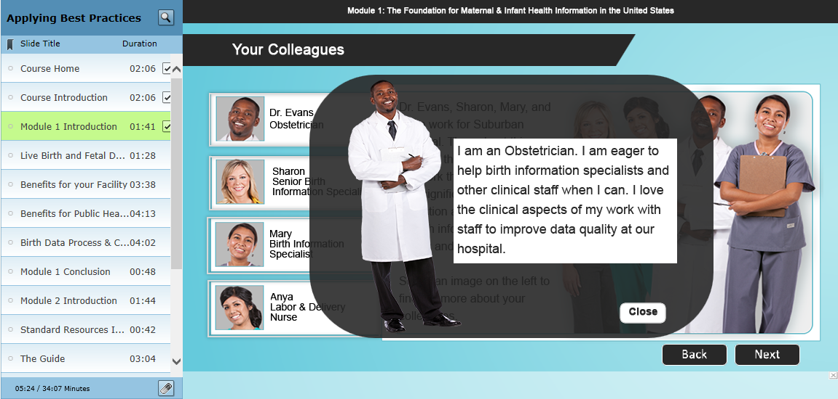
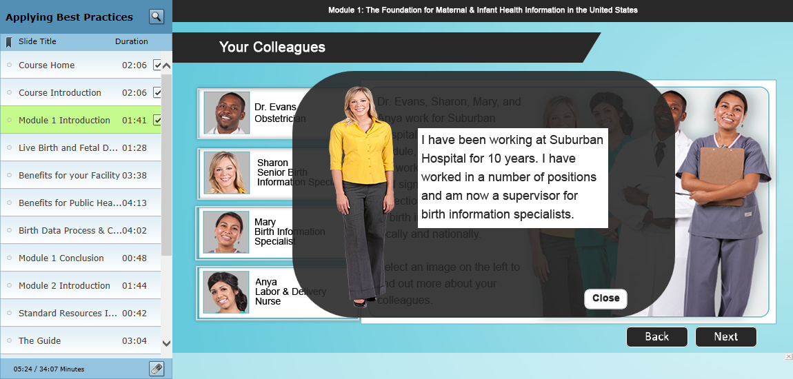
Notes:
We also want to highlight the importance of teamwork and feature characters and scenarios to introduce various content and concepts throughout the course. We have our
[click for auto advance through Anya]
OBGYN – dr. Evans
Our Senior BIS – Sharon
Our new BIS – Mary
And our labor and delivery nurse – Anya

Slide 15
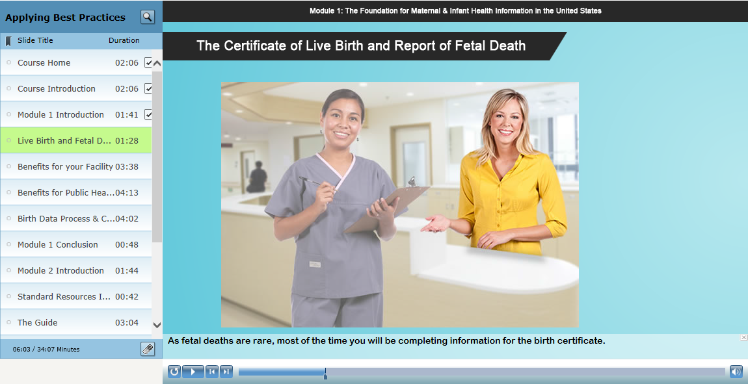
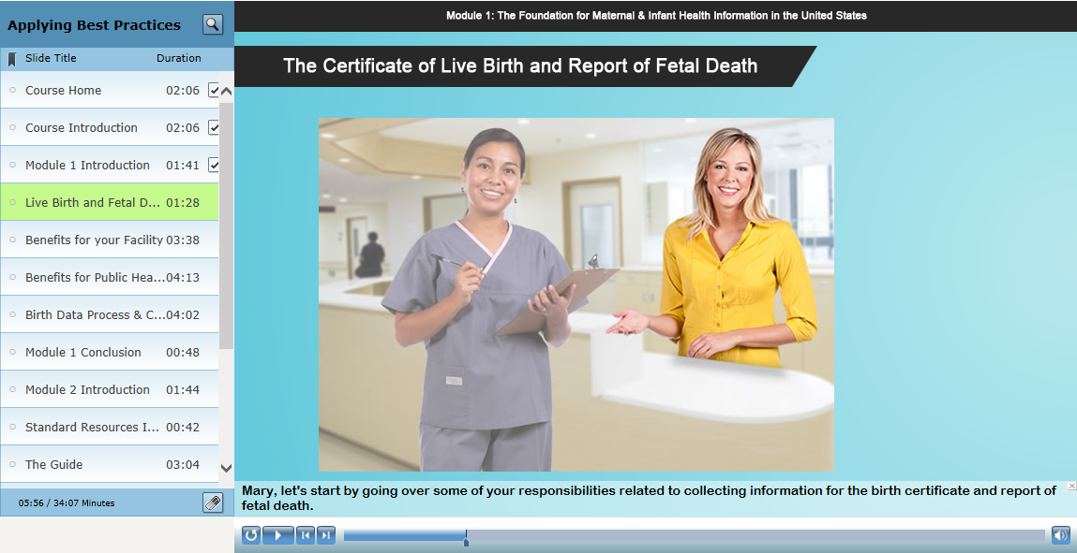
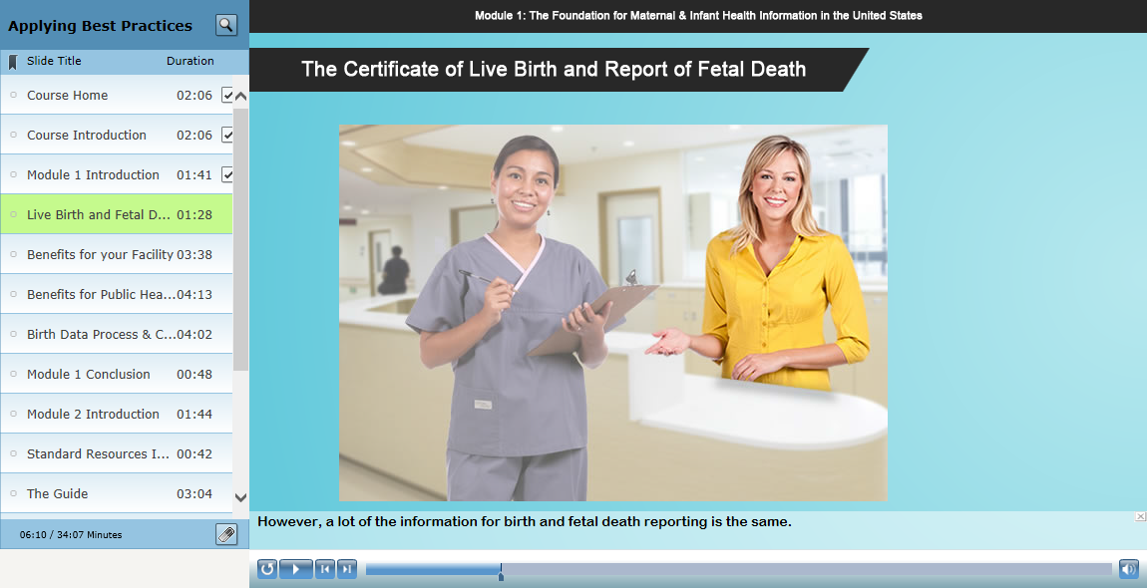

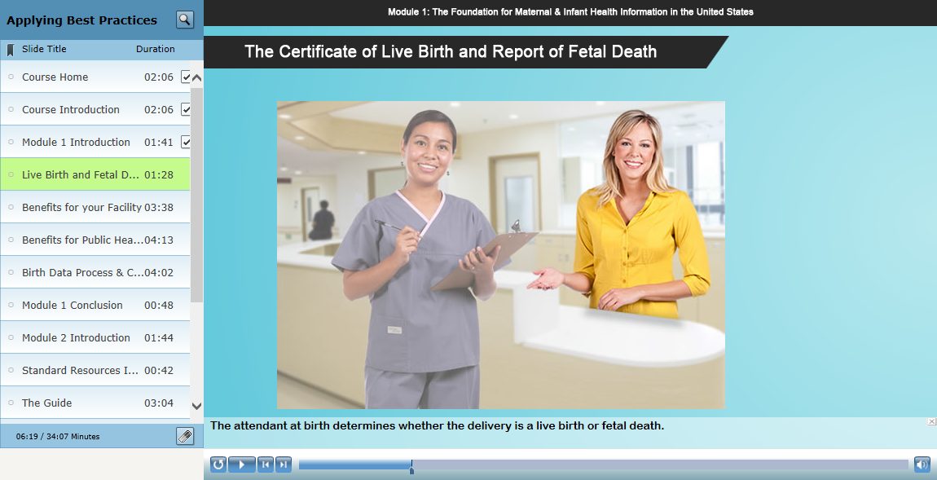
Notes:
The first scenario we feature is Sharon and Mary discussing definitions for a live birth or fetal death.
And also, just to note, that the scenarios in the course were designed to auto advance, which you can see in the changing text here.

Slide 16
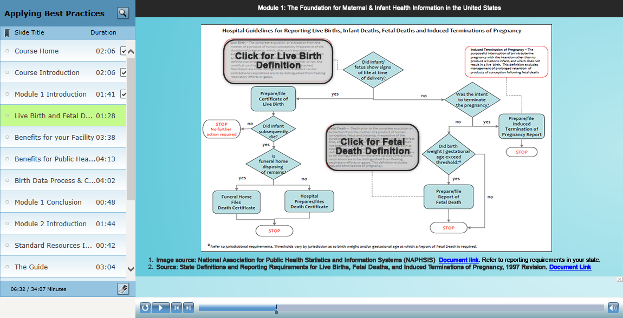
Notes:
We then have options for the learner to click on the Live Birth definition and Fetal death definitions.

Slide 17
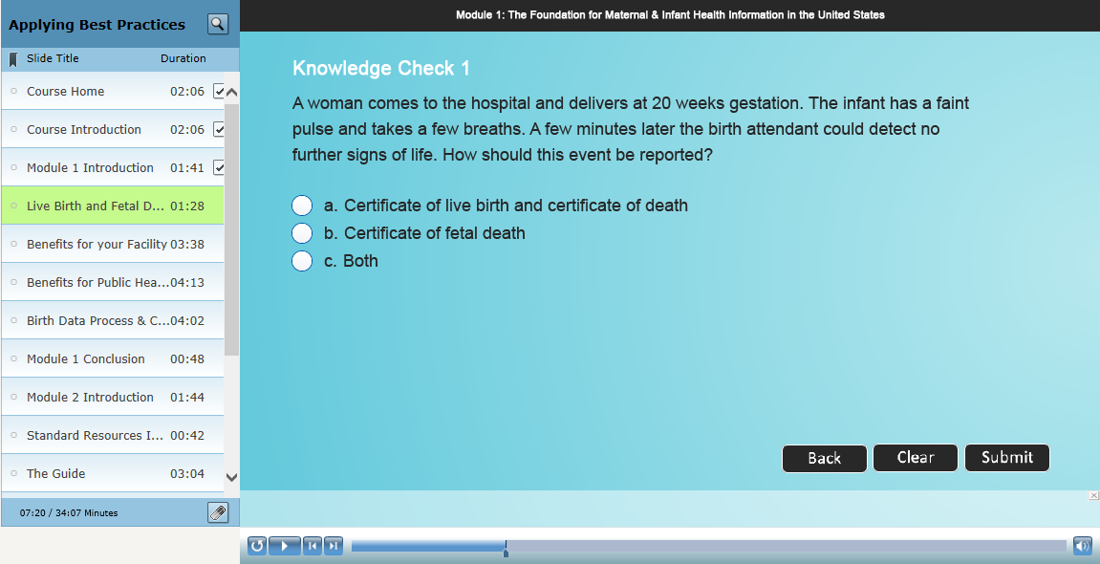
Notes:
And feature a knowledge check to reinforce this objective

Slide 18
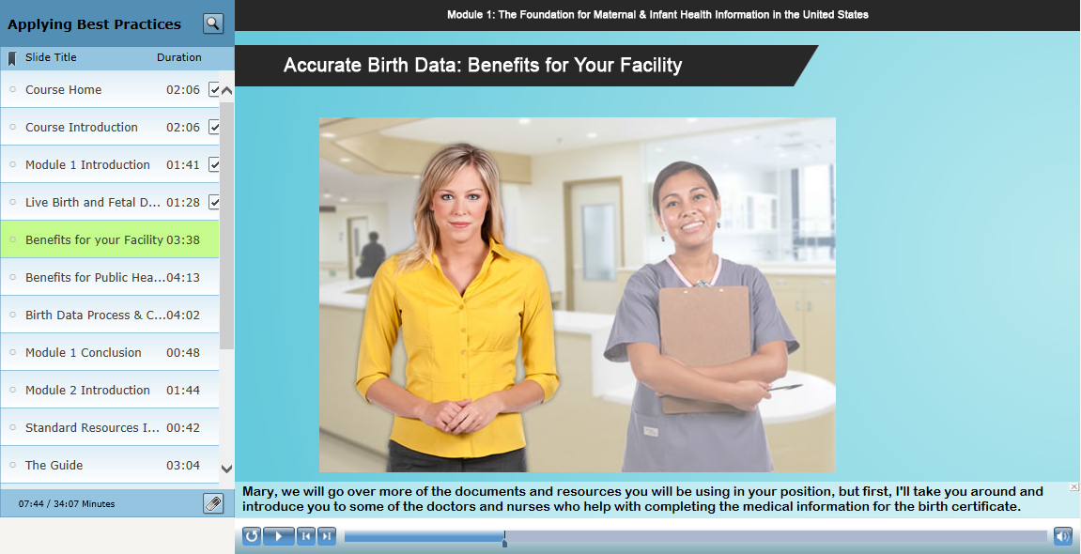
Notes:
In these next two scenarios, we showcase how accurate birth reporting benefits their facility as well as public health.
We start off with a scenario, where colleagues are discussing how they discovered problems with reporting in their hospital and what they did to improve the data.

Slide 19
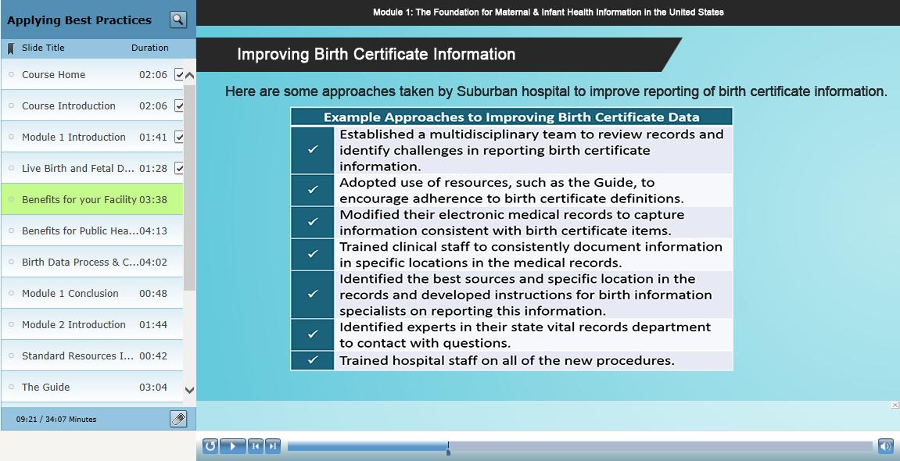
Notes:
In this slide, we talk about the many ways reporting of birth data can be improved within hospitals, but also talk about modifying EHR systems and developing internal instructions for location information in the records.

Slide 20
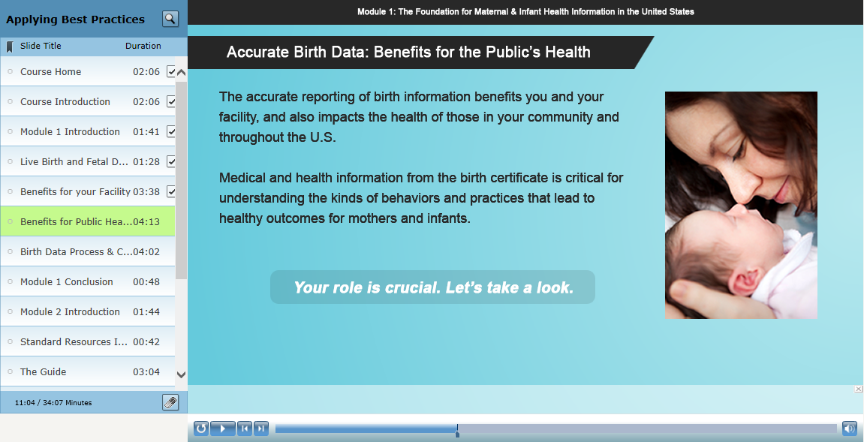
Notes:
We also focus on the public health importance of the data and their role in this process

Slide 21
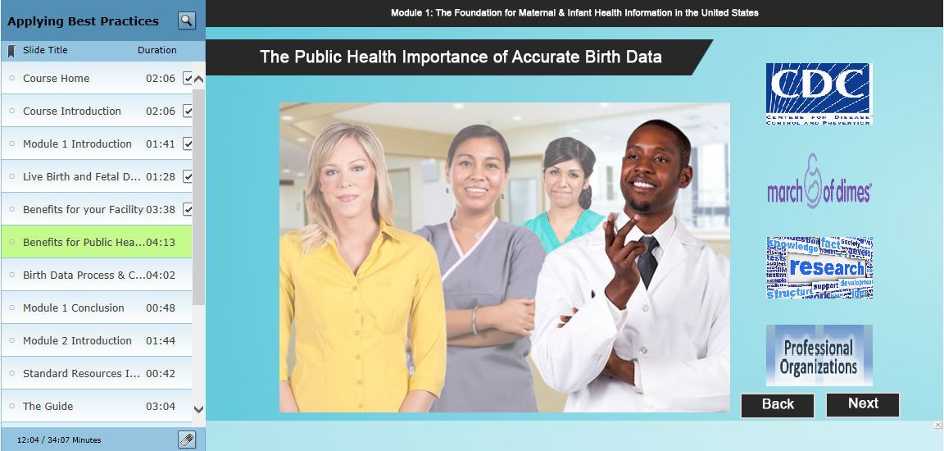
Notes:
In this scenario, we describe some of the specific ways the data have been used and feature interactive boxes, where the learner can click to learn more how organizations like the CDC and NCHS, March of Dimes, Researchers, and professional organizations use the data.

Slide 22

Notes:
And again, a knowledge check to reinforce this information and objective.

Slide 23
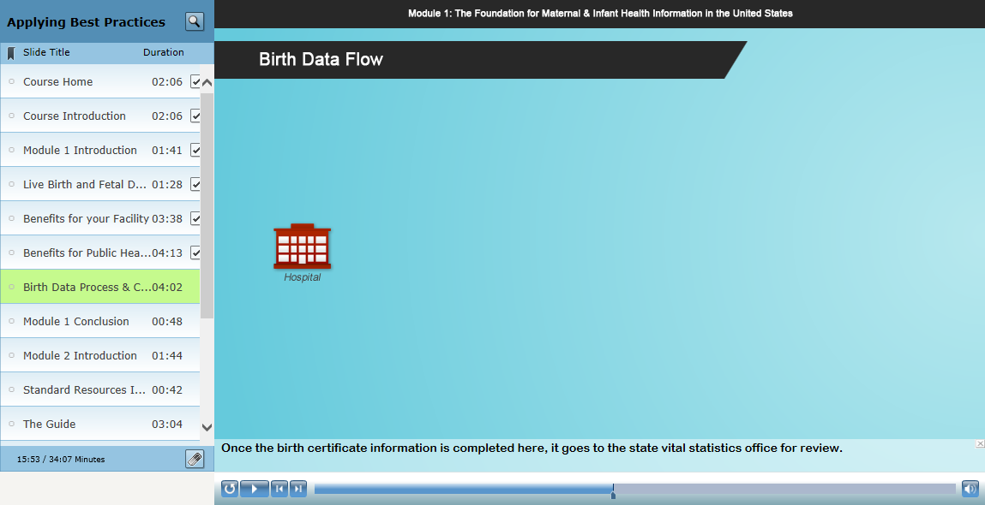
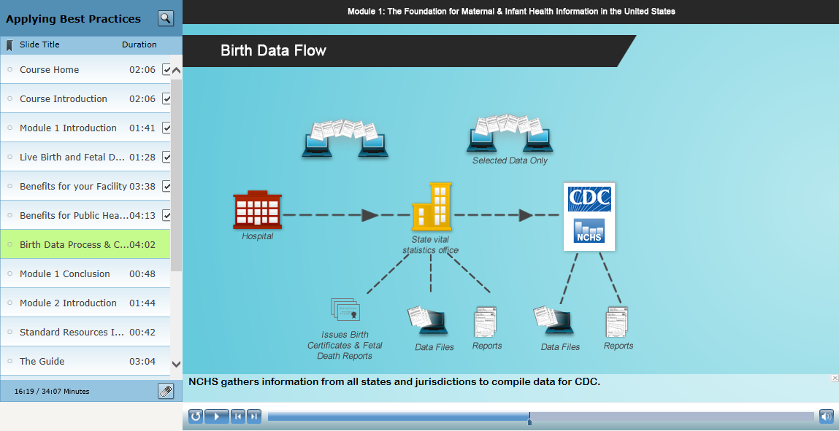
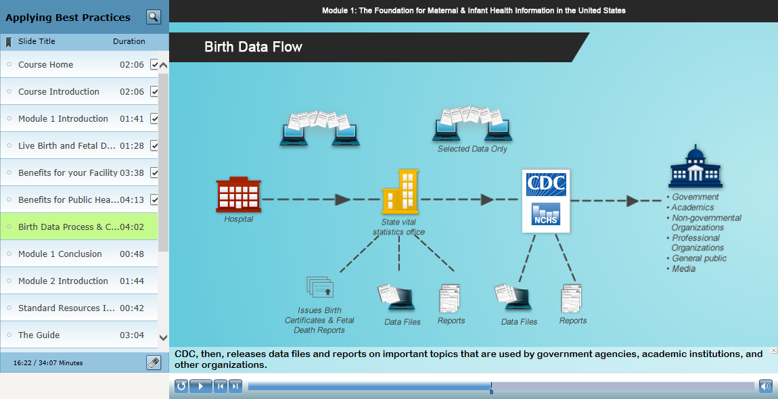
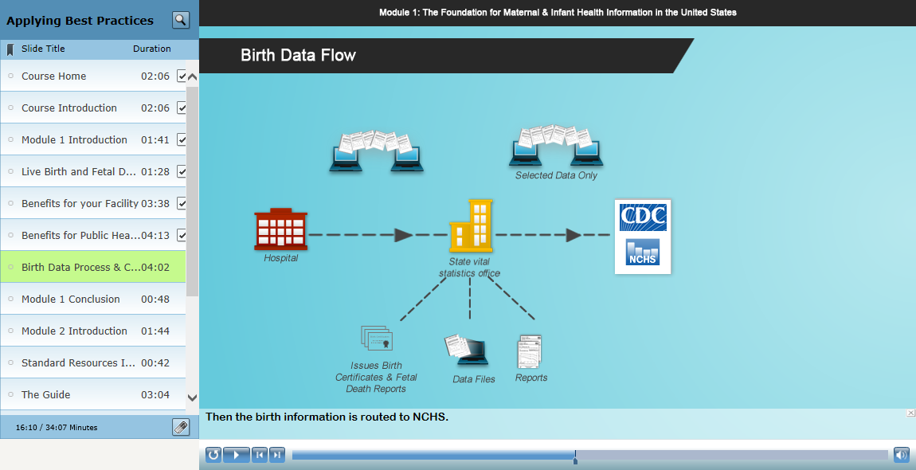
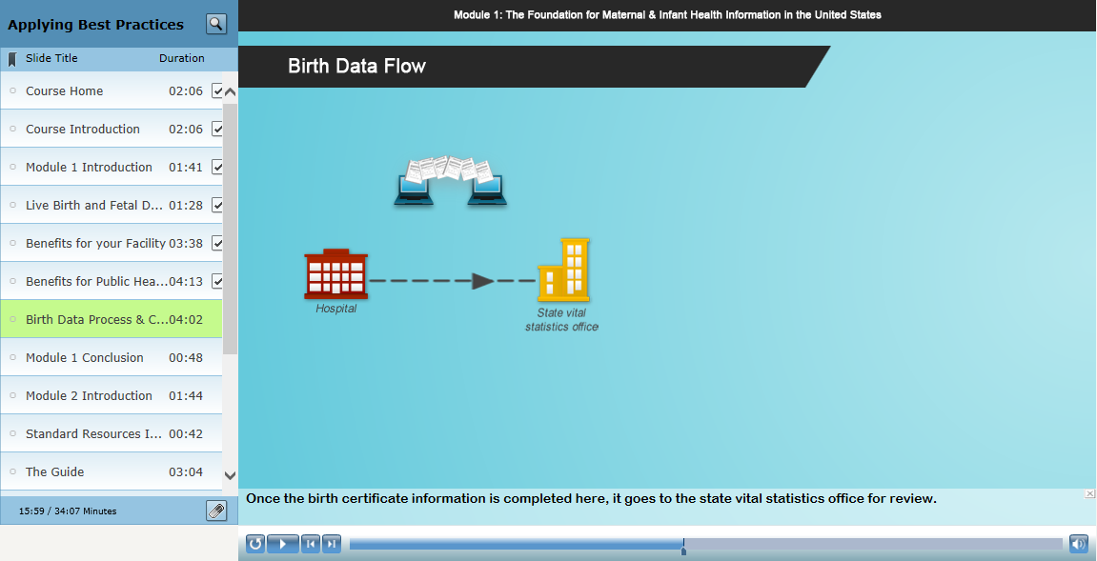
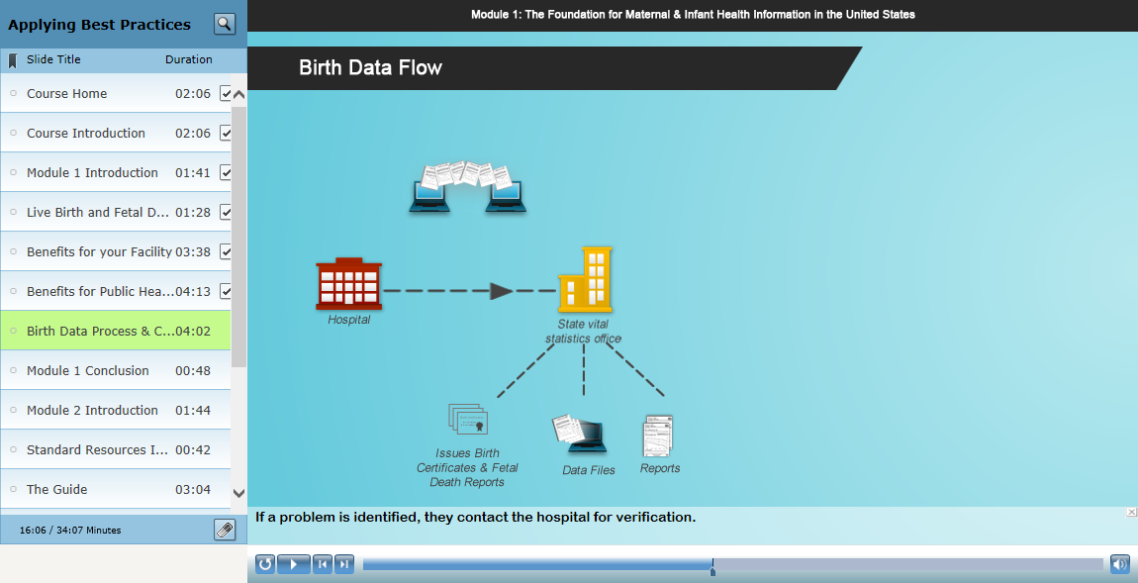
Notes:
Finally, we also talk about the Birth Data Process and Confidentiality
We discuss where this data goes once it leaves the facility

Slide 24
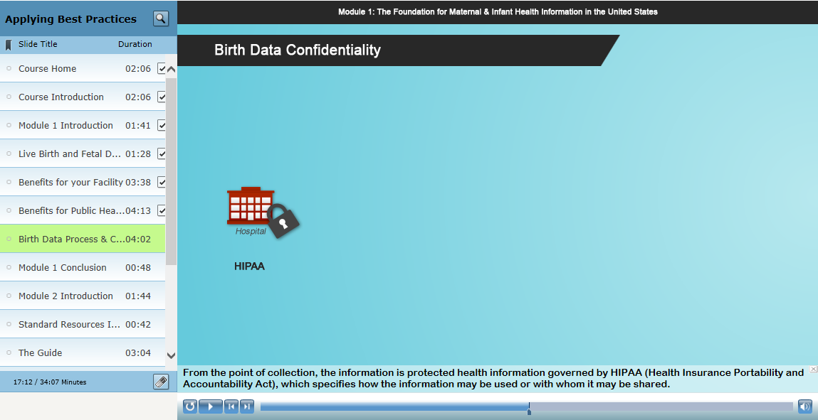
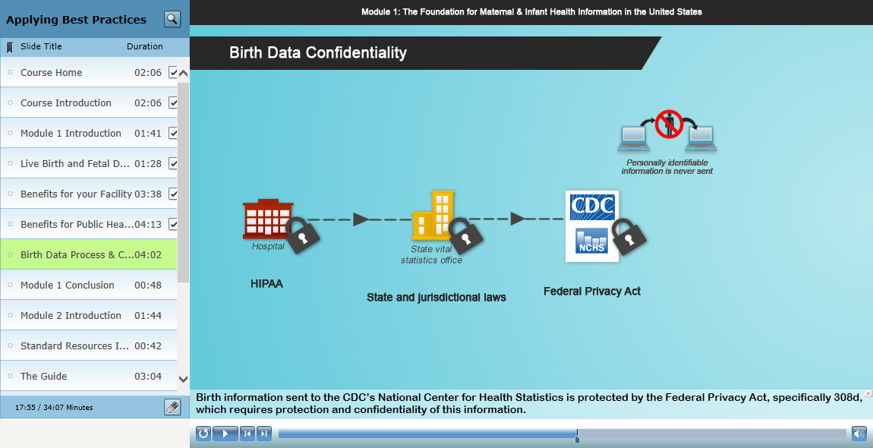
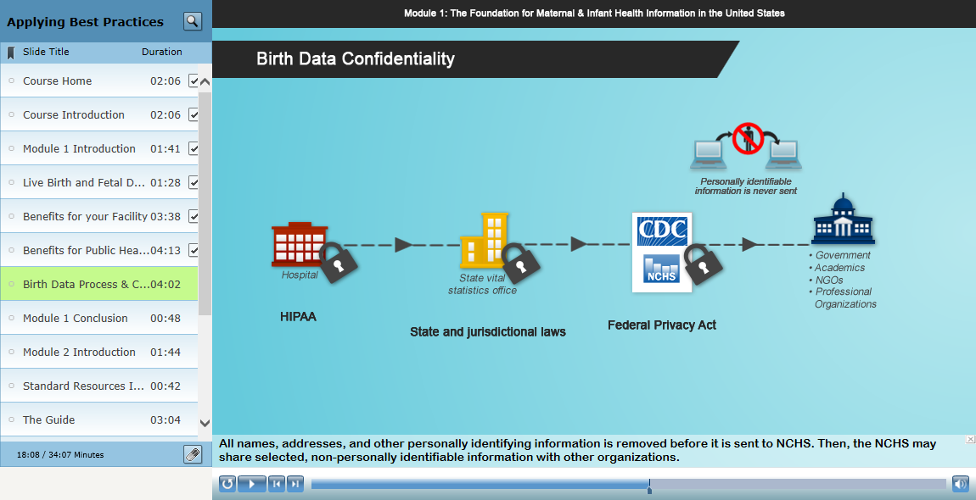
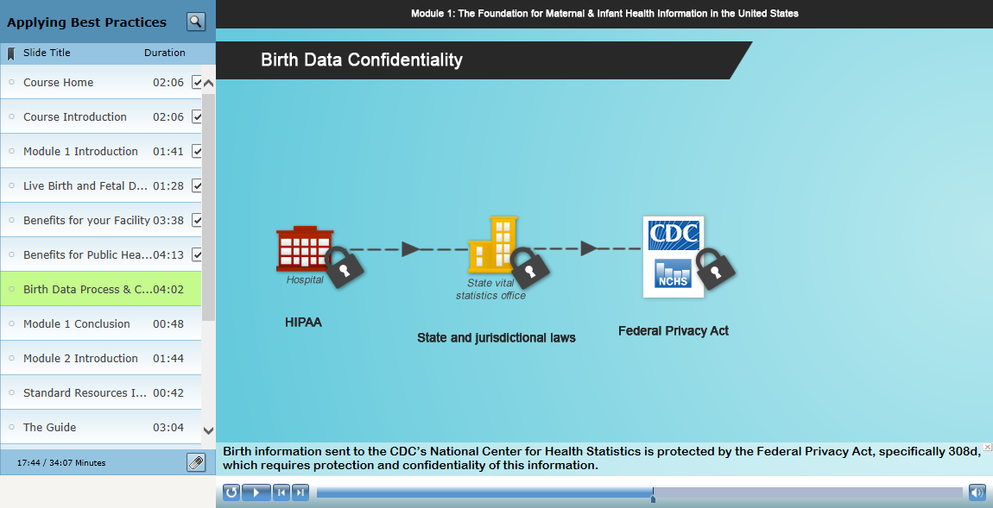
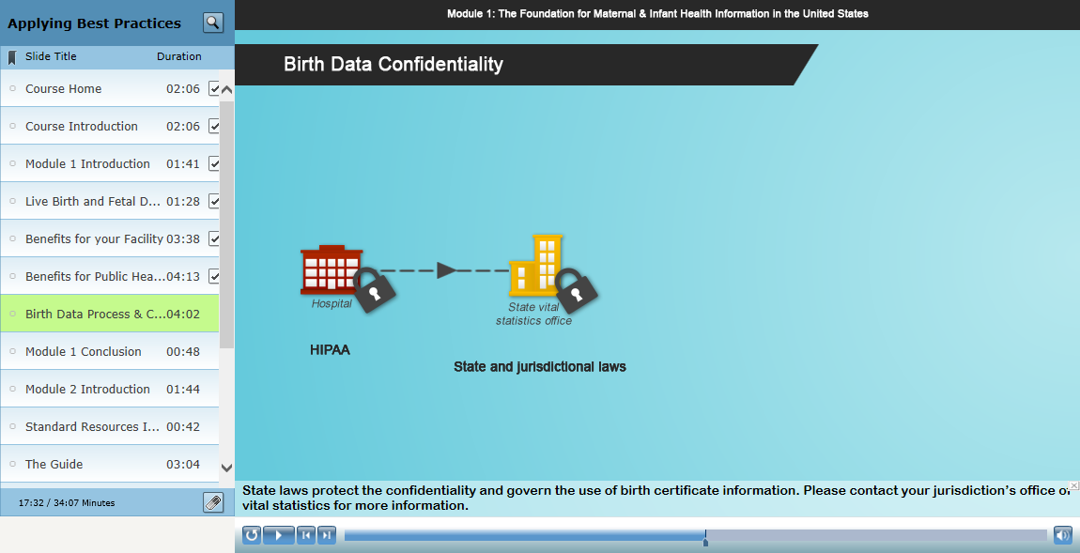
Notes:
And how this data is protected along the way
This Diagram also has interactive links to the specific federal provisions that protect this information.

Slide 25
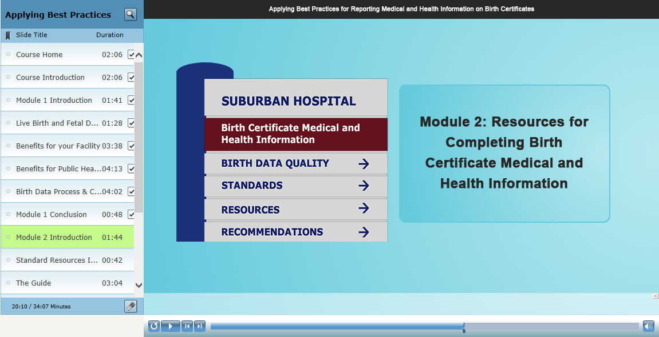
Notes:
Moving on to Module 2 – Resources for Completing Birth Certificate Medical and Health Information

Slide 26
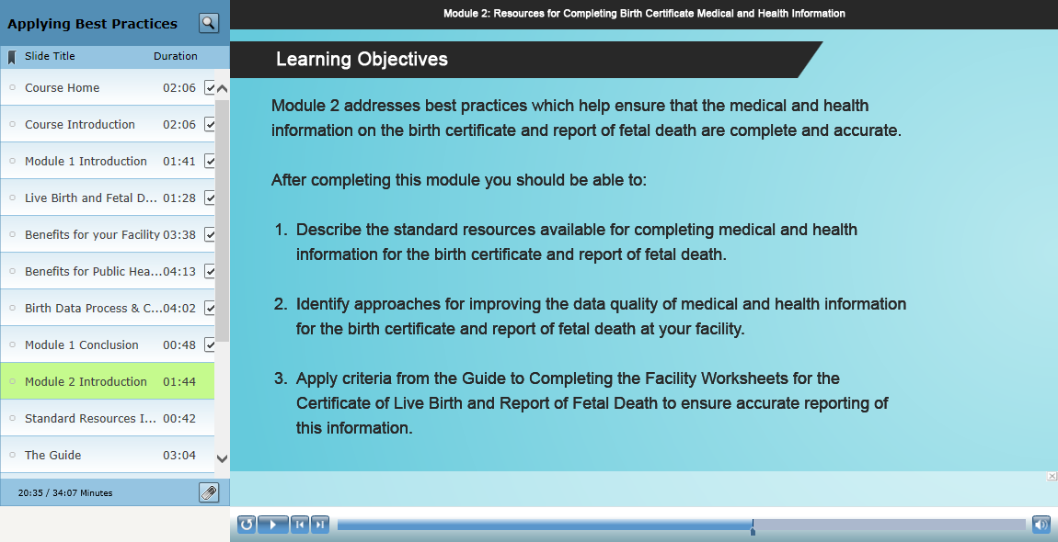
Notes:
The objectives for the learner in module 2 focus on
Describing standard resources available to assist in reporting medical and health information on the birth certificate
Identifying approaches for improving the data quality
And applying criteria from the Guide to Completing the Facility Worksheets

Slide 27
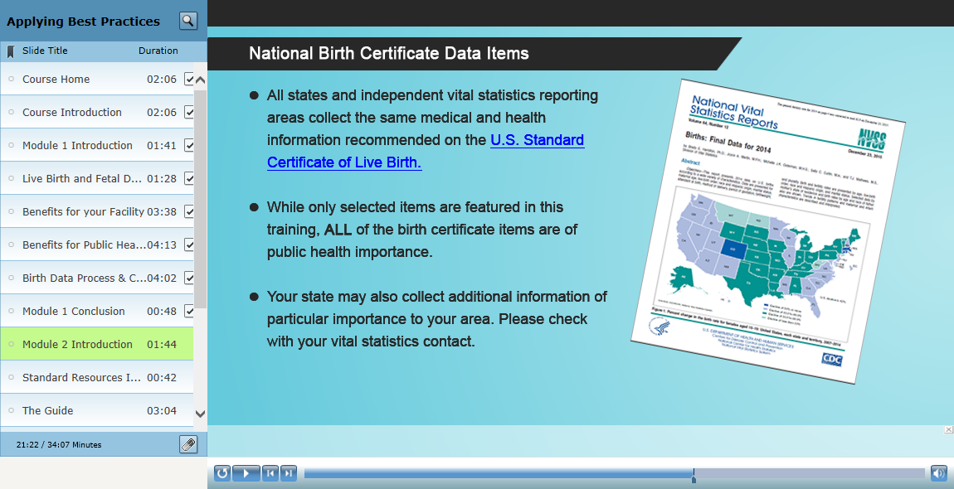
Notes:
We emphasize the importance of standardization when collecting this information

Slide 28
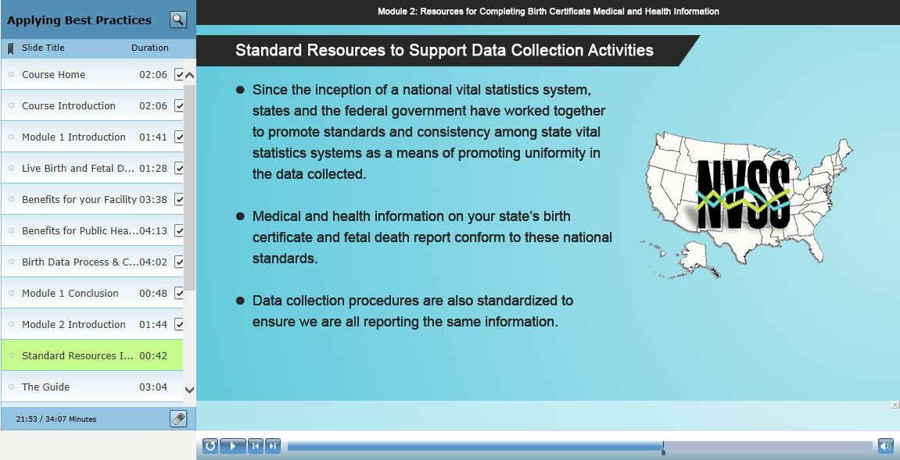
Notes:
And standard resources available to support data collection activities

Slide 29
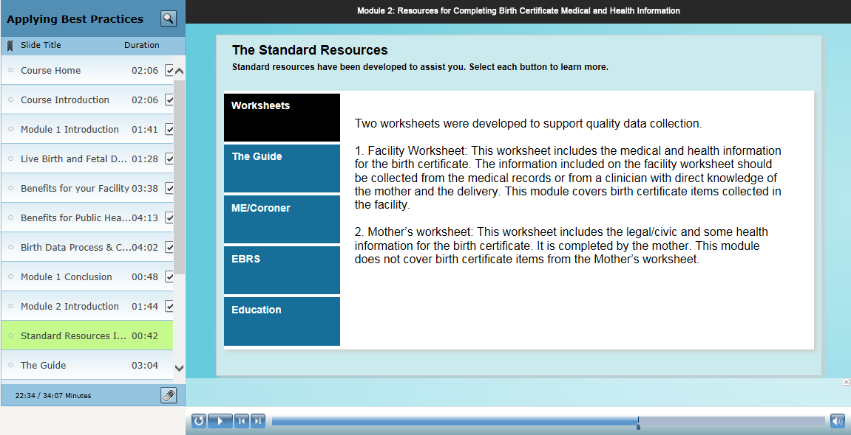
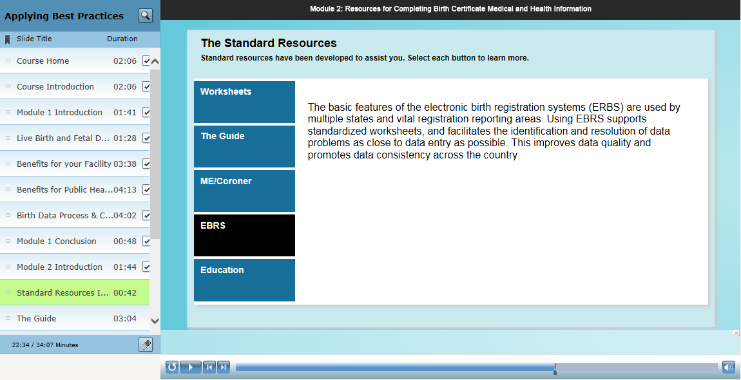
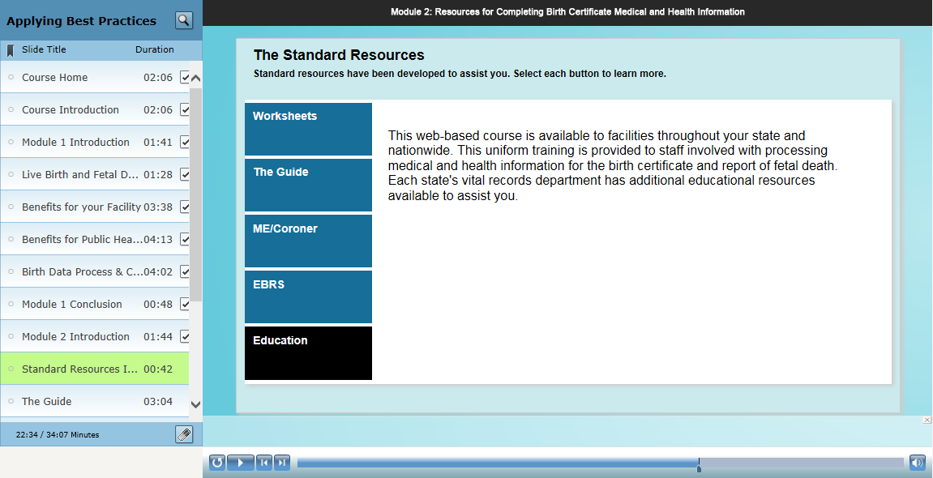
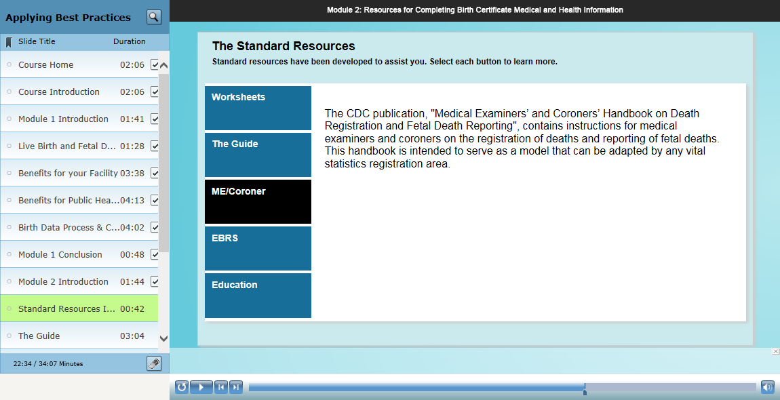
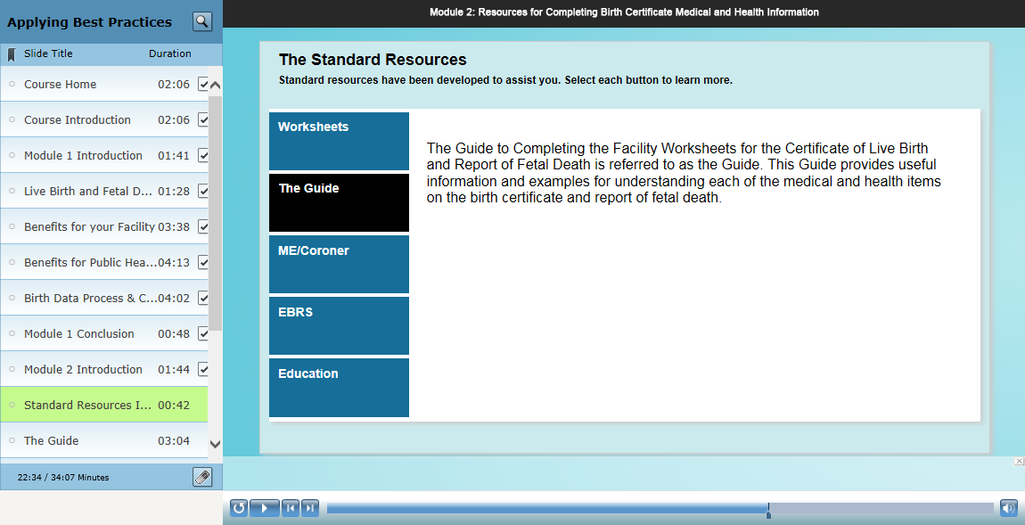
Notes:
We also have interactive tabs listing descriptions
[click on each tab]
of the standardized worksheets,
Guide,
Medical examiner and coroner handbook for cause of fetal death,
electronic birth registration systems,
and education – which is this course.

Slide 30
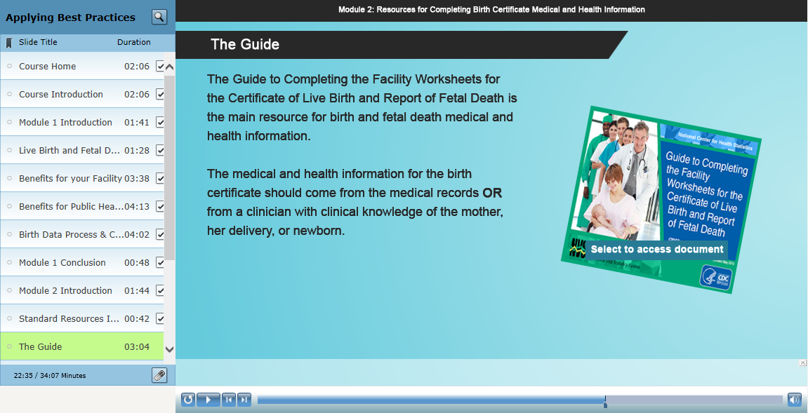
Notes:
The Guide is the main resource we highlight in the course and we have several slides detailing the contents and an example of the type of information they will see in the Guide.

Slide 31
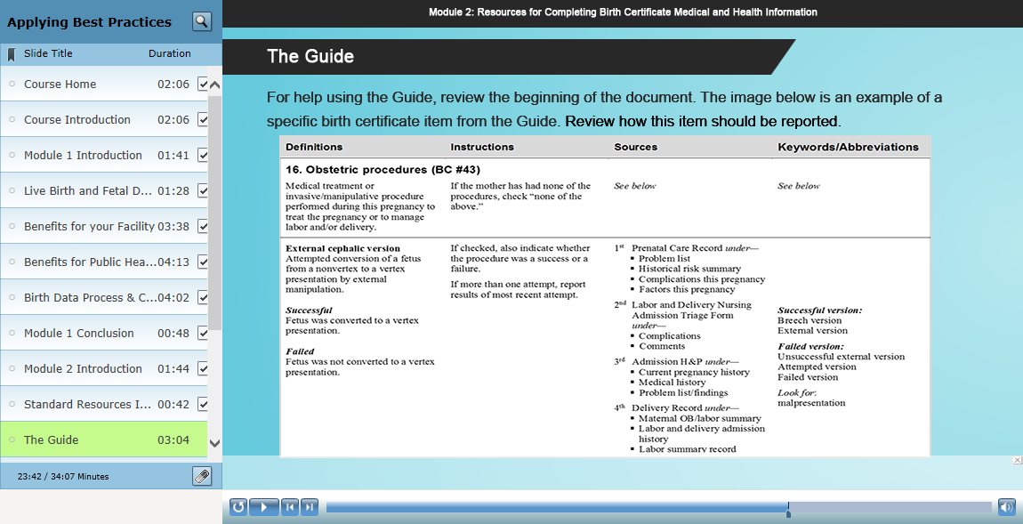
Notes:
This example from the Guide features External Cephalic Version. We show definitions, instructions on how to report the item, preferred sources and keywords to look for in the medical records.

Slide 32
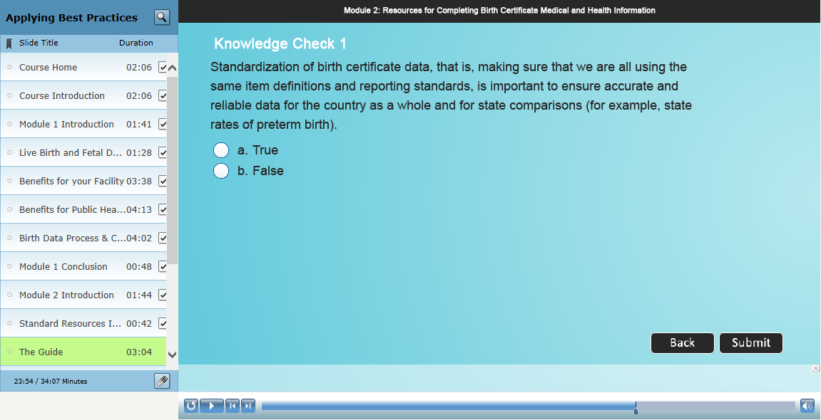
Notes:
We also feature knowledge checks on standardization and content available in the Guide.

Slide 33
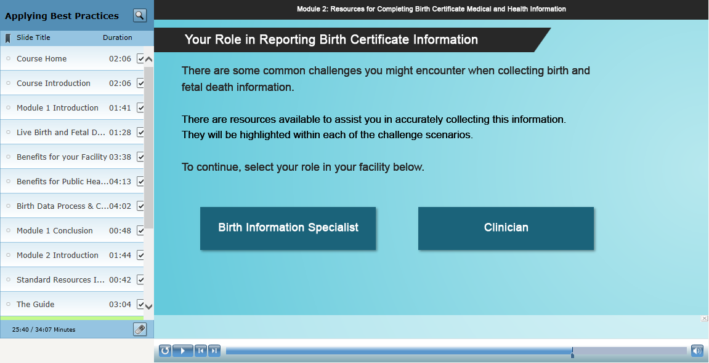
Notes:
As mentioned earlier, we also have incorporated “branched” content in the course.
So the user can select whether they have a non-clinical role, what we call Birth Information Specialist, or a Clinician.
For both roles, we highlight common challenges, but…
For the non-clinical role, we focus on issues around data collection and abstraction
And for the clinician role, we focus mainly on issues of documentation and understanding definitions and content collected on the birth certificate

Slide 34
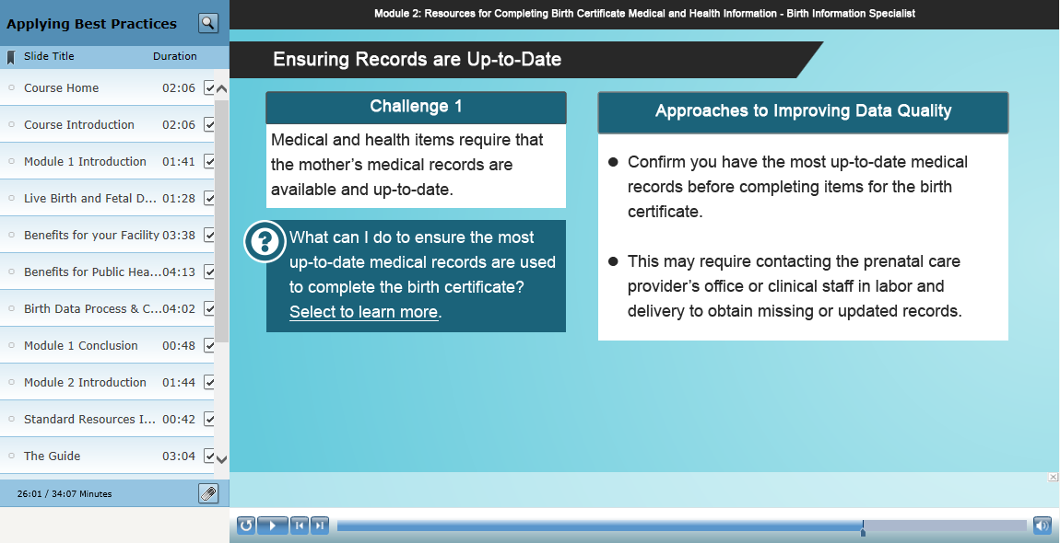

Notes:
For the BIS, we outlined 4 main challenges.
The first is ensuring the records they are using are up-to-date, which mainly relates to prenatal care records.
The learner can then select the question box to reveal approaches to improving data quality.

Slide 35

Notes:
Following this challenge and response, we have a knowledge check or learning activity to test this information. Here the example relates to what happens when Mary does or does not use updated prenatal care records to record information on “number of prenatal care visits” and “hypertension during pregnancy”

Slide 36

Notes:
We show that when Mary doesn’t use updated records, she inputs 11 visits and NO hypertension.

Slide 37

Notes:
However, with the updated records, she actually sees that the mother developed pre-eclampsia and had several more visits due to high blood pressure.
So, this gives the user, a sense of the data quality issues that can arise without updated info.

Slide 38


Notes:
The 2nd challenge is ensuring adherence to the standard definitions, which we mainly emphasize use of the Guide.

Slide 39





Notes:
We then have a series of knowledge checks where they can use the Guide to respond – mostly about specific items that have known data quality issues.
We have questions on:
NICU Definition
Instructions for entering total number of visits
Matching birth certificate items to keywords in the Guide
Distinguishing augmentation and induction of labor
And definitions for breastfeeding

Slide 40

Notes:
The third challenge discusses issues of what to do when medical records are not complete or the information is not readily accessible in the records.
We point out that the information may be contained in the notes and emphasize working with clinical staff after careful review of the records.

Slide 41

Notes:
We also discuss how to complete incomplete date information under this challenge category. Making sure to enter all parts that are known, but that they should not estimate a number when unknown.

Slide 42

Notes:
The knowledge checks in this case, mostly focus on completing dates and processes for what to do when the information is not complete.

Slide 43

Notes:
The last challenge is on reconciling conflicting or unclear medical and health information – so the information may in the records, but different records are either conflicting or not consistent.
In this case, we again emphasize, working with clinical staff, up front, to identify best sources for this information in their facility, checking with the Guide, or checking with a clinician.

Slide 44

Notes:
In the knowledge check that follows, we provide an example of how the nurse can help facilitate the accuracy of this information for the obstetric estimate of gestation.

Slide 45

Notes:
We end the BIS segment with an option to go to the end of the course or review the Clinician content.
For this demo, I’ll only briefly cover the clinician content, as a lot of it overlaps with what you just saw.

Slide 46




Notes:
As I mentioned, the challenges for the BIS and Clinician are similar,
but for the clinician content we focus more on documentation issues and understanding the information that is collected on birth certificates, so that the clinician can provide the proper information in the records for the BIS to find.
[Click to Scroll]
The first 4 challenges are similar to what we just saw for the BIS, but for the clinician, we use slightly different examples and knowledge checks, focused on knowing definitions of the items, making sure to document information consistent with these definitions, and how the clinician can help the BIS accurately record this information.

Slide 47

Notes:
Now, one challenge that differs from the BIS content, is on reporting cause of fetal death.
Which, in discussions on data quality of the the report of fetal death, emerged as an important issue.
Particularly, since certain items were dropped from the Fetal Death report, the cause information becomes more relevant.
Therefore, in our training, we recommend that the cause of fetal death be reported by
The attendant at delivery or medical examiner
We also provide instructions on how to complete this information [emphasize 3rd bullet]
And we highlight other resources they can use, including the Medical Examiner’s and Coroner’s handbook

Slide 48

Notes:
This is a snapshot from a short video demo that highlights the instructions for completing sections 18a (the initiating cause) and 18b (other significant causes) for the fetal death report

Slide 49

Notes:
So, that concludes the clinician content. And learners are instructed to select the box to complete the course.
Clinicians are also provided the option to review the BIS content.

Slide 50

Notes:
At the conclusion of the course, we, again, emphasize the importance of their role in improving data quality and how data can be used to improve maternal and infant health in the US.

Slide 51

Notes:
The last few slides provide additional information and links on resources featured throughout the course.

Slide 52


Slide 53

Notes:
And then the end of the course.

Slide 54
Resources
Course landing page:
  http://www.cdc.gov/nchs/training/BirthCertificateElearning/
CDC TRAIN (certificate of completion)
  http://www.cdc.gov/nchs/training/BirthCertificateElearning/certificate.htm
  https://cdc.train.org/DesktopShell.aspx
TCEO (continuing education credits)
  http://www.cdc.gov/nchs/training/BirthCertificateElearning/continuing-education.htm
  https://www2a.cdc.gov/TCEOnline/
Notes:
These last few slides are just a few resources for you:
Links to the course landing page, and the instructions and login pages for the certificate of completion and the continuing education credits,

Slide 55
Resources
Promotional Flyer
  Email MOsterman@cdc.gov for electronic copy
Notes:
A preview and contact (me) for a promotional flyer you might want to send out to your hospitals,

Slide 56

Resources
Updated Guidebook:
  http://www.cdc.gov/nchs/data/dvs/GuidetoCompleteFacilityWks.pdf
  Email MOsterman@cdc.gov to order hard copies
    Free!
    Order as many as you want!
Notes:
And a link to the updated guidebook.
You may also contact me if you would like to order any hard copies of the guidebook to distribute to the hospitals. They are 100% free and you can have as many copies as you want.

Slide 57
Available NOW!
Come and get it!
Notes:
And before I finish, I just want to emphasize that this training is available now. It launched on October 31 and is ready when you are.

