Slide 1
Creating Accessible PowerPoint Presentations
Presenter
Jennifer Reid
Office of Information Services
Information Dissemination Staff

Slide 2
Introduction
This training is designed to help users create accessible Microsoft PowerPoint 2010 presentations intended for direct distribution on the Internet.

Slide 3
Outline
Section 508: why Comply?
Best practices, Slide Layout
Graphics and Textual Content
Graphics and Images
Alternative Text (Alt Text)
Grouping Images/Graphics
Charts and Graphs
Tables
Modifying the Slide Master
File Properties
Saving the Document

Slide 4
Section 508: Why Comply?
It’s the right thing to do:
13% of the population are deaf or hearing impaired.
1% of the population are visually handicapped from color blindness
5 % of the population have visual conditions not correctable by glasses.
It’s the law:
Section 508 of the Rehabilitation Act (29 U.S.C. 794), as amended by the Workforce Investment Act of 1998 (P.L. 105-220), August 7, 1998.

Slide 5
Best Practices for Slide Layout
Always add text after applying a slide layout.
Using a Slide Layout template avoids the chance of random objects “hiding” on a page and ensures that the same content visible to sighted users is accessible by all assistive devices.
Notes:
Never use text boxes, always use slide layout. Text boxes are considered objects and are not read by some assistive devices.

Slide 6
Formatting Accessible Slides
To choose a slide layout: select ‘Layout’ located under the home tab and select the appropriate slide for your content.
All text should be viewable in the PowerPoint's’ outline view.
Text typed in a text box will not be viewable in the outline view.

Slide 7
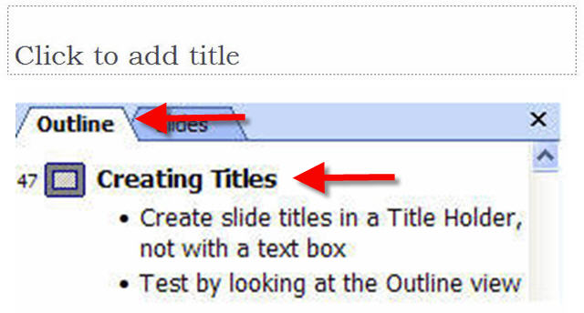
Creating Slides Titles
Best Practices for Slides Titles are to create them with a Title Holder rather than a Text Box. Title holders are available in almost all slide layouts.

Slide 8
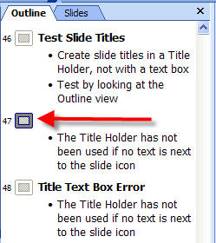
Text Box vs. Title Holder
The Title Holder has not been used if text next to the slide icon is not showing.
All text must appear in Outline View.

Slide 9
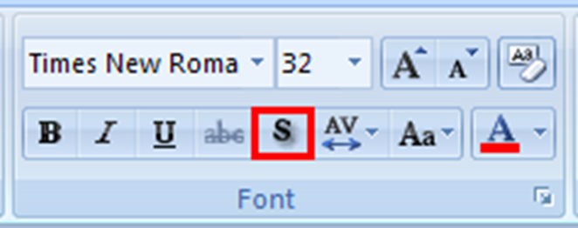
Fonts
Use recommended fonts such as:-
Times New Roman
Verdana
Arial
Tahoma
Helvetica
Avoid the use of text shadow
To remove shadow text, highlight the shadow text and click the “S” symbol located under the home tab.

Slide 10
Additional Considerations for Textual Content
Avoid the use of slide animations and flickering/flashing text.
Text containing hyperlinks should display the fully qualified URL (i.e. http://www.cdc.gov/and not www.cdc.gov).
Slides containing hyperlinks should have active links.

Slide 11
Graphics and Images
When using a graphic, select a slide layout that incorporates an image placeholder.
Insert the graphics/image using the placeholder. Do not paste images directly into he slide.
All graphics/images require an alternate text (alt text) description.

Slide 12
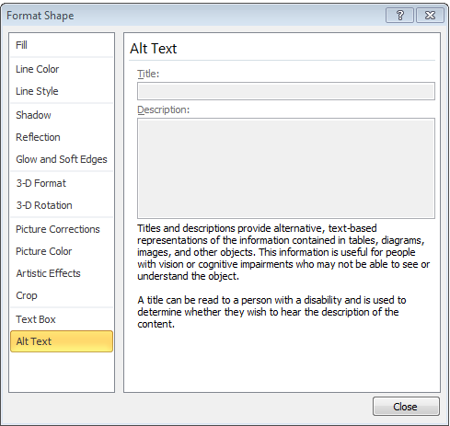
Adding Alternate Text
All graphics must have Alt Text.
If image is decorative or background, apply empty “ “ alt-text.
In order to add Alt Text:
Right click on the image/graphic
Select Format Picture
Select Alt-text
Add title and Alt Text description in the space provided.
Notes:
Alternative text descriptions must be added to all images and objects.
Images
Photos
logos
Objects
Inserted textboxes
Auto shapes
Word art

Slide 13
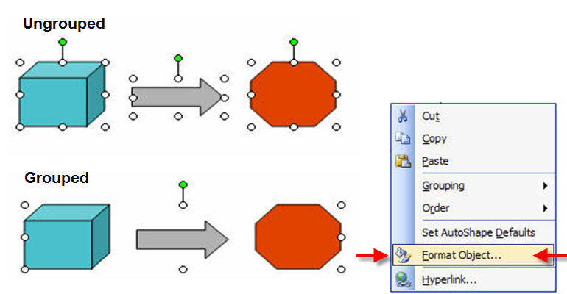
Grouping Images and Graphics
An illustration created from several smaller images must be grouped to form one image/graphics.
Select image/graphics, right-click, and used select Group.
Grouped images/graphics will need Alt Text
Notes:
Objects and shapes that are connected-such as organization charts-must be grouped for usability and coherence.

Slide 14
Charts and Graphs
Charts should be labeled appropriately with Title, Legend, and Axis labels.
Charts are considered complex images and should include a text description directly under the chart.

Slide 15
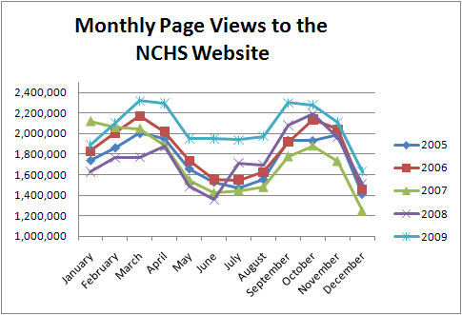
Example Chart
Line graph showing monthly page views to the NCHS website by year, from 2005 through 2009. Page views in 2009 show increases ranging from 10 to 33 percent over monthly totals in previous years.
Notes:
If you do want to add a textual description below the image, you may save the chart object as an image (right click the chart and choose Save as Picture) and apply an alternate text description.

Slide 16
Tables
Tables should be created within PowerPoint using the ‘Table’ feature, located under the Insert tab.
Tabular data should not be displayed through the use of tabs and spacing.
Tables should have
Logical relationships between data
Labeled column and row headers
Title, number (if applicable) and description

Slide 17
Example Table
Table. Calories consumed and hours of exercise, by work day: week of June 13, 2010
 | Monday | Tuesday | Wednesday | Thursday | Friday
Calories Consumed | 2000 | 2100 | 1900 | 1700 | 2500
Hours of Exercise | 1.0 | 1.0 | 0.5 | 1.5 | 0.0

Slide 18
PowerPoint Themes
Themes with pre-selected backgrounds and fonts can be problematic for accessibility. Many themes use shadow text for Slide Titles.
Slide backgrounds and fonts can also be an issue for users with color blindness or users with low vision. Choose a theme that has good color contrast between text and background.

Slide 19
Modifying the Slide Master
Modifying the Slide Master allows you to remove problematic text shadows once rather than every time a new slide is created.
To edit the Slide Master: select ‘Slide Master’ – located under the ‘View’ tab.
Remove text shadow from all slides in the Slide Master. Fonts and colors can also be customized within the Slide Master.
Notes:
It is best to modify the Slide Master before you begin creating your presentation. Slides created before editing the Slide Master may not be affected.

Slide 20
Adding File Properties
All accessible PPT’s must have properties associated with the document:
Select File, Properties
Provide information for the following fields:
Author (ex. National Center for Health Statistics).
Title
Subject
Keywords
To Set language: Select Review, Language
Notes:
An individuals name should NOT be used for the ‘Author’. Always use the government organization name (ex. National Center for Health Statistics)

Slide 21
Saving the Documents
Best practices for saving the document:
Use alpha numeric characters.
Use underscores instead of spaces.
Files names should not contain spaces or special characters (e.g., !, @, #, $, %).
File name should be limited to 20-30 characters.
File name should be indicative of the content presented.

Slide 22
Review
Text
Create all slides using pre-built slide layouts
Always use the Title Holder for slide titles
All text must appear in the Outline view.
Images
All images require an Alternate Text descriptions.
Graphics made with multiple parts must be grouped.
Charts and tables should be labeled appropriately and should be created using PowerPoint.
Modify the Slide master to remove problematic fonts, styles, and colors from Slide Layouts.
Check Document Properties and File Name

Slide 23
Resources
HHS Accessible PowerPoint Checklist
http://www.hhs.gov/web/policies/checklistppt.html
Notes:
See HHS Checklist for a list of the requirements reviewed in this presentation

