Slide 1

Census and NCHS
Robert M. Groves
August 17, 2010

Slide 2
Outline
Overview of 2010 Census Operations
Concepts of Quality in a Census
NCHS and Census
2

Slide 3
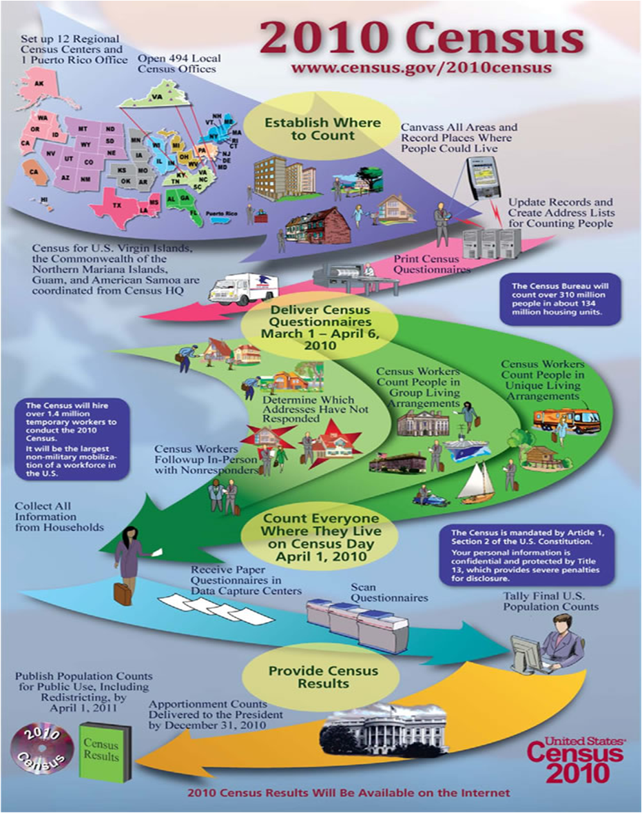
3

Slide 4
2010 Census Key Dates
Jan 17 – advertising launch
Feb 17-19 – advance letters mailed
Mar 15-17 – questionnaire mailed
Mar 18-19 – reminder postcard mailed
April 1 – CENSUS DAY
April 1-10 – replacement forms
May 1-July 10 – non-response follow-up
Dec 31 – deliver population info to President
Apr 2011 – delivery of complete delivery of info to states
4
Notes:
Interesting operational tidbits – we used helicopters in Address Canvassing in Mississippi where flooding prohibited our ability to get people in on the ground, we had listers (and will have enumerators) in the Northwest who face significant challenges getting into places because of snow (as in spent the night in their vehicles), I believe we’ve used boats in lower areas of Louisiana to get to remote areas, and we’ll be dealing with desert heat for NRFU in the Southwest.
Other unique living situations include carnivals, campsites, and motels, as well as marinas.
A lot of what we encounter is planned for in the Tract Action plans. For example, language problems can be identified with the Linguistic Isolation data (by specific languages). Groups (pairs/blitz depending on volume) of interviewers working together can be predicted by the presence/size of large multiunit structures, low return rates indicate reluctance (more partnership help), many vacants indicate more work with realty staff, owners, property managers,etc, to establish the actual status of the units (this will be a big thing with foreclosures etc.), overcrowded households indicate the need to ensure that all persons are accounted for on the form (review coverage questions as a point of emphasis), many rental units and recent movers indicate a fluid population that may be hard to contact (this is where local knowledge is key--what is the best time to call)...etc.

Slide 5
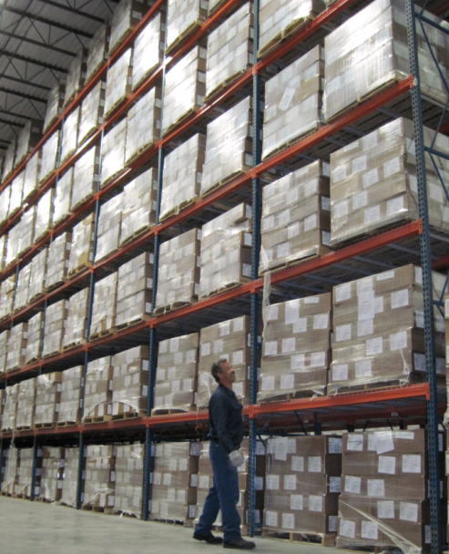
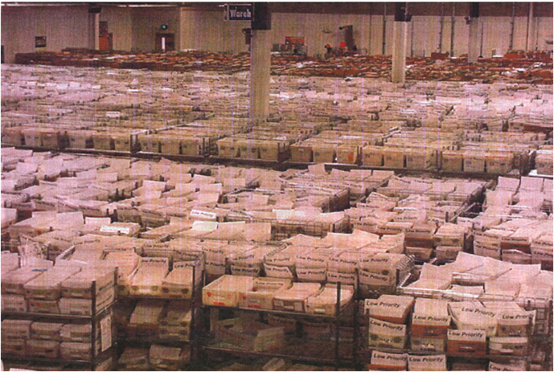
The Questionnaire
120 million questionnaire packages
134 million housing units contacted by mail or in person
5

Slide 6
Design Features Addressing
Burden of response
  Advance letter
  Reminder card
  Replacement questionnaire
Language impediments
  Spanish-English questionnaire
Diversity of community support for participation
Benefits and safety of participation
6

Slide 7
A Small Request
Name
Gender
Age
Ethnicity
Race
Other residence
Own/Rent
Telephone no.
7

Slide 8
2010 Census
Language
Program
Census
Forms (6)
English . Chinese-Simplified Korean . Russian . Spanish Vietnamese
97.8%*
Promotional Materials, Paid Media (TV, Radio, Print, OOH, and/or Web) (28)
99.4%*
Arabic . Armenian. Bengali . Chinese-Mandarin . Chinese-Cantonese English. Farsi. French. German . Greek . Haitian Creole . Hindi . Hmong Italian . Japanese . Khmer . Korean . Laotian . Polish . Portuguese Russian Spanish . Thai . Tagalog . Ukrainian . Urdu. Vietnamese . Yiddish
Language Assistance Guides (59)
99.7%*
Albanian . Amharic . Arabic . Armenian . Bengali . Bulgarian . Burmese . Cebuano . Chamorro . Chinese-Simplified . Chinese-Traditional . Chuukese . Croatian . Czech . Dari . Dinka . Dutch . Farsi . French . German Greek . Gujarati . Haitian Creole . Hebrew . Hindi . Hmong . Hungarian . Ilocano . Italian . Japanese . Khmer Korean . Laotian . Lithuanian . Malayalam . Marshallese . Navajo . Nepali . Polish . Portuguese . Punjabi Romanian . Russian . Samoan . Serbian . Somali . Spanish . Swahili . Tagalog . Tamil . Telugu . Thai . Tigrinya Tongan . Turkish . Ukrainian . Urdu . Vietnamese . Yiddish
99.8%*
Partnership Staff Linguistic Capabilities (101)
Albanian . Amharic . American Sign Language . Anishinaabemowin . Arabic . Aramaic . Armenian . BahasaMelayu . Bengali . Bicol . Bosnian . Bube Burmese . Caddo . Cebuano . Chaldean . Chinese-Cantonese . Chinese-Chaochowese . Chinese-Fukienese . Chinese-Mandarin . Chinese-Shanghaiese Chinese-Simplified . Chinese-Traditional . Choctaw . Coushatta/Koasati . Creole . Dakota . Dutch . English . Fang . Farsi . Flemish . French . French Creole German . Greek . Gujarati . Haitian Creole . Hawaiian . Hebrew . Hindi . Hmong . Hokkien . Hungarian . Igbo . Indonesian . Irish Gaelic . Italian . Japanese Keres . Khmer . Kickapoo . Korean . Lokata . Laotian . Lithuanian . Lummi . Maliseet . Marshallese . Mayan-Yucatec . Micmac . Mixteca . Mohawk . Muskogee . Navajo . Nez Perce . Oneida . Oriya . Oromo . Pawnee . Polish . Portuguese . Portuguese-Brazilian . Portuguese Creole . Punjabi . Purepecha . Russian Sahaptin . Salish . Samoan . Sinhalese . Slovak . Somali . Spanish . Swahili . Tagalog . Taiwanese . Tamil . Taosanese . Teochew . Thai . Tigrinya . Tongan Ukrainian . Urdu . Vietnamese . WikangFilopino . Wolof . Yiddish . Yoruba
8
* Percent of all adults either in their native tongue, or in English for those who are bilingual
As of June 22, 2009

Slide 9
Customization of 2010 Census Operations
Tract Action Plan - options for each Local Census Office (LCO) to use specific to tracts with high hard-to-count scores
Specific activities within 3 main areas:
  Recruiting
  Partnership
  Data Collection/Enumeration
“All Census is Local”
9
Notes:
Tract Action Plans are informed by data, supported by local knowledge and experience, and implemented with civic commitment to count every resident, only once and in the right place.
HTC (Hard to Count) scores range from 0 to 132 indicating increasing operational difficulty as the score increases. Scores calculated from neighborhood tract data from the 2000 Data for Census 2000 Planning. Characteristics used to calculate are vacant, not single family, renter, overcrowded, not husband/wife, no phone, below poverty, public assistance, unemployed, not high school grad, language, recent mover.
Non-paid recruiting tactics – flyer, poster, community organization, government organization, presentation, job fair, friends/relative, news article, internet, school, business
Paid recruiting tactics – newspaper ads, radio, mailing, TV
Partnership tactics – Language/Culture (in language material, in language media blitz, foreign/immigrant outreach), Church/School (faith based outreach, Census in schools), Site Specific (questionnaire assistance center, Be Counted site), Special Emphasis (special community event, CCC targeted focus, partnership support program)
Enumeration tactics – blitz, teams, Language/Culture (bilingual enumerators, guides/facilitators), Other (apartment mix-ups, special populations, gated communities, high security areas, high crime areas)
“All Census is Local” – We work with and hire local residents who know the social landscape of their community. This includes language, culture, neighborhood practices, etc. We do this by recruiting at the neighborhood level working with our partners and/or tapping into local housing organizations, newpapers (local--pennysavers etc,). Word of mouth is our most powerful motivational strategy in recruiting local Census employees. Next, we train employees in the basics (technical and administrative) and then support them. The support is the most important since we strive to have regular (daily if practical) contact with enumerators to solve problems that arise. For example, dealing with locked buildings, dogs, reluctant respondents, safety issues, location problems (cannot find the unit), etc. Sometimes we need to hire interpreters, guides, cultural facilitators, etc. to get access to our respondents....whatever it takes. In general, access to the respondent is the most generic way of describing enumeration problems.

Slide 10
2010 Census Integrated Communications Campaign
Partnership
Earned Media/PR
Digital
Paid Advertising
Census in Schools
10
Notes:
Census in Schools – Materials developed for grades K-12 (for 50 states and Puerto Rico). Distributed online and via direct mail. Take home materials developed in 28 languages. Scholastic Inc. developed curriculum, and Sesame Street is a key partner.
Digital Outreach – Have website to mobilize individuals to become advocates for 2010 Census, will be in Spanish as well. More than 150 forms of social media being used. Website has blog by Dr. Groves and language support for 59 languages.
Earned Media/PR – 2010 Portrait of America Census road tour made up of 13 vehicles. One vehicle for each of 12 regions and one national vehicle. Events from Super Bowl, Daytona 500, NCAA finals, and local and regional stops. Kick off on The Today Show on January 4, 2010. Response rate feedback program, “Take 10”
Partnership – Combine the strengths of state, local, and tribal governments, community-based organizations, faith-based organizations, schools, media, businesses and others to ensure an accurate 2010 Census. Regional partnership specialists’ goal is to recruit, train, support and advise trusted local leaders who will use their influence and existing networks to motivate their constituents to participate in the 2010 Census. Also developing partnership agreements with hundreds of major corporations, including Target, Coca-Cola, Best Buy, MTV, Google, UPS, FedEx, Home Depot, General Mills and many more.
Paid Advertising – Skewed toward “hard to count” segments of the population. Television, Radio, Interactive (internet or digital), outdoor and transit, and print (newspapers and magazines). 53% local buys and 47% national buys, allowing a focus at the local level. Starting January 10, 2010, the Census Bureau will be largest advertiser in the country. Developed in 28 languages.

Slide 11















2010 Census Asian Posters

Slide 12
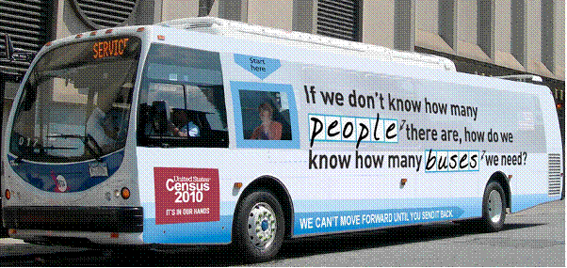

Slide 13
Current Status
Finished followup on 47 million nonrespondent units, using about 600,000 interviewers
In middle of final quality assurance steps doubling checking status of complicated cases
Starting post-enumeration sample survey

Slide 14
Head’s Up! A Confusing Few Months Ahead
September – One-year 2009 ACS estimates
December – 2010 Demographic Analysis
December – 2005-2009 five-year ACS estimates
December – 2010 decennial census state counts, reapportionment results

Slide 15
Outline
Overview of 2010 Census Operations
Concepts of Quality in a Census
NCHS and Census
15

Slide 16
Concepts of Quality in a Census
Distance from an Ideal Outcome
Similarity to an Alternative
Soundness of Process of Data Collection

Slide 17
No Two Uses of Census Counts have the Same Quality
These have different challenges
  Total population count of the US
  Total population count of each of the 50 states
  Total population count of each of the 8 million census blocks
  Total African-American, Hispanic, Asian population count of each of the 8 million blocks

Slide 18
1. Distance from an Ideal Outcome
Common evaluation with known truth
  Percentage correct on examinations
  Percentage unscheduled downtime for computer systems
Ideal for all population enumeration use:
  “Count every resident once and only once and in the right place”
For a census we have no measured ideal

Slide 19
2. Similarity to an Alternative
Demographic Analysis (Fall, 2010)
  Vital registration system supplies births, deaths
  Emigration and immigration from records and diverse other sources
National totals for age by gender by race/ethnicity
Weaknesses
  Undocumented immigration
  Ethnicity measurement on records

Slide 20
2. Similarity to an Alternative (contd.)
Post-enumeration sample survey (2012)
  Matches and nonmatches to census records
Estimates of matches and nonmatches for states and larger areas
Weaknesses
  Subject to sampling variance
  “correlation bias”
  Recall error re April 1 status

Slide 21
3. Soundness of Process of Data Collection
Feature | Evaluative Indicator Relative to 2000
Local government participation in Update of Census Addresses | Percentage of governments is lower; percentage of population represented is similar
Continuous update of Address List | Total housing units closer to independent estimate; fewer deleted listings (4 million vs 6 million in 2000); fewer additions in followup phase (635K vs 689K)
Communications campaign | Similar awareness, intention to participate

Slide 22
3. Soundness of Process of Data Collection
Feature | Evaluative Indicator Relative to 2000
Short-form only design | Higher participation rates than long form (overall 72% in 2010 vs. combined short-long 69% in 2000)
Bilingual questionnaire to 13 million households with >20% Spanish-speakers | Increased participation rate by about 2 percentage points
Replacement form sent to 40 million households, targeting hard to enumerate | Increased participation in hard to enumerate areas

Slide 23
3. Soundness of Process of Data Collection
Feature | Evaluative Indicator Relative to 2000
Verification of composition for households with dynamic membership | Recontact with more households (7.5 million versus 2.5 million)
Assignment to enumerators | Fewer miles per interview
Nonresponse followup visiting rules the same | Higher percentage of population counts in households from proxy respondents
Percentage of occupied units without population counts after nonresponse followup | Higher in 2010; 2% (2010) vs 0.5% (2000)
Notes:
New slide with info about occupied units without population counts

Slide 24
3. Soundness of Process of Data Collection
Feature | Evaluative Indicator Relative to 2000
Vacant housing units | 14.3 million in 2010 vs. 9.9 million in 2000; fits expected results of mortgage crisis
Match of Coverage Survey Listings to Address File used for Census | Better initial match in 2010 (96%) than 2000 (91%)
Quality control reinterviews | Essentially all enumerators subject to reinterviews (vs. 75% in 2000); smaller percentage of enumerators failing to meet quality standards
Meeting deadlines on data collection | All 11 operations since mid-2009 on schedule and significantly under budget

Slide 25
Outline
Overview of 2010 Census Operations
Concepts of Quality in a Census
NCHS and Census
25

Slide 26
NCHS in the Statistical World
A science-driven statistical agency
For many years a key contributor to innovation in measurement, processing, and dissemination of important statistical information for the US
A voice for quality and the need for statistical independence

Slide 27
Key Partnerships between NCHS and Census
A sister agency of the Federal statistical system
Household surveys
  National Health Interview Survey
Facility surveys
  The National Ambulatory Medical Care Survey
  The National Hospital Ambulatory Medical Care Survey
  National Hospital Discharge Survey
Data dissemination
Statistical re-use of administrative records

