Slide 1
National Conference on Health Statistics

Slide 2
Data for Action and Health Reform

Slide 3
NCHS at 50
A brief history …
NCHS today
Our principal roles
Impact of Reform
A glimpse of the future
Dissemination and Community Data
Notes:
Dewey didn't take risks. He spoke in platitudes, trying to transcend politics. Speech after speech was filled with empty statements of the obvious, such as the famous quote: "You know that your future is still ahead of you." An editorial in the Louisville Courier-Journal summed it up best:
"No presidential candidate in the future will be so inept that four of his major speeches can be boiled down to these historic four sentences:
Agriculture is important.
Our rivers are full of fish.
You cannot have freedom without liberty.
Our future lies ahead.“
Mort Sahl -- 1958

Slide 4
But first….
Thank you to our plenary speakers
Thomas Frieden (this morning)
Ed Spar (this afternoon)
Bob Groves (this afternoon)
Kathy Wallman (this afternoon)
Connie Citro (this afternoon)
Michael Wolfson (Wednesday morning)

Slide 5
But first….
Thank you to our NCHS
Conference Committee
Our Speakers and
Our Reception’s Sponsors

Slide 6
We invite you to…
Our Conference sessions, exhibits and posters
Join us for tonight’s reception
Give us your feedback—attend our informal session in the Senate room during lunchtime today or tomorrow

Slide 7
A Brief History …
1956: Congress passed the National Health Survey Act
1960: NCHS was established
Brought together the National Health Survey and the National Office of Vital Statistics
Mission:
Monitor Health and Health Care
State and local needs (Cooperative Program)
Research and Training

Slide 8
National Center for
Health Statistics
Bureau of
Transportation
Statistics
National Center for
Education Statistics
Economic
Research Service
Bureau of Labor Statistics
National
Agricultural
Statistics Service
Bureau of
Justice Statistics
Energy Information
Administration
Bureau of
the Census
Bureau of
Economic Analysis
NSF Science Resources Statistics
IRS Statistics of Income
SSA Research Evaluation and Statistics

Slide 11
A Brief History …
Health Records Survey (1965)
➔ Health Care Surveys
National Survey of Family Growth (1973)
State and Local Area Integrated Telephone Survey (1997)
The Health Survey’s major programs
Health Interview Survey (1957)
Health Examination Survey (1959)
➔ Health and Nutrition Examination Survey
Plus Others

Slide 12
A Brief History …
Health Records Survey (1965)
➔ Health Care Surveys
National Survey of Family Growth (1973)
State and Local Area Integrated Telephone Survey (1997)
The Health Survey’s major programs
Health Interview Survey (1957)
Health Examination Survey (1959)
➔ Health and Nutrition Examination Survey
Vital Statistics (Ancient Egypt, 900, 1946, 1960)

Slide 13
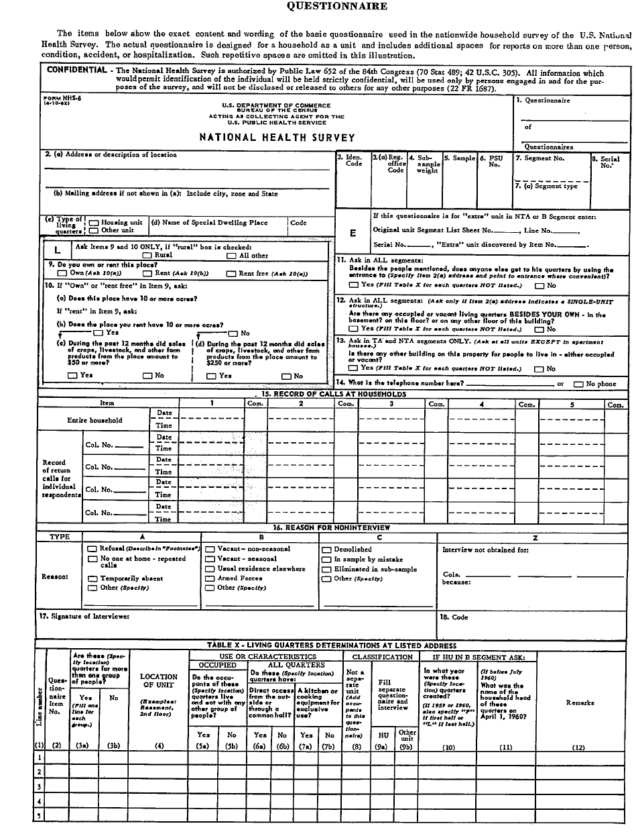

Slide 14
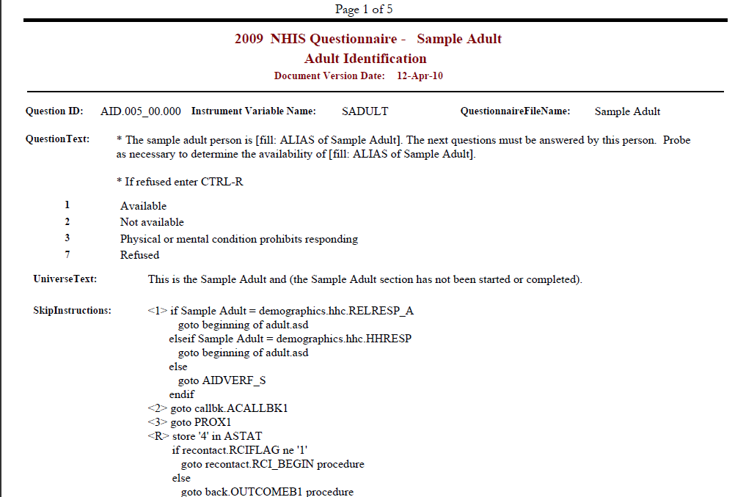

Slide 15
Mobile Exam Center Circa 1960

Slide 16
Mobile Exam Center Today

Slide 17
1960 Data Challenges (National Health Survey Act)
Number and characteristics of persons suffering from heart disease, cancer, diabetes, arthritis and rheumatism, and other diseases, injuries and handicapping conditions…
Need for reasonably current periodic inventories
For appraising true state of health
For adequate planning to improve health
For research in the field of chronic diseases
For measurement of the numbers of persons in working ages so disabled as to be unable to perform gainful work

Slide 18
Current Data Challenges
Health Reform/Affordable Care Act
What are the data needs in this time of health reform?
Open Government and Community needs
How is NCHS meeting state and local (community) needs
Dissemination
How do we focus our data to meet research and policy needs?

Slide 19
Patient Protection and Affordable Care Act

Slide 20
Affordable Care Act Data and Measurement Provisions
Vital statistics
Quality improvement
Disparities
Levels of geography
Health outcomes
Oral health
National health indicators

Slide 21
Uninsured Rates for Persons Under Age 65, By Poverty Status and Age, 1997 and 2008
Percent uninsured
Source: CDC/NCHS , National Health Interview Survey

Slide 22
Trends in Stroke Mortality, By Race and Ethnicity, 1981-2006
Stroke, Blacks
Stroke, Whites
Stroke, Hispanics
Source: CDC/NCHS , National Vital Statistics System

Slide 23
Trends Diabetes Mortality, By Race and Ethnicity, 1981-2006
Blacks
Hispanics
Whites
Source: CDC/NCHS , National Vital Statistics System

Slide 24
Affordable Care Act Evaluation Assessing change over time in …
Coverage and access to care
Low and middle-income families and childless adults
Dependents up to age 26
Barriers to primary care
Access to care for chronic conditions
State variation in coverage and access
Use of clinical preventive services (no longer subject to cost sharing)
Population health and health disparities
Electronic Health Records: Adoption and meaningful use

Slide 25
Affordable Care Act
Requires data on health status and access to care by sub-populations
Race and ethnicity (and underserved rural and frontier populations)
Primary Language
Sex
Disability status
Plus (possibly) other factors
Collected at the lowest geographic level—
Data for local level decision-making

Slide 26
NCHS Challenge: With Limited Resources to Navigate Competing Priorities
Which data are most critical for setting baselines and measuring impact of programs and policies?
What are the most important new data elements and for which populations?
Geographic detail
Which sub-populations?

Slide 27
NCHS Program Changes to Meet Affordable Care Act/ARRA

Slide 28
Program Changes…
Affordable Care Act: New survey questions
For example — new questions on the NHIS about health insurance coverage
Adding new questions to long-term care surveys to respond to anticipated direct care workforce shortages
Developmental work on questions about delivery of clinical preventive services
Assessing adoption and meaningful use of Electronic Health Records

Slide 29
Program Changes…
Expanding sample size of our surveys to provide more data for subpopulations
Selected state-level estimates from the NAMCS on primary care visits
Surveying new provider settings including community health centers and residential care places
NAMCS = National Ambulatory Medical Care Survey

Slide 30
NCHS Continuing Priorities …
Timeliness
Research to improve quality
Data access for confidential and non-confidential data
Targeted dissemination for research and policy [National and Community]
And support of joint agency efforts …

Slide 31
A Word About Timeliness
Two Examples:
Health Interview Survey
Key indicators quarterly
Full year within 6 months of close
NHANES
Full year of data within 8 months of close

Slide 32
Timeliness
Future expansion of electronic registration systems for birth and death (with NAPHSIS)
NAMCS mail survey supplement on use of Electronic Medical Records
Continuous interviewing design for National Survey of Family Growth

Slide 33
Quality
Scientific review of all NCHS programs by our Board of Scientific Counselors
Improved interviewer training for Census interviewers for NHIS
Use paradata to improve management and quality of data collection
Research to assess impact of cell phones and response rates

Slide 34
Access
New publications, including Data Briefs series and Health US in Brief
Advances to NCHS website including award-winning NHANES tutorial, tools such as Health Data Interactive and VitalStats and development of Indicators Warehouse
Expansion of network of Research Data Centers
Work to expand data linkages across agencies, and …..

Slide 35
Dissemination

Slide 37
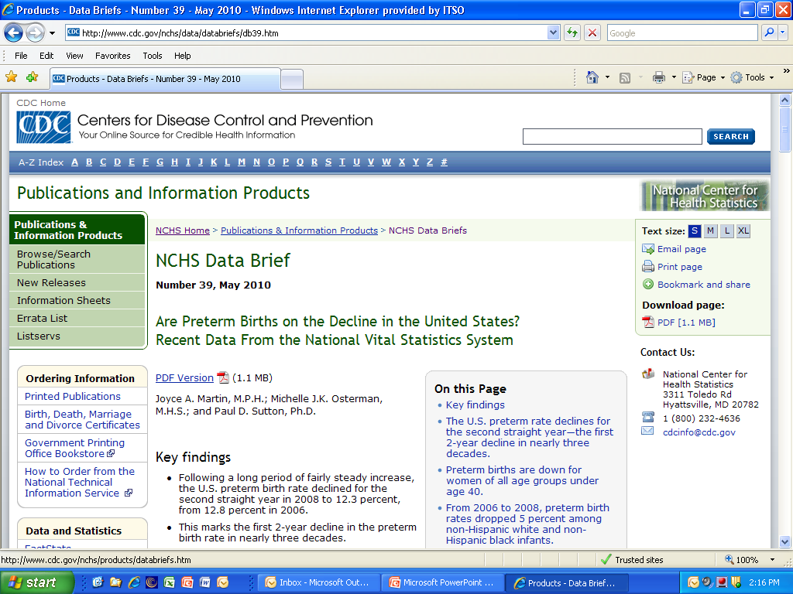

Slide 38
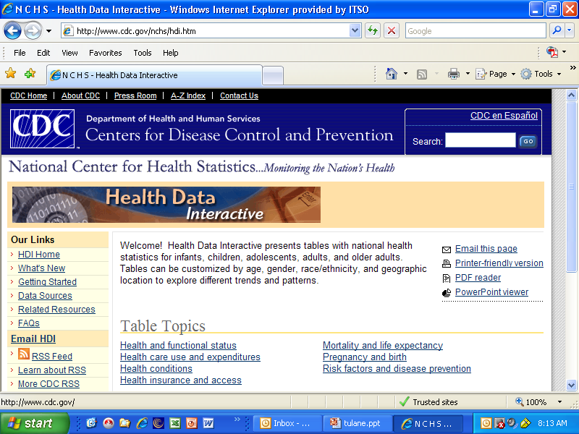

Slide 39
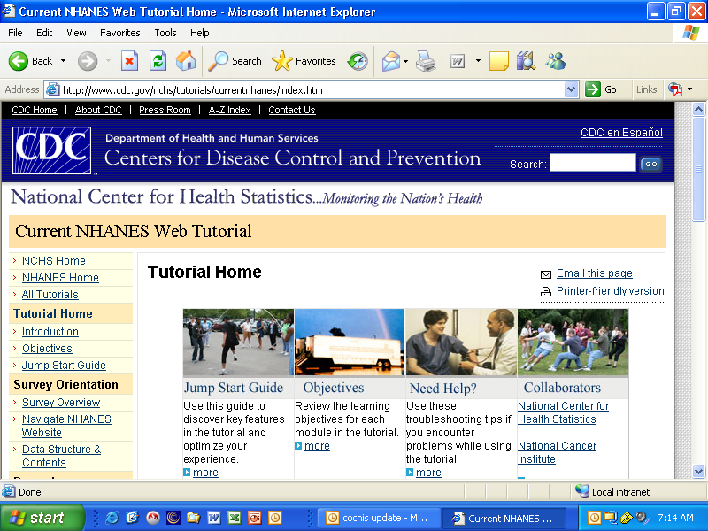

Slide 40
Census and NCHS Research Data Centers
Cornell
Ann Arbor •
•
Chicago •
NYC
•
Boston
•
• UC Berkeley
Hyattsville •
CES - Washington DC •
Triangle •
• UCLA
Atlanta •

Slide 41
NCHS Continuing Priorities …
Timeliness
Research to improve quality
Data access for confidential and non-confidential data
Targeted dissemination for research and policy [National and Community]
And support of joint agency efforts …

Slide 45
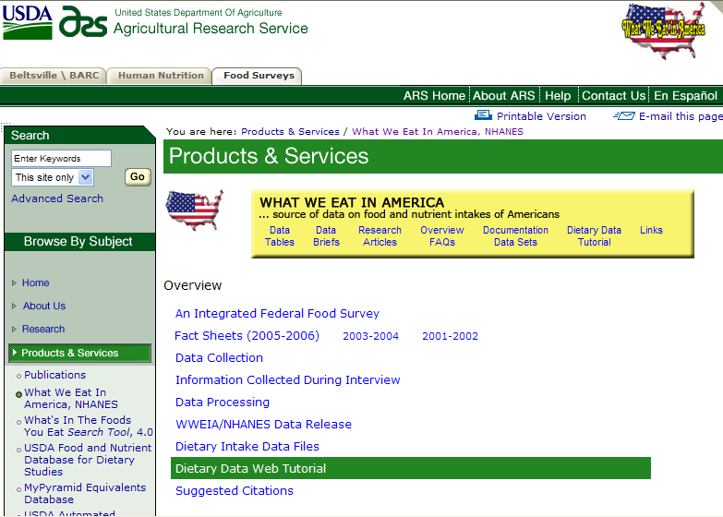

Slide 46
CDC’s Winnable Battles
Tobacco use
Nutrition/obesity
HIV
Healthcare associated infections
Motor vehicle accidents
Teen pregnancy

Slide 47
Demand for Data at The Community Level

Slide 48
Data at The Community Level Health Indicators Warehouse

Slide 49
Health Indicators Warehouse
Aims
Wider dissemination and application of health indicators and HHS data
Harmonize and improve data quality
Warehouse is the core of the HHS Community Health Data Initiative under Open.gov

Slide 52
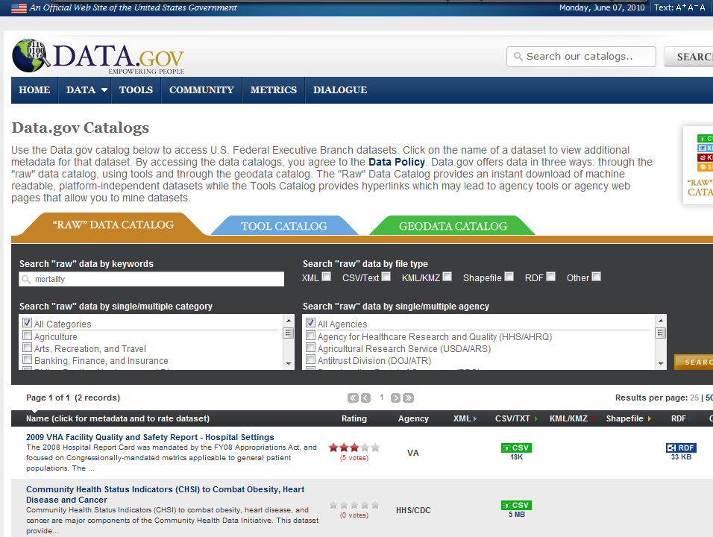

Slide 53
Health Indicators Warehouse
Phase I (2011) will include:
Healthy People 2020
Community Health Status Indicators
CMS data
MATCH indicators
State of the USA

Slide 54
Community Health Data Initiative
Innovators
Data Sources
Health Indicators Warehouse (HIW)
Other federal data sets
State and local governments
Private sector data suppliers
Others
Applications
End Users
Feedback on data

Slide 55
Innovators
Data analytics firms
Social networking providers
Web search providers
Tech companies
Nonprofits / philanthropy
Media / journalism
Real estate information providers
Industries developing health-related products or services
Innovators
Applications
End Users

Slide 56
Applications
Interactive health maps. “mash-ups”
Applications
Networking apps
Challenges
Enhanced web search
“Best places to live” ratings and rankings
Games
Innovators
Applications
End Users

Slide 57
End Users
Patients
Consumers
Providers
Community leaders
Policymakers
Researchers
Corporations
Innovators
Applications
End Users

Slide 58
1960 Data Challenges (National Health Survey Act)
Number and characteristics of persons suffering from heart disease, cancer, diabetes, arthritis and rheumatism, and other diseases, injuries and handicapping conditions…
Need for reasonably current periodic inventories
For appraising true state of health
For adequate planning to improve health
For research in the field of chronic diseases
For measurement of the numbers of persons in working ages so disabled as to be unable to perform gainful work

Slide 59
Vision for 21st Century Health Statistics Influences on the Population's Health
Place & Time
Context
Community Attributes
Biological
Characteristics
Social
Natural
Environment
Built Environment
The Population’s Health
Health Services
Level
Distribution
Cultural Context
Disease
Functioning
Well-being
Economic
Population-based
Health Programs
Collective
Lifestyles
and Health
Practices
Political
Context

Slide 60
More Than Just Numbers

