Slide 1
The effect of ED crowding on outcomes
Jesse M. Pines, MD, MBA, MSCE
Associate Professor of Emergency Medicine and Health Policy
George Washington University
National Conference on Health Statistics– August 18, 2010

Slide 2
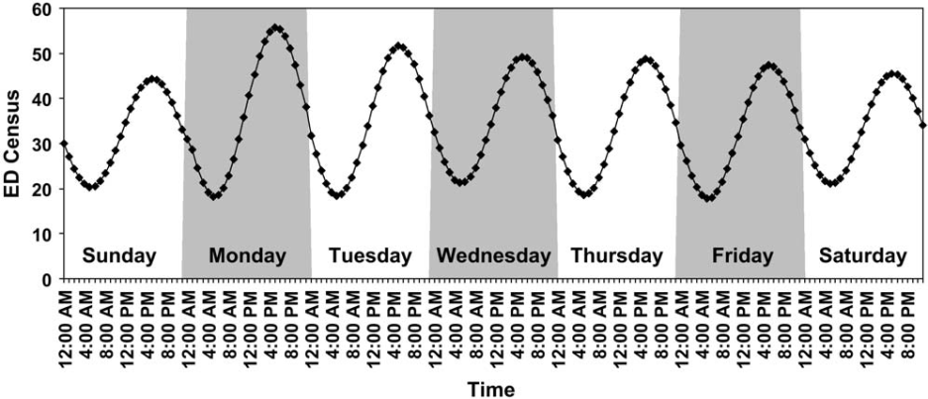
The problem of ED crowding
ED crowding is a periodic supply-demand mismatch
Effects
  Lower satisfaction
  Delays
  Errors &Complications
  Mortality

Slide 3
An exposure to “crowding”
Exposure
  When is the ED at “peak” capacity
  Ways to measure
    ED occupancy, census, waiting room number, NEDOCS, EDWIN, others
  The effect of crowding is longer time intervals
    Many studies have studied the link between longer intervals and outcomes

Slide 4
Satisfaction
Major reason for ED dissatisfaction: long waits
LWBS is related to long waits
  Higher LWBS rates during higher episodes of crowding
ED crowding associated with lower ED satisfaction scores
People don’t forget
  ED length of stay & hallway placement predict lower OVERALL hospital satisfaction
Pines Acad Emerg Med 2009

Slide 5
Satisfaction
Are these LWBS patients inconsequential?
Patients who LWBS are high risk
  60% of LWBS patients seek medical attention within one week
  11% hospitalized or require emergency surgery
Rowe Acad Emerg Med 2006
Baker JAMA 1991

Slide 6
Delays in care
Pneumonia care
  More likely to experience delays in antibiotics
    31% had abx after four hours during least crowded, 72% at most crowded times
Pain management
  More likely to experience delays with acute pain
    Hip fracture
    Abdominal pain
    Back pain
    Severe pain
Pines Ann Emerg Med 2008
Hwang Med Care 2006
Mills Acad Emerg Med 2009

Slide 7
Errors and complications
High workload is a significant factor in medical errors
More than 25% of patients have one or more undesirable events while boarding in the ED
Patients with chest pain 3-5x more likely to have a post-ED complication
Trauma patients who spend > 6 hours in ED intubated more likely to get ventilator pneumonia
Liu Ann Emerg Med 2009
Horowitz Ann Emerg Med 2009
Pines Acad Emerg Med 2009
Carr J Trauma 2007

Slide 8
Mortality
Australian studies
  Crowding - risk factor 10-day mortality (RR 1.34)
  Higher ED & hospital occupancy associated with higher 2, 7, and 30-day mortality (HR 1.2-1.3)
ED LOS > 6 hours associated with higher inpatient mortality in ICU patients
  12.9% < 6 hours; 17.4% > 6 hours
  Differences persist after adjustment
Richardson Med J Aust 2006
Sprivulis Med J Aust 2006
Chalfin Crit Care Med 2007
Notes:
al

Slide 9
Is the link ubiquitous?
Likely no!
Some populations are unlikely to be harmed by crowding
  The first few hours of obviously critically ill patients
  Difference is harm by hospital
Multi-center studies are needed
  NHAMCS may be potentially used to demonstrate the risks of crowding

