Slide 1



 | The National Committee on Vital and Health Statistics The Public Advisory Body to the Secretary of Health and Human Services
NCHS and NCVHS
A FIFTY-YEAR PARTNERSHIP
National Conference on Health Statistics
Washington, D.C.
August 18, 2010
Marjorie S. Greenberg, M.A., NCHS
Executive Secretary, NCVHS

Slide 2
 | NCHS and NCVHS A 50-Year Partnership
The National Center for Health Statistics (NCHS) was established in 1960 as the Nation’s principal federal health statistics agency, bringing together the National Office of Vital Statistics and the National Health Survey.
The National Committee on Vital and Health Statistics (NCVHS) had been established in 1949 as a federal advisory committee in response to a recommendation by the World Health Organization that all governments establish such committees.
Notes:
Specifically, the report from the Paris Conference, held in the spring of 1948, for the Sixth Decennial Revision of the International Lists of Diseases and Causes of Death , urged that all governments establish national committees on vital and health statistics…and that such national committees study broadly the problem of producing satisfactory national and international statistics in the fields of health…
The World Health Organization’s expectation was that governments would establish national committees on vital and health statistics for the purpose of coordinating the statistical activities in the respective country and to serve as a link between the national statistical institutions and WHO.
We are hosting this session on the occasion of NCHS 50th Anniversary and NCVHS 60th Anniversary, which we actually have been celebrating for the past two years!
Historical information comes from past annual reports of the NCVHS and in particular a 50 year history prepared by the NCVHS writer, Susan Kanaan.

Slide 3
 | NCHS and NCVHS A 50-Year Partnership
The NCVHS provides advice and assistance to the Department in the areas of health data, health statistics and national health information policy.
The NCVHS Executive Secretary has always been located in NCHS (or the National Office of Vital Statistics from1949 – 1960) with the exception of 1977-79.
NCVHS was written into the legislation for NCHS in 1974, which gave the Committee official status for advising the Secretary of Health, Education and Welfare.

Slide 4
 | The National Committee on Vital and Health Statistics The Public Advisory Body to the Secretary of Health and Human Services
The Committee received additional responsibilities to advise the Secretary on health data standards and privacy policy with passage of Health Insurance Portability and Accountability Act of 1996 (HIPAA).
Medicare Prescription Drug, Improvement and Modernization Act of 2003 (MMA) added responsibilities for recommending electronic prescribing standards.
Affordable Care Act of 2010 added responsibilities for advising on National Health Plan Identifier and Operating Rules for HIPAA Transaction Standards

Slide 5
 | The National Committee on Vital and Health Statistics The Public Advisory Body to the Secretary of Health and Human Services
History
Since 1949, the NCVHS has provided a bridge between government and the health industry, research and public health communities as well as connections to those working on health information policy in other countries.
Notes:
As I’ve noted, the original concept of a national committee was very much an international one, but for most of its 60-yearhistory, the Committee has focused primarily on domestic issues, while still monitoring international developments. The development of WHO Collaborating Centres for international classifications and other statistical topics took the place of an organization to serve as a link between the national statistical institutions and WHO. In fact, NCHS does house several such collaborating centres, including one for the WHO Family of International Classifications for North America.

Slide 6
 | The National Committee on Vital and Health Statistics The Public Advisory Body to the Secretary of Health and Human Services MEMBERS
Justine M.Carr, M.D. Caritas Christi Healthcare
Leslie Pickering Francis, J.D., Ph.D
University of Utah College of Law
Larry A., Green, M.D.
University of Colorado
Mark C. Hornbrook, Ph.D.
Kaiser Permanente Northwest
John P. Houston, J.D. University of Pittsburgh Medical Center
Garland Land, M.P.H.
National Association for Public Health Statistics and Information Systems
Sallie Milam, J.D.
West Virginia Health Care Authority
Blackford Middleton, M.D., M.P.H., MSc
Center for Information Technology
Partners Healthcare
J. Marc Overhage, M.D., Ph.D.
Indiana Health Information Exchange
Regenstrief Institute
William J. Scanlon, Ph.D.
Health Policy R&D
Donald M. Steinwachs, Ph.D.
Johns Hopkins University
Bloomberg School of Public Health
Walter Suarez M.D., M.P.H.
Kaiser Permanente
Paul Tang, M.D.
Palo Alto Medical Foundation
Judith Warren, Ph.D., RN
University of Kansas School of Nursing

Slide 7
 | The National Committee on Vital and Health Statistics The Public Advisory Body to the Secretary of Health and Human Services
Roles of a federal advisory committee:
Convening
Studying
Educating
Evaluating
Deliberating
Visioning
Recommending
Advocating

Slide 8
 | The National Committee on Vital and Health Statistics The Public Advisory Body to the Secretary of Health and Human Services
The NCVHS current working structure consists of:
Executive Subcommittee
Subcommittee on Population Health
Subcommittee on Privacy, Confidentiality and Security
Subcommittee on Quality
Subcommittee on Standards

Slide 9
 | NCHS and NCVHS A 50-Year Partnership
The Committee’s first fifteen years were largely devoted to revisions of the International Classification of Diseases
In its first annual report (1949 - 1950), NCVHS observed:
“By and large, health statistics are still in the horse and buggy stage of development.”
A National Health Survey hadn’t been conducted since 1937
NCVHS called for better data on illness, issuing a report in 1953 that led to the National Health Survey Act of 1956
This led to establishment of the National Health Interview Survey, conducted continuously since 1957, and the National Health and Nutrition Examination Survey, first conducted in 1960 and now is a continuous survey.

Slide 10
 | NCHS and NCVHS A 50-Year Partnership
In the 1970’s, NCVHS developed uniform data sets for hospital, ambulatory and long-term care data, which have been implemented in the NCHS National Health Care Survey:
National Hospital Discharge Survey has been conducted annually since 1965.
National Ambulatory Medical Care Survey was first conducted in 1973 and annually since 1989; National Hospital Ambulatory Medical Care Survey was inaugurated in 1992 and also is annual.
National Nursing Home Survey first was conducted in 1973-74 and most recently in 2004.
NCVHS also worked closely with the Cooperative Health Statistics System

Slide 11
 | NCHS and NCVHS A 50-Year Partnership
From the mid-1980’s, until 1996, NCVHS had the following Subcommittees, the majority with lead staff from NCHS:
Ambulatory and Hospital Care Statistics
Disease Prevention and Health Promotion Statistics
Long-term Care Statistics
Medical Classification Systems
Mental Health Statistics
Minority Health Statistics
State and Community Health Statistics
Statistical Aspects of Physician Payment Systems

Slide 12
 | NCHS and NCVHS A 50-Year Partnership
As NCVHS scope and legislative mandates grew, there was less bandwidth to address the needs of NCHS data systems.
At the same time, CDC was encouraging the establishment of Boards of Scientific Counselors to conduct peer reviews of Center programs.
NCHS Board of Scientific Counselors (BSC) was established and held its first meeting in October 2003. NCVHS works closely with the BSC and each has a liaison to the other.
NCVHS has continued to advocate for adequate resources for health statistics and NCHS data systems.
Notes:
In 2009, after passage of the American Recovery and Reinvestment Act , the NCVHS sent a letter to the Secretary noting that it had
“longstanding concerns about the deteriorating capacity of the nation’s health statistics enterprise. The resources to collect the necessary information to assess the performance and guide improvements in our health care system have not kept pace with the rising costs of producing basic information, let alone support the collection of sufficient information to fully assess and direct improvements in health care.
NCVHS recommends that adequate funding and resources be made available to assure a robust vital statistics and population health information infrastructure that can provide rigorous, unbiased, statistical metrics of the nation’s health and health care. “
And specifically argued for an “electronic vital records data collection processing and analysis system” and expansion of population-based surveys.
Finally, NCVHS recommended “that stable adequate long-term funding for vital statistics and population-based information collection needs to be assured. “

Slide 13
 | NCHS and NCVHS A 50-Year Partnership
NCVHS has retained its historical interest and oversight for international classifications. This has continued in the current decade:
2001 report on Classifying and Reporting Functional Status (using the International Classification of Functioning, Disability and Health [ICF])
2003 recommendation letter on transition to ICD-10 code sets
Numerous reports and recommendations on terminologies and classifications for electronic health records, in general, and for multiple clinical domains (Consolidated Health Informatics Initiative)
2007 and 2010 recommendation letters on the need to adopt ICD-10 code sets and related standards on schedule

Slide 14
 | NCHS and NCVHS A 50-Year Partnership
The NCHS Director asked the Committee to work with the NCHS, CNSTAT and HHS Data Council on Shaping a Health Statistics Vision for the 21st Century (see 2002 report on www.ncvhs.hhs.gov)
Defined health statistics
Developed a model of the Influences on the Population’s Health
Described the health statistics cycle
Articulated ten guiding principles and detailed recommendations for adopting an overarching conceptual framework
Served as framework for an edited volume on Health Statistics (Oxford University Press 2005)
Notes:
Defined as “numerical data that characterize the health of a population and the factors that influence its health”. Health statistics are distinguished by their focus on 1) quantification, 2) aggregation of data from observations on individuals, their communities and the context of their communities and 3) population health and the influences on it.

Slide 15
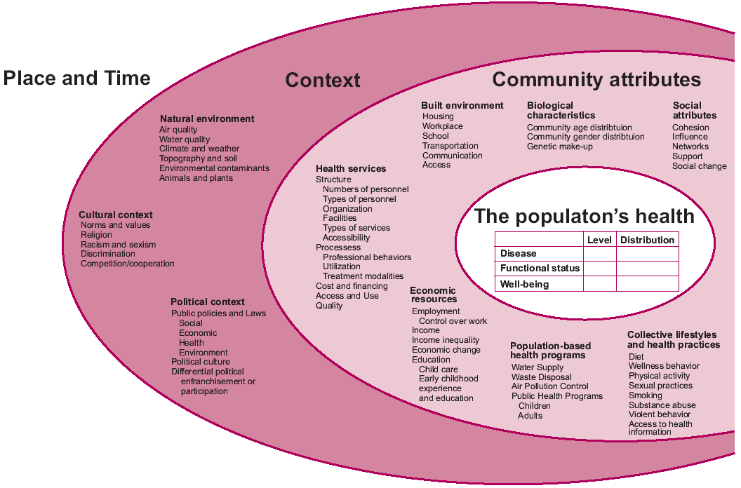

Slide 16
 | NCHS and NCVHS A 50-Year Partnership
The Health Statistics Vision report was closely aligned with the NCVHS 2001 report on Information for Health, which conceptualized the integration of information from three dimensions into a National Health Information Infrastructure drawing data from:
Health care providers
Personal health records
Population health records
Notes:
I refer you to a fascinating article on the Population health Records by our colleagues Dr. Daniel Friedman, a former member of NCVHS, and Dr. Gib Parrish, formerly of CDC, in the July issue of the Journal of the American Medical Informatics Association.

Slide 17
 | The National Committee on Vital and Health Statistics The Public Advisory Body to the Secretary of Health and Human Services

