Slide 1

Surveillance of Heart Diseases and Stroke Using Centers for Medicare and Medicaid (CMS) Data: A Researcher’s Perspective
Judith H. Lichtman, PhD MPH
Associate Professor

Slide 2
Need for strong population-based data to achieve surveillance goals.
Circulation, 2007;115:127-155

Slide 3
Current Gaps
No comprehensive national surveillance system
Track patterns of disease, care, and outcomes over time
Cohort Studies
Provide valuable information, but have limitations
CVD and stroke have a large impact in the elderly population

Slide 4
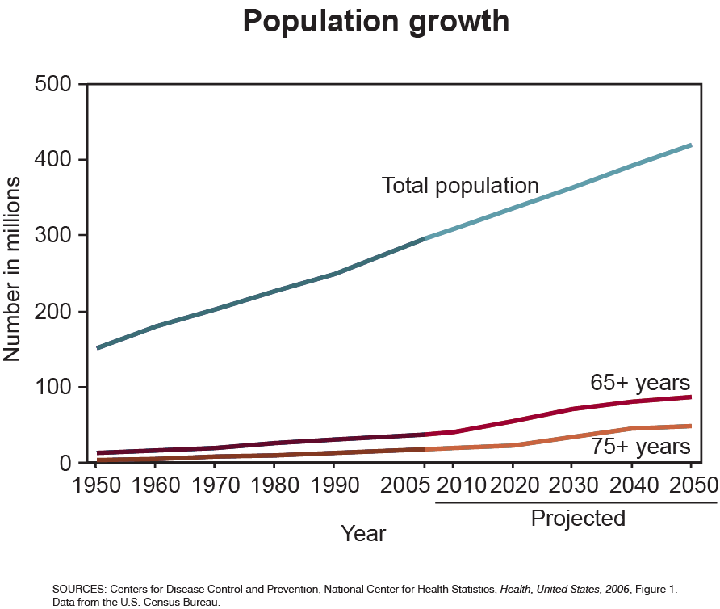

Slide 5
Previous Strategies Using CMS Data
Cross-sectional design
Subset of national cohort
Focus on short-term outcomes
Limited patient-level information
No individual follow-up over time

Slide 6
Notes:
6

Slide 7
Prospective Surveillance
Stroke
Index Event
Outcomes
Mortality
Rehospitalization
Recurrent Event
Other Events
Utilization of Outpatient Resources
Cost

Slide 8
Risk-Adjustment
Cohort
Cohort
Cohort
Cohort
Cohort
Cohort
Outcomes
Index Event: Comorbid or Complication?
1 Year
Prior history

Slide 9
Track Cohort over Time
Cohort
Cohort
Cohort
Cohort
Cohort
Cohort
Outcomes
Continuous FFS

Slide 10
Linked Hospitalizations: “Episode of Care”
Transfer
Stroke Index
Event
Hospital A
Stroke Index
Event
Hospital B
Outcomes
Day 0
Day X

Slide 11
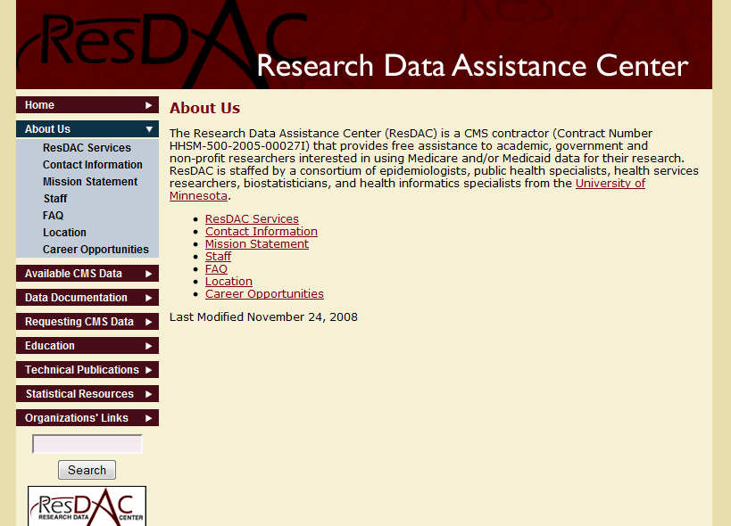
How to Access CMS Data: ResDAC
www.resdac.umn.edu/

Slide 12

CMS Data: Innovations have simplified the process
Notes:
12

Slide 13
Readmission Rates by Sex 122,063 hospital discharges for TIA (ICD-9 435)
* p < 0.0001
** p = 0.001
Stroke 2009;40:2116-2122
Notes:
13

Slide 14
Risk-Adjusted Outcomes (Women / Men)
Analyses are risk-adjusted for age (continuous), race (white vs. other), admission source (ED, skilled nursing facility, vs. other), Deyo comorbidity score (≥ 3 vs. < 3), number of hospitalizations in prior year (≥2 vs. <2), and medical history (yes vs. no; cancer, dementia, chronic obstructive pulmonary disease, ischemic stroke, diabetes, hypertension, acute myocardial infarction, congestive heart failure, and atrial fibrillation).
Stroke 2009;40:2116-2122
Notes:
14

Slide 15
CAD and Mortality
All analyses are adjusted for age (continuous), race (white vs. other), admission source (ED, skilled nursing facility, vs. other), Deyo comorbidity score (≥ 3 vs. < 3), number of hospitalizations in prior year (≥2 vs. <2), and medical history (yes vs. no; cancer, dementia, chronic obstructive pulmonary disorder, ischemic stroke, diabetes, hypertension, acute myocardial infarction, congestive heart failure, and atrial fibrillation). P<0.01
Stroke 2009;40:2116-2122
Notes:
15

Slide 16
1-Year Recurrent Stroke Rates 1994-1996
Cerebrovascular Diseases, in press
Notes:
16

Slide 17
1-Year Recurrent Stroke Rates 2000-2002
Cerebrovascular Diseases, in press
Notes:
17

Slide 18
Percentage Change in Risk Standardized 1-Year Recurrent Stoke Rates from 1994-1996 to 2000-2002
Recurrent stroke hospitalization rates decreased by 5%
Marked geographic variation
Cerebrovascular Diseases, in press

Slide 20
Change in AMI All-Cause Risk-Standardized Mortality Rates (RSMR) From 1995 to 2006
JAMA. 2009;302(7):767-773.
Notes:
Mean risk-standardized mortality rates were 18.8% (SD, 2.1%; range, 10.4%-27.5%) in 1995 and 15.8% (SD, 1.7%; range, 10.6%-21.6%) in 2006. The size of each bin reflects the number of hospitals that filled in a particular interval of risk-standardized mortality rate as well as the distributions (ranges) of rates in 1995 and 2006. Because the number of bins in each year is the same (n=35), the 1995 bin is wider than the 2006 bin to reflect the change in risk-standardized mortality rate distributions.
20

Slide 21
AMI All-Cause Risk-Standardized Mortality Rates (RSMR) From 1995 to 2006
JAMA. 2009;302(7):767-773.

Slide 22
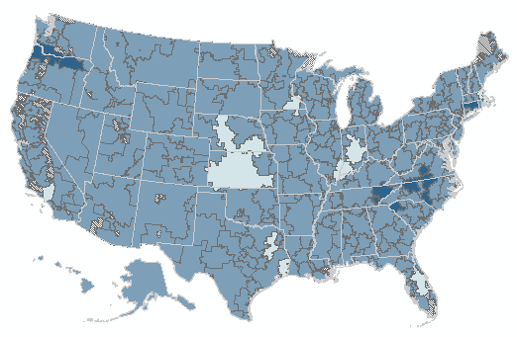
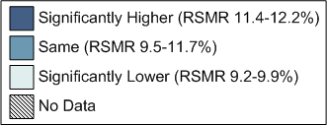
30-Day Stroke Risk Standardized Mortality Rate by HRR
1999
(National Average RSMR = 10.5 [SD 2.6] %)
Presented at ISC 2010
Notes:
22

Slide 23
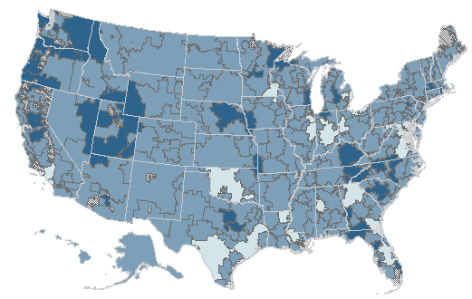
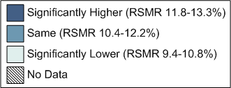
30-Day Stroke Risk Standardized Mortality Rate by HRR
2005
(National Average RSMR = 11.2 [SD 1.7] %)
Presented at ISC 2010
Notes:
23

Slide 24
Organization of Stroke Care:
Joint Commission Certified Primary Stroke Centers
Stroke 2009;40:3574-3579

Slide 25
Stroke 2009;40:3574-3579

Slide 26
Advantages of Using CMS Data
National perspective
Patient level and hospital level analyses
“Aerial” view of disease in the elderly
Subgroups
Time trends
Utilization of resources
Complements the perspective of cohort studies and registries

Slide 27
Limitations
Accuracy of diagnostic codes
Unmeasured factors in administrative data
Symptoms, test results, medical decisions
Disease severity
Medications
Restriction to hospitalized events
Underestimate true burden in community
but .. reflects hospital resource utilization, can expand surveillance with outpatient files
Notes:
27

Slide 28
Future…..
Develop expertise in using administrative data for disease surveillance (seminars, workshops)
Use additional CMS data files (Outpatient, SNF)
Combine data resources
Social economic status
Behavioral / lifestyle factors
Access and availability of care
Medications
Cost data
Registries with additional clinical detail

Slide 29
Thank you

