Slide 1
Comparing Globally Helps Locally
Using International Comparisons for Advocacy and Education
Rebecca Russell, MSPH
Research Analyst
March of Dimes, Perinatal Data Center
National Conference on Health Statistics
August 18, 2010

Slide 2
March of Dimes Mission
The mission of the March of Dimes is to improve the health of babies by preventing birth defects, premature birth, and infant mortality.
We carry out this mission through:
research;
community services;
education;
advocacy.

Slide 3
Advocacy
March of Dimes public affairs focus on national and state public health policy and programs that affect women of childbearing age, infants and children.
Priorities:
Access to health care for women of childbearing age, infants and children
Research and policies to prevent prematurity, birth defects and infant mortality
Prevention and treatment programs to improve maternal, infant and child health
Institutional concerns for tax-exempt organizations.

Slide 4
Global Programs
Building on its extensive experience in care and prevention of birth defects and prematurity through education, community intervention and advocacy in the United States, the March of Dimes is working to improve the health of mothers and babies worldwide.
Strategies:
Strengthening birth defects and prematurity surveillance.
Enhancing professional education and research.
Expanding capacity for community action.
Increasing public awareness.
Collaborations and partnerships are critical to our global health strategy.

Slide 5
March of Dimes National Prematurity Campaign, 2003-2020

Slide 6
March of Dimes Prematurity Campaign (Phase I: 2003-2008)
GOALS
Raise public awareness of prematurity
Decrease the rate of prematurity in the U.S.
AIMS:
Generate concern and action
Educate women about risk reduction
Provide affected families with support
Assist MDs and RNs
Encourage research investment
Expand access to health coverage

Slide 7
Campaign Goal 1: Raise public awareness of the problem of prematurity
Percent saying premature birth is a very or extremely serious problem:
Source: March of Dimes National Brand Study, Gallup Inc, 2010.

Slide 8
Preterm Birth by Maternal Race/Ethnicity, United States, 1990-2008
Percent of live births
*Preliminary data
Source: National Center for Health Statistics, final natality data, 2007-2008 preliminary data
Prepared by March of Dimes Perinatal Data Center, 2010

Slide 9
Prematurity Campaign March of Dimes National Board Resolution
RESOLVED, To declare “Prematurity Prevention” a global
Campaign and extend the Campaign to 2020; to retain the goals
of 15% reduction in rate and increased awareness for the United
States; to set global targets by 2010; and be it further
RESOLVED, To assume a more outspoken public stance on
Issues directly related to prematurity prevention; and be it further
RESOLVED, To focus on three critical investment opportunities
and intervention targets with a three year horizon:
•Accelerate research
•Expand Direct service to NICU affected families
•Develop Community Intervention Programs
- Adopted March 28, 2008

Slide 10
Benefits of Using International Statistics
Advocacy
Importance of issue
Highlight need
Create Awareness
Domestic
International

Slide 11
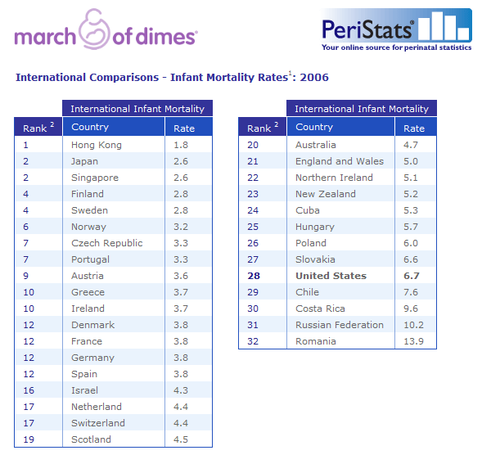
Promotion of NCHS Report: PeriStats website
In 2006, the United States infant mortality rate (6.7 per 1,000 live births) ranked 28th among selected countries.
The United States infant mortality rate was more than 3 times as high as the infant mortality rate in Hong Kong (1.8 per 1,000 live births), the country with the lowest reported rate in 2006.
Footnote: Some of the variation in infant mortality rates (IMRs) is due to differences among countries in distinguishing between fetal and infant deaths.

Slide 12
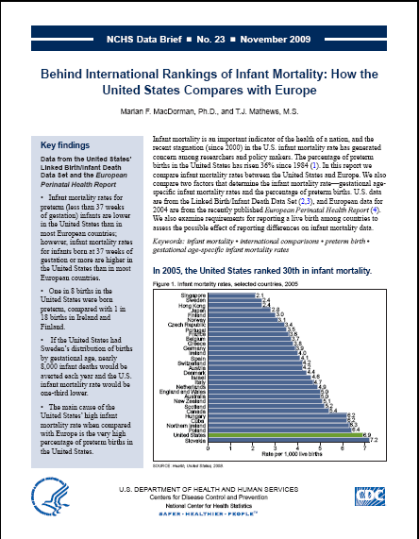
MOD Response to NCHS Report
Promotion of report through:
PeriStats website
Media coverage
Press release
Interviews
High volume of media placements mentioning NCHS report and MOD

Slide 13
Promotion of NCHS Report: March of Dimes Press Release
“March of Dimes Calls for Research to Prevent Preterm Birth”

Slide 14
Interpretation of Rankings: News Articles
Dr. Alan Fleishman, medical director at the March of Dimes, said the finding “is an indictment of the way we delivery health care in the United States, and it’s a reiteration of prematurity as the No. 1 public health problem in America.”
“The quality of neonatal intensive care is superb,” [Dr. Fleishman] said. “We know how to rescue babies who are born very tiny, but what we don’t do well is prevent prematuity. Reasons for this, he said, include a lack of universal access to health care for women of childbearing age or pregnant women of any age. “That’s a tremendous difference with our European friends,” Fleishman said.”
“The suggestion that we would decrease the number of deaths by 33 percent if our gestational age distribution was similar to Sweden is a dramatic way of pointing out this is really serious,” Fleishman said.

Slide 15
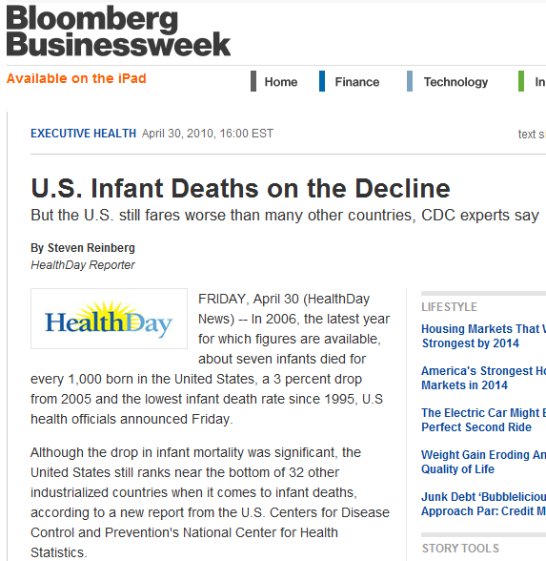
NCHS Linked Birth/Infant Death Report
“What remains concerning is when you compare the rate of infant mortality in the United States to the 32 other industrialized countries, we still rank very low. It’s very disquieting for the rates of infant mortality in our country to still be as high as they are.”
--Jennifer L. Howse,
President, March of Dimes

Slide 16
Global Report on Birth Defects
Purpose: to document the global toll of birth defects and provide feasible, cost-effective recommendations to reduce this toll.
Provided modeled estimates of country-level birth defects prevalence rates for almost 200 countries
Involved an extensive media campaign that resulted in worldwide dissemination raising awareness of issue.
Helped lead to an April 2010 WHO Resolution on Birth Defects

Slide 17
Global Report on Prematurity
Purpose: to document the global and regional toll of preterm birth.
Used data from the WHO systematic review on maternal mortality and morbidity: The global burden of preterm birth, 2009.
Presented at the 4th International Conference on Birth Defects and Disabilities in the Developing World, New Delhi, 2009.
Showed an estimated 13 million babies worldwide were born preterm in 2005.

Slide 18
Global Report on Prematurity--Limitations
Data on the number of preterm births and related deaths are limited
Necessary to improve data on extent of the problem
No internationally accepted classification of preterm births
Need for more country and regional data on the prevalence of acute and long-term health problems caused by preterm birth.

Slide 19
Future Directions
Quantify the problem – Need for country-specific preterm birth data
March of Dimes/WHO Preterm Birth Global Report
Increase international awareness of
preterm birth through global partnerships
Campaign Alliances:
European Foundation for the Care of Newborn Infants (EFCNI) of Germany
Little Big Souls (LBS) of Africa

Slide 20
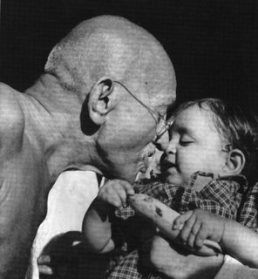
“You must be the change
you want to see in the world.”
- Mahatma Gandhi

