Slide 1
Rankings: What do they matter, what do they measure?
Anne McFarlane
August 18, 2010
Notes:
Good afternoon, I am so pleased to be here to talk about our Health Rankings report.
To begin, let me say I am not a statistician. I have a background in epidemiology but I have spent my career in government – in the Ministries of Finance, Social Services and Health in two provinces.
As a consequence, my interests are more in how data and information are used by policy-makers.
I’m going to tell you the story behind why we wrote the “Making Sense of Health Rankings” report and how we hope it will be used.

Slide 2
Outline
Healthcare statistics in Canada
My organization and what we do
Why we are interested in rankings
Our “Making Sense of Health Rankings” report
Notes:
This is what I’ll cover…But first by way of background

Slide 3

CIHI and the Canadian Context
Notes:
In Canada, constitutional authority for health delivery rests squarely with the provinces; federal government provides basically “no strings attached funding.”
Therefore, there are effectively 14 health systems: provinces(10), territories(3) and the federal government’s Indian services.
However, the federal government does provide a significant amount of funding to the provinces and territories AND Canadians are very proud and supportive of the health care system so the federal government wants data to demonstrate the success of the system.
Administrators, the public, clinicians all want data that gives a picture of services across the country, but the provinces don’t want to give the data to the federal government…. so CIHI was created.

Slide 4
CIHI’s Mandate
Serve as the national coordinating mechanism for a common approach to Canada’s health information system
Produce timely information for:
  Establishment of sound health policy
  Effective management of health system(s)
  Generating public awareness about health determinants
Notes:
Independent, not-for-profit corporation (1994)
We provide unbiased information about healthcare services. We do not take policy positions, make recommendations or comment on the analytical work of other organizations.
Approximately 80% Federal Gov funding – 20% Bilateral Agreements with Provinces and Territories
16-member board with equal representation of health leaders from across Canada
Regional offices across Canada (Western& Atlantic Canada Quebec)
~700 FTEs;
- Basically, CIHI holds administrative data; StatsCan focuses on survey data.

Slide 5
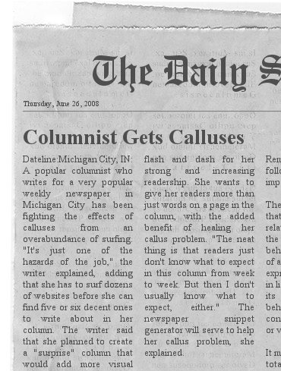
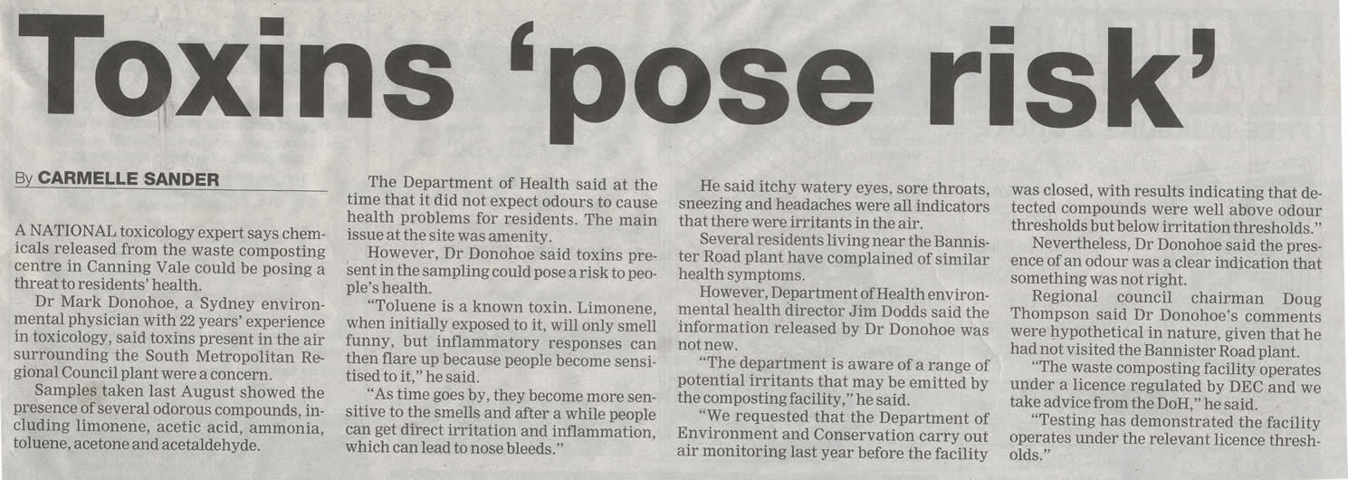

B.C. Leads Country in Meeting Wait Time Benchmarks
Health Care Spending in Canada to Exceed $180 Billion this Year
Number of Regulated Nurses Working in Canada up by 8% between 2004 and 2008
B.C. spends the least on drugs:
Per capita prescriptions lowest in the country
Canadian Hospitals Aim to Reduce Mortality Rates, but Severe Infections Remain a Challenge
Growth in Drug Spending Reaches Lowest Rate in a Decade
Rise in use of common osteoporosis drugs among Canadian seniors
Notes:
CIHI holds all the hospital data in Canada as well as data on financing, HHR, community services, drugs and some registry data.
-We also publish a wide variety of reports and analyses which are widely picked up by the media. The public mostly know us through our reports and analyses but also through…

Slide 6
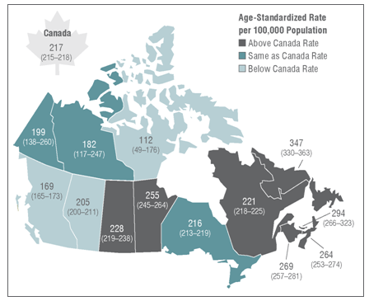
Health Indicators 2010
Canadian Hospitals Aim to Reduce Mortality Rates, but Severe Infections Remain a Challenge
B.C. HAS LOWEST HEART ATTACK RATE IN CANADA
Notes:
Our Health Indicator Report jointly produced with Statistics Canada which provides indicators on population health and performance of the health system.
We simply publish the indicators but don’t try and make explicit comparisons between provinces or the health authorities within provinces.
This report is widely covered in the local and national media
So CIHI provides a picture of the overall Canadian health care system and pictures of each of the systems in the provinces and territories.
“Health Indicators 2010” released today by the Canadian Institute for Health Information (CIHI) reports that if all provinces had the same heart attack rate as B.C., there would be a potential decline of 22 per cent in the national heart attack rate, generating an estimated savings of about $150 million in hospital costs.
Ministry of Health Services New Release
May 27, 2010

Slide 7
Have Canada’s public health policies and health care systems succeeded in promoting the health of its citizens?
Does my province provide high quality services with good outcomes?
Notes:
Over the past ten years, as costs in healthcare escalate, an important question posed on the national scene has been “Have Canada’s public health policies and health care systems succeeded in promoting the health of its citizens?”
While at the provincial level, governments try to answer the question “Does my province provide high quality services with good outcomes?’

Slide 8
Our interest in rankings….
“Canada manages to hang on to its “B,” ranking 10th among the 16 peer countries”
Conference Board of Canada
September 2009
Notes:
So, Headlines like this one, catch the eye of our federal, provincial, and territorial health politicians and administrators.
Ranking reports seem to be a quick, snappy way to get a handle on how well the system is performing.

Slide 9
Our interest in rankings….
Canada ranked 11th among 24 countries belonging to the Organisation for Economic
Co-operation and Development (OECD)
in terms of overall health performance.
The ranking considered life expectancy,
rates of death and disease, immunization
rates, self-reported health and certain risk factors (such as rates of obesity).
OECD, 2007
Notes:
But here we ranked 11 out of 24

Slide 10
Our interest in rankings….
Euro Canada Health Consumer Index,
January 2009
“Canada ranked 23rd among 30 countries”
This incorporated measures of patient rights and information, waiting times for treatment, clinical outcomes, generosity of public health care systems and provision of pharmaceuticals
Notes:
And here we ranked 23 out of 30

Slide 11
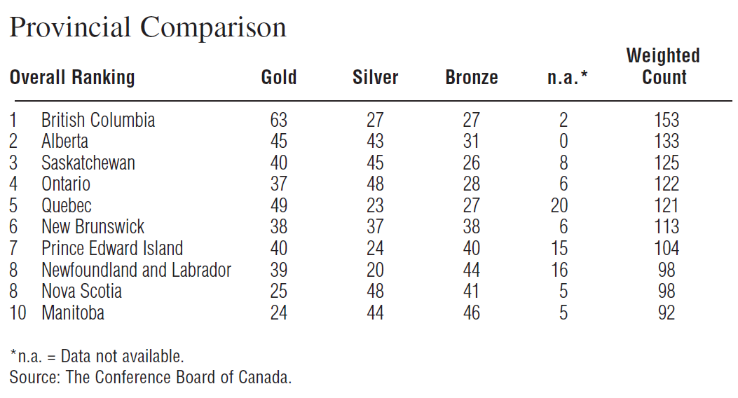
Provincial Rankings
Notes:
And even closer to home here is a report which took CIHI indicators and used them to rank provincial health care systems.
As you can imagine BC was pleased and Manitoba wasn’t.
And CIHI is asked by the media and the provinces to say why the Rankings reports are or are not accurate.
As part of our approach, we don’t comment on the publications of other entities, so we don’t critique specific Ranking Reports.
However, we felt we had to develop a document that could be used as a guide to evaluating Ranking reports.

Slide 12


Making Sense of Health Rankings
Methodology paper designed to help:
  Interpret information that ranks
  health care performance
  Identify strengths and
  weaknesses in ranking
  methodologies
  Assist in better understanding
  and evaluating ranking reports
Notes:
Which is why we set out with Statistics Canada to produce Making Sense of Health Rankings, a methodology paper. We wanted to do two things. First, improve readers’ understanding of ranking reports and second, create a report that we would refer the media and others to when they asked us to comment on ranking reports.
It outlines the components and processes that underlie health rankings and explores why such rankings can be difficult to interpret.

Slide 13
Rankings
Strengths:
Simple
Easy to understand
Easy to communicate
Challenges:
Over-simplified
Highly affected by methodology, measures and motive
Comparability is often questionable
Notes:
Clearly Rankings have strengths and weaknesses….

Slide 14
Making Sense of Health Rankings
Checklist for Reviewing Health Ranking Reports
Assess the soundness of the conceptual framework
Assess the indicators chosen to measure selected aspects of health and health care
Assess the data quality
Examine soundness of methods
Notes:
We devised a 4-step checklist that would be easy for decision-makers to apply as they come across ranking reports. We wanted to help them judge the value of the ranking.

Slide 15
Step 1: Assess the soundness of the conceptual framework
☑Does the ranking scheme’s conceptual framework cover the areas of health and health care that are relevant to the purpose of the ranking?

Slide 16
Step 2: Assess the indicators chosen to measure selected aspects of health and health care
☑Are the indicators of health or healthcare used in the ranking consistent with the conceptual framework?
☑Are the measures used for the selected indicators meaningful and valid?

Slide 17
Step 3: Assess the data quality
☑Are data accurate, reliable, complete, comparable and free from bias?
☑Are data elements defined and collected so that “apples to apples” comparisons are being made?

Slide 18
Step 4: Examine the soundness of methods
☑Are meaningful differences in performance distinguishable?
☑Are absolute and relative comparisons available for review?
☑Have appropriate adjustments been made for underlying differences in the populations being compared?

Slide 19
Step 4: Examine the soundness of methods (cont.)
☑is the way specific measures are combined in the ranking scheme clear?
☑Is the specific formula, along with any weights used to combine individual measures or indicators, based on clear and reasonable principles?
☑Are differences in performance statistically significant?

Slide 20
Step 4: Examine the soundness of methods (cont.)
☑Have other statistical issues been appropriately handled (e.g., adjustments for correlated measures, handling outlier values and ties)?
☑Have the authors of the report reduced the potential for bias through full disclosure of ranking methods and peer review?

Slide 21
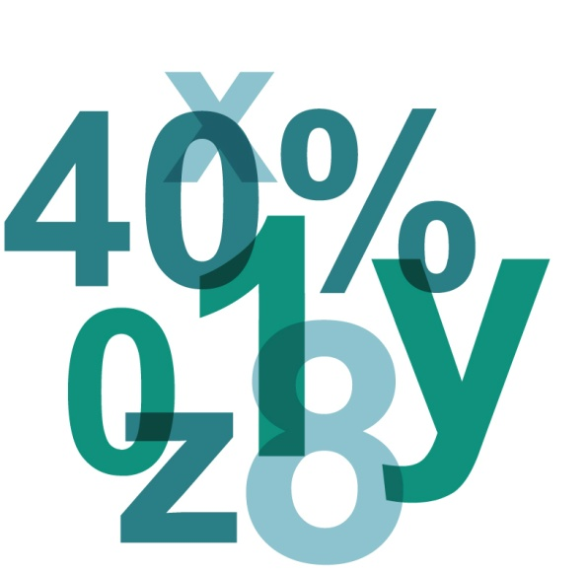
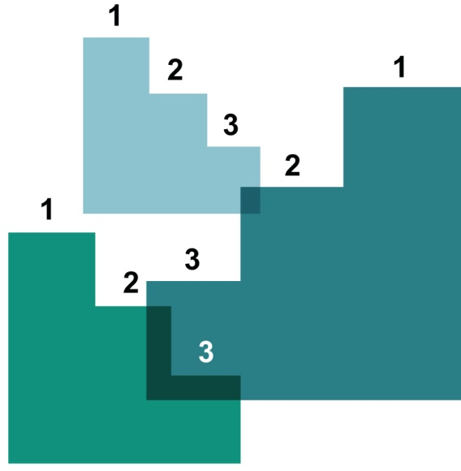

Data, Indicators, Rankings . . .
RAW DATA
INDICATORS
RANKINGS
X
120
X
Y
97
Z
Z
65
Y
Notes:
At CIHI, we steer away from the over-simplification of rankings, as they are so easily shaped by methodology, measures AND motive.
We’re in the business of raw data and indicators. Our job is to ensure there is valid and comparable data available for those running the health care system. We must do this responsibly—by creating information, not misinformation and confusion.

Slide 22

Questions? www.cihi.ca

