Slide 1
Health, United States:
History, Uses, and Future Directions
Health, US Over the Years: Diane Makuc
Health, US in the 21st Century: Amy Bernstein
Media Perspective: Christopher Connell
Academic & Policy Perspective: Judy Shinogle

Slide 2


Health, United States
Over the Years
Diane M. Makuc, DrPH
National Conference on Health Statistics
August 18, 2010
U.S. DEPARTMENT OF HEALTH AND HUMAN SERVICES
Centers for Disease Control and Prevention
National Center for Health Statistics

Slide 3



Slide 4
Outline
Legislation
Goals / audiences
Core content over time
Special focuses over time
Selected findings

Slide 5
Health, US is mandated by the Public Health Service Act
Each year the Secretary shall submit to the President and Congress reports on:
  Health care costs and financing trends
  Health resources by geographic area
  Utilization of health resources
  by age, sex, income, geographic area
  The health of the Nation’s people
  by age, sex, income, geographic area

Slide 6
Goals
Comprehensive source on national trends in health statistics
Useful to a wide audience
Timely
Accurate
Easy to access

Slide 7
Audiences
Policymakers
Researchers
Public health professionals
Educators / students
Librarians

Slide 8
Example: Health US and Policymakers
DHHS Secretary Margaret Heckler established a Task Force on Black and Minority Health in Jan. 1984 after releasing Health US 1983.
Health US showed …”a continuing disparity in the burden of death and illness experienced by Blacks and other minority Americans as compared with our nation’s population as a whole.”
Infant mortality rate for black infants was almost twice the rate for white infants in 1980.

Slide 9
Some core content has remained similar over time
Focus remains on trends and disparities in health statistics
  Highlights summarize findings
  Detailed tables present data on 4 areas in legislation
Statistics are from multiple sources
Data sources and methods are described in footnotes and technical appendixes

Slide 10
Some of the same variables have been used for tabulations in all years
Age
Sex
Race
Income / Percent of poverty level
Geographic area (e.g. State)
Metropolitan status of residence

Slide 11
Some health measures have been used in all years
Birth, death, and infant mortality rates
Life expectancy
Low birth weight
Prenatal care
Cigarette smoking
Alcohol consumption
Obesity
Physical activity
Respondent-assessed health status

Slide 12
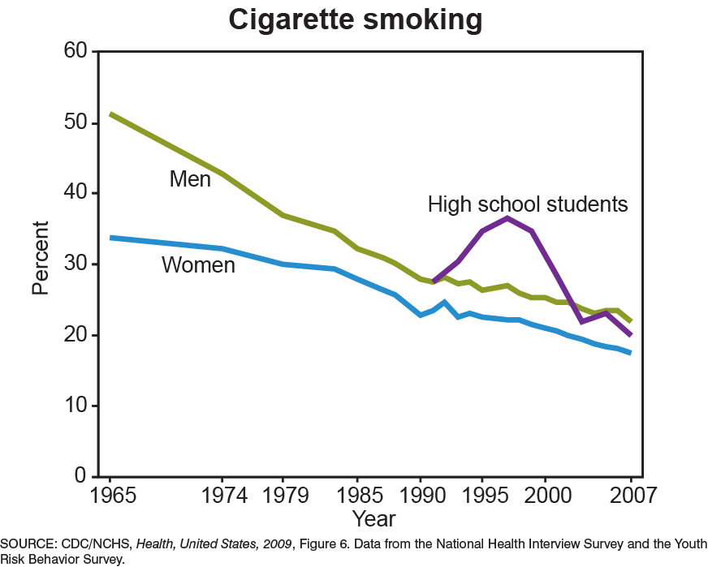

Slide 13
Some health care utilization measures have been used in all years
Immunization
Physician office visits
Hospital outpatient clinic visits
Emergency department visits
Dental visits
Hospital discharges
Nursing home residents

Slide 14
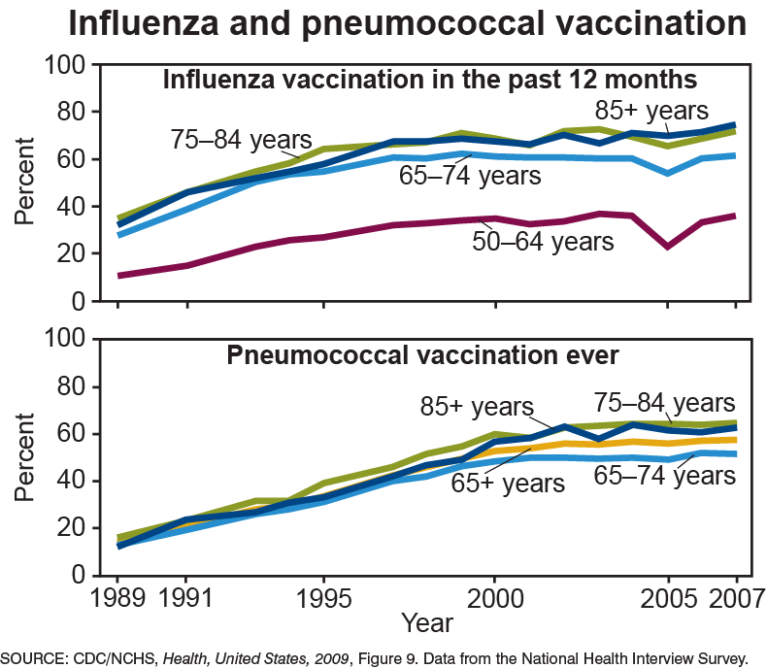

Slide 15
Some health care resources measures have been used in all years
Physicians
Dentists
Nurses
Hospitals
Nursing homes
Mental health facilities

Slide 16
Some health care costs/ financing measures have been used in all years
National health expenditures
Public program expenditures (Medicare and Medicaid)
Personal health care expenditures
Private health insurance coverage
Medical care component of the Consumer Price Index

Slide 17
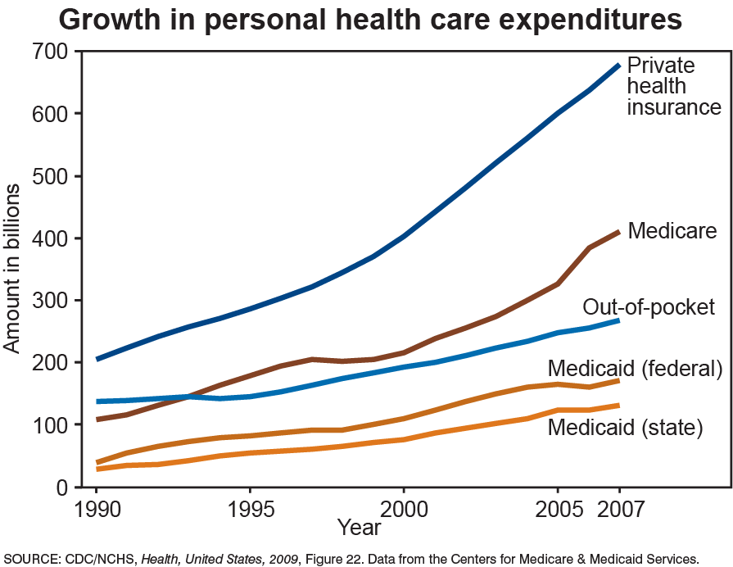

Slide 18
Technical appendixes in all reports help interpret the data including:
  Change from 9th to 10th revision of ICD cause-of-death coding
  Change to 2000 population standard for age adjustment
  Change in OMB standards for race/ethnicity groups
  Change in population estimates
  Changes in survey questionnaires and design

Slide 19
Example of change in core content: expansion of race/ethnicity groups
  1975-1984: white, all other, black
  1985: Heckler Report (Secretary’s Task Force on Black and Minority Health)
  1986-1989: Expanded groups for some tables
  1990: Health,US Chartbook on Minority Health
  1996: Major expansion of groups throughout
  Current: present greatest detail possible taking into account quality and numbers.

Slide 20
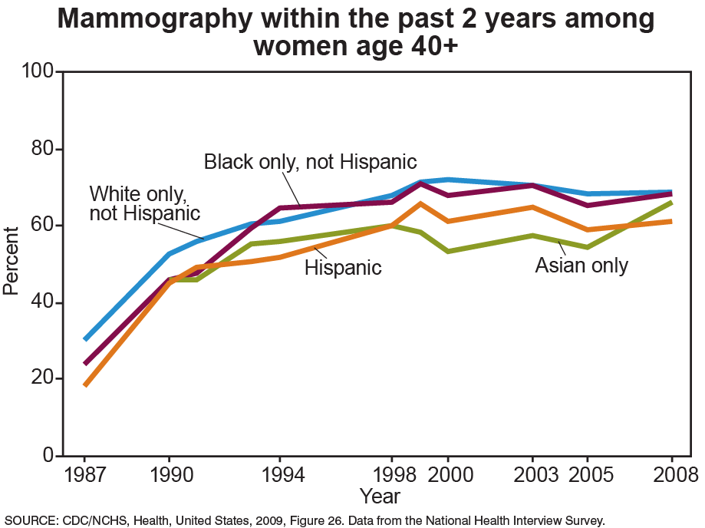

Slide 21
Special focuses and their format have varied over time
1975-1983:
Chapters/short articles on selected health topics
1984-2001:
Chartbooks on specific topics
2002- 2009:
Chartbooks on trends with some charts on a special focus

Slide 22
Selected health topics of articles/ chapters (pre-1984)
1976-77 report had 4 chapters including:
Elderly people
Hypertension
Geographic variation in health, utilization,
resources, and expenditures
1983 report had 12 articles including:
Changes in heart disease risk factors
C-section delivery
Use and costs of Medicare services in the last years of life

Slide 23
Focuses of Selected Chartbooks
Minority health (1990)
Women’s health (1995)
Socioeconomic status and health (1998)
Aging (1999)
Adolescent health (2000)
Urban and rural health (2001)
Prescription drugs (2004)
Access to health care (2007)
Medical technology (2009)

Slide 24
Sources of Input on Content
NCHS staff / reviewers
CDC reviewers
DHHS reviewers
National Committee on Vital and Health Statistics
External experts on special focus areas
Other sources

Slide 25
Summary
Goals and some core content have remained similar for consistency with legislative mandate
Core content has been modified as departmental emphasis and data availability have changed (e.g. expansion of race/ethnicity data)
New content has been added to address current issues (e.g. medical technology)

