Slide 1
2010 National Conference on
Health Statistics
Christine L. Himes, Ph.D.,
Syracuse University,
Center for Policy Research

Slide 2
How I have used vital statistics data
Age patterns of mortality
Causes of death
Links to other surveys

Slide 3
Age Patterns of Mortality
Cross national comparisons of age specific mortality rates
  Need for data by single year of age
  Problems of age misreporting

Slide 4
Compare age patterns of mortality among countries with reliable data…initially did not include U.S.
Interested in trajectory of mortality increase with age
  Value of β greater than 1.0 represents a steeper increase in age specific mortality

Slide 5
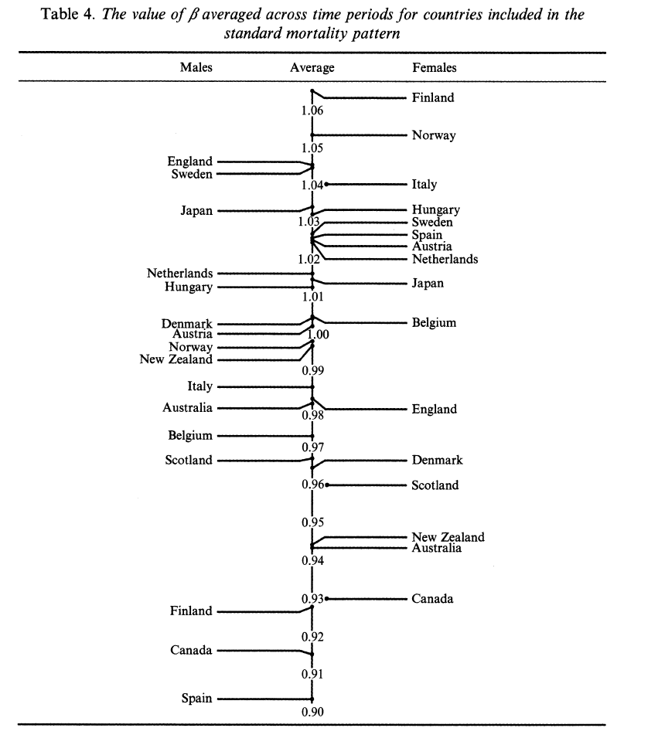

Slide 6
Causes of Death
Cross national comparisons of patterns in cause of death
  Need for data by single year of age
  Cause of death detail comparable to other countries
  Does mortality decline in the same way in all countries?

Slide 7
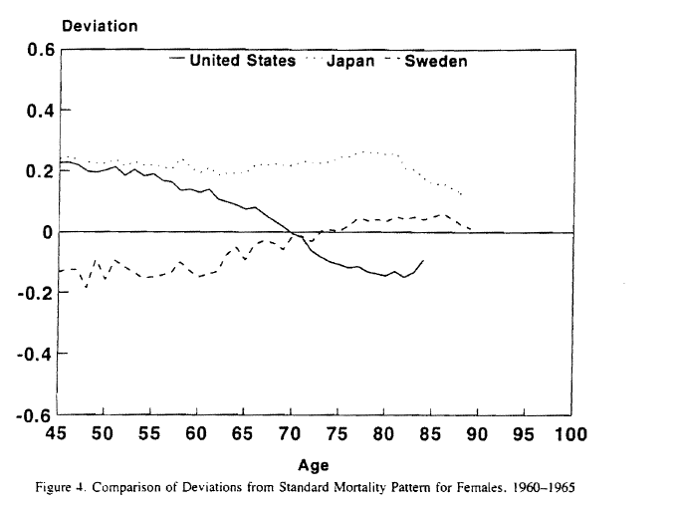

Slide 8
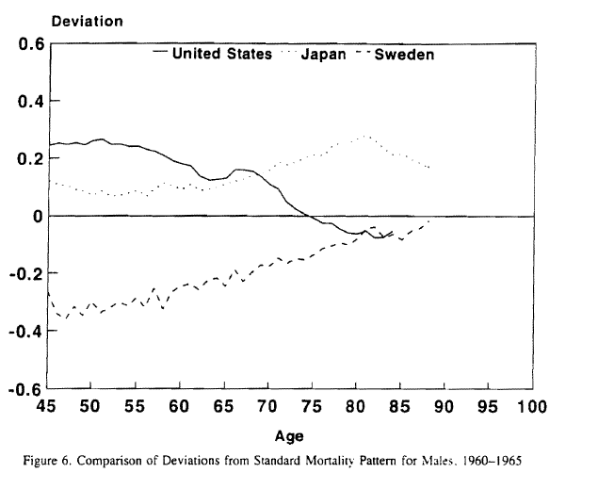

Slide 9
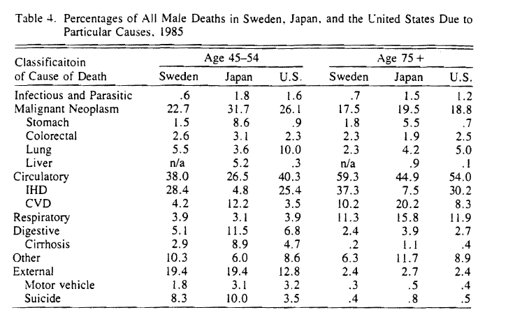

Slide 10
Links to other surveys
Effects of social and economic factors on mortality risk
  LSOA
  HRS

Slide 11
Trends in health and disability
How is obesity related to
  Chronic disease
  Functional limitation
  Survival
Optimal to link survey information with timing of mortality and cause of death

Slide 12
30 year perspective
Online searching and tables
Faster data release
More reliable data

Slide 13
Possible Improvements
Researchers want to link mortality to social and economic factors earlier in life
Can achieve that partly through survey linkages (NDI)
Mortality Followback Survey

