Slide 1


2010 National Conference on Health Statistics
August 17, 2010
Identifying Accidental
Passenger Vehicle
Non-transport Incidents in the NVSS
Seymour Stern
U.S. Department of Transportation
seymour.stern@dot.gov

Slide 2
Purpose
. . . establish a method to collect and maintain data on the number and types of injuries and deaths involving [passenger] motor vehicles … in nontraffic, noncrash events
‘‘SAFETEA-LU’’, Public Law 109-59, Title II, Sec. 10305
‘‘K.T. Safety Act of 2007’’, Public Law 110-189

Slide 3
ICD-10 E-Codes (External cause of injury)
Mechanism of the event
  what caused the injury (ex. motor vehicle crash, a firearm, a drug or a fall)
Manner of death
  intent behind the death (unintentional, suicide, homicide, legal intervention or act of war, and unknown intent)

Slide 4
First Cut
Exclude transport deaths
Exclude intentional deaths
Exclude firearm deaths
Include unintentional deaths and deaths of unknown intent from external causes
61,116 potential cases in 2003
63,978 potential cases in 2004.

Slide 5
Identify Passenger Vehicle Deaths
Passenger vehicles (passenger cars, utility vehicles, pickup trucks, vans)
Perform character string searches of narratives
  medical information
  place of injury
  description of how the injury occurred

Slide 6
Character String Search Keywords
Body type identifiers
  CAR, AUTO, AUTOMOBILE, TRUCK, PICK-UP, PICKUP, SUV, VEHICLE, VAN, TAXI, JEEP, CONVERTIBLE and SEDAN
15 most common vehicle makes
  to identify other cases where these names (e.g., FORD or HONDA) were used instead of the generic body type
Approximately 3,000 cases identified

Slide 7
Review Remaining Narratives
Was a motor vehicle involved? (reduce false positives)
Was motor vehicle a passenger vehicle?

Slide 8
Does narrative indicate the vehicle was a factor in the injury?
Injury occurred inside the vehicle
Injury occurred while a person was entering, exiting, or falling from a vehicle
Injury involved a person outside the vehicle who came in contact with the vehicle
Injury involved a person outside the vehicle who came in contact with a vehicle emission (such as fire, smoke, exhaust, gasoline, battery acid, or radiator fluid)

Slide 9
Data Analysis Limitations
~ 17 percent records-no injury description-used codes/medical narrative
Keywords omitted or misspelled
Narratives only report ‘truck’ or ‘vehicle’
Some non-passenger vehicles
Some non-transport fatalities may meet NHTSA crash definition

Slide 10
Resolutions
Many different search strategies and classifications were attempted
NHTSA believes that ‘limitations’ did not have major effect on results

Slide 11
NiTS 2007: Noncrash Fatalities
Source: NVSS 2003 & 2004
Annual Average = 588

Slide 12
Noncrash Child Fatalities
Source: NVSS 2003 & 2004
Children (14 and under)
Annual Average = 44

Slide 13
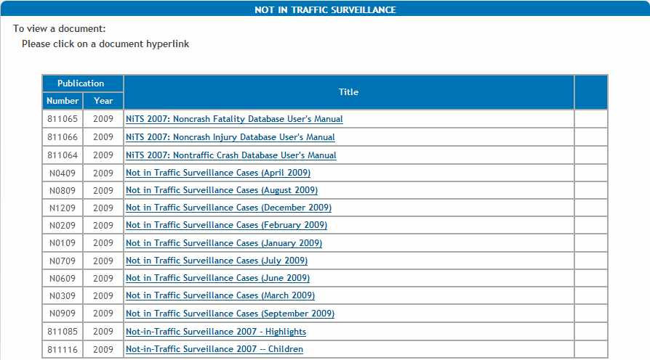
Not in Traffic Surveillance on Web
http://www-nrd.nhtsa.dot.gov/Cats/
listpublications.aspx?Id=233&ShowBy=Category
Next Slide
Notes:
Select the NCSA link from the Blue Links Navigation Bar just under the NHTSA banner image on the NHTSA homepage.
13

