Slide 1



International comparisons of injury using the ICE indicators
Margaret Warner, PhD
Li-Hui Chen, MS, PhD
Office of Analysis and Epidemiology
National Conference on Health Statistics
Washington, DC August 2010
U.S. DEPARTMENT OF HEALTH AND HUMAN SERVICES
Centers for Disease Control and Prevention
National Center for Health Statistics

Slide 2
What we’ll talk about….
International Collaborative Effort on Injury Statistics (ICE) criteria for indicators
Barriers to comparability
Coding rules
Unspecified codes
Global Injury Mortality Database
Fatal injury indicators
All injury
Motor vehicle traffic
Suicide
Homicide
Discussion
Notes:
ICE spent some time determining what injury indicators are. We will discuss this and compare a bit to what the indicators they want from the health care bill

Slide 3

The ICE on Injury Statistics criteria for indicators
Desirable qualities of injury indicators:
Case Definition. The indicator should reflect the occurrence of injury satisfying some case definition of anatomical or physiological damage.
Serious Injury. The indicator should be based on events that are associated with significantly increased risk of impairment, functional limitation, disability or death, decreased quality of life, or increased cost (i.e. serious injury).
Case Ascertainment. The probability of a case being ascertained should be independent of social, economic and demographic factors, as well as service supply and access factors.

Slide 4
The ICE on Injury Statistics criteria for indicators
Desirable qualities of injury indicators (con’t)
Representativeness. The indicator should be derived from data that are inclusive or representative of the target population that the indicator aims to reflect.
Data Availability. It should be possible to use existing data systems, or it should be practical to develop new systems, to provide data for computing the indicator.
Specification. The indicator should be fully specified to allow calculation to be consistent at any place and at any time.
Cryer C, Langley J. Developing indicators of injury incidence that can be used to monitor global, regional and local trends, 2008.
Notes:
Add reference

Slide 5
Barriers to international comparability
Coding rules
Example: Manner of death
Data quality
Example: Unspecified codes
ICE developed fixes
Categorization of ICD codes into meaningful groups: External cause of injury matrices, Injury Mortality Diagnosis Matrix, and Barell Matrix for body region and nature

Slide 6
Example: International comparison of drowning death rates
Unintentional drowning
Country Death rate per 100,000
Australia 9.9
United Kingdom 3.4
United States 11.1
Why is the UK rate so low?
Source: Bhalla, K., Harrison, J., Fingerhut, L., Shahraz, S., Abraham, J., Hsiu-Yeh, P., on behalf of the GBD Injury Expert Group,
The Global Injury Mortality Database, Version 2.0, Released on October 21 2009, Available from www.globalburdenofinjuries.org

Slide 7
Drowning rates per million population for selected countries, 2004
Age adjusted rate per 100,000
Source: Bhalla, K., Harrison, J., Fingerhut, L., Shahraz, S., Abraham, J., Hsiu-Yeh, P., on behalf of the GBD Injury Expert Group,
The Global Injury Mortality Database, Version 2.0, Released on October 21 2009, Available from www.globalburdenofinjuries.org

Slide 8
External cause of injury mortality matrix
intent
 | Unintentional | Suicide | Homicide | Undetermined | Legal intervention / war
All injury
Cut / pierce
Drowning
. . .
Suffocation
Unspecified
mechanism
ICD External cause codes

Slide 9
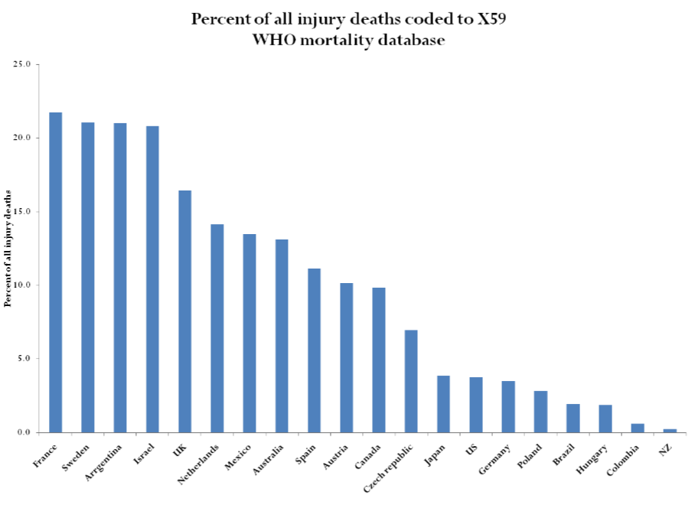
Exposure to Unspecified Factor* Death rates, Selected countries, 2005
* ICD-10 X59 Exposure to Unspecified factor
Source: Bhalla, K., Harrison, J., Fingerhut, L., Shahraz, S., Abraham, J., Hsiu-Yeh, P., on behalf of the GBD Injury Expert Group,
The Global Injury Mortality Database, Version 2.0, Released on October 21 2009, Available from www.globalburdenofinjuries.org

Slide 10
Data Source Global Injury Mortality Database
Data included:
Country level cause of death (injury) tabulations disaggregated by age-sex external cause categories (based on Global Burden of Diseases (GBD) & ICE definitions)
Sources of data:
National civil registration systems
If possible, from the WHO Mortality Database
Other data submitted by the GBD Injury Expert Group*
http://sites.google.com/site/gbdinjuryexpertgroup

Slide 11
Data Source Global Injury Mortality Database
Processing of data:
Reclassified external causes to GBD and ICE definitions
Quality checked by accessing the proportion of deaths coded to partially specified causes
Redistributed cases with unspecified causes
Data access:
GBD Injury Expert Group Website at http://sites.google.com/site/gbdinjuryexpertgroup
Use the Mortality Data : ICE Matrix Definitions

Slide 12
Injury death rates Selected countries, 2005
Age adjusted rate per 100,000
South America
Europe
Pacific Rim
Source: Bhalla, K., Harrison, J., Fingerhut, L., Shahraz, S., Abraham, J., Hsiu-Yeh, P., on behalf of the GBD Injury Expert Group,
The Global Injury Mortality Database, Version 2.0, Released on October 21 2009, Available from www.globalburdenofinjuries.org

Slide 13
Injury death rates Selected countries and years
Age adjusted rate per 100,000
Source: Bhalla, K., Harrison, J., Fingerhut, L., Shahraz, S., Abraham, J., Hsiu-Yeh, P., on behalf of the GBD Injury Expert Group,
The Global Injury Mortality Database, Version 2.0, Released on October 21 2009, Available from www.globalburdenofinjuries.org

Slide 14
Motor vehicle traffic death rates Selected countries, 2005
Age adjusted rate per 100,000
South America
Europe
Pacific Rim
Source: Bhalla, K., Harrison, J., Fingerhut, L., Shahraz, S., Abraham, J., Hsiu-Yeh, P., on behalf of the GBD Injury Expert Group,
The Global Injury Mortality Database, Version 2.0, Released on October 21 2009, Available from www.globalburdenofinjuries.org

Slide 15
Suicide rates Selected countries, 2005
Age adjusted rate per 100,000
South America
Europe
Pacific Rim
Source: Bhalla, K., Harrison, J., Fingerhut, L., Shahraz, S., Abraham, J., Hsiu-Yeh, P., on behalf of the GBD Injury Expert Group,
The Global Injury Mortality Database, Version 2.0, Released on October 21 2009, Available from www.globalburdenofinjuries.org

Slide 16
Homicide rates Selected countries, 2005
Age adjusted rate per 100,000
South America
Europe
Pacific Rim
Source: Bhalla, K., Harrison, J., Fingerhut, L., Shahraz, S., Abraham, J., Hsiu-Yeh, P., on behalf of the GBD Injury Expert Group,
The Global Injury Mortality Database, Version 2.0, Released on October 21 2009, Available from www.globalburdenofinjuries.org

Slide 17
ICE mortality indicators
Progress on mortality indicators
Defined criteria
Identified potential indicators
Compared trends for selected countries
Limitations of mortality indicators
Quality and completeness of data
Non-comparable data sources
Potential measurement of extraneous factors

Slide 18
More ICE indicators to come …
Traumatic Brain Injury mortality indicator
Morbidity indicators
Severity threshold for inclusion
Probability of death
Probability of admission
Functional outcomes/ disability

Slide 19

Questions?
E-mail us at MWarner@CDC.GOV or LChen3@cdc.gov
For more information on injury data and resources from NCHS, see: www.cdc.gov/nchs/injury.htm.

