Slide 1


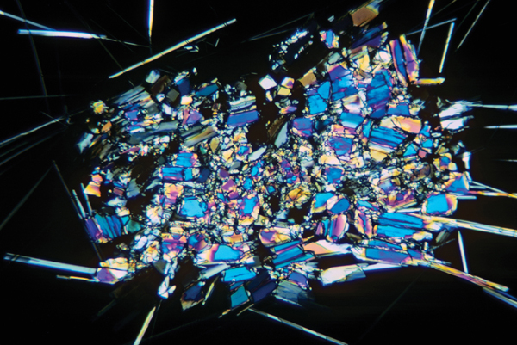
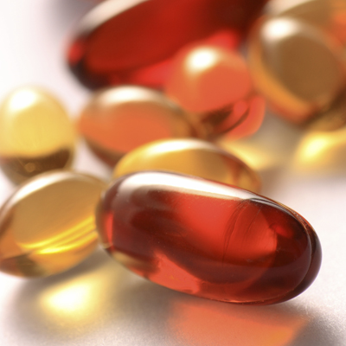
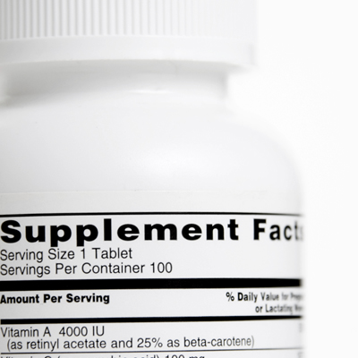

VITAMIN D: How Research Informs Public Health Policy
Paul M. Coates, Ph.D.
Director
Office of Dietary Supplements
National Institutes of Health
Notes:
1
1
1
1
I am Paul Coates, Director of the NIH’s Office of Dietary Supplements.
1

Slide 2

Overview
What is the science telling us about vitamin D?
  Evidence for the importance of vitamin D in health
  Scientific gaps: What are the key issues?
  Who is doing what to fill the gaps?
Challenges and strategies to address them
  Key partners /stakeholders and their roles
Notes:
2
2
2
2
Our office has taken a strong interest in vitamin D, as it has become recognized as a potentially important public health intervention.
We’ve learned from Cliff Johnson’s talk that vitamin D has assumed considerable status in discussions about risk for serious health conditions. There is a clamor for more vitamin D intake, and there is more and more call for people to have their vitamin D status measured and monitored.
These are not unreasonable goals. However, we need to look more closely at the evidence for these relationships before we, as a government, make stronger recommendations about vitamin D for the general population.
I will address some of the scientific issues that are being actively pursued, as well as some of the key players involved.
2

Slide 3
Vitamin D: Nutrient of the of the Day
Vitamin D: The Silver Bullet Against Chronic Disease for African Americans
Wednesday, April 16, 2008 by: Paco Tabachinski. NaturalNews.com
Vitamin D deficiency linked to tuberculosis
Nächste Meldung 09.04.2008
Vitamin D found to guard against artery disease
Thu Apr 17, 2008 1:54am IST
Low Vitamin D Levels Linked to Leg Artery Blockages
But doctors are divided on whether supplements are a good option
By Ed Edelson, Posted 4/16/08, US News World Report
Vitamin D Proven to Lower the Risk of Breast Cancer
FeelGoodforLife.com Examines Women's Health Breakthrough
Science News
High Blood Levels Of Vitamin D Protect Women From Breast Cancer, Study Suggests
Science Daily (Apr. 22, 2008)
Notes:
What is clear today is that vitamin D is of great interest (not only to the public health research community) but to the general population and the lay press.
This slide shows just a few examples of lay press “headlines” in the past two years related to vitamin D and its “proposed” relationship to many public health diseases and conditions.
(Maybe read a couple of them as examples.)

Slide 4
Vitamin D: Nutrient of the Day ???
Vitamin D -- Let’s Get Back to the Evidence Base
Reid IR, Intl Bone and Mineral Society, July, 2010
Vitamin D: A Place in the Sun?
Grey A, Arch Intern Med, July 12, 2010
Anticancer Vitamins de Jour ---The ABCED’s So Far
Byers T, Am J Epidemiol, 2010;172:1-3
Vitamin D Supplementation in the Age of Lost Innocence
Guallar E, Ann Intern Med, March 2, 2010
4
Notes:
However, there are others in the research community who are encouraging caution relative to the merits of vitamin D and various disease endpoints.
For example, Journal of Epidemiology editorial, the author is concerned that vitamin D may just be the latest in a long list of nutrients linked to various forms of cancer (all of which were eventually shown in randomized control trials to not be the panacea for many forms of cancer).

Slide 5
Vitamin D and Health
Clear effect of vitamin D on measures of bone health
Low vitamin D levels associated with increased risk for other health outcomes
  Various cancers
  Cardiovascular disease
  Autoimmune disease (e.g., multiple sclerosis)
  Dementia
  Diabetes
  Glucose intolerance
Associations primarily based on ecologic/observational studies
Cause and effect has not been proven for most of the associations
5
Notes:
5
5
5
5
5
In recent years, low vitamin D levels have been associated with increased risk for numerous other health outcomes including: various cancers, cardiovascular disease, autoimmune conditions (such as multiple sclerosis), dementia, diabetes and glucose intolerance.
These associations are primarily based on ecologic or observational studies.
The cause and effect has not been proven for most of the associations.
At the same time, excessive amounts of vitamin D in blood can become toxic and can produce a variety of health problems. So, excess as well as deficiency is important with respect to vitamin D.

Slide 6
Current Guidelines for Adequate Intake for Vitamin D, IOM 1997
Age | Males and Females
0–50 years | 200 IU/day
51–70 years | 400 IU/day
≥71 years | 600 IU/day
Pregnant and lactating females | 200 IU/day
Tolerable Upper Intake Level (UL) for all groups >1 year is 2000 IU/day
http://ods.od.nih.gov/factsheets/vitamind.asp
Notes:
Adequate intake of vitamin D is 200 IU/day for persons less than or equal to 50 years, 400 IU/day for persons 51-70 years, and 600 IU/day for those 71 years and older. For pregnant and lactating females the guideline is 200 IU/day.
The tolerable upper intake level for all age groups is 2000 IU/day.NEW SLIDE: Cliff please write the notes for the slide.

Slide 7
  Vitamin D Intake from Foods and Dietary Supplements
  NHANES 2003–2006, Males
Above adequate intake, percentage
Supplements
Foods
Age (Years)
Bailey RL et al. J Nutr 2010;140:817-822
7
Notes:
7
7
7
7
7
Based on an analysis of recent dietary intake data from NHANES (both from foods alone and foods and dietary supplements), much of the U.S. population is not meeting the recommended adequate intake for vitamin D.
This is especially the case for men over the age of 50. In those age groups, only ¼ to 1/3 meet the recommended adequate intake.
And for those oldest age groups, dietary supplements are a significant source of vitamin D intake.

Slide 8
Measuring Vitamin D Status Vitamin D in Serum
Biomarker: Serum 25(OH)D
Methodology: Radioimmunoassay (RIA)
anes
Serum 25(OH)D Cutoff Values
< 27.5 nmol/L
< 50 nmol/L
< 80 nmol/L
Level defined by the 1997 IOM report
Levels defined
by others in
research community
8
Notes:
8
8
8
8
Serum concentration of 25-hydroxy vitamin D is generally accepted as the best indicator of vitamin D status in blood. A radioimmunoassay method was used to assess 25-hydroxy vitamin D in NHANES III (1988-1994) and in the continuous NHANES through the 2005–2006 survey cycle.
However, there was a reformulation of the RIA method after NHANES III ended and before the continuous NHANES began.
with the consequence, that we need to bridge the gap between data obtained by the different RIA methodologies.
In the following presentation, Dr. Christine Pfeiffer will address the complications that occur because of assay method changes and the resulting implications for interpreting trends in findings over time.
[[CLICK] There is also disagreement among experts on the most appropriate 25(OH)D “cutpoint for optimal health.”
Since the release of the IOM report in 1997, the cutpoint of <27.5 nmol/L has been used in this country to define deficiency status for Vitamin D. This cutpoint was known to be associated with increased risk of rickets and osteomalacia. In recent years, other cutpoints (such as 50 and 80 nmol/L ) have been proposed by members of the research community as more appropriate cutpoints for inadequate or “at risk” levels , especially for other public health concerns or diseases.
8

Slide 9
Prevalence of Low Levels of Serum 25(OH)D (nmol/L), NHANES 2000-2004
Yetley EA. Am J Clin Nutr 2008;88:558S-64S.
9
Notes:
If these 3 proposed “cutpoints” for vitamin D “deficiency” or “inadequacy” are applied to the NHANES data, you will come to very different conclusions about the vitamin D status of the U.S. population.
At 27.5 nmol/L, shown in light green, the prevalences for all population age groups is less than 6 percent. At the cutpoint of 80 nmol/L, shown in light purple, one concludes that more than 70 percent of the population has inadequate vitamin D levels. The cutpoint of 50 nmol/L , show in dark purple (as expected), produces a prevalence of vitamin D deficiency around 30 percent for the population.
Differences among race-ethnic groups in the prevalence of low levels of serum 25(OH)D have also been found, but what this means is unclear at this time.

Slide 10
Changes in the DiaSorin RIA Over Time
  Change from the original RIA to the reformulated RIA
    Resulted in 12% lower biomarker levels
  Reformulated RIA fluctuated over time
      Between 2000 and 2006, the assay performed for some extended periods 5–10% higher or lower than expected
  Impact of assay changes on population levels
Notes:
Specifically, the change from the original to the reformulated assay produced 25(OH)D results that were on average 12% lower.
Furthermore, our laboratory observed that the reformulated RIA fluctuated over time. Between 2000 and 2006, the assay performed for some extended periods 5–10% sometimes higher and sometimes lower than expected.
Obviously this had an impact on monitoring of the population levels – let me show you that.

Slide 11
Impact of Assay Changes on Population Levels
A. Observed difference
After accounting for assay difference**
18.3 nmol/L*
10.3 nmol/L*
7.1 nmol/L*
0 nmol/L*
0
0
Observed mean for NHANES III
Predicted mean for NHANES III assuming reformulated DiaSorin RIA was used
Observed mean for NHANES 2003–2004
* Non-Hispanic whites, 20–50 years, examined April-October
      **The difference in age-standardized 25(OH)D means was reduced by 10–11 nmol/L after correcting for assay changes
Looker AC et al. Am J Clin Nutr 2008;88:1519-27
11
Notes:
11
11
11
11
These data are from a publication led by Dr. Anne Looker from NCHS. They show how the reformulation of the DiaSorin RIA in the late 1990s made the interpretation of population levels difficult.
In Panel A you can see that the observed age-standardized means were 10–18 nmol/L higher in NHANES III, where the original DiaSorin RIA was used, than in NHANES 2003–2004, where the reformulated assay was used.
Panel B shows that when the NHANES III values were adjusted for the change in assay,
[CLICK] the difference in age-standardized means between surveys was reduced by 10.3–11.2 nmol/L, depending on sex. This means that a large proportion of the previous difference between these two surveys was attributable to changes from the original to the reformulated assay and not to the real difference in population levels of vitamin D.
Note for self:
The predicted age-standardized means for NHANES III, assuming the current assay had been used, were only 7.1 nmol/L higher than the observed age-standardized mean for males from NHANES 2003–2004, and the 2 means did not differ significantly between surveys in females. The remaining difference in males likely represents a real difference in serum 25OHD status between NHANES III and NHANES 2003–2004 for this subsample.

Slide 12
Current Status
NHANES is valuable source of information on Vitamin D
Based on the current IOM criteria
  Intake: Fewer than 1/3 of older people meet the recommended adequate intake for vitamin D based on total intake (supplements included)
  Serum levels: Fewer than 6 % of the U.S. population have 25(OH)D levels generally considered inadequate
    A subject of current and intense discussion
Serum levels decreased slightly from the late ‘80s/early ’90s to NHANES 2003-2004, most likely in response to altered behavior
      Increase in body mass index (BMI)
      Decrease in sun exposure; decrease in milk consumption
12
Notes:
12
12
12
12
12
NHANES is a valuable source of information on vitamin D.
Based on the current IOM criteria: (read two sub-bullets)
Additional analyses of NHANES III and continuous NHANES data have shown that: (read bullets).

Slide 13
Vitamin D Initiative
Coordinated by the NIH Office of Dietary Supplements
  Involves partners from DHHS (CDC, NIH, FDA, AHRQ), NIST, DoD, USDA, and Health Canada
Goals
  Improve measurement of vitamin D in foods and supplements
  Improve measurement of vitamin D status in NHANES
  Identify and fill research gaps
Outcomes
  Systematic reviews, publications, conferences
  Inform public policy
Notes:
13
13
13
Let me start by telling you about the Vitamin D initiative coordinated out of my office.
It involves numerous partners across the US and Canadian governments and its goals are to:
Improve measurement of vitamin D in foods and supplements;
Improve measurement of vitamin D status in NHANES; and
Identify research gaps.
Outcomes to date have been:
A series of systematic reviews of the literature;
Publication of the recommendations for vitamin D status measurement in NHANES; and
Publication of a report of research recommendations.

Slide 14
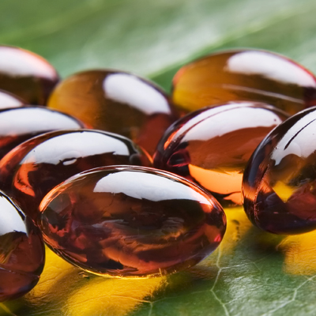
Systematic Reviews of Vitamin D Status and Health Outcomes
Agency for Healthcare Research and Quality (AHRQ)
  Evidence-Based Practice Center Network (www.ahrq.gov/clinic/epc)
  Systematic reviews inform policy, research, guidelines
Two Reviews of Vitamin D
  Cranney A et al: Am J Clin Nutr 88:513S-519S, 2008
    Sponsored by NIH/ODS to inform a public meeting, 2007
  Chung M et al: Am J Clin Nutr 92:273-276, 2010
    Sponsored by U.S. and Canadian governments to
    inform Dietary Reference Intakes Panel of the
    Institute of Medicine, 2009
Notes:
14
14
14
There is considerable information about vitamin D in the literature; there is also a lot of opinion, sometimes based on selective reading of this literature.
We adopted a systematic review approach to addressing the relevant literature on vitamin D and chronic disease conditions.
This was done in collaboration with our sister agency, the Agency for Healthcare Research and Quality (AHRQ), which operates a network of Evidence-based Practice Centers (EPC) around the US and Canada to address challenging health questions.
These reviews are frequently used to inform public policy, the development of clinical guidelines, insurance coverage, and – in our case – building research agendas. In recent years, ODS – along with other partners in the US and Canadian governments – has sponsored two systematic reviews on vitamin D.

Slide 15
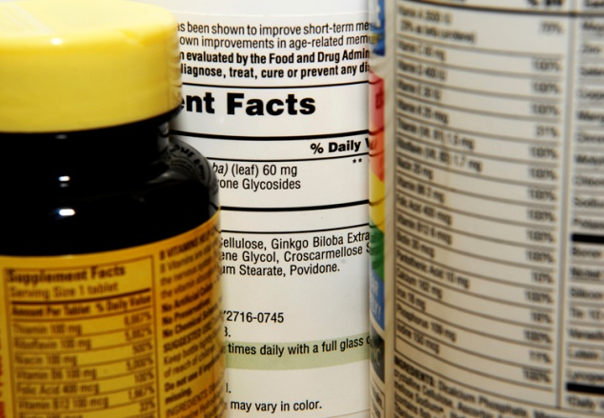
Findings from the First Systematic Review
Evidence that vitamin D supplementation reduces falls,
fractures, and bone loss in men and women >60 years
Sparse data on other age and gender groups
Not possible to separate the effect of vitamin D from Ca supplementation
  Typical amounts used were 700-800 IU vitamin D/day
  and 500-1,200 mg Ca/day
Difficult to identify a specific blood level of 25-hydroxyvitamin D indicative of optimal bone health in all population subgroups:
Lack of data
  Cranney A et al: Am J Clin Nutr 88:513S-519S,2008
Notes:
The first of these was conducted by the University of Ottawa EPC.
It focused on vitamin D and bone health measures because, at the time, it was clear that this was the area in which most of the relevant data could be found. Even in this case, apart from a strong body of data relating vitamin D supplementation to improved measures of bone health in the elderly, there were considerable gaps in available knowledge for other population groups.
Furthermore, it was noted that the effect of vitamin D could not be separated from that of calcium, since most studies – appropriately – included a calcium supplement along with vitamin D.
Finally, it was not possible to say what level of vitamin D status, measured by serum 25-(OH)D, could predict risk of bone-related injury, at least in adults.

Slide 16
Vitamin D and Colorectal Cancer: Observation
0.1
0.2
0.5
1.0
2.0
5.0
10.0
Wei MY et al,.Cancer Epidemiol Biomarkers Prev 17:2958-2969, 2008
Notes:
There are clues from ecologic data such as these pointing to a benefit of vitamin D, in which a series of cross-sectional studies were analyzed correlating vitamin D status with risk of colorectal cancer.
They showed an overall odds ratio of 0.70 for high vs. low circulating levels of 25(OH)D.

Slide 17
Vitamin D and Cancer Incidence: Intervention
1179 Healthy women, 66+7 yrs, 4-year study, Ca (1400 mg/d), Vitamin D₃ (1100 IU/d)
Fraction cancer-free
RR = 0.232
Ca + D
Ca only
Placebo
Time (Years)
Lappe J et al. Am J Clin Nutr 85:1586-1591, 2007
Notes:
There have been few intervention studies of vitamin D related to cancer, but results such as those described here have encouraged further work.
In this study, published in 2007, elderly white women in Nebraska were followed for 4 years in a 3-arm RCT of vitamin D and calcium, and all cancers were scored. There was a substantial reduction in all cancers in the calcium-only arm and there was further reduction in the group to which vitamin D was added.
Limitations of this study included the fact that cancer incidence was a secondary outcome of this study and there was no vitamin D-only arm. The National Cancer Institute has recently funded this group to conduct a similar study, the results of which will be available in a few years.

Slide 18

Findings from the Second Systematic Review
Infant growth: Most studies find no effect
Cardiovascular disease
  Randomized controlled trials: No effect
  Cohort studies: Variable association
Body weight: No effect
Cancer: No effect
Infectious diseases: No effect
Pregnancy outcomes: Inadequate data
All-cause mortality: Inconsistent data
Hypertension: Inconsistent data
  Chung M et al: Am J Clin Nutr 92:273-276, 2010
Notes:
The second of these systematic reviews was conducted by the Tufts University EPC. It extended the discussion:
1) to the role of vitamin D in other health conditions; and
2) to include a review of calcium and health.
This review was specifically commissioned by the governments of the US and Canada to inform the upcoming evaluation of the Dietary Reference Intakes for these nutrients by an independent panel convened by the Institute of Medicine.

Slide 19

Women’s Health Initiative
  NIH-sponsored: http://www.nhlbi.nih.gov/whi/
  Largest intervention trial in history: >160,000 women
  One of the sub-studies randomized women to vitamin D
  and calcium for a 7-year period to examine potential
  effects on hip fractures
www.nhlbi.nih.gov/whi
Notes:
Generally speaking, there have been few if any reported harms associated with vitamin D at usual dietary intakes, and there are now more and more dietary supplement products containing amounts well beyond the currently-recommended levels. Nonetheless, it’s important to assess potential signals of harm.
The NIH-sponsored Women’s Health Initiative was the largest intervention trial in history. More than 160,000 generally healthy postmenopausal women were enrolled over a 15-year period beginning in 1991.
One of the sub-studies randomized more than 36,000 women to vitamin D and calcium for a 7-year period to examine potential effects on hip fractures.
.

Slide 20
Trial Results after 7 Years
  Hip fractures: 12% decrease, not significant
    21% decrease for women aged 60-80 years at baseline
    29% decrease among women who took ≥ 80% of pills
  Improved hip bone density
  Other fractures (self-reported vertebral, lower arm/wrist, total): No differences
  Kidney stones: Significantly increased 17%
  (5 per 10,000/year)
NEJM 354:669-683, 2006.
Notes:
Here are the results.
There was no significant effect on fractures in the entire group, although the fracture rate did decrease significantly among women who complied with supplement use.
Of note, there was a statistically significant increase in kidney stones in women on vitamin D and calcium. This finding has rarely been reported elsewhere, but needs to be followed up.

Slide 21
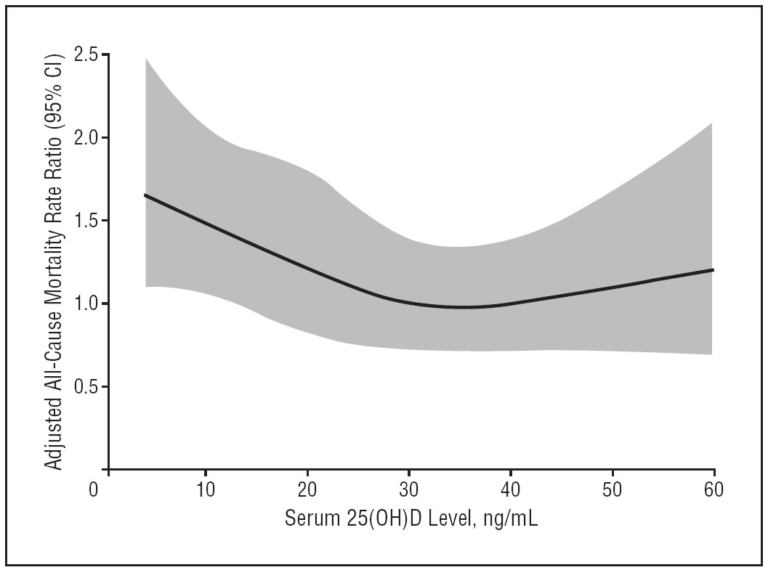
Serum 25(OH)D and All-Cause Mortality
Melamed et al. Arch Intern Med 2008;168:1629-1637
Notes:
This is particularly the case since the data on this slide appeared.
Here, all-cause mortality was plotted as a function of 25(OH)D in NHANES III (1988-1994). Individuals were passively followed for mortality through 2000.
As expected, the lowest quartile of 25(OH)D level (< approximately 18 ng/mL) was significantly associated with increased all-cause mortality.
But there is also a non-significant increase in CVD and cancer-related deaths at the highest levels – in other words, a U-shaped curve. Although this is not significant and the data at the high end to the right are scant, the finding remains as yet unexplained.
It behooves us to understand the biology of this finding, especially if we are going to recommend increases in intake of vitamin D, and therefore shift the population curve to the right.

Slide 22
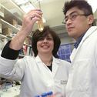
Examples of Ongoing
NIH-supported Research
NCI and others: Vitamin D and Omega-3 Trial (VITAL) to examine the role of vitamin D and Omega-3 fatty acids in primary prevention of cancer and CVD
NIA and others: Dose response for vitamin D in elderly
NCI: Replication of cancer incidence study
Many NIH Institutes and Centers: Intermediary metabolism
ODS and others: Incorporation of analytical tools into measurement of vitamin D status
  Standard reference material for 25(OH)D in plasma
  Reference methods developed by NIST and NCEH
Notes:
22
22
22
I wanted to give you some idea of ongoing research supported by the NIH that we hope will inform future recommendations about vitamin D intake.
Several NIH Institutes, Centers, and Offices are jointly funding the VITAL trial which will examine the role of vitamin D and omega-3 fatty acids in the primary prevention of cancer and CVD.
An NIA-funded study relates the dose response of vitamin D to falls and fractures in the elderly.
An NCI-funded study that demonstrated a significant effect on cancer incidence is being replicated.
Many studies are also funded by the NIH to explore mechanisms of action and the metabolic fate of vitamin D.
And finally, ODS, CDC, and NIST have joined forces to develop important analytical tools for the measurement of vitamin D status including a Standard Reference Material and Reference Methods for 25(OH)D.

Slide 23

Vitamin D Status Measurement: Bridging the Gap
In 2009, ODS and NCHS sponsored a roundtable on vitamin D issues in NHANES and recommended:
  Future methodology should be LC-MS/MS
  A subset of the samples analyzed with the DiaSorin RIA will be re-analyzed by LC-MS/MS to bridge the past and the future
  Data generated previously with the DiaSorin RIA need to be adjusted for the assay changes to avoid incorrect interpretation of trends
Yetley EA et al. J Nutr 2010 (in press)
Notes:
23
23
But if we’re changing methods, how do we make past and future data comparable?
Last summer, the NIH Office of Dietary Supplements and the CDC NCHS sponsored a roundtable on vitamin D issues in NHANES.
The experts agreed that the future methodology in NHANES should be the LC-MS/MS method.
They recommended that a subset of samples previously analyzed with the DiaSorin RIA be re-analyzed with the LC-MS/MS method to bridge the past and the future.
Most importantly though, the experts agreed that data generated previously with the DiaSorin RIA need to be adjusted for the assay changes to avoid incorrect interpretation of trends.

Slide 24
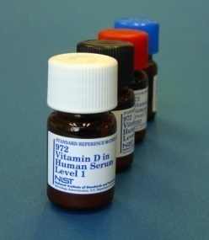
NIST SRM 972 Vitamin D in Human Serum
Four levels, each containing 1.0 mL serum
Certified and reference values for 25(OH)D₂, 25(OH)D₃, and 3-epi-25(OH)D₃
Value assignment by isotope-dilution LC-MS and LC-MS/MS using data from NIST and CDC
Metabolite concentrations reported in ng/mL and nmol/L
COA does not provide data from other analytical techniques

Slide 25
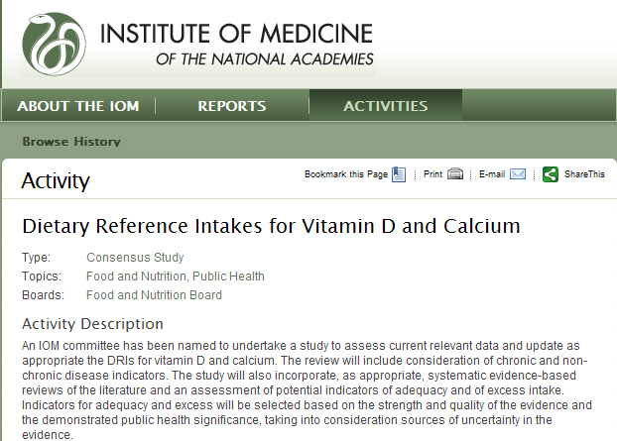
IOM Review of Dietary Reference Intakes
www.iom.edu/Activities/Nutrition/DRIVitDCalcium.aspx
Notes:
IOM has been conducting such reviews for many years under sponsorship by the governments and had not reviewed vitamin D and calcium for more than a decade. It is currently reviewing the recommendations for intake of Vitamin D, along with calcium, but we do not yet know what their recommendations will be. The project is well underway and is expected to be completed in the fall of 2010.

Slide 26

Current Public Health Recommendations
Most recent Dietary Reference Intakes (IOM, 1997)
  Adequate Intake (AI): 200/400/600 IU/day
  Upper Limit: 2000 IU/day
  Summarized at: http://ods.od.nih.gov/factsheets/vitamind.asp
Ongoing IOM Review of Recommended Intakes
  Expected release: Fall 2010
Dietary Guidelines Advisory Committee Report
(USDA-DHHS, 2010)
  Meet AI via food; some may require supplements
  http://www.cnpp.usda.gov/dietaryguidelines.htm
Notes:
26
26
26
Finally, I wanted to give you the current status of recommendations that relate to vitamin D intake.
The IOM-recommended intakes, based on the report released in 1997, are 200 International Units per day from birth through 50 years, 400 IU/day for those between 51 and 70 years and 600 IU/day above 70 years. The tolerable upper limit for all ages is 2000 IU/day.
As mentioned earlier, the IOM is currently reviewing the recommended intakes, and we expect the updated report later this year.
In the meantime, the Dietary Guidelines Advisory Committee has commented briefly on recommended intakes, suggesting that consumers meet their needs from foods, and taking supplements if required. The Committee deferred further comments until the DRI panel releases its report.

Slide 27
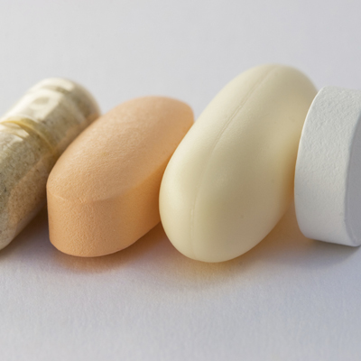
Recommendations Made by
Professional Groups
American Academy of Pediatrics www.aap.org/healthychildren/09s_bts/Vitamin%20D.pdf
  400 IU for children
Canadian Paediatric Society www.cps.ca/english/statements/ii/fnim07-01.htm
  Weight-based intake for children
  Up to 2000 IU for pregnant and lactating women
American Academy of Dermatology
www.aad.org/forms/policies/uploads/ps/ps-vitamin%20d.pdf
  More from supplements, not more sun exposure
National Osteoporosis Foundation www.nof.org/prevention/vitaminD.htm
  400-800 IU for adults <50 yrs; 800-1000 IU >50 yrs
Notes:
In the meantime, as we await the outcomes of the IOM review, a number of professional organizations have weighed in on recommended intakes of vitamin D.
Here is a selection of recent recommendations made to the public.
In general, these organizations have recommended higher intakes than those recommended in the 1997 IOM report, and some have recommended achieving target levels of the biomarker, 25(OH)D, with frequent monitoring to accompany this recommendation.
We believe that this approach is reasonable, although we are less certain about the actual target values that are recommended.

Slide 28
Vitamin D Challenges
Exposure
  UV exposure
  Foods, including fortified foods
  Dietary supplements
Health outcomes
  Enormous interest based on case reports, observational studies
  Inconsistent findings from controlled studies
  Safety must be addressed
Measurement of status
  Potential for incorrect interpretation of status measurement, especially when assessing trends over time
Notes:
28
28
28
28
Here I summarize some of the key challenges in addressing the relationship between vitamin D and health outcomes.
One problem in understanding this relationship – and very likely a cause of uncertainty in many previous studies – is the difficulty in assessing exposure to vitamin D. As Cliff Johnson noted, an important advance has been the ability to now measure vitamin D exposure from all dietary sources, including dietary supplements. But we still have challenges in measuring the proportion that comes from sun exposure.
In general, while many observational studies point to a strong relationship between vitamin D status and health outcomes, there have been inconsistent findings from controlled trials, as we’ve seen from the systematic reviews.
As noted by Dr. Pfeiffer, problems in measurement of vitamin D status may have led to incorrect interpretation, especially in assessing trends over time.
28

Slide 29
Future Needs
Continued monitoring of status to assess impact of public health recommendations for vitamin D intake
Dose-response relationships
Research into basic mechanisms
Ongoing partnerships among agencies in US and Canada: CDC, NIH, NIST, USDA and Health Canada
Notes:
29
29
29
Continued monitoring of vitamin D status will help us to assess any changes related to population-based recommendations regarding vitamin D intake. This was a particularly effective use of NHANES data when monitoring folate status following the fortification of the US grain supply with folic acid in the 1990s.
There is a need to better understand the dose-response relationships for vitamin D exposure and health outcomes, both positive and negative.
There is still much to be learned about the basic mechanisms by which vitamin D exerts its multiple effects.
All of these will require continued partnership among relevant federal agencies – both public health and research funding - in both the US and Canada.

Slide 30

www.ods.od.nih.gov

