Slide 1
2010 National Conference on
Health Statistics
Exploring NHIS Data by Census Division
Deborah Rose Ph.D.
National Center for Health Statistics
Research Data Center
August 16, 2010
Omni Shoreham Hotel, Washington, DC

Slide 2
The previous presentations have covered some of the formal aspects
of the NCHS RDC.
This presentation is more exploratory, to help you think about what YOU can do with restricted data at the RDC.

Slide 3
Restricted Data at the NCHS/RDC
Frequently requested types of data include:
  Small geographic areas
  Sensitive information
  Mortality and linked mortality files
  Exact dates
  Small race/ethnicity groups
  Genetic data

Slide 4
Restricted Geographic Data
Frequently used geographic areas include:
  State
  County
  Census tract

Slide 5
Geographic Data in the National Health Interview Survey (NHIS)
The sampling frame for the NHIS allows public use estimates to be made for:
  The whole United States
  The four Census Regions
  State is a restricted variable, and:
  State is not a level in the NHIS sample frame
  Some states are not included in the sample
  Some states are too small for stable estimates
  Using state in analysis may violate confidentiality

Slide 6
A Methodological
Research Question
What can we use when Region is too large, and State is too small?
Division may allow for finer detail than Region, without violating confidentiality.

Slide 7
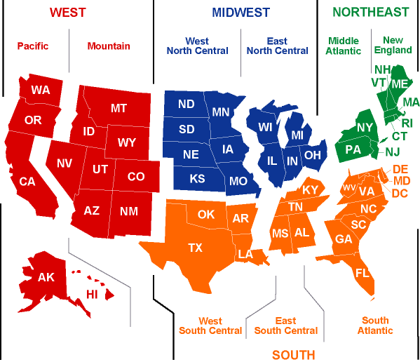
Source: Dept. of Energy, Regional Energy Profiles.
Map of US Census Regions and Divisions
MIDWEST
West
North Central
East
North Central
W

Slide 8
Census Divisions
US Census Region | US Census Division | States
Region 1: Northeast | 1. New England | CT, ME, MA, NH, RI, VT
 | 2. Middle Atlantic | NY, NJ, PA
Region 2: Midwest | 3. East North Central | IN, IL, MI, OH, WI
 | 4. West North Central | IA, KS, MN, MO, NE, ND, SD
Region 3: South | 5. South Atlantic | DE, MD, WV, DC, VA, NC, SC, GA, FL
 | 6. East South Central | MS , AL, TN, KY
 | 7. West South Central | TX, OK, AR, LA
Region 4: West | 8. Mountain | MT, ID, WY, NV, UT, CO, AZ,NM
 | 9. Pacific | CA, OR, WA, AK, HI
Source: US Census Bureau

Slide 9
Goal
To compare the use of Region with Division to review the prevalence of selected covariates and five chronic disease conditions.

Slide 10
Overview of the
National Health Interview Survey
National Health Interview Survey (NHIS)
  Fielded each year
  Personal interview, in the home
  30-40,000 households
  75-100,000 people
  A multi-stage random sample
  Represents the civilian, non-institutionalized US population
  Region is the smallest public use geographic unit
Source: NHIS website

Slide 11
Notes
Estimates were calculated from the 2009 NHIS Sample Adult file, using the Sample Adult weight.
Estimates by Division are not representative of the US population because Division is not part of the NHIS sampling frame.
This work is exploratory. Relationships have not been tested for statistical significance.

Slide 12
Demographic and smoking variables
Sex
Race/ethnicity
Cigarette smoking status
Current smoking

Slide 13
Percent Male and Female by Region
Source: 2009 NHIS

Slide 14
Percent Male and Female by Division
Source: 2009 NHIS

Slide 15
Smoking Status by Region
Source: 2009 NHIS

Slide 16
Smoking Status by Division
Source: 2009 NHIS

Slide 17
Prevalence of Current Smoking by Region
Source: 2009 NHIS

Slide 18
Prevalence of Current Smoking by Division
Source: 2009 NHIS

Slide 19
Prevalence of Current Smoking by Region and Division
Source: 2009 NHIS

Slide 20
Percentage of the Division Population by Race/Ethnicity Group
Source: 2009 NHIS

Slide 21
The Percentage of a Race/Ethnicity
Group in Each Division
Source: 2009 NHIS

Slide 22
Selected conditions from the 2009 NHIS Core Questionnaire
Have you EVER been told by a doctor or other health professional that you had:
. . . Coronary heart disease
. . . Hypertension
. . . A stroke
. . . Diabetes
. . . Asthma

Slide 23
Prevalence of Coronary Heart Disease (CHD) by Region
Source: 2009 NHIS

Slide 24
Prevalence of CHD by Division
Source: 2009 NHIS

Slide 25
Prevalence of CHD by Region and Division
Source: 2009 NHIS

Slide 26
Prevalence of Hypertension by Region
Source: 2009 NHIS

Slide 27
Prevalence of Hypertension by Division
Source: 2009 NHIS

Slide 28
Prevalence of Hypertension by Region and Division
Source: 2009 NHIS

Slide 29
Prevalence of Stroke by Region
Source: 2009 NHIS

Slide 30
Prevalence of Stroke by Division
Source: 2009 NHIS

Slide 31
Prevalence of Stroke by Region and Division
Source: 2009 NHIS

Slide 32
An area in the southeast part of the United States with a high prevalence of stroke.
The East South Central Division is in the stroke belt.
Stroke Belt

Slide 33
Prevalence of Diabetes by Region
Source: 2009 NHIS

Slide 34
Prevalence of Diabetes by Division
Source: 2009 NHIS

Slide 35
Prevalence of Diabetes by Region and Division
Source: 2009 NHIS

Slide 36
Prevalence of Asthma by Region
Source: 2009 NHIS

Slide 37
Prevalence of Asthma by Division
Source: 2009 NHIS

Slide 38
Prevalence of Asthma by Region and Division
Source: 2009 NHIS

Slide 39
Five Conditions by
Region
Source: 2009 NHIS

Slide 40
Five Conditions by
Division
Source: 2009 NHIS

Slide 41
Summary and Conclusions
Displaying chronic conditions and covariates by Division can reveal more detail than showing them by Region.

Slide 42
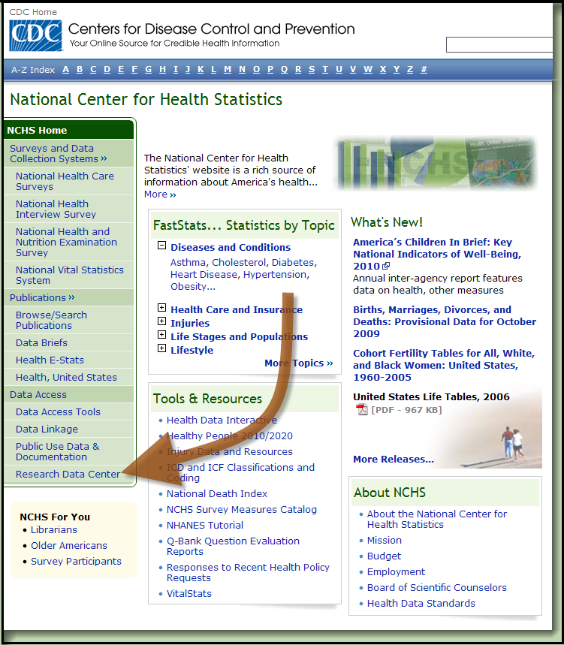
Reaching the RDC from the NCHS Homepage

Slide 43
Or, go directly to the
NCHS/RDC home page:
http://www.cdc.gov/rdc

Slide 44
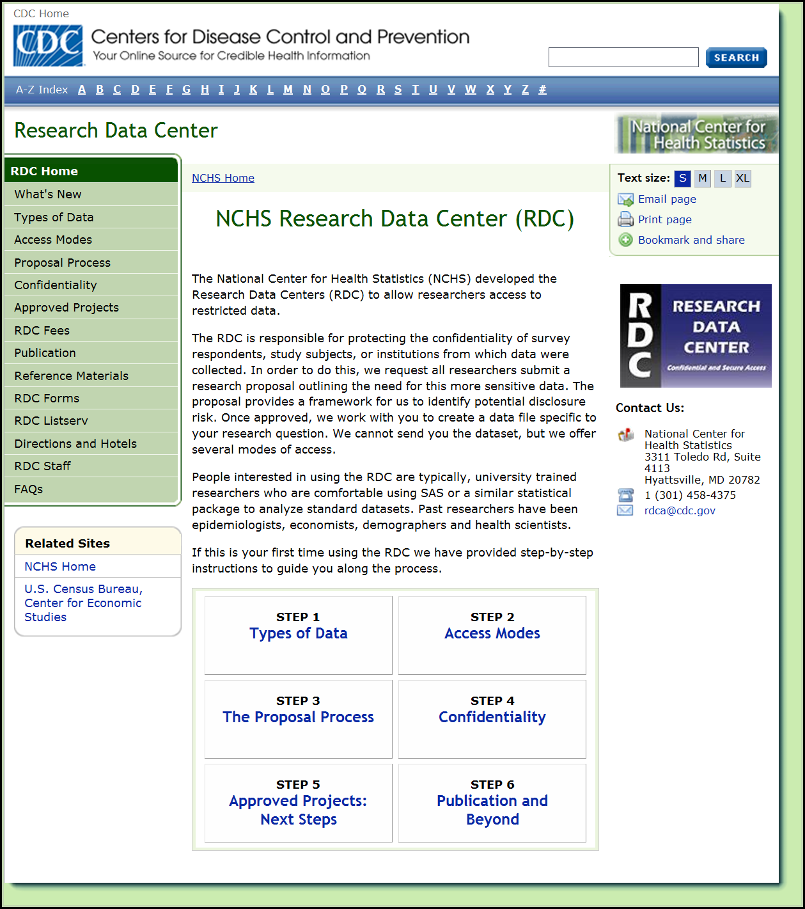

Slide 45
To learn more about the geocode data available at the NCHS / RDC:
Click on “Step 1: Types of Data”
On the next page, pick “Restricted Data”
Click on “Geocodes by NCHS Survey”
We look forward to seeing you soon!

