Slide 1
2010 National Conference on Health Statistics
Session 4.
Finding Key Resources on the NCHS Website
Anthony Quintana
Evangeline Adams
Alana Yick
Office of Information Services
National Center for Health Statistics

Slide 2
Outline of the Session
Explanation of handouts
Rules for the class
Key resources we will cover in the class
Overview of NCHS
Overview of each key resource with web navigation exercises after each section
Participant questions and answers

Slide 3
Handouts
Copy of slides
Guide to NCHS Surveys, Data Systems, and Publications.
Printed copy of the NCHS homepage with the “Homepage Goodies” and key resources highlighted for easy identification.

Slide 4
Rules for the Class
Do not use the CDC search box
Do not use any search engines such as Google, Yahoo, or Bing
All answers must be attained by navigating through the NCHS website
Do not use the blue A-Z index bar at the top of the page

Slide 5
Key Resources that we will cover:
Home Page Goodies
Surveys and Data Collection Systems
    Questionnaires
    Raw Data
Publications
FastStats
Data Access
    Vital Stats Online
    Health Data Interactive
    CDC Wonder

Slide 6
Overview of NCHS
Provides fundamental public health and health policy statistics that meet the needs of a wide range of users
Tracks changes in health and health care across the nation
Provides mechanisms for obtaining consistent, uniform statistics

Slide 7

NCHS Data Uses
Comparisons across populations, providers, and geographic areas
Planning/assessing public health programs
Identifying health problems, risk factors, and disease patterns

Slide 8
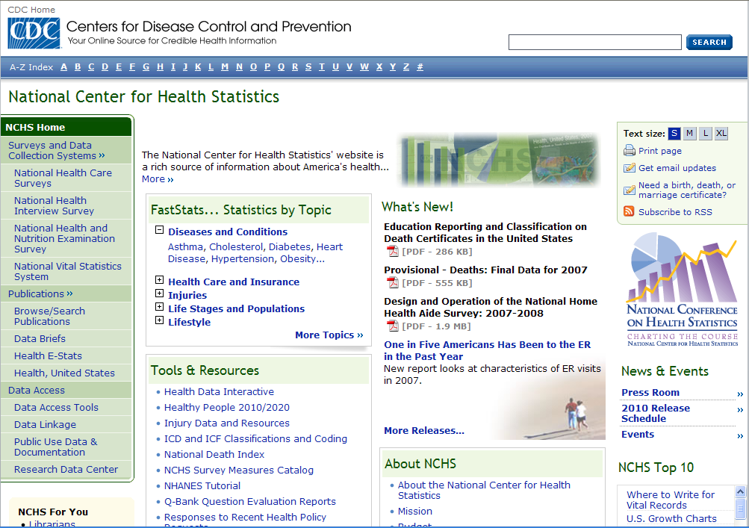
http://www.cdc.gov/nchs

Slide 9
Homepage Goodies
What’s New!
NCHS Top 10
2010 Release Schedule
Tools and Resources
CDC Data and Statistics

Slide 10
Surveys and Data Collection Systems
Evangeline Adams

Slide 11

Major Data Systems and Surveys
National Vital Statistics System
National Health Interview Survey
National Health Care Surveys
National Health and Nutrition Examination Survey

Slide 12


Subject Specific Surveys
National Survey of Family Growth
State and Local Integrated Telephone Survey
The Longitudinal Studies of Aging
National Immunization Survey

Slide 13

Data Collection Methods
Vital statistics data collected in partnership with states
Household interview surveys
Examination surveys
Health care provider surveys
Telephone surveys

Slide 14
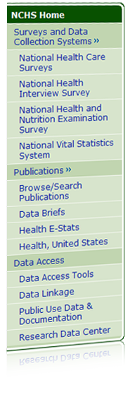
Survey and Data Collection
Systems Exercises
The National Health Care Survey consists of seven surveys. Which survey collects data on visits to office-based physicians?
Public-use data files (micro-data) are available from each NCHS survey. What is the latest year data are available from the National Health Interview Survey?

Slide 15
Survey and Data Collection
Systems Exercises
NHANES is a complex survey and analyzing the data may require some training. What is a possible first step in the learning process?
Using the NHANES examination datasets, find the most recent blood pressure data available. When was it released?

Slide 16
Publications and Reports,
FastStats
Alana Yick

Slide 17
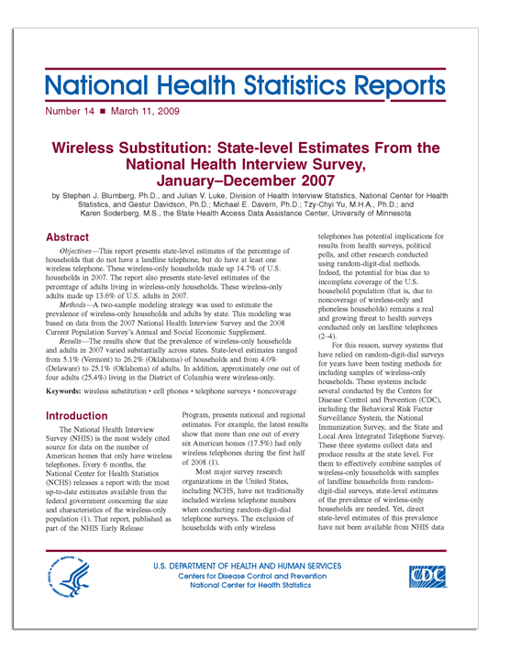
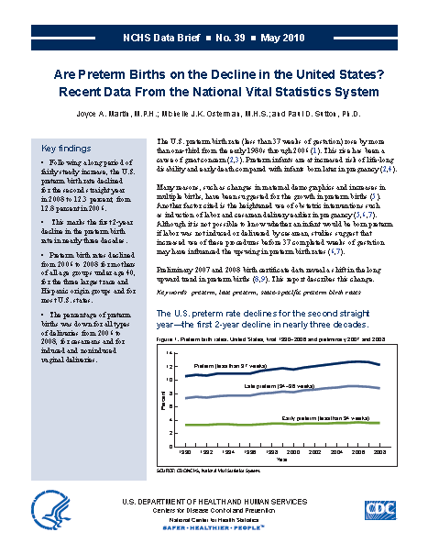
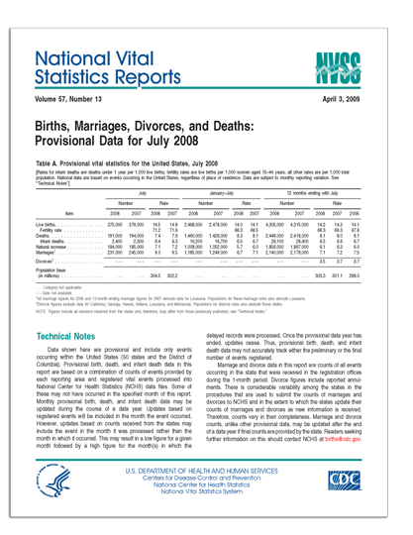
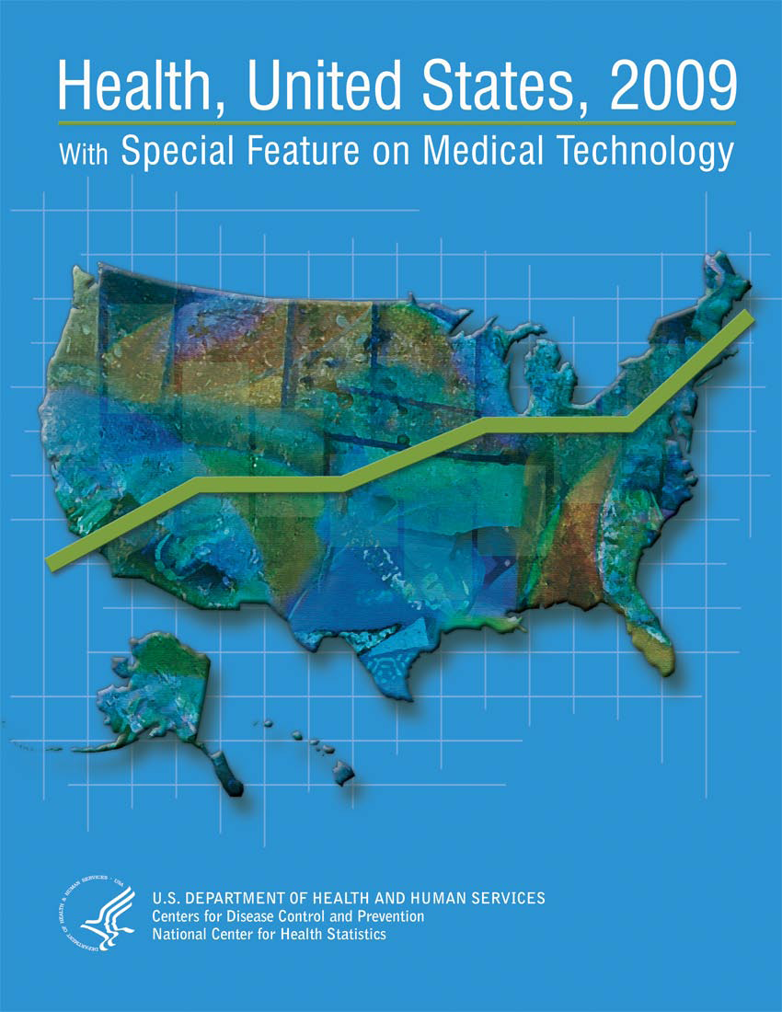

Publications and Reports

Slide 18
Publications and Reports Exercises
How many live births were there in November 2009?
Find the NHANES report about blood folate levels.
What is the life expectancy for someone born in 2006?
Using the report Health, United States, what percent of adults currently smoke cigarettes?

Slide 19
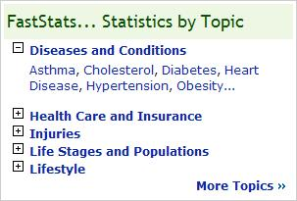
FastStats
“Statistics by Topic”
Alphabetical listing of popular health topics
Each topic has links to reports and surveys in which data on the topic is collected

Slide 20
FastStats Exercises
What percentage of people that visit the emergency room end up being admitted?
What is the average height and weight of a man?
How many new cases of chlamydia were reported in 2007?
How many deaths were there in Virginia in 2007?

Slide 21
Data Access Tools
Anthony Quintana

Slide 22
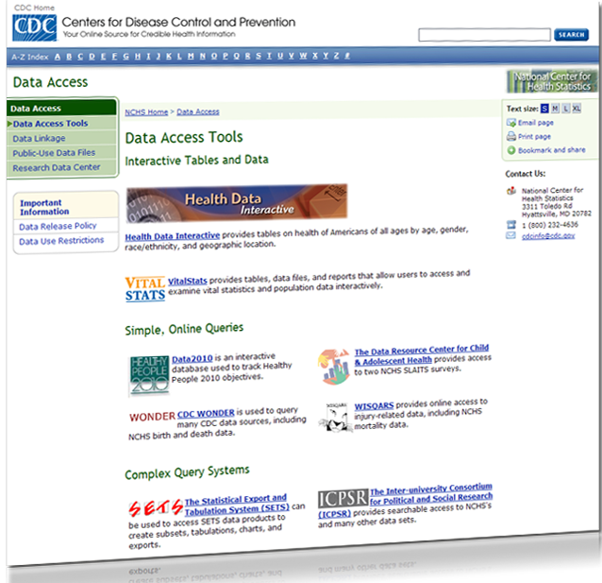
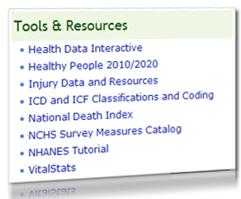
Data Access Tools
http://www.cdc.gov/nchs/data_access/data_tools.htm

Slide 23
Health Data Interactive
What race/ethnicity has the highest percentage of persons who have never smoked cigarettes? How current is the data?
What percentage of American Indian males 18-24 years engage in regular physical activity? How current is the data?
What percentage of Black females among Medicare beneficiaries 65 years and over in 2007 had difficulty walking? Make a chart.
What is the infant mortality rate for Pennsylvania, Montana, and Florida? How current is the data? Make a chart.

Slide 24
VitalStats
In 2006, how many girls under the age of 15 delivered a baby over 5000 grams?
In 1990, how many Black women between 40-44 years of age had a VBAC?
What was the U.S. Population in 2006?

Slide 25
CDC Wonder
Find the number of neoplasm deaths that occurred in Calumet County, Wisconsin each year between 1980 and 1985, broken down by age.

Slide 26
Questions and Answers

Slide 27
Contact Information
Anthony Quintana
AQuintana@cdc.gov
Evangeline Adams
EDAdams@cdc.gov
Alana Yick
AYick@cdc.gov
General information and inquiries:
E-mail: cdcinfo@cdc.gov
Telephone: 1 (800) 232-4636

