Slide 1
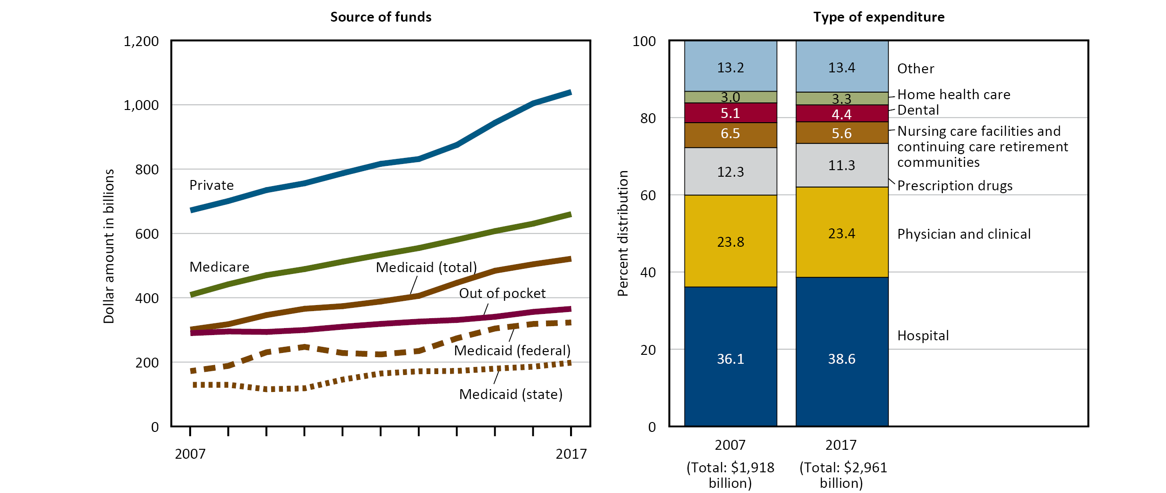
Health Care Expenditures and Payers
Figure 18. Personal health care expenditures, by source of funds and type of expenditure: United States, 2007–2017
NOTES: Personal health care expenditures are outlays for goods and services relating directly to patient care. Personal health care expenditures are in current dollars and are not adjusted for inflation. See data table for Figure 18.
SOURCE: Centers for Medicare & Medicaid Services, National Health Expenditure Accounts (NHEA). Excel and PowerPoint: https://www.cdc.gov/nchs/hus/contents2018.htm#Figure_018

