Slide 1
Prevention of Foodborne Illness and Medical Product Adverse Events: A Healthy People 2020 Progress Review January 8, 2014

Slide 2
Howard K. Koh, MD, MPH Assistant Secretary for Health U.S. Department of Health and Human Services

Slide 3
Overview and Presenters
Chair
Howard K. Koh, MD, MPH, Assistant Secretary for Health
U.S. Department of Health and Human Services
Data Presentation
Irma Arispe, PhD, Associate Director
National Center for Health Statistics, CDC
Research and Program Presentation
John Whyte, MD, MPH, Director
Professional Affairs and Stakeholder Engagement
Center for Drug Evaluation and Research, FDA
Roberta Wagner, BS, MS, Deputy Director
Regulatory Affairs , Center for Food Safety and Applied Nutrition, FDA
CAPT David Goldman, MD, MPH, Assistant Administrator
Office of Public Health Science
Food Safety and Inspection Services, U.S. Department of Agriculture
Community Highlight
Shelley Feist, Executive Director
Partnership for Food Safety Education

Slide 4
Healthy People 2020 Evolves

Slide 5
Overview: Food Safety
1 in 6 Americans is affected by foodborne illness each year
Costs are estimated between $78 and $152 billion dollars annually (2011 and 2010)
At least 2 million people acquire serious infections with antibiotic resistant bacteria annually, not all foodborne
SOURCE: Scharff 2011 and 2010
NOTES: 1 http://www.cdc.gov/drugresistance/threat-report-2013/
2 http://www.tufts.edu/med/apua/consumers/personal_home_5_1451036133.pdf (accessed 8-5-2013); extrapolated from
Roberts RR, Hota B, Ahmad I, et al. Hospital and societal costs of antimicrobial-resistant infections in a Chicago teaching
hospital: implications for antibiotic stewardship. Clin Infect Dis. 2009 Oct 15;49(8):1175-84

Slide 6
Federal Agencies with Major Roles in Food Safety
Food Safety and Inspection Service (FSIS)
U.S. Food and Drug Administration (FDA)
Centers for Disease Control and Prevention (CDC)

Slide 7
Overview: Medical Product Safety
The role of the Food and Drug Administration
Premarket Review
Postmarket Surveillance
Inspection
Compliance
Enforcement
Medical Products Include:
Medical devices
Drugs
Biologics
Radiological Products

Slide 8
Prescription Painkiller Overdoses in the US
SOURCE: CDC Vital Signs. Prescription Painkiller Overdoses in the US. November 2011.

Slide 9
Irma Arispe, PhD Associate Director, National Center for Health Statistics Centers for Disease Control and Prevention

Slide 10
Presentation Outline
Food Safety
Foodborne infections
Foodborne disease outbreaks
Antimicrobial resistance
Food safety practices and food allergies
Medical Product Safety
Adverse drug events
Tracking of adverse drug events
Potential new data source
10

Slide 11
Food Safety: Public Health Impact
Foodborne illnesses caused by 31 major pathogens annually account for:
9.4 million episodes of foodborne illnesses
55,961 hospitalizations
1,351 deaths
Estimates of the illnesses caused by four key pathogens tracked annually in Healthy People are:
Salmonella
1,027,561 illnesses; 19,336 hospitalizations; and 378 deaths
Campylobacter
845,024 illnesses; 8,463 hospitalizations; and 76 deaths
Shiga toxin producing Escherichia coli serogroup O157
63,153 illnesses; 2,138 hospitalizations; and 20 deaths
Listeria monocytogenes
1,591 illnesses; 1,455 hospitalizations; and 255 deaths
SOURCES: Scallan, E., et al.; 2011a. Foodborne illnesses acquired in the United States—major pathogens. Emerg. Infect. Dis. 17(1): 7-15. Scallan, E., et al.; 2011b Foodborne illnesses acquired in the United States—unspecified agents. Emerg. Infect. Dis. 17(1): 16-22.

Slide 12
Major Data Systems Used for Foodborne Illness Surveillance
CDC leads federal surveillance efforts to collect
foodborne illness and outbreak data with these systems:
Foodborne Diseases Active Surveillance Network (FoodNet)
tracks laboratory confirmed cases of infection targeting nine pathogens transmitted commonly through food with a network of 10 states, USDA-FSIS and the FDA
National Outbreak Reporting System (NORS)
collects reports of enteric disease outbreaks caused by bacterial, viral, parasitic, chemical, toxin, and unknown agents
National Antimicrobial Resistance Monitoring System for Enteric Bacteria (NARMS)
tracks antimicrobial resistance in human infections caused by Salmonella and other enteric bacteria

Slide 13
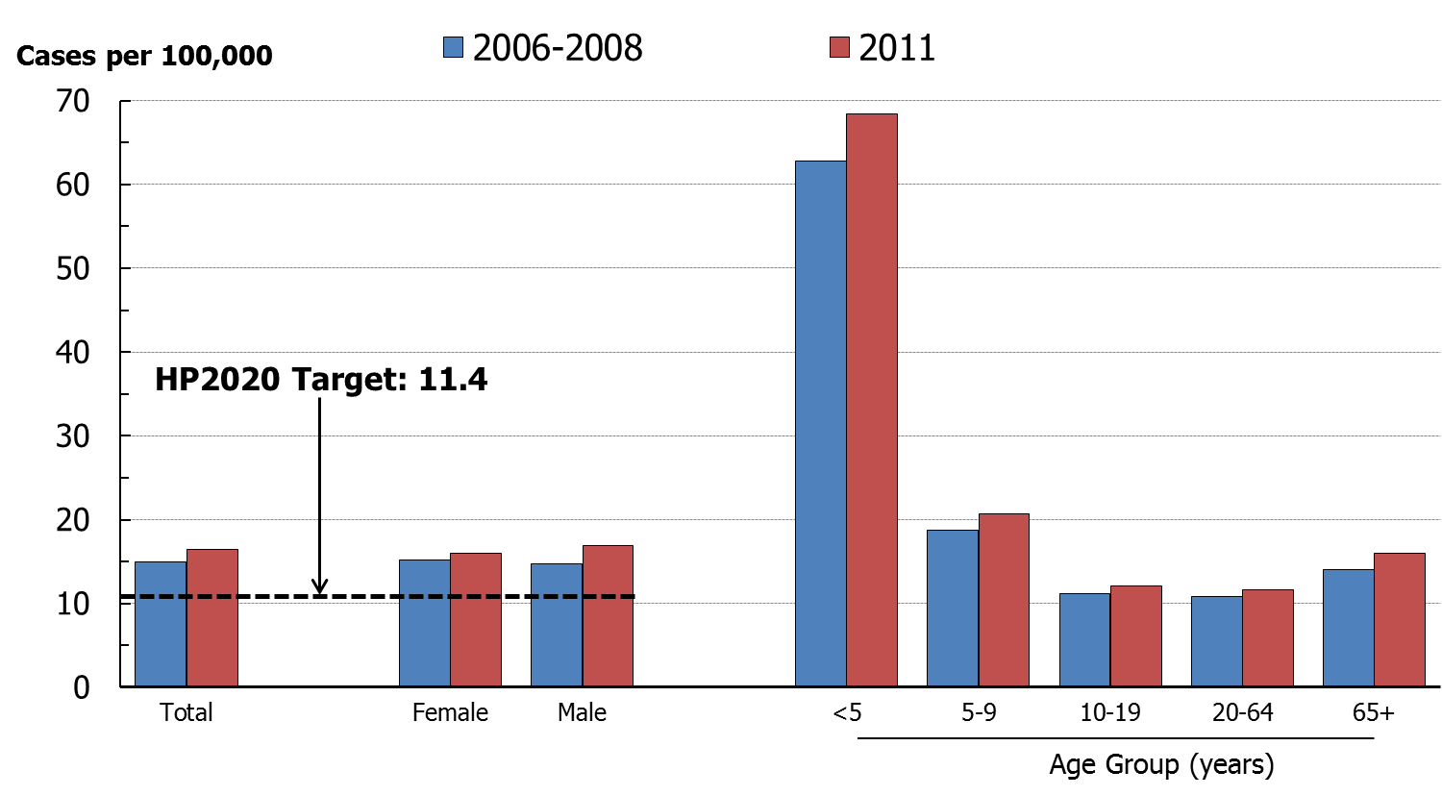
Infections Caused by Salmonella, 2006–2008* and 2011
NOTES: Data for age groups between 20 and 64 are similar and were aggregated to highlight the other, most at-risk groups; Rates include both foodborne and non-foodborne illnesses.
SOURCE: Foodborne Diseases Active Surveillance Network (FoodNet), CDC/NCEZID.
* The baseline figure was calculated using a 3-year average (2006-08).
Obj. FS-1.4
Decrease desired

Slide 14
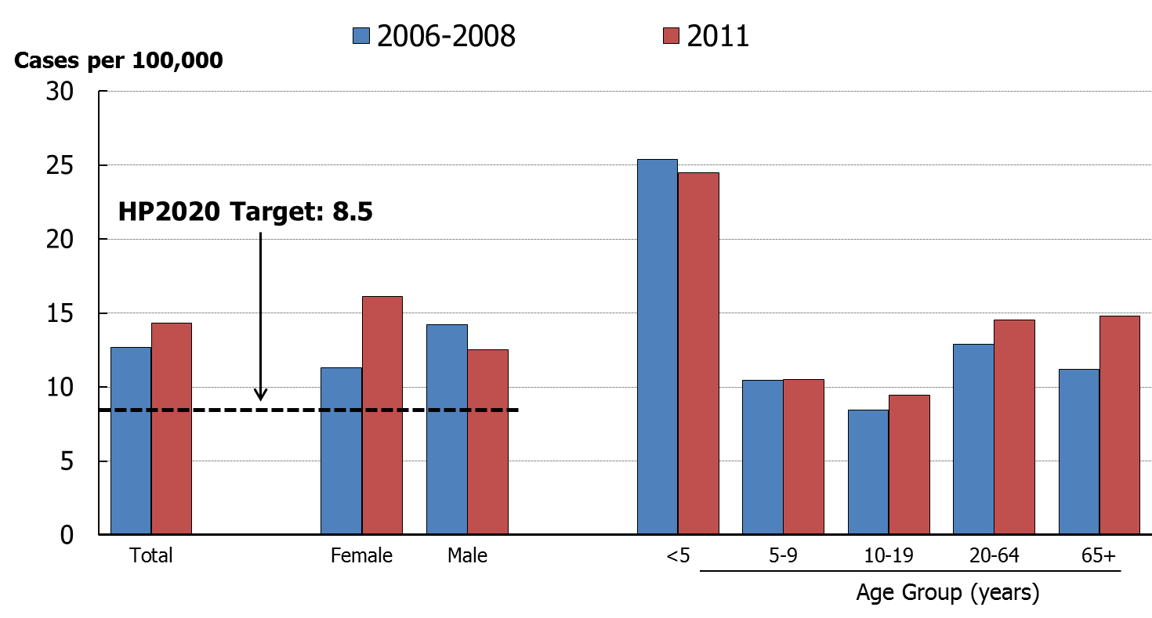
Infections Caused by Campylobacter, 2006–2008* and 2011
Obj. FS-1.1
Decrease desired
NOTES: Data for age groups between 20 and 64 are similar and were aggregated to highlight the other, most at-risk groups; Rates include both foodborne and non-foodborne illnesses.
SOURCE: Foodborne Diseases Active Surveillance Network (FoodNet), CDC/NCEZID.
* The baseline figure was calculated using a 3-year average (2006-08).

Slide 15
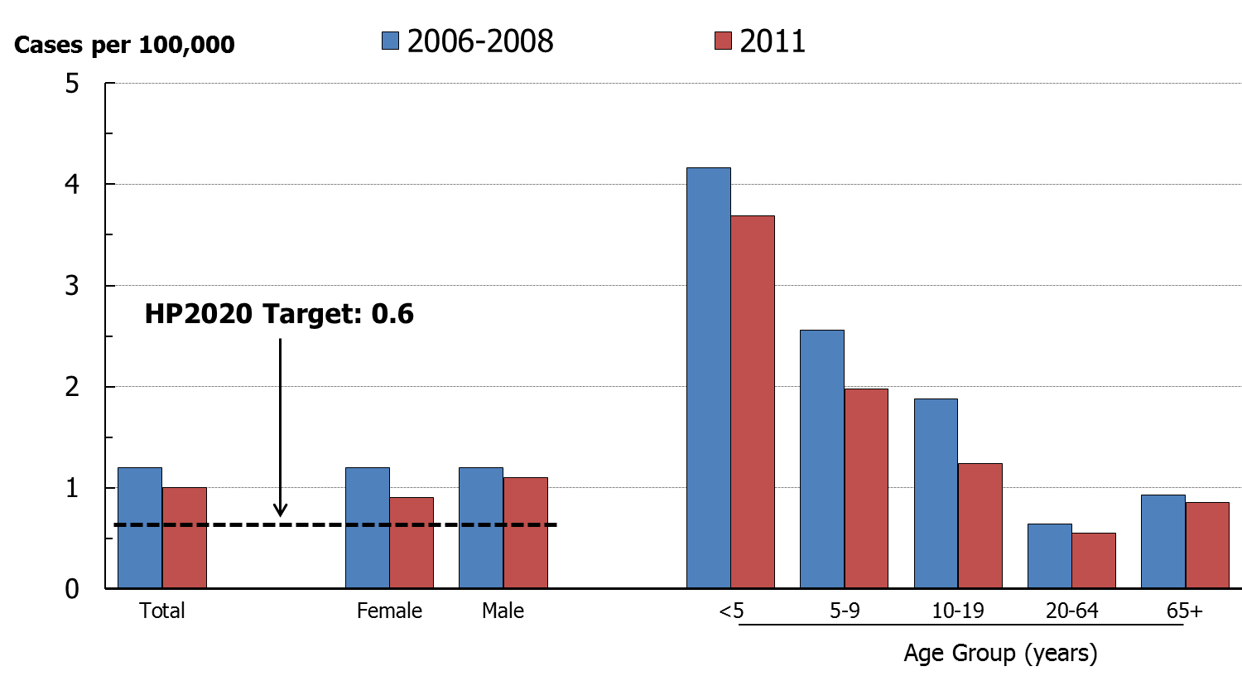
Infections Caused by E. coli * O157, 2006–2008** and 2011
NOTES: Data for age groups between 20 and 64 are similar and were aggregated to highlight the other, most at-risk groups; Rates include both foodborne and non-foodborne illnesses.
SOURCE: Foodborne Diseases Active Surveillance Network (FoodNet), CDC/NCEZID.
* STEC O157 is a Shiga toxin-producing Escherichia coli, serogroup O157.
** The baseline figure was calculated using a 3-year average (2006-08).
Obj. FS-1.2
Decrease desired

Slide 16
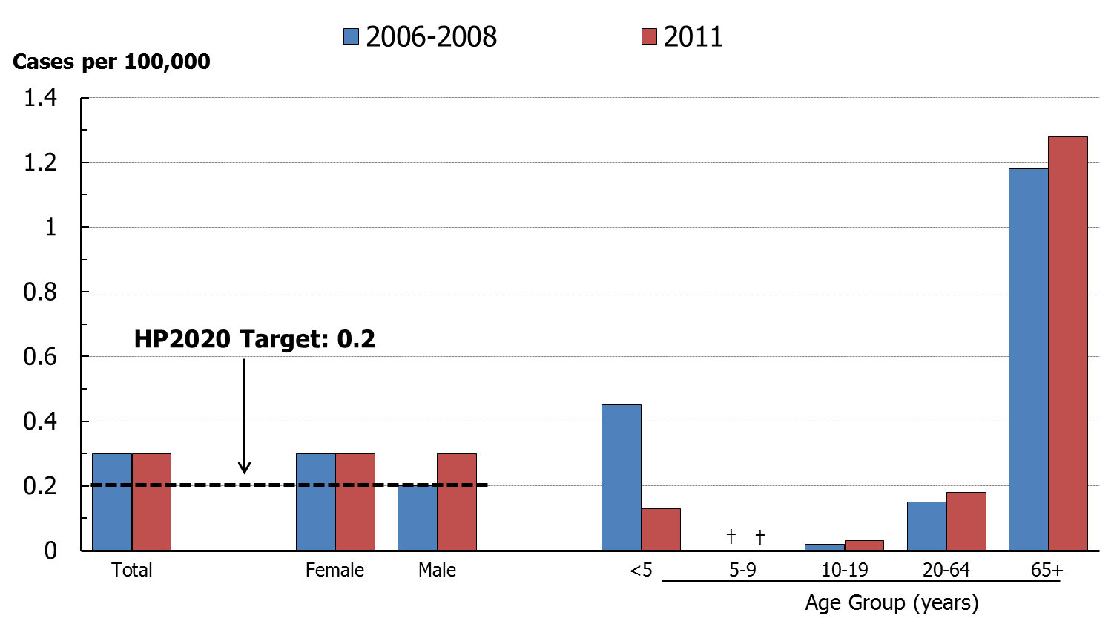
Infections Caused by Listeria monocytogenes, 2006–2008* and 2011
NOTES: Data for age groups between 20 and 64 are similar and were aggregated to highlight the other,most at-risk groups; Rates include both foodborne and non-foodborne illnesses.
SOURCE: Foodborne Diseases Active Surveillance Network (FoodNet), CDC/NCEZID.
*The baseline figure was calculated using a 3-year average (2006-08).
†Zero cases in 2006 through 2008, and 2011.
Obj. FS-1.3
Decrease desired

Slide 17
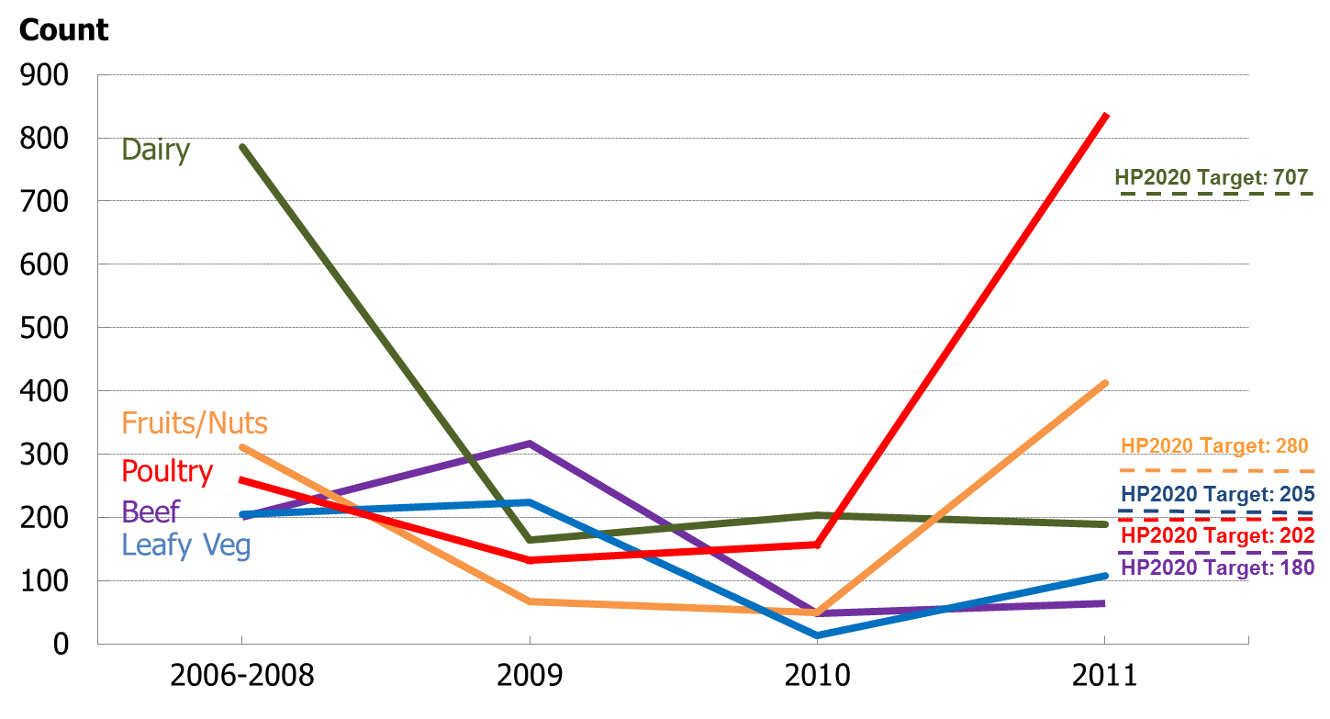
Outbreak-Associated Infections Attributed to Five Food Groups, 2006–2008* through 2011
*The baseline figure was calculated using a 3-year average (2006-08).
SOURCE: National Outbreak Reporting System (NORS), CDC/NCEZID and CSTE.
Obj. FS-2.1 through 2.5 Decrease desired

Slide 18
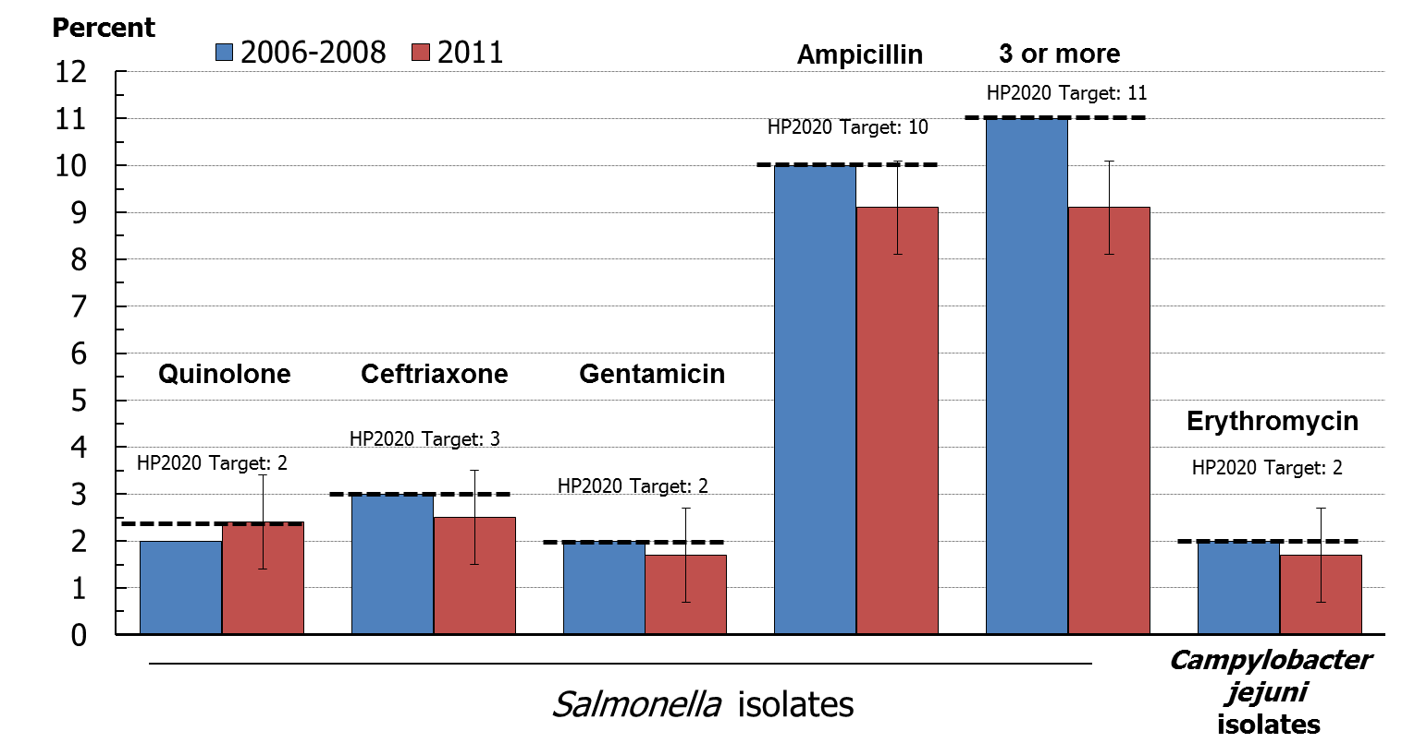
Percent of Salmonella and Campylobacter Clinical Isolates Resistant to Antibiotics, 2006–2008* and 2011
NOTES: I = 95% confidence interval; FS-3.5 tracks resistance of 3 or more from among 24 antibiotics;
Confidence intervals were not available for baseline estimates.
SOURCE: National Antimicrobial Resistance Monitoring System for Enteric Bacteria (NARMS), CDC/NCEZID.
* The baseline is a 3-year average (2006-08).
Obj. FS-3.1 through 3.6
Maintain Baseline

Slide 19
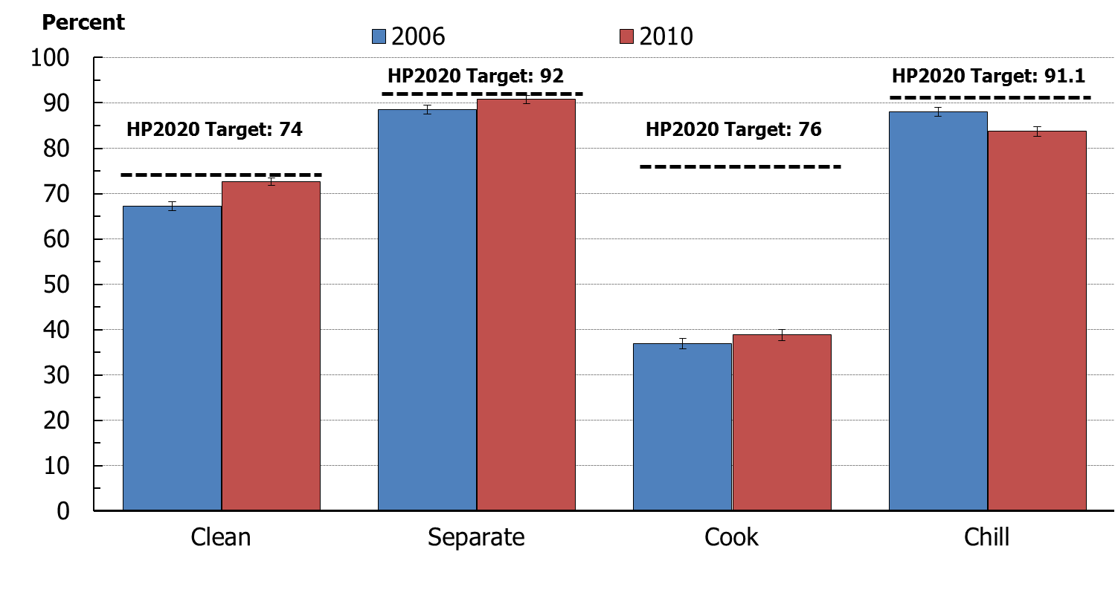
Key Food Safety Practices, 2006 and 2010
NOTES: I = 95% confidence interval.
FightBAC!™ Messages:
Clean – Wash hands and surfaces often Separate – Don’t cross-contaminate
Cook – Cook to proper temperature Chill – Refrigerate promptly
SOURCE: Food Safety Survey, FDA/CFSAN.
Obj. FS-5.1 through 5.4
Increase desired

Slide 20
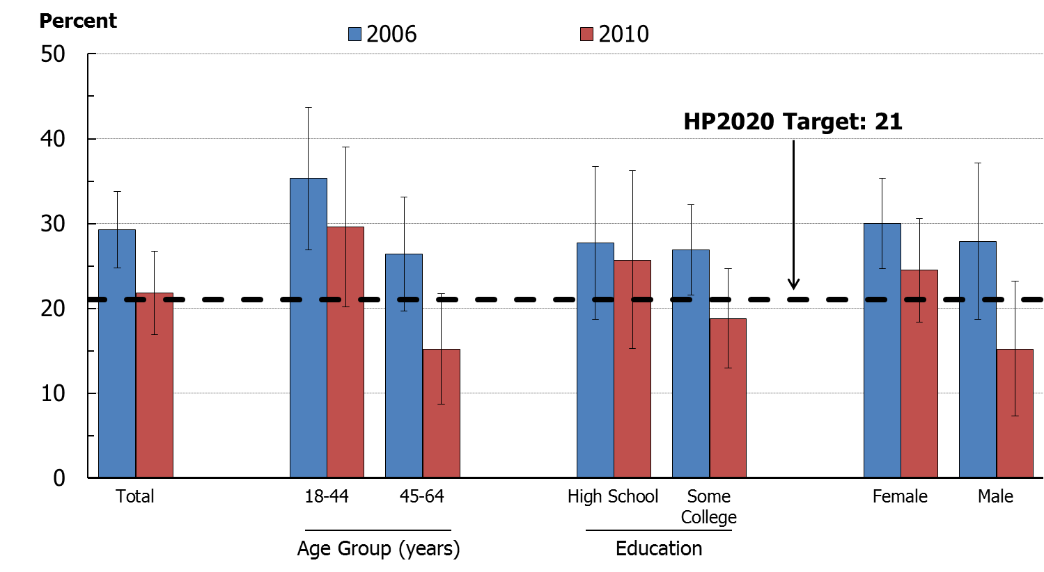
Severe Allergic Reactions to Food Among Adults with a Food Allergy Diagnosis, 2006 and 2010
Obj. FS-4 Decrease desired
NOTE: I = 95% confidence interval. Data are statistically unreliable for age 65+ year and less than high school education.
SOURCE: Food Safety Survey, FDA/CFSAN.

Slide 21
Medical product safety

Slide 22
Presentation Outline
Food Safety
Foodborne infections
Foodborne disease outbreaks
Antimicrobial resistance
Food safety practices and food allergies
Medical Product Safety
Adverse drug events
Tracking of adverse drug events
Potential new data source
22

Slide 23
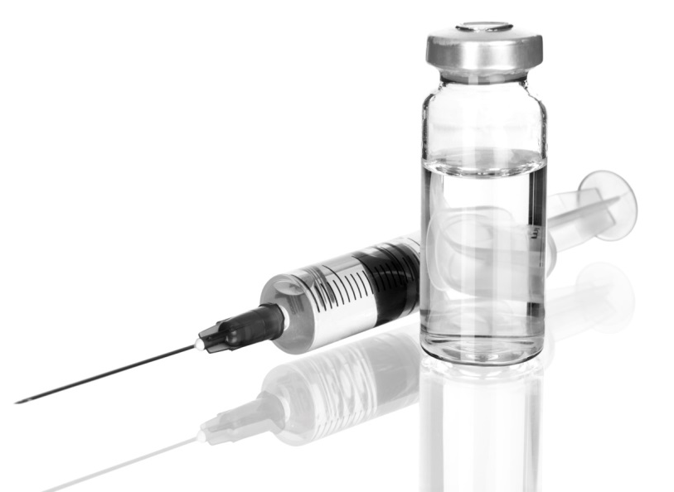
Medical Products
Drugs
Biological Products
Medical Devices

Slide 24
Medical Product Safety
3 billion prescriptions written annually
1.5 million preventable adverse drug events occur within the healthcare system each year costing more than $4 billion annually
Major Causes of Injury
Medication overdoses in children
Prescription pain medication overdoses
SOURCE: FDA. Safe Use Initiative Fact Sheet. 2012. Accessed 10/10/2013. Available from: http://www.fda.gov/Drugs/DrugSafety/SafeUseInitiative/ucm188760.htm.

Slide 25
Emergency Department Visits for Overdoses, 2006–2007 and 2008–2009
Rate per 10,000 outpatient prescription-visits
2006–2007 2008–2009
HP2020 Target: 39.1
HP2020 Target: 32.3
HP2020 Target: 8.0
Oral Anticoagulants
Injectable Antidiabetic
Agents
Narrow-Therapeutic-Index
Medications
NOTES: I = 95% confidence interval. Data are for the number of emergency department visits for overdoses per 10,000 outpatient prescription-visits.
Objs. MPS-5.1 through 5.3
Decrease desired
SOURCES: National Electronic Injury Surveillance System:-Cooperative Adverse Drug Events Surveillance Project (NEISS-CADES), CDC/NCIPC, CPSC, and FDA; National Ambulatory Medical Care Survey (NAMCS), CDC/NCHS; National Hospital Ambulatory Medical Care Survey (NHAMCS), CDC/NCHS.

Slide 26
Emergency Department Visits for Medication Overdoses, Children < 5 years, 2007–2008 and 2009–2010
Rate per 10,000
HP2020 Target: 29.4
NOTES: I = 95% confidence interval. Data are for the number of emergency department visits for overdoses per 10,000 children under age 5 years.
Obj. MPS-5.4
Decrease desired
SOURCES: National Electronic Injury Surveillance System-Cooperative Adverse Drug Events Surveillance Project (NEISS-CADES), CDC/NCIPC, CPSC, and FDA.

Slide 27
Drug Overdose Deaths, 1979–2010
Rate per 100,000
NOTE: Data are for deaths with an underlying cause of drug overdose by all intents: unintentional, suicide, homicide, and undetermined intent. 1979-1998: ICD-9 codes E850-E858, E950.0-E950.5, E962.0, or E980.0-E980.5; 1999-2010: ICD-10 codes X40-X44, X60-X64, X85, or Y10-14. Data are age adjusted to the 2000 standard population.
SOURCE: National Vital Statistics System-Mortality (NVSS-M), CDC/NCHS.

Slide 28
Hospitals Reporting Adverse Drug Events, 2009 and 2012
Percent
HP2020 Target: 66.8%
NOTES: For this objective, an adverse drug event is defined as an injury resulting from the use of, or not using, a needed medication. Adverse drug events include both adverse drug reactions and medication errors, including both errors of commission and omission, that result in adverse clinical outcomes. Hospitals were counted as reporting adverse drug events externally if they reported to FDA, Medwatch, Institute for Safe Medication Practices, or the manufacturer.
Obj. MPS-1
Increase desired
SOURCE: National Survey of Pharmacy Practice in Hospital Care Settings, American Society of Health-System Pharmacists (ASHP).

Slide 29
National Hospital Care Survey
The National Hospital Care Survey (NHCS) integrates three long-standing surveys:
NHDS - the longest continuously fielded sample of inpatient care from 1965–2010
NHAMCS - surveying hospital emergency departments and outpatient departments since 1992, hospital ambulatory surgery locations since 2009, and freestanding ambulatory surgery centers since 2010
DAWN - collected data on drug-involved emergency department visits since 1970s; conducted by SAMHSA from 1992–2011

Slide 30
Key Takeaways – Food Safety
Foodborne pathogens continue to be a major cause of illnesses, despite significant reduction in some infections.
The very young and the elderly are the most vulnerable to foodborne illnesseses.
Antimicrobials are still effective against Salmonella and Campylobacter.
Severe allergic food reactions in adults have decreased and have nearly met the HP2020 target.
Most consumer food safety practices are near their HP2020 target.

Slide 31
Key Takeaways – Medical Product Safety
Adverse drug events are a major problem, although progress in reducing them is possible.
Some HP2020 objectives for reducing ED visits for adverse drug events may have been met. However, estimates must be interpreted cautiously.
The tracking of adverse drug events is improving.
The percent of hospitals that report adverse drug events has exceeded the HP2020 target.
Healthy People anticipates developing objectives on pain treatment, medical products, and personalized medicine.

Slide 32
John Whyte, M.D.,M.P.H. Director of Professional Affairs and Stakeholder Engagement U.S. Food and Drug Administration Center for Drug Evaluation and Research

Slide 33
Medical Product Safety: Future Direction
HHS Initiative: National Action Plan for Adverse Drug Event Prevention
MPS-1: Monitoring and analysis of adverse events associated with medical therapies
MPS-2: Pain treatment (developmental)
MPS-3: Adverse events from medical products (developmental)
MPS-4: Medical products associated with predictive biomarkers (developmental)
MPS-5: Emergency department visits for adverse events from medications
FDA Advancing Regulatory Science Initiative
MPS-2: Pain treatment (developmental)
MPS-3: Adverse events from medical products (developmental)
MPS-4: Medical products associated with predictive biomarkers (developmental)
FDA Initiative: Personalized Medicine
MPS-4: Medical products associated with predictive biomarkers (developmental)

Slide 34
HHS National Action Plan for Adverse Drug Event Prevention
In 2006, 82% of US population reported using at least one prescription medication, over the counter medication or dietary supplement, and 29% reported using five or more prescription medications.
Among older adults (65 years of age or older), 57-59% reported taking five to nine medications and 17-19% reported taking 10 or more.
Given the ever-increasing magnitude of medication exposure, the potential for harms from ADEs constitutes a critical patient safety and public health challenge.
Two objectives:
Identify common, clinically significant, preventable, and measurable adverse drug events (ADEs)
Align the efforts of federal health agencies to reduce patient harms from these specific ADEs nationally
U.S. Department of Health and Human Services, Office of Disease Prevention and Health Promotion. (2013). National Action Plan for Adverse Drug Event Prevention. Washington, DC

Slide 35
HHS National Action Plan for Adverse Drug Event Prevention
Three initial targets of the Action Plan:
Anticoagulants (bleeding)
Aligned with HP2020 MPS Objective -5.1: Reduce emergency department visits for overdoses from anticoagulants
Diabetes agents (hypoglycemia)
Aligned with HP2020 MPS Objective -5.2: Reduce emergency visits for overdoses from injectable antidiabetic agents
Opioids (accidental overdoses, oversedation, respiratory depression)
Aligned with HP2020 MPS Objective -2: Increase the safe and effective treatment of pain (developmental)
FDA Surveillance Systems
FDA Sentinel Initiative
FDA Adverse Event Reporting System (FAERS)
U.S. Department of Health and Human Services, Office of Disease Prevention and Health Promotion. (2013). National Action Plan for Adverse Drug Event Prevention. Washington, DC

Slide 36
FDA Advancing Regulatory Science Initiative
Launched in February 2010
Regulatory Science: the science of developing new tools, standards and approaches to assess the safety, efficacy, quality and performance of FDA-regulated products
8 priority research areas
Example: Modernize Toxicology to Enhance Product Safety
http://www.fda.gov/ScienceResearch/SpecialTopics/RegulatoryScience/default.htm
Notes:
The FDA Advancing Regulatory Science Initiative was launched in February 2010 with the release of the Advancing Regulatory Science for Public Health report. In August of 2011, the strategic plan for Advancing Regulatory Science at FDA was released.
Regulatory science is defined as the science of developing new tools, standards and approaches to assess the safety, efficacy, quality and performance of FDA-regulated products.
The plan identifies eight priority areas of regulatory science where new or enhanced engagement is essential to the continued success of FDA’s public health and regulatory mission.
One priority research area that relates to all of the current Medical Product Safety objectives is Modernizing Toxicology to Enhance Product Safety
Serious and sometimes rare and unexpected adverse events may be observed in clinical trials or post-approval, suggesting that critical gaps exist in our understanding of the relationship between patient response and preclinical toxicology findings.
FDA can close these gaps and improve preclinical safety predictions by further investing in three particular areas of regulatory science: the evaluation and development of models and assays that better predict patient response, the identification and evaluation of more reliable biomarkers for monitoring toxicities, side effects, and abnormalities, and the use of computational tools to integrate and draw conclusions from a wide range of preclinical safety data types and sources.
By addressing these needs, FDA will be better able to identify and accurately predict and reduce the magnitude and likelihood of risks associated with products.

Slide 37
FDA Initiative: Personalized Medicine
Paving the Way for Personalized Medicine: FDA’s Role in a New Era of Medical Product Development
Developing Regulatory Standards, Research Methods, and Tools
MPS-4: Medical products associated with predictive biomarkers (developmental)
Example: Biomarker Qualification Program
http://www.fda.gov/ScienceResearch/SpecialTopics/PersonalizedMedicine/ucm20041021.htm

Slide 38
FDA’s Efforts in Decreasing Prescription Painkiller Overdoses in the U.S.
Medical Product Safety Objective - 2: Increase the safe and effective treatment of pain (developmental)
Safety labeling changes and post market study requirements
Risk Evaluation and Mitigation Strategy (REMS) for Extended Release and Long-Acting Opioids
Recommendation to reclassify hydrocodone combination products from Schedule III to Schedule II
Opioid Patient-Prescriber Agreement

Slide 39
Conclusion
Next steps for the Medical Product Safety Working Group:
Continue to address medical product safety issues
Develop measurable objectives that align with HHS and FDA initiatives and priorities

Slide 40
Roberta F. Wagner, B.S., M.S. Deputy Director for Regulatory Affairs FDA/Center for Food Safety and Applied Nutrition
Protecting and Promoting Your Health

Slide 41
Food Safety: Preventing Foodborne Illness

Slide 42
FDA and Food Safety
FDA regulates 80% of food consumed in the U.S.
All human foods except the meat, poultry, and processed egg products regulated by USDA/FSIS
FDA’s Center for Food Safety and Applied Nutrition and its Office of Regulatory Affairs in partnership with State counterparts are responsible for the regulatory oversight of this food industry
Challenges
Too many preventable foodborne illnesses, causing costly disruptions in the marketplace, loss of public confidence in the food supply
An increasingly complex global supply chains resulting in pressures on food safety and oversight system

Slide 43
Healthy People 2020 Food Safety Topic Area Objectives
FS-1 Reduce infections caused by bacterial pathogens transmitted commonly through food.
FS-2 Reduce number of outbreak-associated bacterial
infections associated with food commodity groups.
FS-3 Prevent increase in proportion of non-typhoidal Salmonella and Campylobacter jejuni isolates from humans resistant to antimicrobial drugs.
FS-4 Reduce severe allergic reactions among adults with food allergies.
FS-5 Increase proportion of consumers who follow key food safety practices.
FS-6 Improve food safety practices in food service and retail establishments (developmental).

Slide 44
FS-1: Reduce Infections Caused By Pathogens Transmitted through Food
Key Food Safety Modernization Act (FSMA) Principles
Modernizes and enhances FDA’s authorities and oversight of the global food supply
Recognizes “industry’s” responsibility for food safety
Prevention focus as opposed to reactionary
Focus on farm to table prevention; reliant on science/risk based, flexible standards
Provides for enhanced domestic/foreign inspections, new enforcement tools and modern import oversight
Partnerships are key to success

Slide 45
FS-1 FSMA Key Rules Proposed
Preventive Controls (Human Food)
Jan 2013
Preventive Controls (Animal Food)
Oct 2013
Produce Safety
Jan 2013
Foreign Supplier Verification Programs for Importers
July 2013
Accredited 3rd Party Certification
July 2013
Intentional Adulteration
Dec 2013
Safe Food Transport

Slide 46
FS-1 FSMA in Action: New Enforcement Tools Used to Improve Food Safety
Mandatory Recall Authority
Mandatory recalls of adulterated pet treats and adulterated dietary supplements in 2013
Administrative Detention
Used 6 times since the enactment of FSMA
In 2013 detained $8 million dietary supplements containing DMAA, a new dietary ingredient that has not been shown to be safe
Suspension of Registration
Suspended registration of peanut butter processor linked to a nation-wide Salmonella outbreak

Slide 47
FS-1 FS-1
FS-1 FS-2
FDA works with partners, through CORE, to:
Find the outbreak
Signals and Surveillance Team
Stop the outbreak
Response Teams
Prevent the next outbreak
Post-Response Team

Slide 48
FS-2: Reduce Outbreak-Associated Infections Associated with Food Categories
Agencies need to know how many cases of foodborne disease are attributable to each food commodity group they regulate
CDC, FSIS, and FDA have historically pursued their own attribution analyses
Interagency Food Safety Analytics Collaboration (IFSAC) formed to improve coordination of Federal food safety agencies
Developed a shared tri-agency food scheme for attribution analysis
Updated attribution estimates

Slide 49
FS-1/FS-2: OMB HHS Priority Goal Reduce Foodborne illness in the Population
By December 31, 2013, decrease the rate of Salmonella Enteritidis illness in the population from 2.6 cases per 100,000 (2007-2009 baseline) to 2.1 cases per 100,000
Salmonella serotype Enteritidis (SE), a Salmonella subtype, is now the most common type of Salmonella in the United States and accounts for approximately 20% of all Salmonella cases in humans.

Slide 50
FS-3: Prevent an Increase in Clinical Isolates Resistant to Antimicrobial Drugs
Antimicrobial resistance is a complex issue with many causes; uses of antimicrobial drugs in humans and animals contribute to antimicrobial resistance
Dec 2013: FDA announced a plan to limit the effect that animal antimicrobial use may have on increasing drug resistance to help preserve the effectiveness of medically important antimicrobials for treating disease in humans
Plan phases out the use of medically important antimicrobials in food animals for production purposes only, i.e., to enhance growth or improve feed efficiency, and phases in veterinary oversight of the therapeutic uses of these drugs

Slide 51
FS-4: Reduce Illness from Food Allergies
Reducing the presence of undeclared allergens by:
Reducing cross-contamination through modernized food GMPs and new preventive controls
Conducting focused enforcement activities for problematic allergens in foods
Developing improved methods for accurate measurement of allergens in complex foods
Completing a risk assessment to determine if thresholds can be established for undeclared allergens

Slide 52
FS-5: Consumer Focused Safe Food Handling Education and Outreach
http://www.Foodsafety.gov
Food Safety Recalls & Tips Widget; Tips includes 4 FightBac!® Messages - Clean, Separate, Cook, and Chill
http://www.fda.gov
FDA launched an we version of its website Nov 2013
Works well with most mobile devices, including smartphones and tablets
Continues to support traditional desktop and laptop computers.
Provides easy access to the most popular content
Makes it easier for people to report problems with FDA regulated products to the Agency
CFSAN Outreach and Information Center
Phone: 1-888-SAFEFOOD (1-888-723-2266)
Email:
consumer@fda.gov Industry@fda.gov

Slide 53
FS-5: Consumer Focused Safe Food Handling Education and Outreach
http://www.Foodsafety.gov
Food Safety Recalls & Tips Widget
Tips includes 4 FightBac!® messages
Clean: Wash hands and surfaces often
Separate: Don’t cross-contaminate
Cook: Cook to proper temperatures
Chill: Refrigerate promptly

Slide 54
FS-5: Consumer Focused Safe Food Handling Education and Outreach
http://www.fda.gov
FDA launched a new version of its website Nov 2013
Works well with most mobile devices, including smartphones and tablets
Continues to support traditional desktop and laptop computers.
Provides easy access to the most popular content
Makes it easier for people to report problems with FDA regulated products to the Agency

Slide 55
FS-5: Consumer Focused Safe Food Handling Education and Outreach
http://www.Foodsafety.gov
http://www.fda.gov
CFSAN Outreach and Information Center
Phone: 1-888-SAFEFOOD
(1-888-723-2266)
Email:
Consumer@fda.gov
Industry@fda.gov

Slide 56
FS-6: Retail Food Safety
Prevent foodborne illness from foods prepared in retail establishments through a collaborative Federal, state, and local effort, with the FDA as the lead Federal agency
Develop /implement strategies to leverage and enhance food safety and defense capacities of state/local/tribal regulatory retail food protection programs
Form cooperative working relationships with foodservice and retail food industries to promote the implementation of effective food safety management systems
Update the Food Code, engage the Conference for Food Protection
Food Code published in December 2013
Maintain the Retail Program Standards

Slide 57
USDA Food Safety and Inspection Service David Goldman, MD, MPH Assistant Administrator, Office of Public Health Science

Slide 58
The Role of FSIS
FSIS is the public health regulatory agency within the U.S. Department of Agriculture
FSIS ensures that the commercial supply of meat, poultry, and egg products in the U.S. is safe, secure, wholesome, and correctly labeled and packaged
~10,000 people – inspectors, scientists, veterinarians, educators
In more than 6,200 plants every day; 150 million head of livestock and 9 billion birds annually
Outbreak response, enforcement, laboratory testing, food defense, food safety education, industry performance standards

Slide 59
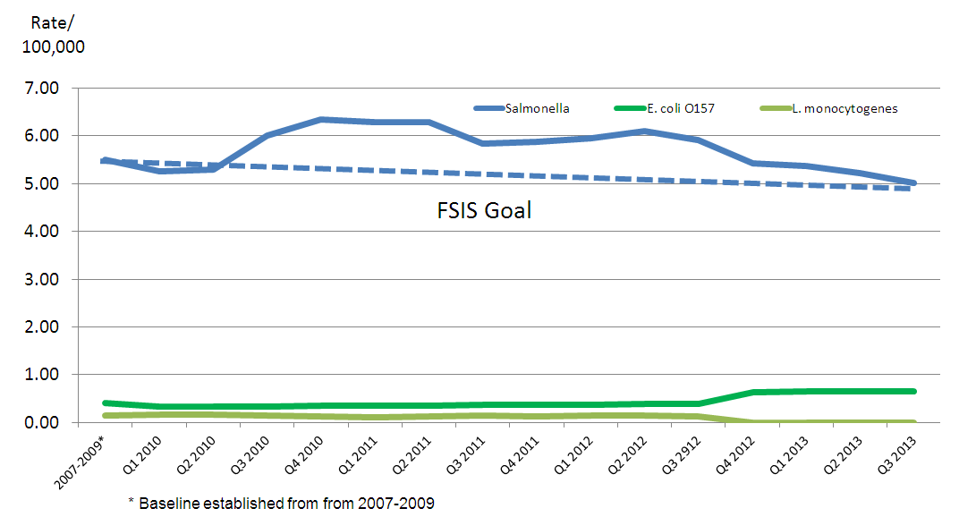
Illness Rates by Pathogen Attributed to FSIS-Regulated Foods

Slide 60
Focus on Salmonella
Rates of salmonellosis have not decreased significantly since the inception of FoodNet
Salmonella is found in nearly all foods, commonly found in poultry and meat products
FSIS is raising expectations on food producers through more stringent performance standards and implementation of an Agency action plan

Slide 61
10-Point Plan to Reduce Salmonella
Implement pre-harvest lessons learned
Modernize poultry and swine slaughter rules
Revise sampling activities and performance standards
Revise and develop in-plant and enforcement strategies and expedited feedback to industry
Provide improved food safety messages related to Salmonella
Implement focused research e.g.,
Does Salmonella from lymph nodes provide a contamination pathway?

Slide 62
Focus on Shiga Toxin-Producing E. coli (STECs)
Changed E. coli O157:H7 sampling and testing
Implemented non-O157 STEC testing
Proposed new traceback and recall procedures
Completed risk assessment for mechanically-tenderized beef rule

Slide 63
Listeria monocytogenes
Joint risk assessment with FDA to evaluate public health impact of retail practices and conditions
Zero tolerance in Ready-to-Eat foods
FSIS continues sampling and testing foods, food contact surfaces, and the environment
Completed 3 studies on transmission in retail grocery stores
Developing guidance for retail markets and retail enforcement strategy

Slide 64
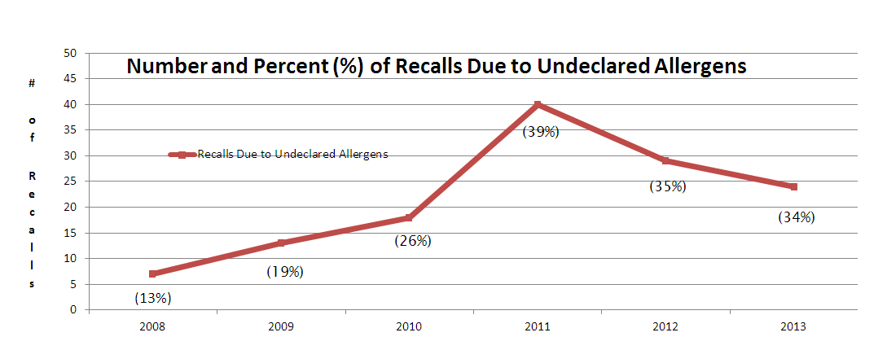
FSIS Actions to Reduce Food-Related Allergens
FSIS found undeclared allergens in processed foods and changed verification processes

Slide 65
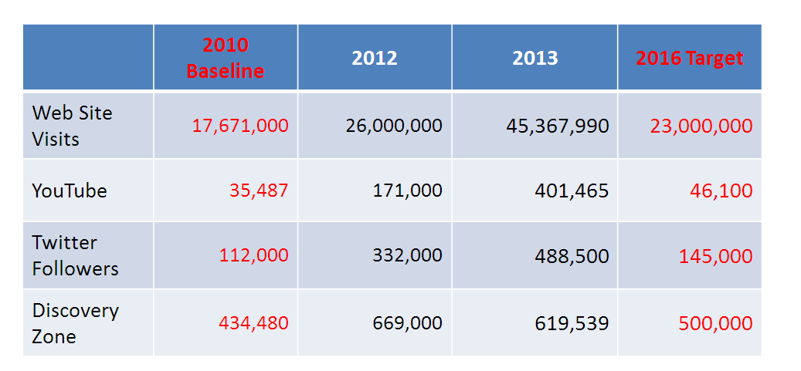
Food Safety Education
FSIS uses many different communication tools to reach the public to ensure food safety

Slide 66
FSIS Summary
Healthy People food safety goals are FSIS goals
FSIS regulates but also serves
Reducing foodborne disease is the goal of every team member
Reducing Salmonella-related illnesses is a priority
FSIS collaborates with multiple stakeholders to leverage scientific knowledge and technology
Through outreach and other service, we aim to further reduce foodborne disease

Slide 67
Partnership for Food Safety Education

Slide 68
The partnership delivers trusted science-based information.

Slide 69
What we are known for, trusted content.

Slide 70
What we bring, collaboration, connections, credibility and trust.

Slide 71
Core focus areas

Slide 72
Contributing partners

Slide 73
Bac Fighters! By sector

Slide 74
Together: A Food Safe America

Slide 75
Other Convening

Slide 76
Amplifies

Slide 77
The Reach of Bac Fighters

Slide 78
Leads Evaluation

Slide 79
Programming Overview

Slide 80
Sporadic Cases – majority of illnesses

Slide 81
Consumer behavior snapshot

Slide 82
FDA analysis of trends

Slide 83
On the web

Slide 84
Dozens of free downloads

Slide 85
One the web continued

Slide 86
Perfect picnic iOS game for kids

Slide 87
Screen shot of perfect picnic

Slide 88
Other stuff for kids

Slide 89
Retailer resources

Slide 90
Get to know the Parnership

Slide 91
Hold the date

Slide 92
Thank you

Slide 93
Roundtable Discussion Please take a moment to fill out our brief survey

Slide 94
LHI Infographic Gallery http://www.healthypeople.gov/2020/LHI/infographicGallery.aspx
Notes:
[ Scroll through for Q&A ]

Slide 95
Healthy People 2020 Progress Review Webinar
Please join us as we review select
Healthy People 2020 objectives in the
Mental Health, Mental Disorders and Substance Abuse topic areas.
February 2014
Hear from a community-based organization that is working to improve outcomes in the community.
To register, visit: www.healthypeople.gov
Notes:
[ Scroll through for Q&A ]

Slide 96
Stay Connected
Web healthypeople.gov
Email hp2020@hhs.gov
Twitter @gohealthypeople
LinkedIn Healthy People 2020
YouTube ODPHP (search “healthy people”)
Join the Healthy People Listserv & Consortium
Notes:
[ Scroll through for Q&A ]
96

Slide 97
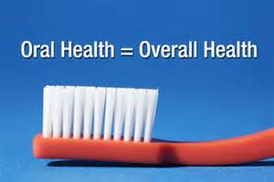
Healthy People 2020 Oral Health LHI Webinar
Join us on January 23rd for a
Who’s Leading the Leading Health Indicators?
Webinar to learn how one group is working to address the importance of oral health.
Register soon!
www.healthypeople.gov
Notes:
[ Scroll through for Q&A ]

Slide 98
Healthy People 2020 Sharing Library
A library of stories highlighting ways organizations across the country are implementing Healthy People 2020
Healthy People in Action - Sharing Library http://healthypeople.gov/2020/implement/MapSharingLibrary.aspx
Notes:
[ Scroll through for Q&A ]

Slide 99
Healthy People 2020 Progress Review Planning Group
Kara Morgan, FDA/OC
Elisa Elliot, FDS/CFCAN
Roblyn Gest, FDA/CFSAN
Tim Ihry, USDA/FSIS
Eileen Dykes, USDS/FSIS
Olga Henao, CDC/OID
Jeff Morelli, CDC/OID
Mary Ghods, FDA/CDER
Camelia Owens, FDA/OC
Francis Kalush, FDA/CDRH
Dan Budnitz, CDC/OID
Lee Hampton, CDC/OID
Stan Lehman, CDC/NCHHSTP
Rebecca Hines, CDC/NCHS
Leda Gurley, CDC/NCHS
Amy M Branum, CDC/NCHS
Jeff Pearcy, CDC/NCHS
Sirin Yaemsiri, CDC/NCHS
Carter Blakey, HHS/ODPHP
Holly McPeak, HHS/ODPHP
Ellis Davis, HHS/ODPHP
Yen Luong, HHS/ODPHP
Notes:
Dr. Koh:
Thank you to all of our presenters today for sharing their expertise and detailed information. To our viewers, I hope that you’ll join us for our next Progress Review in February which will feature new data about Mental Health Mental Disorders and Substance Abuse.
Finally, I want to thank the workgroup members from the Food Safety and Medical Product Safety topic areas, as well as the teams from ODPHP and NCHS who have worked tirelessly to update the data and pull this information together.
Together, we CAN make Healthy People come alive for all Americans. I can’t thank you enough for all that you do.

