Slide 1
Healthy People 2020 Progress Review:
Diabetes & Chronic Kidney Disease
September 29, 2014

Slide 2
Prevention Treatment and Care of Diabetes and Chronic Kidney Diseases:
A Healthy People 2020 Progress Review

Slide 3
Wanda Jones, DrPH
Acting Assistant Secretary for Health
U.S. Department of Health and Human Services

Slide 4
Overview and Presenters
Chair
Wanda Jones, DrPh, Acting Assistant Secretary for Health
U.S. Department of Health and Human Services
Presentations
Rebecca Hines, MHS, Chief, Health Promotion Statistics Branch National Center for Health Statistics, CDC
Andrew Narva, MD, Director, National Kidney Disease Education Program National Institute of Diabetes & Digestive & Kidney Disease, NIH
Ann Albright, PhD, RD, Director, Division of Diabetes Translation, National Center for Chronic Disease Prevention and Health Promotion, CDC
Community Highlight
Karen Wauchope, RN, BSN, CDE, Manager, Clinical Community Programs, EmblemHealth
Notes:
The theme of today’s Progress Review is “Prevention Treatment and Care of Diabetes and Chronic Kidney Diseases.” This is a topic that has much depth and breadth. As a result, we have a number of colleagues joining us today. This is a topic that has much depth and breadth. As a result, we have a number of colleagues joining us today.
Leading off will be, Rebecca Hines, Chief of the Health Promotion Statistics Branch at the National Center for Health Statistics who will provide an update on critical Healthy People 2020 objectives. Next, we’ll have a number of subject matter experts tell us what is being done on the federal level to meet the targets. First is Dr. Andrew Narva, Director of the National Kidney Disease Education Program at NIDDK with NIH. He will be followed by Dr. Ann Albright, Director of CDC’s Division of Diabetes Translation.
I’m also delighted to welcome Dr. Adriana Hung, who is a nephrologist and Medical Director of Dialysis at the Nashville VA. She will be on hand to answer your questions about how they are addressing these issues among their patients.
Finally, my favorite part of the Progress Review is the community highlight, when a non-Federal organization tells us about how they have achieved outcomes in the community. Today, we’ll hear from Karan Wauchope [pronounced Washup], manager of clinical and community programs at EmblemHealth.

Slide 5
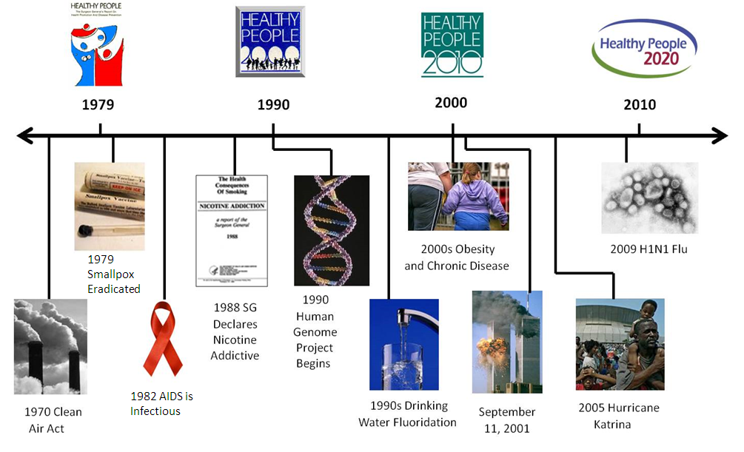
Healthy People 2020 Evolves

Slide 6
What is Diabetes?
Diabetes is a group of diseases marked by high levels of blood glucose resulting from problems in how insulin is produced, how insulin works, or both.
Diabetes types:
  Type 1 Diabetes
  Type 2 Diabetes – 90-95% of all adults diagnosed
  Gestational Diabetes
  Other Types of Diabetes
SOURCES: Centers for Disease Control and Prevention. National Diabetes Statistics Report: Estimates of Diabetes and Its Burden in the United States, 2014. Atlanta, GA: US Department of Health and Human Services; 2014.
6

Slide 7
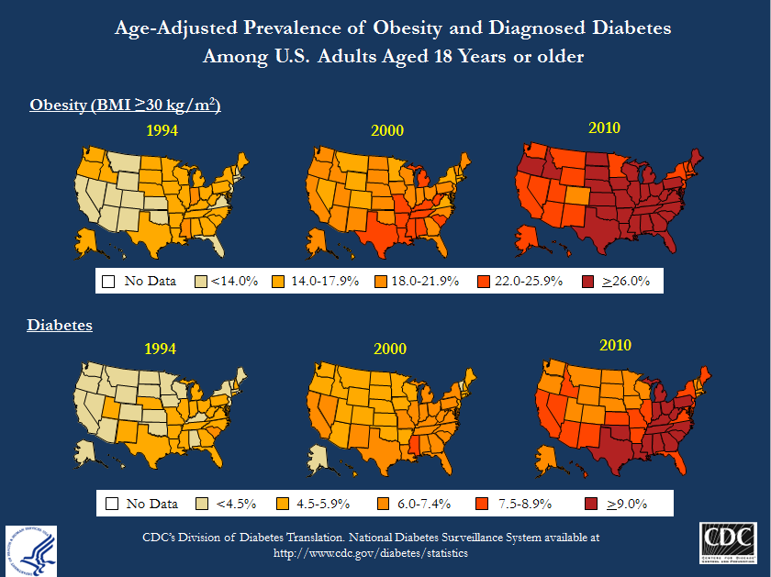
Obesity and diabetes prevalence 1991-2011

Slide 8
Chronic Kidney Disease (CKD)
  Chronic Kidney Disease is a gradual and permanent loss of kidney function
  CKD is caused by:
  Diabetes
  Hypertension
  Glomerulonephritis or Polycystic kidney disease
  Other conditions (atherosclerosis, HIV, sickle cell disease, kidney stones, chronic kidney infections)
  More than 20 million US adults may have CKD
U.S. Renal Data System, USRDS 2013 Annual Data Report: Atlas of Chronic Kidney Disease and End-Stage Renal Disease in the United States. National Institutes of Health, National Institute of Diabetes and Digestive and Kidney Diseases, Bethesda, MD, 2013. Available at http://www.usrds.org/atlas.aspx.
8

Slide 9
CKD and End Stage
Renal Disease (ESRD)
  Medical treatment goals for CKD patients:
  Slow the progression of CKD
  Treat underlying causes
  Treat complications
  Replace loss of kidney function
  ESRD is a total and permanent kidney failure
  Renal replacement therapies for ESRD patients:
  Hemodialysis
  Peritoneal dialysis
  Kidney transplantation
U.S. Renal Data System, USRDS 2013 Annual Data Report: Atlas of Chronic Kidney Disease and End-Stage Renal Disease in the United States. National Institutes of Health, National Institute of Diabetes and Digestive and Kidney Diseases, Bethesda, MD, 2013. Available at http://www.usrds.org/atlas.aspx.
9

Slide 10
Diabetes and Chronic Kidney Disease: Connection
  Adults with diabetes are two to three times as likely to have CKD and make up 44% of new ESRD cases
  Similar disease management
  In 2011:
    $85.9 billion – diabetes Medicare expenditures
    $45.5 billion – CKD Medicare expenditures
SOURCES: Centers for Disease Control and Prevention. National Diabetes Statistics Report: Estimates of Diabetes and Its Burden in the United States, 2014. Atlanta, GA: US Department of Health and Human Services; 2014.
U.S. Renal Data System, USRDS 2013 Annual Data Report: Atlas of Chronic Kidney Disease and End-Stage Renal Disease in the United States, National Institutes of Health, National Institute of Diabetes and Digestive and Kidney Diseases, Bethesda, MD, 2013. Centers for Disease Control and Prevention. Chronic Kidney Disease Surveillance System—United States. Available at http://nccd.cdc.gov/CKD. Centers for Disease Control and Prevention (CDC). National Chronic Kidney Disease Fact Sheet, 2014. Atlanta, GA: US Department of Health and Human Services, Centers for Disease Control and Prevention; 2014.
10

Slide 11
Rebecca Hines, MHS
Chief, Health Promotion Statistics Branch
National Center for Health Statistics
Centers for Disease Control and Prevention

Slide 12
Presentation Overview
  Tracking the Nation’s Progress
  Diabetes
  Burden
  Treatment and Care
  Prevention
  Chronic Kidney Disease
  Prevalence of Chronic Kidney Disease (CKD)
  Medical evaluation
  New cases of End-Stage Renal Disease (ESRD)
  ESRD deaths
12

Slide 13
Tracking the Nation’s Progress
18 HP2020 Measurable Diabetes Objectives:
  24 HP2020 Measurable Chronic Kidney Disease Objectives:
4 | Target met
1 | Improving
11 | Little or No detectable change
0 | Getting worse
1 | Baseline data only
1 | Informational
9 | Targets met
5 | Improving
4 | Little or No detectable change
2 | Getting worse
2 | Baseline data only
2 | Informational
NOTES: The Diabetes Topic Area contains 1 informational objective and 2 developmental objectives. The CKD Topic Area contains 2 informational objectives. Measurable objectives are defined as having at least one data point currently available, or a baseline, and anticipate additional data points throughout the decade to track progress. Informational objectives are also measurable objectives, however, they do not have a target associated with their data. Developmental objectives lack baseline data and targets.
13

Slide 14
Burden of Diabetes
Affects 29.1 million or 9.3% of the U.S. population (2012, all ages)
  Diagnosed: 21.0 million people
  Undiagnosed: 8.1 million people
7th leading underlying cause of death (2011)
The total cost of diabetes in the U.S.: $245 billion (2012)
  $176 billion in direct medical costs
  $69 billion in indirect costs including disability, work loss, premature mortality
NCHS data for diabetes do not differentiate by type of diabetes. Gestational diabetes is excluded from our data.
SOURCES: Centers for Disease Control and Prevention. National Diabetes Statistics Report: Estimates of Diabetes and Its Burden in the United States, 2014. Atlanta, GA: US Department of Health and Human Services; 2014; CDC/NCHS, National Vital Statistics System, Mortality 2011. Available at http://www.cdc.gov/nchs/data/dvs/LCWK9_2011.pdf.
14

Slide 15
Prevalence of Diagnosed Diabetes,
1997–2012
Percent
NOTES: Data are for prevalence of diagnosed diabetes. Diagnosed diabetes is defined as self-reported physician diagnosed diabetes. Women who only had diabetes while pregnant and persons with borderline diabetes are excluded. Data for total are for adults aged 18 years and over and are age adjusted to the 2000 standard population.
SOURCE: National Health Interview Survey (NHIS), CDC/NCHS; Summary Health Statistics for U.S. Adults: National Health Interview Survey, 1997-2012.
15

Slide 16
New Cases of Diagnosed Diabetes Per 1,000 Per Year, Adults 18–84 Years, 1997–2013
Rate Per 1,000
HP2020 Target: 7.2
Total
NOTES: Data are for three year estimates of diagnosed diabetes in the past year. Data are for adults aged 18-84 years and are age adjusted to the 2000 standard population. Diagnosed diabetes is defined as self-reported physician diagnosed diabetes. Women who only had diabetes while pregnant and persons with borderline diabetes are excluded. 2011-2013 is the most recent data year currently available.
Obj. D-1
Decrease desired
SOURCE: National Health Interview Survey (NHIS), CDC/NCHS.
16

Slide 17
New Cases of Diagnosed Diabetes Per 1,000 Per Year, Adults 18–84 Years, 1997–2013
Rate Per 1,000
65–74 years
45–64 years
75–84 years
18–44 years
NOTES: Data are for three year estimates of diagnosed diabetes in the past year. Diagnosed diabetes is defined as self-reported physician diagnosed diabetes. Women who only had diabetes while pregnant and persons with borderline diabetes are excluded. 2011-2013 is the most recent data year currently available.
Obj. D-1
Decrease desired
SOURCE: National Health Interview Survey (NHIS), CDC/NCHS.
17

Slide 18
New Cases of Diagnosed Diabetes Per 1,000 Per Year, Adults 18–84 Years, 2011–2013
HP2020 Target: 7.2 per 1000
Decrease desired
Family Income (percent poverty threshold)
I
NOTES: = 95% confidence interval. *2006-2008 data – HP2020 baseline. Data are for three year average of diagnosed diabetes in the past year for adults aged 18-84 years and are age adjusted to the 2000 standard population. Diagnosed diabetes is defined as self-reported physician diagnosed diabetes. Women who only had diabetes while pregnant and persons with borderline diabetes are excluded. Persons of Hispanic origin may be any race. The categories Black and White exclude persons of Hispanic origin. Respondents were asked to select one or more races. Data for the single race categories are for persons who reported only one racial group. Data for American Indian/Alaska Native, Native Hawaiian or other Pacific Islander, and 2 or more races are not shown because they are statistically unreliable (DSU).
SOURCE: National Health Interview Survey (NHIS), CDC/NCHS.
Obj. D-1

Slide 19
Proportion of Diabetes That is Diagnosed,
Adults 20+ Years, 2009–2012
HP2020 Target: 80.1%
Increase desired
Health Insurance Status
(aged 20-64)
I
NOTES: = 95% confidence interval. *2005-2008 data – HP2020 baseline. Data are for adults aged 20 years and over with diabetes and are age adjusted to the 2000 standard population. Diabetes is defined as diagnosed diabetes -OR- fasting blood glucose greater or equal to 126 mg/dL -OR- HbA1c level greater or equal to 6.5%. Diagnosed diabetes is defined as self-reported physician diagnosed diabetes. Women who only had diabetes while pregnant and persons with borderline diabetes are excluded. The categories black and white include persons who reported only one racial group and exclude persons of Hispanic origin. Persons of Hispanic origin may be any race.
SOURCE: National Health and Nutrition Examination Survey (NHANES), CDC/NCHS.
Obj. D-15

Slide 20
Diabetes: Co-Existing Conditions and Complications
Hypoglycemia and hyperglycemic crisis
High blood pressure
High LDL cholesterol
Heart disease and stroke
Blindness and eye problems
Kidney disease
Amputations
Nerve disease
Non-alcoholic fatty liver disease
Periodontal disease
Hearing loss
Erectile dysfunction
Depression
Complications of pregnancy
SOURCES: Centers for Disease Control and Prevention. National Diabetes Statistics Report: Estimates of Diabetes and Its Burden in the United States, 2014. Atlanta, GA: US Department of Health and Human Services; 2014.
20

Slide 21
Glycemic, Cholesterol, and Blood Pressure Control in Adults with Diagnosed Diabetes
Percent
Decrease desired
Increase desired
Increase desired
HP2020 Target: 16.1%
HbA1c >9%
LDL Cholesterol <100 mg/dL
Blood pressure <130/80 mm Hg
NOTES: I = 95% confidence interval. Data are for adults aged 18 years and over with diagnosed diabetes and are age adjusted to the 2000 standard population. Diagnosed diabetes is defined as self-reported physician diagnosed diabetes. Women who only had diabetes while pregnant and persons with borderline diabetes are excluded. Criteria for LDL Cholesterol control and blood pressure control were chosen to follow the 2010 American Diabetes Association guidelines at the time the objectives were set.
SOURCE: National Health and Nutrition Examination Surveys (NHANES), CDC/NCHS.
Objs. D-5.1, D-6, D-7
21

Slide 22
Lower Extremity Amputations Among Persons with Diabetes
Rate per 1,000
2008-2010
Total
Black
White
Male
Female
Race
Sex
NOTES: I = 95% confidence interval. *Indicates Healthy People 2020 baseline year for this measure. This objective is being tracked without a target. Data are age adjusted to the 2000 standard population and include any amputation of lower limb. For NHDS data prior to 2000, only one race category was recorded; reporting more than one race was not an option. For NHIS data prior to 1999, respondents reported one or more races and identified one race as best representing their race. Respondents were asked to select one or more races starting in 1999 (NHIS) or 2000 (NHDS), although more than one race selection was not used for 1999 NHIS data in order to be consistent with 1997-1998 data. Data for the single race categories shown are for persons who reported only one racial group.
SOURCE: National Hospital Discharge Survey (NHDS) and National Health Interview Survey (NHIS), CDC/NCHS.
Obj. D-4
22

Slide 23
Prediabetes (High Risk Group)
Prediabetes is a condition in which people have high blood glucose or hemoglobin A1c levels above normal, but not high enough to be classified as diabetes.
Prediabetes affects 86 million or 37% of the U.S. adult population (ages 20+, 2009-2012).
For Healthy People measures, persons are considered at high risk for diabetes if they:
  did not report diagnosed diabetes -and-
  had fasting glucose ≥100 and <126 mg/dL -or- an HbA1c value ≥5.7% and <6.5%.
SOURCE: Centers for Disease Control and Prevention. National Diabetes Statistics Report: Estimates of Diabetes and Its Burden in the United States, 2014. Atlanta, GA: US Department of Health and Human Services; 2014.
23

Slide 24
Prevention Behaviors in Adults at High Risk for Diabetes
Percent
2005-2008
2011-2012
Weight Control/Loss
NOTES: I = 95% confidence interval. Data are for adults aged 18 years and over at high risk for diabetes and are age adjusted to the 2000 standard population. Persons are considered at high risk for diabetes if they: did not report diagnosed diabetes and had fasting glucose ≥100 and <126 mg/dL or an HbA1c value ≥5.7% to <6.5%. Two-year and four-year data are not comparable. Different age adjustment groups are used for two-year and four-year data. Two-year estimates are generally less stable and reliable than four-year estimates.
Objs. D-16.1, 16.2, 16.3
Increase desired
24
SOURCE: National Health and Nutrition Examination Surveys (NHANES), CDC/NCHS.

Slide 25
Presentation Overview
  Tracking the Nation’s Progress
  Diabetes
  Chronic Kidney Disease
  Prevalence of Chronic Kidney Disease (CKD)
  Medical evaluation
  New cases of End-Stage Renal Disease (ESRD)
  ESRD deaths
25

Slide 26
CKD and ESRD Burden, 2011
  615,899 patients received treatment for ESRD
  115,643 new ESRD cases reported
  17,671 patients received kidney transplantations
    Median time on transplant wait list for adults: 2.6 years
Medicare CKD expenditures: $45.5 billion (nearly 20% of total Medicare expenditures)
Total ESRD costs: $49.3 billion including $34.4 billion of Medicare expenditures
SOURCE: National Chronic Kidney Disease Fact Sheet, 2014. US DHHS, Centers for Disease Control and Prevention, Atlanta, GA: 2014. Available at http://www.cdc.gov/diabetes/pubs/factsheets/kidney.htm.
U.S. Renal Data System, USRDS 2013 Annual Data Report: Atlas of Chronic Kidney Disease and End-Stage Renal Disease in the United States. National Institutes of Health, National Institute of Diabetes and Digestive and Kidney Diseases, Bethesda, MD, 2013. Available at http://www.usrds.org/atlas.aspx.
26

Slide 27
Chronic Kidney Disease, Adults, 2005–2010
HP2020 Target: 13.7%
Decrease desired
Family Income (percent poverty threshold)
Age (years)
I
NOTES: = 95% confidence interval. *HP2020 baseline. Data are for adults 18 years+ with CKD stages 1-4. Stage 1 is defined as estimated glomerular filtration rate (eGFR) ≥90 ml/min/1.73 m² and urinary albumin/creatinine ratio (ACR) ≥30 mg/g; stage 2: eGFR 60-89 ml/min/1.73 m² and ACR ≥30 mg/g; stages 3 and 4: eGFR 30-59 and 15-29 ml/min/1.73 m², respectively. Except for age specific groups, data are age adjusted to the 2000 standard population. Respondents were asked to select one or more races. The categories black and white include persons who reported only one racial group and exclude persons of Hispanic origin. Mexican American persons may be of any race.
SOURCE: National Health and Nutrition Examination Survey (NHANES), CDC/NCHS.
Obj. CKD-1

Slide 28
Hypertension in Adults with CKD, 2005–2010
HP2020 Target: 49.2%
Decrease desired
Family Income (percent poverty threshold)
Age (years)
I
NOTES: = 95% confidence interval. *HP2020 baseline. Data are for adults 18 years+ with CKD stages 1-4 and either self-reported hypertension, reported prescription for hypertension medication, or measured high systolic (≥140 mmHg) or diastolic (≥90 mmHg) blood pressure. Except for age specific groups, data are age adjusted to the 2000 standard population. Respondents were asked to select one or more races. The categories black and white include persons who reported only one racial group and exclude persons of Hispanic origin. Mexican American persons may be of any race.
SOURCE: National Health and Nutrition Examination Survey (NHANES), CDC/NCHS.
Obj. CKD-6.1

Slide 29
Recommended Medical Evaluation,
Adults 65+ Years with CKD
Percent
2001
2011
HP2020 Target: 28.3%
Age (years)
NOTES: I = 95% confidence interval. AIAN – American Indian/Alaska Native. Recommended medical evaluation included serum creatinine, lipids, and urine albumin tests. Respondents were asked to select one or more races. The categories black and white include persons who reported only one racial group and exclude persons of Hispanic origin. Persons of Hispanic origin may be of any race.
SOURCE: United States Renal Data System (USRDS), NIH/NIDDK.
Obj. CKD-4.1
Increase desired

Slide 30
Recommended Medical Evaluation,
Adults 65+ Years with CKD and Diabetes
Percent
2001
2011
HP2020 Target: 25.3%
Age (years)
NOTES: I = 95% confidence interval. AIAN – American Indian/Alaska Native. Recommended medical evaluation for adults with type 1 and type 2 diabetes and CKD included serum creatinine, urine albumin, A1c, lipids tests, and eye examinations. Respondents were asked to select one or more races. The categories black and white include persons who reported only one racial group and exclude persons of Hispanic origin. Persons of Hispanic origin may be of any race. SOURCE: United States Renal Data System (USRDS), NIH/NIDDK.
Obj. CKD-4.2
Increase desired

Slide 31
New Cases of End-Stage Renal Disease,
1980–2011
Per 1,000,000
HP2020 Target: 344.3
NOTES: The data are adjusted for age, sex, race and ethnicity.
SOURCE: United States Renal Data System (USRDS), NIH/NIDDK.
Obj. CKD-8
Decrease desired

Slide 32
New Cases of End-Stage Renal Disease
Per 1,000,000
2001
2011
HP2020 Target: 344.3
Age (years)
NOTES: I = 95% confidence interval. AIAN – American Indian/Alaska Native. The data are adjusted for age, sex, and race/ethnicity. Respondents were asked to select one or more races. The categories black and white include persons who reported only one racial group and exclude persons of Hispanic origin. Persons of Hispanic origin may be of any race.
SOURCE: United States Renal Data System (USRDS), NIH/NIDDK.
Obj. CKD-8
Decrease desired

Slide 33
New Cases of ESRD due to Diabetes,
Patients with Diabetes
Per 1,000,000
2007
2011
HP2020 Target: 2380.5
NOTES: I = 95% confidence interval. AIAN – American Indian/Alaska Native. Data are for patients with ESRD and diabetes whose cause of renal failure was due to diabetes. The data are adjusted for age, sex, and race/ethnicity. Respondents were asked to select one or more races. The categories black and white include persons who reported only one racial group and exclude persons of Hispanic origin. Persons of Hispanic origin may be of any race.
SOURCE: United States Renal Data System (USRDS), NIH/NIDDK.
Age (years)
Obj. CKD-9.2
Decrease desired

Slide 34
Deaths in Patients with ESRD on Dialysis
Per 1,000 patient years
2001
2011
HP2020 Target: 190.0
Age (years)
NOTES: I = 95% confidence interval. AIAN – American Indian/Alaska Native. Respondents were asked to select one or more races. The categories black and white include persons who reported only one racial group and exclude persons of Hispanic origin. Persons of Hispanic origin may be of any race.
SOURCE: United States Renal Data System (USRDS), NIH/NIDDK.
Obj. CKD-14.1
Decrease desired

Slide 35
Deaths in ESRD Patients with a Functioning Kidney Transplant
Per 1,000 patient years
2001
2011
HP2020 Target: 29.3
Age (years)
NOTES: I = 95% confidence interval. AIAN – American Indian/Alaska Native. Respondents were asked to select one or more races. The categories black and white include persons who reported only one racial group and exclude persons of Hispanic origin. Persons of Hispanic origin may be of any race.
SOURCE: United States Renal Data System (USRDS), NIH/NIDDK.
Obj. CKD-14.4
Decrease desired

Slide 36
Key Takeaways – Diabetes
Prevalence of diagnosed diabetes in adults has increased over the last decade, but has leveled off in recent years.
New cases of diagnosed diabetes have also increased over the past decade, but have decreased since the HP2020 baseline and have met the HP2020 target.
About two-thirds of adults with diabetes had their condition diagnosed.
About 20% of adults with diagnosed diabetes have a hemoglobin A1c > 9.0%.
Over half of diabetes objectives have seen little or no change thus far in the decade.
36

Slide 37
Key Takeaways – CKD
CKD estimates have shown little or no change over the last decade.
Since 2001 there has been a significant reduction in new cases of ESRD and ESRD deaths.
About 50% of patients with CKD had hypertension in 2005–2010.
Medical evaluation has improved for Medicare CKD patients and for patients with diabetes and CKD.
Although there have been improvements, disparities still persist.
Over half of HP2020 CKD objectives, 14 out of 24, have met or moved towards their HP2020 targets thus far in the decade.
37

Slide 38
NIH Research to Improve Outcomes in People with Diabetes and Kidney Disease
Andrew Narva, MD
National Kidney Disease Education Program
National Institutes of Health

Slide 39
NIDDK’s Integrated Research Programs
Chronic Kidney Disease
Type 2 Diabetes
Obesity

Slide 40


Diabetes: The Tip of the Iceberg
U.S. Diabetes
29.1 million*
21 million diagnosed; 8.1 million undiagnosed
U.S. Prediabetes
86 million†
*All ages, 2012
† Age 20 and older with IGT +/or IFG +/or A1c between 5.7 and 6.4 (2012)

Slide 41
The Diabetes Prevention Program Clinical Trial (DPP)
3234 participants (45% minority) with IGT who were overweight or obese
Compared 3 approaches to diabetes prevention for 3 years:

Slide 42
DPP Results
12
8
Cases/100 person-yr
4
0
Caucasian
(n=1768)
African American (n=645)
Hispanic
(n=508)
American Indian (n=171)
Asian
(n=142)

Slide 43


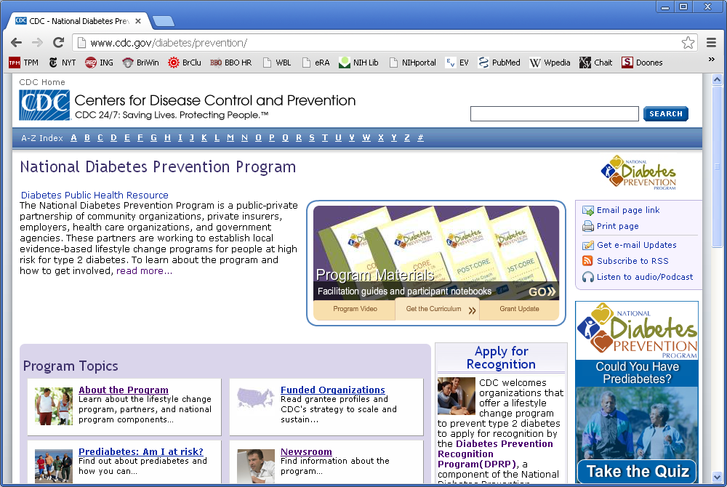
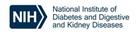
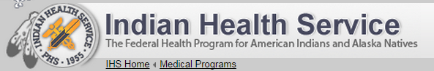

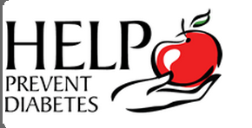

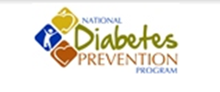
Translating from Efficacy Research to Public Health
Partnership

Slide 44

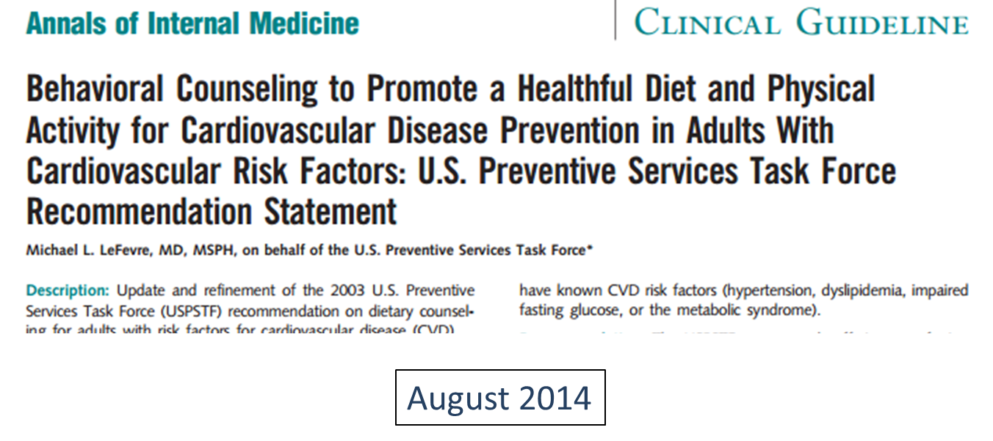
DPP Affects on Coverage of Care
DPP Affects on Coverage
of Care

Slide 45


DCCT/EDIC: Glucose control can significantly reduce risk of complications
DCCT/EDIC: Glucose Control Can Significantly Reduce the Risk of Complications
Reductions in Risk:
Cardio-vascular
Disease
Eye
Disease
Nerve Disease
Kidney
Disease
50%
57%
60%
76%

Slide 46
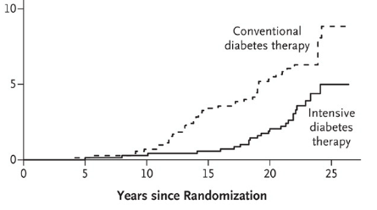

Impaired GFR Reduced by half
Impaired GFR Reduced
by Half
GFR<60
Source: NEJM 365: 2366, 2011

Slide 47
Prevalence of Diabetic kidney disease
Prevalence of Diabetic Kidney Disease (DKD)
Among Adults with Diabetes;
United States, 2005-2008
Albuminuria = ACR ≥30 mg/g
Impaired GFR = eGFR <60 ml/min/1.73m²
JAMA 305:2532-2539, 2011

Slide 48
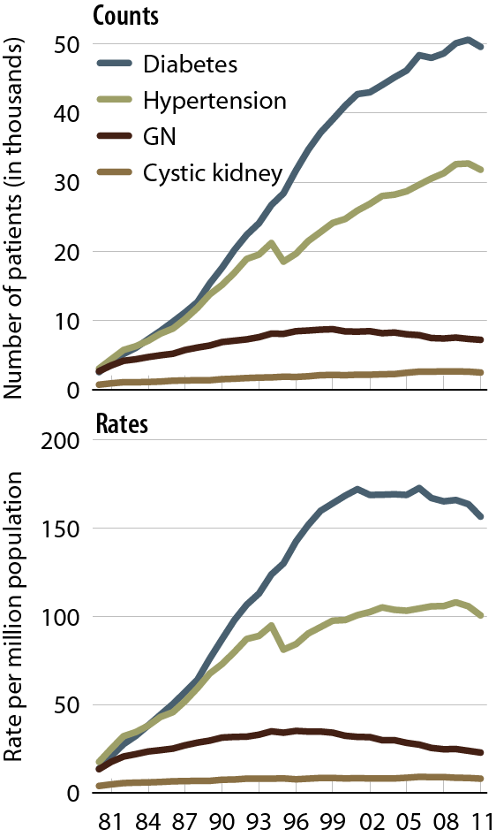
Diabetes is leading cause of esrd
Diabetes is the leading cause of ESRD
Incident counts & adjusted rates of ESRD, by primary diagnosis
Incident ESRD patients.
Adj: age/gender/race; ref: 2010 ESRD patients.
Reference: USRDS Annual Data Report (NIDDK, 2013)

Slide 49
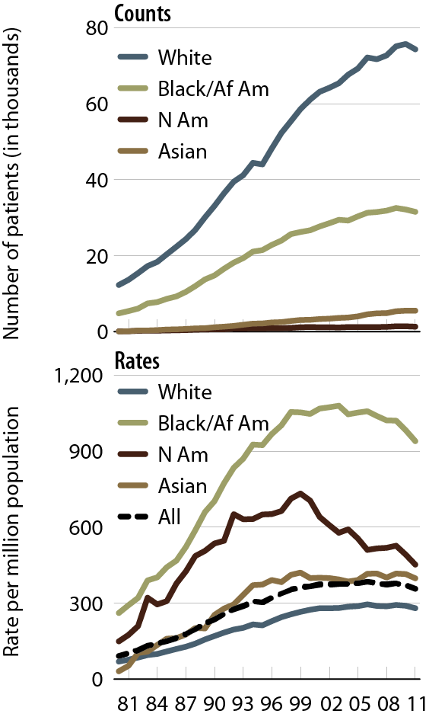
Disparieites in ESRD burden
Disparities in the Burden of ESRD
Incident counts & adjusted rates of ESRD, by race
Reference: USRDS Annual Data Report (NIDDK, 2013)

Slide 50
Awareness of kidney disease among adults with ckd is low
Awareness of Kidney Disease among
adults with CKD is Poor
NHANES 2007-2010

Slide 51

Encouraging african americans to make the kidney connection
Encouraging African Americans to Make the Kidney Connection
  Research-based program leverages influence of faith leaders to share health information
  Engages faith organizations to host educational events on kidney health
  Reached 100,000 people in March 2014

Slide 52
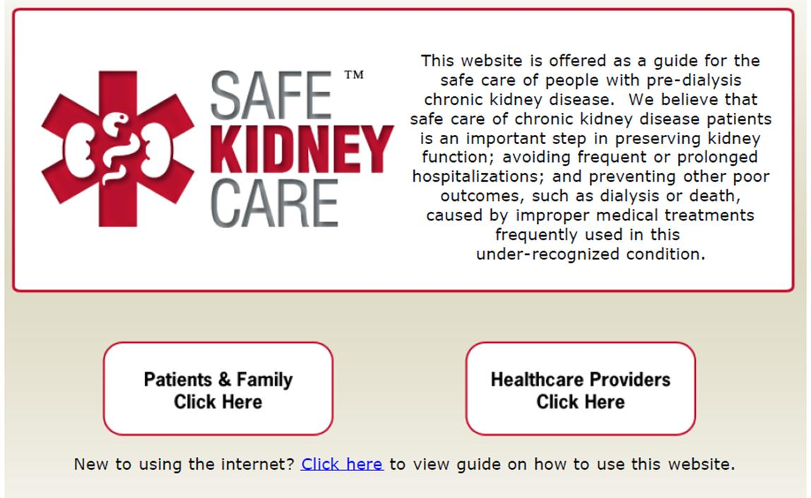
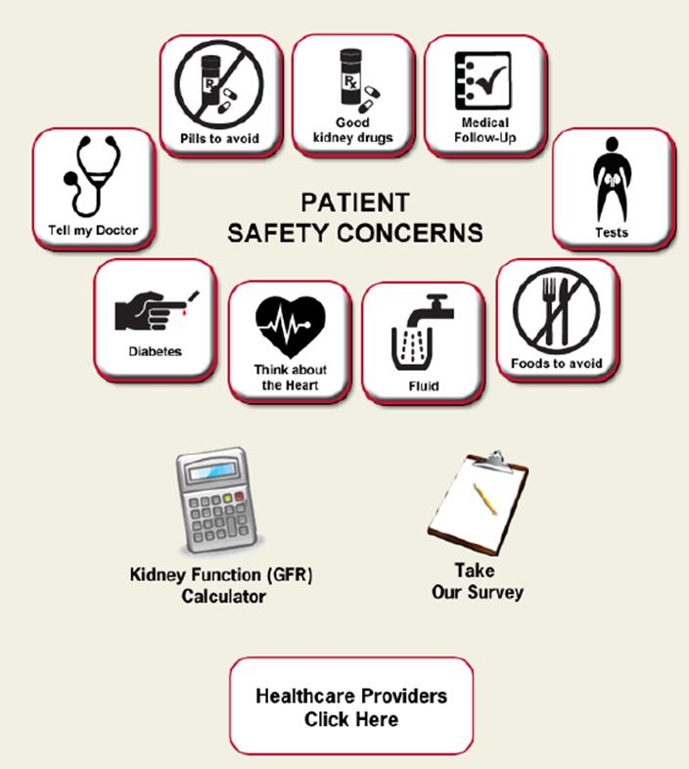
Testing Interventions
“Usability of a CKD Educational Website Targeted to Patients and Their Family Members”
Diamantidis, CJASN, 2012

Slide 53
Translational research
Translational Research in CKD
Integrated Population Program for Diabetic Kidney Disease (Duke)
Goal: Improve identification and care of diabetic kidney disease (DKD) patients with uncontrolled hypertension
Group-based Chronic Kidney Disease Care (Einstein)
Goal: Improve blood pressure control among CKD patients
Health IT Enhanced for CKD in Safety-Net Primary Care (UCSF)
Goal: Mitigate disparities through improved delivery of CKD care

Slide 54
Pragmatic reasearch
Pragmatic Research in Multiple
Chronic Conditions
Improving Chronic Kidney Disease Management with Pieces (ICD-Pieces) UT-Southwestern
Goal: Leverage EHR information to improve care for patients with diabetes, hypertension, and CKD
Interventions: Collaborative model of primary care and subspecialty care implemented through Parkland intelligent e-coordination and evaluation system (Pieces)
Challenges: Lack of electronic health records (EHR) interoperability, primary care provider hesitance to engage, lack of CKD education resources in EHRs

Slide 55
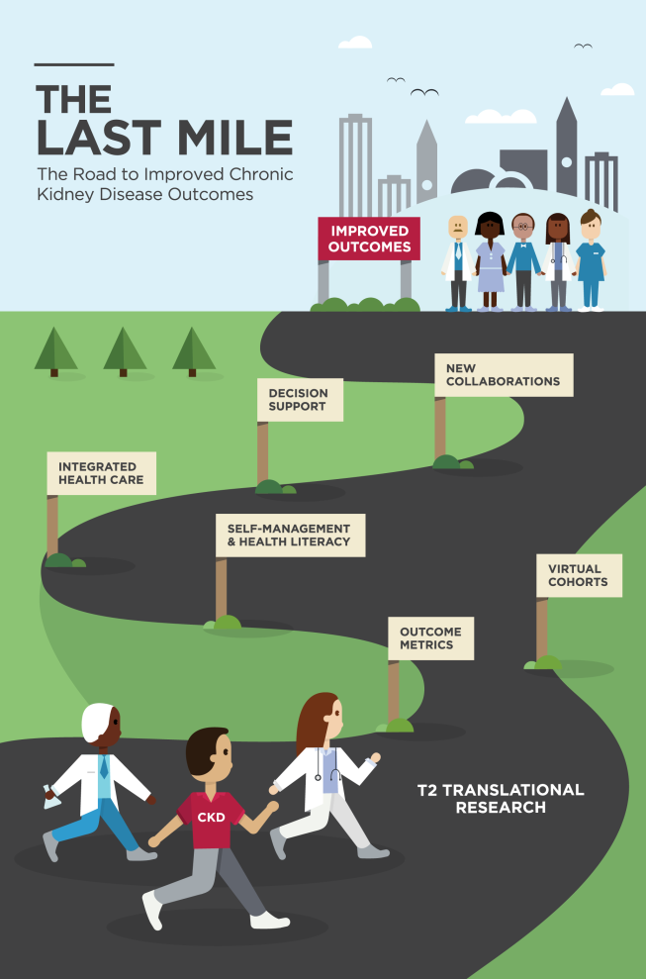
T2 translational reearch
Translational research in CKD

Slide 56
CDC’s Priorities in the Public Health Response to Diabetes

Slide 57
Ann Albright, PhD, RD
Director
Division of Diabetes Translation
Centers for Disease Control and Prevention

Slide 58
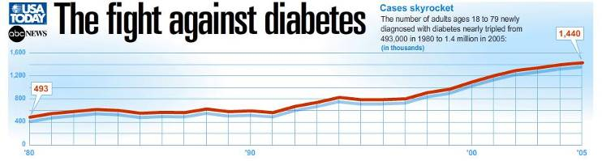
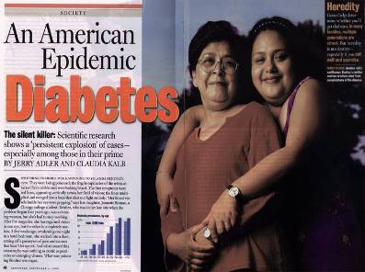



Slide 59
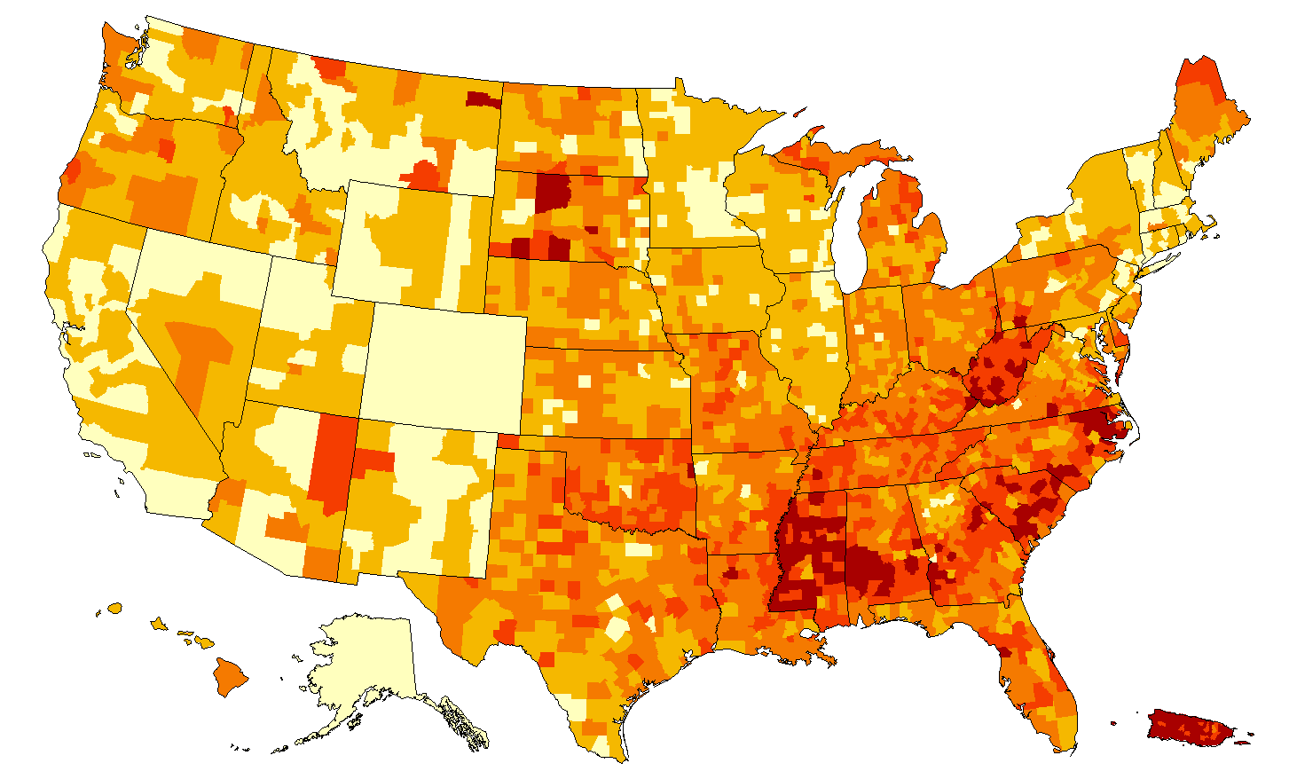
County-level Estimates of Diagnosed Diabetes
among Adults Aged ≥20 Years: United States 2004
Percentage
National Diabetes Surveillance System www.cdc.gov/diabetes
59

Slide 60
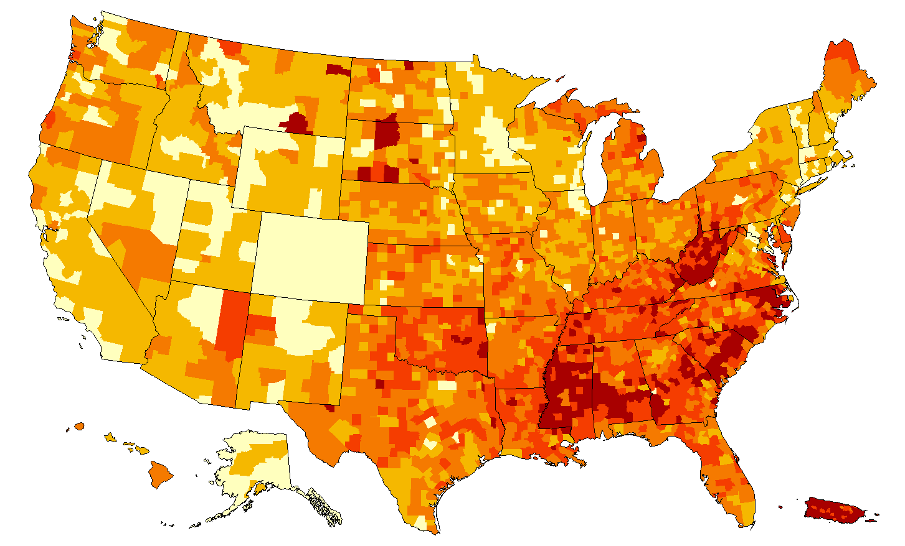
County-level Estimates of Diagnosed Diabetes
among Adults Aged ≥20 Years: United States 2005
Percentage
National Diabetes Surveillance System www.cdc.gov/diabetes
60

Slide 61
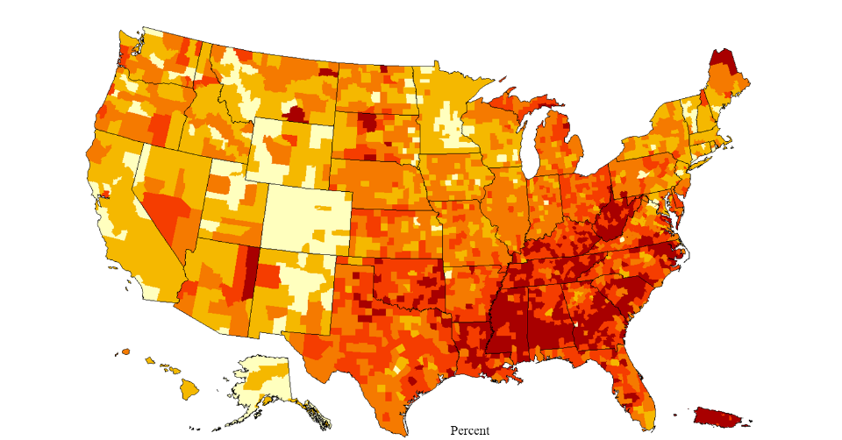
County-level Estimates of Diagnosed Diabetes
among Adults Aged ≥20 Years: United States 2006
Percentage
National Diabetes Surveillance System www.cdc.gov/diabetes
61

Slide 62
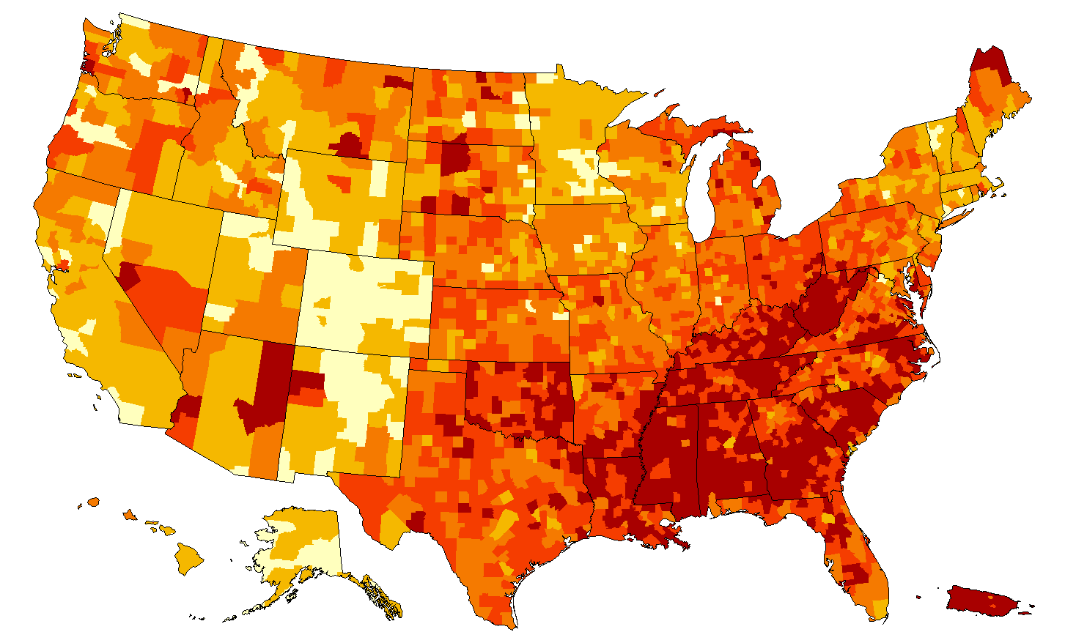
County-level Estimates of Diagnosed Diabetes
among Adults Aged ≥20 Years: United States 2007
Percentage
National Diabetes Surveillance System www.cdc.gov/diabetes
62

Slide 63
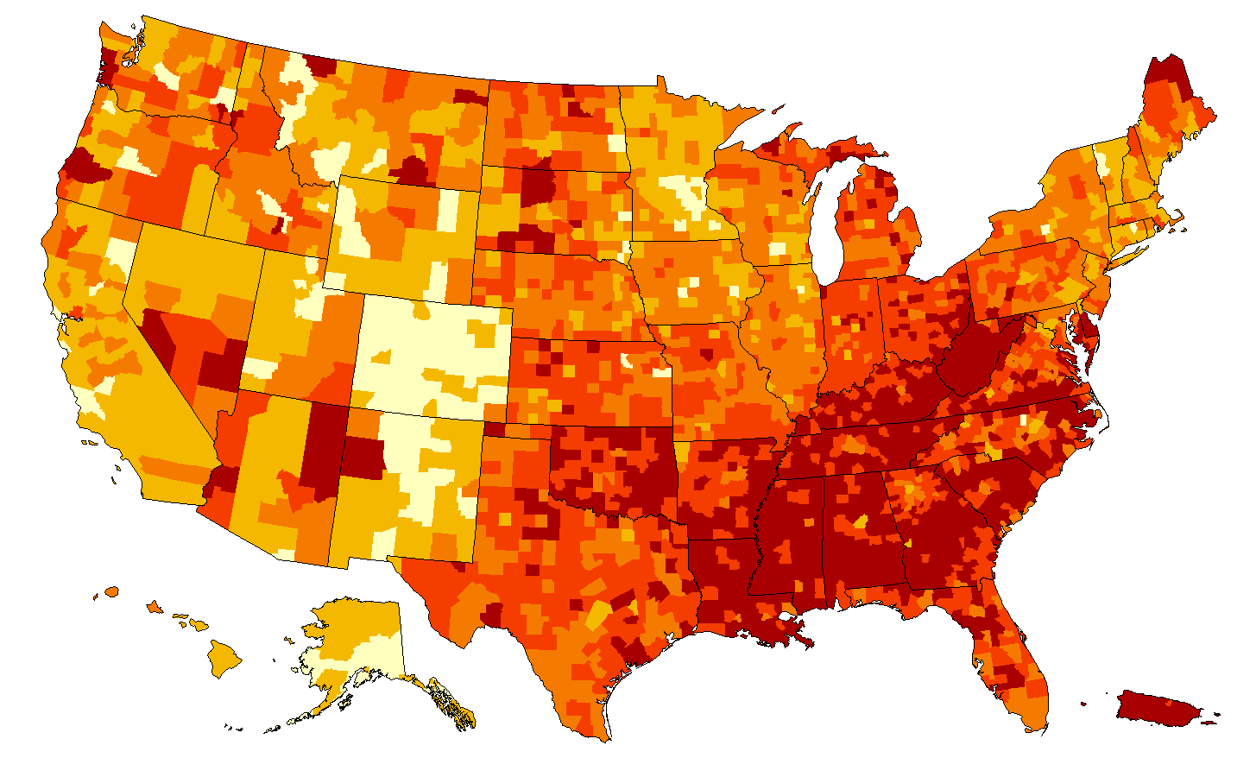
County-level Estimates of Diagnosed Diabetes
among Adults Aged ≥20 Years: United States 2008
Percentage
National Diabetes Surveillance System www.cdc.gov/diabetes
63

Slide 64
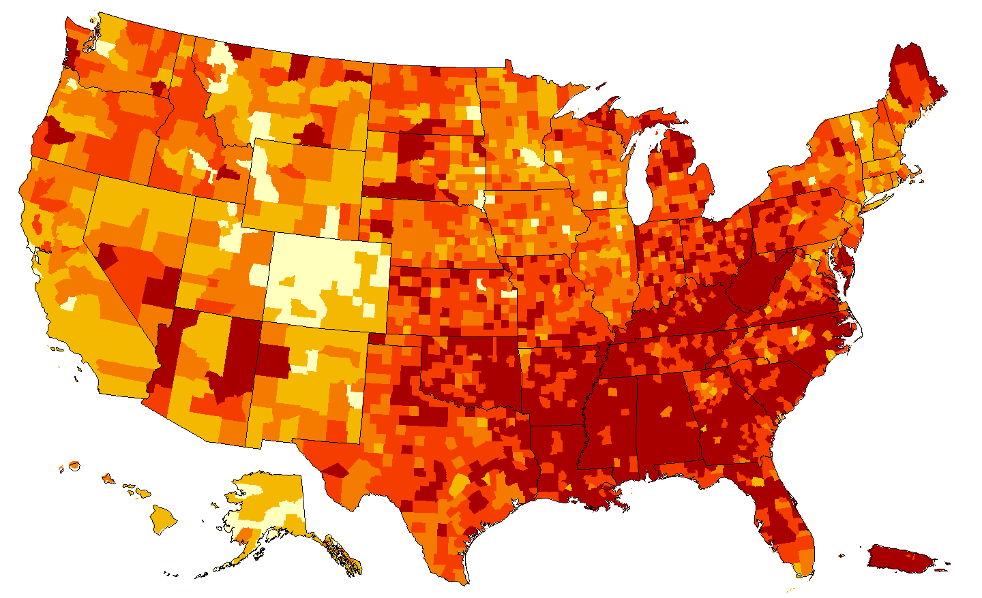
County-level Estimates of Diagnosed Diabetes
among Adults Aged ≥20 Years: United States 2009
Percentage
National Diabetes Surveillance System www.cdc.gov/diabetes
64

Slide 65
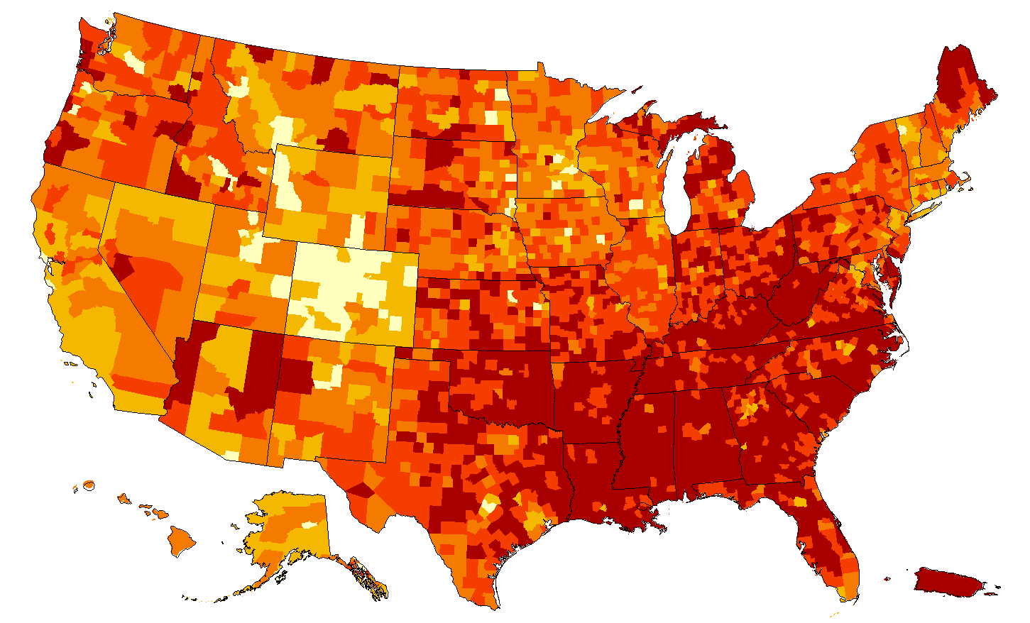
County-level Estimates of Diagnosed Diabetes
among Adults Aged ≥20 Years: United States 2010
Percentage
National Diabetes Surveillance System www.cdc.gov/diabetes
65

Slide 66
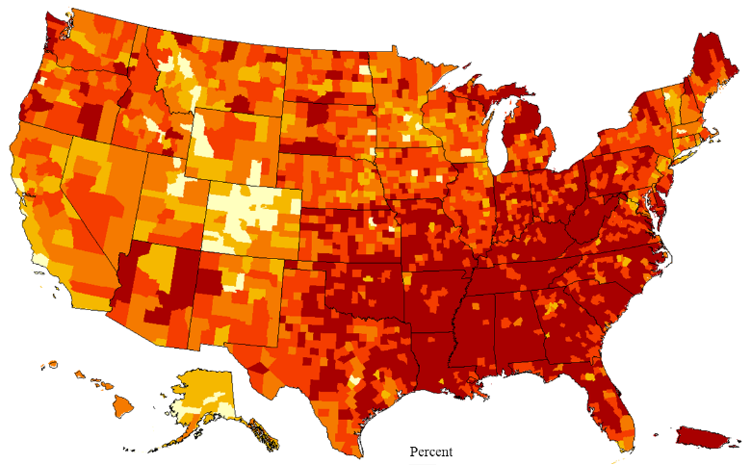
County-Level Estimates of Diagnosed Diabetes
among Adults Aged ≥20 Years: United States 2011
Percentage
National Diabetes Surveillance System www.cdc.gov/diabetes
66

Slide 67
Trends in Type 2 Diabetes Prevalence, 2001–2009, among Youth Age 10–19 Years
31% relative increase
Dabelea D et al. JAMA. 2014 May 7;311(17):1778–86.
67

Slide 68
Changes in Lifetime Risk for Diagnosed Diabetes after Age 20 Years in the United States, 1985 to 2011
Gregg et al., Lancet Diabetes & Endocrinology, 2014
68

Slide 69
Trends in Age-Standardized Rates of Diabetes-Related Complications from 1990 to 2010 among U.S. Adults with Diagnosed Diabetes
150
Myocardial Infarction
S
t
r
oke
130
Amputation
110
ESRD
H
ype
r
gl
y
c
emic
D
e
a
th
90
70
50
30
10
5
3
1
1990
1995
2000
2005
2010
Gregg et al., New Engl J Med, 2014
69

Slide 70


Successes and Challenges in the Public Health Response to Diabetes
Reductions and Improvements
Continued increases
Incidence and
Prevalence
Mortality
and
Complications
1990 1995 2000 2005 2010
1990 1995 2000 2005 2010
70

Slide 71



Public Health Response to Diabetes
Prevent diabetes
  Increase diabetes preventive behaviors
  Improve the access to effective lifestyle intervention
  Promote healthy environments for the whole population
Prevent diabetes complications
  Increase access and delivery of preventive health care
  Enhance and improve community and environmental strategies to support people with diabetes
Prevent chronic kidney disease
  Increase awareness and early diagnosis
  Build a national CKD surveillance program
  Promote use of evidence-based, cost-effective care
Eliminate diabetes-related health disparities
71

Slide 72
DISTRIBUTION
(Diffusion of interventions)
AVAILABILITY
(Supply)
EFFICIENCY
(Biggest effect on most people)
EFFECTIVENESS
(Real world settings)
EFFICACY
(Ideal settings)
BASIC SCIENCE
(Molecular/physiological)
Adapted from information in Sinclair JC, et al. N Engl J Med. 1981;305:489–94
and Detsky AS, et al. Ann Intern Med. 1990;113:147–54.
72

Slide 73
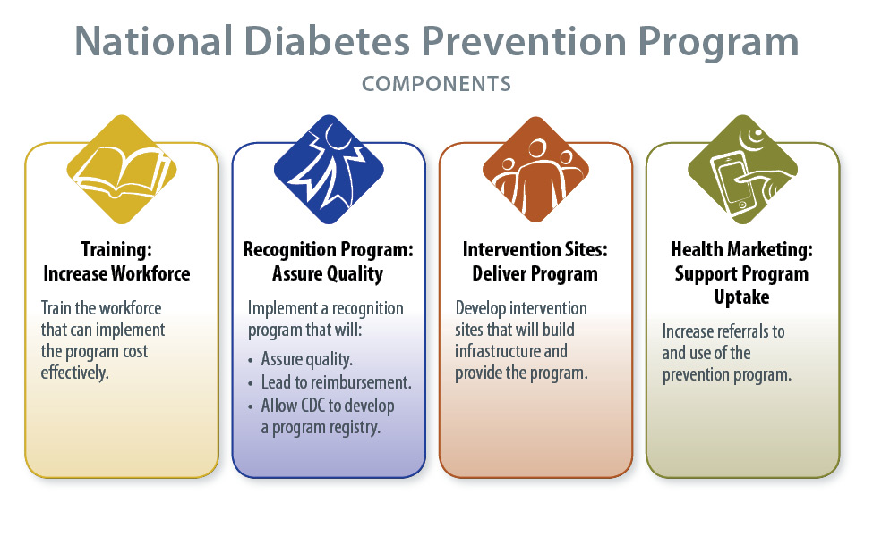
Albright A, Gregg EW. Am J Prev Med. 2013;44(4S4):S346–51.
73
Division Name in this space

Slide 74

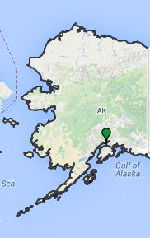
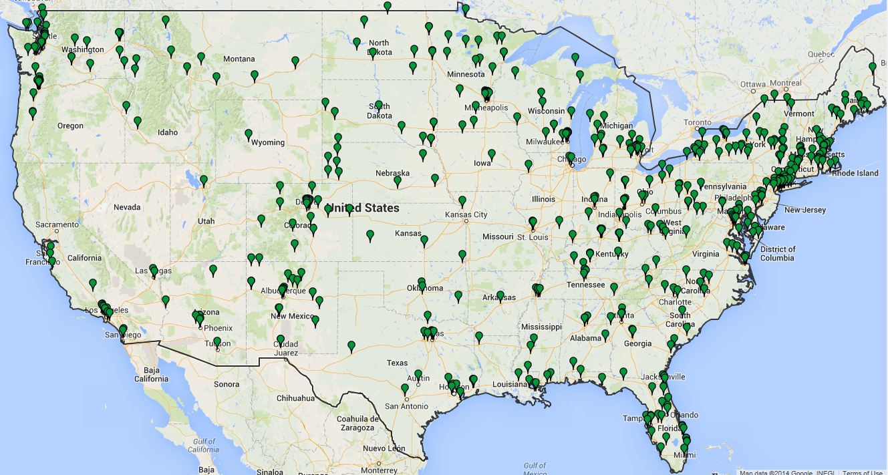


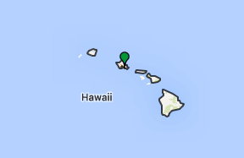
Progress to Date for National Diabetes Prevention Program
Source: Diabetes Prevention Recognition Program (CDC/National Diabetes Prevention Program)
Copyright © 2005-2014 Zee Source. All rights reserved.
74

Slide 75
Summary
The number of and health impact from diabetes-related complications, including kidney complications, have declined substantially
Incidence (new cases) of diagnosed diabetes has increased over two decades. Preventing type 2 diabetes is an important step in preventing kidney disease
Continued improvements are needed for preventing diabetes and its complications
Strong community lifestyle-change programs are needed for high-risk individuals and healthy communities to reduce risk and prevent diabetes in the population as a whole
75

Slide 76
Thank You!
Please visit the
Division of Diabetes Translation web site at
www.cdc.gov/diabetes
www.cdc.gov/ckd
For more information, please contact:
The Centers for Disease Control and Prevention
1600 Clifton Road NE, Atlanta, Georgia 30333
Telephone, 1-800-CDC-INFO (232-4636)/TTY: 1-888-232-6348
E-mail: cdcinfo@cdc.gov Web: www.cdc.gov
76

Slide 77

EmblemHealth National Diabetes Prevention Program
Bulleted Text

Slide 78
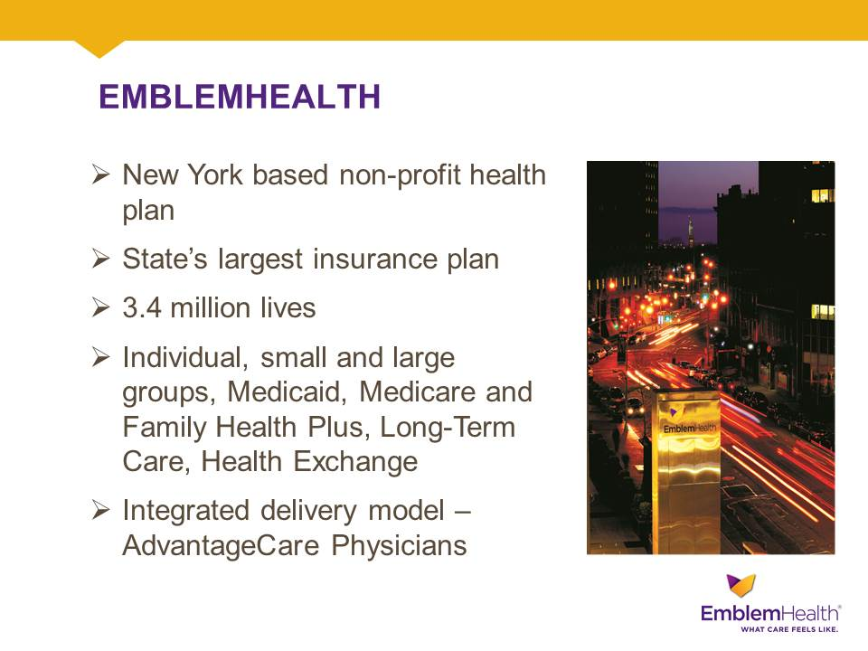
EmblemHealth

Slide 79

Neighborhood Care

Slide 80
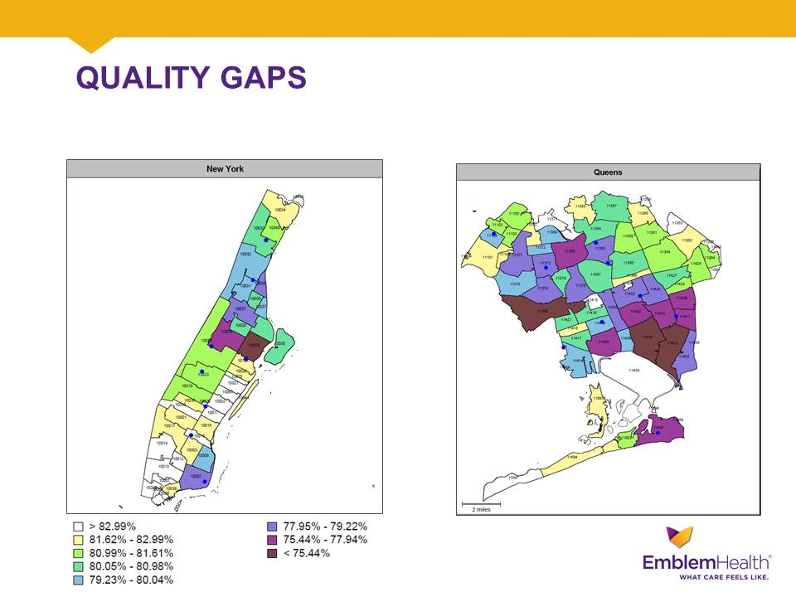
Quality Gaps

Slide 81
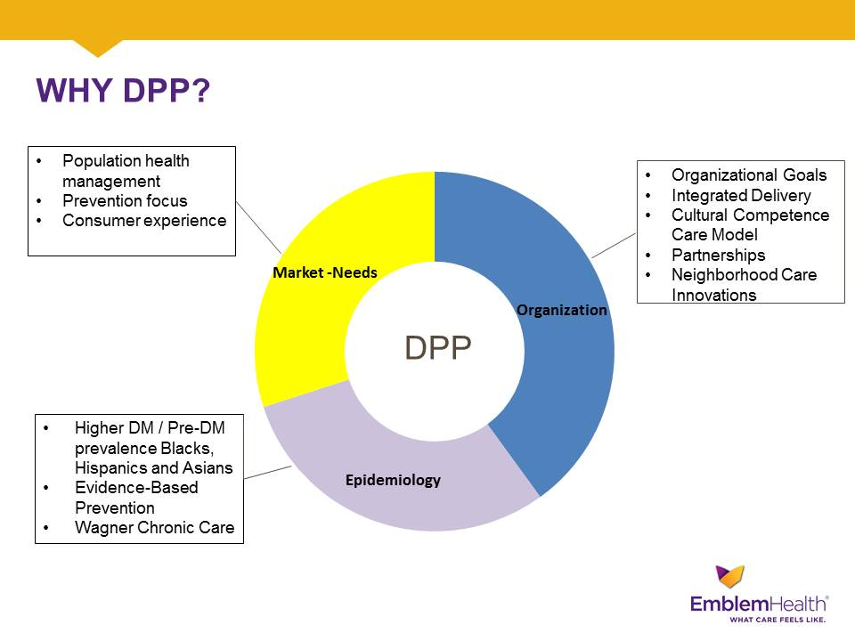
Why DPP?

Slide 82
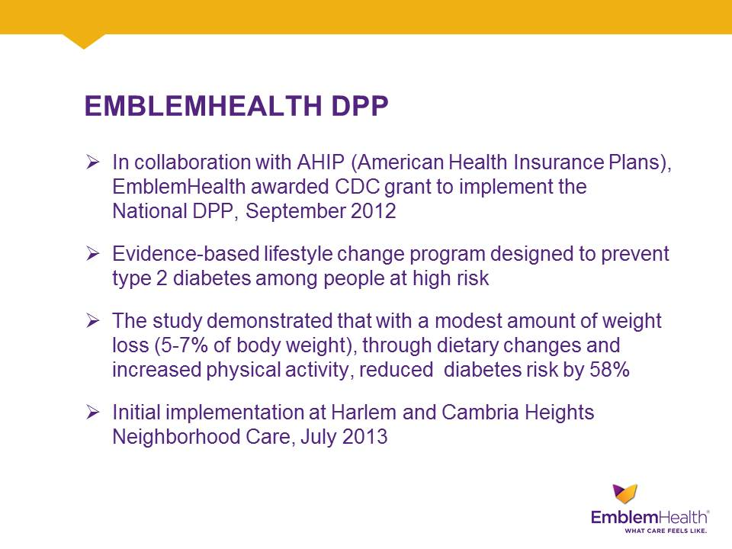
EmblemHealth DDP

Slide 83
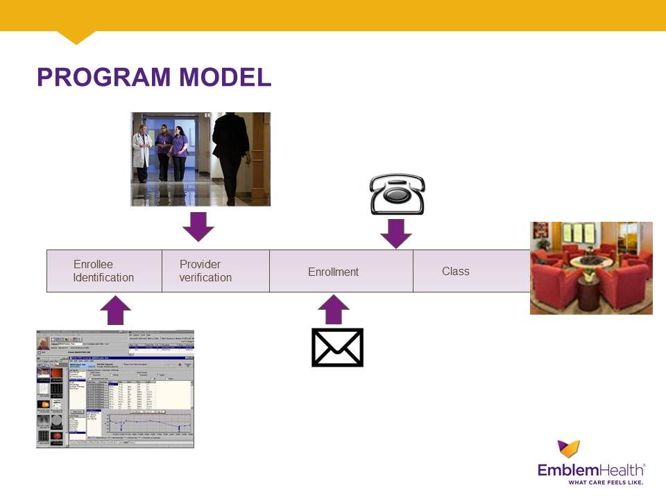
Program Model

Slide 84
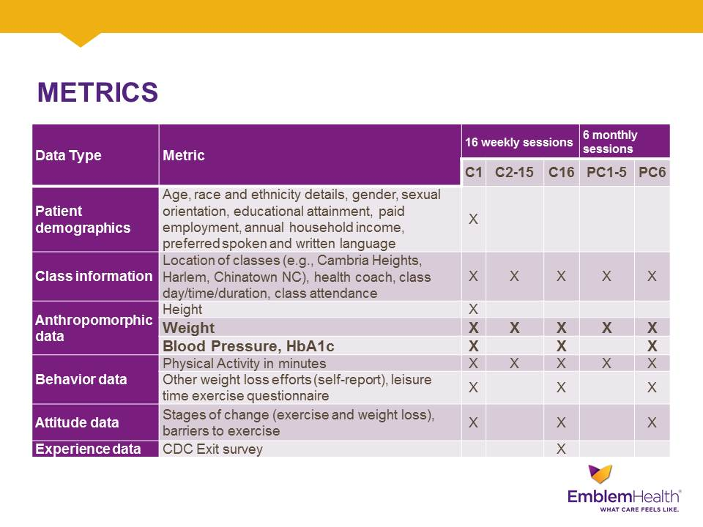
Metrics

Slide 85
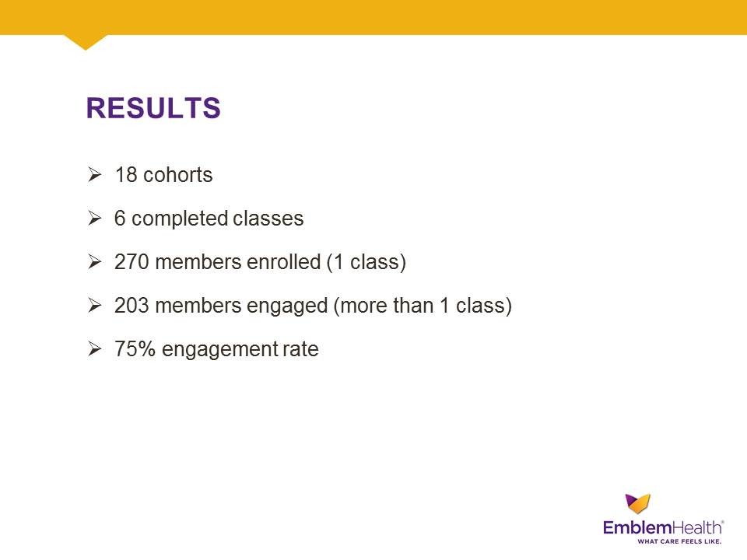
Overall Results

Slide 86
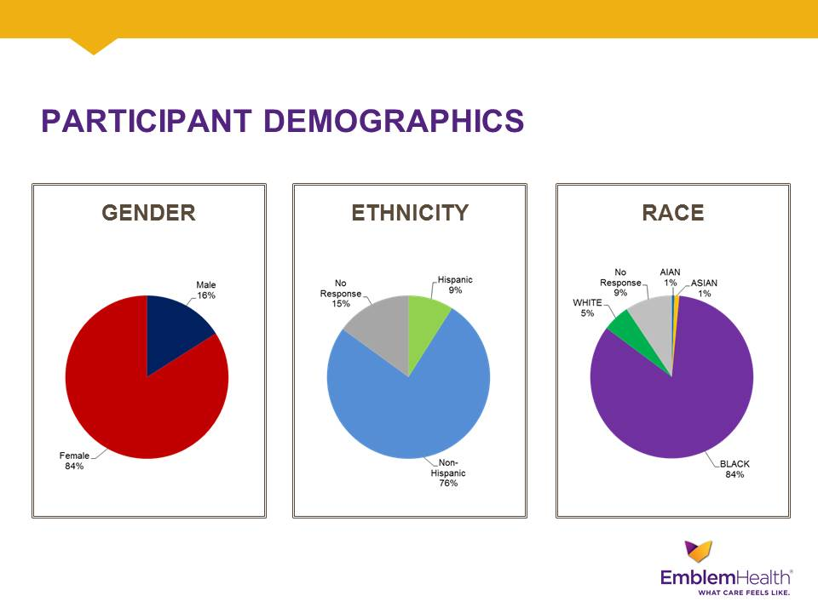
Participant Demographics

Slide 87
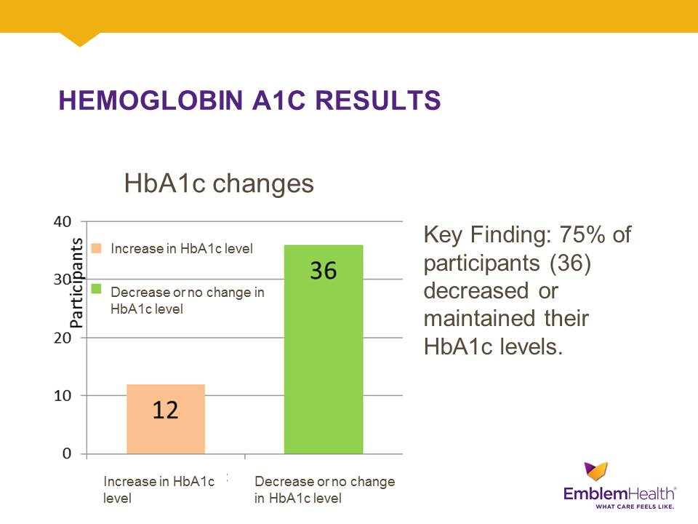
Hemoglobin A1C Results slide 1

Slide 88
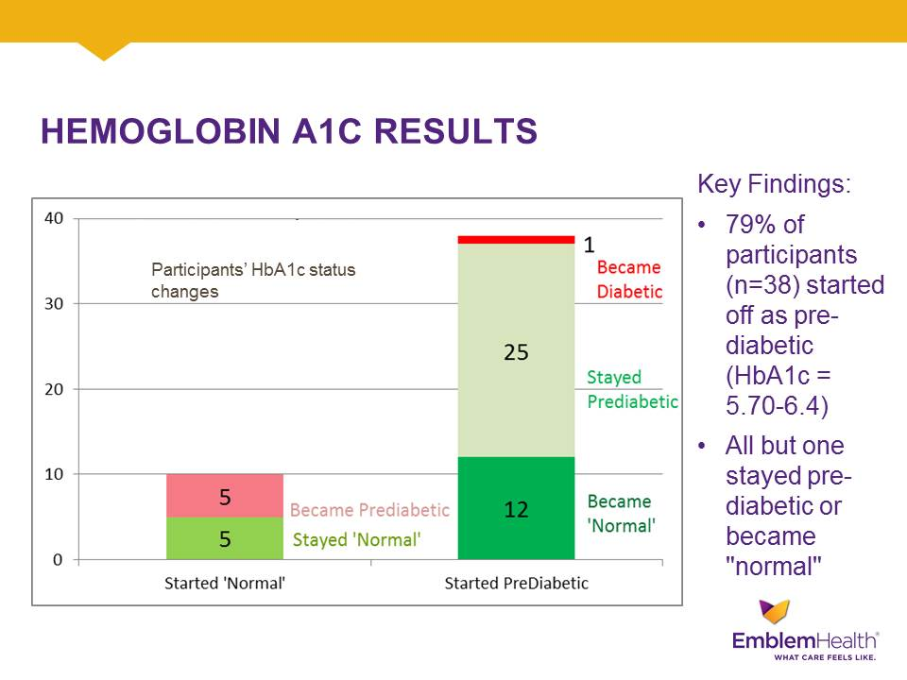
Hemoglobin A1C Results

Slide 89
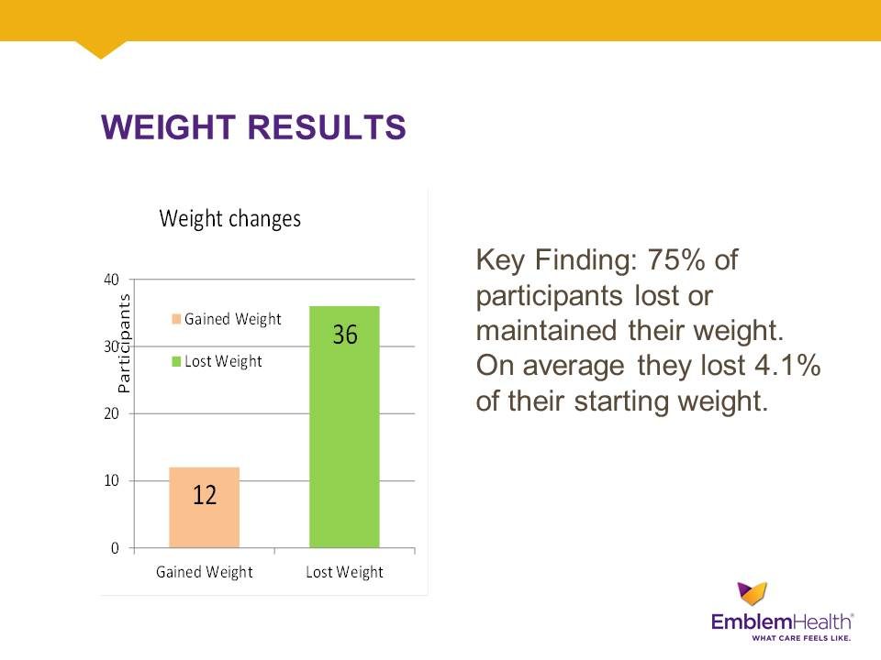
Weight Results slide 1

Slide 90
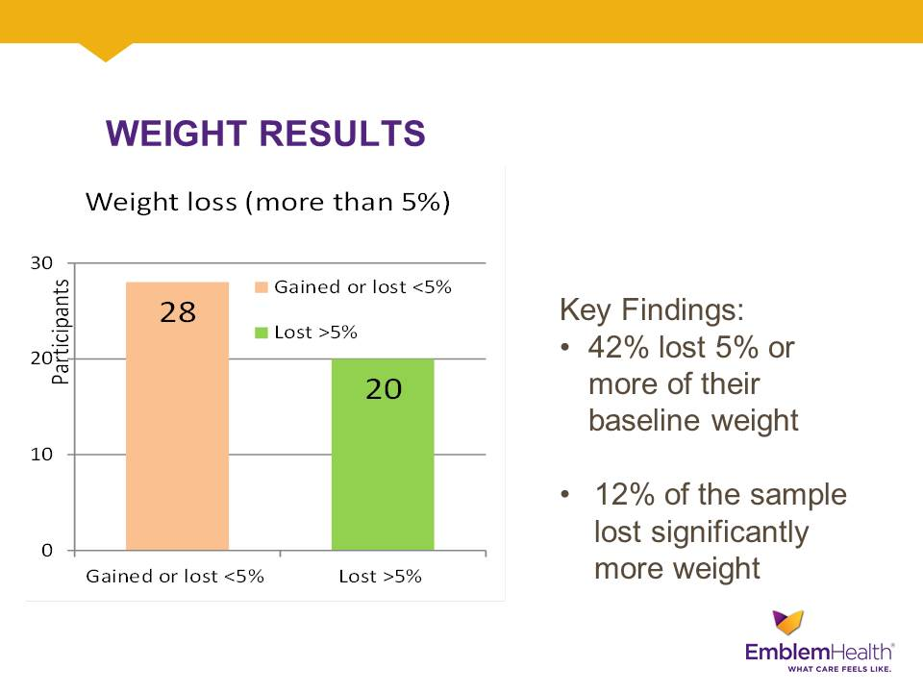
Weight Results

Slide 91
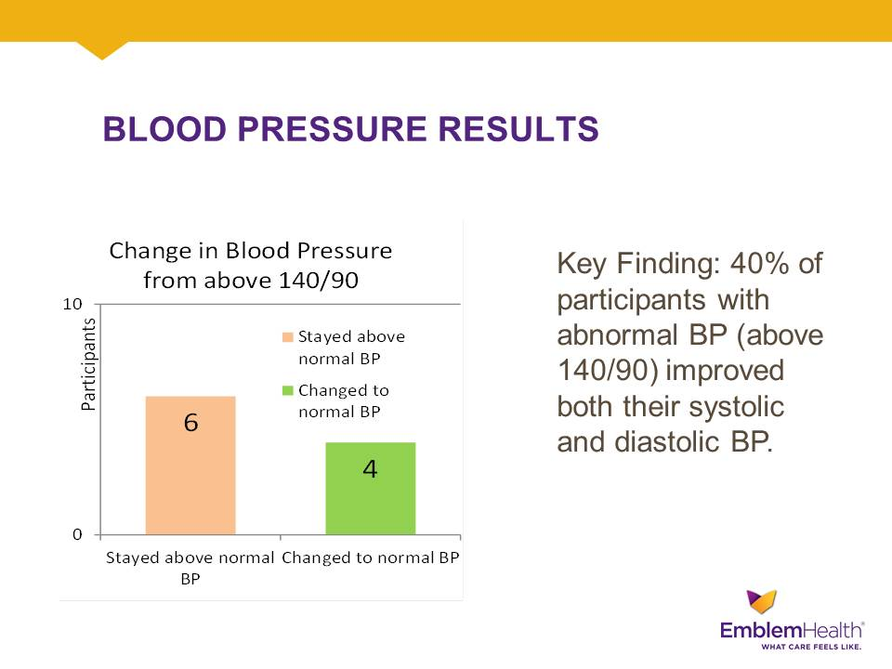
Blood Pressure Results

Slide 92
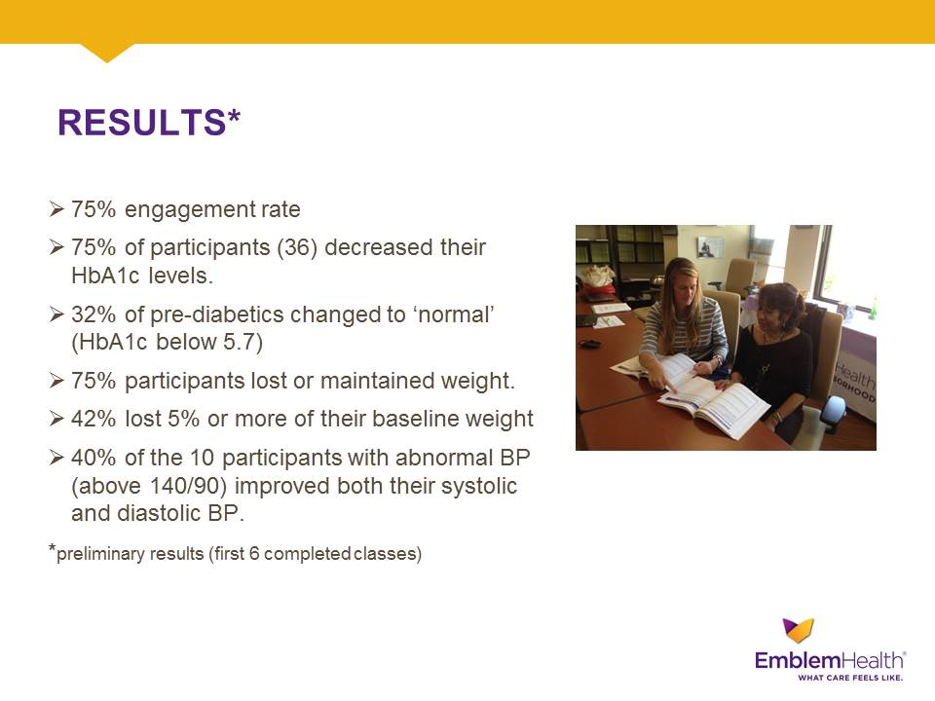
Results

Slide 93
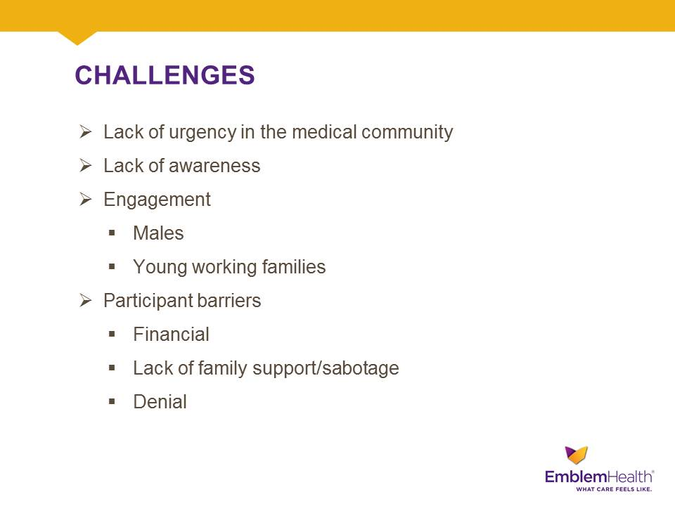
Challenges

Slide 94
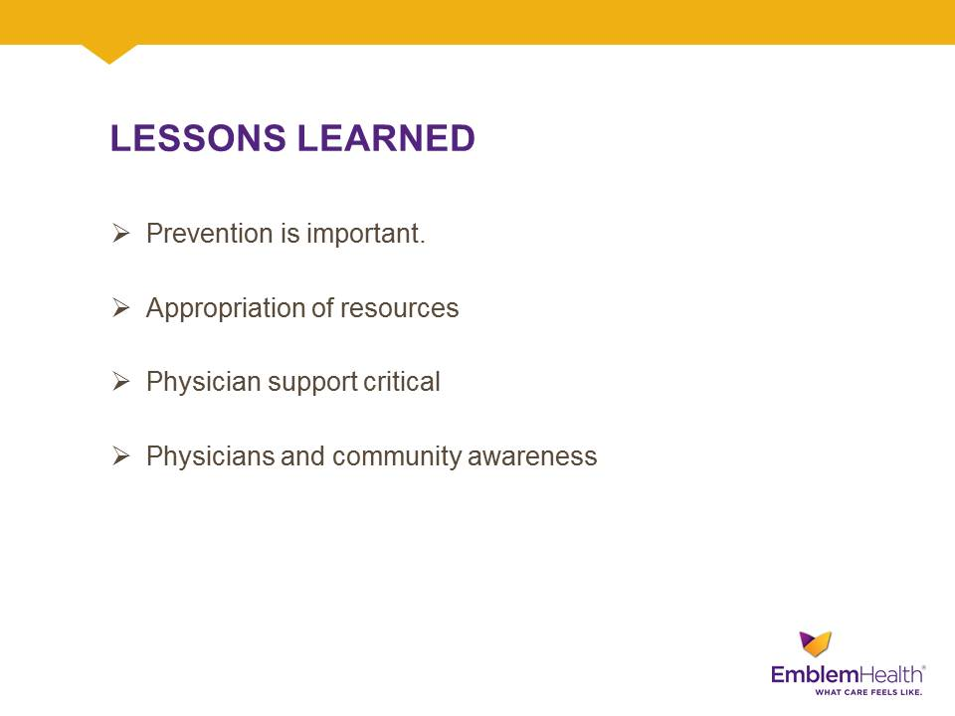
Lessons Leanred

Slide 95
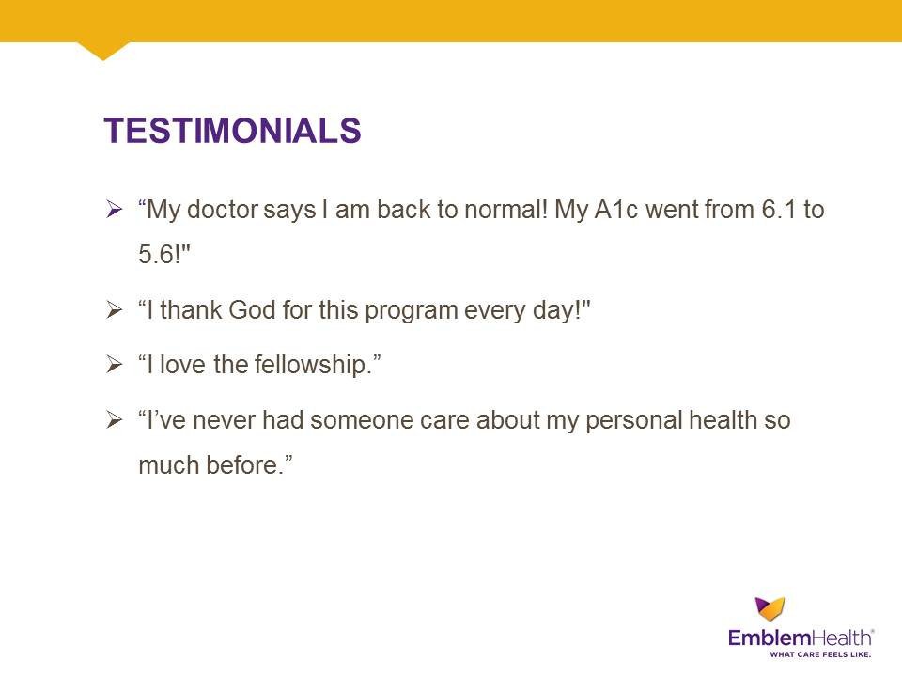
Testimonials

Slide 96

A success story

Slide 97

Graduation – May 2014

Slide 98

Thank you.

Slide 99
Roundtable Discussion
Please submit your questions using the Q&A function.
Thank you for filling out our brief survey.
Notes:
These presentations have just been excellent. Thank you so much to our presenters for joining us today. At this time, I’d like to turn the review over to Dr. Don Wright, Deputy Assistant Secretary for Disease Prevention and Health Promotion, to facilitate the round table discussion.
Dr. Wright:
Thank you Dr. Jones, and a big thank you to all of our presenters for joining us today. I’d like to remind our viewing audience that we also have Dr. Adriana Hung, who is a nephrologist and Medical Director of Dialysis at the Nashville VA.
At this time, I’d like to remind the viewing audience to submit your questions through the Q and A feature on the right hand side of your screen. While you do that, I’ll also mention to anyone seeking CEUs or CMEs, that you will receive a survey by email. You must complete the survey for credit. For all of our viewers today, a survey will appear on the right hand panel of your screen. Your feedback is important to us and it allows us to improve our webinars. Please take the time to fill that out.
We’ve already received a number of questions. [See prepared questions]

Slide 100
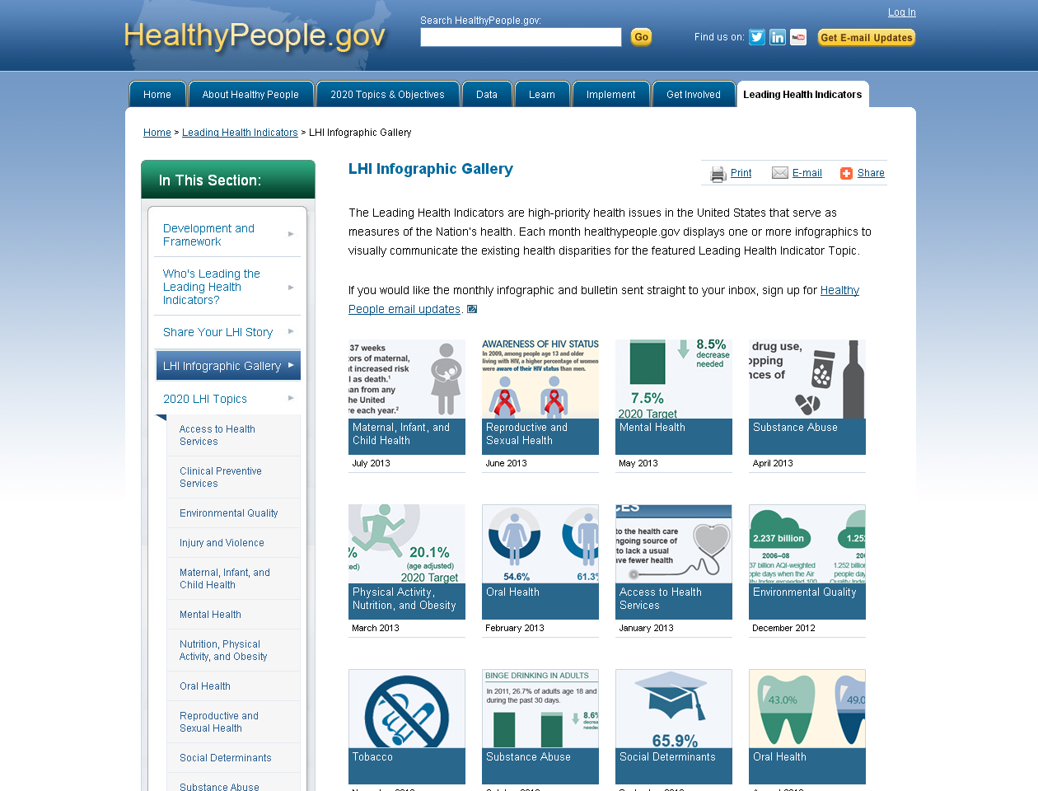
LHI Infographic Gallery http://www.healthypeople.gov/2020/LHI/infographicGallery.aspx

Slide 101
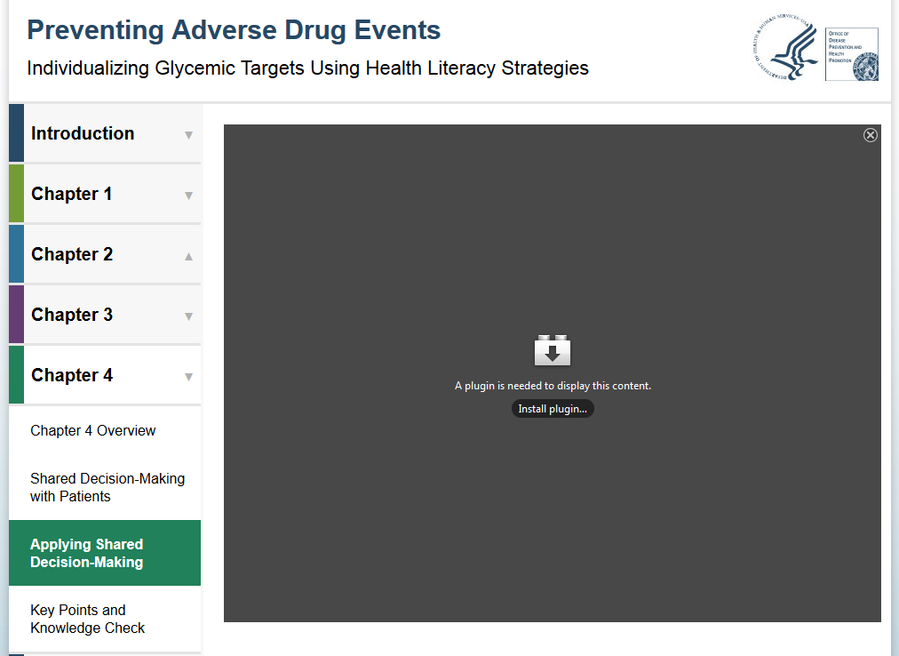
New Training on Diabetes Agents
Preventing Adverse Drug Events: Individualizing Glycemic Targets Using Health Literacy Strategies
Earn continuing education credit (CME, CNE, CEU, CPE)
Available on the training tab of www.health.gov

Slide 102


Healthy People 2020
Progress Review Webinar
  Please join us as we review select
  Healthy People 2020 objectives in the Environmental Health and Tobacco Use topic areas.
  Friday, December 5, 2014
  Hear from a community-based organization that is working to improve outcomes in the community.
  To register, visit:
  www.healthypeople.gov

Slide 103




Stay Connected
Web healthypeople.gov
Email hp2020@hhs.gov
Twitter @gohealthypeople
LinkedIn Healthy People 2020
YouTube ODPHP (search “healthy people”)
Join the Healthy People Listserv & Consortium
Notes:
103

Slide 104
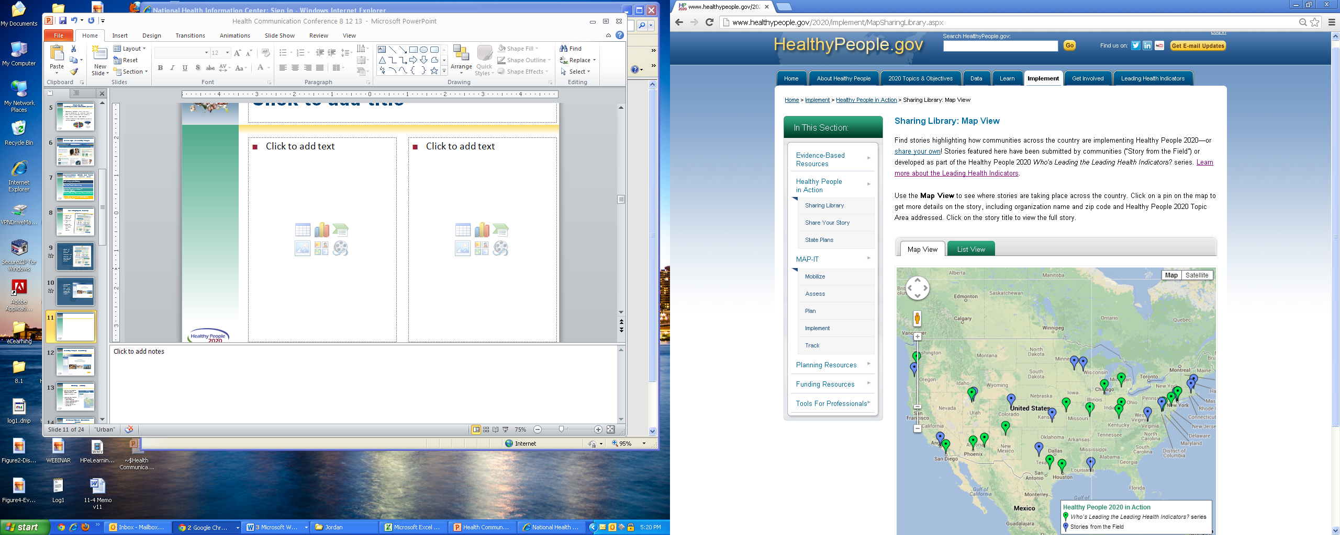
Healthy People 2020
Sharing Library
A library of stories highlighting ways organizations across the country are implementing Healthy People 2020
Healthy People in Action - Sharing Library http://healthypeople.gov/2020/implement/MapSharingLibrary.aspx

Slide 105
Healthy People 2020
Progress Review Planning Group
  Ed Greg (CDC/NCCDPHP)
  Desmond Williams
  (CDC /NCCDPHP)
  Paul Eggers (NIH/NIDDK)
  Lawrence Agodoa (NIH/NIDDK)
  Peter Savage (NIDDK/NIH)
  Nilka Rios Burrows
  (CDC/NCCDPHP)
  Sharon Saydah (CDC/NCCDPHP)
  Stan Lehman (CDC /NCCHSTP)
  Denise Stredrick (NIH/OD)
  Rebecca Hines (CDC/NCHS)
  Leda Gurley (CDC/NCHS)
  Asel Ryskulova (CDC/NCHS)
  Lesley Dobrzynski (CDC/NCHS)
  Mark Eberhardt (CDC/NCHS)
  David Lacher (CDC/NCHS)
  Carter Blakey (HHS/ODPHP)
  Emmeline Ochiai (HHS/ODPHP)
  Debbie Hoyer (HHS/ODPHP)
  Yen Luong (HHS/ODPHP)

