Slide 1
Country Report on the Pre Test to
Improve Disability Measurement
Statistics
Sri Lanka 2009
(UNESCAP /WG supported)

Slide 2
Contents of the Report – 9 Headings
Introduction
Preparatory work
Training
Field work
Debriefing sessions
Data Processing
Results
Recommendations and conclusions
Appendices

Slide 3
Why Improvement is needed for Disability Statistics Measurements to Sri Lanka
Past censuses collected disability information only from permanent disabled persons
Increasing aged population
Victims of civil war
Increasing road accidents due to new roads (HI ways)
To construct disabled free life expectancy

Slide 4
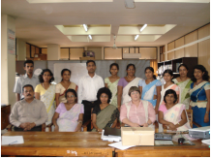
Pilot testing Extended set

Slide 5
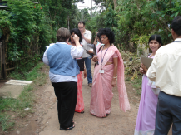
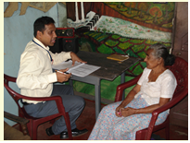
Field work - Interviewed 1000 individuals
Covered Urban , Rural and Estate sectors
Cognitive testing – To check people could understand the questions
Used Qnotes to enter data online

Slide 6
Problems
Translation problems
Vision : Eg. Do you have a problem in seeing, even if wearing glasses? It is better to ask do you wear glasses? Before that question.
Unable to remember the age of on set where the difficulty occurred.
2 liter jar was not understood by some respondents. Better to use pot of water.
The words anxiety and depression was not understood by respondents .
Collecting information about the income was very difficult and some respondents could not read the card.
The severity of the difficulty was difficult to answer for most of the time. They requested examples to explain them.

Slide 7
Results -% with any difficulties
Domain | % with any difficulty
Walking | 35
Pain | 31
Vision | 27
Remembering | 23
Anxiety | 21
Hearing | 12
Depression | 12
Fatigue | 11
Upper body | 11
Learning | 9
Communication | 5

Slide 8
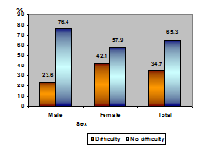
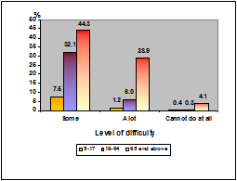
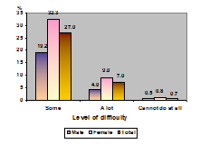
Walking
On average, 65 percent reported as no difficulty in mobility while 35 percent reported that they have difficulty in walking.

Slide 9
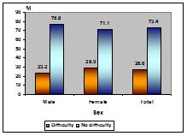
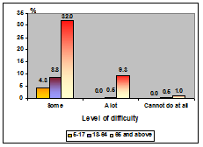
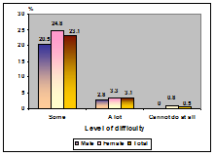
Vision
On average, 73 percent reported as no difficulty in seeing while 27 percent reported that they have difficulties in seeing.

Slide 10
Thoughts
Sustainability of the activity
Importance should be recognized by leaders/ heads etc.
Use of data by respective authorities
Publicity for the data
Data analysis / Definitions

