Slide 1

2009 Maldives Demographic and Health Survey

Slide 2

The 2009 Maldives Demographic and Health Survey (MDHS) is the first DHS conducted in Maldives. The MDHS was carried out by the Ministry of Health and Family (MOHF).
ICF Macro, an ICF International company, provided technical assistance through every phase of the survey.
Funding for the MDHS was received from the government of Maldives, UNFPA, the United Nations Children’s Fund (UNICEF), and the World Health Organisation (WHO).

Slide 3
Objectives
The 2009 MDHS was designed to provide data to monitor the population and health situation in Maldives.
Provide data on: fertility, marital status, sexual activity, family planning awareness and use, breastfeeding practices, nutrition of women and young children, childhood mortality, maternal and child health, and awareness and behaviour regarding AIDS and other sexually transmitted infections.
Collect data on physical disability among those age 5 and older, developmental disability among young children, support for early learning, children at work, the impact of the tsunami of 2004, health expenditures, and physical activity levels of adults age 65 and older.
Assess additional features of blood pressure, diabetes, heart attack, and stroke.

Slide 4
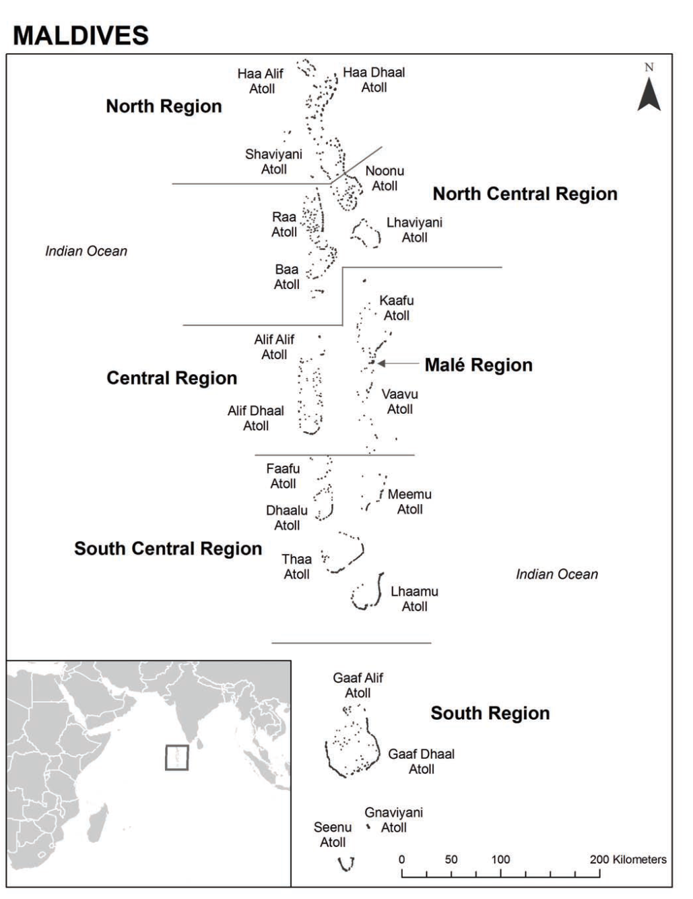
2009 MDHS Regions & Sample Design
Sampling frame: The 2006 Maldives Population and Housing Census 2006
First stage: 270 census blocks selected
Second stage: systematic sampling of households from each census block selected; final sample of 6,443 households
The MDHS sample is a nationally representative sample.
It was designed to provide estimates for the country as a whole, for urban and rural areas, for the six geographical regions, and for key indicators for each of the atolls of the country.

Slide 5
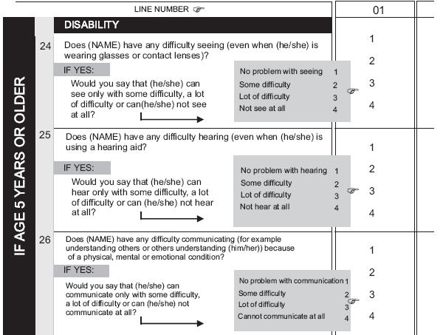

Slide 6
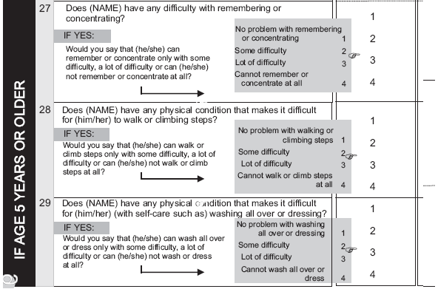

Slide 11
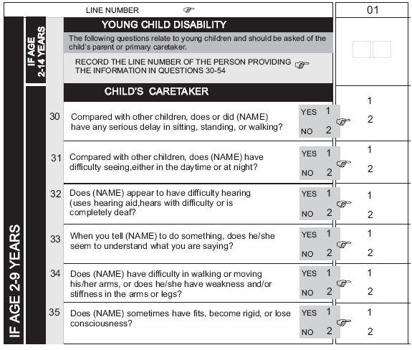

Slide 12
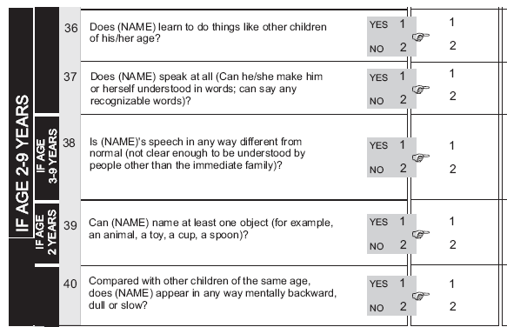

Slide 14
Thank you

