Slide 1

Exploring the
Washington Group Data from the 2011 U.S.
National Health Interview Survey
Julie D. Weeks, Ph.D.
National Center for Health Statistics, USA
Washington Group on Disability Statistics
Bangkok, Thailand
22-24 October 2012

Slide 2
Purpose of Presentation
The WG questions have been collected as part of the U.S. National Health Interview Survey since 2010. In this presentation:
Overview of NHIS survey characteristics;
Examine the WG-SS items by sociodemographics;
Examine the overall prevalence of “disability” using the WG-SS and a broad definition of disability;
Examine the WG-ES items by sociodemographics;
Discussion of coding choices in all domains;
Discuss the cut points for definitions of disability prevalence;
Make suggestions for next steps.

Slide 3
The National Health Interview Survey
(NHIS)
The principal source of information on the health of the civilian noninstitutionalized population of the United States.
Since 1956, the NHIS has provided statistical information on the amount, distribution, and effects of illness and disability in the U.S. and the health services received for such conditions.
Comprised of “Core” questions asked each year of the Household, Family, a Sample Adult and a Sample Child, and “Supplement” questions that address special topics and change periodically.

Slide 4
NHIS Characteristics
Survey context: Health and health care survey
Survey scope: Civilian, noninstitutionalized population
Survey mode: In-person, some telephone followup
Trained U.S. Census interviews
Computer-assisted personal interviewing
Periodicity: Annual, repeated cross-sectional estimates
Sample Size: Each year completed interviews with
35,000 households
87,500 persons

Slide 5
NHIS Interview Protocol
Household respondent provides basic socio-demographic information on all members of household
  For each family within a household
    knowledgeable adult 18 or older responds for him/herself and all other family members
    sample adult 18 or older and sample child under age 18 randomly selected for more extensive set of questions

Slide 6
NHIS Structure: Basic Module
Family Core
General info on all family members
Household and family data
Allows proxy respondents
Fielded each year
Sample Adult Core
Self-response only
Fielded each year
Sample Child Core
Knowledgeable adult responds for child
Fielded each year
Demographic and general health data
Health condition, risk behavior, and health behavior data

Slide 7
Examples of Previous and Current
NHIS Supplements
Arthritis (2002, 2003, 2006, 2009)
Asthma (2002, 2008, 2013)
Balance/Dizziness (2008)
Complementary and Alternative Medicine (2002, 2007, 2012)
Cancer (2000,2005, 2010)
Diabetes (2003, 2007)
Disability (2002, 2008-present) (WG 2010-present)
Epilepsy (2010, 2013)
Food Security (2011- present)
Immunization (2008-present)
Hearing (2002, 2007, 2008)
Heart Disease (2001, 2008)
Mental Health (2001-2010)
Occupational Health (2010)
Oral Health (2008)
Vision (2002, 2008)

Slide 8
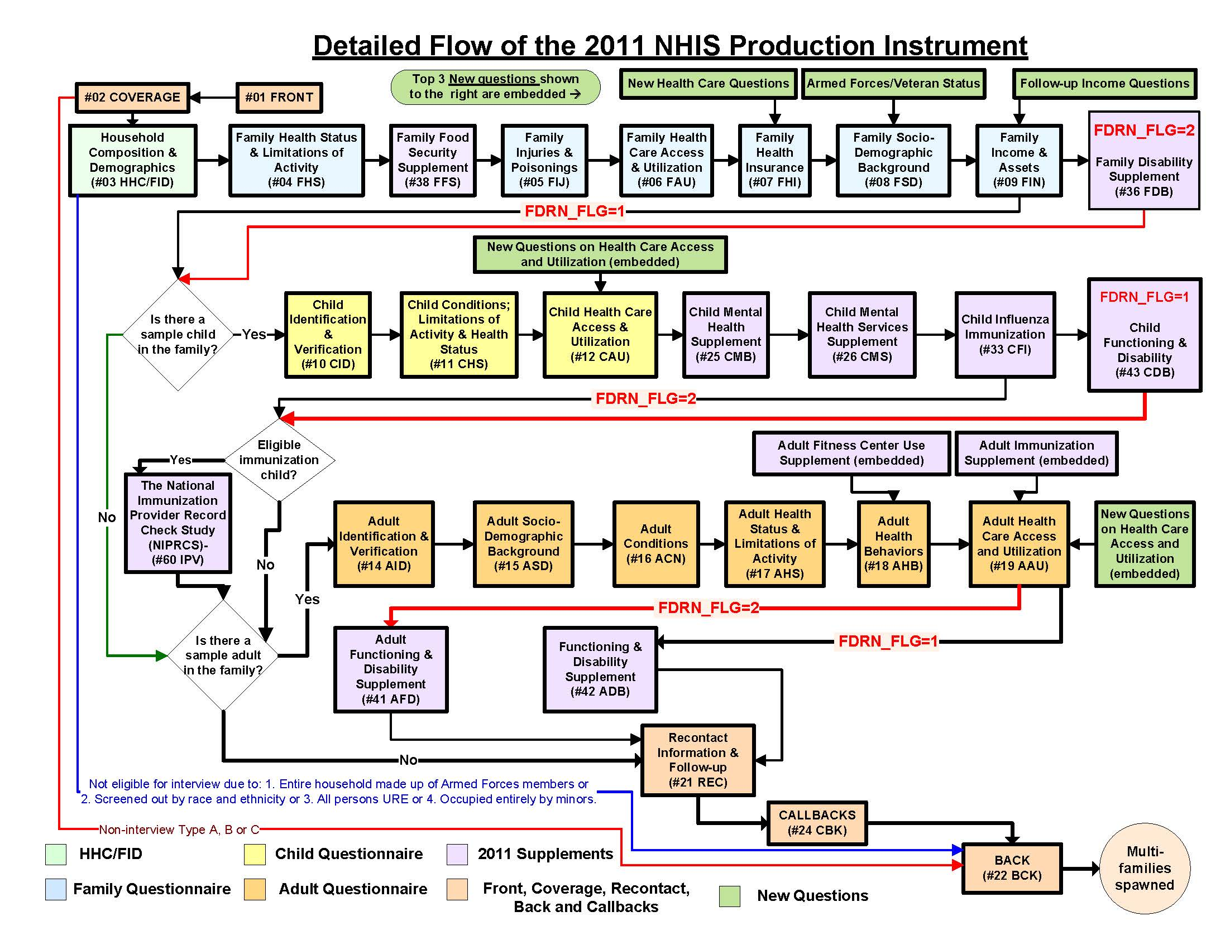

Slide 9
2011 NHIS-WG Data
Characteristics
Analytic Sample: 16,540 adults, ages 18 years and over
Male: 45%
Female: 56%
18-44 years: 46%
45-64 years: 34%
65+: 21%
Less than high school: 17%
High school or equiv.: 56%
College: 27%
Below 100% poverty: 18%
100% - < 200% poverty: 21%
200% or above poverty: 61%

Slide 10
Short Set WG Items: Methods
Tables on pages 1-12 contain provide NHIS data from the following:
Short Set items, individually, by sociodemographics:
Vision
Hearing
Mobility
Communication
Cognition
Upper Body
All response categories are shown: no diff, some diff, a lot of diff, cannot do at all.
U.S. population 18 years and over

Slide 11
Short Set WG Individual Items: Impressions
Results of the individual Short Set questions show some interesting results:
Women > Men: vision, mobility, cognition.
Men > Women: hearing, communication
Age relationship as expected: severity worsens with age
However, even though the older pop have greater proportion of difficulty, the largest population with difficulty is the 18-64 population.
Education, poverty status and marital status also as expected.
“Some” category captures largest pop with difficulty. Is this a problem?

Slide 12
Definitions for Prevalence of Disability
Four measures have been proposed by the WG:
1. a broad measure that includes everyone with at least one domain coded as some difficulty, a lot of difficulty, or unable to do it
2. a measure that excludes the mildest degrees of difficulty and includes everyone with at least one domain coded as a lot of difficulty, or unable to do it
3. a narrow measure that focuses on the most severe levels of difficulty and includes everyone with at least one domain coded as unable to do it at all
4. a measure that is slightly more restrictive than #1 and includes everyone with at least one domain that is coded as a lot of difficulty or cannot do it at all or at least some difficulty in two domains.

Slide 13
Short Set WG Summary Measure: Impressions
Page 13 shows the prevalence of disability in the 18+ population, combining the six Short Set questions.
The overall rate of disability, using the broad definition, is 33.4%.
This rate is consistent with another measure of difficulty used in the U.S. indicating “Basic Actions” difficulty.
Difficulty walking or climbing steps contributes the greatest to the overall rate.
Followed by cognition, hearing and vision.
The “some difficulty” category is much larger than others.
Page 15 shows disability by sociodemographic characteristics.

Slide 14
Short Set WG Summary Measure:
Varying Cut-Off Points
What would the overall rate of disability be, as measured by the Short Set, using the other recommended definitions?
1. at least one domain is scored some difficulty = 33.4%
2. at least one domain is scored a lot of difficulty = 8.9%
3. at least one domain is scored unable to do it at all = 2.4%
4. at least one domain is scored
a) as a lot of difficulty or unable to do it or
b) at least some difficulty is scored in two domains
= 17.6%

Slide 15
Extended Set WG Items: Methods
Tables on pages 17-30 contain provide NHIS data from the following:
Extended Set items, individually, by sociodemographics:
Hearing: quiet room, noisy room, comparison
Mobility: 100 yards, 1/3 mile, walking stairs, comparison
Upper Body: lifting, grasping, comparison
Anxiety
Depression
Pain
Fatigue
All response categories are shown: no diff, some diff, a lot of diff, cannot do at all.
U.S. population 18 years and over

Slide 16
Extended Set WG Items:
Coding of Hearing
For the extended set, the hearing variable combines difficulty hearing, difficulty hearing in a quiet room and difficulty hearing in a noisier room:
Any difficulty hearing “yes” = 11.4%
Any difficulty hearing in a quiet room or a noisier room, AND, “no” difficulty to #1 = 16.7%
Any difficulty hearing – extended set = 28.2%
In this way, we add the Short Set measure and the Extended set questions on hearing to form the Extended Hearing measure.
Page 19

Slide 17
Extended Set WG Items:
Coding of Mobility
For the extended set, the mobility variable combines difficulty walking or climbing stairs, difficulty walking 100 yards, difficulty walking 1/3 mile, difficulty walking stairs, and use of wheelchair or scooter:
Any difficulty walking or climbing stairs “yes” = 16.3%
Any difficulty walking 100 yards or 1/3 mile or walking up and down stairs, OR, uses a wheelchair or scooter, AND “no” difficulty to #1 = 7.3%
Any difficulty with mobility – extended set = 23.6%
Page 23

Slide 18
Extended Set WG Items:
Coding of Upper Body
For the extended set, the upper body variable combines difficulty with self care, raising a 2L bottle, and using hands or fingers to grasp:
Any difficulty with self care = 3.9%
Any difficulty raising a 2L bottle from waist to eye level or using hands or fingers to grasp, AND, no difficulty to self care = 6.9%
Any difficulty with upper body – extended set = 10.8%
Page 26

Slide 19
Extended Set WG Summary Measure: Impressions
Page 31 shows the prevalence of disability in the 18+ population, combining the questions in the 10 domains.
The overall rate of disability, using the broad definition, is 61.1%.
This rate is almost double the rate derived from the Short Set.
Adding a) follow-up questions in the hearing and mobility domains and b) adding the domains anxiety, depression, pain and fatigue greatly increase the prevalence rate.
Further work to create measures in the additional extended domains may or may not further increase this rate.
Page 32 shows disability by sociodemographic characteristics.

Slide 20
Extended Set Analyses: Next Steps
Understanding how the WG Extended Set is operating and who we are capturing requires much more analysis.
For hearing, is “quiet” and “noisy” room operating the way we want? Are we constructing the mobility and upper body extended measure correctly?
For the domains of anxiety, depression, pain and fatigue, how do we construct summary measures across the questions of frequency, intensity and duration?
Do questions about equipment tell us anything about functioning? Are the medication questions adding to our understanding?

Slide 21
Extended Set Analyses: Next Steps
Understanding how the WG Extended Set is operating and who we are capturing requires much more analysis.
What cut points in level of difficulty are useful for what purposes?
Is the purpose of the Extended Set to add more people to the prevalence rate or understand greater detail within a domain of functioning?
Examine disparities among those at risk, including participation (social inclusion) and quality of life.

