Slide 1
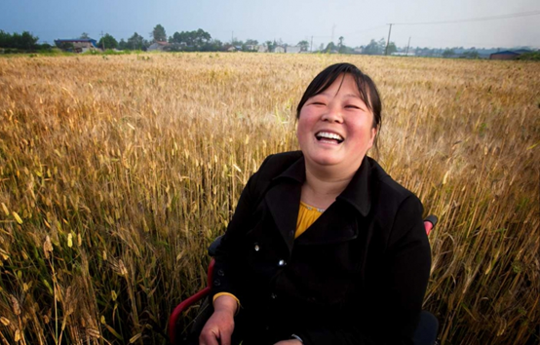
An overview of
WG collaboration with
Handicap International
Presented by
Aude Brus: Technical Studies and Research Coordinator, HI
(abrus@handicap-international.org)
Ulrike Last: Technical Advisor Civil Society Support
(ulast@handicap-international.org)

Slide 2
Who are we?
1982 HI’s foundation in the Cambodian Refugee Camps with provision of health related rehabilitation in Thailand
Work in situations of poverty and exclusion, conflict and disaster alongside people with disabilities and vulnerable groups
Taking action and bearing witness in order to respond to their essential needs and to improve their living conditions and promote respect for their dignity and fundamental rights

Slide 3
Who are we?
Across 59 countries: projects run by Departments of Humanitarian Action and Development supported by Technical Resource Division
Disability Inclusive Development (education, income generation, political participation and governance, protection, support to civil society and authorities, health, rehabilitation, disaster risk reduction, urban planning)
Disability Inclusive Disaster Preparedness & Disaster Risk Reduction
Access to Basic and Specific Humanitarian Needs and Inclusive Protection
Arm Risk Reduction, including Mine Risk Education

Slide 4
Context
Locating our work in contribution to achieve the Sustainable Development Goals and human rights frameworks, like CRPD
« Leave no one behind! »
-> Inclusive approach to development and humanitarian action
-> Work with and in support of partners in development collaboration
-> Capacity development of local partners in relation to the SDGs
-> Implement humanitarian action directly

Slide 5
Context
Data… For what?
Assess & analyze the situation of people with disability in a project and between countries
Understand and identify environmental factors
In order to:
Support persons with disabilities, services providers and authorities in realizing rights and equalization of opportunities
Inform HI staff to develop relevant projects answering to local requests
Answer to request by civil society partners to enhance their work for instance evidence based advocacy, policies input at local, national and international levels
Answer to requests by authorities to adapt policies and programs & facilitate the planning of services
Monitoring, evaluation & accountability

Slide 6
What do we use?
Sources
Census, population based survey, administrative records
Researches and studies (assessments, qualitative studies)
Projects monitoring & evaluation (as baselines), Project related surveys
A lack of evidence to plan our work, communicate, and add to the major gaps (comprehensive and disaggregated data on disability but also barriers),
No comparability

Slide 7
Disability data at Handicap International
We are collecting and using disability-related data..
Emergency project, Lebanon, 2012-2013
Projects (national, local, regional, international)
We screen and/ or count/
Monitor rights situation/ identify B&F in environment
Table 4: Unmet service needs across the sample and camps of Dadaab, HI 05/11
Unmet access to services | Total | % of sample
Shelter | 8.139 | 63.4
Specialized health services | 3.754 | 29.3
Mental health service | 926 | 7.2
Education, including vocational training | 2.105 | 16.4
Livelihood | 2.986 | 23.3
Non-food items: Clothing | 1.512 | 11.8
Access to food rations | 1.416 | 11.0
Protection services | 811 | 6.3
Water and sanitation | 332 | 2.6

Slide 8
Disability data at Handicap International
Projects: We disaggregate data to orient our action…
« Children with disabilities in Somaliland », 2012

Slide 9
Disability data at Handicap International
Projects: We monitor and measure the outcomes/ impact at individual and service access levels
Proportion of respondents reporting problems
before and after HI’s intervention. Jordan, 2012-2013

Slide 10
Disability data at Handicap International
Projects: Increasingly we use the WG tools
Microfinance project, Paraguay, 2013

Slide 11
Disability data at Handicap International
Researches/ Surveys
Disability prevalence in Port-au-Prince, 2012

Slide 12
Disability data at Handicap International
Evidence based input on global guidelines and mainstream approaches
And advocacy..
Need for disaggregated data

Slide 13
Handicap International & the WG
 | 13th Meeting of the WG in Amman: First HI participation | 14th Meeting of the WG in Buenos Aires: Participation of HI | First Regional Workshop on the measurement of Child Disability: Participation of HI | HI Training in Lyon | 15th Meeting of the WG in Copenhagen: First HI Intervention
… | 2013 | 2014 | 2015
Early stage… Promoting the SS in different projects : e.g. 2009: Cambodia support of DPO to advocate the national bureau of statistics 2011: Haïti, research on disability measure |  | Orientation Note about disability-related data in National Censuses for HI and partners to help understanding national census data | Development of projects in partnership with the WG (3) Promotion of the WG tools to others actors and our partners Integration of the SS in project tools (emergency for example) Use of the WG tools in research/ surveys

Slide 14
Handicap International & the WG
Projects & Training for supporting
towards more comparable and robust data on disability
Projects
- Andean Countries
- East Africa
&
- Emergency Contexts
Training
- All technical advisors
- E-learning module to come

Slide 15
Questions or comments?

