Slide 1

Gold indicators to the un convention on the rights of persons with disabilities
MARIA VENTEGODT LIISBERG, PHD
DEPARTMENT DIRECTOR
EQUAL TREATMENT
MVL@HUMANRIGHTS.DK

Slide 2
About the danish institute for human rights
The Danish Institute for Human Rights is an independent state-funded institution. Our mandate is to promote and protect human rights and equal treatment in Denmark and abroad.

Slide 3
Disability
Vision:
We will ensure that persons with disabilities enjoy the same human rights as everyone else.
Our goal is to:
always refer to the ten greatest challenges that exist for implementing UN’s Convention on the Rights of Persons with Disabilities in Denmark
remove the barriers that prevent people with disabilities from full and effective participation in society.
To do so we focus on:
ensuring that Denmark introduces a general prohibition against discrimination based on disability
ensuring that the use of force in psychiatry is reduced and that compulsive restrainment in excess of 48 hours is abolished
ensuring that the state ceases to provide support to pay off mortgage loans for the construction of new large institutions
changing the electoral legislation so people with disabilities do not lose their right to vote when put under guardianship.

Slide 4
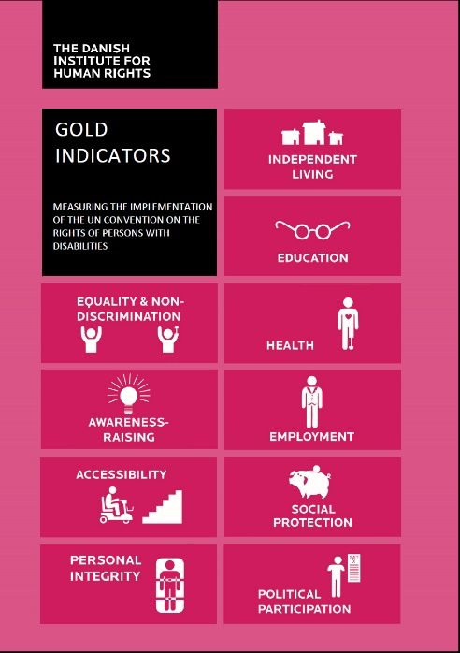
Latest publications
Gold Indicators
Measuring the implementation of the CRPD
The publication outlines the Gold Indicators, a set of 10 statistical outcome indicators which compare the situation of persons with and without disabilities in relation to 10 key rights of the CRPD.
http://www.humanrights.dk/publications/gold-indicators
The human rights guide to the SDGs
http://www.humanrights.dk/files/media/dokumenter/sdg/dihr_human_rights_reference_paper_to_the_sdg_indicators_new.pdf

Slide 5
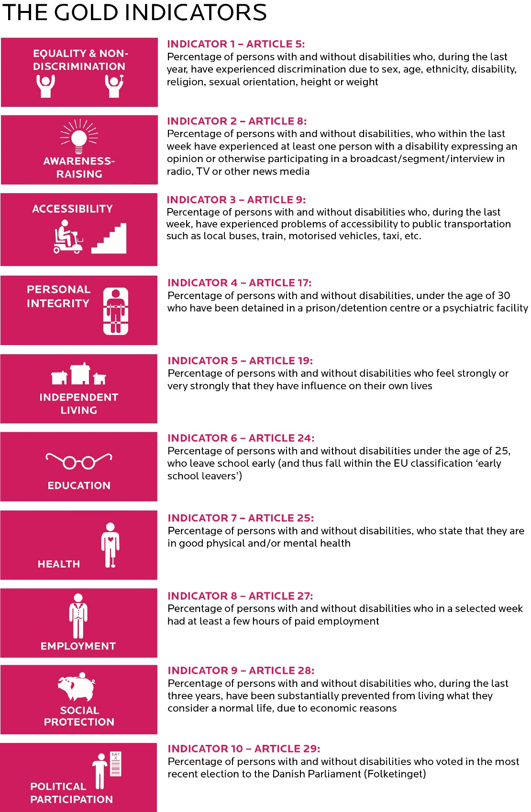
The gold indicators

Slide 6
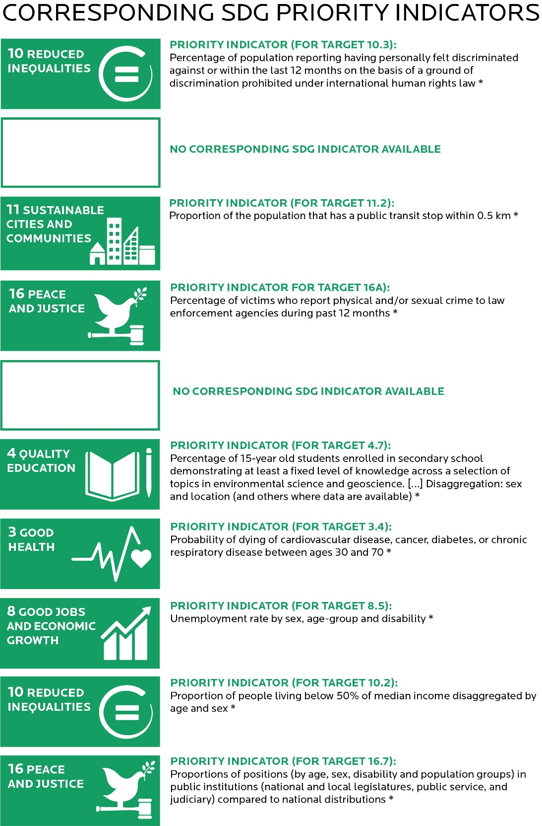
Corresponding sdg priority indicators

Slide 7
A short film on the gold indicators
Link to the film: https://www.youtube.com/watch?v=Joj9QFVQlxM

Slide 8

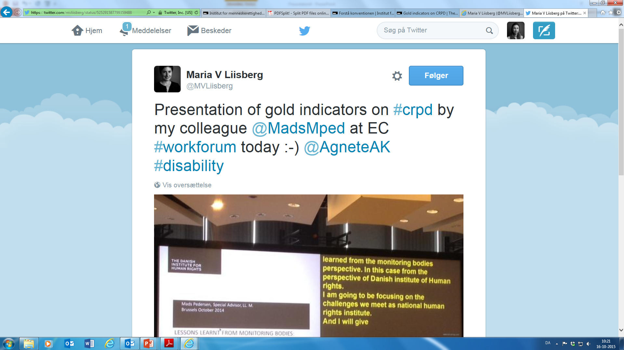
Social media and website
www.twitter.com/MVliisberg
Website: http://www.humanrights.dk/our-work/our-work-denmark/disability

