Slide 1
Leaving no-one behind: Disability-inclusive indicators in the post-2015 framework
Washington Group on Disability Statistics
Jennifer H Madans
Associate Director for Science,
National Center for Health Statistics, USA and
Chair, Washington Group on Disability Statistics

Slide 2
Monitoring the UN CRPD and SDGs
The WG short set of questions were developed to collect internationally comparable data based on the ICF model to fulfill the monitoring requirements established by the CRPD and SDGs.
The WG questions
describe a continuum of functioning based on graded responses to questions in 6 functional domains
define a cut-off (or a set of cut-offs) with international agreement to disaggregate outcome indicators (e.g. access to education, employment) by disability status

Slide 3
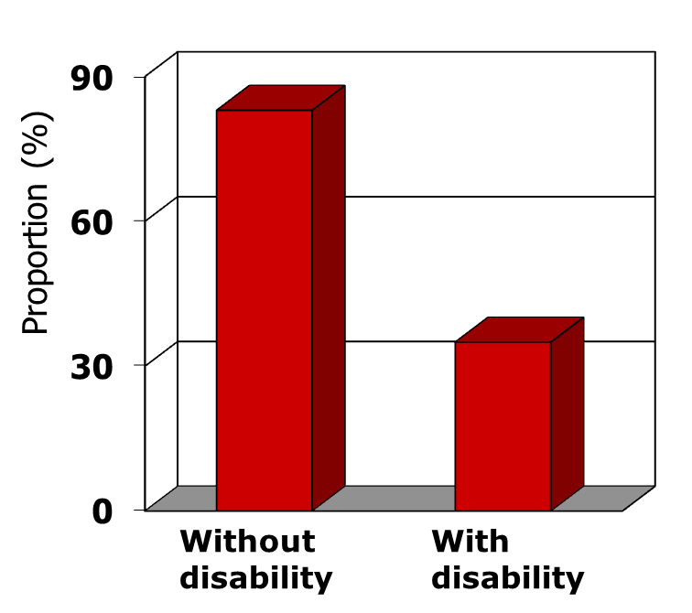
WG Short Set Purpose: Equalization of Opportunities
% Employed
Seeks to identify all those at greater risk than the general population for limitations in participation.
Disability used as a demographic.

Slide 4
…from Operational Definition to Measurement
Because of a Health problem:
Do you have difficulty seeing even if wearing glasses?
Do you have difficulty hearing even if using a hearing aid?
Do you have difficulty walking or climbing stairs?
Do you have difficulty remembering or concentrating?
Do you have difficulty with (self-care such as) washing all over or dressing?
Using your usual language, do you have difficulty communicating (for example understanding or being understood by others)?
Response categories:
No difficulty; Some difficulty; A lot of difficulty; Cannot do at all

Slide 5
Disability by Employment status
NHIS 2010 Weighted % |  | Employment Status Last Week 18-64 years of age
WG Short set | Prevalence | Without disability | With Disability
Cut-off is cannot do at all in at least 1 domain | 0.9 | 71.1 | 24.7
Cut-off is at least a lot of difficulty in at least 1 domain | 6.2 | 73.4 | 29.1
Cut-off is some difficulty in at least 2 domains | 13.1 | 73.9 | 49.4
Cut-off is some difficulty in at least 1 domain | 32.8 | 74.9 | 62.0

Slide 6
Mainstreaming disability statistics
The short set of 6 questions can be added to on-going data collections
Can be used in any national or subnational survey (health, labor force, income & expenditure, DHS etc.)
Once they become integrated as part of regular statistical systems – disaggregating outcomes (education, employment etc.) by disability status becomes a matter of routine

