Slide 1
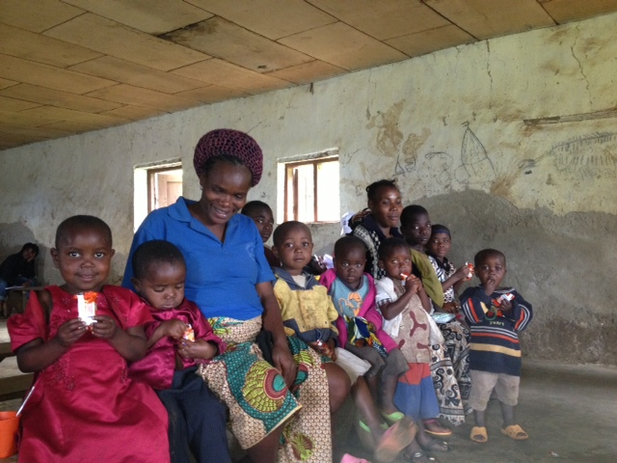
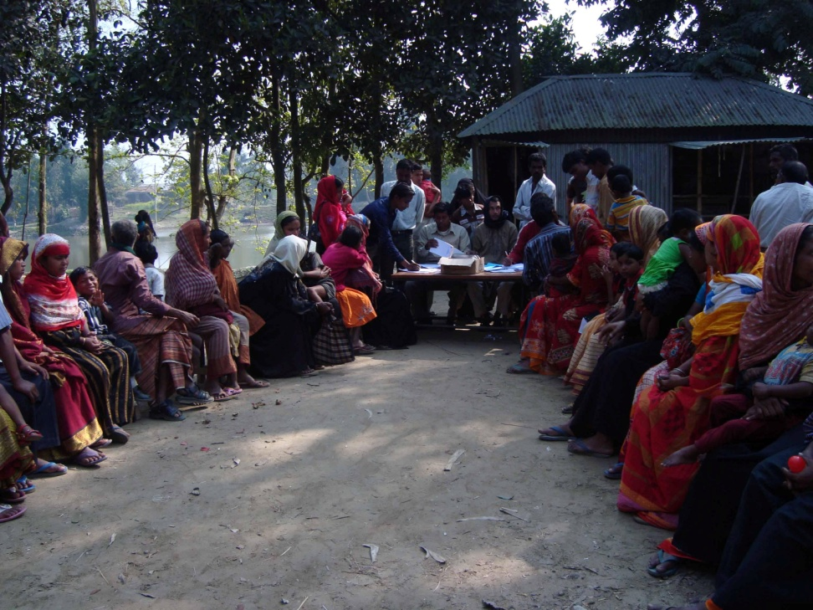
Field-testing an earlier draft of the WG/UNICEF Question Set in Cameroon, India and Fiji
Islay Mactaggart
Research Fellow in Disability
International Centre for Evidence in Disability, LSHTM

Slide 2
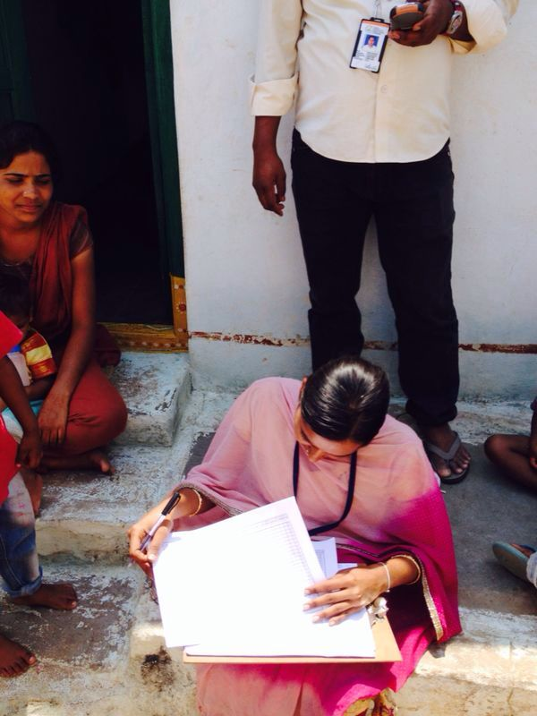
1. Building Evidence Study
AIM:
To develop a comprehensive population-based survey methodology that is compatible with the ICF, and to explore the inter-relationship between the impairment and activity limitation components of this framework

Slide 3
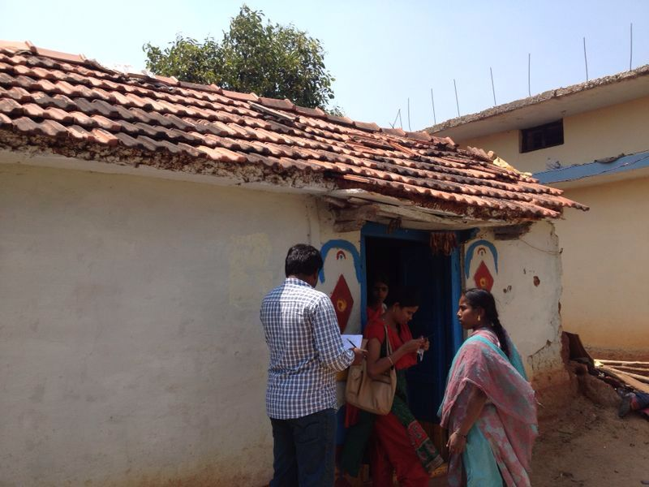
1. Building Evidence Study
METHODS:
All age population-based survey (n=4056 per country) of:
1. Self reported functional limitations
2. Clinically measured visual impairment, hearing impairment , musculoskeletal impairment and depression
2. Nested Case-control study (age 5+):
CASES: People with disabilities
CONTROLS: People without
disabilities

Slide 4
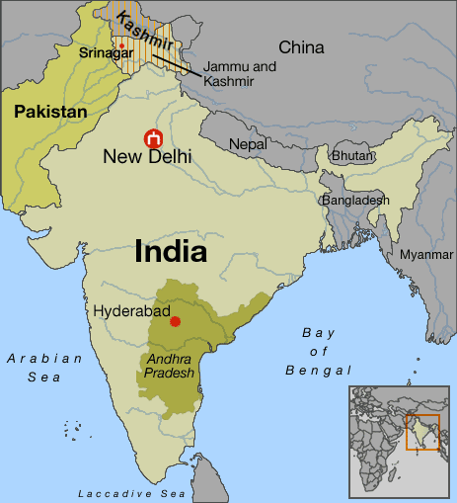
1. Building Evidence Study
Cameroon: North West Region (July-Sept 2013)
India: Mubabnager, Andra Pradesh (Feb-April 2014)

Slide 5
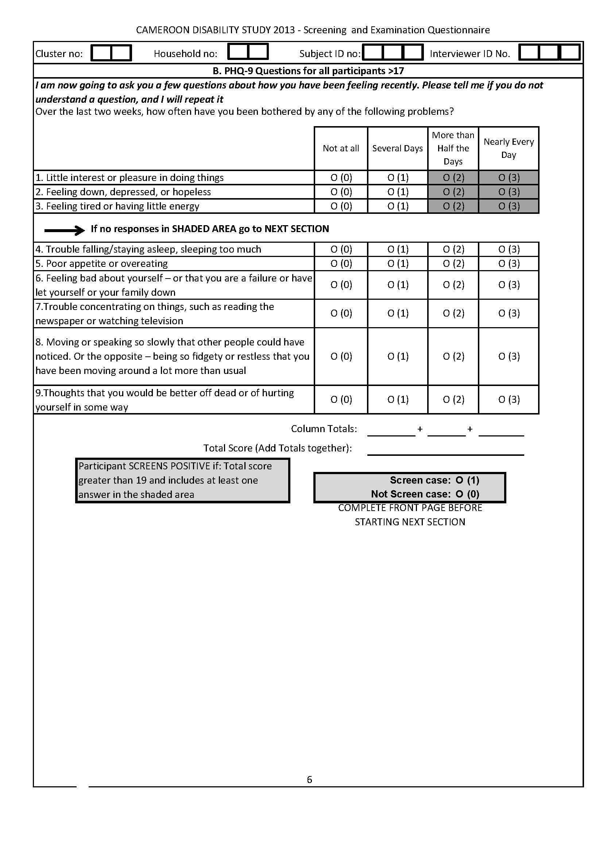
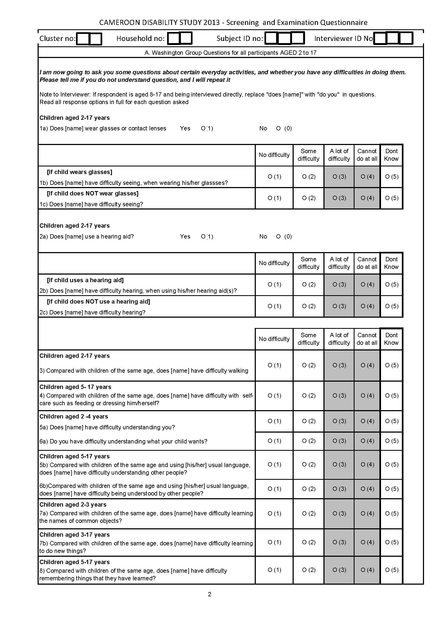
1. Building Evidence Study
Screening tools
WG/UNICEF and WG-ESF Self-Reported Screen (2+)*
PHQ-9 Clinical Depression Screen (18+)
RAAB Vision Screen (all ages)
WHO E&H Hearing Screen (all ages)
RAM Musculoskeletal Screen (all ages)
Clinical examination, diagnosis and referral for all participants screening positive to any clinical screen
Case/Control interviews for all participants screening positive to any screen aged 5+
*NB. Children <8 or participants unable to communicate screened via proxy, 9+ self-report

Slide 6
1. Building Evidence Study
Screening tools
WG/UNICEF and WG-ESF Self-Reported Screen (2+)*
PHQ-9 Clinical Depression Screen (18+)
RAAB Vision Screen (all ages)
WHO E&H Hearing Screen (all ages)
RAM Musculoskeletal Screen (all ages)
Clinical examination, diagnosis and referral for all participants screening positive to any clinical screen
Case/Control interviews for all participants screening positive to any screen aged 5+
c
*NB. Children <8 or participants unable to communicate screened via proxy, 9+ self-report

Slide 7
1. Building Evidence Study
DOMAIN TYPE | AGE GP | No. | DOMAIN OF FUNCTIONING |  | DOMAIN TYPE |  | AGE GP | No. | DOMAIN OF FUNCTIONING
Basic activity domains | 2-17 | D1 | Seeing |  | Complex activity/ participation domains |  | 2-17 | D9 | Controlling Behaviour
 |  | D2 | Hearing |  |  |  |  | D10 | Playing
 |  | D3 | Walking |  |  |  | 5+ only | D11 | Anxiety/Sadness
 |  | D4 | Understanding |  |  |  |  | D12 | Completion of Task
 |  | D5 | Being Understood |  |  |  |  | D13 | Accept Change
 |  | D6 | Learning |  |  |  |  | D14 | Get along with other children
 | 5+ only | D7 | Remembering
 |  | D8 | Self Care
Draft Module Domains (no probes)

Slide 8
2. Findings
Cohort Descriptives
 | Cameroon |  |  | India
 | Male | Female | Total | Male | Female | Total
 | n (%) | n (%) | n (100%) | n (%) | n (%) | n (100%)
2 to 5 | 237 (46.9) | 268 (53.1) | 505 | 113 (48.5) | 120 (51.5) | 233
6 to 9 | 256 (51.3) | 243 (48.7) | 499 | 163 (53.8) | 140 (46.2) | 303
10 to 13 | 230 (51.7) | 215 (48.3) | 445 | 138 (50.5) | 135 (49.5) | 273
14 to 17 | 126 (47.7) | 138 (52.3) | 264 | 161 (55.1) | 131(44.9) | 292
Total | 849 (49.6) | 864 (50.4) | 1,713 | 575 (52.2) | 526 (47.8) | 1,101

Slide 9
2. Findings - Overall

Slide 10
2. Findings - Overall

Slide 11
2. Findings - Overall

Slide 12
2. Findings - Overall

Slide 13
2. Findings – by age

Slide 14
2. Findings – by age
No difference by sex (not shown)
Age 2-4 more likely to have no difficulty in any domain and less likely to have “some difficulty” in one or more basic or complex domain
No difference at a lot or cant do threshold by age

Slide 15
2. Findings – by age

Slide 16
2. Findings – by age
As in Cameroon but less differences across age groups

Slide 17
2. Findings – by domain

Slide 18
2. Findings – by domain
India

Slide 19
2. Findings – by domain x age
Cameroon Basic Domain endorsement (some) by age (% age group)
Domain | 2-4 | 5-8 | 9-12 | 13-17 | Total | P value (chi²)
Increasing with age:
Seeing | 1.6 | 3.4 | 7.4 | 11.0 | 5.8 | <0.001
Hearing | 1.9 | 5.5 | 10.0 | 12.8 | 7.6 | <0.001
Remembering | - | 22.1 | 31.3 | 34.7 | 28.8 | <0.001
Decreasing with age:
Being Understood | 8.2 | 4.3 | 3.8 | 3.6 | 4.8 | <0.01
Self-Care | - | 11.8 | 3.6 | 0.8 | 5.9 | <0.001
No significant association with age for: walking, learning, understanding

Slide 20
2. Findings – by domain x age
Cameroon Complex Domain endorsement (some) by age (% age group)
Domain | 2-4 | 5-8 | 9-12 | 13-17 | Total | P value (chi²)
Increasing with age:
Worry | - | 16.6 | 19.0 | 25.8 | 20.0 | <0.01
Decreasing with age:
Completing a task | - | 26.0 | 16.1 | 12.5 | 18.8 | <0.001
No significant association with age for: Controlling behaviour, playing, accepting change and getting along with other children.

Slide 21
2. Findings – by domain x age
India Basic Domain endorsement (some) by age (% age group)
Domain | 2-4 | 5-8 | 9-12 | 13-17 | Total | P value (chi²)
Increasing with age:
Seeing | 1.3 | 1.0 | 5.5 | 8.6 | 4.2 | <0.001
Decreasing with age:
Being Understood | 9.9 | 7.6 | 5.9 | 5.1 | 6.0 | <0.05
Learning | 16.7 | 11.2 | 8.4 | 9.9 | 11.4 | <0.05
No significant association with age for: hearing, remembering, walking, self care, understanding

Slide 22
2. Findings – by domain x age
India Basic Domain endorsement (some) by age (% age group)
Domain | 2-4 | 5-8 | 9-12 | 13-17 | Total | P value (chi²)
Increasing with age:
Seeing | 1.3 | 1.0 | 5.5 | 8.6 | 4.2 | <0.001
Decreasing with age:
Being Understood | 9.9 | 7.6 | 5.9 | 5.1 | 6.0 | <0.05
Learning | 16.7 | 11.2 | 8.4 | 9.9 | 11.4 | <0.05
No significant association with age for any complex domains

Slide 23
3. Evidence Study - Discussion
63.9% of children in Cameroon and 34.9% of children in India endorsed at least one domain with at least “some difficulty”
→ May reflect translation issues (Pidgin)
→ May also reflect contextual interpretation of “some” category
High levels of endorsement (“some”) and negative age association in domains related to early childhood development (e.g. Being understood, learning, self care) amongst younger children
→ May suggest reflection of development rather than functional limitation

Slide 24
3. Evidence Study - Discussion
Much smaller percentage endorsing at least one domain with at least “a lot or can not do” → requires age x domain analysis with larger sample
Similar findings for basic domains in both countries (2.5% Cameroon and 2.3% India)
Higher proportion complex domains reported in Cameroon (7.4% vs 2.3% in India)
Higher levels of worry in Cameroon amongst older children (self report 9+)
→ Consistent with research on limitations of parent reported emotional functioning

Slide 25
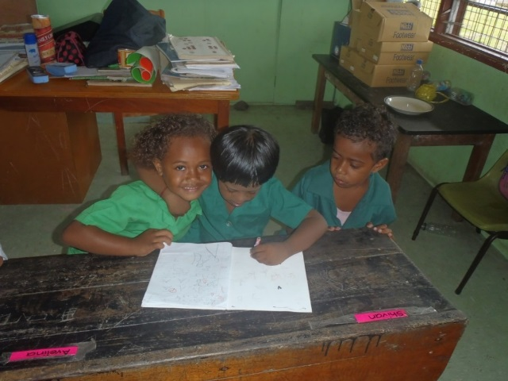
4. FEMIS Study
Validating a tool for schools to identify children with disabilities in Fiji
with the purpose of Disaggregating Fiji’s Education Management Information System by disability Very preliminary analysis – for consideration by the Washington Group, Oct 2015
Beth Sprunt & Manjula Marella
Nossal Institute for Global Health
The University of Melbourne

Slide 26
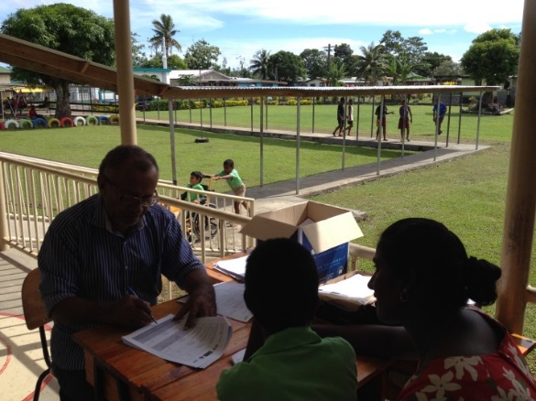
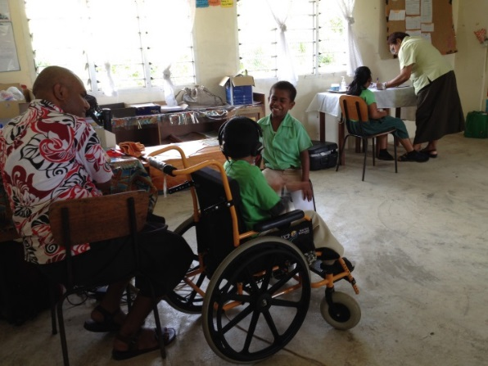
4. FEMIS Study - methods
Aim: to develop and test an approach to disaggregating the Fiji Education Management Information System (FEMIS) by disability.
Methods: Cross-sectional, case-control approach to assess the validity of the draft Washington Group/UNICEF Module on Children’s Functioning and Disability (WG/UNICEF Module) in identifying children at risk of disability, using a multidisciplinary team clinical assessment as the comparison.
Children underwent clinical assessments: vision, hearing, musculoskeletal (and speech and cognitive).
Responses of parents and teachers to the draft WG/UNICEF Module (current Feb 2015) were compared.

Slide 27
5. FEMIS Study - findings
Functional limitation (parent response) | Severity based on clinical assessment*, n (%) |  |  |  | Total n (%)
Difficulty seeing | No/mild VI | Moderate VI | Severe VI | Blind
No | 167 (97.7) | 1 (2.3) | 0 (0.0) | 0 (0.0) | 171 (100)
Some | 23 (54.8) | 6 (14.3) | 1 (2.4) | 12 (28.6) | 42 (100)
A lot | 0 (0.0) | 2 (50.0) | 1 (25.0) | 1 (25.0) | 4 (100)
Cannot do | 0 (0.0) | 0 (0.0) | 0 (0.0) | 1 (100.0) | 1 (100)
Visual impairment based on visual acuity assessment

Slide 28
5. FEMIS Study - findings
Functional limitation (parent response) | Severity based on clinical assessment*, n (%) |  |  |  | Total n (%)
Difficulty seeing | No/mild VI | Moderate VI | Severe VI | Blind
No | 167 (97.7) | 1 (2.3) | 0 (0.0) | 0 (0.0) | 171 (100)
Some | 23 (54.8) | 6 (14.3) | 1 (2.4) | 12 (28.6) | 42 (100)
A lot | 0 (0.0) | 2 (50.0) | 1 (25.0) | 1 (25.0) | 4 (100)
Cannot do | 0 (0.0) | 0 (0.0) | 0 (0.0) | 1 (100.0) | 1 (100)
Visual impairment based on visual acuity assessment
Over 50% of “some” category have no or mild VI

Slide 29
5. FEMIS Study - findings
Functional limitation (parent response) | Severity based on clinical assessment*, n (%) |  |  |  | Total n (%)
Difficulty hearing | No/mild | Moderate HI | Severe HI | Profound HI
No | 136 (98.6) | 1 (0.7) | 1 (0.7) | 0 (0.0) | 138 (100)
Some | 17 (54.8) | 5 (16.1) | 2 (6.5) | 7 (22.6) | 31 (100)
A lot | 4 (36.4) | 2 (18.2) | 2 (18.2) | 3 (27.3) | 11 (100)
Cannot do | 0 (0) | 3 (37.5) | 1 (12.5) | 4 (50.0) | 8 (100)
Hearing Impairment based on audiometry assessment

Slide 30
5. FEMIS Study - findings
Functional limitation (parent response) | Severity based on clinical assessment*, n (%) |  |  |  | Total n (%)
Difficulty hearing | No/mild | Moderate HI | Severe HI | Profound HI
No | 136 (98.6) | 1 (0.7) | 1 (0.7) | 0 (0.0) | 138 (100)
Some | 17 (54.8) | 5 (16.1) | 2 (6.5) | 7 (22.6) | 31 (100)
A lot | 4 (36.4) | 2 (18.2) | 2 (18.2) | 3 (27.3) | 11 (100)
Cannot do | 0 (0) | 3 (37.5) | 1 (12.5) | 4 (50.0) | 8 (100)
Hearing Impairment based on audiometry assessment
Over 50% of “some” category have no or mild HI

Slide 31
5. FEMIS Study - findings
Functional limitation (parent response) | Severity based on clinical assessment*, n (%) |  |  |  | Total n (%)
Difficulty walking | None | Mild | Moderate | Severe
No | 113 (95.8) | 3 (2.5) | 2 (1.7) | 0 (0) | 118 (100)
Some | 4 (36.4) | 1 (9.1) | 6 (54.5) | 0 (0) | 11 (100)
A lot | 1 (14.3) | 2 (28.6) | 1 (14.3) | 3 (42.9) | 7 (100)
Cannot do | 0 (0.0) | 0 (0.0) | 1 (9.1) | 10 (90.9) | 11 (100)
Based on Rapid Assessment of Musculoskeletal Impairment # includes: difficulty walking for children who do not need equipment, plus those who require equipment but have difficulty walking without it (allows comparison with the RAM which tests function without equipment)

Slide 32
5. FEMIS Study - findings
parent report consistent with physiotherapy assessments
however for wheelchair users the responses for the walking questions are confusing for data collectors and respondents
Functional limitation (parent response) | Severity based on clinical assessment*, n (%) |  |  |  | Total n (%)
Difficulty walking | None | Mild | Moderate | Severe
No | 113 (95.8) | 3 (2.5) | 2 (1.7) | 0 (0) | 118 (100)
Some | 4 (36.4) | 1 (9.1) | 6 (54.5) | 0 (0) | 11 (100)
A lot | 1 (14.3) | 2 (28.6) | 1 (14.3) | 3 (42.9) | 7 (100)
Cannot do | 0 (0.0) | 0 (0.0) | 1 (9.1) | 10 (90.9) | 11 (100)
Based on Rapid Assessment of Musculoskeletal Impairment # includes: difficulty walking for children who do not need equipment, plus those who require equipment but have difficulty walking without it (allows comparison with the RAM which tests function without equipment)

Slide 33
5. FEMIS Study - findings
WG/UNICEF – parent vs teacher responses
Similar trends between parents and teachers across the domains:
seeing
anxious/nervous/ worried
sad/depressed
Hearing: parents more likely to report “some difficulty”; but reasonable consistency between teachers and parents in the categories “a lot of difficulty” and “cannot do at all”
Teachers tend to rank the level of difficulty higher in: self-care, learning, remembering and controlling behavior
Walking – teacher data needs further cleaning to be useful; they got the skips wrong on too many occasions to be worth reporting at this stage
Being understood inside and outside the household – note in the teacher version, this states inside or outside the “classroom”
As expected, more difficulty in being understood by people outside the house / classroom (in both parent and teacher responses)

Slide 34
6. FEMIS Study - Discussion
The WG/UNICEF CFD questions appear promising as a means of disaggregating an administrative data system (for the vision, hearing and physical domains; speech and cognitive yet to be analyzed).
The category “some” appears that it should be a trigger for clinical assessment to ensure cases are not missed.
Next steps:
More data still arriving and further analyses required Comparison of WG/UNICEF questions and clinical findings vs “participation/learning support needs” responses by teachers Analysis of speech and cognition findings vs WG/UNICEF questions Provide dataset to WG (particularly for review of built-in cognitive questions, e.g. CFD9A, 9B, etc.)

Slide 35
International Symposium
Disability in the SDGs: Forming Alliances and Building Evidence for the 2030 Agenda
February 18 & 19, 2016 at the London School of Hygiene & Tropical Medicine, London, UK
AIM: To bring together researchers, activists and practitioners to discuss new research findings and debate academic and policy issues related to Global Disability, Health and Development.
OBJECTIVES: To form alliances, build evidence and maintain momentum in the field of global disability and development.
Key Topics:
Evidence on Inclusive Development and Universal Access; Measuring Disability Inclusion; Evidence of Best Practice in Disability Programmes
Deadline for abstracts: November 30, 2015.
Sponsors:

