Slide 1
The WG-UNICEF Module on Child Functioning and disability: review of the work
Roberta Crialesi*, Elena De Palma*, Mitchell Loeb**
Washington Group on Disability Statistics
*Italian Institute of Statistics Istat;
**National Center for Health Statistics
15th WG meeting, Copenhagen 27-29 October 2015

Slide 2
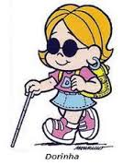
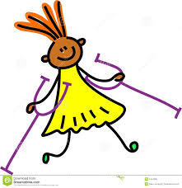

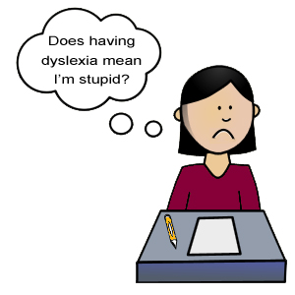
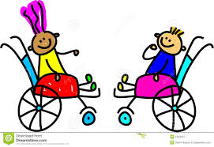

What do we know about children with disabilities at international level?
Not much, indeed, because…

Slide 3
… lack of data on children with disabilities…
The quality and quantity of data available on child disability varies enormously across the world due to:
  different priority given to children and to disability in the political agenda at national level
  different local resources available for data collection at national level
  cultural factors (such as differences in values and attitudes towards individuals with disabilities) influence reporting child disability in the surveys
  several aspects related to data collection (such as definition of disability, purpose of measurement, data collection method, different age-group bands….)
  No international comparability

Slide 4
Why do we need data on child disability?
Understand the situation of children with disabilities: prevalence, social circumstances and geographic location, unmet needs and the quality of the support they are receiving.
Assess the role of environmental factors (including societal attitudes and physical barriers) in the experience of disability.
Advocate for the rights of children with disabilities.
Prioritize interventions: inform policies and programs, facilitate the planning of services, and improve participation and quality of life of children with disabilities and their families.
Monitor progress on the UN Convention on the Rights of People with Disabilities (CRPD) and Convention on the Rights of the Child (CRC).

Slide 5
Specific measurement challenges for children
Disability in children is far more difficult to define than in adult:
children are in a constant developmental process that implies continuous changes in their ability to perform activities, especially in the early ages
milestones of development can be reached with variation among children
Type of disability in children is different from adult disability
Disability measurement often takes place through the filter of a parent or other adult: parental knowledge of norms and children performances as well as their expectations and variations by culture may affect the parental reporting
Questions used for adult are not always appropriate for children

Slide 6
Objectives
At the end of 2009 the WG created a working group, that UNICEF has joined in 2011, with the task to develop and test a survey module specially designed to capture child functioning and disability.
Purpose
  To identify the sub-population of children and youth (aged 2-17 years) who are “at greater risk” than the child of the same age of experiencing limited social participation due to functional limitations .
  Functional difficulties in basic actions are the focus of the measurement as these difficulties may place children at risk of experiencing limited participation in a non-accommodating environment.
Aim
  To provide cross-nationally comparable data
  To be used as part of national population surveys or in addition to specific surveys (e.g., health, education, etc.)

Slide 7
Main steps in developing the Child Module
Establish guiding principles
Select appropriate and feasible ICF domains
Draft and review the questionnaire
Validate the module and establish analytic properties of the module
Prepare a methodological manual

Slide 8
Principles for the development of the module
The working group, composed by representatives of NSO and other “experts”, took into account:
WG work in the development of the short and the extended set of questions
Studies already carried out on the development of child disability measures and national and international surveys
Suggestions of the attendees, from across the world and with different expertise, of the WG meetings (10th-14th)
Results from the experts consultation process (paediatricians, developmental psychologists, speech therapists etc.)- UNICEF meeting, June 2012
Results from the cognitive testing and field tests

Slide 9
General principles for drafting the questions
To use the ICF bio-psychosocial model
  To select basic actions and activities that can identify the main types of functional limitations in children
To use, with appropriate changes, questions already tested and adopted by the WG or in other tools
  To design the questions in a way that enables to identify children with a similar type and level of functional difficulties regardless of nationality or culture
  To use as respondents parents or primary caregivers
To standardize the expectations of the proxy-respondents, where appropriate, questions are prefaced with the clause “Compared with children of the same age…”.
To adopt response options that reflect the disability continuum: no difficulty, some difficulty, a lot of difficulty, cannot do at all

Slide 10
Three main challenges addressed
Identifying appropriate and feasible ICF domains
Selecting the age of the reference population
Reducing the age-group disaggregation

Slide 11
Identifying appropriate and feasible ICF domains
To accomplish this, questionnaires on children were collected and analyzed.
The questions used in population surveys to capture children with disabilities were mapped with the ICF-CY checklists specific to each age group.
This allowed a review of the domains already covered in at least one population survey and has provided, together with disability childhood literature review, the base for selecting a parsimonious set of ICF domains that reliably describes the most common types of disability in children.

Slide 12
Selected domains for the Module
The following domains are included in the survey disability measure for children and youth for international comparison:
Not all domains are covered in both age bands identified (children aged 2-4 and 5-17), taking into account accuracy/reliability of the data that could be collected due to the level of development in children and other cultural factors.
Seeing
Hearing
Walking
Communication
Learning
Playing
Relationships
Behavior
Attention
Self-care
Emotions
Coping with change
Dexterity

Slide 13
Selecting the age of the reference population
Early detection of disability in children and thus early intensive intervention can have a profound impact on the quality of life for children at risk and their families.
However, children are constantly developing and this complicate the task of assessing function, distinguishing significant limitations from variations in normal developmental process.
Furthermore, the development of infants and toddlers is very variable, subjective and culturally influenced and a developmental delay at this age is not necessarily a sign of functional limitation.
Despite the recognized importance of early detection of functional difficulties, it is extremely difficult to capture children disability among those less than 2 years of age through population surveys.
The population reference ages for the module is 2-17 years.

Slide 14
Selecting the age-group disaggregation
Considering the continuous changes of children in their ability to perform actions and activities, to obtain accurate information on their functional difficulties requires to include questions on specific activities that apply to very limited age ranges.
The first draft of questions based on this approach led to a questionnaire that proved to be very complicated to administer accurately, requiring numerous skip patterns.
To balance simplicity and accuracy of the measurement, questions appropriate for larger age ranges were designed.
The module is composited by two questionnaires:
one for children 2-4 aged
another for children/youth 5-17 aged

Slide 15
Domains and number of questions by age class
DOMAINS | AGE CLASS
 | 2-4 years | 5-17 years
Vision | 2 | 2
Hearing | 2 | 2
Walking | 2-3 | 2-7
Communication/Comprehension | 2 | 2
Learning | 1 | 1
Behaviour | 1 | 1
Playing | 1 | -
Dexterity/Fine motor | 1 | -
Remembering | - | 1
Attention | - | 1
Relationships | - | 1
Self-care | - | 1
Emotions | - | 2
Coping with change | - | 1

Slide 16
Question wording
The purpose of each question is to identify children who have difficulties that affect their ability to undertake age appropriate activities
PREAMBLE (interviewer read): The next questions ask about difficulties your child may have in doing certain activities…
Would you say… [Read response categories]
Response categories are:
1) No difficulty
2) Some difficulty
3) A lot of difficulty
4) Cannot do at all

Slide 17
Validation process
From September 2012 cognitive tests and fields test have been carried out.
Cognitive testing determines if respondents understand the question as intended:
    Do individual respondents understand the survey question differently?
    Does the question mean the same in all the languages, cultures and socio-economic groups that it is asked?
India, Belize, Oman, Montenegro and by several rounds in USA
Field testing provides evidence to better understand the extent to which patterns of interpretations exist in a population.
At different stage of the development of the Module:
  Independent field testing in Haiti, India, Cameroon, Italy, Samoa, Myanmar, El Salvador, Zambia, South Africa and Mexico

Slide 18
Cognitive testing
The results from cognitive test led to:
simplifying wordings
eliminate examples or specification in some questions
avoid using the preface “compared with children of the same age…”, when not necessary
select the best wording when alternative questions have been used
reduce the number of questions used for the same domain, when the same population was identified by more questions
add questions for the some domains when necessary.

Slide 19
Future steps
Final Field Test in Serbia by the end of this year
Finalization of module and release in Spring 2016
Finalization of a methodological manual user of Module in Spring 2016.

Slide 20
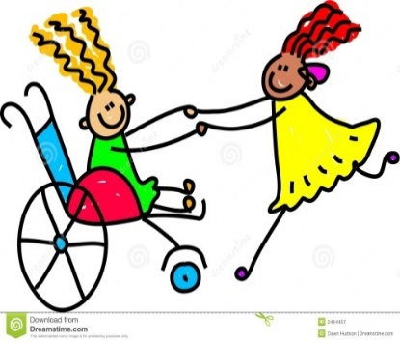
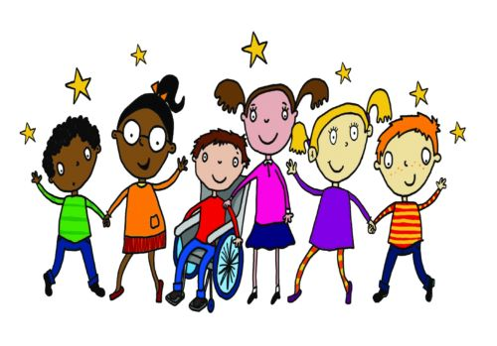
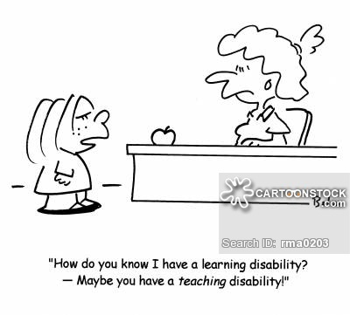
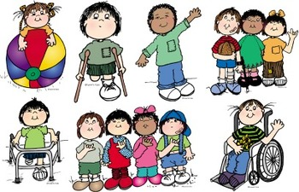
Thank you

Slide 21
Dexterity / Self-care
2-4 years | 5-17 years
Compared with children of the same age, does [name] have difficulty picking up small objects with his/her hand? Would you say… [Read response categories] | Does [name] have difficulty with self-care such as feeding or dressing [him/herself]? Would you say… [Read response categories]
  No difficulty
  Some difficulty
  A lot of difficulty
  Cannot do at all

Slide 22
Communication/Comprehension
2-4 years | 5-17 years
Does [name] have difficulty understanding you? Would you say… [Read response categories] When [name] speaks, does he/she have difficulty being understood by you? Would you say… [Read response categories] | When [name] speaks, does he/she have difficulty being understood by people inside of this household? Would you say… [Read response categories] When [name] speaks, does he/she have difficulty being understood by people outside of this household? Would you say… [Read response categories]
  No difficulty
  Some difficulty
  A lot of difficulty
  Cannot do at all

