Slide 1
Mental Health measures workgroup
Update
14th Washington Group meeting
Buenos Aires
8-10 October 2014

Slide 2
Overview
Discussion document – revised
Key considerations
Review of most commonly used instruments
Proposal for next steps

Slide 3
Revising the background document
Based on inputs from group members and a few mental health experts
Contextualises the importance of Mental health in public health and disability statistics
Raises important issues around current measures used
  Clinical rating scales used in surveys by lay interviewers
  Content of survey measures: Common mental disorders (CMD) and/or severe mental disorders (SMD)
  Uni- or multidimensional constructs
Provides some country examples (e.g. Latin American countries, Eurostat)

Slide 4
Main points from background document
MH measures are important
  Growing awareness of mental health problems
  Movement for Global Mental Health
  Inclusion the sustainable development goals (MH and poverty; unmet needs)
What to focus on:
  common mental disorders (Anxiety, depression and possibly PTSD)
  Severe mental illness – Different kinds of questions?
Do screening or diagnosis
Uni- or multi-dimensional
  E.g. Just depression or just anxiety or combination
Taking into account existing measures and how these are used

Slide 5
Uses of common scales:
  Clinical screening and/or diagnosis
  Research tool – identifying participants, monitoring change over time, categories of severity
  Surveys
Different scoring approaches:
  Algorithm for combining all questions into a summary score with cutoff points – Scales; composite score
  Individual question analysis – WG ES-F

Slide 6
Workplan set out in October 2013
Define the aim and the approach in measuring mental health (or mental disability?)
Review of all the work carried out in Europe and prepare additional research to determine the suitability of these for other regions of the world.
Review any work in other regions of the world.
Consideration of the relationship between mental health measures and measures of Quality of Life, Wellbeing and satisfaction.
Separating out measures of severe mental illness and CMDs and deciding whether to include both or only CMDs in a proposed module.

Slide 7
Common instruments for MH
Depression and anxiety measures
  Patient health questionnaire (PHQ2, PHQ8, PHQ9)
  Kessler scales (K6, K10)
  Centre for Epidemiological Studies Depression scale (CES-D)
  Generalised anxiety disorder (GAD2, GAD7)
  Modules from other scales – e.g. MH Inventory from SF36
PTSD
  Primary care PTSD screen (PC-PTSD)
Washington Group extended set questions:
  Anxiety
  Depression
  (Fatigue)
  (Pain)

Slide 8
Patient health questionnaire - PHQ
PHQ full version led to many variations
  PHQ2 – mild and moderate depression; screening; 0-6
  PHQ4 – mild and moderate depression and anxiety (PHQ2+GAD2)
  PHQ8 – mild and moderate depression (exclude suicidal thoughts)
  PHQ9 – mild and moderate depression; screening + severity; 0-27
  PHQ10 – mild and moderate depression and anxiety
  PHQ15 – physical symptoms + trouble sleeping and low energy
PHQ2 and 9 most used
Validated
Translated into a number of languages – High, Middle and Low income countries

Slide 9
PHQ9 (PHQ2 and PHQ8)
Over the last 2 weeks, how often have you been bothered by any of the following problems?
Little interest or pleasure in doing things................
Feeling down, depressed, or hopeless..................
Trouble falling or staying asleep, or sleeping too much..........
Feeling tired or having little energy................
Poor appetite or overeating..............
Feeling bad about yourself - or that you are a failure or have let yourself or your family down......
Trouble concentrating on things, such as reading the newspaper or watching television..................
Moving or speaking so slowly that other people could have noticed? Or the opposite - being so fidgety or restless that you have been moving around a lot more than usual.............
Thoughts that you would be better off dead or of hurting yourself in some way....................
Response options
0 = Not at all; 1 = Several days; 2 = More than half the days
  3 = Nearly every day

Slide 10
Kessler 10 (K6)
The following questions ask about how you have been feeling during the past 30 days. For each question, please circle the number that best describes how often you had this feeling.
Q1. During the past 30 days, about how often did you feel …
…tired out for no good reason ?
…nervous?
…so nervous that nothing could calm you down?
…hopeless?
…restless or fidgety?
…so restless that you could not sit still?
…depressed?
…so depressed that nothing could cheer you up?
…that everything was an effort?
…worthless?
1 = All of the time
2 = Most of the time
3 = Some of the time
4 = A little of the time
5 = None of the time

Slide 11
K10/6 continued
Q2. The last set of questions asked about feelings that might have occurred during the past 30 days. Taking them altogether, did these feelings occur more often in the past 30 days than is usual for you, about the same as usual, or less often than usual?
  Q2a. A lot less than usual, somewhat less, or only a little less than usual?
  Q2b. A lot more than usual, somewhat more, or only a little more than usual?
Q3. [Not counting (that day/those days)], how many days in the past 30 were you able to do only half or less of what you would normally have been able to do because of these feelings?
Q4. During the past 30 days, how many times did you see a doctor or other health professional about these feelings?
Q5. During the past 30 days, how often have physical health problems been the main cause of these feelings

Slide 12
Mental Health inventory (MHI) SF36
How much of the time in the previous 4 weeks:
Have you been very nervous?
Have you felt so down in the dumps nothing could cheer you up?
Have you felt calm and peaceful?
Have you felt downhearted and depressed?
Have you been happy?
The response categories:
All of the time
Most of the time
Some of the time
A little of the time
None of the time

Slide 13
CES-D
Response options:
Rarely or none of the time (less than 1 day)
Some or little of the time (1-2 days)
Occasionally or a moderate amount of time (3-4 days)
All of the time (5-7 days)
During the past week,
  I was bothered by things that usually don’t bother me
  I had trouble keeping my mind on what I was doing
  I felt depressed
  I felt that everything I did was an effort
  I felt hopeful about the future
  I felt fearful
  My sleep was restless
  I was happy
  I felt lonely
  I could not “get going”

Slide 14
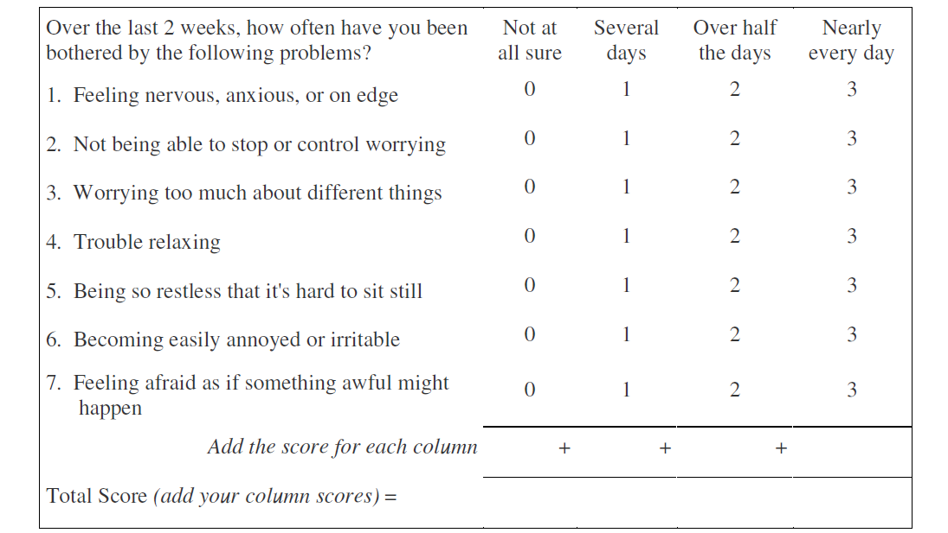
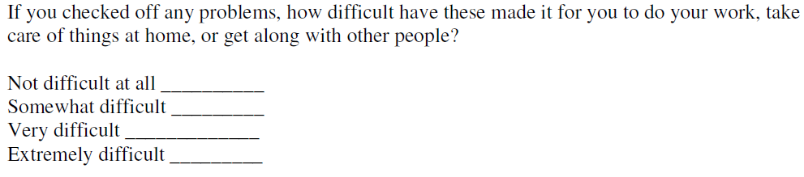
GAD7

Slide 15
Country efforts in collection MH data
World Mental health survey : ~2003; full battery of tests
EUROHIS project and MINDFUL project – indicator on Mental Health
Latin America
  Chile: second disability survey including 4 MH questions – intellectual , psychiatric, communication and drug/alcohol abuse problems
  Colombia: 2003 and 2013 – studies in MH
  Mexico: 2010 census – Q on ‘limitaci ó n mental’, ‘poner atención o aprender cosas sencillas’ , entonces, ¿no tiene dificultad fisica o mental’
  Peru: single MH questions as part of disability survey; Institute on Mental Health do research in this area
Use of registries in Denmark
Others?

Slide 16
Summary of features
Scales
CMD scales cover anxiety and depression
Screening
Common questions
Use of scaled response options
Generally short period of time (7 days – 30 days)
Composite scoring using set algorithms
WG ES-F – DEP and ANX
Scaled responses
Different type of analysis – separate domain analyses
Inclusion in an overall disability summary measure

Slide 17
Adding stats on MH to disability summary measures:
Increase estimates significantly
Problems of having a single summary measure covering a wide range of domains
? Dissemination and statistical literacy

Slide 18
Approach to MH measures work
Conceptual framework:
  ICF - mental functions, activity and participation
  Mental health – e.g. CMD and SMD; mental illness vs intellectual/cognitive disability
  To be developed further
Purpose of measurement:
  Describe population at risk (Screen for CMDs)
  Classify population to measure disparities
Approach to measurement
  Existing scales
  WG ES-F – ANX and DEP
  Further measures?
Population reference
  Adults
  Youth?
  Young children?

Slide 19
Some suggestions for way forward
Focus on CMDs – multidimensional (anxiety, depression, ?PTSD)
Focus on cognitive testing
Systematic review of use of MH scales in population surveys
Compare WG ES-F ANX and DEP questions and compare to use of scales
Symptom indicators, functioning and ADL/IADL functioning as consequence of CMD
Common functioning profiles:
  Cognitive/intellectual disability
  Severe mental illness
  Common mental disorders
Consultation process
  The ‘UNICEF’ equivalent for MH

