Slide 1
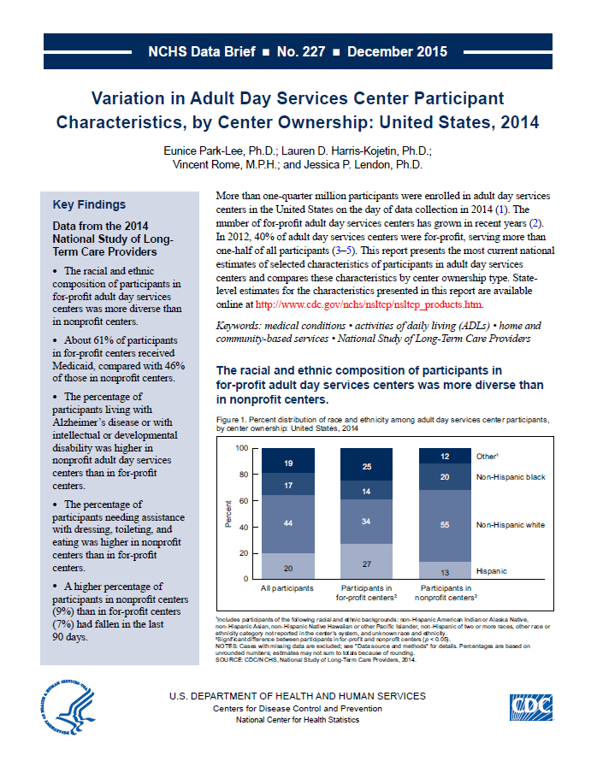
Health US 2014
This slide set contains figures from NCHS data brief No. 227: Variation in Adult Day Services Center Participant Characteristics, by Center Ownership: United States, 2014
This Data Brief is available at:
http://www.cdc.gov/nchs/data/databriefs/db227.htm

Slide 2
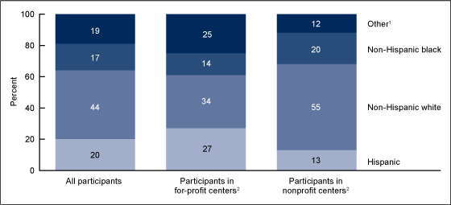
Percent distribution of race and ethnicity among adult day services center participants, by center ownership: United States, 2014
¹Includes participants of the following racial and ethnic backgrounds: non-Hispanic American Indian or Alaska Native, non-Hispanic Asian, non-Hispanic Native Hawaiian or other Pacific Islander, non-Hispanic of two or more races, other race or ethnicity category not reported in the center’s system, and unknown race and ethnicity. ²Significant difference between participants in for-profit and nonprofit centers (p < 0.05). NOTES: Cases with missing data are excluded; see "Data source and methods" for details. Percentages are based on unrounded numbers; estimates may not sum to totals because of rounding. SOURCE: CDC/NCHS, Variation in Adult Day Services Center Participant Characteristics, by Center Ownership: United States, 2014, NCHS Data Brief No. 227, Figure 1. Data from the National Study of Long-Term Care Providers (NSLTCP), 2014.

Slide 3
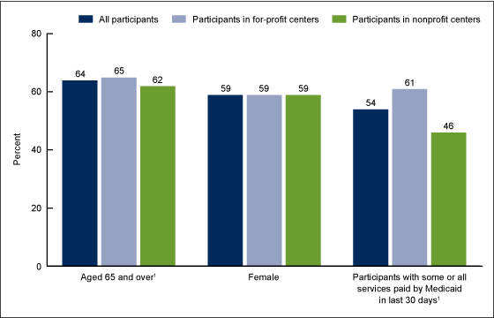
Selected sociodemographic characteristics of adult day services center participants, by center ownership: United States, 2014
¹Significant difference between participants in for-profit and nonprofit centers (p < 0.05). NOTE: Cases with missing data are excluded; see "Data source and methods" for details. SOURCE: CDC/NCHS, Variation in Adult Day Services Center Participant Characteristics, by Center Ownership: United States, 2014, NCHS Data Brief No. 227, Figure 2. Data from the National Study of Long-Term Care Providers (NSLTCP), 2014.

Slide 4
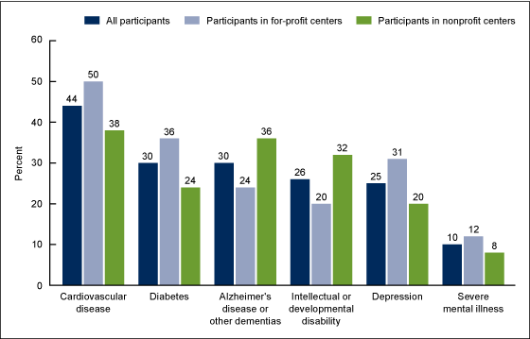
Selected diagnosed medical conditions among adult day services center participants, by center ownership: United States, 2014
NOTES: Significant differences between participants in for-profit and nonprofit centers for all conditions selected (p < 0.05). Cases with missing data are excluded; see "Data source and methods" for details. SOURCE: CDC/NCHS, Variation in Adult Day Services Center Participant Characteristics, by Center Ownership: United States, 2014, NCHS Data Brief No. 227, Figure 3. Data from the National Study of Long-Term Care Providers (NSLTCP), 2014.

Slide 5
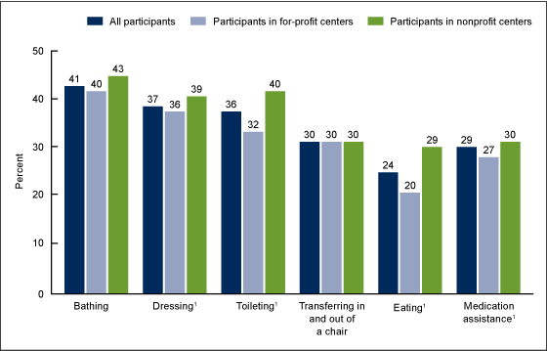
Need for assistance with selected activities of daily living and receipt of medication assistance among adult day services center participants, by center ownership: United States, 2014
¹Significant difference between participants in for-profit and nonprofit centers (p < 0.05). NOTE: Cases with missing data are excluded; see "Data source and methods" for details. SOURCE: CDC/NCHS, Variation in Adult Day Services Center Participant Characteristics, by Center Ownership: United States, 2014, NCHS Data Brief No. 227, Figure 4. Data from the National Study of Long-Term Care Providers (NSLTCP), 2014.

Slide 6
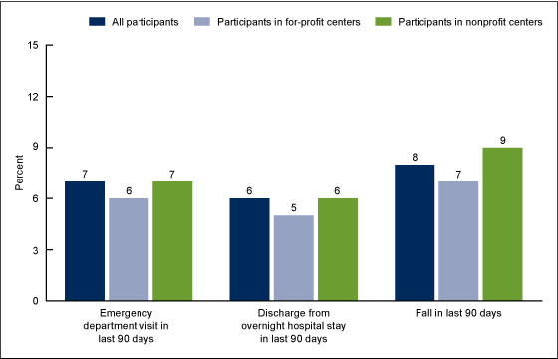
Emergency department visits, discharges from overnight hospital stays, and falls among adult day services center participants, by center ownership: United States, 2014
NOTES: Significant differences between participants in for-profit and nonprofit centers for all three characteristics (p < 0.05). Cases with missing data are excluded; see "Data source and methods" for details. SOURCE: CDC/NCHS, Variation in Adult Day Services Center Participant Characteristics, by Center Ownership: United States, 2014, NCHS Data Brief No. 227, Figure 5. Data from the National Study of Long-Term Care Providers (NSLTCP), 2014.

Slide 7

For questions about this Data Brief or NSLTCP, please contact the Long-Term Care Statistics Branch at NCHS.
Email: ltcsbfeedback@cdc.gov
Phone: 301-458-4747
Visit us on the web at: http://www.cdc.gov/nchs/nsltcp.htm

