Slide 1
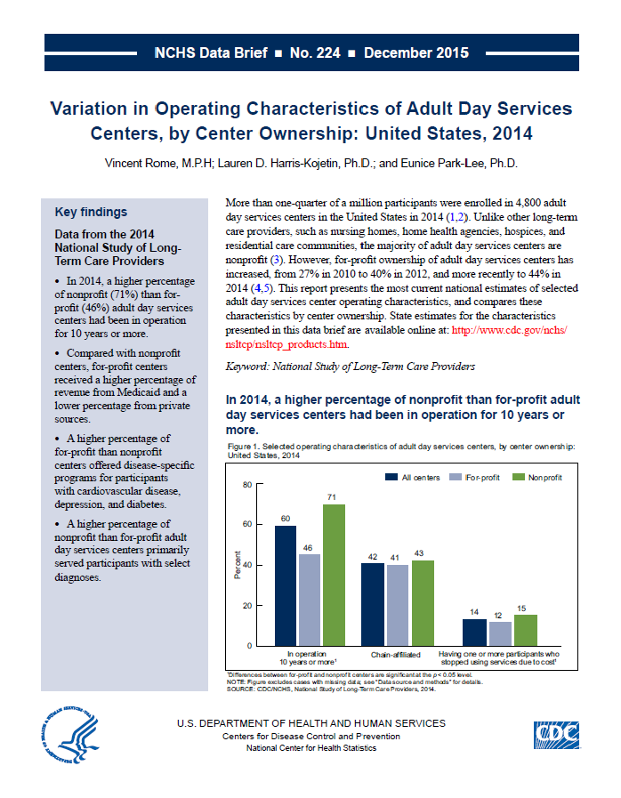
Health US 2014
This slide set contains figures from NCHS data brief No. 224: Variation in Operating Characteristics of Adult Day Services Centers, by Center Ownership: United States, 2014
This Data Brief is available at:
http://www.cdc.gov/nchs/data/databriefs/db224.htm

Slide 2
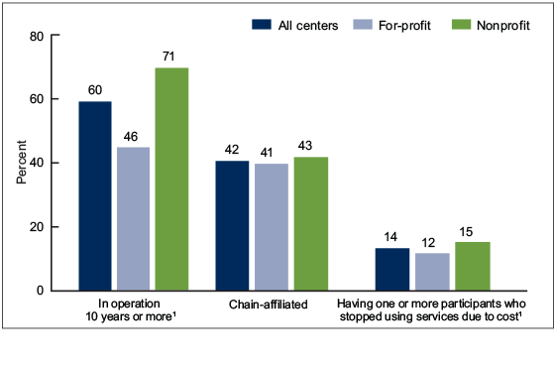
Selected operating characteristics of adult day services centers, by center ownership: United States, 2014
¹Differences between for-profit and nonprofit centers are significant at the p < 0.05 level. NOTE: Figure excludes cases with missing data; see “Data source and methods” for details. SOURCE: CDC/NCHS, Variation in Operating Characteristics of Adult Day Services Centers, by Center Ownership: United States, 2014, NCHS Data Brief No. 224, Figure 1. Data from the National Study of Long-Term Care Providers (NSLTCP), 2014.

Slide 3
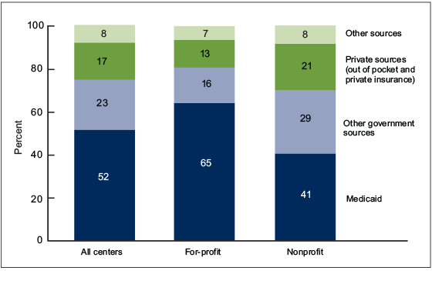
Revenue among adult day services centers, by source and center ownership: United States, 2014
NOTES: Imputed data were used for sources of revenue; all sources of revenue are from paid participant fees only. Differences between for-profit and nonprofit centers are significant at the p < 0.05 level for all sources of revenue. Percentages are based on unrounded numbers. Estimates may not add to totals because of rounding. SOURCE: CDC/NCHS, Variation in Operating Characteristics of Adult Day Services Centers, by Center Ownership: United States, 2014, NCHS Data Brief No. 224, Figure 2. Data from the National Study of Long-Term Care Providers (NSLTCP), 2014.

Slide 4
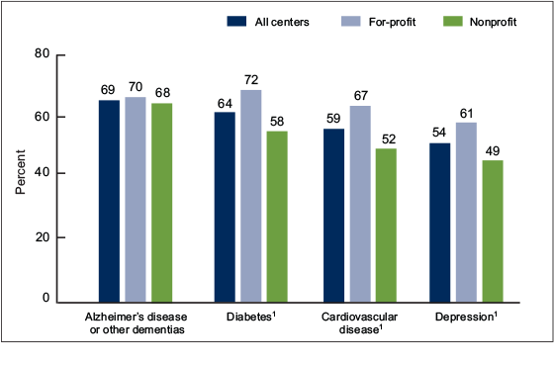
Disease-specific programs offered for selected conditions among adult day services centers, by center ownership: United States, 2014
¹Differences between for-profit and nonprofit centers are significant at the p < 0.05 level. NOTE: Figure excludes cases with missing data; see “Data source and methods” for details. SOURCE: CDC/NCHS, Variation in Operating Characteristics of Adult Day Services Centers, by Center Ownership: United States, 2014, NCHS Data Brief No. 224, Figure 3. Data from the National Study of Long-Term Care Providers (NSLTCP), 2014.

Slide 5
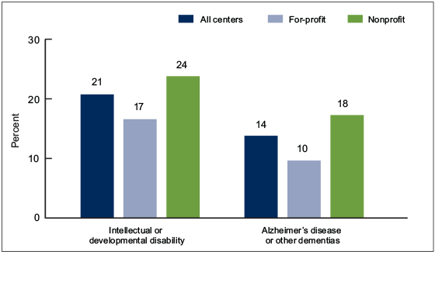
Adult day services centers that primarily serve participants with a specific diagnosis, by center ownership: United States, 2014
NOTES: Centers that primarily serve participants with a specific diagnosis are defined as those having 80% or more of currently enrolled participants with the specific diagnosis. Differences between for-profit and nonprofit centers are significant at the p < 0.05 level for all diagnoses. Figure excludes cases with missing data; see “Data source and methods” for details. SOURCE: CDC/NCHS, Variation in Operating Characteristics of Adult Day Services Centers, by Center Ownership: United States, 2014, NCHS Data Brief No. 224, Figure 4. Data from the National Study of Long-Term Care Providers (NSLTCP), 2014.

Slide 6

For questions about this Data Brief or NSLTCP, please contact the Long-Term Care Statistics Branch at NCHS.
Email: ltcsbfeedback@cdc.gov
Phone: 301-458-4747
Visit us on the web at: http://www.cdc.gov/nchs/nsltcp.htm

