Slide 1
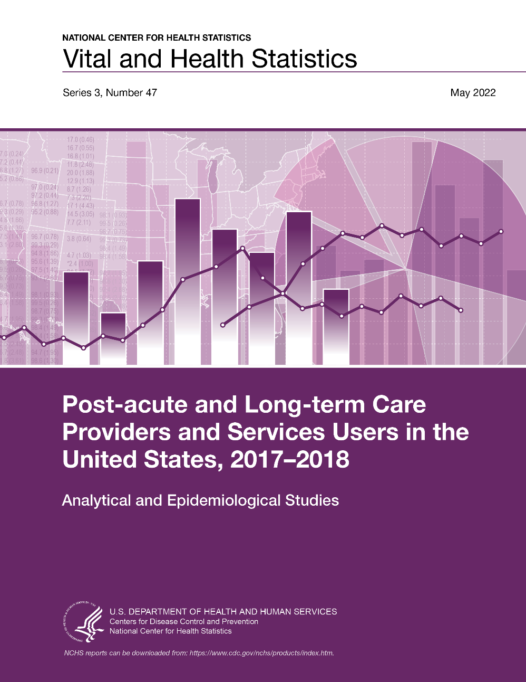
Figures from
Post-acute and Long-term Care Providers and Services Users in the United States, 2017–2018
Series 3, Number 47 is available from: https://www.cdc.gov/nchs/data/series/sr_03/sr03-047.pdf

Slide 2
.
All material appearing in this product is in the public domain and may be reproduced or copied without permission; citation as to source, however, is appreciated. DOI: https://dx.doi.org/10.15620/cdc:115346.
For questions about the report, figure slides, or survey, please contact the Long-Term Care Statistics Branch at NCHS.
  Email: ltcsbfeedback@cdc.gov
  Phone: 301–458–4747
  Visit us on the web at: https://www.cdc.gov/nchs/nsltcp.htm

Slide 3
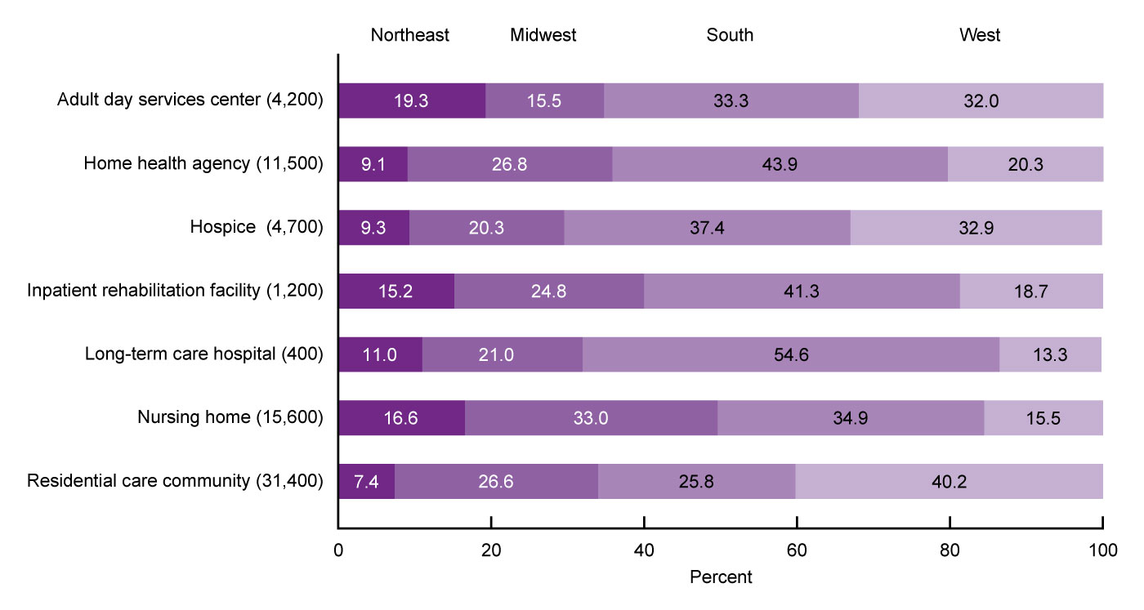
Percent distribution of post-acute and long-term care services providers, by sector and region: United States, 2018
NOTES: Percentages are based on unrounded estimates. Percent distributions may not add to 100 because of rounding. Access data for this figure in Table IX of Appendix III in Series 3, Number 47.
SOURCES: National Center for Health Statistics, National Study of Long-Term Care Providers, 2018, and Centers for Medicare and Medicaid Services data files, 2018.
Notes:
The supply of providers in the seven post-acute and long-term care services sectors varied in their geographic distribution.
The largest shares of adult day services centers (33.3%), home health agencies (43.9%), hospices (37.4%), nursing homes (34.9%), inpatient rehabilitation facilities (41.3%), and long-term care hospitals (54.6%) were in the South, while the largest share of residential care communities (40.2%) was in the West.

Slide 4
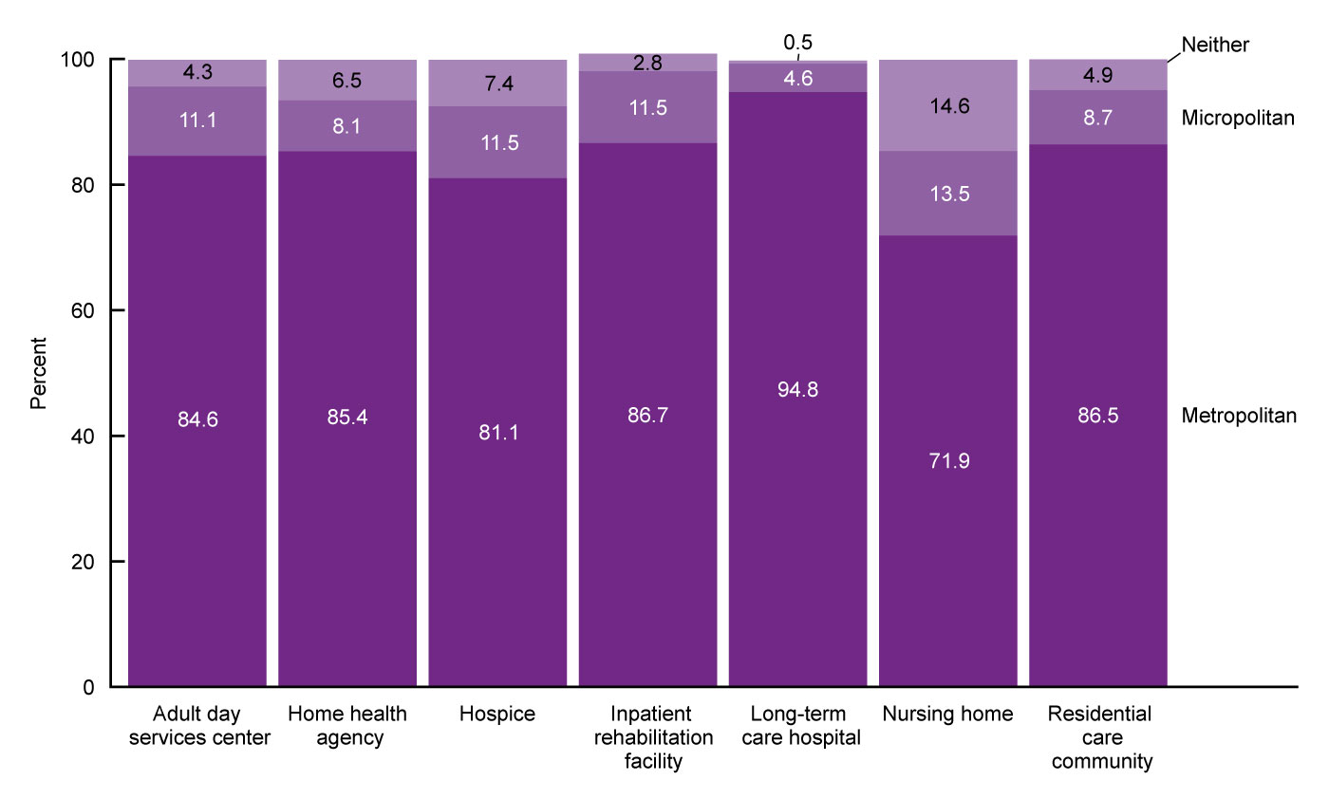
Percent distribution of post-acute and long-term care services providers, by sector and metropolitan statistical area status: United States, 2018
NOTES: Metropolitan statistical areas and micropolitan statistical areas are geographic areas defined by the Office of Management and Budget for use by federal statistical agencies in collecting, tabulating, and publishing federal statistics. A metropolitan statistical area contains a core urban area of 50,000 or more population, and a micropolitan statistical area contains an urban core of at least 10,000 but less than 50,000 population. Each metropolitan or micropolitan statistical area consists of one or more counties and includes the counties containing the core urban area as well as any adjacent counties that have a high degree of social and economic integration (as measured by commuting to work) with the urban core. Percentages are based on unrounded estimates. Percentages may not add to 100 because of rounding. Access data for this figure in Table IX of Appendix III of Series 3, Number 47.
SOURCES: National Center for Health Statistics, National Study of Long-Term Care Providers, 2018, and Centers for Medicare and Medicaid Services data files, 2018.
Notes:
Most providers in all seven sectors were in metropolitan statistical areas or MSAs. This distribution reflects the higher population density in these areas.
Compared with hospices (81.1%) and nursing homes (71.9%), a greater percentage of long-term care hospitals (94.8%), inpatient rehabilitation facilities (86.7%), residential care communities (86.5%), home health agencies (85.4%), and adult day services centers (84.6%) were in MSAs.

Slide 5
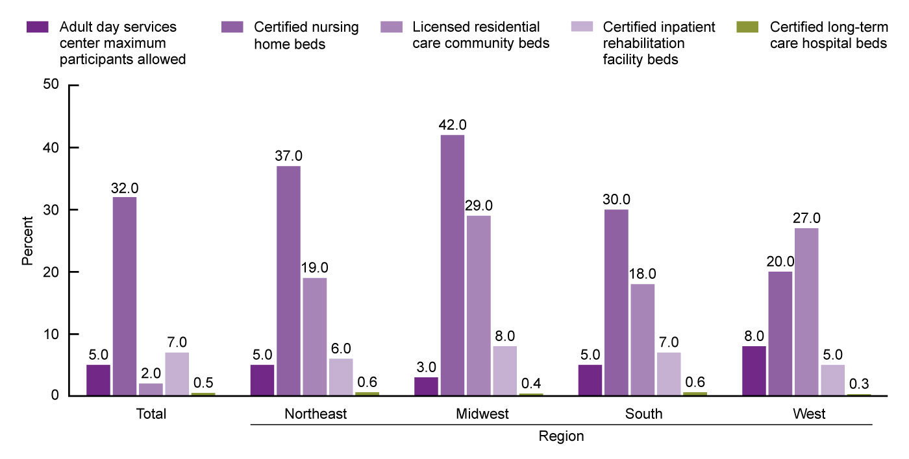
Post-acute and long-term care services provider capacity per 1,000 people aged 65 and over, by sector and region:
United States, 2018
NOTES: Capacity refers to number of certified nursing home, inpatient rehabilitation facility, and long-term care hospital beds; number of licensed residential care community beds; and maximum number of adult day services center participants allowed. See Appendix II in Series 3, Number 47 for definitions of capacity used for each sector. Capacity for home health agencies and hospices was not examined because licensed maximum capacity or a similar metric was not available. Rates are based on unrounded estimates.
SOURCES: National Center for Health Statistics, National Study of Long-Term Care Providers, 2018; Centers for Medicare and Medicaid Services data files, 2017–2018; and U.S. Census Bureau, Population Division, Population Estimates, July 1, 2018.
Notes:
Adult day services center capacity and nursing home, residential care, inpatient rehabilitation facility, and long-term care hospital beds varied by region.
Compared with other regions, the Midwest had the largest supply of nursing home beds (42) and the smallest adult day services center capacity (3) per 1,000 people aged 65 and over.
The Midwest (29) and West (27) had a larger supply of residential care beds per 1,000 people aged 65 and over compared with the Northeast (19) and the South (18).
In the West, the supply of residential care beds (27) was greater than the supply of nursing home beds (20) per 1,000 people aged 65 and over, while nursing home beds outnumbered residential care beds in all other regions.
The West had the smallest number of inpatient rehabilitation (5) and long-term care hospital (0.3) beds per 1,000 people aged 65 and over compared with other regions.

Slide 6
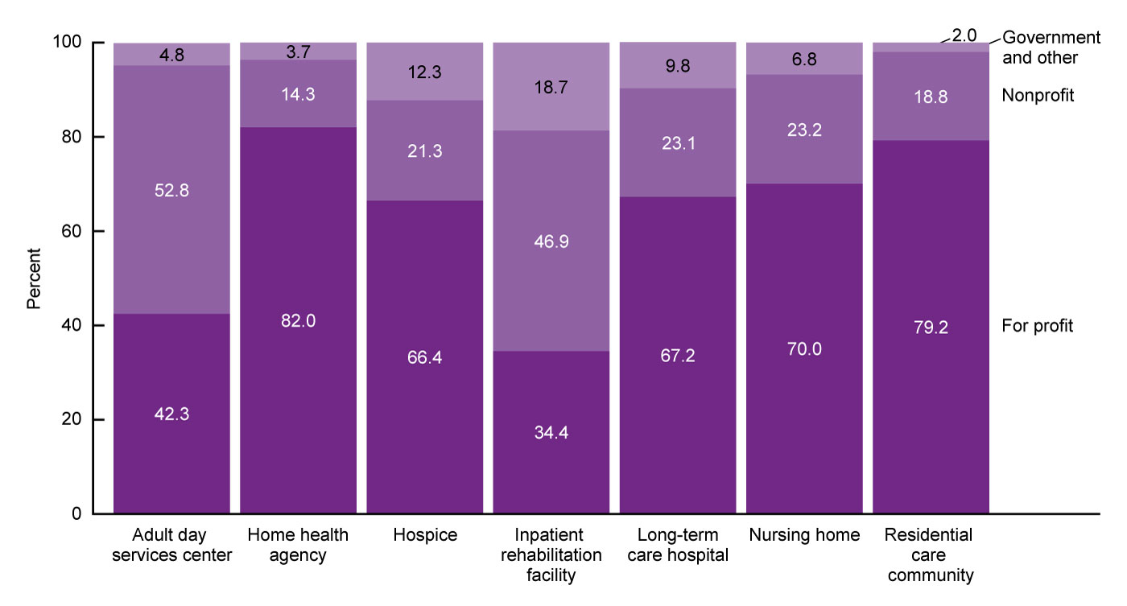
Percent distribution of post-acute and long-term care services providers, by sector and ownership: United States, 2018
NOTES: See Appendix II in Series 3, Number 47 for definitions of ownership used for each sector. Percentages are based on unrounded estimates. Percentages may not add to 100 because of rounding. Access data for this figure in Table IX of Appendix III.
SOURCES: National Center for Health Statistics, National Study of Long-Term Care Providers, 2018, and Centers for Medicare and Medicaid Services data files, 2018.
Notes:
In all sectors except adult day services centers and inpatient rehabilitation facilities, most post-acute and long-term care services providers were for profit.
Home health agencies (82.0%) and residential care communities (79.2%) had the highest percentages of for-profit ownership, while inpatient rehabilitation facilities (34.4%) and adult day services centers (42.3%) had the lowest percentages.
About one-half of adult day services centers (52.8%) and 46.9% of inpatient rehabilitation facilities were nonprofit.

Slide 7
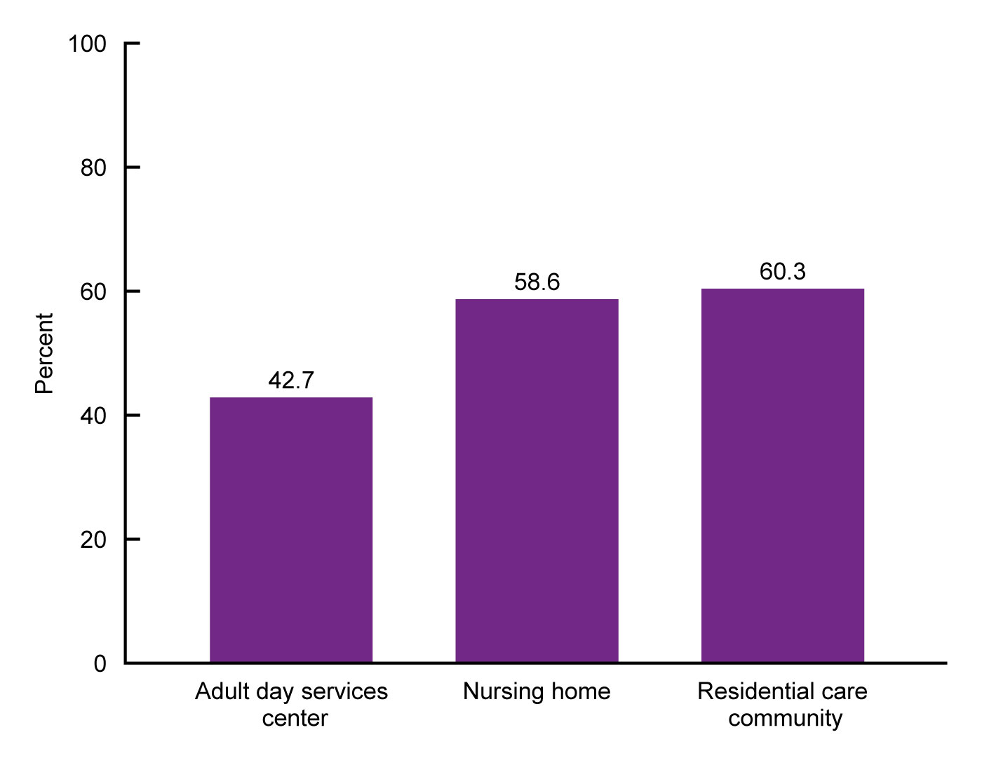
Percentage of post-acute and long-term care services providers that are chain-affiliated, by sector:
United States, 2018
NOTES: See Appendix II in Series 3, Number 47 for definitions of chain affiliation used for each sector. Chain affiliation information for home health agencies, hospices, inpatient rehabilitation facilities, and long-term care hospitals was not available. Percentages are based on unrounded estimates. Access data for this figure in Table IX of Appendix III.
SOURCES: National Center for Health Statistics, National Study of Long-Term Care Providers, 2018, and Centers for Medicare and Medicaid Services data files, 2018.
Notes:
The majority of residential care communities (60.3%) and nursing homes (58.6%) were chain-affiliated, while fewer adult day services centers (42.7%) were part of a chain.
Chain affiliation for home health agencies, hospices, inpatient rehabilitation facilities, and long-term care hospitals was not examined because this information was not available.

Slide 8
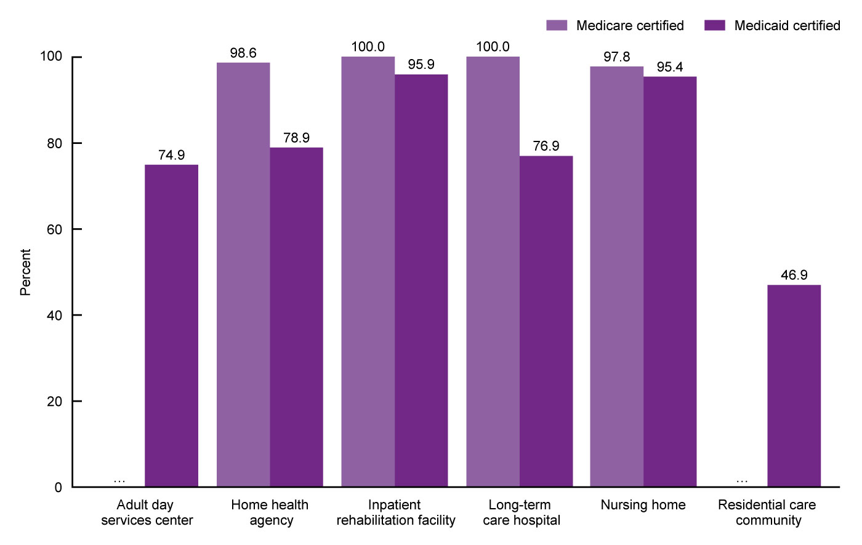
Percentage of post-acute and long-term care services providers that are Medicare- and Medicaid-certified, by sector: United States, 2018
… Category not applicable.
NOTES: See Appendix II in Series 3, Number 47 for definitions of Medicare and Medicaid certifications used for each sector. All hospices were Medicare-certified and are not shown. Percentages are based on unrounded estimates. Access data for this figure in Table IX of Appendix III.
SOURCES: National Center for Health Statistics, National Study of Long-Term Care Providers, 2018, and Centers for Medicare and Medicaid Services data files, 2018.
Notes:
All data on home health agencies, nursing homes, inpatient rehabilitation facilities, and long-term care hospitals used in Series 3, Number 47 are only for Medicare- or Medicaid-certified providers, and all data on hospices are only for Medicare-certified hospices.
Virtually all inpatient rehabilitation facilities (100%), long-term care hospitals (100%), home health agencies (98.6%), and nursing homes (97.8%) were Medicare-certified.
Medicare does not pay for adult day care services or for the cost of residency and care in residential care communities, so they were not asked about Medicare certification.
Almost all inpatient rehabilitation facilities (95.9%) and nursing homes (95.4%); about three-quarters of adult day services centers (74.9%), home health agencies (78.9%), and long-term care hospitals (76.9%); and almost one-half of residential care communities (46.9%) were authorized or certified to participate in Medicaid. Information was not available on whether any Medicare-certified hospices were also certified by Medicaid.

Slide 9
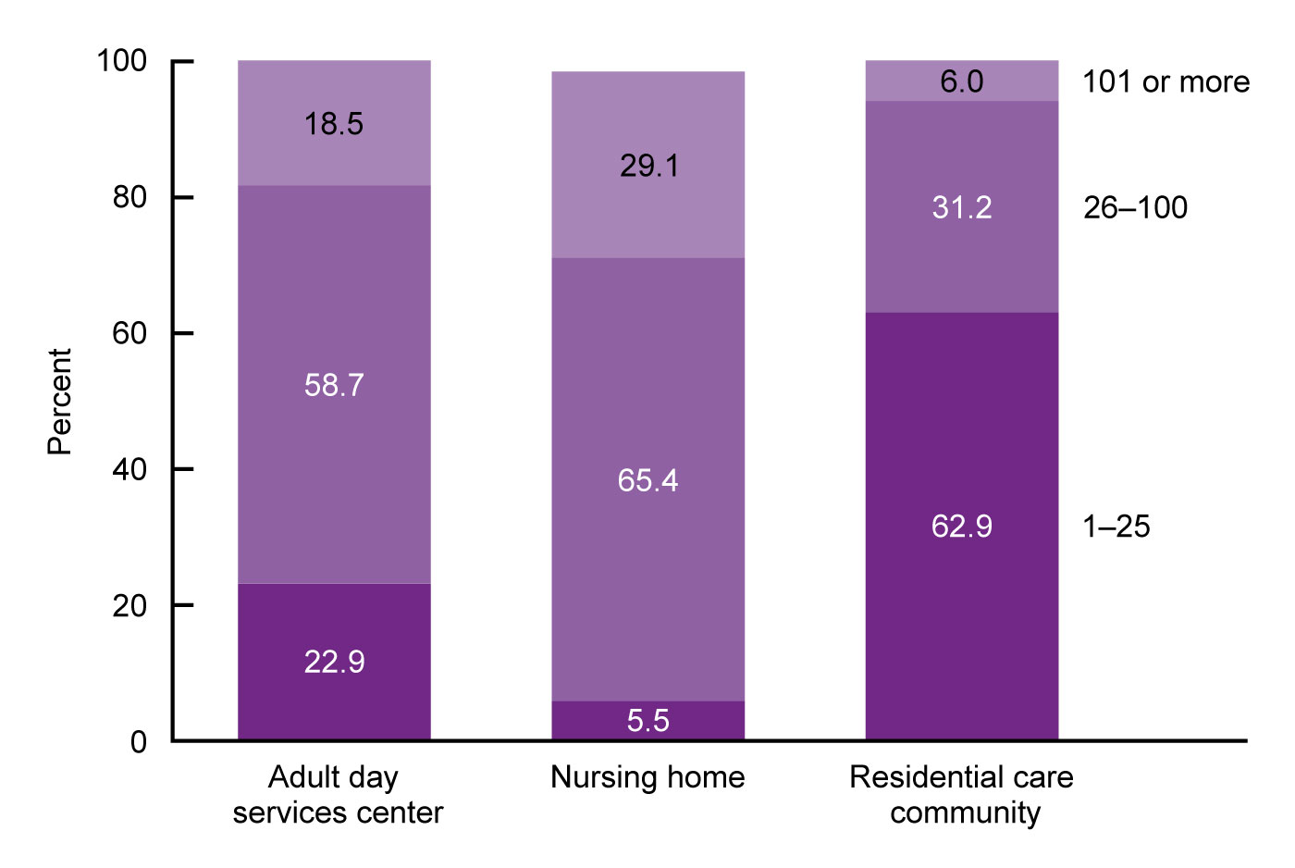
Percent distribution of post-acute and long-term care services providers, by sector and number of people served daily:
United States, 2018
NOTES: Number of people served categorizes the number of current residents (nursing homes and residential care communities) or the total number of participants enrolled (adult day services centers) into three categories: 1–25, 26–100, and 101 or more. See Appendix II in Series 3, Number 47 for definitions of number of people served for each sector. Figure does not include home health agencies, hospices, inpatient rehabilitation facilities, or long-term care hospitals because the data on services users in these sectors used in this report are about users served annually, not daily. Percentages are based on unrounded estimates. Percent distributions may not add to 100 because of rounding. Access data for this figure in Table IX of Appendix III.
SOURCES: National Center for Health Statistics, National Study of Long-Term Care Providers, 2018, and Centers for Medicare and Medicaid Services data files, 2018.
Notes:
The majority of adult day services centers (58.7%) and nursing homes (65.4%) served between 26 and 100 residents daily, while the majority of residential care communities (62.9%) served 25 residents or fewer daily.
The percentage of nursing homes serving more than 100 people daily (29.1%) was almost five times higher than the percentage of residential care communities (6.0%) doing so, and about 1.5 times higher than the percentage of adult day services centers (18.5%) doing so.

Slide 10
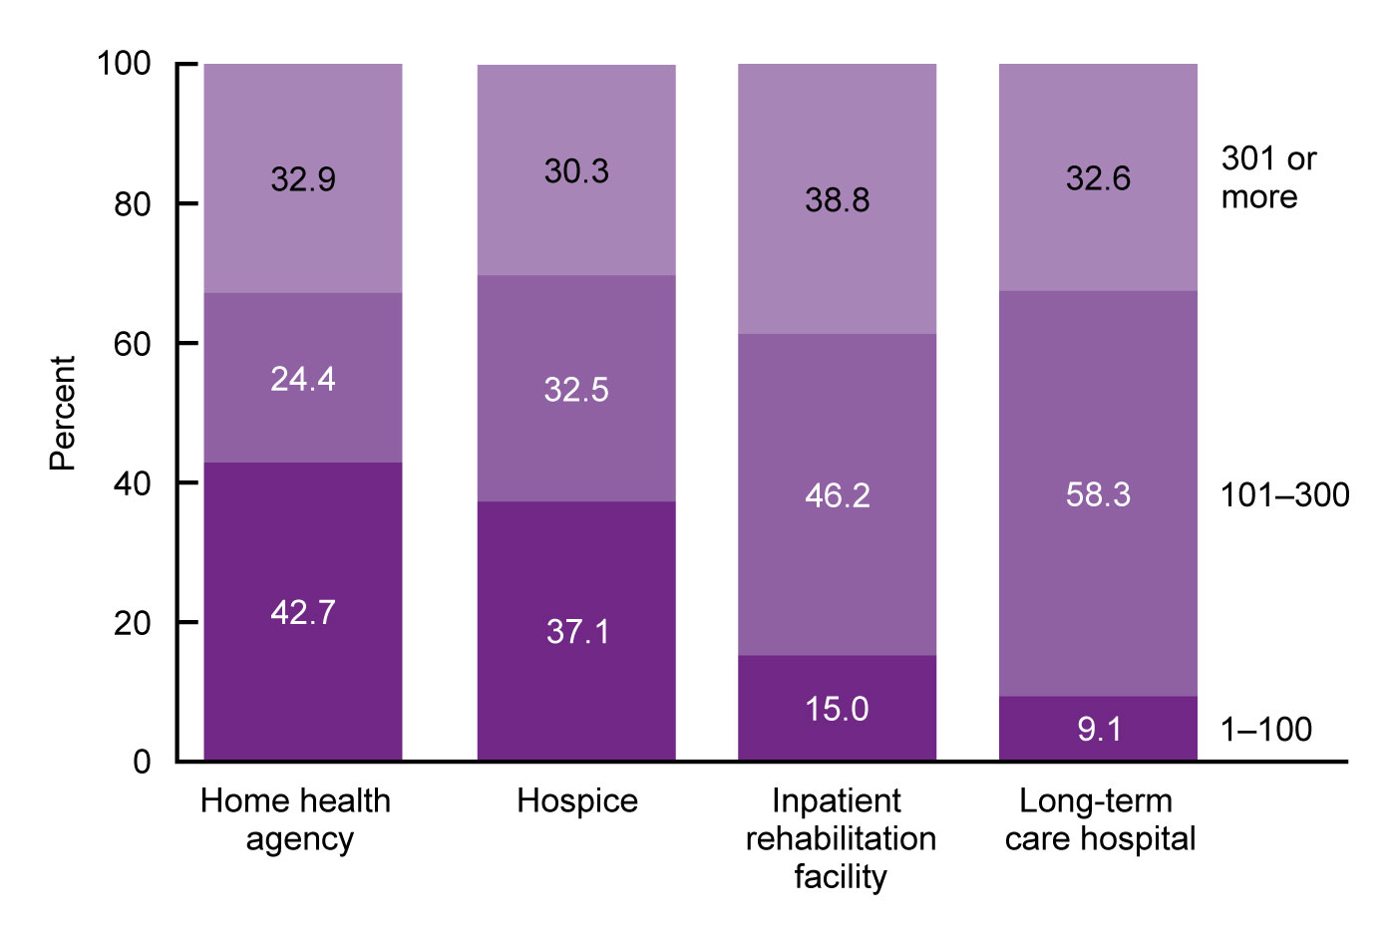
Percent distribution of post-acute and long-term care services providers, by sector and number of people served annually: United States, 2017
NOTES: Number of people served is derived from the number of home health patients whose episode of care ended at any time in 2017 and the number of hospice, inpatient rehabilitation facility, and long-term care hospital patients receiving care at any time in 2017, respectively, and has three categories: 1–100, 101–300, and 301 or more. See Appendix II in Series 3, Number 47 for definitions of number of people served for each sector. Figure does not include adult day services centers, nursing homes, or residential care communities because data on services users in these sectors used for this report are about services users daily, not annually. Percentages are based on unrounded estimates. Percent distributions may not add to 100 because of rounding. Access data for this figure in Table IX of Appendix III.
SOURCE: Centers for Medicare and Medicaid Services data files, 2017.
Notes:
In terms of people served annually, in 2017, home health agencies served an average of 458 patients (who were then discharged from the agency in 2017), hospices served an average of 356 patients, inpatient rehabilitation facilities served an average of 348 patients, and long-term care hospitals served an average of 293 patients (Appendix III, Table IX).
About 42.7% of home health agencies discharged 100 patients or fewer annually, while 24.4% discharged 101–300 patients, and 32.9% discharged 301 or more patients.
The number of patients served annually per hospice agency was about evenly distributed, with about one-third of agencies each serving 1–100 patients (37.1%), 101–300 patients (32.5%), and 301 or more patients (30.3%).
For inpatient rehabilitation facilities, 15.0% served 100 or fewer patients, 46.2% served 101–300 patients, and 38.8% served more than 300 patients. More than one-half of long-term care hospitals served 101–300 patients (58.3%), about one-third (32.6%) served more than 300 patients, and 9.1% served 1–100 patients.

Slide 11
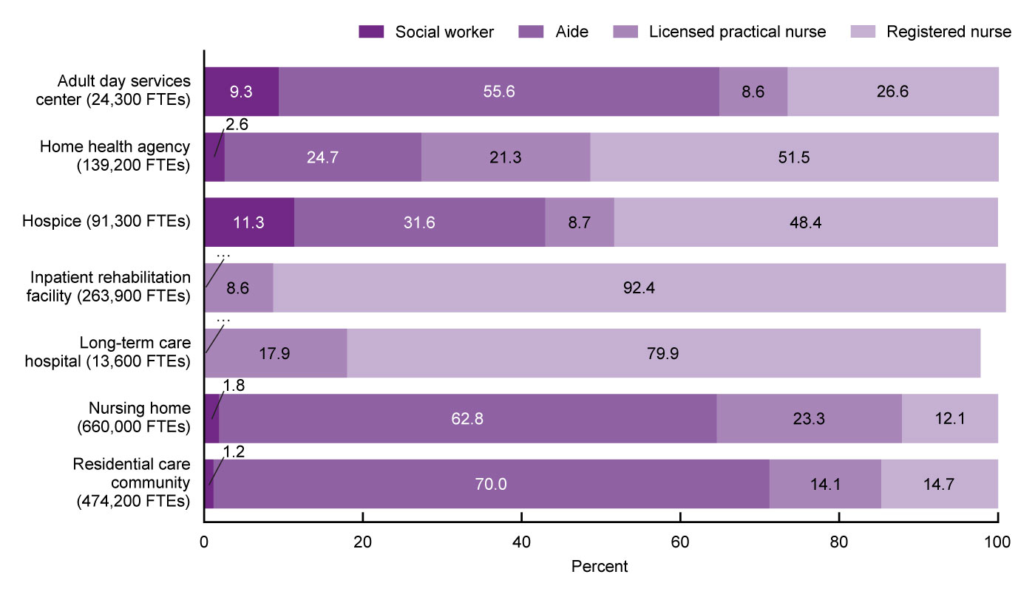
Total number and percent distribution of nursing and social work full-time equivalent employees, by sector and staff type: United States, 2018
... Category not applicable.
NOTES: FTE is full-time equivalent. Only employees are included for all staff types; contract staff are not included. For adult day services centers and residential care communities, aide refers to certified nursing assistants, home health aides, home care aides, personal care aides, personal care assistants, and medication technicians or medication aides. For home health agencies and hospices, aide refers to home health aides. For nursing homes, aide refers to certified nurse aides, medication aides, and medication technicians. Social workers include licensed social workers or persons with a bachelor's or master's degree in social work in adult day services centers and residential care communities; medical social workers in home health agencies and hospices; and qualified social workers in nursing homes. See Appendix I in Series 3, Number 47 for information on how outliers were identified and coded. Percentages are based on unrounded estimates. Percent distributions may not add to 100 because of rounding. Access data for this figure in Table X of Appendix III.
SOURCES: National Center for Health Statistics, National Study of Long-Term Care Providers, 2018, and Centers for Medicare and Medicaid Services data files, 2018.
Notes:
In 2018, about 1,632,700 nursing employee full-time equivalents or FTEs worked in the seven sectors, and about 33,700 social work employee FTEs worked in the five sectors that employed social workers (data not shown).
Of these nursing and social work employees, 39.6% (660,000 FTEs) were nursing home employees, 28.5% (474,200 FTEs) were residential care community employees, 15.8% (263,900 FTEs) were inpatient rehabilitation facility employees, 8.4% (139,200 FTEs) were employed by home health agencies, 5.5% (91,300 FTEs) were employed by hospices, 1.5% (24,300 FTEs) were adult day services center employees, and 0.8% (13,600 FTEs) were employed by long-term care hospitals (Appendix III, Table X).
The relative distribution of social work and nursing employee FTEs varied across sectors.
The majority of employee FTEs in adult day centers (55.6%), nursing homes (62.8%), and residential care communities (70.0%) were aides.
However, in inpatient rehabilitation facilities (92.4%), long-term care hospitals (79.9%), home health agencies (51.5%), and hospices (48.4%), registered nurses or RNs were the most common employee FTEs.
Social work FTE employees were most common in hospices (11.3%), followed by adult day services centers (9.3%), home health agencies (2.6%), nursing homes (1.8%), and residential care communities (1.2%).
The administrative data used in Series 3, Number 47 for the home health, hospice, and nursing home sectors used less-inclusive wording to capture aides than was used in the questionnaire data for adult day services centers and residential care communities.
Consequently, estimates using the administrative data may undercount the number of aides employed by providers in those sectors. See Appendix II for how aide was defined for each sector.

Slide 12
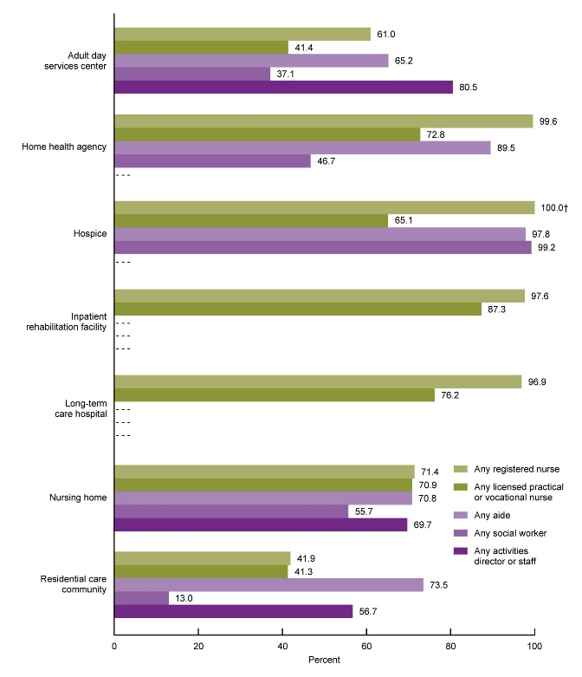
Percentage of post-acute and long-term care services providers with any full-time equivalent employees, by sector and staff type: United States, 2018
† Percentage is 90% or higher but estimate is not displayed as it may pose a disclosure risk.
- - - Data not available.
NOTES: Only employees are included for all staff types; contract staff are not included. For adult day services centers and residential care communities, aide refers to certified nursing assistants, home health aides, home care aides, personal care aides, personal care assistants, and medication technicians or medication aides. For home health agencies and hospices, aide refers to home health aides. For nursing homes, aide refers to certified nurse aides, medication aides, and medication technicians. Social worker includes licensed social workers or persons with a bachelor’s or master’s degree in social work in adult day services centers and residential care communities; medical social workers in home health agencies and hospices; and qualified social workers in nursing homes. See Appendix I in Series 3, Number 47 for information on how outliers were identified and coded. Percentages are based on unrounded estimates. Access data for this figure in Table X of Appendix III.
SOURCES: National Center for Health Statistics, National Study of Long-Term Care Providers, 2018, and Centers for Medicare and Medicaid Services data files, 2018.
Notes:
Among the four staff types (registered nurses or RNs, licensed practical or vocational nurses or LPNs or LVNs, aides, and social workers) examined across the five sectors where they were employed, most providers employed aides: hospices (97.8%) were most likely and adult day services centers (65.2%) were least likely to have any aides on staff.
Use of aide staff was not examined for inpatient rehabilitation centers or long-term care hospitals because this information was not available.
All sectors employed licensed nursing staff (RNs and LPNs or LVNs).
In contrast, 71.4% of nursing homes, 61.0% of adult day services centers, and 41.9% of residential care communities directly employed at least one RN.
Most inpatient rehabilitation facilities (87.3%), long-term care hospitals (76.2%), home health agencies (72.8%), nursing homes (70.9%), and hospices (65.1%) employed at least one LPN or LVN, while a minority of adult day services centers (41.4%) and residential care communities (41.3%) directly employed at least one LPN or LVN.
Employing any social workers showed the most variation across the five sectors where they were employed. Virtually all hospices employed social workers (99.2%), as did most nursing homes (55.7%).
About 46.7% of home health agencies and 37.1% of adult day services centers employed social workers, but only 13.0% of residential care communities directly employed social workers. Use of social worker staff was not examined for inpatient rehabilitation facilities or long-term care hospitals because this information was not available.

Slide 13
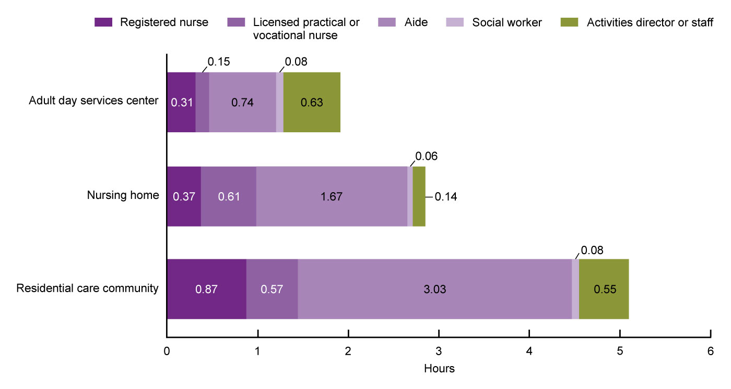
Average staff hours per resident or participant per day, by sector and staff type: United States, 2018
NOTES: Only employees are included for all staff types; contract staff are not included. For adult day services centers and residential care communities, aide refers to certified nursing assistants, home health aides, home care aides, personal care aides, personal care assistants, and medication technicians or medication aides. For nursing homes, aide refers to certified nurse aides, medication aides, and medication technicians. Social worker includes licensed social workers or persons with a bachelor’s or master’s degree in social work in adult day services centers and residential care communities; medical social workers in home health agencies and hospices; and qualified social workers in nursing homes. For adult day services centers, average hours per participant per day was computed by multiplying the number of full-time equivalent (FTE) employees for the staff type by 35 hours, then dividing by total number of participants and by 5 days. For nursing homes and residential care communities, the average hours per resident per day was computed by multiplying the number of FTE employees for the staff type by 35 hours, then dividing by the number of current residents and by 7 days. See Appendix I in Series 3, Number 47 for information on how outliers were identified and coded. Hours per patient per day could not be provided for home health agencies, hospices, inpatient rehabilitation facilities, and long-term care hospitals because the administrative data available provided total number of all patients served in a year, not the number served on a given day. Rates are based on unrounded estimates. Access data for this figure in Table X of Appendix III. SOURCES: National Center for Health Statistics, National Study of Long-Term Care Providers, 2018, and Centers for Medicare and Medicaid Services data files, 2018.
Notes:
For both licensed nursing staff types examined (RN and LPN or LVN), the average staff hours per resident or participant per day was higher in residential care communities than in nursing homes and adult day services centers.
The average total nursing hours (combining RNs, LPNs or LVNs, and aides) per resident or participant per day was 4.47 (4 hours and 28 minutes) for residential care community residents, 2.65 (2 hours and 39 minutes) for nursing home residents, and 1.20 (1 hour and 12 minutes) for adult day participants. The average total nursing hours per resident per day in adult day services centers was less than one-half the size of the ratio for nursing homes and less than one-third for residential care communities.
The average total licensed nursing hours (combining RNs with LPNs or LVNs) per resident or participant per day was 1.44 (1 hour and 26 minutes) for residential care community residents, 0.98 (59 minutes) for nursing home residents, and 0.46 (28 minutes) for adult day participants. The average total licensed nursing hours per resident or participant per day in residential care communities was about three times the size of the corresponding ratio for adult day services centers.
The average social work staff hours per resident or participant per day was higher in residential care communities (0.08 hours, or 48 minutes) than in adult day services centers (0.08 hours, or 5 minutes) and nursing homes (0.06 hours, or 4 minutes). The average activities staff hours per resident or participant per day in adult day services centers (0.63 hours, or 38 minutes) was more than residential care communities (0.55 hours, or 33 minutes) or nursing homes (0.14 hours, or 8 minutes).

Slide 14
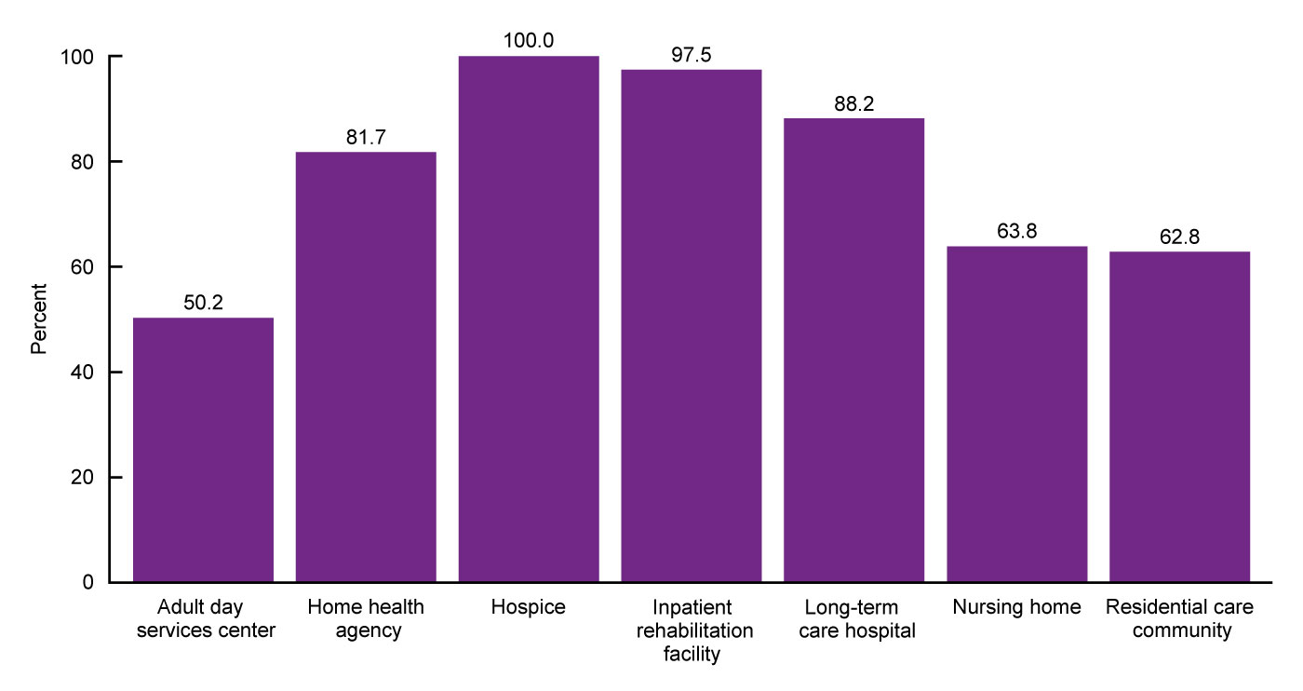
Percentage of post-acute and long-term care services providers that provide social work services, by sector:
United States, 2018
NOTES: Social work services refer to services provided by licensed social workers or persons with a bachelor’s or master’s degree in social work, and include an array of services such as psychosocial assessment, individual or group counseling, and referral services. See Appendix II in Series 3, Number 47 for definitions of the provision of social work services for each sector. See Appendix I for an explanation of differences in how services were measured in the 2012, 2014, and 2016 versions of this report. Percentages are based on unrounded estimates. Access data for this figure in Table XI of Appendix III.
SOURCES: National Center for Health Statistics, National Study of Long-Term Care Providers, 2018, and Centers for Medicare and Medicaid Services data files, 2018.
Notes:
Most providers in all sectors offered social work services.
All hospices provided social work services (100.0%), as did most inpatient rehabilitation facilities (97.5%), long-term care hospitals (88.2%), home health agencies (81.7%), and nursing homes (63.8%), likely because providing these services is required for Medicare certification.
A majority of residential care communities (62.8%) provided social work services, but fewer adult day services centers (50.2%) did so.

Slide 15
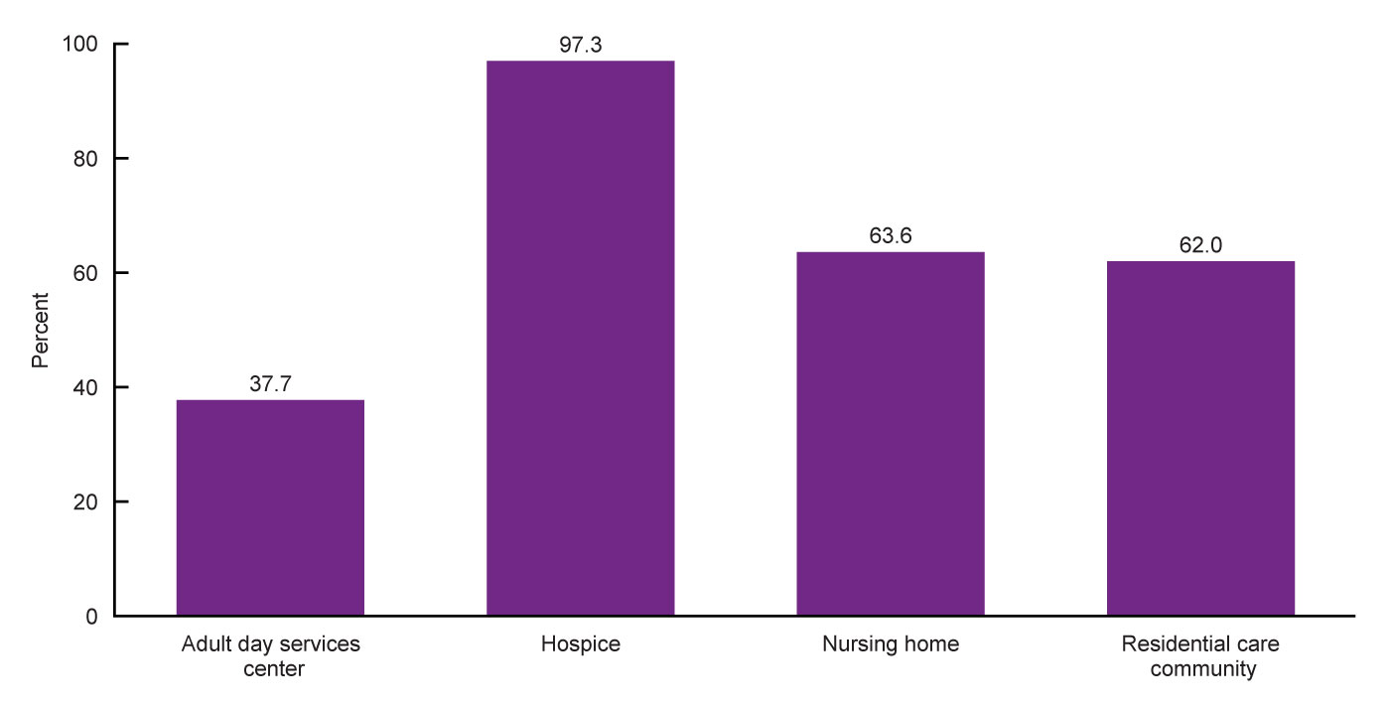
Percentage of post-acute and long-term care services providers that provide mental health or counseling services, by sector: United States, 2018
NOTES: Mental health services refer to services that target residents' mental, emotional, psychological, or psychiatric well-being, and include diagnosing, describing, evaluating, and treating mental conditions. The available administrative data did not have information for home health agencies, inpatient rehabilitation facilities, and long-term care hospitals. See Appendix II in Series 3, Number 47 for definitions of the provision of mental health services for each sector. See Appendix I for an explanation of differences in how services were measured in the 2012, 2014, and 2016 versions of this report. Percentages are based on unrounded estimates. Access data for this figure in Table XI of Appendix III.
SOURCES: National Center for Health Statistics, National Study of Long-Term Care Providers, 2018, and Centers for Medicare and Medicaid Services data files, 2018.
Notes:
Mental health or counseling services were offered by most hospices (97.3%) and a majority of nursing homes (63.6%) and residential care communities (62.0%), while just over one-third of adult day services centers (37.7%) reported offering these services.

Slide 16
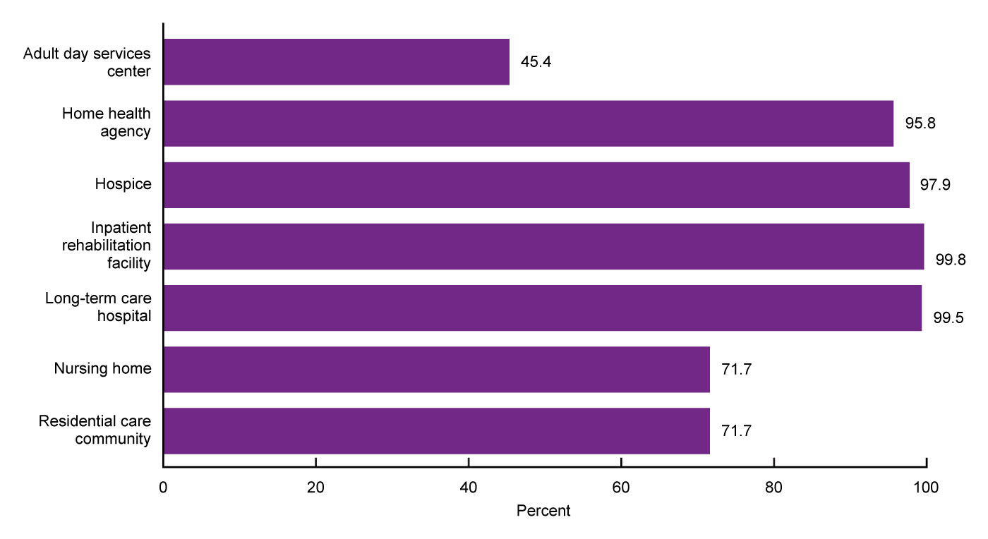
Percentage of post-acute and long-term care services providers that provide any therapeutic services, by sector: United States, 2018
NOTES: All differences by sector are significant at p < 0.05. Any therapuetic services refer to physical, occupational, or speech therapy services. See Appendix II in Series 3, Number 47 for more information on how the provision of any therapeutic services was defined for each sector. See Appendix I for an explanation of differences in how services were measured in the 2012, 2014, and 2016 versions of this report. Percentages are based on unrounded estimates. Access data for this figure in Table XI of Appendix III.
SOURCES: National Center for Health Statistics, National Study of Long-Term Care Providers, 2018, and Centers for Medicare and Medicaid Services data files, 2018.
Notes:
Virtually all inpatient rehabilitation facilities (99.8%), long-term care hospitals (99.5%), hospices (97.9%), and home health agencies (95.8%) offered therapeutic services, as did more than seven-tenths of residential care communities (71.7%) and nursing homes (71.7%) and almost one-half of adult day services centers (45.4%).

Slide 17
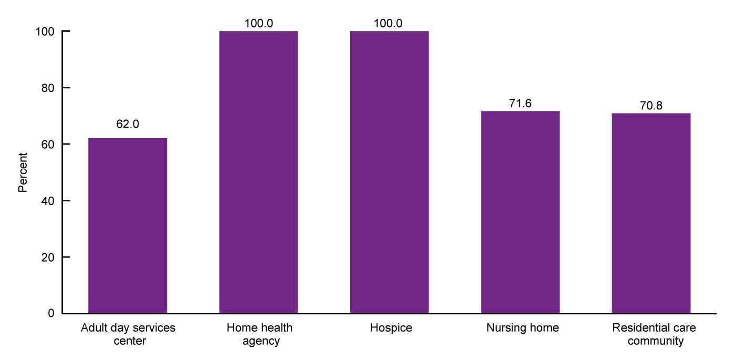
Percentage of post-acute and long-term care services providers that provide skilled nursing or nursing services, by sector: United States, 2018
NOTES: Differences by sector are significant at p < 0.05, except between home health agencies, hospices, and nursing homes, and between adult day services centers and residential care communities. Skilled nursing services refer to services that must be performed by a registered nurse or licensed vocational or practical nurse and are medical in nature. See Appendix III in Series 3, Number 47 for more information on how the provision of skilled nursing services was defined for each sector. See Appendix I for an explanation of differences in how services were measured in the 2012, 2014, and 2016 versions of this report. Percentages are based on unrounded estimates. Access data for this figure in Table XI of Appendix III.
SOURCES: National Center for Health Statistics, National Study of Long-Term Care Providers, 2018, and Centers for Medicare and Medicaid Services data files, 2018.
Notes:
All home health agencies and hospices (100.0%) offered skilled nursing or nursing services, as did most nursing homes (71.6%), residential care communities (70.8%), and adult day services centers (62.0%).

Slide 18
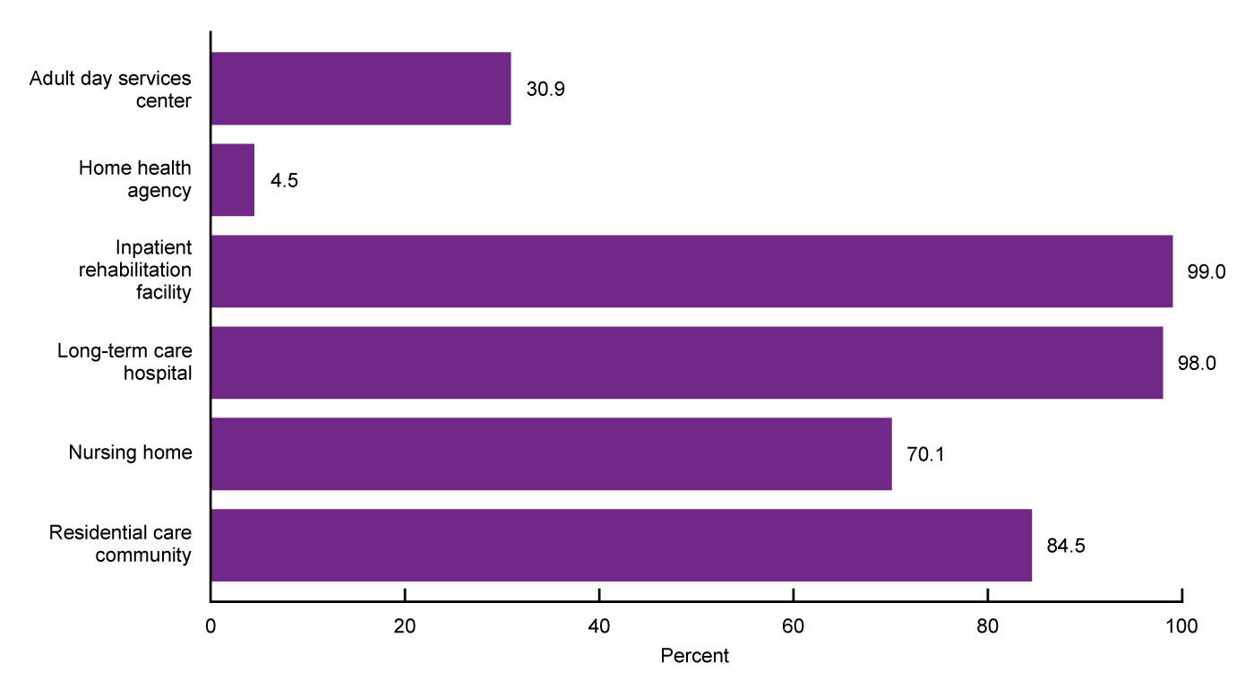
Percentage of post-acute and long-term care services providers that provide pharmacy or pharmacist services, by sector: United States, 2018
NOTES: All differences by sector are significant at p < 0.05. Pharmacy services refer to the filling and delivery of prescriptions. See Appendix II in Series 3, Number 47 for more information on how provision of pharmacy services was defined for each sector. The available administrative data did not have information on whether or not hospices provided pharmacy or pharmacist services. See Appendix I for an explanation of differences in how services were measured in the 2012, 2014, and 2016 versions of this report. Percentages are based on unrounded estimates. Access data for this figure in Table XI of Appendix III.
SOURCES: National Center for Health Statistics, National Study of Long-Term Care Providers, 2018, and Centers for Medicare and Medicaid Services data files, 2018.
Notes:
Nearly all inpatient rehabilitation facilities (99.0%) and long-term care hospitals (98.0%) and most residential care communities (84.5%) and nursing homes (70.1%) offered pharmacy or pharmacist services. Fewer adult day services centers (30.9%) and home health agencies (4.5%) provided these services.

Slide 19
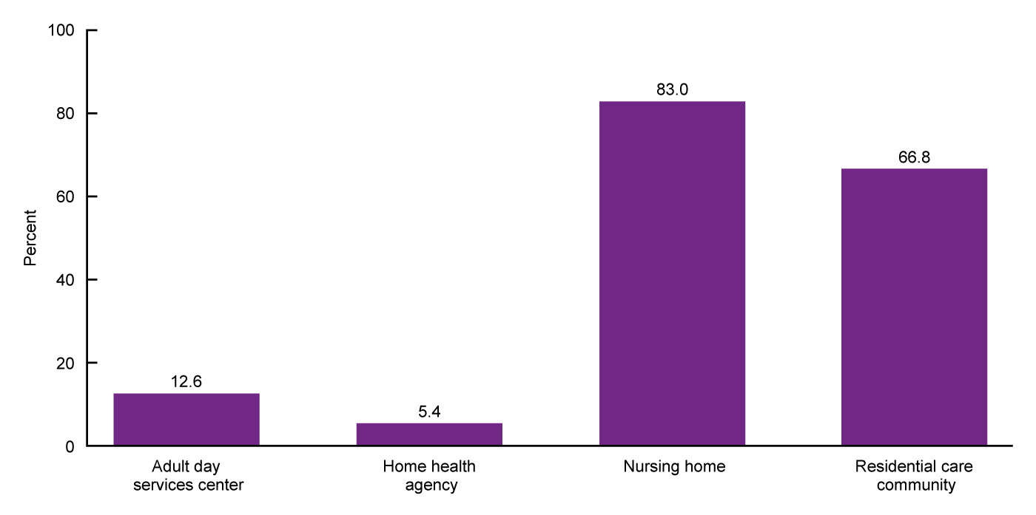
Percentage of post-acute and long-term care services providers that provide hospice services, by sector: United States, 2018
NOTES: All differences by sector are significant at p < 0.05. See Appendix II in Series 3, Number 47 for more information on how provision of hospice services was defined for each sector. See Appendix I for an explanation of differences in how services were measured in the 2012, 2014, and 2016 versions of this report. Percentages are based on unrounded estimates. Access data for this figure in Table XI of Appendix III.
SOURCES: National Center for Health Statistics, National Study of Long-Term Care Providers, 2018, and Centers for Medicare and Medicaid Services data files, 2018.
Notes:
About 83.0% of nursing homes offered hospice services, compared with 66.8% of residential care communities, 12.6% of adult day services centers, and 5.4% of home health agencies.

Slide 20
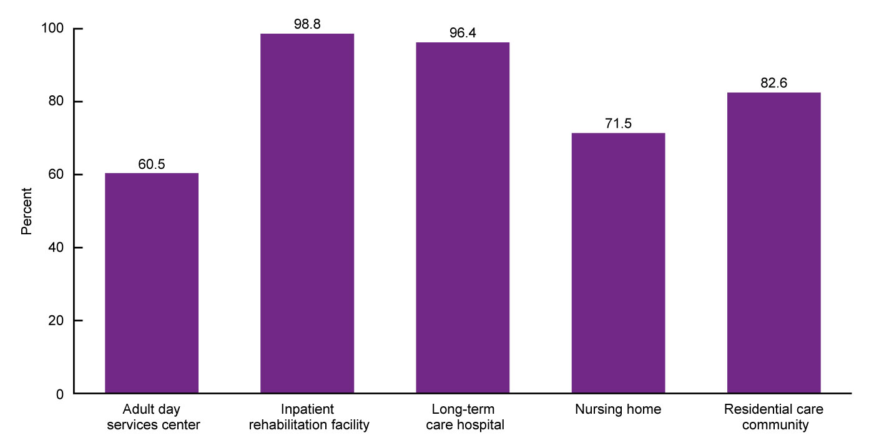
Percentage of post-acute and long-term care services providers that provide dietary and nutritional services, by sector: United States, 2018
NOTES: All differences by sector are significant at p < 0.05. See Appendix I in Series 3, Number 47 for more information on how provision of dietary services was defined for each sector. See Appendix I for an explanation of differences in how services were measured in the 2012, 2014, and 2016 versions of this report. Percentages are based on unrounded estimates. Access data for this figure in Table XI of Appendix III.
SOURCES: National Center for Health Statistics, National Study of Long-Term Care Providers, 2018, and Centers for Medicare and Medicaid Services data files, 2018.
Notes:
Nearly all inpatient rehabilitation facilities (98.8%) and long-term care hospitals (96.4%) and most residential care communities (82.6%) and nursing homes (71.5%) offered dietary and nutritional services, while 60.5% of adult day services centers provided these services.

Slide 21
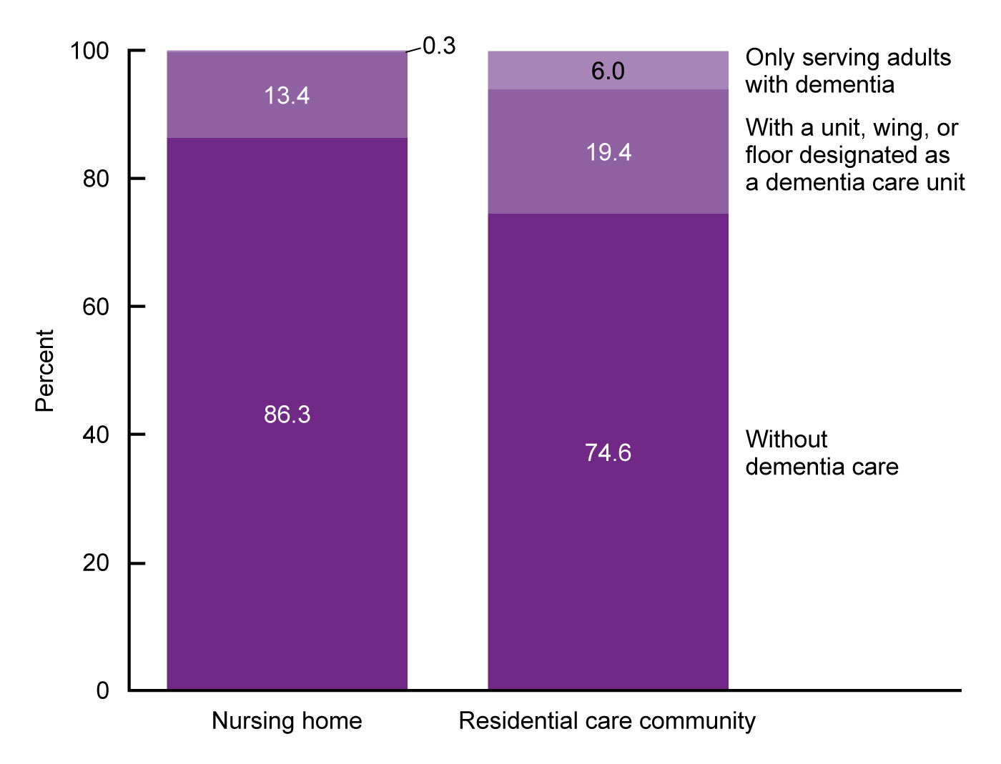
Percent distribution of post-acute and long-term care services providers, by sector and dementia care: United States, 2018
NOTES: Dementia care units or dementia-only providers were not examined for adult day services centers, home health agencies, hospices, inpatient rehabilitation facilities, or long-term care hospitals because these topics are more relevant for residential sectors such as nursing homes and residential care facilities. See Appendix II in Series 3, Number 47 for information on how dementia care was defined for each sector. Percentages are based on unrounded estimates. Percent distributions may not add to 100 because of rounding. Access data for this figure in Table XI of Appendix III.
SOURCES: National Center for Health Statistics, National Study of Long-Term Care Providers, 2018, and Centers for Medicare and Medicaid Services data files, 2018.
Notes:
About 19.4% of residential care communities and 13.4% of nursing homes offered a dementia care unit within a larger facility or community.
While another 6.0% of residential care communities served only residents with dementia, few nursing homes (0.3%) did so.
Dementia care units or dementia-only providers were not examined for adult day services centers, home health agencies, hospices, inpatient rehabilitation facilities, or long-term care hospitals because these topics are more relevant for residential sectors, such as nursing homes and residential care communities.

Slide 22
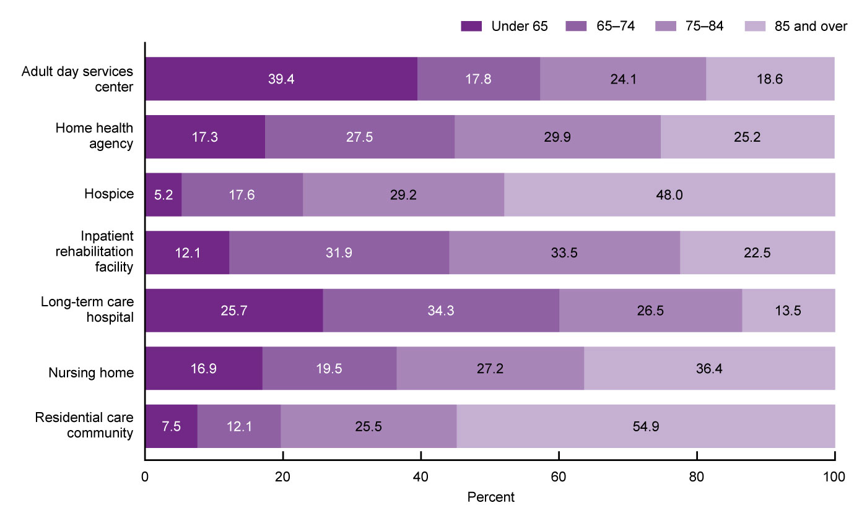
Percent distribution of post-acute and long-term care services users, by sector and age group: United States, 2017 and 2018
NOTES: Percentages for adult day services centers, nursing homes, and residential care communities were based on the number of users on a given day in 2018. Percentages for home health agencies, hospices, inpatient rehabilitation facilities, and long-term care hospitals were based on the number of patients who received care at any time in 2017. See Appendix I in Series 3, Number 47 for more information on data sources used for each sector. Percentages are based on unrounded estimates. Percent distributions may not add to 100 because of rounding. Access data for this figure in Table XII of Appendix III.
SOURCES: National Center for Health Statistics, National Study of Long-Term Care Providers, 2018, and Centers for Medicare and Medicaid Services data files, 2017–2018.
Notes:
Most services users were aged 65 and over: 94.8% of hospice patients, 92.5% of residential care residents, 87.9% of inpatient rehabilitation patients, 83.1% of nursing home residents, 82.6% of home health patients, 74.3% of long-term care hospital patients, and 60.5% of participants in adult day services centers.
Among nursing home residents, 81.1% of short-stay residents and 84.6% of long-stay residents were aged 65 and over (Appendix III, Table XIII).
The age composition of services users varied by sector, with residential care communities (54.9%), hospices (48.0%), and nursing homes (36.4%) serving more people aged 85 and over, and adult day services centers (39.4%) and long-term care hospitals (25.7%) serving more people under age 65 than other sectors.
Among nursing home residents, 30.7% of short-stay residents and 40.9% of long-stay residents were aged 85 and over (Appendix III, Table XIII).

Slide 23
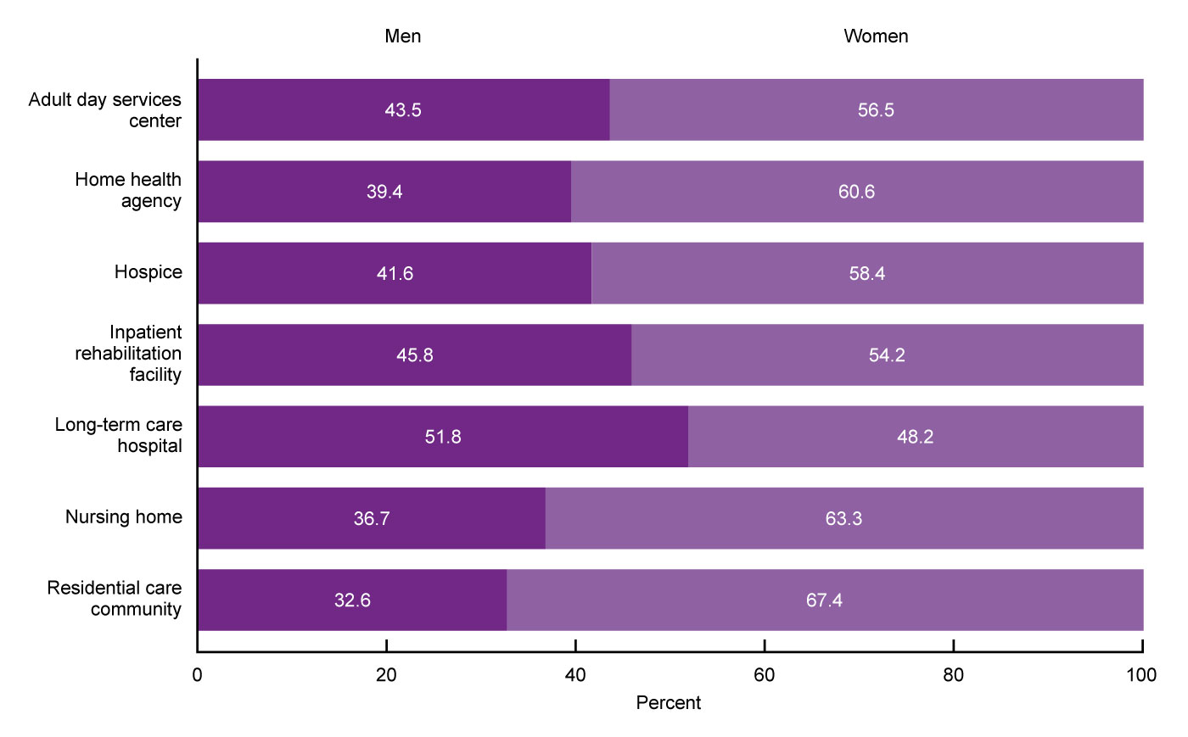
Percent distribution of post-acute and long-term care services users, by sector and sex: United States, 2017 and 2018
NOTES: Percentages for adult day services centers, nursing homes, and residential care communities were based on the number of users on a given day in 2018. Percentages for home health agencies, hospices, inpatient rehabilitation facilities, and long-term care hospitals were based on the number of patients who ended care at any time in 2017. See Appendix I in Series 3, Number 47 for more information on data sources used for each sector. Percentages are based on unrounded estimates. Percent distributions may not add to 100 because of rounding. Access data for this figure in Table XII of Appendix III.
SOURCES: National Center for Health Statistics, National Study of Long-Term Care Providers, 2018, and Centers for Medicare and Medicaid Services data files, 2017–2018.
Notes:
In all sectors except long-term care hospitals, where 51.8% of patients were men, the majority of users were women, with residential care communities having the highest percentage (67.4%).
Among nursing home residents, 59.0% of short-stay residents and 66.6% of long-stay residents were women (Appendix III, Table XIII).

Slide 24
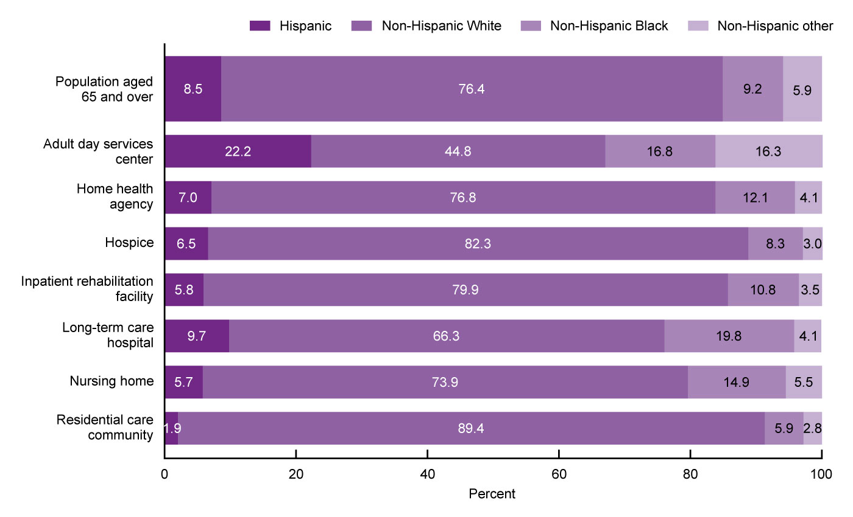
Percent distribution of post-acute and long-term care services users, by sector and race and Hispanic origin:
United States, 2017 and 2018
NOTES: Percentages for adult day services centers, nursing homes, and residential care communities were based on the number of users on a given day in 2018. Percentages for home health agencies, hospices, inpatient rehabilitation facilities, and long-term care hospitals were based on the number of patients who ended care at any time in 2017. See Appendix I in Series 3, Number 47 for more information on data sources used for each sector. Percentages are based on unrounded estimates. Percent distributions may not add to 100 because of rounding. Access data for this figure in Table XII of Appendix III.
SOURCES: National Center for Health Statistics, National Study of Long-Term Care Providers, 2018; Centers for Medicare and Medicaid Services data files, 2017–2018; and U.S. Census Bureau, Population Division, Population Estimates, July 1, 2018.
Notes:
The percentage of non-Hispanic White people was highest in residential care communities (89.4%), followed by hospices (82.3%), inpatient rehabilitation facilities (79.9%), home health agencies (76.8%), nursing homes (73.9%), and long-term care hospitals (66.3%).
Less than one-half of the participants in adult day services centers were non-Hispanic White (44.8%).
Adult day services centers were the most racially and ethnically diverse among the seven sectors: 16.8% of center participants were non-Hispanic Black and 22.2% were Hispanic.
Long-term care hospitals (19.8%), adult day services centers (16.8%), and nursing homes (14.9%) had the highest percentage of non-Hispanic Black services users.
About one-tenth of home health patients (12.1%), inpatient rehabilitation facility patients (10.8%), hospice patients (8.3%), and residential care residents (5.9%) were non-Hispanic Black.
In nursing homes, 73.3% of short-stay residents and 74.4% of long-stay residents were non-Hispanic White, followed by non-Hispanic Black (14.6% and 15.2% of short- and long-stay residents, respectively) (Appendix III, Table XIII).

Slide 25
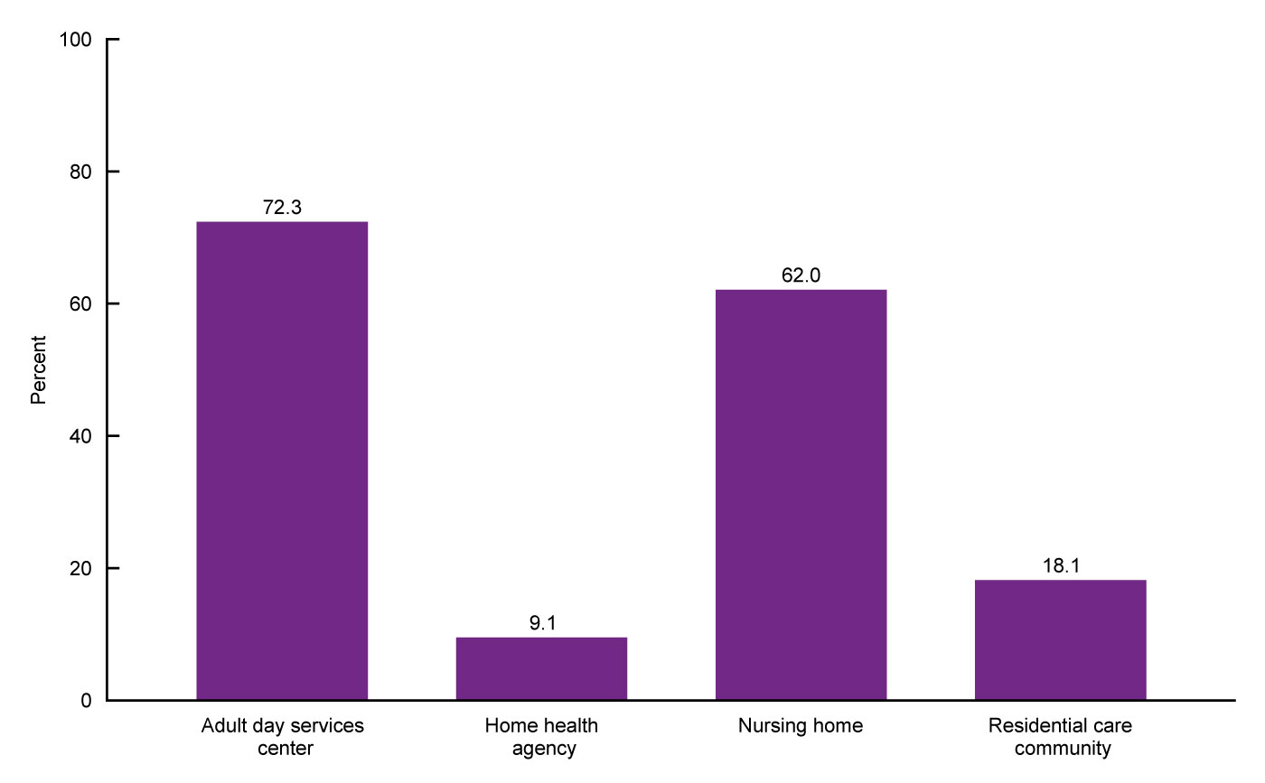
Percentage of post-acute and long-term care services users with Medicaid as payer source, by sector:
United States, 2017 and 2018
NOTES: Percentages for adult day services centers, nursing homes, and residential care communities were based on the number of users on a given day in 2018. Percentages for home health agencies were based on the number of patients who ended care at any time in 2017. Data on Medicaid as payer source were not available for hospice patients. See Appendix II in Series 3, Number 47 for definitions of Medicaid as payer source for each sector. See Appendix II for more information on data sources used for each sector. Percentages are based on unrounded estimates. Access data for this figure in Table XII of Appendix III.
SOURCES: National Center for Health Statistics, National Study of Long-Term Care Providers, 2018, and Centers for Medicare and Medicaid Services data files, 2017–2018.
Notes:
The percentage of services users using Medicaid as a payer source was highest in adult day services centers (72.3%) and nursing homes (62.0%).
Among residential care residents, 18.1% used Medicaid as a payer source, followed by 9.1% of home health patients. Data on Medicaid as payer source were not available for hospice, inpatient rehabilitation, and long-term care hospital patients.

Slide 26
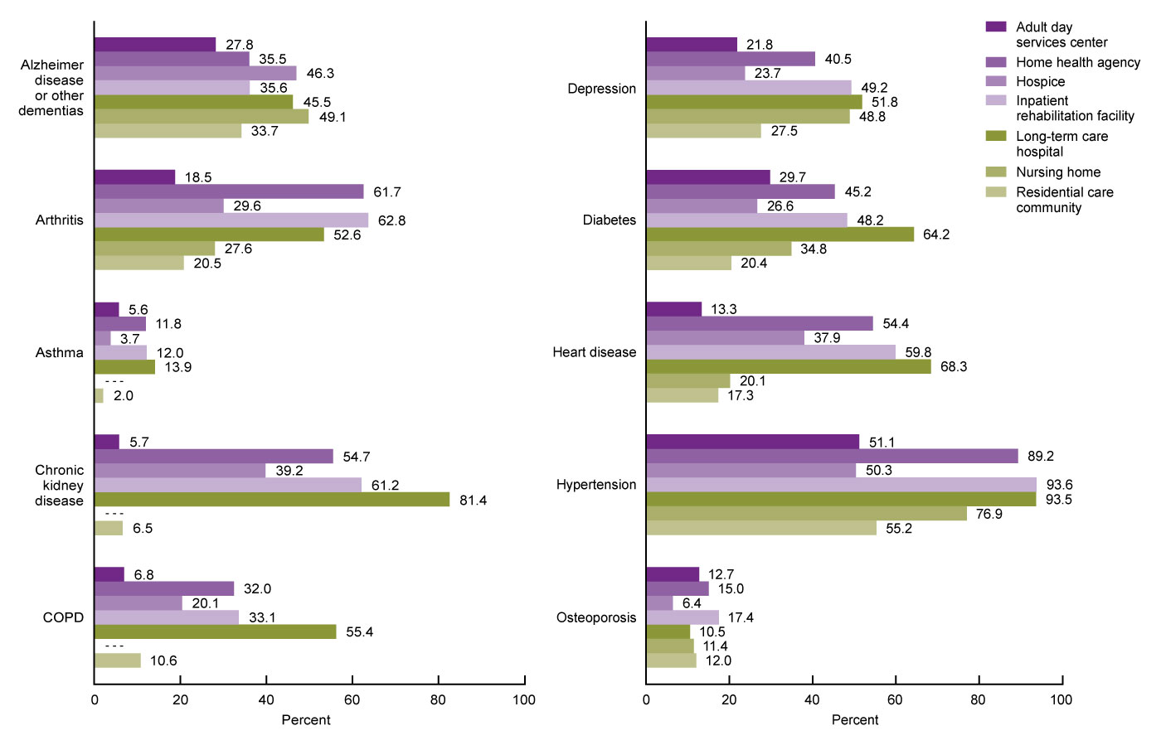
Percentage of post-acute and long-term care services users with selected diagnoses, by sector:
United States, 2017 and 2018
- - - Data not available.
NOTES: Percentages for adult day services centers, nursing homes, and residential care communities were based on the number of users on a given day in 2018. Percentages for home health agencies, hospices, inpatient rehabilitation facilities, and long-term care hospitals were based on the number of patients who ended care at any time in 2017. Available data for nursing homes could not produce estimates for asthma, chronic kidney disease, and chronic obstructive pulmonary disease (COPD), because asthma and COPD were grouped together and only end-stage renal disease was available. See Appendix II in Series 3, Number 47 for definitions of conditions used for each sector. See Appendix I for more information on data sources used for each sector. Percentages are based on unrounded estimates. Access data for this figure in Table XII of Appendix III.
SOURCES: National Center for Health Statistics, National Study of Long-Term Care Providers, 2018, and Centers for Medicare and Medicaid Services data files, 2017–2018.
Notes:
Alzheimer disease or other dementias were most prevalent in nursing home residents (49.1%), followed by hospice patients (46.3%) and long-term care hospital patients (45.5%), and were least prevalent in adult day services center participants (27.8%). The percentage of nursing home residents with a diagnosis of Alzheimer disease was higher in long-stay residents (57.6%) than short-stay residents (35.8%) (Appendix III, Table XIII).
Arthritis was most prevalent in patients in inpatient rehabilitation facilities (62.8%), followed by home health patients (61.7%), and was least prevalent in adult day participants (18.5%) (Appendix III, Table XII).
The percentage of services users with a diagnosis of asthma was highest in long-term care hospital patients (13.9%) and lowest in residential care community residents (2.0%).
A diagnosis of chronic kidney disease was most common in long-term care hospital patients (81.4%) and least common in adult day services center participants (5.7%) and residential care community residents (6.5%).
Similarly, COPD was most common in long-term care hospital patients (55.4%) and least prevalent in adult day services center participants (6.8%).
The percentage of services users with a diagnosis of depression was highest in long-term care hospitals (51.8%), followed by inpatient rehabilitation facilities (49.2%) and nursing homes (48.8%), and lowest in adult day centers (21.8%) and hospices (23.7%). In nursing home residents, the prevalence of a diagnosis of depression was higher in long-stay residents (52.7%) than short-stay residents (42.8%) (Appendix III, Table XIII).
A diagnosis of diabetes was most prevalent in long-term care hospital patients (64.2%) and least prevalent in residential care community residents (20.4%).
A diagnosis of heart disease was most common in long-term care hospital patients (68.3%), followed by patients in inpatient rehabilitation facilities (59.8%) and home health patients (54.4%).
More than one-half of services users in all seven sectors had a diagnosis of hypertension, with the highest percentage in patients in inpatient rehabilitation facilities (93.6%) and long-term care hospitals (93.5%), followed by home health patients (89.2%).
The percentage of services users with a diagnosis of osteoporosis was highest in inpatient rehabilitation facilities (17.4%) and lowest in hospices (6.4%).

Slide 27
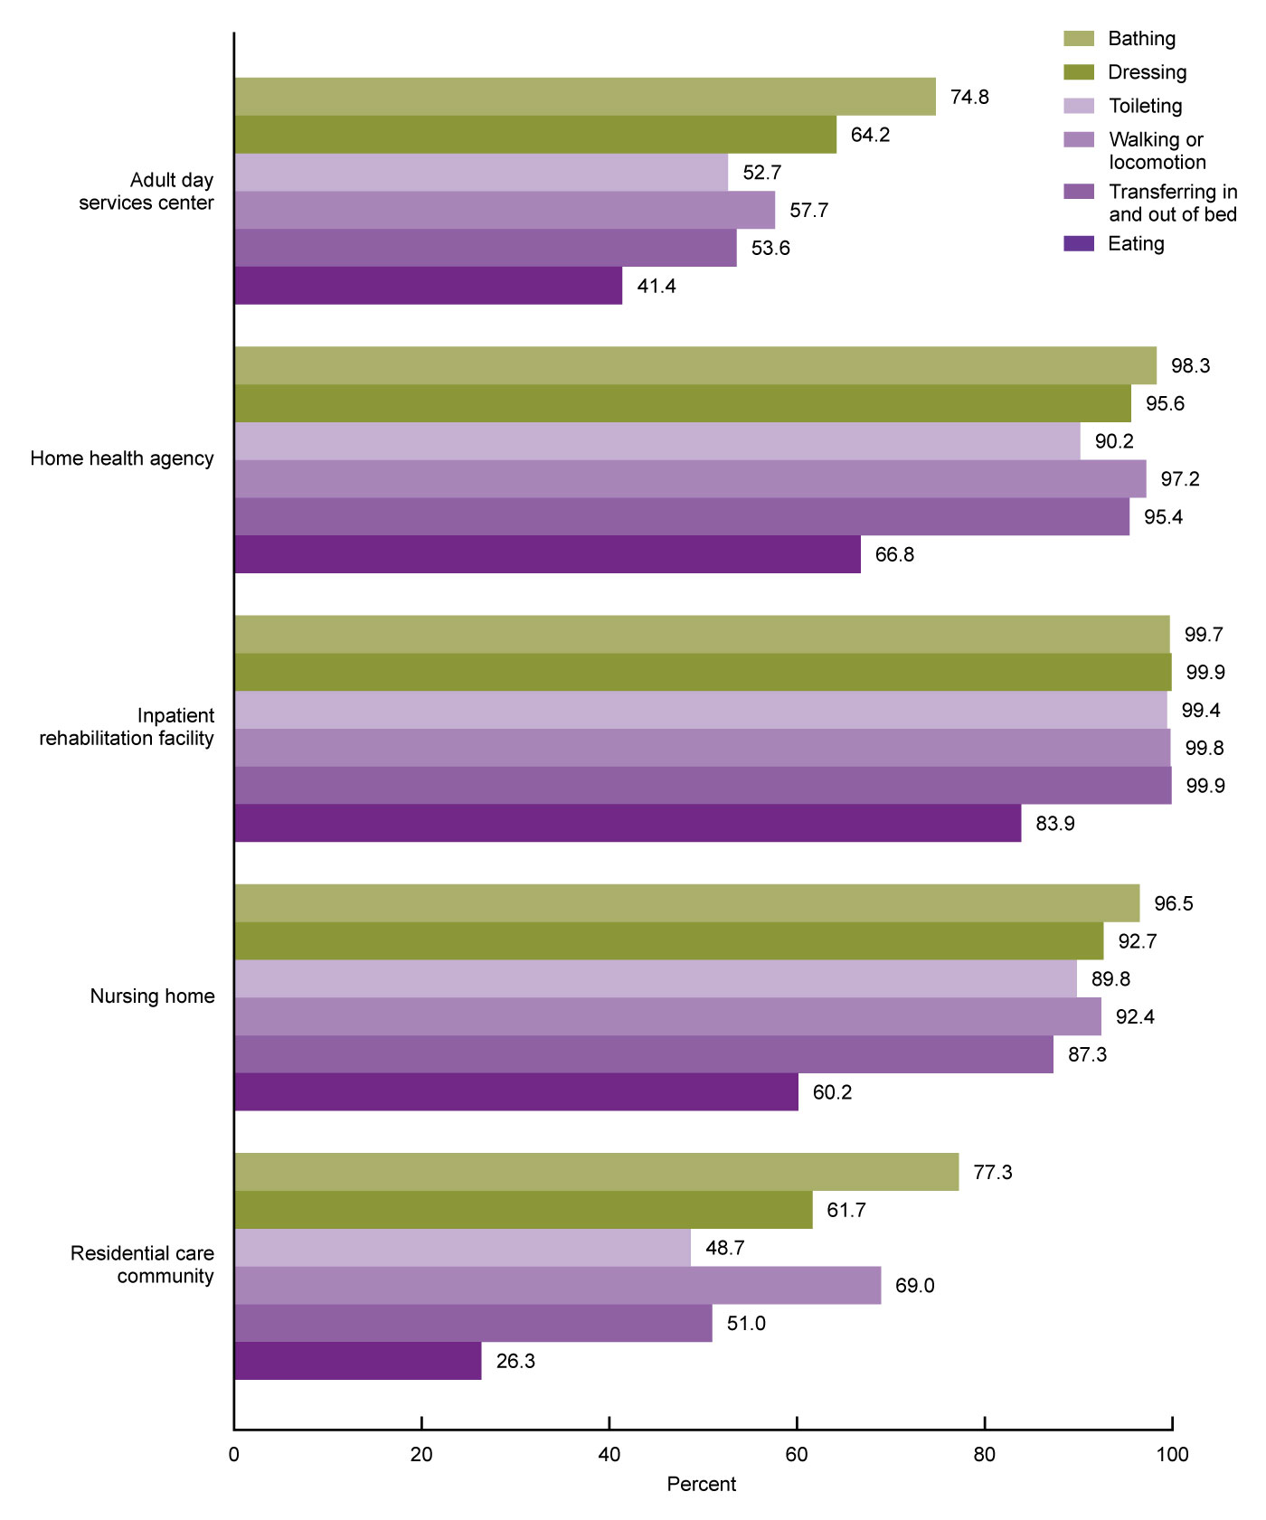
Percentage of post-acute and long-term care services users needing any assistance with activities of daily living, by sector and activity: United States, 2017 and 2018
NOTES: Percentages for adult day services centers, nursing homes, and residential care communities were based on the number of users on any given day in 2018. Percentages for home health agencies, hospices, inpatient rehabilitation facilities, and long-term care hospitals were based on the number of patients whose episode of care ended at any time in 2017. Users were considered needing any assistance with a given activity if they needed help or supervision from another person or used assistive devices to perform the activity. Data on needing any assistance with activities of daily living were not available for hospice and long-term care hospital patients. See Appendix I in Series 3, Number 47 for more information on how needing any assistance with a given activity was defined. Percentages are based on unrounded estimates. Access data for this figure in Table XII of Appendix III.
SOURCES: National Center for Health Statistics, National Study of Long-Term Care Providers, 2018, and Centers for Medicare and Medicaid Services data files, 2017–2018.
Notes:
Series 3, Number 47 uses the need for assistance with six activities of daily living or ADLs— bathing, dressing, toileting, walking or locomotion, transferring in and out of bed, and eating—to measure physical and cognitive functioning in adult day services center participants, home health patients, residents in nursing homes and residential care communities, and inpatient rehabilitation facility patients. Data on the need for assistance with ADLs were not available for hospice patients and long-term care hospital patients.
Overall, functional ability varied by sector. Within each sector, the need for assistance with bathing was most common.
Fewer adult day services center participants needed assistance with bathing (74.8%) compared with services users in the other four sectors.
Therefore, while the prevalence of ADL needs differed by sector, at minimum, 74.8% of services users across all sectors needed assistance with at least one of the six ADLs.
The need for assistance with eating was least common in each of the five sectors.
Residential care communities had the fewest residents that needed assistance with dressing, toileting, transferring in and out of bed, and eating than services users in other sectors.
Nearly all patients in inpatient rehabilitation facilities needed assistance with bathing, dressing, toileting, locomotion, and transferring.

Slide 28
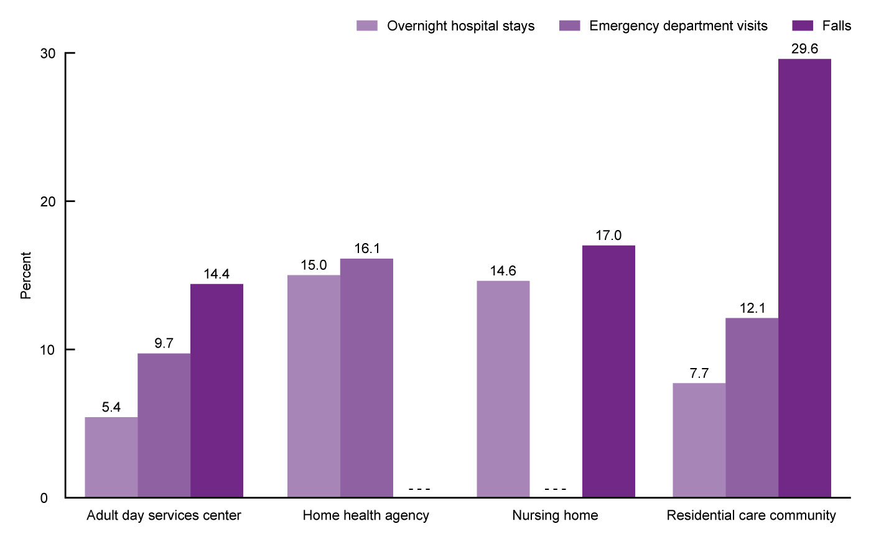
Percentage of post-acute and long-term care services users with overnight hospital stays, emergency department visits, and falls, by sector: United States, 2017 and 2018
- - - Data not available.
NOTES: For adult day services centers and residential care communities, adverse event refers to a period of 90 days before the survey. For home health agencies and nursing homes, adverse event refers to a period since admission and most recent assessment. See Appendix I in Series 3, Number 47 for more information on data sources used for each sector. Percentages are based on unrounded estimates. Access data for this figure in Table XII of Appendix III.
SOURCES: National Center for Health Statistics, National Study of Long-Term Care Providers, 2018, and Centers for Medicare and Medicaid Services data files, 2017–2018.
Notes:
Series 3, Number 47 estimates the prevalence of overnight hospitalizations, emergency department visits, and falls as indicators of adverse, potentially avoidable events. For adult day services centers and residential care communities, adverse event refers to a period of 90 days before the survey. For home health agencies, adverse event refers to a period since the last Outcome and Assessment Information Set or OASIS assessment. For nursing homes, overnight hospitalization and fall refer to the period since admission or since the prior assessment, whichever is more recent. Varying reference periods by sector do not allow for direct comparisons between sectors.
Similar percentages of home health patients had overnight hospital stays (15.0%) and emergency department visits (16.1%). About 14.6% of nursing home residents had overnight hospital stays; more short-stay residents had overnight hospital stays (23.0%) than long-stay residents (8.2%) (Appendix III, Table XIII). About 7.7% of residential care community residents and 5.4% of adult day services center participants had overnight hospital stays. About 9.7% of adult day services center participants and 12.1% of residential care residents had emergency department visits.
About 29.6% of residential care community residents, 17.0% of nursing home residents, and 14.4% of adult day services center participants had falls. More long-stay nursing home residents (19.3%) than short-stay residents (13.5%) had falls.
For home health patients, data for falls were not available. For nursing home residents, data for emergency department visits were not available. For hospice patients, long-term care hospital patients, and patients in inpatient rehabilitation facilities, data for emergency department visits, overnight hospital stays, and falls were not available.

