Slide 1
Early provisional estimates of drug overdose, suicide, and transportation-related deaths: Nowcasting methods to account for reporting lags
Lauren M. Rossen, PhD, MS
Division of Research and Methodology
National Center for Health Statistics
Centers for Disease Control and Prevention
1

Slide 2
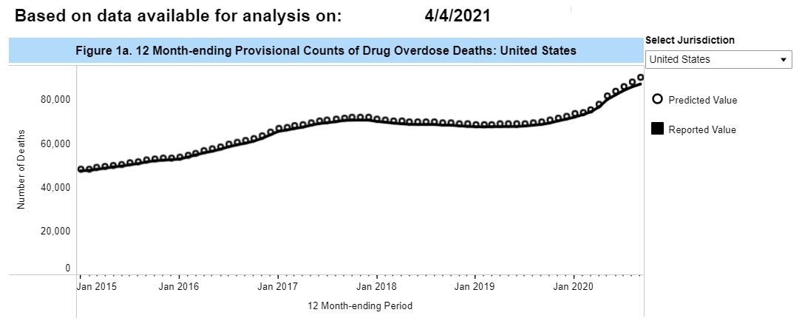
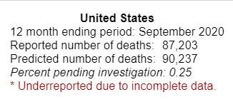
Monthly provisional drug overdose death counts from the Vital Statistics Rapid Release Program
12 month-ending provisional counts of drug overdose deaths are published with a 6-month lag
Need to ensure counts are reasonably complete and accurate
6-month reporting lag
Date of analysis: 4/4/2021
Jan 2021
2
https://www.cdc.gov/nchs/nvss/vsrr/drug-overdose-data.htm

Slide 3
Deaths due to injury-related causes often undergo lengthy investigations and testing to determine the cause and manner of death
About 60% of death certificate records overall are received by NCHS within 10 days of death
External causes of death take substantially longer (9 months or more)
Death
Investigation, toxicology testing
Data updated
Data sent from state to NCHS
Data processed and coded
Data analysis
Fact of death data submitted
3

Slide 4
Timeliness of drug overdose death data is improving
Drug overdose deaths are being reported, coded, and processed faster than in years past
As a result, provisional drug overdose data are more complete than in prior years
4

Slide 5
What has the impact of the COVID-19 pandemic been on injury-related causes of death?
Problems:
Need weekly estimates
Existing provisional data are rolling annual estimates
Need timely estimates, account for reporting lags
Existing provisional data released with a 6-month lag
Need to account for improvements in timeliness
Unclear how timeliness and reporting may have changed since the pandemic (e.g., overburdened systems, vital statistics offices shifting to remote work, IT changes)
5

Slide 6
Nowcasting or “predicting the present”
Used weekly ‘snapshots’ of provisional data (from 2018-2019) to model underreporting relative to final data
Use models to predict completeness of provisional data within 2 weeks of death, 4 weeks, 6 weeks, … , 39 weeks
Create weights based on the inverse of predicted completeness
For example, if provisional mortality data in 2019 was 50% complete within 12 weeks of death, then the weight for that jurisdiction would be 2 for data presented with a 12-week lag
Model the weighted counts, generate predicted numbers of deaths
Validate the models by running on older provisional data and compare predictions with the reported counts 6-10 months later
6

Slide 7
Multi-stage hierarchical modeling process
Stage 1: Develop Weights
Model completeness
Provisional 2019 data by jurisdiction and lag
Predict completeness
3 scenarios:
No change in timeliness
Moderate improvement
Extreme improvement
Create weights
For each jurisdiction and lag, weight = 1/completeness
Stage 2: Model Outcomes
Model weighted counts
Under 3 timeliness scenarios
Predict number of deaths
Weekly number of deaths per jurisdiction from each model
Validation
Fit stage 2 models
Using older provisional data (May, 2020)
Predict number of deaths
Under 3 timeliness scenarios
Compare predicted values to reported values from recent (nearly complete) data
https://www.cdc.gov/nchs/nvss/vsrr/reports.htm
7

Slide 8
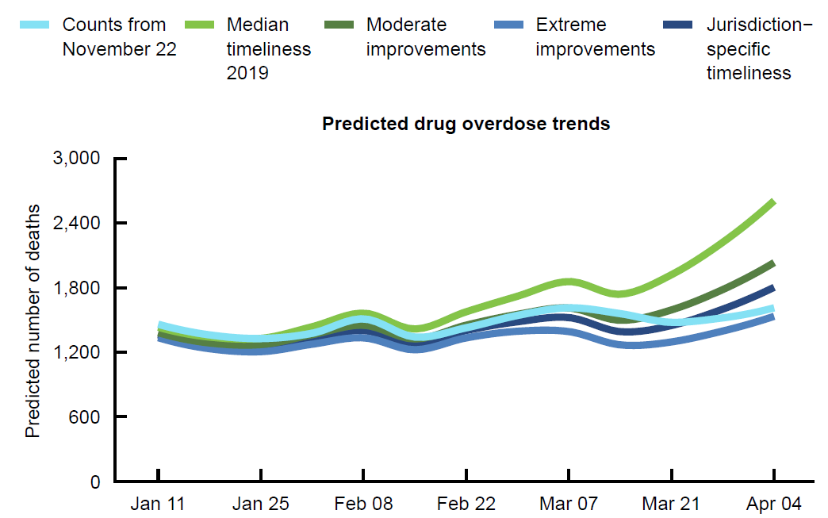
Validation Results: US*
*excludes Connecticut and North Carolina
8

Slide 9
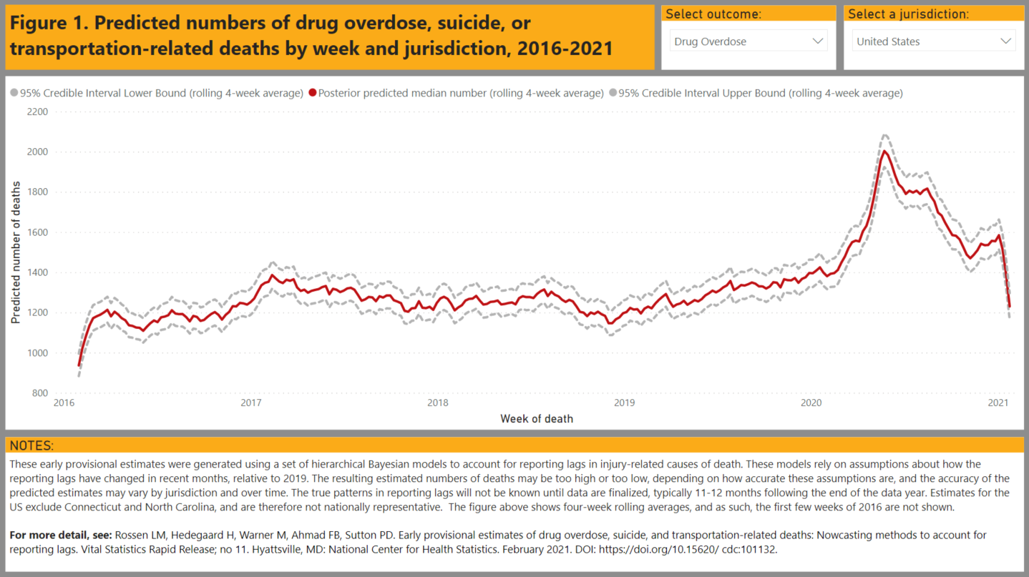
Predicted numbers of drug overdose deaths by week, United States, 2016-2020
Existing provisional data: 12 month-ending counts with a 6-month lag
Nowcasting ➔ shorter lag (1 month), weekly counts

Slide 10
Predicted numbers of drug overdose deaths by week, United States, 2016-2021

Slide 11
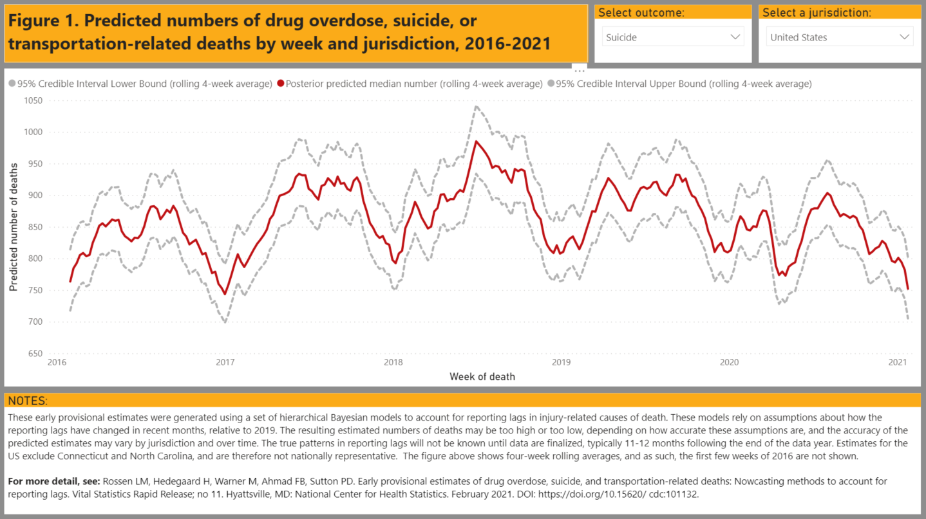
Predicted numbers of suicide deaths by week, United States, 2016-2021

Slide 12
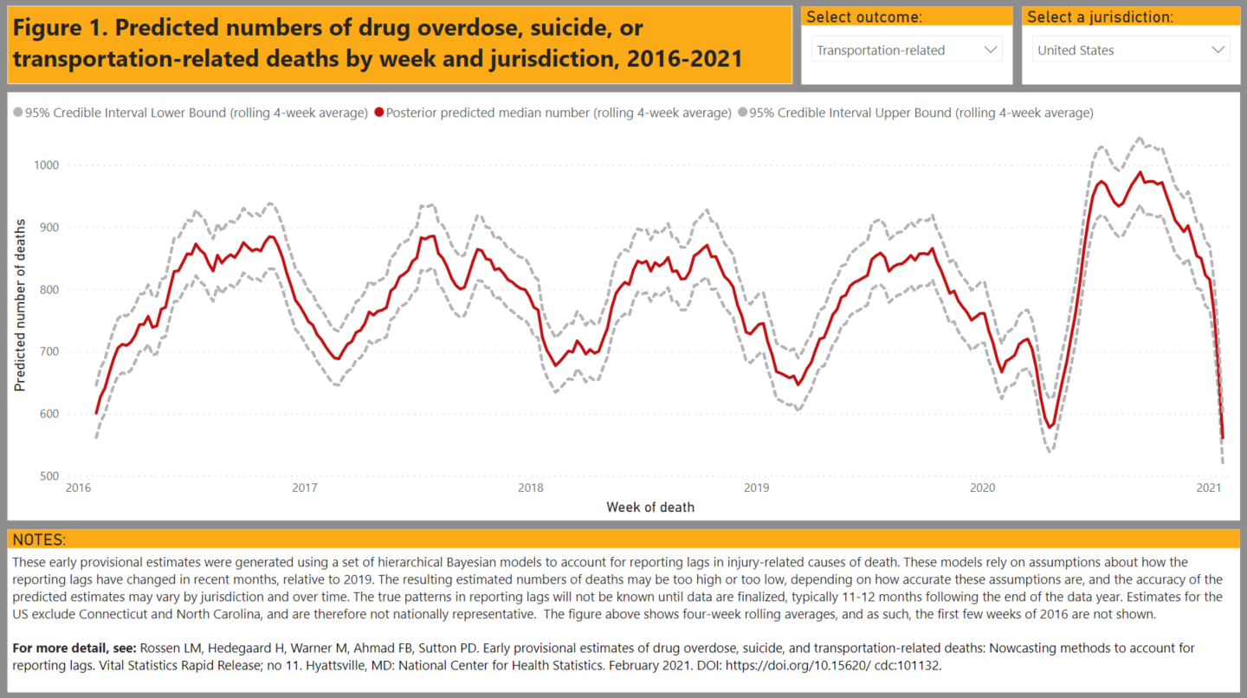
Predicted numbers of transportation-related deaths by week, United States, 2016-2021

Slide 13
Limitations to the current approach
Timeliness may have improved more at shorter lags than longer
Timeliness may have changed throughout the pandemic
Hard to quantify, since injury-related death data is not complete for months
Weights may be too large in some jurisdictions where timeliness is improving, and too small where timeliness has been a challenge
Better account for uncertainty around timeliness?
13

Slide 14
Where do we go from here?
Data Modernization Initiative project focused on further development, automation, expansion
Continue to refine methods
Expand to additional outcomes and data sources
Examine smaller geographies (e.g., county)
14

Slide 15
Thank you
Contact info:
Lauren Rossen
LRossen@cdc.gov
15

