Slide 1
NCHS Board of Scientific Counselors, September 5, 2019
Toward World Class Data and Analytics
Chesley Richards, MD, MPH, FACP
Deputy Director, Public Health Science and Surveillance
Centers for Disease Control and Prevention
Notes:
Thank you for the opportunity to talk with you today
To get us started, I want to talked about a transformative strategy aimed at changing how we collect, use, and share data through modern IT capabilities to save lives and improve health. But to make that work we must rely on innovation that goes outside our comfort zone
CLICK to next slide

Slide 2
We cannot solve our problems with the same thinking we used when we created them.
Albert Einstein
Notes:
The Problem
We have an adaptability problem. The chains of command, standard operating procedures (including but not limited to SOPs for budgeting, procurement, and personnel), and governance structures that helped CDC rise to become the preeminent public health agency in the world now constrain our tempo. The threats we face today spread wider and change faster than our ability track and respond. We assume that the future will be like the present, but we’re wrong.

Slide 3
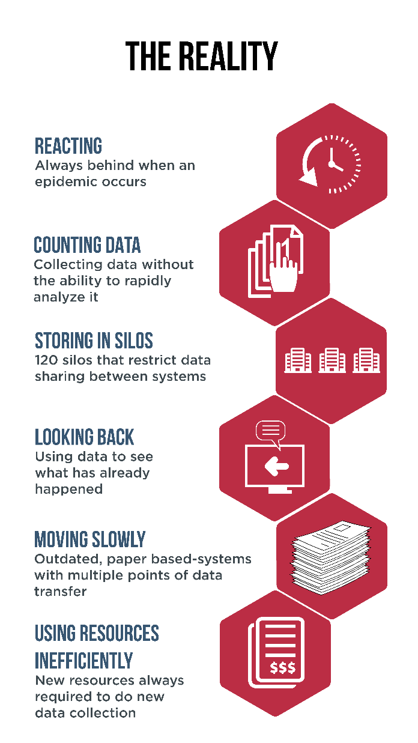
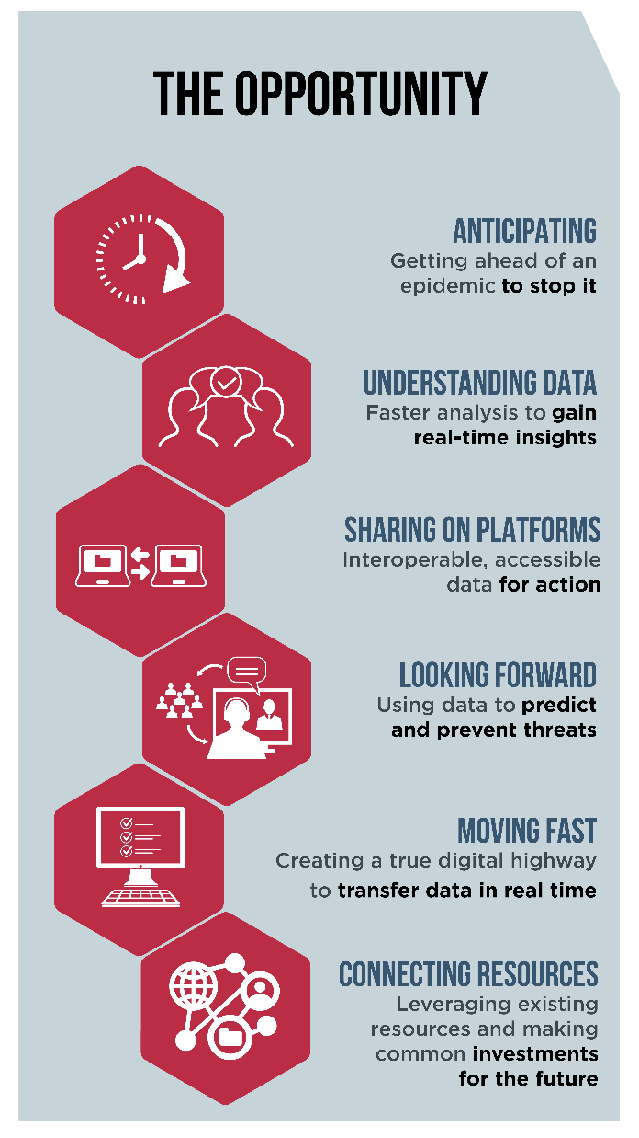
The New World of Public Health Data Timely, Accurate, Accessible…
CDC is developing world-class data and analytics to transform today’s reality and meet new opportunities for lifesaving prevention and response.

Slide 4
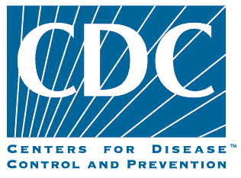
Data & IT Modernization
Current Difficulties
States
Underfunded
Under staff/lack of skills
Outdated IT
Many CDC data requests
Direct relationship with health care
Security concerns
CDC
Too many siloed systems
Lack of enterprise approach
Inconsistent use of standards
Lagging in data analytics
Core infrastructure can’t handle demand
Workforce doesn’t have skills
Too much time processing data
Security concerns
Data Sharing
slow, hard
X

Slide 5
As public health leaders, we must be prepared to handle the challenges of today and, at the same time, to make real the potential of the new innovation of tomorrow.
Robert R. Redfield, MD
Director, CDC, and Administrator, ATSDR
Notes:
The Problem
We have an adaptability problem. The chains of command, standard operating procedures (including but not limited to SOPs for budgeting, procurement, and personnel), and governance structures that helped CDC rise to become the preeminent public health agency in the world now constrain our tempo. The threats we face today spread wider and change faster than our ability track and respond. We assume that the future will be like the present, but we’re wrong.

Slide 6
CDC Using Science and Innovation to Prevent, Detect and Respond
Aspiration
We Save Lives
Aspiration: We save American lives by ending epidemics, eliminating disease, ensuring domestic preparedness, and securing global health.
Secure Global Health
and America’s Preparedness
Pandemic contagions
Bioterrorism threats Vector-borne
Strategic Priorities: Our priorities reaffirm our leadership and commitment to confront and respond to health threats wherever they occur. We will focus our scientific expertise on bringing an end to the devastation of epidemics, finally eliminating certain diseases, and providing a new level of domestic health preparedness and global health security against current and emerging threats.
Strategic Priorities
Eliminate Disease
HIV/AIDS Vaccine-preventable Hepatitis C
End Epidemics
Opioids Influenza Antibiotic resistance Diabetes
Accelerate Priorities through:
World-class data, analytics, and laboratories
Elite public health workforce
Strategic communication
Outbreak response
Priority Accelerators
Priority Accelerators: Protecting America’s health requires continuous improvement in our most vital assets: our data, laboratories, and people.
Enabling Capabilities
Enable strategic achievement through:
State and local partnerships
Global capacity
Operational excellence
Stakeholder engagement
Enabling Capabilities: Our strategic priorities are enabled by unique expertise and interdependent capabilities.

Slide 7
CDC Public Health Data Strategy
Why? Data are the foundation of our nation’s public health network. We must have the capacity to generate and use timely, accurate, and accessible data to meet the health challenges of today and tomorrow.
Why now? Data is moving slower than disease. We are too slow –
Getting data
Analyzing data
Sharing data
Moving data modernization forward requires
Leadership
Data Sharing
Funding and Resources
Capability to use Evolving Technologies

Slide 8
Data & IT Modernization
Future Opportunities
States
Guidance and technical support from CDC
Funding for
technology
people
Expertise
Data Sharing
fast, secure, automated
CDC
Enterprise approach within CDC
Common data portal
Real-time mentality (tools, data)
Modern analytical tools
Augmented workforce
Predicative
Bi-Directional Data Sharing
Cloud hosted solutions
Interoperability
Analysis & data viz tools
Decision Support

Slide 9
Implementation Priorities
Moving from Data Collection to Predictive Data
Governance
enterprise approach
Modern Technologies
cloud, common portal, analytical tools
Data
sharing, interoperability
Partnership
support state and local
Notes:
Security must be embedded into all aspects of the implementation.

Slide 10
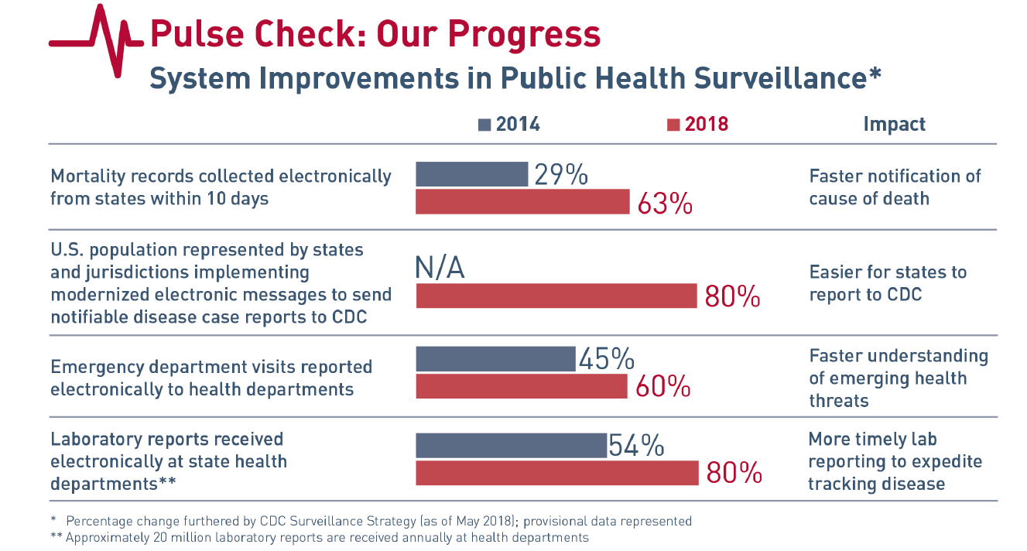
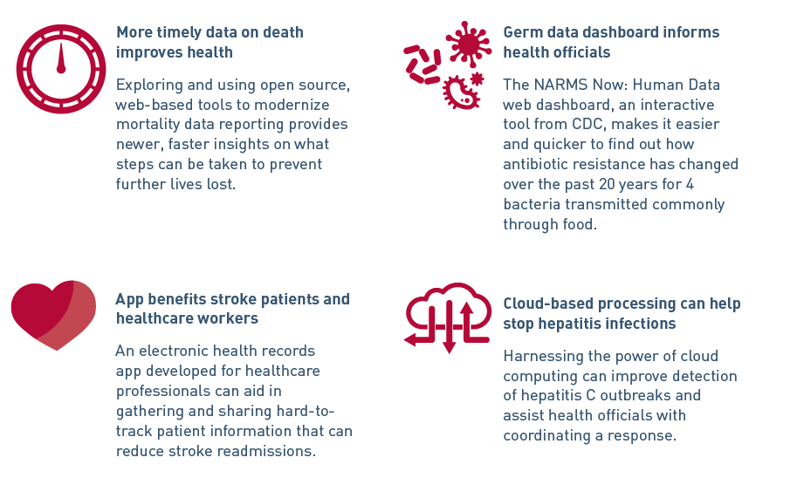
Builds on Prior Strategies and Innovation
PROGRESS
Innovation
Notes:
When we developed the surveillance strategy, our end state was always about data.
Given the proliferation of data systems, new tools and technologies, and new workforce needs, we learned very quickly that must be open to a new way of doing business.
Let me walk you through some of the ways we have begun to do this.
For NCHS and CSELS the capacity to support opioid-related surveillance was boosted by the CDC 2014 Public Health Surveillance Strategy.
One of the goals of the strategy focused on accelerating the use of technology and approaches to improve availability timeliness of surveillance data.
To stimulate progress, the strategy had 4 primary Initiatives. I’ll be discussing two of them today - improving mortality and syndromic surveillance.
The first circle highlights mortality reporting.
Efforts prior to the surveillance strategy and since have resulted in a significant increase in the percentage of deaths reported to NCHS within 10 days. Today, 63% of mortality records are reported within 10 days.
The second circle highlights syndromic surveillance.
Since 2014, efforts to create the National Syndromic Surveillance Program and modernize the BioSense platform have increased the percent of national emergency department visits captured on the platform from 45 to 64%

Slide 11
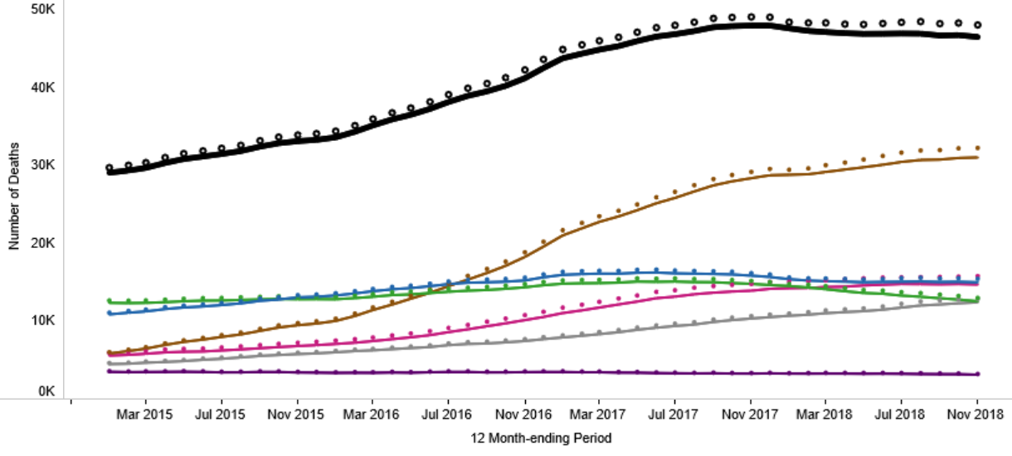
Provisional Data for Timely Surveillance
Suggested citation: Ahmad FB, Rossen LM, Spencer MR, Warner M, Sutton P. Provisional drug overdose death counts. National Center for Health Statistics. 2019. (Available from https://www.cdc.gov/nchs/nvss/vsrr/drug-overdose-data.htm)
Notes:
Improvements to mortality data have given us a clearer picture of what is happening across the country. We now have Rapid Release data in the form of provisional counts of drug overdose deaths. While they are not final, these estimates offer us even timelier insight into the epidemic, which we can use to target resources and take action.
We are also taking the current stream of drug overdose death data and using it to predict what the final counts will be.
Provisional death reports are currently released with a 6 month lag – faster than final data. Data presented here are deaths through the end of November 2018.

Slide 12
National Syndromic Surveillance Connecting Real-time Data
An early alert for many different health events:
Emerging infectious diseases and outbreaks
Chronic diseases and their complications
Injury issues (drownings, overdoses)
Mass gatherings and their situational needs
Environmental Conditions and their impact
Natural and manmade disaster response needs
Source: National Syndromic Surveillance System, DOI, June, 2018
Notes:
Key Messages: Let’s look at syndromic surveillance, another foundational system that performs both in emergencies and in everyday health.
What you might not know is that this system is evolution of Biosense, which is the first HHS system that used the cloud.
Following 9/11, initial investments were made in enhancing syndromic surveillance as an early warning system for bioterrorism which has transformed to a system now allows officials to detect a much wider range of health threats—from opioid overdoses to chemical spills to outbreaks.
Equipping communities with diverse, real-time health data that reflect local realities enables faster decision making and better protects Americans.
These days, there are 2.6 million health messages received each day from emergency room visits. Roughly 60%-65% of emergency department visits are reported electronically to health departments, with most health messages from ER visits reported within 24 hours to health departments.
The technology is better, and the data are much more abundant. And while there is still much more to do, information is being connected in real-time so we get a true early warning coming right from hospitals to health departments.

Slide 13
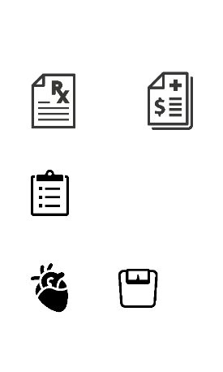
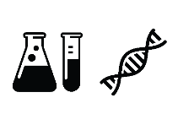
Laying the Conditions for Broad Interoperability
Notes:
This kind of broad interoperability is a key part of CDC’s data strategy. We must encourage and prioritize innovative ways to connect data using newer technologies we now have available, like biosurveillance in the cloud, application programming interfaces (APIs), Fast Healthcare Interoperability Resources (FHIR, pronounced “fire”), and SMART (Substitutable Medical Apps, Reusable Technology) on FHIR apps.
We are making progress on this in some areas, but we must keep going.
With as much progress as we’ve made with drug related injuries and fatalities as an example, it is possible that a future overdose epidemic may be driven by a new or obscure drug that is not among the leading causes of drug overdose death today. In fact, the current opioid overdose epidemic stands as just one part of a longer curve of drug epidemics over time. Understanding the forces that are holding multiple subepidemics together into a smooth exponential trajectory may be important in revealing, and effectively dealing with, the root causes of the current epidemic.
But our traditional systems were built for a simpler era: disease specific, isolated, and with limited inputs known a priori that came in at a slow and predictable cadence. These systems were designed to calculate counts/rates/ratios, typically at the national level, often only once or twice a year. Secondary and tertiary uses of the data were generally precluded by the use agreements under which the data were collected.
The technology was developed in isolation from those who depended on it. This approach gave us flashes of insights that were fit for purpose at the time, however, it now precludes our ability to use the best available data to guide decision-making and inform public health action in emergent situations.
We need change.. and we need partners looking at the data from many different areas of health and non-health to get ahead of the problems.
See this link for reference:
https://science.sciencemag.org/content/361/6408/eaau1184.full
CLICK to next slide

Slide 14
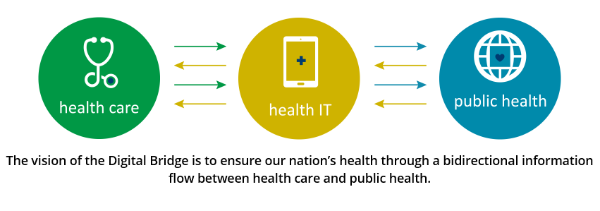
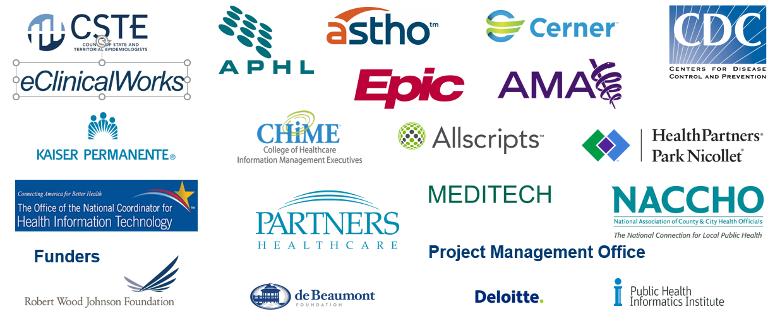
Digital Bridge Connecting Clinical Care and Public Health
8
Our Vision
Our Partners
Notes:
Key message: With leadership from CDC and working with the Robert Wood Johnson Foundation, DeBeaumont Foundation, Public Health Informatics Institute, public health organizations, HIT vendors, and clinical organizations, we are making progress on a project known as Digital Bridge.
As a component of data modernization, the Digital Bridge represents
The power of public – private partnerships
The promise of innovative ideas
The challenge of ever-evolving technology
CLICK to next slide

Slide 15
Goal
Seven Imperatives for 2024
By 2024, CDC will be operating to a new normal, working across programs and agency initiatives & through emerging priorities
Cloud
CDC data will be in a cloud
Enterprise Level
At the enterprise level, CDC data will be catalogued, have metadata and be labelled with appropriate access and privacy controls
To transform CDC and our partners from a culture of primarily historical data analytics to predictive data science supported by modern IT platforms and enterprise services that facilitate CDC’s public health mission
Common Portal
Data reporting to CDC will be through a common portal
Analytical Tools
CDC scientists will have efficient access to relevant data science tools and the capability and expectation to perform both historic and predictive analyses
Interoperability
CDC data will be interoperable within and external to CDC
Data Sharing
CDC data will be shared and public, while protecting privacy and confidentiality
State & Local Support
State and local health departments will be supported to accomplish complementary goals

Slide 16
Congressional Interest Authorizing Legislation
Leading Infrastructure for Tomorrow’s America Act (LIFT America Act) (House)
$100,000,000 for each fiscal year 2020-2024
Under consideration by the House Energy & Commerce Committee
Saving Lives Through Better Data Act (House)
$100,000,000 for each fiscal year 2020-2024
Under consideration by the House Energy & Commerce Committee
Lower Health Care Costs Act (Senate)
“there are authorize to be appropriated such sums as may be necessary for fiscal years 2020 through 2024’’
Reported out of Health, Education, Labor, and Pensions (HELP) on 6/26/19

Slide 17
Discussion

